Slide 1
Classes And Objects
Defining new types of variables that can have custom attributes and capabilities

Slide 2
Composites
What you have seen
Lists
Strings
Tuples (depends upon semester)
What if we need to store information about an entity with multiple attributes and those attributes need to be labeled?
Example: Client attributes = name, address, phone, email
The best option you have seen thus far is a list as it’s composite (each field is an attribute) and it doesn’t have to be homogenous (attributes can store different types of information)

Slide 3
Some Drawbacks Of Using A List
The parts of a composite list can be accessed via [index] but they cannot be labeled (what do these fields store?)
Which field contains what type of information? This isn’t immediately clear from looking at the program statements.
client = [“xxxxxxxxxxxxxxx",
“0000000000",
“xxxxxxxxx",
0]
There isn’t a way to specify rules about the type of information to be stored in a field e.g., a data entry error could allow alphabetic information (e.g., 1-800-BUY-NOWW) to be entered in the phone number field.

Slide 4

New Term: Class
Can be used to define a generic template for a new non-homogeneous (elements not always same type) composite type.
It can label and define more complex entities than a list.
This template defines what an instance (example) of this new composite type would consist of but it doesn’t create an instance.
Copyright information unknown

Slide 5


Classes Define A Composite Type
New term: Attribute
The class definition specifies the type of information (called “attributes”) that each instance (example) tracks.
Name:
Phone:
Email:
Purchases:
Name:
Phone:
Email:
Purchases:
Name:
Phone:
Email:
Purchases:

Slide 6
Defining A Class¹
Note the convention: The first letter is capitalized.
Format:
class <Name of the class>:
def __init__(self):
self.name of first field = <default value>
self.name of second field = <default value>
Example (attributes are explicitly named):
class Client:
def __init__(self):
self.name = "default"
self.phone = "(123)456-7890
Describes what information that would be tracked by a “Client” but doesn’t yet create a client variable
Defining a ‘client’ by using a list (# mapped to a attribute is not self- evident, determined by the index).
client = ["xxxxxxxxxxxxxxx",
[0]
1 It’s analogous to defining a function via ‘def’, the function definition specifies instructions when the function is called. The class definition specifies information to be stored should an instance of the class be declared but doesn’t actually create an instance.

Slide 7
Creating An Instance Of A Class
New terms:
Instance
Instantiation
Object
instantiation
Creating an actual instance (instance = object) is referred to as
Instantiation: declaring a variable whose type is new type that you defined in the class definition (e.g. creating a new Client variable).
Object: it is the variable whose type is the class you defined e.g. firstClient is a variable whose type is Client.
Similar to lists: the creation of an object creates a reference and the actual variable (object) Format:
<reference name> = Name of class>()
Example:
firstClient = Client()

Slide 8


Defining A Class Vs. Creating An Instance Of That Class
Defining a class (~List type)
A template that describes that class: how many fields, what type of information will be stored by each field, what default information will be stored in a field (and more…coming later)
Creating an object (~creating a new list)
Instances of that class (during instantiation) which can take on different forms.
Image copyright unknown
Example:
class Client:
def __init__(self):
self.name = "default"
self.phone = "(123)456-7890
Example:
firstClient = Client()

Slide 9
The Client List Example Implemented Using Classes And Objects
Exactly as-is i.e. no spaces, 2 underscores
Name of the online example: 1client.py
class Client:
def __init__(self):
self.name = "default"
self.phone = "(123)456-7890"
self.email = "foo@bar.com"
self.purchases = 0

Slide 10
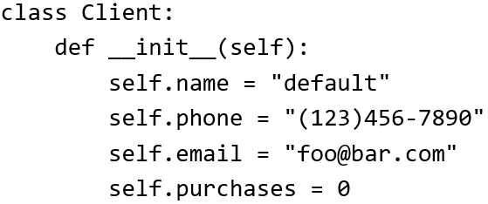

The Client List Example Implemented Using Classes (2)
Changes 2 attributes:
name = "James Tam"
email = "tam@ucalgary.ca"
def start():
firstClient = Client()
firstClient.name = "James Tam"
firstClient.email = "tam@ucalgary.ca"
print(firstClient.name)
print(firstClient.phone)
print(firstClient.email)
print(firstClient.purchases)
start()

Slide 11

Important Details
Accessing attributes inside the methods of the class.
MUST preface the attribute with ‘self’
class Client:
def __init__(self):
self.name = "default"
(More on the ‘self’ keyword later in
this section)
Accessing attributes outside the methods in the body of the class (e.g. start() function)
Must create a reference to the object first
firstClient = Client()
Then access the object through that reference
firstClient.name = "James Tam"
Format:
self.<attribute name>
Format:
<Ref. name> = <Class name>()
Format:
<Ref. name>.<attribute name>

Slide 12
What Is The Benefit Of Defining A Class?
It allows new types of variables to be declared.
The new type can model information about most any arbitrary entity:
Car
Movie
Your pet
A bacteria or virus in a medical simulation
A ‘critter’ (e.g., monster, computer-controlled player) a video game
An ‘object’ (e.g., sword, ray gun, food, treasure) in a video game
A member of a website (e.g., a social network user could have attributes to specify the person’s: images, videos, links, comments and other posts associated with the ‘profile’ object).
Notes:
12

Slide 13
What Is The Benefit Of Defining A Class (2)
Unlike creating a composite type by using a list a predetermined number of fields can be specified and those fields can be named.
This provides an error prevention mechanism
class Client:
def __init__(self):
self.name = "default"
self.phone = "(123)456-7890"
self.email = "foo@bar.com"
self.purchases = 0
firstClient = Client()
print(firstClient.middleName) #Error: no such field defined

Slide 14
Revisiting A Previous Example: __init__()
New terms:
__init__()
Constructor
Python:
__init__() is used to initialize the attributes
Classes have a special function (actually ‘method’ – more on this later in this section) called a constructor that can be used to initialize the starting values of a class to some specific values.
This method is automatically called whenever an object is created e.g. bob = Person()
Format:
class <Class name>:
def __init__(self, <other parameters>):
<body of the method>
Example:
class Person:
def __init__(self):
self.name = "No name"
This calls the init() constructor

Slide 15

Classes Have Attributes
But Also Behaviors
ATTRIBUTES
Name:
Phone:
Email:
Purchases:
BEHAVIORS
Open account
Buy investments
Sell investments
Close account
A client
Image of James courtesy of James Tam

Slide 16
New Term: Class Methods (“Behaviors”)
List reference
Method operating on the list
1 Not all composites have methods e.g., arrays in ‘C’ are a composite but don’t have methods
Functions: not tied to a composite type or object
The call is ‘stand alone’, just name of function
E.g.,
print(), input()
Methods: must be called through an instance of a composite¹.
E.g.,
aList = []
aList.append(0)
Unlike the above pre-created functions (e.g. append), the methods that you define with your classes can be customized to do anything that a regular function can.
Functions that are associated with classes (call through an instance) are referred to as methods.

Slide 17
Defining Class Methods
Format:
class <classname>:
def <method name> (self, <other parameters>):
<method body>
Example:
class Person:
def __init__(self):
self.name = "I have no name :("
def sayName (self):
print ("My name is...", self.name)
Unlike functions, every method of a class must have the ‘self’ parameter (more on this later)
Reminder: When the attributes are accessed INSIDEs the methods of a class they MUST be preceded by the suffix “.self”

Slide 18

Defining Class Methods: Full Example
Name of the online example: 2personV1.py (has a method other than just the constructor).
class Person:
def __init__(self):
self.name = "I have no name :("
def sayName(self):
print("My name is...", self.name)
def start(): #Access outside class requires a reference
aPerson = Person()
aPerson.sayName()
aPerson.name = "Big Smiley :D"
aPerson.sayName()
start()

Slide 19
Calling A Method Inside Another Method Of The Same Class
Similar to how attributes must be preceded by the keyword ‘self’ before they can be accessed so must the classes’ methods:
Example:
class Bar:
def __init__(self):
self.x = 0
def method1(self):
print(self.x) #Accessing attribute ‘x’
def method2(self):
self.method1() #Calling method ‘method1’

Slide 20
Why Is ‘Self’ Needed
Name of the full online example: 3need_for_self.py
class Person:
def __init__(self,aName):
self.name = aName
def sayFriend(self,myFriend):
print("Calling object's name %s" %(self.name))
print("name of friend is %s" %(myFriend.name))
def start():
stacey = Person("Stacey")
jamie = Person("Jamie")
stacey.sayFriend(jamie)
start()

Slide 21
Whose Method Is Called: Stacey’s Due To Self
Self distinguishes the object whose method is called from other object(s)
def sayFriend(self,myFriend):
print("Calling object's name %s" %(self.name))
print("name of friend is %s" %(myFriend.name))
def start():
stacey = Person("Stacey")
jamie = Person("Jamie")
stacey.sayFriend(jamie)

Slide 22
Whose Method Is Called: Jamie’s Due To Self
Self distinguishes the object whose method is called from other object(s)
def sayFriend(self,myFriend):
print("Calling object's name %s" %(self.name))
print("name of friend is %s" %(myFriend.name))
def start():
stacey = Person("Stacey")
jamie = Person("Jamie")
jamie.sayFriend(stacey)

Slide 23
Self Is Still Needed Even With A Single Object
Error: ‘Name’ is neither local nor global
Reference to the identifier ‘name’
Not specified as ‘self.name’
It’s not treated as an attribute.
def cannotSay(self):
print("My name is %s" %(name))
def start():
stacey.cannotSay()
Check global scope for variable declaration
Check local scope for variable declaration

Slide 24
Including Out Of Scope Reference Name Inside Of The Class
Name of the full online example: 4need_for_reference_name.py
Inappropriately including reference name in method.
class Person:
def __init__(self,aName):
self.name = aName
def doesNotSetName(self,newName):
stacey.name = newName
jamie.name = newName
def start():
stacey = Person("Stacey")
jamie = Person("Jamie")
stacey.doesNotSetName(jamie)
Scope
Problem

Slide 25
Excluding The Reference Name
You wouldn’t do this now (I hope!)
def start():
aList1 = []
aList2 = []
append(321) #No such ‘function’

Slide 26

Excluding Reference Name Outside Of Class
def start():
stacey = Person("Stacey")
jamie = Person("Jamie")
#print("What would the output be? Why?")
#print(name)

Slide 27
Using ‘Self’ Outside Of The Class
Name of the full online example: 5mixing_up_self_with_references.py
def start():
stacey = Person("Stacey")
jamie = Person("Jamie")
#self.name = "Jamie’s friend"
Recall: ‘self’ must be (and really can only be) used within a class definition.

Slide 28
Using ‘Self’ Outside Of The Class
Name of the full online example: 5mixing_up_self_with_references.py
Self: Not declared globally
def start():
stacey = Person("Stacey")
jamie = Person("Jamie")
#self.name = "James friend"
Self: Not declared locally
The identifier ‘self’ is not known in this function.
The same problem if the identifier ‘name’ is used without a reference name

Slide 29

Decomposing Large Programs: By File
Because real life programs are large, they are not only divided into functions but also split into multiple files.
Example: There’s so many files for the game RPG Icewind Dale that they are distributed among several folders (multi-file install is not unique to this game).

Slide 30
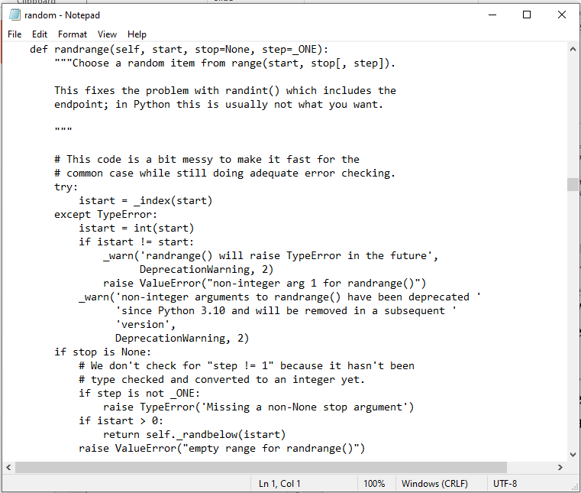
Python File Decomposition: Modules
Each module is a separate library of python features (functions, class definitions).
Recall: the ‘Random’ module:
Name of file: random.py
File contains 1 or more functions

Slide 31
Review: Using The Code In A Module
Add the name ‘Random’ to your program
Format:
import <Module/filename>
Example:
import random
Running a function/method from this module
Format:
<Module/filename>.<function/method call>
Example:
print(random.randrandint(1,6))

Slide 32
Defining Your Own Module
Name of the folder containing the full online example: 1st_module_example
To start the whole program run the module with the ‘start’ function (in this case it is Driver.py).
Filename: Draw.py
def rectangle():
print("""
#########
#########
#########
#########
#########
#########
#########
#########""")
def right():
print("""
#
###
######""")
def triangle():
print("""
#
###
#####""")

Slide 33
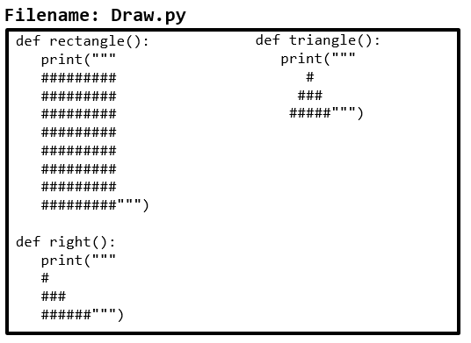
Defining Your Own Module (2)
Adding the name ‘Draw’ to your program
Filename: Driver.py
import Draw
def start():
Draw.rectangle()
Draw.right()
Draw.triangle()
start()
Running functions from the ‘Draw’ module (similar to running the random methods this requires <module name>.<method name>

Slide 34
Naming The Starting Module
Recall: The function that starts a program (first one called) should have a good self-explanatory name e.g., “start()” or follow common convention e.g., “main()”
Similarly the file module that contains the ‘start()’ or ‘main()’ function should be given an appropriate name e.g., “Driver.py”, “Start.py”, “Main.py” (it’s the ‘driver’ of the program or the starting point)
Filename: “Driver.py”
def start():
#Instructions
start()

Slide 35
Importing Modules Containing Class Definitions
A common convention is to have the module (file) name match the name of the class e.g. file/module ‘Person.py’ contains definition for “class Person”
Approach 1: import just the name of the file containing the class definition.
Example: import PersonFile (similar this previous approach: import Random)
Advantage:
Allows access to other ‘names’ in the file e.g. other utility methods, constants etc.
Recall Random.py contains: Random.randrange(0,6), Random.randint(1,6)
Disadvantage:
The name of the file must be included along with the name of the function/method/attribute e.g. Random.randint(1,6)
File: Random.py
def randint(start,end):
def randrange(start,end):

Slide 36
Importing Modules Containing Class Definitions
Approach 2: import just the name of the file containing the class definition.
Example: from PersonFile import Person (or using this approach with an existing library from Random import randint)
Advantage:
Imports only the names needed (reduced conflicts between the names in the module being imported and the file where the import is included).
from Random import randint
#only imports the randint name

Slide 37
Approach 1: An Example
Name of the folder complete online example: 2nd_oo_module_example
Only the module/filename is imported so other names (e.g. class, method, function name) must be prefaced by the module name (‘context’ needed).
Filename: PersonFile.py
Filename: Driver.py
class Person:
def __init__(self):
self.name = "I have no name :("
def sayName(self):
print("My name is...", self.name)
def fun():
print("called fun")
import PersonFile
def start():
#Only filename imported
aPerson = PersonFile.Person()
aPerson.sayName()
PersonFile.fun()
start()

Slide 38
Approach 2: An Example
Name of the folder complete online example: 3rd_oo_module_example
More specific: only imports the class name, other names (e.g. function, global names) cannot be accessed.
The class name doesn’t need to be prefaced by the module name.
References to the imported name are shorter.
Reduces the possibility of naming conflicts e.g. if there’s already a function ‘fun’ in Driver.py (won’t conflict with ‘fun’ in Person).
Filename: PersonFile.py
Filename: Driver.py
class Person:
def __init__(self):
self.name = "I have no name :("
def sayName(self):
print("My name is...", self.name)
def fun():
print("called fun")
from PersonFile import Person
def start():
aPerson = Person()
aPerson.sayName()
start()

Slide 39
Recall: Objected Approach Ties Behaviors (Methods) To Classes
Capabilities are defined in class Flyer mean that all objects whose type is a Flyer have thee abilities of abilities of a flyer.
class Flyer():
def fly(self):
...
class Flock:
def __init__(self):
self.aFlock = []
for i in range(0,12,1):
aFlyer = Flyer() #Each element can ‘fly’
self.aFlock.append(aFlyer)
def takeFirstFlight(self):
for i in range(0,12,1):
self.aFlock[i].fly() #Flyer types ‘flying’

Slide 40
An Addition Object-Oriented Concept: Inheritance
Capabilities are defined in a class (in this case it’s the Flyer() which is a parent class) and all classes that inherit all the abilities of a flyer (in this cases the child class: Airplane).
class Flyer():
def fly(self):
….
Via inheritance: class definitions be extended by specifying that ‘child’ classes (derived from the parent) inherit (are able to access) the attributes and methods of the parent.
class Airplane(Flyer):
Alternative example: Java
public class Airplane extends Flyer
{
}
In python this allows an Airplane object to ‘fly’ by inheriting the abilities of the ‘Flyer.
Notes:
*Multiple inheritance
class Airplane(Flyer,Machine):

Slide 41

Inheritance: A Complete Example
Name of the folder complete online example: 4th_inheritance_example
#Flyer.py
class Flyer():
def fly(self):
print("flying")
#Driver.py
from Flyer import Flyer
from Person import Person
from Airplane import Airplane
def start():
aFlyer = Flyer()
aFlyer.fly()
aPlane = Airplane()
aPlane.refuel()
aPlane.fly()
aPerson = Person()
aPerson.doPersonStuff()
#aPerson.fly() #Error
#Airplane.py
#'Flyer' not defined here
from Flyer import Flyer
class Airplane(Flyer):
def refuel(self):
print("Fueling up!")
#Person.py
class Person():
def doPersonStuff(self):
print
("Doing people things")

Slide 42
Object-Oriented Design: Advantage Over Procedural Decomposition
Procedural approach: functions can allow for nonsensical behaviors e.g. “flying pigs”
E.g.
def fly():
...
pigs = list["pig1","pig2"] fly(pigs)

Slide 43
After This Section You Should Now Know
How to define an arbitrary composite type using a class
Attributes and methods are bundled with (‘encapsulated’ into the class definition)
What are the benefits of defining a composite type by using a class definition over using a list
How to create instances of a class (instantiate)
How to access and change the attributes (fields) of a class
How to define methods/call methods of a class
What is the ‘self’ parameter and why is it needed
What is a constructor (__init__ in Python), when it is used and why is it used
How to divide your program into different modules
How inheritance can allow access to group of derived classes.

Slide 44
Copyright Notification
“Unless otherwise indicated, all images in this presentation are used with permission from Microsoft.”

