Slide 1
Functions: Decomposition And Code Reuse, Part 3
Global identifiers, scope and program design
Declaring variables: where in your function/at what level in your program
Boolean functions
Breaking long functions into parts
Common errors when defining functions
Program design and defining functions
Testing functions
Benefits & drawbacks of defining functions

Slide 2
In Class Exercise, Functions
Write a function called ‘emphasize’ that takes a string as a parameter.
This function returns a modified version of the string:
!!! will be added onto the end (three exclamation marks are added to the end of the existing string).
Recall: The concatenation operator is the ‘plus’ operator ‘+’ and it can connect two strings.

Slide 3
In Class Exercise: Solution
def emphasize(aString):
emphasizedString = aString + "!!!"
return(emphasizedString)

Slide 4
Declaring Variables: Stylistic Note
Creating variables all at once at the start of a function.
def start():
#Variables declared
principle = -1
rate = -1
time = -1
interest = -1
amount = -1
introduction()
principle,rate,time = getInputs()
interest, amount =
calculate(principle,rate,time)
display(principle,rate,time,
interest,amount)
start()
Origins: many languages (e.g. C, C++, Java, Pascal) require variables to be declared with a specific type before they can be used:
fun ()
{
//Variables declared
Scanner in = null;
int age = 0;
in = new Scanner(System.in);
age = in.nextInt()
System.out.print("Age:");
}
Not syntactically required but a stylistic approach

Slide 5
Global Scope (Again)
Identifiers (constants or variables) that are declared within the body of a function have a local scope (the function).
def fun():
num = 12
# End of function fun
Identifiers (constants or variables) that are created outside the body of a function have a global scope (the program).
num = 12
def fun1():
# Instructions
def fun2():
# Instructions
# End of program
Scope of num is the function
Scope of num is the entire program

Slide 6

Global Scope: An Example
Name of the example program: 8simple_global_example.py
Learning objective: how global variables are accessible throughout a program.
num1 = 10
def fun():
print(num1)
def start():
fun()
print(num2)
num2 = 20
start()

Slide 7
Scoping Rules: Globals
When an identifier is referenced (variable or constant) then:
First look in the local scope for the creation of the identifier: if found here then stop looking and use this identifier
If nothing exists at the local level then look globally
Check globally
def aFunction():
print(num)
num = <value> here?
Check locally
num = <value> here?
Reference to an identifier

Slide 8

Global Variables: Python Specific Characteristic
Name of the example program: 9detailedGlobalsVsLocals.py
Learning objective: Relationship between accessing global variables and creating locals.
num = 1
def fun():
num = 2
print(num)
def start():
print(num)
fun()
print(num)
start()
Local created and displayed
Global
Global

Slide 9
Python Globals: ‘Read’ But Not ‘Write’ Access
By default global variables can be accessed globally (read access).
Attempting to change the value of global variable will only create a new local variable by the same name (no write access to the global, a local is created).
num = 1
def fun():
num = 2
print(num)
Prefacing the name of a variable with the keyword ‘global’ in a function will indicate changes in the function will refer to the global variable rather than creating a local one.
global <variable name>
Global num
Local num

Slide 10

Globals: Another Example (‘Write’ Access Via The “Global” Keyword)
Name of the example program: 10modifyingGlobals.py
Learning objective: How global variables can be modified inside functions.
num = 1
def fun():
global num
num = 2
print(num)
def start():
print(num)
fun()
print(num)
start()
References to the name ‘num’ now affect the global variable, local variable not created inside function ‘fun’
Global changed
Global
Global still changed after ‘fun()’ is done

Slide 11
Global Variables: General Characteristics
You can access the contents of global variables anywhere in the program.
Python: this can occur even if the ‘global’ keyword is not used.
Benefits (why avoid global variables.)
Reason 1st: more efficient use of memory (covered in the last section)
Reason #2 why the use of global variables is regarded as bad style¹: In most programming languages you can also modify global variables anywhere as well.
This is why the usage of global variables is regarded as bad programming style, they can be accidentally modified anywhere in the program.
Changes in one part of the program can introduce unexpected side effects in another part of the program.
Reason #3: pedagogical (creating variables locally forces you to apply important programming concepts such as parameter passing, function return values and scope).
Unless you have a compelling reason you should NOT be using global variables but instead you should pass variables as parameters/returning values.
Unless you are told otherwise using global variables can affect the style component of your assignment grade.
Global constants are acceptable and are commonly used.
1 Reminder of reason #1: it’s an inefficient use of memory as variables should be allocated only as needed.

Slide 12
What Level To Declare Variables
Declare your variables as local to a function.
When there are multiple levels of functions (a level is formed when one function calls another) then:
A variable should be created at the lowest level possible
fun1
fun1
Need
x,y here
fun2
Fun3(x,y)
fun2
fun3
Get and return x,y
x,y
Needed here
x
Needed here y, z
Notes:
Case 1:
x,y: needed in fun1, fun3 e.g., get input in fun1 and then display in fun3
Must declare in fun2 so you can pass x,y into fun3
Case 2:
If x is only used in fun2 then that’s where it should be created
If y,z is used only in fun3 then that’s where they should be created
Fun1 doesn’t need to access x,y,z so these variables aren’t created here

Slide 13
Recap #1 For The Upcoming Example: Format Specifiers
Format:
print ("%<placeholder for type of info to display/code>" %<source of the info to display>)
Types of information (that can be formatted via the format specifier):
Specifier | Information type | Example
%s | String | print("%s" %(aStr)) ^{1 Example value: aStr = "axy"} print ("%s" %("ab"))
%d | Integer | print("%d" %(aNum)) ^{1 Example value: aNum = 13} print("%d" %(7))
%f | Floating point | print("%f" %(12.55))
Notes:
For floats rounding up occurs at 5 and above

Slide 14
Recap #2 For The Upcoming Example: Storing String Information
Typically characters are encoded using ASCII
https://www.ascii-code.com/
Each character is mapped to a numeric value
E.g., ‘A’ = 65, ‘B’ = 66, ‘a’ = 97, ‘2’ = 50
Values are sequential
e.g. ‘0’=48, ‘1’=49, ‘2’=50… ‘9’=57,

Slide 15

New Term: Boolean Function
Return a Boolean value (true/false): “Asks a question”
Typically the Boolean function will ‘ask the question’ about a parameter(s) and return a True or False value.
Name of the example program: 11booleanFunctionIsNum.py
Is it true that a single character string can be passed to the int() function (i.e. it’s an integer)
def start():
aChar = "0"
print(isDigit(aChar))
# Boolean function
def isDigit(aChar):
digit = False
if((aChar >= "0") and \
(aChar <= "9")):
digit = True
return(digit)
# Testing the Boolean function (test driver case)
print("Testing '%s': " %(aChar), isDigit(aChar))
Notes:
Two args to print: 1st arg=single character string, 2nd arg=return value of isDigit which is a Boolean value

Slide 16
New Term: Test Driver (Paraphrased From Many Sources)
Program code that calls a function under different conditions.
The conditions are typically simulated through the arguments passed to the function being tested.
aChar = "9"
print("Testing '%s': " %(aChar), isDigit(aChar))
aChar = "A"
print("Testing '%s': " %(aChar), isDigit(aChar))
The results are often evaluated through the return value of the function being tested.
Testing '9': True
Testing 'A': False

Slide 17
Example: How To Decompose A Long Function
To decompose (break into parts) long functions examine the structure for sections e.g. loops (and their bodies), branches (and their bodies).
Each of these sections may be a candidate to be moved into it’s own separate function body:
Before
def fun1():
while(BE1):
if(BE2):
#If body #1
if(BE3):
#If body #2
After
def fun3():
#If body #2
def fun2():
#If body #1
def fun1():
while(BE1):
if(BE2):
fun2()
if(BE3):
fun3()

Slide 18
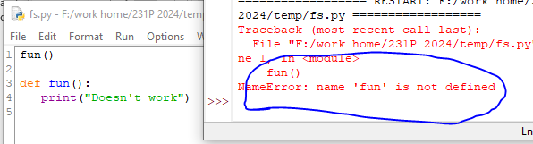
The Starting Function Needs To Be Defined Before It Can Be Called
Correct ☺
def fun():
print("Works")
# Start
fun()
Incorrect ☹
# Start
fun()
def fun():
print("Doesn't work")
Function definition
Function call
Function definition
Function call
Notes:
Doesn’t work if the start function calls another function but it seems to work if any function other than the start function calls another.

Slide 19
Another Common Mistake
Forgetting the brackets during the function call:
def fun():
print("In fun")
# Start of program
print("Starting the program")
fun
Notes:
Function fun is never called so the second message never appears onscreen.

Slide 20
Another Common Mistake
Forgetting the brackets during the function call:
def fun():
print("In fun")
# Start of program
print("Program started")
fun
()
Unlike many other languages the missing set of brackets do not produce a syntax/translation error (likely it will be logic error because the function isn’t called)
Notes:
Function fun is never called so the second message never appears onscreen.

Slide 21
Another Common Problem: Indentation
Recall: In Python indentation indicates that statements are part of the body of a function.
(In other programming languages the indentation is not a mandatory part of the language but indenting is considered good style because it makes the program easier to read).
Forgetting to indent:
def start():
print("start")
start()

Slide 22
Another Common Problem: Indentation (2)
Inconsistent indentation:
def start():
print("first")
# Error: Unless this is the body of branch or loop
print("second")
start()

Slide 23
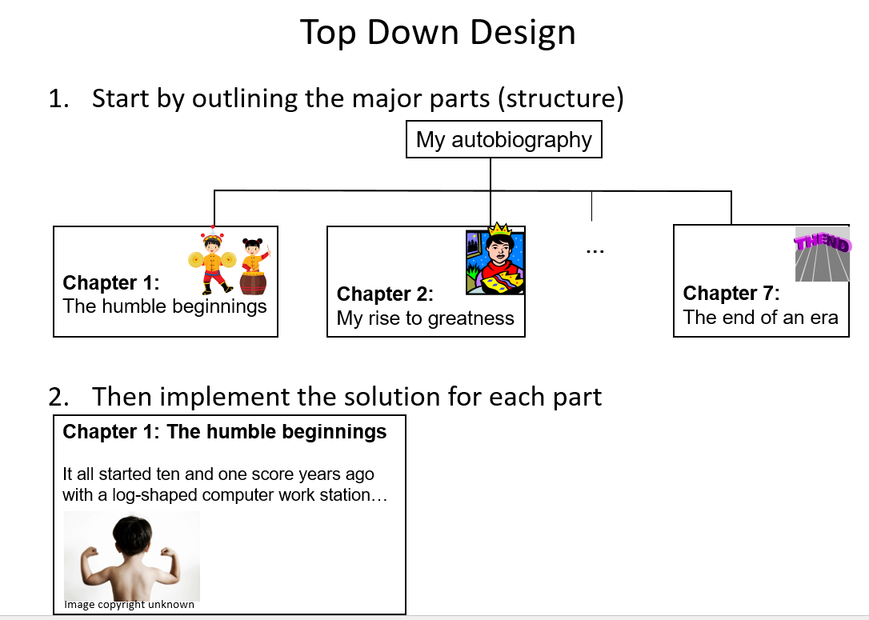
Creating A Large Document
Recall: When creating a large document you should plan out the parts before doing any actual writing.
Step 1: Outline all the parts (no writing)
Chapter 1
Introduction
Section 1.1
Section 1.2
Section 1.3
Conclusion
Chapter 2
Introduction
Section 2.1
Section 2.2
Section 2.3
Section 2.4
Conclusion
Chapter 3
Introduction
Section 3.1
Section 3.2
Conclusion
Step 2: After all parts outlined, now commence writing one part at a time
Section 1.1
It all started seven and two score years ago…

Slide 24
Creating A Large Program
When writing a large program you should plan out the parts before doing any actual writing.
Step 1: Calculate interest (write empty ‘skeleton’ functions)
def getInformation():
def doCalculations():
def displayResults():
Step 2: All functions outlined, write function bodies one-at-a-time (test before writing next function)
def getInformation():
principle = int(input())
interest = int(input())
time = int(input())
return(principle,interest,time)
# Simple test: check inputs
# are properly read as input
# and returned to caller
p,r,t = getInformation()
print(p,r,t)

Slide 25
Yet Another Problem: Creating ‘Empty’ Functions
def start():
start()
Problem: This statement appears to be a part of the body of the function but it is not indented???!!!

Slide 26
Solution When Outlining Your Program By Starting With ‘Empty’ Functions
Alternative (writing an empty function: ‘pass’ a python instruction that literally does nothing)
def fun():
pass
# Program’s start
fun()
def fun():
print()
# Program’sstart
fun()
A function must have at least one instruction in the body

Slide 27
Testing Functions
The correctness of a function should be verified. (“Does it do what it is supposed to do?”)
Typically this is done by calling the function, passing in predetermined parameters and checking the result i.e. via a test driver
Example¹: 12absoluteTest.py
def absolute(number):
if (number < 0):
result = number * -1
else:
result = number
return(result)
# Test cases/drivers
print(absolute(-13))
print(absolute(7))
Expected results:
13
7
1: In case you are wondering about the naming use. It’s not testing for an absolute value but instead you’re testing a program that implements an absolute value feature.

Slide 28
How To Write Your Programs
Reminder:
Outline the whole program with empty functions (stubs) that don’t perform any tasks yet.
Implement the code for each function one at a time.
Test each function with a driver.
Fix any bugs, test again until you are reasonable sure the function is correct.
Only then should you move onto writing the next function.
One approach:
Write/test each function in a file separate from the main program.
Only after you are sure of that function’s correctness do you add its code into the file containing the main program.

Slide 29
Why Employ Problem Decomposition And Modular Design (1)
Drawback
Complexity – understanding and setting up inter-function communication may appear daunting at first.
Tracing the program may appear harder as execution appears to “jump” around between functions.
These are ‘one time’ costs: once you learn the basic principles of functions with one language then most languages will be similar.
Notes:
Functions and Procedures in Pascal
29

Slide 30
Why Employ Problem Decomposition And Modular Design (2)
Benefit
Solution is easier to visualize and create (decompose the problem so only one part of a time must be dealt with).
Easier to test the program:
Test one feature/function at a time
(Testing multiple features increases complexity)
Easier to maintain (if functions are independent changes in one function can have a minimal impact on other functions, if the code for a function is used multiple times then updates only have to be made once).
Less redundancy, smaller program size (especially if the function is used many times throughout the program).
Smaller programs size: if the function is called many times rather than repeating the same code, the function need only be defined once and then can be called many times.

Slide 31
Extra Topics
These are language specific implementations and will be covered (and tested) only there is time (i.e. we are ahead of schedule in the lectures).

Slide 32

Default Arguments
If some parameters are excluded in the function call then default values (“default arguments”) can be specified.
It can be employed when some parameters are not always known when the function is called.
Example: creating a new ‘client’ or ‘patient’ but the information is not all available when the person signs up.
New term, default argument: if an argument is omitted then the default value is used for the missing value.
P2=18 (default)
P1=123456
P2=18
P2=18
P1=111111
P3= (default)
Usage:
e.g. retail creating customer account

Slide 33

Default Arguments: An Example
Name of the example program: 13_default_parameters
Learning objective: how define and call a function with default arguments.
def display(studentID,anAge=-1,aName="No name"):
print(aName,studentID,anAge)
def start():
display(123456,18,"Smiley")
display(111111)
Non-default values used
No name provided for name
Age not provided so default of -1 used

Slide 34
Syntax requirements For Default Arguments
Default arguments cannot be followed by non-default arguments.
Alternative wording: all optional arguments must be at end of the parameter list.
Example below: 1st argument (default) is followed by a non-default argument
Non default follows default

Slide 35
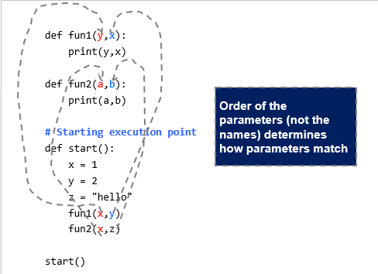
Recall: In General Parameter Order Is Critical

Slide 36
New Term: Key Word Arguments
The except is when the parameters being passed into a function are assigned values during the call.
In this case it’s the name of the parameters that determine which parameters match up on the function call vs. the function definition.
In this case the names must match.
But order is not relevant.
Format (during function call):
<function name>(<arg1>=<value>, <arg2>=<value>, <arg3>=<value>… )
Example of using keyword arguments
Function call (default values mandatory):
fun1(aNum=888,aStr="Lucky")
Example
Function definition:
def fun1(aStr,aNum):
print(aNum,aStr)
If keyword are used (name matches up parameters) then each parameter must be set to a value

Slide 37
Example Of Keyword Arguments
Name of the example program: 14_keyword_arguments
Learning objective: how to use keyword arguments (using the name of the arguments to specify how arguments are matched up in the function call vs. the function definition).
def fun1(aStr,aNum):
print(aNum,aStr)
def fun2(localNum,localString):
print(localNum,localString)
def start():
print("fun1(), using keyword arguments: ", end="")
fun1(aNum=888,aStr="Lucky")
aNum=777
print("fun2(), using normal positional arguments: ", end="")
fun2(aNum,"Also lucky")
Keyword arguments
Name is how things match up
Positional arguments: names don’t have to match (or in the case of the 2nd parameter there is no name because it is an unnamed constant). Matching occurs in order in which parameters are passed in

Slide 38
If The Names Don’t Match: Won’t Work
#def fun3(aNum1,aStr1):
# print(aNum1,aStr1)
#print("fun3(), using keyword arguments but names don't
#match: ")
#fun3(aNum=888,aStr="lucky")
Treated as keyword not positional arguments because default values are NOT provided

Slide 39
After This Section You Should Now Know
What is global scope
Consequences of employing global scope
What are scoping rules when referring to an identifier
Where variables should be declared in the body of a function
A guideline for the level at which variables should be declared
How/when to employ doc string documentation
What is a Boolean function
A technique for decomposing a long function into smaller functions
Common errors when defining functions
The basics of testing a function
The benefits & drawbacks of defining functions
New terms & concepts: Boolean function, test driver, default arguments, keyword parameters.

Slide 40
Copyright Notification
“Unless otherwise indicated, all images in this presentation are used with permission from Microsoft.”

