Slide 1
Functions: Decomposition And Code Reuse, Part 2
Parameter passing
Function return values
Function specific style requirements (rules of thumb for good style)
Documenting functions

Slide 2
New Problem: Local Variables Only Exist Inside A Function
def display():
print()
print("Celsius value: ", celsius)
print("Fahrenheit value :", fahrenheit)
def convert():
celsius = float(input("Type in the celsius temperature: "))
fahrenheit = celsius * 9 / 5 + 32
display()
convert()
What is celsius???
What is fahrenheit???
Variables celsius and fahrenheit are local to function convert()
New problem: How to access local variables outside of a function?

Slide 3
One Solution: Parameter Passing
Passes a copy of the contents of a variable as the function is called:
convert
Synonyms for parameters
Arguments
Inputs
celsius
fahrenheit
Parameter passing: communicating information about local variables (via parameters/inputs) into a function
display
Celsius? I know that value!
Fahrenheit? I know that value!

Slide 4
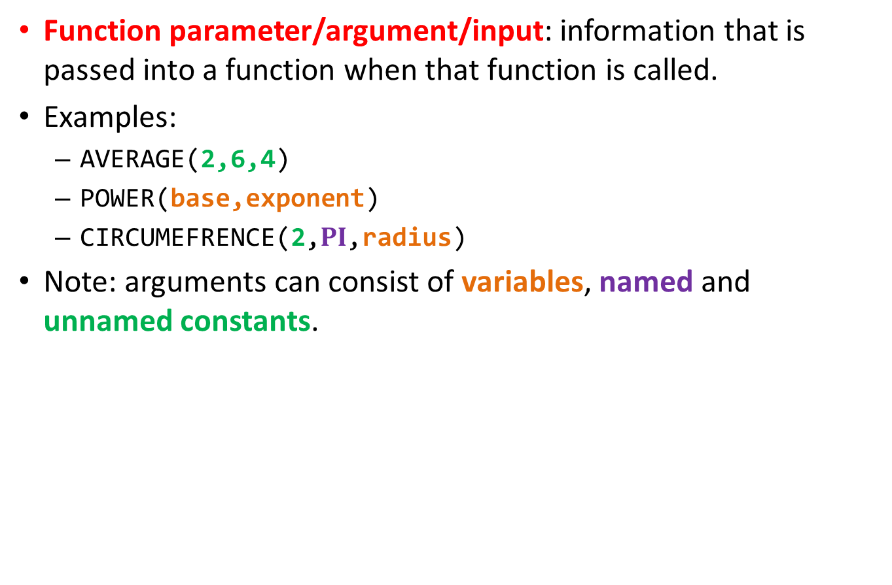
New (Already Known?): Definitions
Function parameter/argument/input: information that is passed into a function when that function is called.
Examples:
AVERAGE(2,6,4)
POWER(base,exponent)
CIRCUMEFRENCE(2,$PI$,radius)
Note: arguments can consist of variables, named and unnamed constants.

Slide 5
Parameter Passing (Function Definition)
List the names of the variables in the round brackets that will store the name of the information passed in.
Format:
def <function name>(<parameter 1>,<parameter 2>...
<parameter n-1>, <parameter n>):
Example:
def display(celsius,fahrenheit):
n is a non-negative integer (you pass in 0 or more parameters)

Slide 6
Parameter Passing (Function Call)
Just list the information to be passed as parameters to the function in the round brackets.
Passing variables or named constant: just specify the name of the identifier e.g. print(num), random.ranrange(MIN,MAX)
Passing unnamed constants: just specify the value of the parameter e.g. input("Enter your name: "), print("Hello")
Format:
<function name>(<parameter 1>, <parameter 2>...
<parameter n-1>, <parameter n>)
Example:
display(celsius,fahrenheit)
Notes:
Draw a structure chart of the calls

Slide 7
Memory And Parameter Passing
Parameters passed as parameters/inputs into functions become variables in the local memory of that function.
def fun(num1): print(num1)
num2 = 20
print(num2)
def start():
num1 = 1
fun(num1)
start()
Parameter num1: local to fun
Copy
num2: local to fun
num1: local to start
Notes:
Do variations
what if num1 changed in function.
What if name of parameter doesn't match what's passed in.

Slide 8
Important Terminology
Getting user input:
The user “types in” the information
In Python the input() function is employed
Passing inputs/parameters into a function
Information passed into a function as the function runs
Format:
<Function name>( )
Examples of function inputs (not examples of user input) :
print("hello") #function input = "hello"
random.randrange(6) # function input = 6
print() #No input
round(3.14,1) #2 inputs: 3.14(data), 1(# fractional digits)
Inputs/parameters

Slide 9
Sample (Simple) Example Question: Terminology
Write a function that takes two inputs: a numerator and denominator
The function will calculate and display onscreen the floating point quotient
Solution:
There is no mention of user input
Don’t call the input() function!
Consequently the input in the program description refers to information passed into the function as it runs
def displayQuotient(numerator,denominator): #Correct
quotient = numerator/denominator
print(quotient)
def displayQuotient(): #Incorrect
numerator = float(input())
...

Slide 10
Structure Charts
Useful for visualizing the layout of function calls in a large and complex program.
Format:
Example:
def start():
age = float(input())
print(age)
Calling function
Function being called
Function being called
start
age
input
float
print

Slide 11
Structure Chart: temperature.py
To reduce clutter most structure charts only show functions that were directly implemented by the programmer (or the programming team).
start
introduction
convert
celsius
fahrenheit
Inputs(celsius,fahrenheit)
display

Slide 12

Parameter Passing: Putting It All Together
Name of the example program: 4temperature_parameters_arguments_inputs.py
Learning objective: defining functions that take arguments/parameters/inputs when they are called.
Reminder: Function inputs does not refer to user input
e.g. print("hello") #Input is the string hello
def introduction():
print("""
Celsius to Fahrenheit converter
-------------------------------
This program will convert a given Celsius temperature to an equivalent
Fahrenheit value.
""")

Slide 13

Parameter Passing: Putting It All Together (2)
def display(celsius,fahrenheit):
print()
print("Celsius value: ", celsius)
print("Fahrenheit value:", fahrenheit)
def convert():
celsius = float(input ("Type in the celsius temperature: "))
fahrenheit = celsius * 9 / 5 + 32
display(celsius, fahrenheit)
# Starting execution point
def start():
introduction()
convert()
start()

Slide 14

Parameter Passing: Important Recap!
A parameter is copied into a local memory space.
# Inside function convert()
display(celsius,fahrenheit) # Function call
Data
Data
Make copy
Make copy
# Inside function display
def display(celsius,fahrenheit): # Function
# definition
Separate
Data
copy
RAM
Memory: ‘convert’
Memory: ‘display’
celsius
-34
celsius
-34
fahrenheit
-29.2
fahrenheit
-29.2
Separate

Slide 15

Parameter Passing: Another Example
Name of the example program: 5parameter_copy.py
Learning objective: How function parameters/arguments/inputs are local copies of what’s passed in.
def fun(num1,num2):
num1 = 10
num2 = num2 * 2
print(num1,num2)
def start():
num1 = 1
num2 = 2
print(num1,num2)
fun(num1,num2)
print(num1,num2)
start()

Slide 16
A Common Mistake: Not Declaring Parameters
You wouldn’t do it this way with pre-created functions:
def start():
print(num)
So why do it this way with functions that you define yourself:
Etc. (Assume fun() has been defined elsewhere in the program)
# start (incorrect)
def start():
fun(num)
start()
What is ‘num’? It has not been declared in function ‘start()’
# start (corrected)
def start():
num = <Create first>
fun(num)
start()
What is ‘num’? It has not been created in function ‘start()’
Notes:
Show this
def start():
print(num)

Slide 17
Parameter Passing: Why It’s Needed
You did it this way so the function ‘knew’ what to display:
age = 27
# Pass copy of 27 to
# print() function
print(age)
You wouldn’t do it this way:
age = 27
# Nothing passed to print
# Function print() has
# no access to contents
# of ‘age’
print()
# Q: Why doesn’t it
# print my age?!
# A: Because you didn’t
# tell it to!

Slide 18
A Common Mistake: Forgetting To Pass Parameters
Example:
def displayAge():
print(age)
def start():
age = int(input("Age in years: "))
displayAge()

Slide 19
The Type And Number Of Parameters Must Match!
Correct ☺:
def fun1(num1,num2):
print(num1,num2)
def fun2(num1,str1):
print(num1, str1)
# Starting execution point
def start():
num1 = 1
num2 = 2
str1 = "hello"
fun1(num1,num2)
fun2(num1,str1)
start()
DO THIS:
Two numeric parameters are passed into the call for ‘fun1()’ which matches the two parameters listed in the definition for function ‘fun1()’
DO THIS:
Two parameters (a number and a string) are passed into the call for ‘fun2()’ which matches the type for the two parameters listed in the definition for function ‘fun2()’

Slide 20
A Common Mistake: The Parameters Don’t Match
Incorrect ☹:
def fun1(num1):
print(num1,num2)
def fun2(num1,num2):
num1 = num2 + 1
print(num1, num2)
# starting exeuction point
def start():
num1 = 1
num2 = 2
str1 = "hello"
fun1(num1,num2)
fun2(num1,str1)
start()
DON’T DO
Two numeric parameters are passed into the call for ‘fun1()’ but only one parameter is listed in the definition for function ‘fun1()’
DON’T DO
Two parameters (a number and a string) are passed into the call for ‘fun2()’ but in the definition of the function it’s expected that both parameters are numeric.
Good naming conventions can reduce incidents of this second type of mistake.

Slide 21
Scope: A Variant Example
What happens at this point?
Why?
def fun1():
num = 10
# statement
# statement
# End of fun1
def fun2():
fun1()
num = 20
: :
fun2()
Notes:
Go over an example now where parameter modified (pass by reference so caller doesn’t see the changes)
Def square(num):
num = num * num
Def start():
num = 3
square(num)
print(num)
Draw memory maps for this one!
Use this as another segway for return values

Slide 22
New Problem: Results That Are Derived In One Function Only Exist While The Function Runs
Stored locally
interest = 50
def calculateInterest(principle,rate,time):
interest = principle * rate * time
def start():
principle = 100
rate = 0.1
time = 5
calculateInterest(principle,rate,time)
Problem:
Value stored in interest cannot be accessed here
print("Interest earned $",
interest)

Slide 23
Solution: Have The Function Return Values Back To The Caller
def calculateInterest(principle,rate,time):
interest = principle * rate * time
return(interest)
Variable interest is still local to the function.
The value stored in the variable interest local to calculateInterest() is passed back and stored in a variable that is local to the “start function”.
def start():
principle = 100
rate = 0.1
time = 5
interest = calculateInterest(principle,
rate,time)
print ("Interest earned $", interest)

Slide 24
Why Are Function Return Values Needed?
Remember that local variables only exist for the duration of a function.
RAM
Memory: ‘calculateArea’
def calculateArea():
w = int(input())
l = int(input())
a = w * l
w
l
a
def main():
calculateArea()
print(area)
Memory: ‘main’

Slide 25
Why Are Function Return Values Needed? (2)
After a function has ended local variables are ‘gone’.
RAM
Memory: ‘calculateArea’
def calculateArea():
w = int(input())
l = int(input())
a = w * l
w
l
a
def main():
calculateArea()
print(a)
Memory: ‘main’
a? (no longer exists)

Slide 26
Why Are Function Return Values Needed? (3)
Function return values communicate a copy of information out of a function (back to the caller) just as the function ends.
RAM
Memory: ‘calculateArea’
def calculateArea():
w = int(input())
l = int(input())
a = w * l
w
l
return(a)
a
The return statement passes back a copy of the value stored in ‘a’
Memory: ‘main’
def main():
a = calculateArea()
print(a)
Copy of data in a (calculate-srea)
a

Slide 27
Accessing Return Values
1 Although bracketing the return value isn’t required when only a single value is returned it’s still recommended that you get in the habit of doing it because it is required for ‘multiple’ return values. The actual details about the difference between returning a single vs. ‘multiple’ values will be covered in the ‘composites’ section.
Accessing means “to store” the values returned by a function.
Format (Single value returned)¹:
return(<value returned>) # Function definition
<variable name> = <function name>() # Function call
Example (Single value returned) ¹:
def calculateInterest():
return(interest)
def display():
interest = calculate(principle,rate,time)
Notes:
Square brackets not needed with single value.
Note calculate interest has three values passed in but only one value returned (only one value to the left of the assignment statement).

Slide 28
Accessing Return Values
Format (Multiple values returned):
# Function definition
return(<value1>, <value 2>...)
# Function call
<variable 1>, <variable 2>... = <function name>()
Example (Multiple values returned):
# Function definition
def getInputs():
return(principle, rate, time)
# Function call
def start():
principle, rate, time = getInputs()
Notes:
Note calculate interest has three values passed in but only one value returned (only one value to the left of the assignment statement).

Slide 29
Structure Chart: interest.py
start
principle
rate
time
interest
amount
Args
(principle,rate,time, interest,amount)
Args
(principle,rate,time)
introduction
display
getInputs
calculate
principle
rate
time
interest
amount
Return
(interest,amount)
Return
(principle,rate,time)

Slide 30
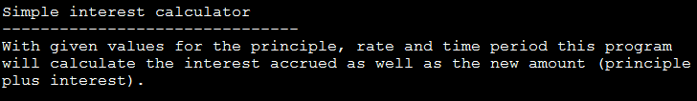
Accessing Return Values: Putting It All Together
Name of the example program: 6interest_return_values.py
Learning objective: parameter passing, defining functions with parameters passed in when they are called and return outputs when they end.
def introduction():
print("""
Simple interest calculator
-------------------------------
With given values for the principle, rate and time period this program
will calculate the interest accrued as well as the new amount (principle
plus interest).
""")

Slide 31

Accessing Return Values: Putting It All Together (2)
def getInputs():
principle = float(input("Enter the original principle: "))
rate = float(input("Enter the yearly interest rate %"))
rate = rate / 100
time = input("Enter the number of years that money will be invested:
")
time = float(time)
return(principle,rate,time)
def calculate(principle,rate,time):
interest = principle * rate * time
amount = principle + interest
return(interest,amount)

Slide 32
Accessing Return Values: Putting It All Together (3)
def display(principle,rate,time,interest,amount):
temp = rate * 100
print("")
print("Investing $%.2f" %principle, "at a rate of %.2f" %temp, "%")
print("Over a period of %.0f" %time, "years...")
print("Interest accrued $", interest)
print("Amount in your account $", amount)

Slide 33
Accessing Return Values: Putting It All Together (4)
# Starting execution point
def start():
principle = -1
rate = -1
time = -1
interest = -1
amount = -
introduction()
principle,rate,time = getInputs()
interest,amount = calculate(principle,rate,time)
display(principle,rate,time,interest,amount)
start()

Slide 34
Signifying The End Of A Function
A function will immediately end and return back to the caller if:
A return instruction is encountered (return can be empty “None”)
def convert(catAge):
if (catAge < 0):
print("Can’t convert negative age to human years")
return() # Explicit return to caller (return
# instruction)
else:
: :
There are no more instructions in the function (no more indenting).
def introduction():
print()
print("TAMCO INC. Investment simulation program")
print("All rights reserved")
print() # Implicit return to caller (last instruction)

Slide 35
Another Common Mistake: Not Saving Return Values (Pre-Created Functions)
You would typically never use the input() function this way
(Function return value not stored)
input("Enter your name")
print(name)
(Function return value should be stored so it can be used)
name = input("Enter your name")
print(name)

Slide 36
Yet Another Common Mistake: Not Saving Return Values (Your Functions)
def calculateArea(length,width):
area = length * width
return(area)
# Start: error
area = 0
calculateArea(4,3)
print(area)
This value has to be stored or used in some expression by the caller
# Start: fixed
area = 0
area = calculateArea(4,3)
print(area)
Just because a function returns a value, does not automatically mean the return value will be usable by the caller of that function.
Function return values must be explicitly saved by the caller of the function.
Name of the example program: 7mistakeSavingReturn.py

Slide 37
Parameter Passing Vs. Return Values
Parameter passing is used to pass information INTO a function before the function executes (during the function call).
Parameters are copied into variables that are local to the function.
def start():
aStr = input("Enter number: ")
num = int(aStr)
absNum = (absolute(num))
print(absNum)
def absolute(num):
etc.
Memory: absolute
num
-10
Memory: start
absNum
-10

Slide 38
Parameter Passing Vs. Return Values
Return values are used to communicate information OUT OF a function as a function ends (going back/returning to a caller).
The return value must be stored in the caller of the function.
def square(num):
result = num * num
return(result)
Memory: square
num
3
result
9
Parameter
Return value
def start():
aStr = input("Enter number: ")
num = int(aStr)
result = square(num)
print(result)
Memory: start
num
3
result
9

Slide 39

What Type Of Information Is Retuned Without A Return?
Name of the example program: 8function_return_types.py
Learning objective: using the type function to specify the type of information, knowing the return type if nothing is returned.
The type function takes as an argument some data (variable, named or unnamed constant) and it returns the type of that data. E.g. int, float, bool, string
def fun1():
print("fun1 return type: ",end="")
def fun2():
print("fun2 return type: ", end="")
return
def start():
print(type(1),type(2/5),type(True),type("hi")
print(type(fun1()))
print(type(fun2()))
start()
Make sure you store the expected type into a variable.
Mismatch of types can lead to problems introduced earlier.

Slide 40
Good Style: Functions
Each function should have one well defined task. If it doesn’t then this may be a sign that the function should be decomposed into multiple sub-functions.
Clear function: A function that squares a number.
Ambiguous function: A function that calculates the square and the cube of a number.
Writing a function that is too specific makes it less useful (in this case what if we wanted to perform one operation but not the other).
Also functions that perform multiple tasks can be harder to test.

Slide 41
Good Style: Functions (2)
(Related to the previous point). Functions should have a self-descriptive action-oriented name (verb/action phrase or take the form of a question – the latter for functions that check if something is true): the name of the function should provide a clear indication to the reader what task is performed by the function.
Good: drawShape(), toUpper()
isNum(), isUpper() # Boolean functions: Asks a question
Bad: doIt(), go(), a()

Slide 42
Good Style: Functions (2)
Try to avoid writing functions that are longer than one screen in length.
Tracing functions that span multiple screens is more difficult.
See each assignment description for what constitutes “one screen”.
The conventions for naming variables should also be applied in the naming of functions.
Lower case characters only.
With functions that are named using multiple words capitalize the first letter of each word except the first (so-called “camel case”) - most common approach or use the underscore (less common). Example: toUpper()
(Python doesn’t follow this convention but it’s an exception).
Notes:
In tutorial have TAs show them how to shorten functions e.g. prints move another function if original too long, move the body of loop to another a function and the loop just calls function

Slide 43
Documenting Functions (Parameters)
Python doesn’t require the type to be specified in the parameter list.
Therefore the number and type of parameters/inputs should be specified in the documentation for the function.
# display(float,float)
def display(celsius, fahrenheit):

Slide 44
Documenting Functions (Return Values)
Similar to specifying the function parameters/inputs, the return type should also be documented.
Example:
# calculate
# returns(float,float)
def calculate(principle, rate, time):

Slide 45
Documenting Functions
(As previously mentioned the documentation should include)
The type and number of parameters/inputs e.g., # fun(int,string)
The type and number of return values e.g., # returns(float,float,int)
Additional documentation
Functions are a ‘mini’ program.
Consequently the manner in which an entire program is documented should also repeated in a similar process for each function:
List of program features implemented in a function should be specified in the documentation for that function.
Limitations, assumptions e.g., if a function will divide two parameters then the documentation should indicate that the function requires that the denominator is not zero.
(Authorship and version number may or may not be necessary for the purposes of this class although they are often included in actual practice).

Slide 46
After This Section You Should Now Know
How to pass information to functions via parameters
How and why to return values from a function
How to document a function
Function specific style requirements
New definitions: function arguments, parameters, inputs

Slide 47
Copyright Notification
“Unless otherwise indicated, all images in this presentation are used with permission from Microsoft.”

