Slide 1
Functions: Decomposition And Code Reuse, Part 1
Defining new functions
Calling functions you have defined
Declaring variables that are local to a function

Slide 2
Tip For Success: Reminder
Look through the examples and notes before class.
This is especially important for this section because the execution of these programs will not be sequential order.
Instead execution will appear to ‘jump around’ so it will be harder to follow the examples if you don’t do a little preparatory work.
Also it would be helpful to take notes that include greater detail:
For example: Literally just sketching out the diagrams that I draw without the extra accompanying verbal description that I provide in class probably won’t be useful to study from later.

Slide 3
Writing Your Own Functions: Why Do It?
First reason, you have no choice: the code hasn’t been implemented for this feature yet.
Example: you can’t just look up the prebuilt functions in python and have one of them do all the work for one of your assignments.

Slide 4
Writing Your Own Functions: Why Do It?
Second reason, you need to know this: it’s not only done all the time in real life but it’s a key component of this course.
(Exert from the university calendar description):
“Introduction to problem solving, analysis and design of small-scale computational systems and implementation using a procedural programming language. ”
Expectation students who have successfully finished this course will be able to properly implement a non-trivial program not only using functional decomposition but also apply important related concepts such as: parameters, return values and scope.
This is why later assignments are strict in marking – you must implement your solution using proper procedural programming techniques (taught in class).
New terminology:
Function, procedure, method
For now you can think of them as largely interchangeable although you will learn the difference between a function and method towards the end of this course.
Most languages don’t distinguish procedures from functions.

Slide 5

Writing Your Own Functions: Why Do It?
Third reason, reuse/efficiency: Once the function definition is complete (and tested reasonably) it can be called (reused) many times.
def displayInstructions():
print("Displaying instructions")
# Main body of code (starting execution point)
displayInstructions()
displayInstructions()
displayInstructions()
Think about how many times prewritten functions such as input and print have be used.

Slide 6
Writing Your Own Functions: Why Do It?
Fourth reason, easier maintenance: (related to the previous benefit: write once, use many times): when program maintenance (changes to code) is needed.
If the same code is written over and over again in different parts of the program then each location must be changed.
Implementing that same code in one function requires only changes to the code in that function.
This may result in a smaller program with fewer/no redudancies as well.
def myFunction():
#Just modify here
#Version: no functions requires #many modifications
#Code to modify
#Code to modify
#Code to modify

Slide 7
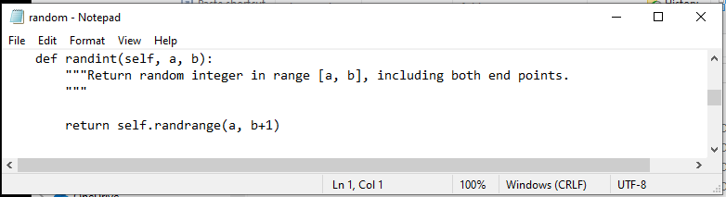
Writing Your Own Functions: Why Do It?
Fifth reason, decoupling of your code:
New terminology, decoupling: a fancy term for a simple concept.
In this case it means you can simply use a function without worrying about the ‘internal’ details of how it was written.
You simply need things such as: how to call it, what operations the function implements, what are it’s return values etc.
This is the actual code from the randint() function.
You just have to know how to call it not know all the intimate details of how every line works.

Slide 8
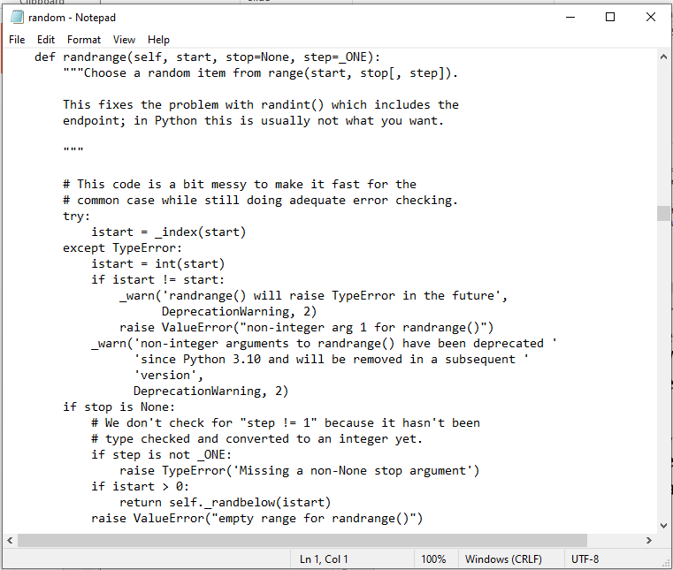
Writing Your Own Functions: Why Do It?
More Of The Random Library/Module
1

Slide 9
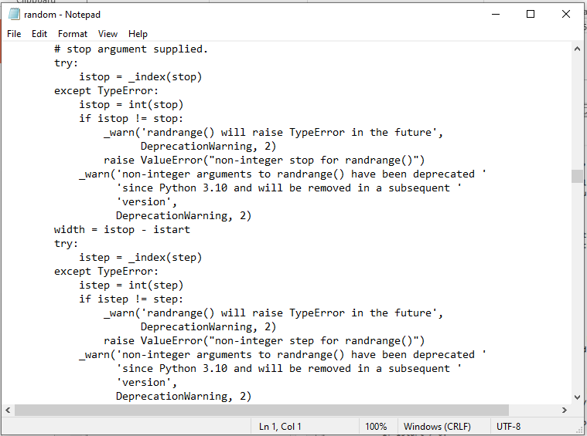
Writing Your Own Functions: Why Do It?
More Of The Random Library/Module
2

Slide 10
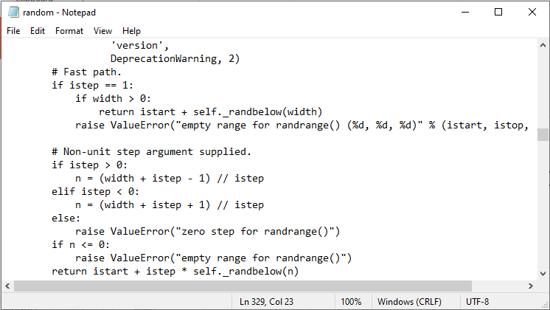
Writing Your Own Functions: Why Do It?
More Of The Random Library/Module
3

Slide 11
Writing Your Own Functions: Why Do It?
Sixth reason: to simplify the problem.
Sometimes you will have to write a program for a large and/or complex problem.
One technique employed in this type of situation is the top down approach to design.
The main advantage is that it reduces the complexity of the problem because you only have to work on it a portion at a time.

Slide 12
Solving Larger Problems
Sometimes you will have to write a program for a large and/or complex problem.
One technique employed in this type of situation is the top down approach to design.
The main advantage is that it reduces the complexity of the problem because you only have to work on it a portion at a time.
Notes:
Can apply to big problems in general e.g., wedding to plan
Break into parts:
Who to invite: getting contact info, buying invitations, filing in invitations, sending invitations
Where to hold it
etc.

Slide 13

Top Down Design
Start by outlining the major parts (structure)
Then implement the solution for each part
My autobiography
Chapter 1:
The humble beginnings
Chapter 2:
My rise to greatness
…
Chapter 7:
The end of an era
Chapter 1: The humble beginnings
It all started ten and one score years ago
with a log-shaped computer work station…
Image copyright unknown
Notes:
Functions and Procedures in Pascal
13

Slide 14
Decomposing Your Program Into Functions According To Tasks/Features It Needs To Implement
Main tasks to be fulfilled by the program
Important subtask #1
Important subtask #2
Important subtask #3
…Etc.
Function #1
Function #2
Function #3
…Etc.
When do you stop decomposing and start writing functions? No clear cut off but use the “Good style” principles (later in these notes) as a guide e.g., a function should have one well defined task and not exceed a screen in length.

Slide 15
Applying The Top Down Design To Programming
First: outline the parts of your program before writing the instructions.
These ‘parts’ will take the form of functions.
Second: implement (write) the code for one part/function at a time.
Third: run a reasonable number of tests on that function to ensure it is correct.
Fourth: apply any bug fixes that may be needed and test again.
Fifth: only after a reasonable amount of testing has been done on a function should Steps 2 – 4 be applied on another function.

Slide 16
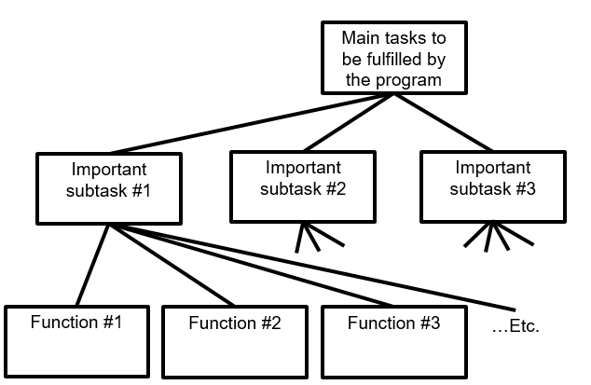
How To Decompose A Problem Into Functions
Break down the program by what it does (described with actions/verbs or action phrases).
Eventually the different parts of the program will be implemented as functions.
Notes:
If you want an example show this breaks down for checkers:
Initialize board – put pieces in the starting positions
Display board – show locations of current pieces
Prompt player for movement
Check if movement is valid
Move piece

Slide 17
Example Problem
Design a program that will perform a simple interest calculation.
The program should prompt the user for the appropriate values, perform the calculation and display the values onscreen.
Notes:
Functions and Procedures in Pascal
17

Slide 18
Example Problem
Design a program that will perform a simple interest calculation.
The program should prompt the user for the appropriate values, perform the calculation and display the values onscreen.
Action/verb list:
Prompt
Calculate
Display
Notes:
Functions and Procedures in Pascal
18

Slide 19
Top Down Approach: Breaking A Programming Problem Down Into Parts (Functions)
Calculate Interest
Get information
Do calculations
Display results
Notes:
Functions and Procedures in Pascal
19

Slide 20
Things Needed In Order To Use Functions
Function call
Actually running (executing) the function.
You have already done this second part many times because up to this point you have been using functions that have already been defined by someone else e.g., print(), input()
Function definition
Instructions that indicate what the function will do when it runs.
Before this section: you have used built-in python functions (with their instructions already written by someone else).
In this section: you will learn how to write the instructions inside a function body which execute when that function runs.
Notes:
Functions and Procedures in Pascal
20
* Show how this is similar to defining the start method and calling the executable file e.g., “./a.out” or “Python a1.py”

Slide 21
Functions (Basic Case: No parameters/Inputs)
Function call
You’ve already called prebuilt functions and passed no arguments e.g. print(), input()
Function definition
Notes:
Functions and Procedures in Pascal
21

Slide 22
Defining A Function
1 Functions should be named according to the rules for naming variables (all lower case alphabetic, separate multiple words via camel case or by using an underscore).
2 Body = the instruction or group of instructions that execute when the function executes (when called).
The rule in Python for specifying the body is to use indentation.
Format:
def <function name>¹():
body²
Example:
def displayInstructions():
print ("Displaying instructions on how to use the
program")
You don’t need to define prebuilt functions because some else has defined the code for you.
Notes:
Functions and Procedures in Pascal
22

Slide 23
Calling A Function
Format:
<function name>()
Example:
displayInstructions()
As you mentioned you have already learned how to call a prewritten function e.g. print(), int(), input(), randint(1,6) etc.
Notes:
Functions and Procedures in Pascal
23

Slide 24
Quick Recap: Starting Execution Point
The program starts at the first executable instruction that is not indented.
In the case of your programs thus far all statement have been un-indented (save loops/branches) so it’s just the first statement that is the starting execution point.
But note that the body of functions MUST be indented in Python.
HUMAN_CAT_AGE_RATIO = 7
age = input("What is your age in years: ")
catAge = age * HUMAN_CAT_AGE_RATIO
…

Slide 25
Functions: An Example That Puts Together All The Parts Of The Easiest Case
Name of the example program: 1firstExampleFunction.py
Learning objective:
def displayInstructions():
print("Displaying instructions")
# Main body of code (starting execution point, not indented)
displayInstructions()
print("End of program")

Slide 26
Functions: An Example That Puts Together All The Parts Of The Easiest Case
Name of the example program: 1firstExampleFunction.py
def displayInstructions():
print("Displaying instructions")
# Main body of code (starting execution point)
displayInstructions()
print("End of program")
(Something new in this section): Function definition
(You’ve done this before): Function call

Slide 27
Defining The Main Body Of Code As A Function
Good style: unless it’s mandatory, all instructions must be inside a function.
Rather than defining instructions outside of a function the main starting execution point can also be defined explicitly as a function.
(The previous program rewritten to include an explicit start function) Example program: 2firstExampleFunctionV2.py
Learning objective: enclosing the start of the program inside a function
def displayInstructions():
print ("Displaying instructions")
def start():
displayInstructions()
print("End of program")
Important: If you explicitly define the starting function then do not forgot to explicitly call it!
start ()
Don’t forget to start your program! Program starts at the first executable un-indented instruction

Slide 28
Stylistic Note
By convention the starting function is frequently named ‘main()’ or in my case ‘start()’.
def main():
OR
def start():
This is done so the reader can quickly find the beginning execution point.

Slide 29
New Terminology
Local variables: are created within the body of a function (indented)
Global constants: created outside the body of a function.
(The significance of global vs. local is coming up shortly).
Global constant
HUMAN_CAT_AGE_RATIO = 7
def getInformation():
age = input("What is your age in years: ")
catAge = age * HUMAN_CAT_AGE_RATIO
Local variables

Slide 30
Creating Your Variables
Before this section of notes: all statements (including the creation of a variables) occur outside of a function
Now that you have learned how to define functions, ALL your variables must be created with the body of a function.
Constants can still be created outside of a function (more on this later).
HUMAN_CAT_AGE_RATIO = 7
age = input("What is your age in years: ")
catAge = age * HUMAN_CAT_AGE_RATIO
…
‘Outside’: OK for constants only
HUMAN_CAT_AGE_RATIO = 7
def getInformation():
age = input("What is your age in years: ")
catAge = age * HUMAN_CAT_AGE_RATIO
Inside function body: all variables (e.g. ‘age’, ‘catAge’) must be here

Slide 31
Local Variables
Characteristics
Locals only get allocated (created in memory) when the function is called.
Locals get de-allocated (unavailable in memory) when the function ends.
Benefits (why create them this way)
1st: more efficient use of memory
2nd: minimize the occurrence of side effects of global variables
This is the main reason why it’s regarded as bad style in actual practice.
But details are more complex so the explanation will come later.
3rd: pedagogical (creating variables locally forces you to apply important programming concepts such as parameter passing, function return values and scope).

Slide 32
Scope: Visually Showing When Memory Locations Can Be Accessed
RATIO = 7
def getInformation():
age = input("Age: ")
catAge = age * RATIO
getInformation()
Age, catAge is not in scope outside the function
The scope of an identifier (variable, constant) is where it may be accessed and used.
In Python¹:
An identifier comes into scope (becomes visible to the program and can be used) after it has been declared.
An identifier goes out of scope (no longer visible so it can no longer be used) at the end of the indented block where the identifier has been declared.
Scope of RATIO
(allocated)
Scope of age (allocated)
Scope of catAge (allocated)
Age, catAge is not in scope outside the function
End of function (age, catAge go out of scope/deallocatecd):
End of program (RATIO goes out of scope/deallocated):
1 The concept of scoping (limited visibility) applies to all programming languages. The rules for determining when identifiers come into and go out of scope will vary with a particular language.

Slide 33
Working With Local Variables: Putting It All Together
Name of the example program: 3secondExampleFunction.py
Learning objective: creating/defining variables that only exist while a function runs (local to that function).
def fun():
num1 = 1
num2 = 2
print(num1, " ", num2)
# start function
fun()
Variables that are local to function ‘fun’
Scope of num1
Scope of num2

Slide 34
Variables Vs. Named Constants
As you have already been taught:
Variables can change as the programs run while named constants don’t change after they’ve been set to the initial value.
To visually distinguish the two variables use lower case while constants are capitalized.
Your program should consistently distinguish the two!
The following is only a ‘constant’ in name only and is treated like a variable.
PI = 3.14
radius = 10
area = PI * (radius ** 2)
PI = 3.1 #Do not change the value in a constant!

Slide 35
After This Section You Should Now Know
How and why the top down approach can be used to decompose problems
What is procedural programming
How to write the definition for a function
How to write a function call
How and why to declare variables locally
How to pass information to functions via parameters

Slide 36
Copyright Notification
“Unless otherwise indicated, all images in this presentation are used with permission from Microsoft.”

