Slide 1
Representing Data/Information
What is the decimal based number system.
How do other, non-decimal, systems work (binary, octal and hex).
How to convert from a non-decimal number systems to decimal.
How are negative and rational numbers represented on the computer.

Slide 2
Information Vs. Data
Data:
The raw information without any context
Examples (you don’t have to interpret this data unless you are taught how to do this sometime during the semester).
12, 07, 1941 (or Dec. 7, 1941)
04, 05, 2063 (or April 5, 2063)
01111000 00110010 01000101 (computer stores all data as binary)
Information:
Data that has been processed or manipulated in order to provide a meaningful context
Context for the above examples of data:
World War II: Japan launches a surprise attack on the American naval base at Pearl Harbor resulting on the latter’s entry into the war.
Star Trek: The first contact of an extraterrestrial race (Vulcans) with humans and this leads to the eventual founding of the United Federation of planets.
Third example: If the bits are interpreted as text: x2E
Third example: if the bits are interpreted as (RGB) colors:
Notes:
https://www.diffen.com/difference/Data_vs_Information#:~:text=Data%20are%20simply%20facts%20or%20figures%20%E2%80%94%20bits%20of

Slide 3
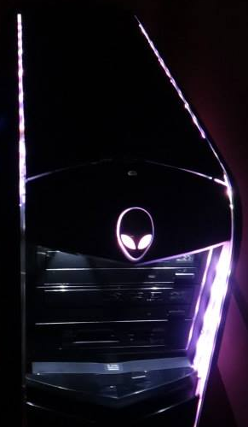
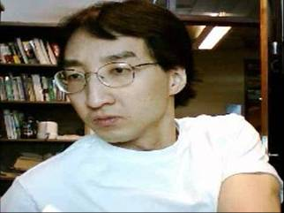
Data Vs. Information: Using A Computer
Stores information as data (binary patterns) e.g. 010*011
If needed process the data e.g. 010*011=110
User communicates information
e.g. 1 what is 2*3
e.g. 2, set color to red
Translate and display the information as output to the user
e.g. 1 what is 2*3=6
e.g. 2, change color of shape to red

Slide 4
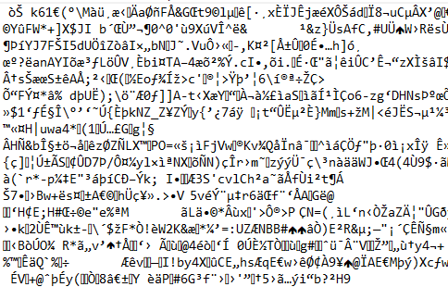
Inappropriate Conversion: Data To Text
Opening an image in a text-only program (Notepad)
This is a pic of your course instructor - see the resemblance? ;)
It’s ‘garbage’ because the bits are not interpreted as an image (e.g. 24 bits=a pixel) but interpreted as ASCII (e.g. 8 bits=a single character).

Slide 5
Alternative Presentation Of These Concepts
To ensure that you don’t “miss anything” I’ve included in the next three screens how Richard Zhao and Jonathan Hudson envisioned how this information was to be communicated in this course.

Slide 6
What is Data?
Data: raw facts, representation of information, no context
Encoding: The translation of information into data
(Decoding the other direction
Data represents information

Slide 7
Information Processing
A change of information in any manner detectable by an observer
Using a computer?
Encode information into data
Process the data
Translate data back into information
Moral: computers process data, not information – it is our responsibility to interpret the data correctly.

Slide 8
Storing Data
All data in a computer is either a 0 or 1
Called a bit
Electrically, this is a switch that is either open or closed
Encoding schemes translate integers, real numbers, letters, pictures, … into bits

Slide 9
Bit (Binary Digit)
You have probably heard of this term in some context e.g. a hard drive is 1 Terabyte in capacity and there’s 8 bits in 1 byte i.e. that hard drive is (1 byte = 8 bits so multiply capacity in bytes to determine capacity in bits – not commonly done) 8 Terabit capacity drive.
All digital information is stored in the form of a bit (bits are not just zeros and ones as you may have been lead/mislead to believe).
The key characteristic of a bit is that information is stored in one of two states.

Slide 10
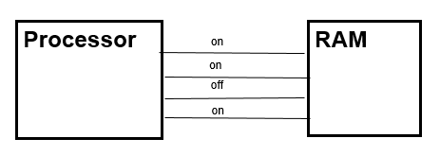

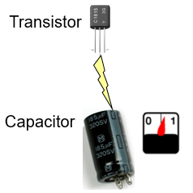
Bits: Example Implementations
Computer bus: wires that transit information via electrical signals on wires.
Optical drives: CD/DVD
RAM (requires the computer to be on to maintain power)
Boolean variables (python examples)
isDone = True
isDone = False

Slide 11
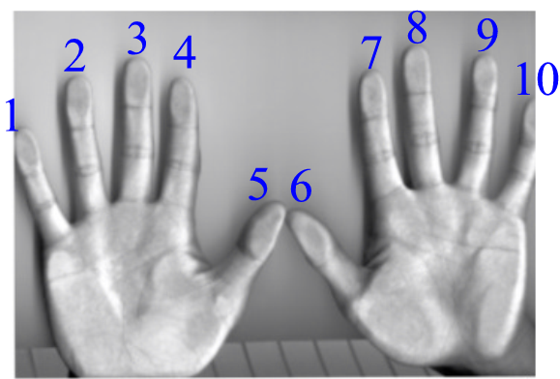
What Is Decimal?
Base 10
10 unique symbols are used to represent values
The number of digits is based on…the number of digits
0
1
2
3
4
5
6
7
8
9
10
:
The largest decimal value that can be represented by a single decimal digit is 9 = base(10) - 1

Slide 12
Representing Integer Information
What you have been taught is the decimal-based system.
0
1
2
3
4
5
6
7
8
9
10
11
12
13
14
15
16
17
18
19
20
21
22
23
24
25
26
27
28
29
30
31
Etc.
Column 1 counts through all 10 possible values
For the next value, column 1 resets back to zero and column 2 increases by one
For the next value, column 1 resets back to zero and column 2 increases by one
Column 1 counts through all 10 possible values, column 2 remains unchanged

Slide 13
Decimal
“Base ten”
Employs ten unique symbols (0, 1, 2, 3, 4, 5, 6, 7, 8, 9)
Each digit can only take on the value from 0 – 9
Once a column has traversed all ten values then that column resets back to zero (as does it right hand neighbours) and the column to it’s immediate left increases by one.

Slide 14
Recall: Computers Don’t Do Decimal!
Most parts of the computer work in a discrete state:
On/off
True/false
Pitted/smooth
Connected/not connected
These two states can be modeled with the binary number system.

Slide 15
Binary
Base two
Employs two unique symbols (e.g. 0 and 1)
Largest value that can be represented by 1 binary digit = 1 = base(2) – 1
Confused? Apply this formula to decimal: largest value represented in decimal = base(10)-1
Stepping through binary values.
Once a column has traversed both values then that column resets back to zero (as does it right hand neighbours) and the column to it’s immediate left increases by one.
This is similar to decimal but because each digit can only take on the value 0 or the value 1 (instead of 0 – 9 for decimal) increments will affect higher order (left most) columns more quickly.

Slide 16
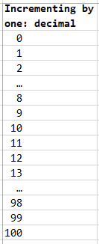
Reminder: Incrementing By 1 In Decimal
Symbols are used up every 10 rows in the lowest order (right most/first) column.

Slide 17
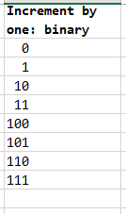
Incrementing By 1: Binary
“Used up” all symbols in previous column, increase next column to left by 1
Right most column increment through all symbols (in this case 0,1). Symbols are used up every 2 rows.

Slide 18
Counting In Binary
Decimal value | Binary value | Decimal value | Binary value
0 | 0000 | 8 | 1000
1 | 0001 | 9 | 1001
2 | 0010 | 10 | 1010
3 | 0011 | 11 | 1011
4 | 0100 | 12 | 1100
5 | 0101 | 13 | 1101
6 | 0110 | 14 | 1110
7 | 0111 | 15 | 1111

Slide 19
Decimal: Represents Values Using Powers Of Ten
For 231
2 1 0
Example: 482
Breaking it down:
4 of the hundreds units 400
8 of the tens units 80
2 of the ones units 2
Total 482
These values are actually computed with powers of 10
Hundreds units: 4x10² = 4x100 = 400
Hundreds units: 8x10¹ = 8x10 = 80
Ones units: 2x10⁰ = 2x1 = 2
Sum 482
You can label the exponents by adding a super script above the digits.

Slide 20
Binary: Represents Values Using Powers Of Two
For 231
Example: 1011₂ (binary) = 11₁₀ (decimal)
Labeled with a super script (allows us to see the ‘powers/exponents)
1 0 1 1
Breaking it down:
1x2³ = 1x8 = 8
0x2² = 0x4 = 0
1x2¹ = 1x2 = 2
1x2⁰ = 1x1 = 1
Sum 11
3
2
1
0

Slide 21
You’ve Learned To Convert: Any Base To Decimal
For 231
Evaluate the expression: the base raised to some exponent_{1,} multiply the resulting expression by the corresponding digit and sum the resulting products.
General formula:
d7 d6 d5 d4. d3 d2 d1_{b}
(d7xb³)+(d6xb²)+(d5xb¹)+(d4xb⁰)+(d3xb⁻¹)+(d2xb⁻²)+(d1xb⁻³)
Example
1 1. 1₂
3 2 1 0 -1 -2 -3
Super script (power)
1 0 -1
Super script (power)
Value in decimal = (1x2¹) + (1x2⁰) + (0x2-¹) = (1x2)+(1x1)+(1/2) = 2.5
1/2 : (1x2⁻¹) = 1x1/2¹ = 0.5
Reminder: evaluate a negative exponent by determining the reciprocal of a positive exponent

Slide 22
Students Do: Exercises
For 231
Convert the following values from binary to decimal
100 000 ₂ -> ??????₁₀
100 001 ₂ -> ??????₁₀
111 111 ₂ -> ??????₁₀
0 000 001₂ -> ??????₁₀
To check your work:
There are various online converter websites
Alternatively: write a python program to do the calculation (hint: you can use the integer division and modulo operators to extract the digits from the number).
You’ll learn the (more involved) formula for converting from decimal in the next section.
Quick look ahead: you keep performing integer divisions by the target base (in this case 2) until the remainder is less than the target base.

Slide 23
Why Bother With Binary?
It’s the method of representing/storing information
ASCII (American Standard Code for Information Interchange)
UNICODE: it’s augmented the original ASCII representations to include additions such as non-English languages.
UNICODE is stored on a electronic device using the UTF-8 system.
All information is stored on an electronic device is using some of binary e.g. your images, videos are encoded using some form of binary.
It's the language of the computer
A computer program must be translated to native machine language (specific to hardware/operating system ‘platform’) in order to run.
Interpreted languages such as python, JavaScript are translated each time the program executes.
Compiled languages (programs installed on your computer/phone) are translated once and it’s the translated version that’s installed (and then executed) on your device.

Slide 24
Representing Information: ASCII
Uses 7 bits to represent characters
Max number of possibilities = 2⁷ = 128 characters that can be represented
8 bits were actually used for various reasons: new characters could be represented, storing as 8 bits rather than 7 is easier etc.
e.g., 'A' is 65 in decimal or 01000001 in binary. In memory it looks like this:
0 | 1 | 0 | 0 | 0 | 0 | 0 | 1

Slide 25
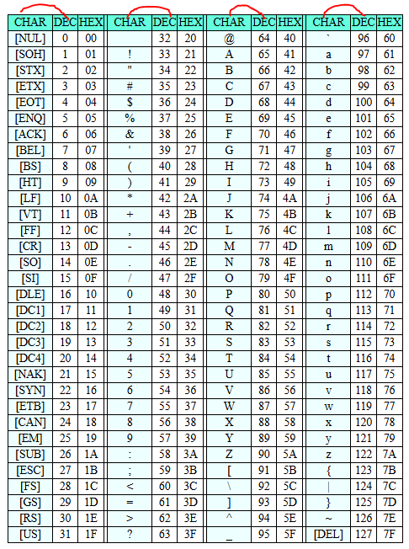
ASCII Codes
https://www.ascii-code.net/
Many codes produce a visible character e.g. letters, numbers, symbols.
Other “control codes” are used for text formatting e.g. tab, new line etc.

Slide 26
The ‘Gist’ Of Some Of The ASCII Codes
ASCII | Decimal | Binary
Invisible (control characters) | 0 – 31 | 00000000 – 00011111
Punctuation, mathematical operations | 32 – 47 | 00100000 – 00101111
Characters 0 - 9 | 48 - 57 | 00110000 – 00111001
Comparators and other miscellaneous characters : ; ? @ | 58 – 64 | 00111010 – 01000000
Alphabetic (upper case A - Z) | 65 - 90 | 01000001 – 01011010
More miscellaneous characters [ \ ] ^ _ ' | 91 – 96 | 01011011 – 01100000
Alphabetic (lower case a - z) | 97 – 122 | 01100001 – 01111010
More miscellaneous characters { | } ~ DEL | 123 – 127 | 01111011 - 01111111

Slide 27
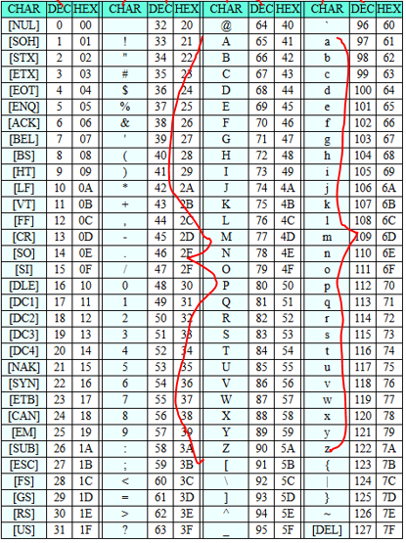
Drawbacks Of ASCII
A good start but limited in what can be represented.
“Latin character set” (alphabet).
Accenting is not possible:
È ĕ Ĉ

Slide 28
ASCII Encoding
What you should already know.
Basic character information for the first 128 combinations (0-127) is specified by ASCII codes.
It includes upper/lower case alphabetic characters, all ten digits, punctuation and more…characters used in basic communications in English (and other languages which use alphabetic characters).
8 bits are used even though only 7 bits are needed (2⁷ = 128)
The left most bit (most significant bit) is either used for error checking or simply set to zero.

Slide 29
UTF-8 Encoding
Previously you were given a basic introduction.
This form of encoding is used to represent additional text information which includes but is not limited to:
Emoji's/emoticons
Languages which use their own symbols rather than alphabetic characters (Latin character set).
To allow backward compatibility: The first 128 UTF-8 codes are identical to the ASCII codes.
To save space only 1 byte is used to encode 0 - 127
Other characters will require 2 to 4 bytes to encode.
2 bytes are used to encode 128 – 65,535, 2¹⁶ = 65,536 combinations.
3 bytes are used to encode 0-16,777,215, 2²⁴ = 16,777,216 combinations.
4 bytes are used to encode combinations above 16,777,216.
FYI for those who will ask: 2³² = over 4 billion combinations (4.294.967.296)

Slide 30
Space Needed To Represent A Character.
A character can be represented with one of the following possible lengths: 1 byte (8 bits), 2 bytes (16 bits), 3 bytes (24 bits), 4 bytes (32 bits).
How do we ‘know’ the number of bytes used?
The ‘prefix’ (left most bits) is what distinguishes the 4 cases.
1 byte:
2 bytes:
3 bytes:
4 bytes:
The other bytes (if any) cannot contain these bit patterns at the start.
They must begin with 10 while the other 6 bits in the byte can either be 0 or 1.
“Continuation bytes” (not left most) start with the pattern 10.
0
7 more bits
0bbb bbbb
b: bit can either be 0 or 1
110
13 more bits
110b bbbb
10bb bbbb
1110
20 more bits
1110 bbbb
10bb bbbb
10bb bbbb
11110
27 more bits
1111 0bbb
10bb bbbb
10bb bbbb
10bb bbbb

Slide 31
Benefits Gained Using UTF-8 Encoding
Space efficiency.
More frequently occurring language sets only using common characters e.g. A-Z, a-z only require 1 byte to store.
“Self synchronization” [JT: error handling]
If bit patterns appear in unexpected locations you know the information for the character is invalid (corrupted during storage or transmission).
It’s the standard encoding used by the WWW: default for hmtl (web pages end in ‘.html’ or ‘htm’ (older suffix) and most web protocols (protocol a method of transmission).
Supported with many programming languages such as but not limited to python (avoids bugs due to mismatched encoding).
1111 0bbb
10bb bbbb
10bb bbbb
10bb bbbb
Invalid: left-most byte starts with 10
Invalid: any of the connector bytes start with one of the prefixes e.g. 1111 0

Slide 32
Python And UTF-8
With python 3.x UTF-8 is the default method of encoding.
Just type the desired character and it will be properly displayed as the character is encoded/represented in the extended (beyond ASCII) approach i.e. more than just the basic alphabetic characters can be represented.
Name of the full example: 1UTF8_example_multi_lingual_hello
print("Hello")
print("Bonjour") #French
print("Hello po") #Tagalog
print("Hallo") #Dutch, German
print("Hola") #Spanish
print("Allô") #Quebecois French
print("你好") #Traditional Chinese
print("مرحبا") #Arabic
print("שלום") #Hebrew

Slide 33
Unicode Vs. UTF-8
Similar to ASCII each character is mapped to a unique numeric value using Unicode mappings.
Unlike ASCII Unicode includes more than just 128 mappings although the original mappings are used for these first combinations to ensure backward compatibility e.g. ‘A’ maps to 65 using ASCII or Unicode.
UTF-8: the numeric Unicode is then stored using UTF-8 standards for encoding: 1 – 4 bytes.
E.g. 1, B Unicode=66 is stored using 1 byte.
E.g. 1, ć Unicode=263 is stored using 2 bytes according to UTF-8 (Co-pilot)
Mappings from 128-255 reserved for ASCII
Mappings after 256 are specified using Unicode
1 Additional explanations
https://askanydifference.com/difference-between-unicode-and-utf-8/ (last viewed 2025)
https://blog.hubspot.com/website/what-is-utf-8 (last viewed 2024)

Slide 34
Alternative Presentation Of These Concepts
Here’s an alternative presentation of UTF-8 as an optional resource to help you understand this method of representation.
The next two screens were created by Richard Zhao and Jonathan Hudson.

Slide 35

Representing More Characters
UTF-8
Another encoding scheme for characters
Variable length – 1, 2, 3 or 4 bytes per character
Compatible with ASCII
Consider each byte
Left most bit is 0? Usual ASCII Character
Left most bits are 110? 2 byte character
Left most bits are 1110? 3 byte character
Left most bits are 11110? 4 byte character
“tears of joy” emoji
0x F0 9F 98 82
which is
11110000 10011111 10011000 10000010
This Photo by Unknown Author is licensed under CC BY-SA

Slide 36
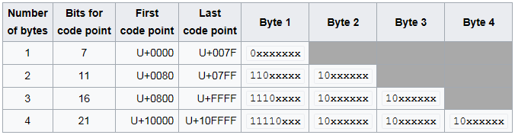
UTF-8
This Photo by Unknown Author is licensed under CC BY-SA

Slide 37
Encoding Data: References
ASCII
https://www.bbc.co.uk/bitesize/guides/zsnbr82/revision/5
UTF-8:
https://www.w3schools.com/charsets/ref_html_utf8.asp (last viewed fall 2024).
https://blog.hubspot.com/website/what-is-utf-8 (last viewed fall 2024).
"UTF-8 support in the Microsoft GDK". Microsoft Learn. Microsoft Game Development Kit (GDK). Retrieved 2023-03-05.
"Encoding Standard". encoding.spec.whatwg.org. Retrieved 2020-04-15.

Slide 38
A Problem With Binary
For 231
1001 0100 1100 1100?
1001 0100 1100 0100?
1001 0100 1100 0011?
Binary is not intuitive for human beings and one string of binary values can be easily mistaken for another

Slide 39

A Shorthand For Binary: Octal
For 231
Machine Octal
language value
1010111000000 012700
1001010000101 011205
Converting from binary to octal: 3 bits are grouped into one octal digit
E.g. 110 = 5
You can look the values up in the table provided at the end of these notes.
Leading zeros don’t count e.g. 0100 in decimal is the same as 00100 or 100.

Slide 40
Octal
For 231
Base eight
Employs eight unique symbols (0 - 7)
Largest value that can be represented by 1 octal digit = 7 = base(8) - 1

Slide 41
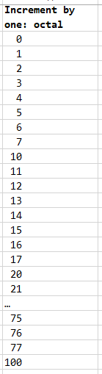
Incrementing By 1: Octal
For 231
“Used up” all symbols in previous column, increase next column to left by 1
Right most column increment through all symbols (in this case 0,1,2,3,4,5,6,7)

Slide 42
Table Of Octal Values
For 231
Decimal value | Octal value | Decimal value | Octal value
0 | 0 | 8 | 10
1 | 1 | 9 | 11
2 | 2 | 10 | 12
3 | 3 | 11 | 13
4 | 4 | 12 | 14
5 | 5 | 13 | 15
6 | 6 | 14 | 16
7 | 7 | 15 | 17

Slide 43
Octal: Represents Values Using Powers Of Eight
For 231
Example: 273₈ (octal) = 187₁₀ (decimal)
Labeled with a super script lets us to see the powers/exponents.
2 7 3
Breaking it down
2x8² = 2x64 = 128
7x8¹ = 7x8 = 56
3x8⁰ = 3x1 = 3
Sum 187
2
1
0

Slide 44
Students Do: Exercises
For 231
Convert the following values from octal to decimal
6₈ -> ??????₁₀
7₈ -> ??????₁₀
10₈ -> ??????₁₀
26₈ -> ??????₁₀
31₈ -> ??????₁₀
245₈ -> ??????₁₀
712₈ -> ??????₁₀
Computer geek joke: Oct 31 is actually Dec 25 (hint: it’s an application of the lesson not just some random humor).

Slide 45
Problems With Binary: Got Worse As Computers Got More Powerful
For 231
1001 0100 1000 0000 1100 0100 0110 1010?
Or
1001 0100 1000 0000 1100 0100 0110 1011?

Slide 46
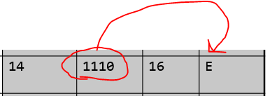
Hexadecimal: An Even More Compact Way Of Representing Binary Instructions
For 231
Machine Hexadecimal
language value
1010011000001 14C1
110000011100000 60E0
FYI: 4 binary digits are grouped to represent 1 hexadecimal digit
e.g. 1110 = E
(You can look these values up in the table near the end of these notes).
Example from 68000 Family Assembly Language by Clements A.

Slide 47
Hexadecimal (‘Hex’ For Short)
For 231
Base sixteen
Employs sixteen unique symbols (0 – 9, followed by A - F)
Largest decimal value that can be represented by 1 hex digit = 15

Slide 48
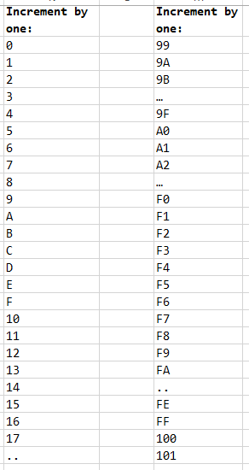
Incrementing By 1: Hexadecimal
For 231
Right most column increment through all symbols (in this case 0,1,2,3…D,E,F)
“Used up” all symbols in previous column, increase next column to left by 1

Slide 49
Table of Hexadecimal Values
For 231
Decimal value | Hexadecimal value | Decimal value | Hexadecimal value
0 | 0 | 9 | 9
1 | 1 | 10 | A
2 | 2 | 11 | B
3 | 3 | 12 | C
4 | 4 | 13 | D
5 | 5 | 14 | E
6 | 6 | 15 | F
7 | 7 | 16 | 10
8 | 8 | 17 | 11

Slide 50
Hexadecimal: Represents Values Using Powers Of 16
For 231
Example: 2A8₁₆ (hex) = 680₁₀ (decimal)
Labeled with a super script (allows us to see the ‘powers/exponents)
2 A 8
Breaking it down:
2x16² = 2x256 = 512
Ax16¹ = 10x16 = 160
8x16⁰ = 8x1 = 8
Sum 680
2
1
0

Slide 51
Students Do: Exercises
For 231
Convert the following values from hexadecimal to decimal
6₁₆ -> ??????₁₀
A₁₆ -> ??????₁₀
C₁₆ -> ??????₁₀
F₁₆ -> ??????₁₀
26₁₆ -> ??????₁₀
245₈ -> ??????₁₀
712₈ -> ??????₁₀

Slide 52
Summary (Decimal, Binary, Octal, Hex)
For 231
Decimal | Binary | Octal | Hex | Decimal | Binary | Octal | Hex
0 | 0000 | 0 | 0 | 8 | 1000 | 10 | 8
1 | 0001 | 1 | 1 | 9 | 1001 | 11 | 9
2 | 0010 | 2 | 2 | 10 | 1010 | 12 | A
3 | 0011 | 3 | 3 | 11 | 1011 | 13 | B
4 | 0100 | 4 | 4 | 12 | 1100 | 14 | C
5 | 0101 | 5 | 5 | 13 | 1101 | 15 | D
6 | 0110 | 6 | 6 | 14 | 1110 | 16 | E
7 | 0111 | 7 | 7 | 15 | 1111 | 17 | F

Slide 53


Other Units Of Measurement: Positive Numbers
By itself a bit is inadequate for representing values.
Only 2 values (0,1 or zero to 2⁰-1) = 2⁰
Larger groupings are needed.
Byte uses 8 bits e.g. 0001 1000
256 values = 2⁸ (range from 0-255 or 0-2⁸-1)
Half word/short uses 16 bits:
65,536 values = 2¹⁶ (range from 0-65,535 or 0-2¹⁶-1)
Word uses 32 bits:
2³² ~4 billion values (range from 0-2³²-1)
Double word/long uses 64 bits
2⁶⁴ possible values (range from 0-2⁶⁴-1)
1 bit/2 combos
2 bit2/4 combos

Slide 54
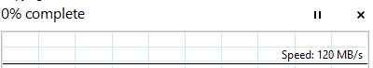
Units Of Measurement By Operating System
Value | Windows | MAC
1 byte | 8 bits | 8 bits
1 Kilobyte | 1,000 bytes or 1024 = 2¹⁰ | 1000 bytes (1 KB)
1 Megabyte | ~~1,000,000 bytes or 1,048,576 = 2²⁰ | 1,000,000 bytes (1 MB)
1 Gigabyte | ~1 billion bytes or 1,073,741,824 = 2³⁰ | 1,000,000,000 bytes (1 GB)
1 Terabyte | ~1 trillion bytes = 2⁴⁰ | 1,000,000,000,000 bytes (1 TB)
Keep in mind whether bits or bytes are used when specifications are listed.
Storage (hard drives), memory (RAM) use bytes
ISP transmission speeds use bits e.g. 1,000 Mbps is actually 1,000 Mbits/second (125 MBs or 125,000,000 bytes, Blu-ray stores ~25 GB or 25,000,000,000 = 200 seconds).
Computers typically show transmissions as bytes/second.

Slide 55
Units Of Measurement: Some Computer Applications
Bytes (example computer ad):
Acer Predator P03 Gaming PC
Intel Core i7-13700F 2.1 /5.2 GHz
16 GB of RAM
1 TB HDD/512 GB
Bits:
(From the above ad)
RJ45 Ethernet, Wi-Fi 6E, Bluetooth 5.3, 10 USB ports (Front=4: Type A USB 10 Gbps, Type C USB 20 Gbps; Back: USB Type A 480 Mbsx4, USB Type A 5 Ggps x 2, HDMIx1, Display portx3
What does this mean:
Copying the contents of 1 TB storage device (speeds is the ideal max. – often not realized)
USB C 20 Gbps: 6.67 minutes
USB A 480 Mbps: 277.78 minutes
More examples and the formulas used to derive the above times:
https://cspages.ucalgary.ca/~tam/2025/217F/examples/representations/Transfer_speed_comparisons.xlsx
Date of last access
Last accessed from www.bestbuy.ca January 2024

Slide 56
Representing Negative Numbers
One bit is used for the sign, the other bits (# bits - 1) is used to represent the magnitude e.g. 4 bits (1 for sign, 3 for magnitude)
There are different sub-approaches that use a sign bit.
Sign-magnitude is the one covered in this class now.
(The others ones and twos complement may be covered later this term or in another class, likely CPSC 355).
Sign magnitude with 8 bits
Format:
s bbb bbbb
Examples:
0 000 0011 (positive 3)
1 000 0100 (negative 4)
Sign bit: 0=positive,
1 = negative
Magnitude:
Represents quantity (size)

Slide 57
Representing Real Numbers
The approximation of a real number is represented as a float.
Standard Representation is IEEE 754 Floating Point
-0.0002589 becomes -2.589 * 10⁻⁴
32-bit floating point representation:
sign (1 bit), exponent (8 bits), mantissa (23 bits)
64-bits:
sign (1 bit), exponent (11 bits), mantissa (52 bits)
Why an approximation?
Not all values can be represented e.g. 0 >= range <=1 there’s an infinite number of values.
Or a single expression can have an infinite number of possible digits e.g. 1/3
Even with 64 (or more bits) to store a real number some values will missed or stored incorrectly.

Slide 58
Illustrative Example: Why Floats Only Approximate Real Values
Example of (non IEEE floating point): 5 digits used to represent the mantissa:
The exponent affects how much the decimal shifts ‘floats’”
Size of the exponent indicates the number of shifts e.g. squared = 2 shifts
Sign of the exponents specifies direction.
Negative exponent: shift right when storing as floating point
Positive exponent: shift left when store as floating point
e.g. One: 123.45 is represented in floating point as 12345 * 10⁻²
e.g. Two: 0.12 is represented in floating point as 12000 * 10⁻⁵
e.g. Three: 123456 is represented in floating point as 12345 * 10¹
Notice: in the last example one digit is lost during storage.
This serves to illustrate why floating point (any programming language) only approximates real values.
Precision may be lost even with non-repeating rational values.

Slide 59
Programming Lesson: Floating Point Representation
Note: the drawbacks that come from storing real values is due to the floating point representation (not unique to python).
Avoid floats when an integer will do!
Example: represent currency as whole cents rather than fractional dollar values.
Never check for equality when comparing floats.
Name of the full example: 2_floats_not__same_as_real.py
num = 1.0 - 0.55
print(num == 0.45): #Don’t do this!
If a float is necessary then consider the use of an epsilon.
Example use (if you’re interested, it will be covered this semester if the specific need arises):
https://pages.cpsc.ucalgary.ca/~tamj/2021/217P/ (Branching Part II)

Slide 60
Copyright Notification
Unless otherwise indicated, all images in this presentation were provided courtesy of James Tam.

