Slide 1
Loops In Python: Part 2
Basic introduction into the use of the for loop
Application of loops for lists and strings

Slide 2
Loops In Python
Already covered (last section): While-loop
The most flexible (powerful) type of loop.
It can be used almost any time repetition is needed.
Situations when it can’t be used are very specific (when back tracing during ‘recursion’ is needed).
New (this section): for-loop
Python: can be used when the program can step through (‘iterate’) through a sequence.
E.g. 1: count through a numerical sequence (1, 2, 3…)
E.g. 2: the sequence of characters in a string
E.g. 3: the sequence of lines in a file.
Strength of python:
With most other languages for-loops can only count through a numerical sequence (5, 25, 125…). Consequently referred to as “counting loops”.
With python for-loops they can not only count through (iterate) a sequence but also iterate through other things as well e.g. read in lines in a text file
Drawback of python: Python for-loops can only count through a sequence using addition or subtraction (with the application of bad style one can force a for-loop to execute as a while-loop (awful programming style).

Slide 3
General Use: The For Loop
In Python a for-loop is used to iterate (step through) a sequence e.g., count through a series of numbers or step through the lines in a file.
General syntax:
for <name of loop control> in <something that can be iterated>:
body
Syntax, counting loop (steps through number sequence):
for <name of loop control> in range():
body
Example, counting loop (steps through number sequence):
for i in range(1,4,1):
print("i=", i)
The python for-loop is used when it’s known in advance (before loop executes) how many times it will execute.

Slide 4
Example Use Of The For Loop
Program name: 1for_counting_up.py
Learning objective: a simple for counting loop stepping through a sequence (1 - 3)
for i in range(1, 4, 1):
print("i=", i)
print("Done!")
1) Initialize control (include)
2) Check condition (exclude)
4) Update control
3) Execute body

Slide 5
Example Use Of The For Loop
Program name: 1for_counting_up.py
Learning objective: a simple for counting loop stepping through a sequence (1 - 3)
for i in range(1, 4, 1):
print("i=", i)
print("Done!")
Loop executes: when control (i) is within range e.g. 1..3 (initial value and after update).
Loop ends: when control is not within the range.
An equivalent While-loop:
i = 1
while(i < 4):
print("i=", i)
i = i + 1
print("Done!")

Slide 6
Counting Down With A For Loop
Program name: 2for_counting_down.py
Learning objective: a simple counting loop stepping down through a sequence (3 - 1)
for i in range(3, 0, -1):
print("i = ", i)
print("Done!")
Reminder: the python for-loop cannot do anything other than count up (add) or down (subtract).
But you can add or subtract by values other than one
e.g. (0,5,10…90.95,100) for i in range(0,105,5):
An equivalent While-loop:
i = 3
while(i > 0):
print("i=", i)
i = i - 1
print("Done!")

Slide 7
In Range()
Sometimes referred to as a ‘type’ sometimes referred to as a function.
Type (“Sequence types”): https://docs.python.org/3/library/stdtypes.html
Function: https://docs.python.org/3/library/functions.html
To follow good programming conventions you should make your code as self explanatory as possible.
With respect to Range() you should specify it with all 3 values
Format:
range(start value, end value, update value)
Example (iterate through 1-3):
range(start value, end value, update value)
Unfortunately you may have to work with code that may not follow all style conventions.
Python stipulates that only the 2nd value is mandatory, the 1st and 3rd values are optional.
1st value excluded: default starting value of 0 is used e.g. range(3) #0..2
3rd value excluded: default update value of 1 (positive one) is used. e.g. range(3) #0,1,2 (automatically increases by 1)

Slide 8
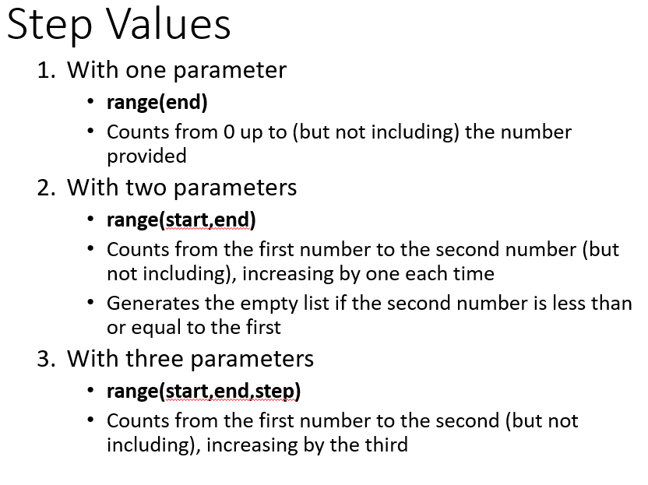
Alternative Rules Of Thumb
From the lecture notes of Michelle Cheatham.
Notes:
for i in range(2,4):
print(i)
2
3

Slide 9
Students-Do: Program Traces
All values specified.
for i in range(1,4,1):
print(i, end=" ")
3rd value omitted
for i in range(1,4):
print(i, end=" ")
1st and 3rd value omitted
for i in range(4):
print(i, end=" ")

Slide 10
Students Do: Code Writing
Write a python program which uses loops to calculate these math operations.
The idea is for you to learn how to develop your skill at writing a program that uses loops.
Consequently you are not to use pre-created function e.g. pow() or factorial() .
Nor should you use the exponent operator: **
Program 1: prompt the user for a base and power and the program can calculate the exponent.
Program 2: calculate the factorial for any user entered integer zero or greater (FYI: 0! = 1)

Slide 11
But Wait: The Python Loop Can Do More!
Cover after midterm
Python: can be used when the program can step through (‘iterate’) through a sequence.
E.g. 1: count through a numerical sequence (1, 2, 3…)
E.g. 2: the sequence of characters in a string
E.g. 3: the sequence of lines in a file
Examples 2 & 3 illustrate the strength of python:
With most other languages for-loops can only count through a numerical sequence (5, 25, 125…). Consequently referred to as “counting loops”.
With python for-loops they can not only count through (iterate) a sequence but also iterate through other things as well e.g. read in lines in a text file

Slide 12
While Loop: Stepping Through A Sequence Of Characters
Cover after midterm
Program name: 3while_iterating_string.py
Learning objectives:
How to access the characters in a string using an index
Using a while loop stepping through a sequence in a string
activity = input("What are you doing with dog now: ")
print("We are taking the dog for a '", end="")
i = 0
ch = activity[i] #i=0 here so accessing 1st character: b
aLength = len(activity) #len returns 4 with string: bath
#Display characters at indices 0-3 using loop
while(i<aLength):
print(activity[i] + "-", end="")
i = i + 1

Slide 13
For Loop: Stepping Through A Sequence Of Characters
Cover after midterm
Program name: 4for_iterating_string.py
Learning objective: a for loop stepping through a sequence in a string
activity = input("What are you doing with dog now: ")
print("We are taking the dog for a '", end="")
for ch in activity:
print(ch + "-", end="")
print("'")

Slide 14
New Type Of Variable: List
Cover after midterm
This is only a very basic introduction.
For the keeners: more details will come later.
String: consists of individual elements that can be accessed via an index (zero to length of the string minus one) s1 = "Jim tam"
List: need not consist only of characters nor does it have to be homogeneous (e.g. all integers, all Booleans)
i.e. Python lists can be heterogeneous
list1 = [1, "a",True]
0
1
2
3
4
5
6
Jim tam
0
1
2
1 a True

Slide 15
Creating A List (Fixed Size)
Cover after midterm
Element 0
Element 1
Element n-1
0
1
2
3
4
1 These 4 names (Borg, Klingon, Hirogin, Jem’hadar) © are CBS
Format (‘n’ element list):
<list_name> = [<value 1>, <value 2>, ... <value n>]
Example:
#List with 5 elements, index ranges from 0 to (5-1)
percentages = [50.0, 100.0, 78.5, 99.9, 65.1]
Other Examples:
letters = ["A", "B", "A"]
names = ["The Borg", "Klingon ", "Hirogin", "Jem’hadar"]

Slide 16

Accessing/Displaying A List
Cover after midterm
Because a list is composite you can access the entire list or individual elements.
percentages = [50.0, 100.0, 78.5, 99.9, 65.1]
Name of the list accesses the whole list
print(percentages)
Name of the list and an index “[index]”accesses an element
print(percentages[1])
List
Elements

Slide 17
Basic List Operations
Cover after midterm
Name of the online example: 5modifying_displaying_list
Common list operations:
Create a new fixed size list:
aList = [2,6,2]
Displaying entire list:
i = 0
size = len(aList)
while(i < size): #i takes on values from 0 – (size-1)
print(aList[i], end=" ")
i = i + 1
Modifying a single element
aList[size-1] = 3
Modifying all elements
while(i < size): #i takes on values from 0 – (size-1)
aList[i] = aList[i] * 2
i = i + 1

Slide 18
Additional List Operations
Cover after midterm
Name of the online example: 6adding_2_end_modify_select_while
aList = ["A","a","z","B"]
New list operations:
Adding new elements: adding new elements to end (append method):
aList.append(ch)
Modifying select elements (based upon a condition):
i = 0
size = len(aList)
while(i < size): #A=ASCII 65, Z=90
if((aList[i]>="A") and (aList[i]<="Z")):
aList[i] = aList[i] + "!" #Applies to caps only
i = i + 1

Slide 19
For Loops Can Be Used To Iterate Lists
Cover after midterm
Name of the online example: 7adding_2_select_for
aList = ["A","a","z","B"]
Iterating list using a for-loop:
for ch in aList:
print(ch)

Slide 20
Students-Do: Programming Problems
Cover after midterm
You can find some online examples of extra problems to work through at the following URL (simple 1D lists):
https://cspages.ucalgary.ca/~tam/2025/217F/exercises/1D_lists/

Slide 21
After This Section You Should Now Know
When and why are loops used in computer programs.
How to trace the execution of a while-loop.
How to properly write the code for a while-loop in a program.
What is a sentinel controlled loop and when should they be employed.
How to access the individual elements of a string.
How to use basic operations of a new type of variable (list):
Creating a new fixed size list.
Stepping through the entire list.
Accessing/modifying list elements.
Display an entire list.
Modifying the elements of a list.
Modifying select elements of a list.

Slide 22
Copyright Notification
Unless otherwise indicated, all images in this presentation were provided courtesy of James Tam.

