Slide 1
Getting Started With Python Programming: Part II
Converting between different types of data
Operator overloading
Formatting text output
Different types of programming errors

Slide 2
Storing Information: Bottom Line (You Need Know)
Information is stored differently between strings, integers and floats
E.g. String “1” = 00110001 (ASCII) whereas the number 1 = 1111 1111 (2s complement).
For now: you don’t have to know how these values were obtained.
Why it important to know that different types of information is stored differently?
One motivation: sometimes students don’t why it’s significant that “123” is not the same as the number 123.
Certain operations only apply to certain types of information and can produce errors or unexpected results when applied to other types of information.
Example
num = input("Enter a number")
numHalved = num / 2
Program ‘crashes’:
Cannot perform division operation on a string

Slide 3
Converting Between Different Types Of Information
Example motivation: you get user input in the form of a string but also you need to perform calculations on that input.
Some of the conversion mechanisms (functions) available in Python:
Format:
int(<value to convert>)
float(<value to convert>)
str(<value to convert>)
Examples:
Name of the full example: 1convert.py
var1 = 10.9
var2 = int(var1)
print(var1,var2)
An error occurs if the conversion cannot be made e.g. int("t")
Digits right of decimal are removed (truncation - no rounding)
Value to convert
( )
Conversion function
Converted result

Slide 4
Overloaded Operators
The same symbol can have different results depending upon the context.
One example of where this issue may come up is when you don’t convert the variable type when you should e.g. you get user input in the form of a string but you don’t convert it to a number prior to performing a mathematical operation.
Example: the ‘plus’ operator +
Previously this symbol represented mathematical addition because the values left and right of the symbol (operands) were numeric e.g.,
num1 = 2 + 2
If the operands are strings then the symbol represents the string operation concatenation e.g.,
str1 = "2" + "2"

Slide 5
Overloaded Operators (2)
Name of the full example: 2overloadedOperator.py
var1 = "100"
var2 = "-10.5"
# Concatenation operation (combines two strings).
print(var1 + var2)
# Addition operation is performed.
print(int(var1) + float (var2))
#Error cannot perform a concatenation on a number
str2 = "2" + 2

Slide 6
Converting Types: Extra Practice For Students
Determine the output of the following program:
print(12+33)
print("12"+"33")
x = 12
y = 21
print(x+y)
print(str(x)+str(y))
a = 2 * 0.5
print(a)
print(3/0.5)
To determine the result of dividing by a rational number, follow these steps:
Express the rational number in fraction form if necessary.
Multiply the first rational number by the reciprocal of the second rational number (the divisor).
Multiply the numerators together and the denominators together to find the result.
Bing generated synopsis
That is multiply by the reciprocal of the rational value.

Slide 7
More On Getting User Input
Format:
<variable / memory location> = <name of the function i.e. input>(<Optional: a string that acts as the prompt>)
Example:
lastName = input("Family (last) name: ")
Python 3.x: the value returned by input is a string

Slide 8

Converting Between Different Types Of Information: Getting Numeric Input
Since the ‘input()’ function only returns a string so the value returned must be converted to the appropriate type as needed.
Name of the full example: 3convert4Input.py
# No conversion performed: problem!
HUMAN_CAT_AGE_RATIO = 7
age = input("What is your age in years: ")
catAge = age * HUMAN_CAT_AGE_RATIO
print ("Age in cat years: ", catAge)
‘Age’ refers to a string not a number.
The ‘*’ is not mathematical multiplication (repetition operator)

Slide 9

Converting Between Different Types Of Information: Getting Numeric Input (2)
# Input converted: Problem solved!
HUMAN_CAT_AGE_RATIO = 7
ageString = input("What is your age in years: ")
ageNum = int(ageString)
catAge = ageNum * HUMAN_CAT_AGE_RATIO
print("Age in cat years: ", catAge)
print("Alternative: combines 2 steps into 1")
age = int(input("What is your age in years: "))
catAge = age * HUMAN_CAT_AGE_RATIO
print("Age in cat years: ", catAge)
‘Age’ converted to an integer.
The ‘*’ now multiplies a numeric value.

Slide 10
By Default Output Is Unformatted
Example:
num = 1/3
print("num=",num)
Sometimes you get extra spaces (or blank lines)
The number of places of precision is determined by the language not the programmer
There may be other issues e.g., you want to display output in columns of fixed width, or right/left aligned output
There may be times that specific precision is needed in the displaying of floating point values

Slide 11
Formatting Output
Original approach: but compatible with many languages such as C (printf), Java (System.out.printf) (covered if there is time): format specifiers and escape codes.
Second approach developed: using the Format class (Java has an equivalent class MessageFormat).
Current approach for python: using f-string.
Powerful (most options)
Some find it more complicated than the original approach.
As of 2025: You may note fewer resources available that clearly AND completely explain its usage (typically you see examples for a few specific cases).
No wide spread equivalents in other languages e.g. in Java you can try ~format() method of class String.

Slide 12

Format Specifiers (If There’s Time)
Format:
print ("%<placeholder for type of info to display/code>" %<source of the info to display>)
Example (starting with simple cases):
Name of the full example: 4formatSpecifiersAsPlaceholders
num = 123
st = "cpsc 231"
print("num=%d" %num)
print("course: %s" %st)
num = 12.5
print("%f %d" %(num,num))
Doesn’t literally display this: It’s a placeholder (for information to be displayed)

Slide 13
Types Of Information That Can Be Formatted Via Format Specifiers (Placeholders: If There’s Time)
Specifier | Type of Information to display
%s | String
%d | Integer
%f | Floating point
%g | “Scientific notation” (similar to floating point in terms of output)

Slide 14

Format Specifiers: Precision & Field Width (If There’s Time)
Precision:
The number of digits to the right of the decimal point.
E.g. 3.14 has 2 places of precision
Alternate ways of specifying this term as: number of places of precision, number of fractional digits
Field width:
Think of it as “the width of a column” (the column created for each format specifier/placeholder).
E.g. 1: Four column width %4s
E.g. 2: Ten column width %10d
When the column is too narrow to display the data then the column width is automatically expanded.
When the column is wider than the width of the data then extra spaces will be added before or after the data.
Space before the first “ab” and a space after the second “ab”
Space after the first “ab” and a space before the second “ab”

Slide 15
Formatting Effects Using Format Specifiers (If There’s Time)
Format:
%<field width>¹.<precision>²<type of information>
Examples (format specifiers to format output):
Name of the full example: 5formatSpecifier4AlignmentNPrecision
num1 = 12.55
num2 = 12
str1 = "hi"
print ("%s" %str1)
print ("%3.1f" %num1)
print ("%6.1f" %num1)
print("%-5s" %num2)
print ("%3s%-3s" %("ab", "ab"))
print ("%-3s%3s" %("ab", "ab"))
1
2
.
6
<SP>
<SP>
1
2
.
6
1
1
2
<SP>
<SP>
<SP>
<SP>
a
b
a
b
<SP>
a
b
<SP>
<SP>
a
b
1 A positive integer will add leading spaces before the information to display (right align), negatives will add trailing spaces (left align). Excluding a value will set the field width to a value large enough to display the output
2 For numeric variables only.

Slide 16
Escape Codes/Characters (If There’s Time)
The back-slash character enclosed within quotes won’t be displayed but instead indicates that a formatting (escape) code will follow the slash.
Escape codes can be used in ‘C’ and ‘Java (same usage as well).
Escape sequence | Description
\a | Alarm: Causes the program to beep.
\n | Newline: Moves the cursor to beginning of the next line.
\t | Tab: Moves the cursor forward one tab stop.
\" | Double quote: Prints a double quote.
\\ | Backslash: Prints one backslash.

Slide 17

Escape Codes (2: If There’s Time)
Program name: 6escapeCodes.py
print ("\a*Beep!*")
print ("hi\nthere")
print ("he\\y \"you\"")

Slide 18
Text Formatting: F-String
The newest of the three approaches with the most options but it is specific to python.
Not a function such as: print() or input()
Nor is it an operator such as: +, -, *, /.
It is a feature of python syntax that allows strings to be formatting according to the expression.
General format:
print(f"<string to be formatted")
Example:
print(f"4 learning only: 4 string without formatting")

Slide 19

Basic Use Of F-String
Name of the full example: 7f_string_basic.py
num1 = 1/8
precision = -1
print("Unformatted: f-string not used num=",num1)
print(f"Unformatted: f-string used num={num1}")
print(f"3 places of precision num={num1:0.3}")
precision = int(input("Number of places of precision (0+): "))
print(f"{precision} rational digits num={num1:0.{precision}}")

Slide 20
Aligning Output: F-String
Format:
print(f"{<display data>:<field width>}") #L-align: trailing spaces
print(f"{<display data>: > <field width>}") #R-align: leading spaces
Examples:
print(f"Name: {name:7}is me.") #L-align: trailing spaces
print(f"Age={age:>3}") #R-align: leading spaces
Name of the full example: 8f_string_alignment.py
name = "JAMES"
age=37
print(f"Name:{name:7}is me.")
#Valid but not mandatory
print(f"Name: {name:<7}is me.")
JAMES (needs 5 ‘slots’)
Name:
M
E
S
is me.
J
A
SP
SP

Slide 21
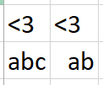

Aligning Output: F-String (2)
print(f"Age={age:>1}")
print(f"Age={age:>2}")
print(f"Age={age:>3}")
Column width matches width of data
Column winder than the width of data (right-align: leading ‘space’)
#No greater than, equal to Co-pilot says “3 or greater”
print(f"Age={age:>=3}")
Field width is 1
3 7
37 (needs 2 ‘slots’)
Field width is 2
3 7
37 (needs 2 ‘slots’)
Field width is 3
SP 3 7
37 (needs 3 ‘slots’)
Notes:
#No greater than, equal to
print(f"Age={age:>=3}")
The = equals as literal output

Slide 22
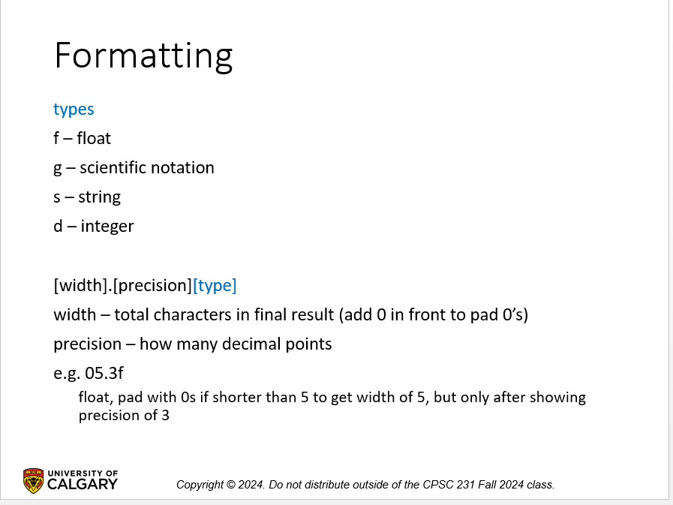
F-String Aligning Output/Precision: “Required Knowledge”
FYI: This is how this topic was presented in the notes provided by the course coordinator (Dr. Michelle Cheatham)

Slide 23
Types Of Information: F-String
Types:
Format (to specify the type of the information)
print(f"…{<information>¹:<type>} ")
Some examples:
print(f"Display as integer{num2:4d}")
print(f"Display in scientific notation {1/3:e}")
Type | Information displayed | Symbol
Integer | Whole numbers | d
Float | ~Rational numbers | f
String | Characters | s
Scientific notation | S.N.: displays as an exponent | e
General | Scientific notation (depends upon # rational digits) | g
1: Information can take the form of a variable (name), named constant (PI) or an unnamed constant (e.g. 3.14, "TAX_RATE")

Slide 24
F-String Data Types: “Required Knowledge”
FYI: This is how this topic was presented in the notes provided by the course coordinator (Dr. Michelle Cheatham)

Slide 25

Types Of Information: F-String
Name of the full example: 9f_string_display_types.p
num1 = 1/8
num2 = 123
string1 = "abc"
print(f"Display as fixed point {num1:0.2f}")
print(f"Display as integer{num2:4d}")
print(f"Display as string:{string1:s}")
print(f"Display in scientific notation {1/3:e}")

Slide 26
Why Bother Specifying The Type
That is, the previous examples would have ‘worked’ without using type specifies (e.g. ‘f’ for “floating point”)
You can read discussions online but here’s one quick reason:
type checking:
If information can only be of a certain ‘type’ then the program can flag the incorrect type as a visible error rather than producing a bug in the program.
Example: if you only want an ID number to consist only of digits then specify the type of display as integer, something such as a string will produce an error.
print(f"{num1:s}") #can’t display a float as a string
print(f"{num2:s}") #can’t display an int as a string
num1 = 1/8
num2 = 123

Slide 27
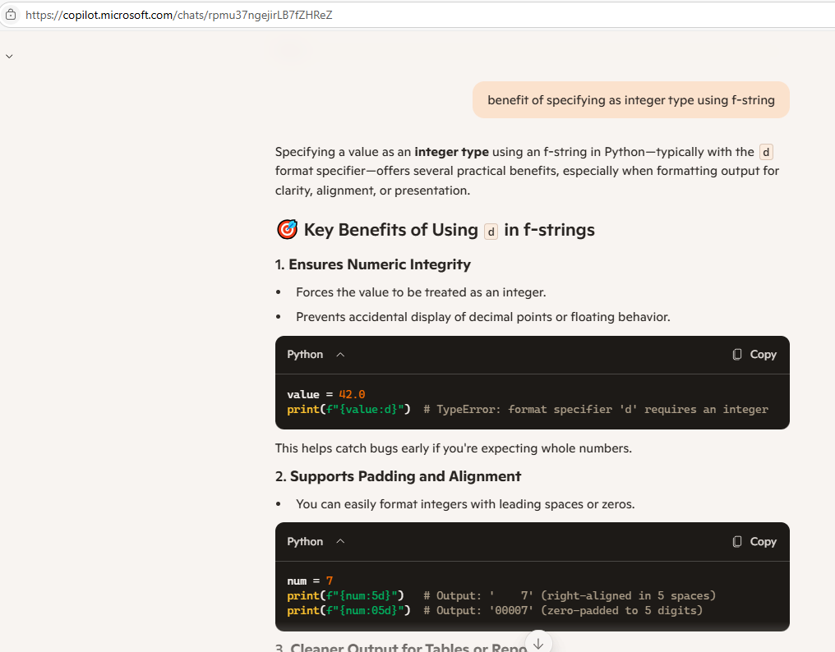
Example: More Information On Types, How AI Can Be Legitimately Used (Learning)
JT’s note: Much like the web, AI isn’t always correct nor is it always a ‘good’ source of information.
Source: Bing Co-pilot

Slide 28
Formatting Text Output Vs. Changing Variables
Features such as: F-String for specifying precision and alignment and format specifiers only affect the information displayed for functions such as print.
They DO NOT change the value stored!
Example:
num = 1/3
print(f"Num's displayed value here={num:3.1}")
print(f"Num's actual stored value={num}")

Slide 29

Functions Can Change Values In Variables
Recall: variables are changed via an assignment
Example:
num = 12
print(num) #Num passed to a function not changed.
num = 21 #Updates value stored in num.
Some functions (such as ‘round’ can return a modified value of what was passed into it).
Example:
num = 1/3
round(num,2)
print("Num unchanged",num)
num = round(num,2)
print("Num updated by assignment",num)

Slide 30
F-String: Easy Pitfall (To ‘Fall’ Into)
Tam says: “Small details matter because they can produce drastic effects, pay attention to syntax (e.g. the ‘Format’ headings in my notes)!”
This isn’t a “Tam A.R. thing” it’s a property of all programming languages.
Example what you if exclude the ‘f’ in an attempt to use F-String.
num = 1/3
print("{num:3}") #Incorrect: “literal string” between quotes
print(f"{num:3}") #Correct: ‘f’: specifies the use of F-String

Slide 31
Types Of Programming Errors
Syntax/translation errors
Runtime errors
Logic errors

Slide 32
Syntax/ Translation Errors
Each language has rules about how statements are to be structured.
An English sentence is structured by the grammar of the English language:
My cat sleeps the sofa.
Python statements are structured by the syntax of Python:
5 = num
Grammatically incorrect (FYI: missing the preposition to introduce the prepositional phrase ‘the sofa’)
Syntactically incorrect: the left hand side of an assignment statement cannot be a literal (unnamed) constant (or variable names cannot begin with a number)

Slide 33

Some Common Syntax Errors
Miss-spelling names of keywords
e.g., ‘primt()’ instead of ‘print()’
Forgetting to match closing quotes or brackets to opening quotes or brackets e.g., print("hello)
Using variables before they’ve been named (allocated in memory).
Name of the full example: 10error_syntax.py
print(num)
num = 123

Slide 34
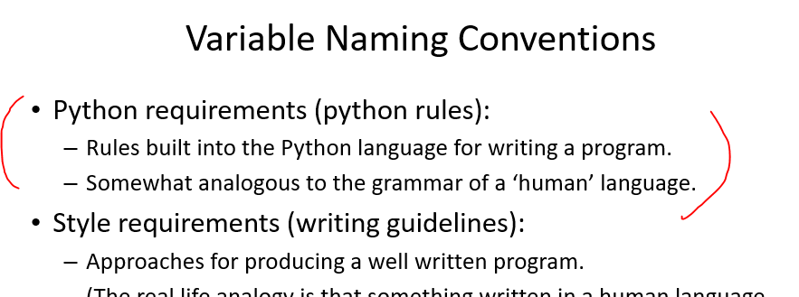
Syntax Errors: Rules For Specifying Python Instructions
The rules were introduced in the previous section:
The python ‘rules’ are specified in the syntax of the language.

Slide 35
Runtime Errors
“My computer crashed!”
Occur as a program is executing (running).
The syntax of the language has not been violated (each statement follows the rules/syntax).
During execution a serious error is encountered that causes the execution (running) of the program to cease.
A common example of a runtime error is a division by zero error.
Another example is a type error e.g. var = "1" + 1
We will talk about other run time errors later.

Slide 36

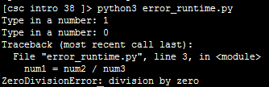
Runtime Error¹: An Example
Name of the full example: 11error_runtime.py
num2 = int(input("Type in a number: "))
num3 = int(input("Type in a number: "))
num1 = num2 / num3 # When zero is entered
print(num1)
1 When ‘num3’ contains zero

Slide 37

Logic Errors
Software “bugs”
The program has no syntax errors.
The program runs from beginning to end with no runtime errors.
But the logic of the program is incorrect (it doesn’t do what it’s supposed to and may produce an incorrect result).
Name of the full example: 12error_logic.py
print ("This program will double the number.")
number = int(input("Type in the number to be doubled: "))
doubledIt = number + 2
print("Number: %d, Doubled: %d" %(number,doubledIt))

