Slide 1
Using Two Common IDEs¹ For Python Development
IDLE
PyCharm
1 IDE = Integrated Development Environment (for writing/running programs and more)

Slide 2
Example Program To Type Into Each Editor
print ("hello")

Slide 3
Using PyCharm

Slide 4
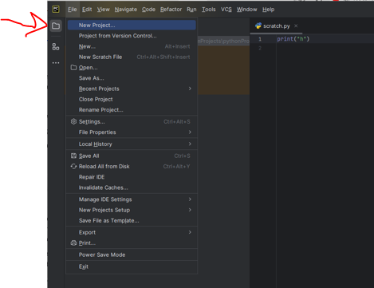
Create A New Project

Slide 5
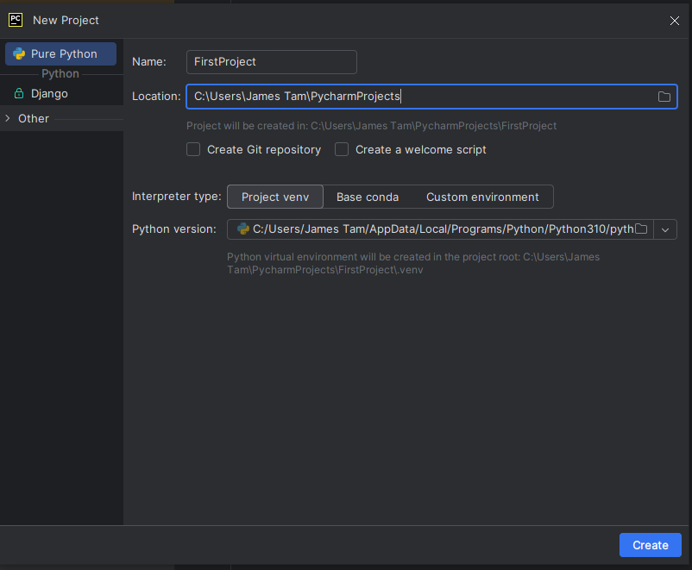
Type In A Good Project Name

Slide 6
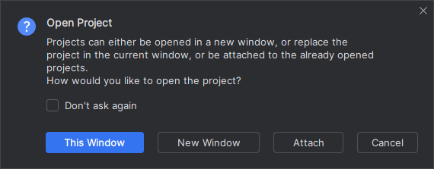
Pick Either 1 Or 2 (Irrelevant For First Project)

Slide 7
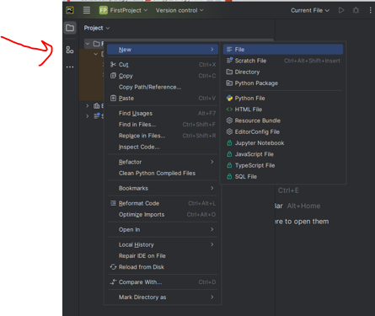
Create A New File (To Store The Program)

Slide 8
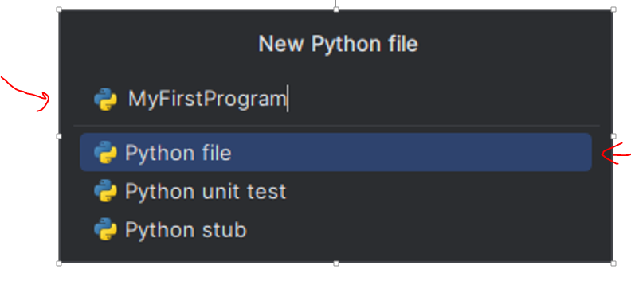
Type In A Descriptive Name For Program
Program name
File type (select this one)

Slide 9
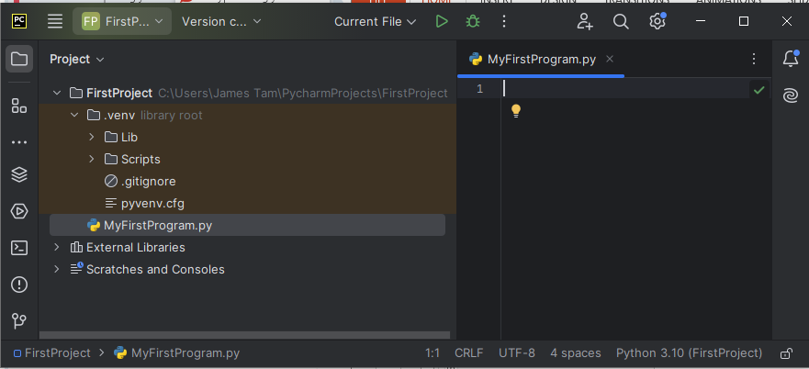
Type Your Program Into The Editor
Type in your program here
print ("hello")

Slide 10
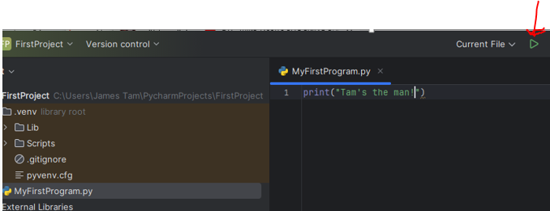
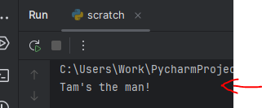
Click The ‘Run’ Button To Run/Execute Your Program
Result of running above program

Slide 11
Using IDLE

Slide 12
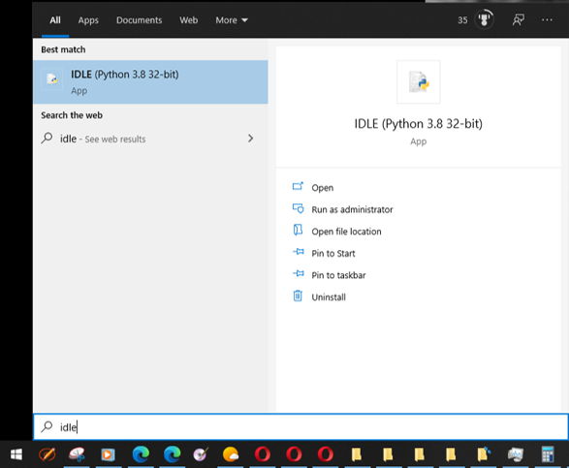
Creating/Running Programs: Windows
Step 0: Before writing your program start IDLE (python editor)
  The editor automatically comes installed with your python download so it’s the one that we will officially support.
    Starting IDLE (Windows)
  One Apple resource for using IDLE: https://www.python.org/download/mac/tcltk/

Slide 13
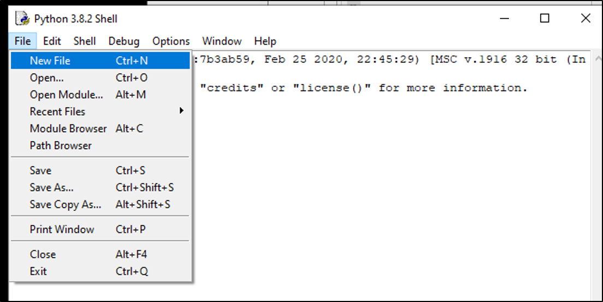
Creating/Running Programs: Windows (2)
Step 1: Starting the python program editor from IDLE: File->New File

Slide 14
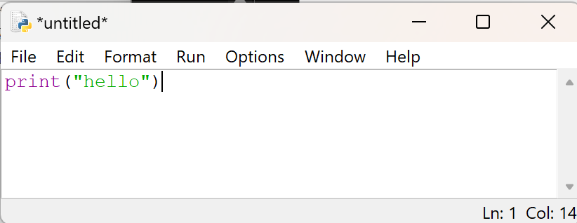
Creating/Running Programs: Windows (3)
Step 2: Type your program into the editor window that appears (appears if you completed the previous step correctly):
(The specifics of what to type into the editor will form the bulk of teaching material for this semester – details are coming soon).
  For now you can just type in what you see in the above image.

Slide 15
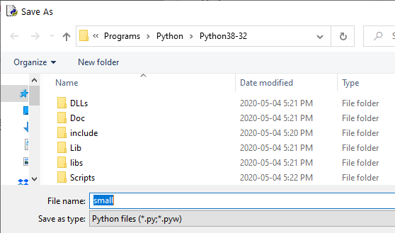
Creating/Running Programs: Windows (4)
Step 3: Name your program: File->Save
  Using the IDLE editor you can simply save under the default file type.
    (If you use another text editor such as WordPad then you will have to save it as a text file and make sure the filename ends with the right suffix “.py”).
    Save the program in a easy to remember location (don’t use the default location – it’s the install location of python and not easy to remember for most).
  Standards for naming programs
    Only use alphabetic or numeric characters in the save name
    Don’t include spaces or any other characters!

Slide 16
Creating/Running Programs: Windows (5)
Step 4: Running your program
  Via the menu: Run->Run Module
  Via key board shortcut: F5

Slide 17
Opening Previously Created Programs
Do this through the editor (IDLE):
Menu options: File->Open
Do not try to ‘click’ on the file (Windows users)
  Windows: by default the operating system will try to run python programs (not allow you to edit it).

Slide 18
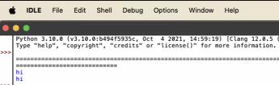
MAC Version Of IDLE
It should appear similar to the Windows version (or even the Linux version installed on the computers in the tutorial room).
But you need to keep in mind that the menu bar on a MAC does not appear in the same location as the current application (i.e. in the image below the user has had to move IDLE window to just below the menu bar).
If you wish to customize the configuration of the menu:
  https://discussions.apple.com/thread/252656653?sortBy=best
Image: Screengrab by James Tam from a student computer (with permission).

Slide 19
Windows: Do Not Click On The Python File
Why you should not run your program by clicking on it!
  By default Windows will try to run the program in a new popup window and then close the window after the program finishes.
  FYI: don’t send python programs. The university MS-Exchange email server will block such file attachments.
    Workaround for mailing a python program: rename the file name from .py to .txt before attaching it.
      How to rename a file in Windows 10:
        https://www.howtogeek.com/665514/6-ways-to-rename-files-and-folders-in-windows-10/
      (How to view filename extensions in Windows 10):
        https://www.howtogeek.com/205086/beginner-how-to-make-windows-show-file-extensions/
      A MAC resource:
        https://support.apple.com/en-ca/guide/mac-help/mchlp2304/mac
    Don’t copy-paste the code into email because it may introduce new errors.
Video: showing how useless it is to just click on a file containing a python program (use the method that will be covered shortly): https://pages.cpsc.ucalgary.ca/~tamj/resources/python/Clicking_on_a_python_program_annotated.mp4

Slide 20

Embedded Video (In Case You Can’t See It Via The Link On The Last Screen).

