Slide 1
Classes And Objects
Encapsulation/information hiding, inheritance, modular design in python/multi-file programs.

Slide 2

Decomposing Large Programs: By File
Because real life programs are large, they are not only divided into functions but also split into multiple files.
Example: There’s so many files for the game RPG Icewind Dale that they are distributed among several folders (this is not unique to this game).

Slide 3
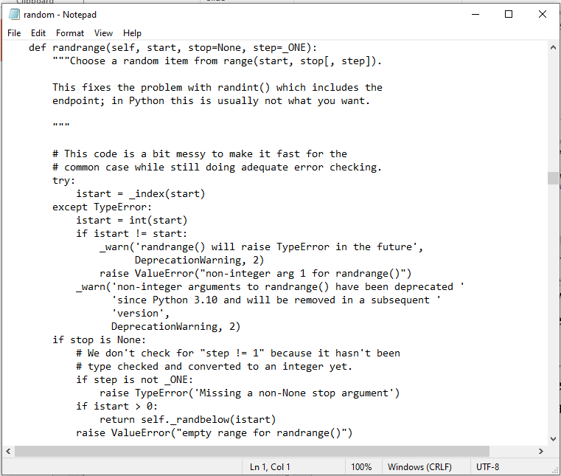
Python File Decomposition: Modules
Each module is a separate library of python features (functions, class definitions).
Recall: the ‘Random’ module:
Name of file: random.py
File contains 1 or more functions

Slide 4
Review: Using The Code In A Module
Add the name ‘Random’ to your program
Format:
import <Module/filename>
Example:
import random
Running a function/method from this module
Format:
<Module/filename>.<function/method call>
Example:
print(random.randrandint(1,6))

Slide 5
Defining Your Own Module
Name of the folder containing the full online example: 1st_module_example
To start the whole program run the module with the ‘start’ function (in this case it is Driver.py).
Filename: Draw.py
def rectangle():
print("""
#########
#########
#########
#########
#########
#########
#########
#########""")
def right():
print("""
#
###
######""")
def triangle():
print("""
#
###
#####""")

Slide 6
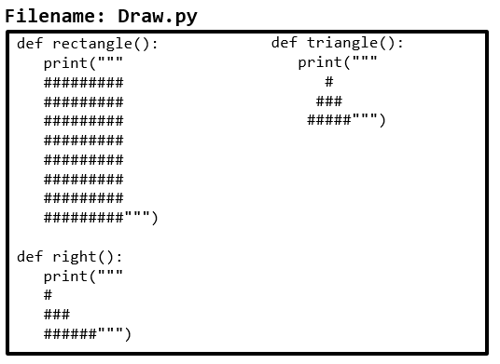
Defining Your Own Module (2)
Adding the name ‘Draw’ to your program
Filename: Driver.py
import Draw
def start():
Draw.rectangle()
Draw.right()
Draw.triangle()
start()
Running functions from the ‘Draw’ module (similar to running the random methods this requires <module name>.<method name>

Slide 7
Naming The Starting Module
Recall: The function that starts a program (first one called) should have a good self-explanatory name e.g., “start()” or follow common convention e.g., “main()”
Similarly the file module that contains the ‘start()’ or ‘main()’ function should be given an appropriate name e.g., “Driver.py”, “Start.py”, “Main.py” (it’s the ‘driver’ of the program or the starting point)
Filename: “Driver.py”
def start():
#Instructions
start()

Slide 8
Importing Modules Containing Class Definitions
Approach 1: import just the name of the file containing the class definition.
Example: import PersonFile (similar this previous approach: import Random)
Advantage:
Allows access to other ‘names’ in the file e.g. other utility methods, constants etc.
Recall Random.py contains: Random.randrange(0,6), Random.randint(1,6)
Disadvantage:
The name of the file must be included along with the name of the function/method/attribute e.g. Random.randint(1,6)
File: Random.py
def randint(start,end):
def randrange(start,end):

Slide 9
Importing Modules Containing Class Definitions
Approach 2: import just the name of the file containing the class definition.
Example: from PersonFile import Person (or using this approach with an existing library from Random import randint)
Advantage:
Imports only the names needed (reduced conflicts between the names in the module being imported and the file where the import is included).
from Random import randint
#only imports the randint name

Slide 10
Approach 1: An Example
Name of the folder complete online example: 2nd_oo_module_example
Only the module/filename is imported so other names (e.g. class name) must be prefaced by the module name (‘context’ needed).
Note: sayName is accessed via a reference name not class name.
Filename: PersonFile.py
Filename: Driver.py
class Person:
def __init__(self):
self.name = "I have no name :("
def sayName(self):
print("My name is...", self.name)
def fun():
print("called fun")
import PersonFile
def start():
#Only filename imported
aPerson = PersonFile.Person()
aPerson.sayName()
PersonFile.fun()
start()

Slide 11
Approach 2: An Example
Name of the folder complete online example: 3rd_oo_module_example
Only imports the class name, other names (e.g. function name) cannot be accessed.
The class name doesn’t need to be prefaced by the module name.
References to the imported name are shorter.
Reduces the possibility of naming conflicts e.g. if there’s already a function ‘fun’ in Driver.py (won’t conflict with ‘fun’ in Person).
Filename: PersonFile.py
Filename: Driver.py
class Person:
def __init__(self):
self.name = "I have no name :("
def sayName(self):
print("My name is...", self.name)
def fun():
print("called fun")
from PersonFile import Person
def start():
aPerson = Person()
aPerson.sayName()
start()

Slide 12
Object-Oriented Design: Advantage Over Procedural Decomposition
Procedural approach: functions can allow for nonsensical behaviors e.g. “flying pigs”
E.g.
def fly(aFlyer):
...
pigs = list["pig1","pig2"] fly(pigs)

Slide 13
Recall: Objected Approach Ties Behaviors (Methods) To Classes
Capabilities are defined in a class (in this case it’s the Flyer() which is a parent class) and all classes that inherit all the abilities of a flyer (in this cases the child class: Airplane).
class Flyer():
def fly(self):
….
Via inheritance: class definitions be extended by specifying that ‘child’ classes (derived from the parent) inherit (are able to access) the attributes and methods of the parent.
class Airplane(Flyer):
Alternative example: Java
public class Airplane extends Flyer
{
}
In python this allows an Airplane object to ‘fly’ by inheriting the abilities of the ‘Flyer.
Notes:
*Multiple inheritance
class Airplane(Flyer,Machine):

Slide 14

(A Very Simple) Inheritance Example
Name of the folder containing the full online example: 4th_inheritance
Filename: Flyer.py
Filename: Airplane.py
class Flyer():
def fly(self):
print("Engage flying mode")
from Flyer import Flyer
class Airplane(Flyer):
def beginTrip(self):
print("seat belts")
self.fly()
Filename: Start.py
from Airplane import Airplane
def start():
p = Airplane()
p.beginTrip()
start()

Slide 15
New Terms: Previous Example
Parent class: a class from which another class is derived.
class Flyer():
Child class: a class that is derived from the parent class.
class Airplane(Flyer):
Inheritance: the relationship between a parent and child class.
Format:
class <ChildClass>(<Parent class>):
Example (python):
class Airplane(Flyer):
Example (java – not needed for 231 but needed for 233):
public class Airplane extends Flyer

Slide 16
New Term: Encapsulation
Definition 2 for encapsulation: hiding the variable attributes of a class so they can only be accessed and changed in a specific fashion (via the class methods).
Alternative term, information hiding: the private attributes are hidden behind the public methods of a class.
Enforcing encapsulation/information hiding:
Approach 1 (better approach – many languages do it this way): It’s a built in rule of the syntax i.e. violating it results in syntax/translation error and the program not translate let alone run.
Approach 2 (python employs this approach):
Programming stylistic conventions specify an attribute as private.
It’s analogous to how named constants are declared:
GST = 0.05
GST = 0.1 #Bad style but unfortunately it only results in a
#logic error

Slide 17
Stylistically Demonstrating Something Should Not Accessible
The python convention is to preface the attribute with two underscores).
def __init__(self):
self.__friends = ["no friends"]
But the stylistic approach merely indicates to other programmers that the attribute should not be changed.

Slide 18
Encapsulation/Information Hiding: Python
Name of the folder containing the full online example: 5th_information_hiding
Changes/access are possible for private attributes outside of the class.
These parts are bad and should not be allowed outside of the class (but python allows it).
Private attributes (e.g. __friends) or even methods should never be directly accessible outside of a class definition.
class Person:
__friends = []
def __init__(self):
self.__friends = ["no friends"]
jim = Person()
print(jim._Person__friends) #Attribute accessed!
jim._Person__friends = [] #Attribute changed!
jim._Person__friends.append("Stacey Hearn")
print(jim._Person__friends)

Slide 19
Encapsulation/Information Hiding Vs. Abstraction
Don’t mix the two up!
Encapsulation/information hiding: protecting variable attributes of a class by restricting access via controlled mechanisms (methods that prevent misuse).
Class Person:
def __init__(self,newAge):
if(newAge>0):
self.__age = newAge
else:
print("Age can’t be negative")

Slide 20
Enforcing Information Hiding
Many languages (e.g. Java) inforce this with the rules of the language i.e. directly trying to change or access a private attribute results in a syntax error.
Example (unless you are later told this isn’t needed for a CPSC 217/231 exam but is more than fair game for CPSC 219/233).\
public class Person
{
public Person()
{
//this ~self
this.age = 0;
}
private int age;
public void setAge(int newAge)
{
this.age = newAge;
}
}
public class Driver
{
public static void main
(String [] args)
{
//Calling constructor
Person aPerson = new Person();
//Syntax error:
aPerson.age = 12;
}
}

Slide 21
In Case You’re Wondering: Why Bother?
Information hiding can prevent in appropriate access (a part of a program has access to information that it should not) or preventing information being set to incorrect values (e.g. outside an allowable range).
Example: again for your reference this is CPSC 233 material.
pubic class Person {
private int age;
public void setAge(int newAge) {
//Valid age in range from 0-118.
if((age >=0)&&(age<=118)) {
this.age = newAge;
}
else {
System.out.println("Age outside 0-118");
}
}
Properly implemented: information hiding is a unique advantage of Object-Oriented programming.

Slide 22
New Term: Method/Function Signature
Method signature: the name and parameter lists of the methods of class.
It’s how you use (call) the method.
Example for a Person class:
Actions:
Eat
Sleep
Secrete
Multiply
Method signatures for class Person could be (parameter name, parameter type):
eat(howMuch:String)
sleep(duration:integer)
secrete() #I don’t want to know! ;)
multiply(partner:Person)

Slide 23
New Concept For O-O: Abstraction (2)
Abstraction in O-O:
The inner details of the code in a class is not necessarily knowledge for other programmers (it is a ‘black box’ or an abstraction to any except for the programmer who implemented this class).
Instead all that is needed are the details as to how the class is used e.g. how methods are called.
Example (procedural): random module
Function randint
randint(<min value>, <max value>):
This function returns a random integer value within the range of the two parameters.
How this function generates the value is not relevant to other programmers.
The function is a ‘black box’ to outside programmers (inner details are blacked out or hidden).
Other programmers simply need to understand an abstraction of the function (e.g. how to use it, what value it produces etc.)
You just have to know how to properly use the class methods or function not how they are implemented.

Slide 24
New Concept For O-O: Abstraction
Abstraction (Object-Orientation):
Much like with the procedural example (random library/module) other programs simply have to know how to use your class (what are the method signatures).
They do not have to know the “inner workings” of the class (the code inside each method).
Example documentation for class Random (java).
https://docs.oracle.com/javase/8/docs/api/java/util/Random.html
Method: public int nextInt(int bound)
Returns a “…value between 0 (inclusive) and the specified value (exclusive)”
i.e. it behaves just like python’s Random.randrange(1,6) #1-5
Method signatures for class Person could be (parameter name, parameter type):
eat(howMuch:String)
sleep(duration:integer)
secrete() #I don’t want to know! ;)
multiply(partner:Person)

Slide 25
After This Section You Should Now Know
How to decompose a program (functions or classes) into modules.
What are the benefits of Object-Oriented programming:
Inheritance
Information hiding/encapsulation (if properly implemented).
New terminology:
abstraction,
information hiding/encapsulation,
How information hiding is implemented in python vs. other some other languages.
What are some of the benefits of information hiding.
inheritance
parent class
child class

Slide 26
After This Section You Should Now Know (2)
How to divide your program into different modules
How inheritance can allow access to group of derived classes.

Slide 27
Copyright Notification
Unless otherwise indicated, all images in this presentation were provided courtesy of James Tam.

