Slide 1
File Basics, Reading From A File In Python
You will learn the basics of different file formats and different ways of reading from a text file.

Slide 2
Storing Information: What You Were Previously Taught
Information is retained in memory in the form of variables: simple (int, float, bool) or composite/”data structures” (string, list, dictionary, tuple, set).
This information is stored in memory (RAM) and is only accessible (at most) while the program runs.

Slide 3
Storing Information: What You Will Learn
Information is retained on a storage device (hard drive, portable device etc.) or even remotely (on another device via an Internet connection).
Sending data over the Internet can be done by using the “JSON string” format (a python dictionary) – as needed you be provided additional details.
Storing information in a file.
Text files: must be encoded as ASCII or Unicode (the Unicode values are the same as UTF-8).
Recall: ASCII only represents values using 8 bits, UTF-8 is used for representing more than just the basic ASCII characters and uses more bits.
Binary files: “files that aren’t text” but use bits to encode the information (everything else e.g. images, videos, MS-Office files etc.)

Slide 4
Sources Of Information: Python Programs
Hard coded values (unnamed or named constants)
E.g.
age = 12
taxOwed = price * GST
User entered
E.g.
age = float(input("Type in your age in years: "))
Read in from a file
Details come later in this section of notes.

Slide 5
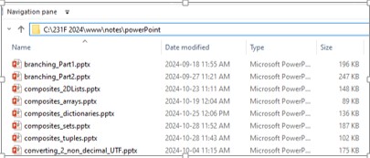
Review: Folders/Directories
Files are contained in a folder/directory.
Windows
Linux/UNIX
Example: /home/profs/tam

Slide 6
Checking Location
Before opening a file with a python program you can first determine if the file exists at the specified location using the ‘os’ library/module/package.
Name of the full online example: 1file_checking_information.py
import os
FILE_PATH = "C:/231F 2024/www/notes/powerPoint/"
FILE_NAME = "input_file.txt"
if(os.path.exists(FILE_PATH+FILE_NAME)):
print("File %s exists in the location %s"
%(FILE_NAME,FILE_PATH))
else:
print("File %s not found in location %s"
%(FILE_NAME,FILE_PATH))
An alternative to a hard-coded path C:\231 F 2024..”) may involve getting the location from the user.

Slide 7
Location Not Specified
If the path is not specified for a program then the program opening a file will look in the directory/folder which contains the program that is trying to access the file.
If the program is moved then the location will reflect the current location.
The following examples assume that the input file is in the same folder as the program.

Slide 8
First Example: Basic File Read
Name of the full online example: 1file_checking_information.py
file_name = input("Type in the complete file name including
extension (e.g. input.txt): ")
#aFile: open file and connects program with file
aFile = open(file_name,"r") #r= read mode
#Reads a single line
aLine = aFile.readline()
print(aLine)
aFile.close() #Frees the file for access by other programs.
print("-")
#Reads line by line from file from beginning to end.
for line in aFile:
#readline returns the information as a string
print(line)

Slide 9
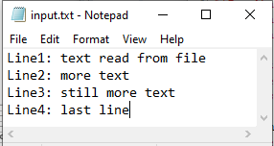
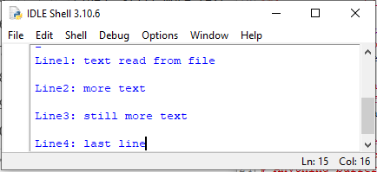
Previous Example: Double Spaced Output?
for line in aFile:
print(line)
Recall: print() displays the specified information AND adds an <EOL>
<EOL>
<EOL>
<EOL>
<EOL>
<EOL>

Slide 10
Removing One Or Both Newlines
Approach 1 (you have already been taught): prevent print from adding an extra newline after ‘line’:
for line in aFile:
print(line, end="")
Approach 2 (use a built in string method): strip (remove) any white space characters (space, tab, new line) at the end of the string read from file:
for line in aFile:
line = line.rstrip() #rstrip is method of strings
print(line, end="")

Slide 11
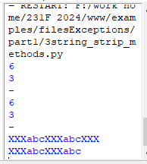
An Example Illustrating The String Strip Methods
Name of the full online example: 3string_strip_methods.py
aString = "abc \t\n"
print(len(aString))
aString = aString.rstrip()
print(len(aString))
aString = " abc"
print(len(aString))
aString = aString.lstrip()
print(len(aString))
aString ="XXXabcXXXabcXXX"
print(aString)
aString = aString.rstrip("X")
print(aString)

Slide 12
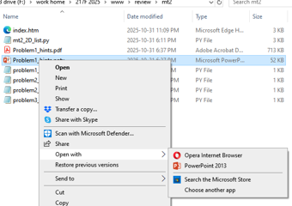
File Name Extensions/Suffixes
Usually hidden by the operating system to protect the user (from “doing something bad”).
The extension/suffix is the part of the file name after the period e.g. files_part1_basics_files_file_input.pptx
Different operating systems use this part of the file name for important purposes.
Example, MS-Windows: a file name extension identifies the file type which in turn is associated with a program (which will open the file and allow viewing or even editing – the latter if appropriate).
Python programs .py
Java programs .java
Image files .jpg, .jpeg, .png etc.

Slide 13
Other Ways Of Reading From A File
Name of the full online example: 4file_alternative_reads.py
Read all lines from the file into one continuous string
someText = aFile.read()
print(someText)
print("# char %d" %(len(someText)))
Read first ‘n’ (e.g. n=3) characters from the file into a string
someText = aFile.read(3)
print(someText)
print("# char %d of text" %(len(someText)), type(someText))
Read all lines from the file into a 1D list (line = list element)
someText = aFile.readlines() #aFile.read() same but reads as string
print(someText)
print("# list has %d elements, of type=" %(len(someText)),
type(someText))
#Determine number characters read (“how far”)
aFile.tell() #returns # char read, includes ‘appended’
Notes:
aFile.tell() #returns # char read, includes ‘appended’
i.e. if file is currently 100 bytes then opening to open will yield a ‘tell’ of 100 characters.

Slide 14
WHILE-Loop Implementation
readline(): returns an empty string if nothing can be read.
Pseudo code solution
Read line from file
If(line is empty) then
indicate that file is empty
End if
Rem: non-empty file
Do while(line read from file is not empty)
process line (display contents onscreen)
Read another line from file
End while

Slide 15
WHILE-Loop File Input Example
Name of the full online example: 5file_read_while_implementation.py
EMPTY =""
file_name = input("Type in the complete file name including
extension (e.g. input.txt): ")
aFile = open(file_name,"r")
#Empty file means readline returns an empty string
line = aFile.readline()
if(line == EMPTY):
print("File input.txt is empty")
#Continue reading until an empty line read in from file
while(line != EMPTY):
print(line,end="")
line = aFile.readline()
aFile.close()

Slide 16
WHILE-Loop File Input Example
Name of the full online example: 6file_read_for_implementation_with_empty_file_check.py
aFile = open(file_name,"r")
#1st modification over the original FOR-loop example (#2)
line = aFile.readline()
if(line == EMPTY):
print("File input.txt is empty")
else:
#2nd modification: process the line just read from file
#before reading the remaining lines
print(line,end="")
for line in aFile:
print(line,end="")

Slide 17
Specific Ways To Access A File
To access a specific location you can ‘seek’.
Whence, you can start the seek at these locations:
0=start of file
1=current location of file pointer
2=end of file
Offset, the number of characters to move the file pointer off the starting location (if you start the seek from the end it must be a negative number to seek ‘backwards’ otherwise it will *likely* result in a run-time error as [JT thinks] python won’t ‘wrap’ and read past the end of file to the start).
Format:
<File variable name>.seek(<offset>, <whence – start location to ‘seek’>)
Example:
aFile.seek(10,0) #Move 10 characters from start of file.
aFile.seek(7,1) #Move 7 characters from current location of file pointer.
aFile.seek(-8,2) #Move back 8 characters from the end of file.

Slide 18
Seek: An Application (Zhao/Hudson)
Consider the file “inputFile.txt”. Each row consists of a 2 character long student ID, and a 4-character long student name.
Retrieve the ID and name of the third student.
inputFile.txt
ID NAME
01 Jack
02 Mack
03 Pham
…

Slide 19
Files - Reading From a File – Example (Zhoa/Hudson)
Program.py
inputFile.txt
filePath = "inputFile.txt"
fileHandler = open(filePath)
for counter in range(3): #skip the first 3 lines
fileHandler.readline()
s_id = fileHandler.read(2)
fileHandler.read(1) #skip a space
s_name = fileHandler.read(4)
print("ID: %s, Name: %s" % (s_id, s_name))
ID NAME
01 Jack
02 Mack
03 Pham
…
Console output:
Student ID: 03, Name: Pham

Slide 20
After This Section You Should Now Know
The difference between storing information in RAM (as variables or constants) vs. in storage (in the form of a text file)
The difference between text vs. binary files.
How to check for the existence of a file in a particular location.
File input basics:
How to open/close a file.
Different ways of reading from a file using different file methods e.g. readline.
What is a file name extension/suffix and their importance.
Reading line by line from a file using a while vs. for loop.
How to check/react to cases of an empty input file.

Slide 21
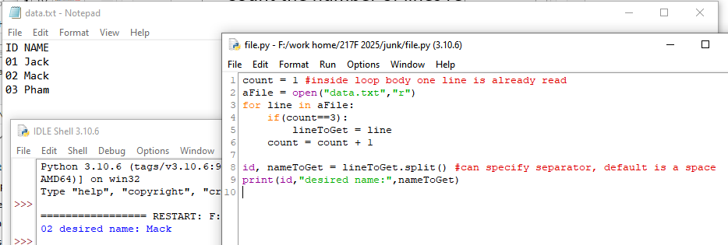
JT’s Implementation Of Previous
Count the number of lines read.
Since the format of the file is fixed (number of characters in each line, separator is a space character):
Read line by line up to the third line.
Use a string function/method to split the string
Alternatively you could also use an index to access a substring

Slide 22
Copyright Notification
Unless otherwise indicated, all images in this presentation were provided courtesy of James Tam.

