Slide 1
Exception Handling
You will learn how to design programs that can recover from runtime errors.

Slide 2
Error Handling With Exceptions
Exceptions are used to deal with extraordinary errors (‘exceptional ones’).
Typically these are fatal runtime errors (“crashes” program)
A non-exhaustive list of examples:
  trying to open a non-existent file,
  invalid conversions between types of data (string to numeric)
  exceeding the bounds of a composite type such as a list
  division by zero.
Current process from what you’ve been taught:
  An exception occurs e.g. trying to open non-existent file
  If no code is written to ‘handle’ the exception then a runtime error crashes the program.
  You will learn how to write code to ‘recover’ from the exception (no run-time error).

Slide 3
Basic Structure Of Handling Exceptions
  Try:
  Attempt something where exception error may happen
  Except:
  React to the error
  Else: # Not always needed
  What to do if no error is encountered
  Finally: # Not always needed
  Actions that must always be performed

Slide 4
Simple Implementation Of Recovering From File I/O Exceptions
Name of the full online example: 1basic_exception_handling_files.py
    INPUT_FILENAME = "input.txt"
    try:
    aFile = open("input.txt","r")
    print(aFile.readline())
    aFile.close()
    except IOError:
    print("Problem encounted during the interaction with %s"
    %(INPUT_FILENAME))

Slide 5

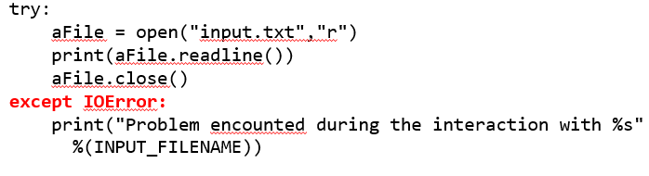
Try-Except Vs. Previous (Branching): Non-Existent File
Only when file exists at this point in the program is this false
T
#The code below is added later in the program
Can still handle run time error case where the file suddenly vanished at this point but also it can also react to other file IO errors

Slide 6
Better Implementation Of Reacting To File I/O Exceptions
  This second approach is more complex not only because it reads multiple lines but because it handles the exception better.
    It allows the user to continue running the program rather than having to run it all over again if an exception is raised
      Useful if something as minor as a typographical error is made while specifying the name of the input file.
    A flag is employed to repeatedly attempt the file input process if an exception is raised (occurs):
    The flag is disabled if no exception occurred during file input.
      Set flag to enabled
      Do while(flag is set to enabled)
      try
      Open file
      read from the file line by line
      close file
      exception: reaction to exception to prevent a runtime error
      else:
      no exception: flag is disabled
      End-while

Slide 7
Better Implementation Of Reacting To File I/O Exceptions (2)
Name of the full online example: 2better_example_of_exception_recovery.py
    fileOK = False
    while(fileOK == False):
    try:
    filename = input("Name of file to open: ")
    aFile = open(filename,"r")
    for line in aFile:
    print(line,end="")
    except IOError:
    print("Problem encounted during the interaction with
    %s" %(filename))
    else:
    aFile.close()
    fileOK = True
    print()
    print("Done reading from file")

Slide 8
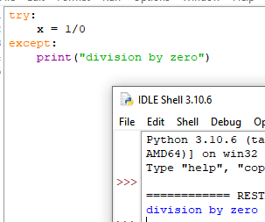
Some Types Of Exceptions That Can Be Caught
IOError: occur during file input or output.
ValueError: can occur when the value of a memory location is invalid e.g. during a conversion between types.
ZeroDivisionError: occurs during division when the denominator is zero.
IndexError: occurs when the index is invalid e.g. index is outside the list bounds.
Except without specifying the type of the exception catches any type of run time exception.

Slide 9
Catching Multiple Types Of Exceptions
Name of the full online example: 3catching_multiple_exceptions.py
  The order in which the exceptions occur determines which exception is caught.
  The order IS NOT determined by the order is which the exceptions are listed.
    aList = [1,2]
    try:
    i = 2
    print(aList[i])
    quotient = 1/0
    except IndexError:
    print("Outside list bounds")
    except ZeroDivisionError:
    print("Cannot divide by zero")
    aList = [1,2]
    try:
    i = 2
    quotient = 1/0
    print(aList[i])
    except IndexError:
    print("Outside list bounds")
    except ZeroDivisionError:
    print("Cannot divide by zero")

Slide 10
“Naming” Exceptions
231
Similar to importing ‘numpy’ with a better name ‘np’
    import numpy as np
A programmer can apparently provide a custom name for exceptions.
  By apparently giving it this custom name one can display more detailed information behind the error.
  JT: what’s actually happening is that the exception itself is not being renamed. Instead you are creating a new variable which is an instance of the exception.
    More information can be derived through approaches such as passing this variable to the print() function.
  Format:
      except <Python name for the exception> as <variable name>:
  Example:
      except ZeroDivisionError as instanceOfDivisionByZero:

Slide 11

Contrast: Naming Vs. Not-Naming Exceptions
Name of the full online example: 4naming_exceptions.py
    try:
    quotient = 1/0
    except ZeroDivisionError:
    #Type name only
    print(ZeroDivisionError)
    try
    quotient = 1/0
    except ZeroDivisionError as instanceOfDivisionByZero:
    #More detailed information can be displayed.
    print(instanceOfDivisionByZero)

Slide 12
Variables: Comparing Type Vs. Instance
Example: integer
    num = 12
Previous example: an exception
    except ZeroDivisionError as instanceOfDivisionByZero

Slide 13
Including This Because It’s In The Notes¹
…but if desired one can list several different types of exceptions under a single ‘except’:
    try:
    <code segment that may cause error>
    except (<type>, <type>, ...) as <name>:
    <action to take when an exception occurs>
    except (<type>, <type>, ...) as <name>:
    <action to take when an exception occurs>
  except (IOError, IndexError) as detail:
  print (detail)
  1 Combining exceptions like this is contrary to what is said in another part of the lecture notes created by Richard Zhao and Jonathan Hudson: “It is a good coding practice to have one except for each exception type.”
The variable detail will be assigned to which ever exception is raised first.

Slide 14
JT: Contrast This With The Previous Screen
Try:
# Where the run time exception may occur.
IOError:
print("Error during file input-output")
ValueError:
print("Invalid type during conversion")
ZeroDivisionError:
print("denominator is zero")
IndexError:
print("List index beyond list bounds")

Slide 15
When To Use Branches (“Conditionals”) Vs. Exceptions
When to use branches:
  To prevent the error/exception from happening.
  For specific cases
When to use exception handling:
  To react to the error/exception after its occurred in order to prevent a run-time error (program crash).
  The error cannot be easily defined (i.e. one of many non-specific events that may happen).
Although this website is someone’s personal opinion (apparently non-profit) site I do agree with this person’s reason for:
  using branching (‘conditionals’) over exceptions,
  using exceptions over branching.
  Consequently it’s listed as a resource for your reference:
    https://avidpython.com/python-basics/when-to-use-try-except-instead-of-if-else/
Branches: for specific cases e.g. Boolean in branch for non-existent file, empty file name
Exception handling: IO runtime error can occur for numerous reasons e.g. no permission to access file, file becomes damaged, file is missing, storage device is dismounted etc. etc.

Slide 16
Examples: Using Branching To Prevent Errors
All the conditions can be clearly defined as Boolean expressions.
    list = []
    denominator = 0
    index = 0
    size = len(list)
    ageString = input("Age in years: ")
    if(denominator == 0):
    print("Cannot divide by zero")
    if((index< 0) or (index>=size)):
    print("Index is outside list bounds")
    if(ageString.isnumeric() == False):
    print(ageString, "is not a number")

Slide 17
Example: Using Exception Handling Over Branches
Reasons for using exceptions for file I/O:
  The availability of the file may have changed since the branch e.g. file is deleted, locked by another process
  Also the except can handle run time errors that may arise beyond just a non-existent file e.g. file exists but it cannot be opened, file can be opened but suddenly it cannot be read/written to etc.
    #Risky
    PATH = "C:/231F/"
    NAME = "input_file.txt"
    if(os.path.exists(PATH+NAME)):
    ...
    else:
    aFile = open(...)
    #Better
    try:
    aFile = open(...)
    Except IOError:

Slide 18
Example: Using Exception Handling Over Branches (2)
Reasons for using exceptions for file I/O (continued)
  An exception may occur when opening or reading from the file may occur for many different (some not so clear) reasons: no file with this name, file permissions don’t allow access, file is corrupt, device on which the file was stored has been dismounted etc. etc.
  The IOError body contains the code for all input/output errors.
    try:
    aFile = open(file_name,"r")
    aLine = aFile.readline()
    Except IOError:

Slide 19
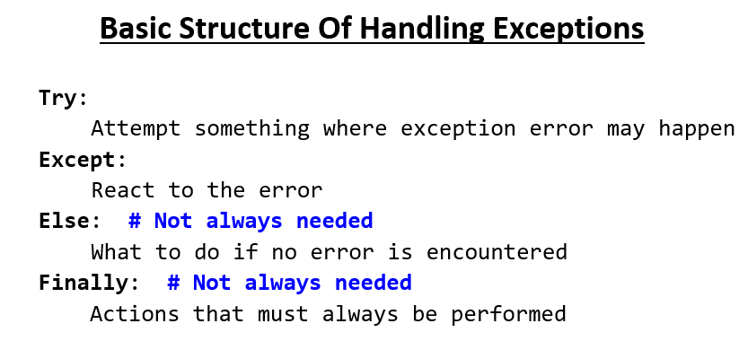
The Last Construct: Finally
Unless the program crashes this body contains instructors that are guaranteed to execute.
It will execute whether or not an exception occurred.

Slide 20
Finally: A Purely Academic Example
Name of the full online example: 5try_catch_finally_learning_example_only.py
  Finally body always run regardless of extraordinary by-passing instructions (you should never do this).
    def fun():
    numerator = float(input("Number to divide: "))
    denominator = float(input("Value to divide by: "))
    try:
    quotient = numerator / denominator
    except ZeroDivisionError:
    print("Cannot divide by zero")
    return() #Extremely bad style
    else:
    print("Quotient=%0.2f" %(quotient))
    return() #Extremely bad style
    finally:
    print("This message always appears")

Slide 21
After This Section You Should Now Know
How exceptions can be used in conjunction with file input and with invalid keyboard/console input.
How components of the exception handling construct: try-except-else-finally each work.
How to catch multiple types of exceptions.
How to create an instance of an exception variable in order to access additional details about the error.

Slide 22
Copyright Notification
Unless otherwise indicated, all images in this presentation were provided courtesy of James Tam.

