Slide 1
Introduction To CPSC 217
Instructor contact information
Course policies
Evaluation: Determining your grade

Slide 2
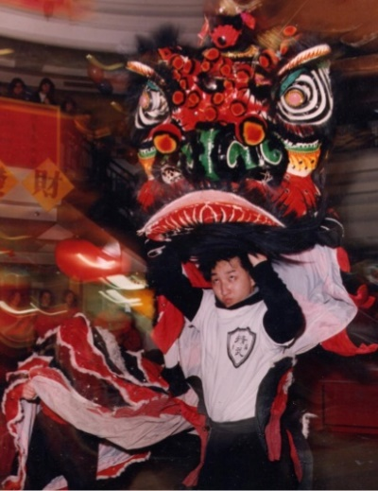
Contact Information (James Tam)
Identification
    James Tam (Tam…James Tam): tam@ucalgary.ca (I’m the ‘Tam’ guy).
    FYI: for those who communicate formally the honorific to use is ‘Prof.’ (Associate professor).
How to reach me
  Email: tam@ucalgary.ca
  Make sure you specify the course name and number in the subject line of the email e.g. ‘CPSC 217’ (otherwise I might miss it).
Office time
  Monday, Tuesday: 2:30 – 3:00 PM
  Zoom (passcode = hope) URL: https://ucalgary.zoom.us/j/93114407392

Slide 3
Who Are You Going To Ask?
  This course is coordinated so the person you contact will depend upon the issue/question.
  Course instructor (that’s the guy in front of you now).
    Things related to the lecture e.g. you don’t understand a concept being taught.
  Course coordinator.
    Overall course policies e.g. the specifics of the term grading system.
      E.g. (From the official course outline) “Each of the above components will be given a letter grade using the official university grading system (see section F.1.1).”
    Time conflicts with the two out of class midterms (see course outline for details).
    Michelle Cheatham: michelle.cheatham@ucalgary.ca
    FYI: for those who communicate formally the honorific to use is ‘Dr.’.
  “Head” Teaching Assistant (TA).
    Assignment grading issues: the head TA (in writing):
      Paige So'Brien paige.sobrien@ucalgary.ca (graduate student student).
  Teaching Assistant teaching your tutorial.
    What’s required for exercises or assignments (‘projects’) or if you are ‘stuck’.
    They have assigned hours to answer questions on Discord: https://discord.gg/FuzC22JbyK
    Exam grading issues (you may not want to ask questions that specifically pertain to you on Discord).
      TA contact information on next screen.
  Other
    Class mates:
      To catch up when you miss class i.e. to get their notes
    Missed midterm -> no one (weight for one is automatically added to final exam)
    Final exam deferral -> https://www.ucalgary.ca/registrar/exams/deferred-final-exams
New from Course Coordinator, Sept. 2: get permission here before exams can be reweighted: https://forms.office.com/r/3hESEf7V7c

Slide 4
TA Contact Information (As Of Aug. 29)
T01 | MW 09:00-09:50 | Yomna ElGhazouly | yomna.elghazouly@ucalgary.ca
T02 | TR 11:00-11:50 | Timothy George | timothy.george@ucalgary.ca
T03 | MW 12:00-12:50 | Aref Motamedi | aref.motamedi1@ucalgary.ca
T04 | TR 09:00-09:50 | Aref Motamedi | aref.motamedi1@ucalgary.ca
T05a | TR 11:00-11:50 | Adnan Ferdous Ashrafi | adnan.ashrafi@ucalgary.ca
T05b | TR 11:00-11:50 | Moshfiq-Us-Saleheen Chowdhury | moshfiqussaleheen.ch@ucalgary.ca
T05c | TR 11:00-11:50 | Ebun Makinde | ebunoluwa.makinde@ucalgary.ca
T06a | TR 12:30-13:20 | Adnan Ferdous Ashrafi | adnan.ashrafi@ucalgary.ca
T06b | TR 12:30-13:20 | Moshfiq-Us-Saleheen Chowdhury | moshfiqussaleheen.ch@ucalgary.ca
T06c | TR 12:30-13:20 | Ebun Makinde | ebunoluwa.makinde@ucalgary.ca
T07a | TR 14:00-14:50 | Saadman Rahman | saadman.rahman1@ucalgary.ca
T07b | TR 14:00-14:50 | NAM NGUYEN VU | namnguyen.vu1@ucalgary.ca
T07c | TR 14:00-14:50 | Raphael Aubut | raphael.aubut@ucalgary.ca
T08a | TR 15:30-16:20 | Saadman Rahman | saadman.rahman1@ucalgary.ca
T08b | TR 15:30-16:20 | NAM NGUYEN VU | namnguyen.vu1@ucalgary.ca
T08c | TR 15:30-16:20 | Raphael Aubut | raphael.aubut@ucalgary.ca
T09 | TR 16:00-16:50 | Saina Daneshmandjahromi | saina.daneshmandjahr@ucalgary.ca
T10 | TR 17:00-17:50 | Mahta Ghorbanian | mahta.ghorbanian@ucalgary.ca
T11 | WF 14:00-14:50 | Timothy George | timothy.george@ucalgary.ca
T12 | MW 10:00-10:50 | Yomna ElGhazouly | yomna.elghazouly@ucalgary.ca
T13 | MW 17:00-17:50 | Carson Witts | carson.witts@ucalgary.ca

Slide 5
Updated TA Assignments (Sept. 22)
Type | Times | GAT | Name | Email
head | tbd | 1 | Paige So'Brien | paige.sobrien@ucalgary.ca
T01 | MW 09:00-09:50 | 0.5 | Yomna ElGhazouly | yomna.elghazouly@ucalgary.ca
T02 | TR 11:00-11:50 | 0.5 | Aref Motamedi | aref.motamedi1@ucalgary.ca
T03 | MW 12:00-12:50 | 0.5 | Aref Motamedi | aref.motamedi1@ucalgary.ca
T04 | TR 09:00-09:50 | 0.5 | Aref Motamedi | aref.motamedi1@ucalgary.ca
T05a | TR 11:00-11:50 | 0.5 | Adnan Ferdous Ashrafi | adnan.ashrafi@ucalgary.ca
T05b | TR 11:00-11:50 | 0.5 | Moshfiq-Us-Saleheen Chowdhury | moshfiqussaleheen.ch@ucalgary.ca
T05c | TR 11:00-11:50 | 0.5 | Ebun Makinde | ebunoluwa.makinde@ucalgary.ca
T06a | TR 12:30-13:20 | 0.5 | Adnan Ferdous Ashrafi | adnan.ashrafi@ucalgary.ca
T06b | TR 12:30-13:20 | 0.5 | Moshfiq-Us-Saleheen Chowdhury | moshfiqussaleheen.ch@ucalgary.ca
T06c | TR 12:30-13:20 | 0.5 | Ebun Makinde | ebunoluwa.makinde@ucalgary.ca
T07a | TR 14:00-14:50 | 0.5 | Saadman Rahman | saadman.rahman1@ucalgary.ca
T07b | TR 14:00-14:50 | 0.5 | NAM NGUYEN VU | namnguyen.vu1@ucalgary.ca
T07c | TR 14:00-14:50 | 0.5 | Raphael Aubut | raphael.aubut@ucalgary.ca
T08a | TR 15:30-16:20 | 0.5 | Saadman Rahman | saadman.rahman1@ucalgary.ca
T08b | TR 15:30-16:20 | 0.5 | NAM NGUYEN VU | namnguyen.vu1@ucalgary.ca
T08c | TR 15:30-16:20 | 0.5 | Raphael Aubut | raphael.aubut@ucalgary.ca
T09 | TR 16:00-16:50 | 0.5 | Saina Daneshmandjahromi | saina.daneshmandjahr@ucalgary.ca
T10 | TR 17:00-17:50 | 0.5 | Mahta Ghorbanian | mahta.ghorbanian@ucalgary.ca
T11 | WF 14:00-14:50 | 0.5 | Ebun Makinde | ebunoluwa.makinde@ucalgary.ca
T12 | MW 10:00-10:50 | 0.5 | Yomna ElGhazouly | yomna.elghazouly@ucalgary.ca
T13 | MW 17:00-17:50 | 0.5 | Carson Witts | carson.witts@ucalgary.ca

Slide 6
Course Resources
Required resources:
  D2L site (You must get the notes from here before lecture)
    Course website can be reached via D2L (Content->L02 – my lecture) or https://pages.cpsc.ucalgary.ca/~tamj/2025/217F/
      The website includes all resources (not all of which may be individually linked to in D2L( and may display better than viewing them from within D2L.
      Recommended but not required textbook:
        https://link.springer.com/book/10.1007/978-3-030-18873-3
      Alternatively you can access any book licensed by the university (“for free”) on the library web site: https://library.ucalgary.ca

Slide 7
Your Engagement Level ---> Your Learning
+
Learning
Computer programs
Computer program

Slide 8
Lecture: How To Use The Course Resources
They are provided to support and supplement this class.
  The notes outline the topics to be covered
  At a minimum look through the notes to see the important topics.
  However the notes are just an outline and just looking at them without coming to class isn’t sufficient to do well
  You will get additional details (e.g., explanations) during lecture time
    Take notes!
    If you miss a lecture then get a copy of the in-class notes from another student (who takes detailed notes)

Slide 9
Lecture Content
You need to attend class
New programming concepts
  E.g. repetition, functional decomposition…
Filtering concepts (i.e. you are told what to focus on): programming languages are extensive, even professional software developers aren’t experts in all parts of a language.
  You will be informed as to what concepts are important for this course
  What parts of the language are important.
  How to do things with language e.g. how to use a random number function as computer simulation.
While “Googling it” can provide links to example programs Google won’t show you all the answers e.g. what’s important for this course.
Beyond this lecture will (may?) provide some opportunities to develop your skills e.g. we’ll go over practice problems

Slide 10
Tutorials
Tutorials provide time to practice using those concepts to solve problems and get help in a small group environment
Students may only attend the tutorial sessions for which they are registered (course coordinator: Michelle Cheatham).

Slide 11
Tam’s House Rules (Remote Learning)
NA: this semester
Some of the common sense rules and social norms that apply for face-to-face to learning also apply to the online version e.g. turn taking.
Please do ask questions!
But when you have a question use the “raise your hand” feature in Zoom: Reactions -> Raise hand
  Of course you shouldn’t just turn on your microphone and start talking.
  Please raise your hand and wait to be acknowledged before you use your talk (with your mic) or type into the chat.

Slide 12

Tam’s “House Rules” (In Person)
I will endeavor to keep the lecture within the prescribed time boundaries
You won’t pack up and end before time is up
  Or if you have to leave then make sure you do it quietly.

Slide 13




Tam’s “House Rules” (In Person)
No recordings/captures without permission during class please
  SAS students with a letter can probably get permission.
(Recall that learning tends to increase with additional levels of engagement).
  Consequently lectures won’t be recorded.

Slide 14
Tam’s “House Rules” (In Person)
Quiet whispering is OK…
But “I can hear it” then you are probably disturbing the students around you.
  “Take it outside” if you have urgent matters to discuss.

Slide 15
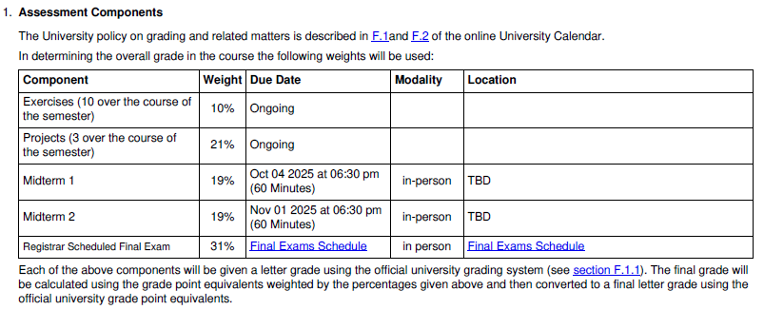
How You Will Be Evaluated
From the official course outline created by the course coordinator.
Reminder: if you have questions about the grading system then you need to contact:
  Michelle Cheatham: michelle.cheatham@ucalgary.ca
Tied to tutorial
‘Assignments’

Slide 16
Exercises (Course Coordinator)
Small problems provided to help you practice a specific programming construct
3 or so provided each week, but you only turn in one
Graded pass/fail on completion, not correctness (“did you give it an ‘honest’ attempt).
Once you turn something in, you can see others’ answers in D2L and discuss solutions with them

Slide 17
Projects/Assignments (Course Coordinator)
Larger, more open-ended problems for which you’ll need to pick and choose which ideas covered in lecture should be used
Two deliverables for each project:
implementation (i.e. python programming code)
reflection (blog post)

Slide 18
Cutoff (Course Coordinator)
A+ [97-100]
A [94-97)
A- [90-94)
B+ [87-90)
B [84-87)
B- [80-84)
C+ [67-70)
C [64-67)
C- [60-64)
D+ [57-60)
D [50-57)
F [0-50)

Slide 19
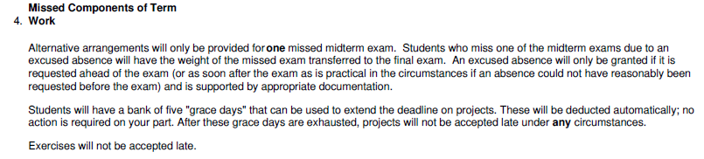
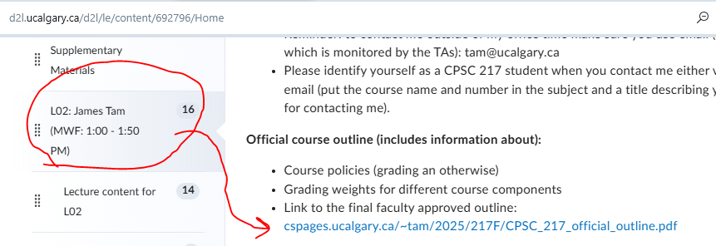
Special Grading Considerations (Course Coordinator)
(From another part of the course outline)
Shortcut link to the course outline:
Details of ‘5 days’
Each one extends a project deadline by 24 hours
This includes weekends and holidays
You do not need to provide a reason; they will be applied automatically

Slide 20
Misconduct Details (Course Coordinator)
All the work you submit must be your own (and content created by a generative AI tool is not your own) [JT: i.e. submitting someone else’s work may be treated as misconduct)
Any justification you give when asking for an exam deferral must be true. [JT: lying may be regarded as misconduct]

Slide 21
What Counts As Cheating (Course Coordinator)
Work on graded assignments (exercises and projects) individually
Do not share code outside of the designated discussion forums on D2L (in particular, do not post code on the Discord)
Do not use someone else’s account to look at the D2L discussions prior to submitting your own work
You can ask a generative AI tool for practice problems or to explain an error message, but do not ask it to write (or fix) code for you that you are submitting for a grade

Slide 22
Penalties For Misconduct (Course Coordinator)
Penalties for academic misconduct can range from a zero on the assignment all the way up to suspension or expulsion
Often, a first academic misconduct violation results in a zero on the assignment and a second offense results in an F in the course
Egregious violations can result in more severe penalties

Slide 23
The Programming Language For Assignments/Exercises
All evaluation components must be completed by writing a program using Python version 3.x (not version 2.x).
  Aim for 3.12 or newer
  During the first tutorial lab instructor will show you the lab environment and possibly assist you in this setup.
Installing python on your own device isn’t mandatory
The tool for writing your assignments using the python language is PyCharm
  Analogy (language vs. writing tool)
    The language used in this class is python, the language used for most of your university reports will be English.
    You may use a tool use as MS-Word to compose your reports while the tool supported in this class is PyCharm).
    You can use other tools (e.g. IDLE which comes from the group who developed python) but the Teaching Assistants will only use and directly support PyCharm.

Slide 24
Why Bother Learning How To Write A Computer Program (‘Programming’)
Generative A.I. (Artificial Intelligence) can produce original content including a computer program.
  Demonstration to illustrate.
Yes programming will be ‘on the exam’ (closed book so you can’t just ‘AI’ your answers) but there are other reasons.
  Another demonstration to illustrate.

Slide 25
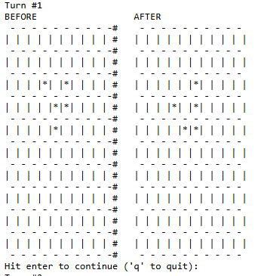
AI: You Asked For It?
Not really.
I asked for a program with text (output displayed).
I got one with a side order of graphics.

Slide 26
AI: Sometimes “The Answer” Is Far From The Best
Inefficient code.
Hard to understand.
More difficult to maintain.
  Making changes for the version may be hard.

Slide 27
How To Succeed In This Course: A Summary
Practice things yourself.
  Write and trace (‘read’ and determine how it executes) as much code as possible.
Make sure that you keep up with the material
  Don’t ‘fall behind’ more than 1 or 2 weeks at most.
  Keeping up means you not only study the material but try to apply (writing/tracing your own code).
Start working on things early
  Student: how hard could this possibly be?
  Reality:
      Harder than you think when you actually have to try it yourself.
      With programming sometimes you may truly know the material but something small and stupid is a major problem e.g. James Tam in CPSC 457 if(systemJobs>=value) { … } vs if(systemJob<=value) { … }

Slide 28
To Do For Next Week (Course Coordinator)
No tutorials this week, but before next week…
Apply for an IT account if you don’t have one yet https://itregport.ucalgary.ca/
(If you have an @ucalgary.ca email, then you already have an IT account)
If you want to work on your own laptop, install Python 3.12 and PyCharm (other IDEs are fine, but course personnel will only support PyCharm); your TA can help you with this on the first day of tutorial if you have trouble

