Slide 1
Composites, Sets: Part 5
A composite type that is a programming implementation of a mathematical set.

Slide 2
Sets: An Overview
When to use:
  You need a composite where elements are unique (not duplicates).
  Python: adding an element that already exists will fail (no error)
Another composite where the data can be accessed in different ways:
  individual elements,
  the entire collective entity { }
Mutable like a list: elements can change and elements are heterogeneous (don’t have to be the same type).
Associated operations are different from a list (likely because it’s not ordered) e.g. indexing, slicing, concatenation, repetition operations are not available.
Duplicates cannot be added.
  Attempting to do this via the ‘add’ method will not add the duplicate element.
  In this way it provides an automatic form of error prevention (should the data being modeled not allow for duplicates e.g. students in a university).

Slide 3
Set Operations
Name of the full online example: 2set_operations.py
Operations covered in the example: creating a set, iterating, adding, discarding, remove, popping, updating, iterating/creating a set dynamically, membership
Invalid set operations (not operations in mathematical sets): concatenation, repetition.

Slide 4
Creating A Set
Format:
    <name> = {<element1>, <element2>,... <element n>,}}
Example:
    cpsc231L01Set = {"Humid","Kin","Wai"}
Note: this is not the same syntax as creating a dictionary!
  Recall: This latter type has a key and pair for each element.
    cpsc231L01Dictionary = {1:"Humid",
    2:“Kin",
    3:"Wai"}
Creating an empty set:
  A function must be called: set()
    aSet = set() #aSet = {} Creates a dictionary not a set
    Note: the later examples occur after a set has already been created.

Slide 5
Adding New Elements
Creating elements one at a time.
    set1 = set()
    set1.add("1")
    set1.add(True)
    set1.add(2)
    set1.add(3)
    set1.add(3) #Duplicate not added.

Slide 6
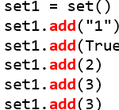
Iterating Through A Set
    for element in set1:
    print(element,end=" ")
Recall: it is not ordered

Slide 7

Discarding (A Single) Specified Element
    set2 = {"Red","Blue","Green"}
    set2.discard("Red")
  Nothing is discarded if the element is not already in the set
    set2.discard("Orchre")

Slide 8
Removing (A Single) Specified Element
    set2 = {"Red","Blue","Green"}
    set2.remove("Red")
  Runtime error results if the element is not already in the set
    set2.remove("Orcher jelly")

Slide 9



Popping (Discard) An Element (Randomly Determined)
    set2 = {"Red","Blue","Green"}
    set2.pop() #Run multiple times and different element removed

Slide 10
Discarding (A Single) Element
    set2 = {"Red","Blue","Green"}
    set2.discard("Orchre")
  Nothing is discarded if the element is not already in the set

Slide 11
Checking Length
    set2 = {"Red","Blue","Green"}
    len(set2)

Slide 12
Updating A Set (Adding One Set To Another)
    set1 = {"Red","Blue","Green"}
    set2 = {"Red","Pink","Purple"}
    print(set1,set2)
    set1.update(set2)
  Duplicates won’t be added.
  The second set (the method argument, in this case set2) will be unchanged.
    print(set1,set2)
X

Slide 13
Iterating And Dynamically Creating New Elements
    set3 = set()
    for i in range(0,4,1):
    set3.add(i)

Slide 14

Checking For Membership (Using The ‘In’ Operator)
    set3 = {1,2,3}
    if 1 in set3:
    print("1 in set3")

Slide 15
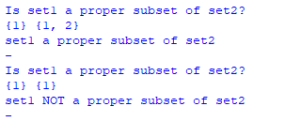
Terminology: Subset Vs. Proper Subset
A proper subset cannot be identical to superset.
Set1 = {1}, Set2 = {1}
  Set1 is a subset of Set2
  Set1 is NOT a proper subset of Set2 because they contain the same values.
Set1 = {1}, Set2 = {1,2}
  Set1 is a subset of Set2
  Set1 IS a proper subset of Set2 because the values they contain are not identical.

Slide 16
Why Use Python Sets?
When mathematical set operations are needed e.g. checking if one set is a superset of another.

Slide 17
Set Operations
Name of the full online example: 3set_comparisons.py
Comparisons covered in the example: intersection, union, symmetric difference, complement difference, subset, superset, equality, inequality, proper subset, proper superset, disjoint sets.

Slide 18
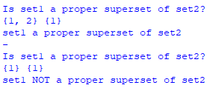
Terminology: Superset Vs. Proper Superset
A proper superset cannot be identical to subset.
Set1 = {1}, Set2 = {1}
  Set1 is a superset of Set2
  Set1 is NOT a proper subset of Set2 because they contain the same values.
Set1 = {1,2}, Set2 = {1}
  Set1 is a subset of Set2
  Set1 IS a proper subset of Set2 because the values they contain are not identical.

Slide 19
Other Set Comparisions
Equality
    if(set1 == set2):
Inequality (not equal)
    if(set1 != set2):
Disjoint (do not share an element)

Slide 20

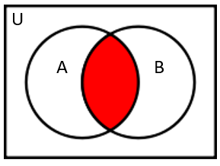

Intersection ($A⋂B$)
    set1 = {1}
    set2 = {1,2}
    set3 = set1 & set2
Image: Richard Zhao, Jonathan Hudson

Slide 21

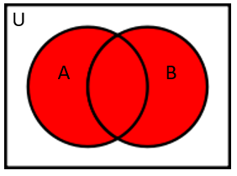

Union ($A∪B$)
    set1 = {1}
    set2 = {1,2}
    set3 = set1 | set2
Image: Richard Zhao, Jonathan Hudson

Slide 22

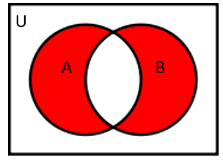

Symmetric Difference ($A△B$)
    The symmetric difference of Set1 and Set2 is the set of elements which are in either of Set1 and Set2, but not in their intersection.
    set1 = {1,2,3}
    set2 = {3,4}
    set3 = set1 ^ set2
Image: Richard Zhao, Jonathan Hudson

Slide 23

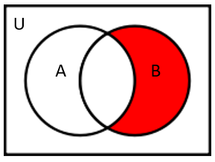

Complement Difference (B \ A
$A^{C}⋂$ B)
    Set subtraction
    set1 = {1,2,3}
    set2 = {3,4}
    set3 = set1 - set2
Image: Richard Zhao, Jonathan Hudson

Slide 24

Subset
    set1 = {1}
    set2 = {1,2}
    if(set1.issubset(set2)):
    OR
    if(set1 <= set2):

Slide 25

Superset
    set1 = {1}
    set2 = {1,2}
    if(set1.issuperset(set2)):
    OR
    if(set1 >= set2):

Slide 26

Equality
    set1 = {1}
    set2 = {1,2}
    if(set1 == set2):

Slide 27

Inequality
    set1 = {1}
    set2 = {1,2}
    if(set1 != set2):

Slide 28


Proper Subset
    set1 = {1}
    set2 = {1,2}
    if((set1 <= set2) and (set1 != set2)):
    OR
    if(set1 < set2):
    set1 = {1}
    set2 = {1}

Slide 29
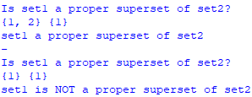
Proper Superset
    set1 = {1}
    set2 = {1,2}
    if((set1 >= set2) and (set1 != set2)):
    OR
    if(set1 > set2):
    set1 = {1}
    set2 = {1}

Slide 30

Disjoint Sets (Do Not Share Elements)
    set1 = {1,2}
    set2 = {2}
    if(set1.isdisjoint(set2)):
    set1 = {1,2}
    set2 = {3}

Slide 31
Review Of The Composites
  The simple types covered thus far (int, float, bool) are all immutable.
  The final composite type (classes) is significantly different so it’s covered separately (introduced at the end of the term and covered in depth in the next course).
 | String | List | Array | Dictionary | Tuple | Set
Method of creation | "" | [] | numpy.array() or np.array() | {} | () | {}
Can be heterogeneous? | No | Yes | No | Yes | Yes | Yes
Ordered and index able? | Yes | Yes | Yes | No | Yes | No
Mutable¹ | No | Yes | Yes | Yes | No | Yes
Duplicates allowed? | Yes | Yes | Yes | Keys=no, values=yes | Yes | No

Slide 32
After This Section You Should Now Know
Set operations: creating a set, iterating, adding, discarding, remove, popping, updating, checking for length, iterating/creating a set dynamically, membership
Operations from mathematical sets implemented in python: intersection, union, symmetric difference, complement difference, subset, superset, equality, inequality, proper subset, proper superset, disjoint sets.
Differences between the composite types covered thus far:
  How to create (distinguish) between strings, lists, dictionaries, tuples, sets and arrays.
  Which ones are mutable and which ones are immutable (you should know this for non-composites as well).
  Which types are ordinal (elements have an ordered) and which ones can be indexed.

Slide 33
After This Section You Should Now Know (2)
Differences between the composite types covered thus far (continued):
  Which ones allow for duplicate elements.
  Which ones can be heterogeneous (elements don’t have to all be of the same type).

Slide 34
Copyright Notification
Unless otherwise indicated, all images in this presentation were provided courtesy of James Tam.

