Slide 1
Composites: Lists
Some list methods
When to use multi-dimensional lists
Creating 2D lists
How to access a 2D list and its parts
Basic 2D list operations: display, accessing parts, copying the list
Using named constants to stay within list bounds
Dynamically creating 2D lists with append.

Slide 2
What You Should Already Know
The following notes were already covered in the looping/repetition section.
They are included for your reference (and if needed to remind you of what you need to review).
We won’t be covering them again in class but instead we will immediately proceed to the next section.

Slide 3
New Type Of Variable: List
Cover after midterm
This is only a very basic introduction.
  For the keeners: more details will come later.
String: consists of individual elements that can be accessed via an index (zero to length of the string minus one) s1 = "Jim tam"
List: need not consist only of characters nor does it have to be homogeneous (e.g. all integers, all Booleans)
  i.e. Python lists can be heterogeneous
  list1 = [1, "a",True]
0
1
2
3
4
5
6
Jim tam
0
1
2
1 a True

Slide 4
Creating A List (Fixed Size)
Cover after midterm
Element 0
Element 1
Element n-1
0
1
2
3
4
1 These 4 names (Borg, Klingon, Hirogin, Jem’hadar) © are CBS
Format (‘n’ element list):
<list_name> = [<value 1>, <value 2>, ... <value n>]
Example:
#List with 5 elements, index ranges from 0 to (5-1)
percentages = [50.0, 100.0, 78.5, 99.9, 65.1]
Other Examples:
letters = ["A", "B", "A"]
names = ["The Borg", "Klingon ", "Hirogin", "Jem’hadar"]

Slide 5

Accessing/Displaying A List
Cover after midterm
Because a list is composite you can access the entire list or individual elements.
  percentages = [50.0, 100.0, 78.5, 99.9, 65.1]
Name of the list accesses the whole list
  print(percentages)
Name of the list and an index “[index]”accesses an element
  print(percentages[1])
List
Elements

Slide 6
Basic List Operations
Cover after midterm
Name of the online example: 5modifying_displaying_list
Common list operations:
  Create a new fixed size list:
    aList = [2,6,2]
  Displaying entire list:
    i = 0
    size = len(aList)
    while(i < size): #i takes on values from 0 – (size-1)
    print(aList[i], end=" ")
    i = i + 1
  Modifying a single element
    aList[size-1] = 3
  Modifying all elements
    while(i < size): #i takes on values from 0 – (size-1)
    aList[i] = aList[i] * 2
    i = i + 1

Slide 7
Additional List Operations
Cover after midterm
Name of the online example: 6adding_2_end_modify_select_while
  aList = ["A","a","z","B"]
  New list operations:
  Adding new elements: adding new elements to end (append method):
    aList.append(ch)
  Modifying select elements (based upon a condition):
    i = 0
    size = len(aList)
    while(i < size): #A=ASCII 65, Z=90
    if((aList[i]>="A") and (aList[i]<="Z")):
    aList[i] = aList[i] + "!" #Applies to caps only
    i = i + 1

Slide 8
For Loops Can Be Used To Iterate Lists
Cover after midterm
Name of the online example: 7adding_2_select_for
  aList = ["A","a","z","B"]
  Iterating list using a for-loop:
    for ch in aList:
    print(ch)

Slide 9
Types Of Variables
How lists fit into what you have learned
A string or list can be decomposed into individual characters.
Python variables
Simple
(atomic)
2. Aggregate
(composite)
integer
boolean
float
Example Simple type
A variable containing the number 707 can’t be meaningfully decomposed into parts
Lists
Tuples
Strings
Notes:
Determine what's a reference vs. an actual composite type and talk about the issues e.g., objects are actually references to objects

Slide 10
Some Topics (Sort Of) Covered

Slide 11
Basic List Operations
Common list operations:
  Create a new fixed size list:
    aList = [2,6,2]
  Displaying entire list:
    i = 0
    size = len(aList)
    while(i < size): #i takes on values from 0 – (size-1)
    print(aList[i], end=" ")
    i = i + 1
  Modifying a single element
    aList[size-1] = 3
  Modifying all elements
    while(i < size): #i takes on values from 0 – (size-1)
    aList[i] = aList[i] * 2
    i = i + 1
  Adding new elements: adding new elements to end (append method):
    aList.append(ch)

Slide 12
Negative Indices
Although Python allows for negative indices (-1 last element, -2 second last…-<size>) this is unusual and this approach is not allowed in other languages.
So unless otherwise told your index should be a positive integer ranging from <zero> to <list size – 1>
Don’t use negative indices.

Slide 13

Creating A Variable Sized List: Looping
You already know: create a fixed size all at once.
aList = [1,2,3]
You can use a loop and append new elements onto the end of the list.
Name of the full example: 1list_creation_loop_N_append.py
SIZE = 5
aList = [] #Create new list
i = 0
while(i<SIZE):
aList.append(i)
print(aList[i],end=" ")
i = i + 1
aList = [] #Create new list
for i in range(0,SIZE,1):
aList.append(i)
print(aList[i],end=" ")

Slide 14
Creating A Variable Sized List: Repetition Operator
Create a list of any size but it is initialized all with the same value.
Name of the full example: 2list_creation_repetition.py
SIZE = 5
aList = [0]*SIZE
print(aList)
aList[0] = 7
aList[SIZE-1]= 13
print(aList)

Slide 15
Some List Methods
Methods we cover in this version of CPSC 217/231:
  Example starting list: aList = [1,2,3]
  (Already covered), add to the end: append
  Insert: add element at the specified index:
    insert(<index>,<element>)
    aList.insert(0,"first")
  Extend: add another list to the end of another list.
    extend(<list>))
    aList.append(["second","third"])
Here’s some online documentation on these and other list methods:
  https://www.w3schools.com/python/python_lists_methods.asp
  If you click ‘next’ at the above link it also provides basic multiple choice questions to evaluate your knowledge (keep in mind some questions are really simple).

Slide 16
The “Slicing-Operator” (Also Works With Strings)
The “square brackets” with a single integer accesses/modifies a single element.
A range can be specified to retrieve multiple elements into a new list “sub list”
Format:
    <new sub list> = <existing list>[<start index>:<end index>]
Example:
    subList1 = aList[1:3]
Include element
Exclude element

Slide 17

Examples Of List Slicing
Name of the online example: 3listSlicing
    aList = ["a","b","c","d","e","f"]
    subList1 = aList[1:3]
    print(subList1)
    subList2 = aList[:3]
    print(subList2)
    subList3 = aList[4:]
    print(subList3)
    subList4 = aList[:]
    print(subList4)
0
1
2
3
4
5

Slide 18
Common List Operations
They have already been covered previously e.g. creating new empty list, iterating a list, changing/accessing elements etc.
You can refer to your notes when lists were first introduced (looping/repetition).

Slide 19

Creating A New List By Copying An Existing List
This is not a comprehensive list
Assume we have this list:
    list1 = [1,2,3]
  Method 1 (python specific): Utilize one of the prebuilt python methods for copying a list (if you don’t know which one to use then use “deep copy).
  Method 2 (python specific): write the code yourself using a FOR-loop
      for element in list1:
      list2.append(element)
  Method 3(language independent): write the code yourself using a WHILE-loop.
      i = 0
      List2 = []
      size = len(list1)
      while(i<size):
      list2.append(list1[i])
      i = i + 1
(Hudson and Zhao)
JT: ‘names’ is a list

Slide 20
Creating A New List Via Copying (Python Specific)
Name of the full example: 4list_creation_copying.py
  original = [1,2,3]
  copy = [i for i in original]
  print(original,copy)

Slide 21
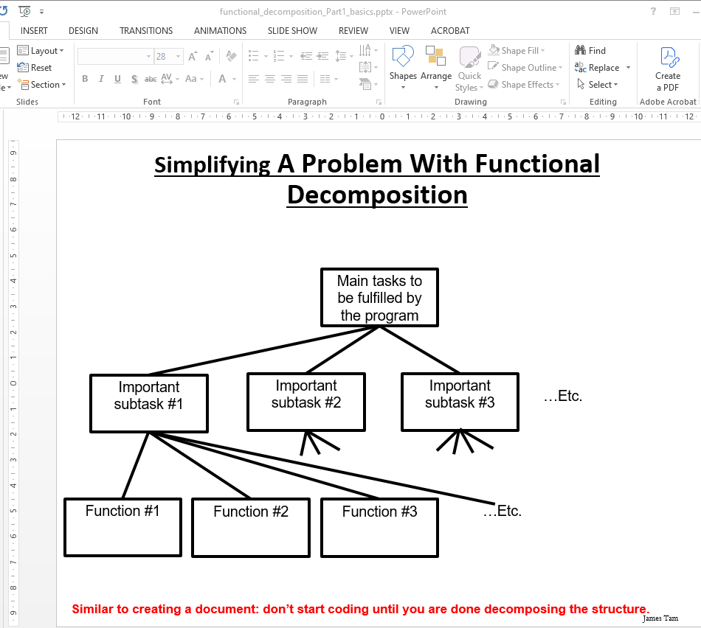
Deciphering The Previous Example
  original = [1,2,3]
  copy = [i for i in original]
  print(original,copy)
Remember what I taught you at the beginning of the term, when faced with a complex and/or big problem break it into parts.
Example: decomposing your program into parts, each part will be implemented with one or more functions.
Tam’s reaction when first seeing this: WTH?

Slide 22
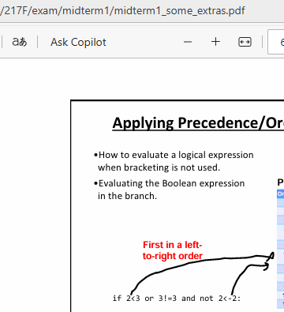
Reminder: Past Examples Of Decomposition
Midterm I help materials: tackle a complex Boolean expression by examining only a part at a time.

Slide 23
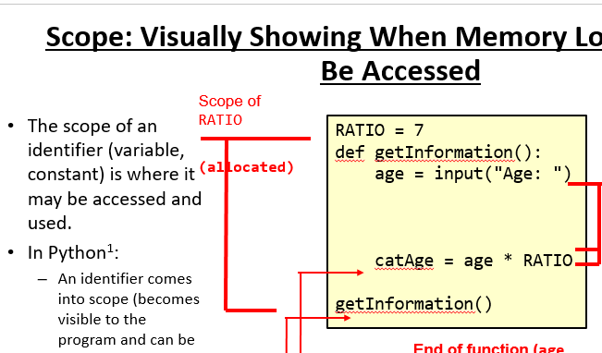
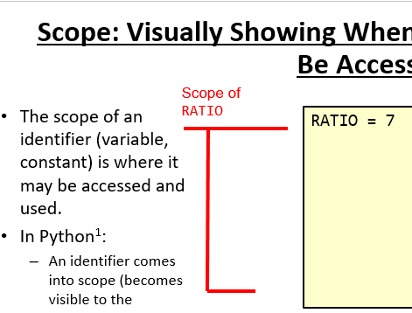
Reminder: Past Examples Of Decomposition (2)
Functional decomposition: scope
Original: Huh???!!!
Simplified: You already know this

Slide 24
Back To The WTH Code
copy = [i for i in original]
for i in original
1) You should know what’s happening: from the repetition section: for-loops iterating a list
i for i in original
2) Now that you have been reminded as to what’s happening in the code above #1 we explain in class what this is doing
copy = [i for i in original]
3) Finally the result of the expression from #2 above is assigned to ‘copy’

Slide 25
But What Do I Do When Tam Isn’t Around In The Future?
Rejoice and dance in the streets! (Hallelujah!)
(Just kidding folks!)

Slide 26
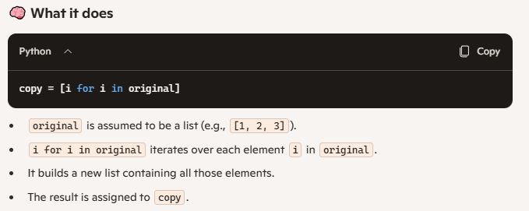
Searching The Web Directly May Be Challenging
It may be okay if you have a search term but in this case you just have a concept (non-CPSC courses) or code (in this example).
Here’s where online A.I. tools ‘may’ help:
  Bing Co-pilot: “explain what this python code is doing copy = [i for i in original]”

Slide 27
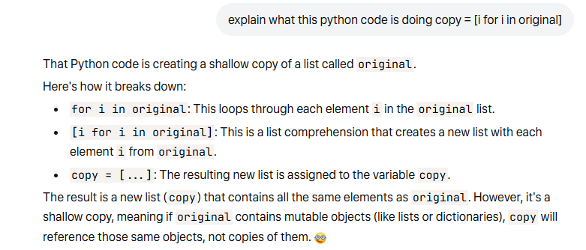
Answer From An Alternative ‘Intelligence’
Facebook’s Meta:
JT’s caution: Just like web searches confirm your information:
  Verify by looking at a good source: textbook published by a reputable publisher.
  Writing your own code and testing the results.

Slide 28
Review: Passing Parameters Which Aren’t Lists
A copy of the data stored in the variable is passed into the function.
For previous examples refer to functional decomposition examples where simple types were passed as function parameters: bool, int, float
Changes made to the parameters are only made to local variables.
    def fun(num):
    num = 21 #Only num local to fun changed
    num = 12
    fun(num) #Still 12
The changed local variables must have their values returned back to the caller in order to be retained.

Slide 29
More Details On Lists
With the simple variable types (integer, float, boolean) you can think of as a single memory location.
  E.g.
    age = 37
    cool = False
Declaring a list variable will result in two memory locations allocated in memory.
  One location is for the list itself (“The multi-suite building”)
  Another location “refers to” or contains the address of the building.
age
37
cool
False
123
123 Sesame St.

Slide 30


Example: Illustrating List References
Name of the example program: 5listReferences.py
  num = 123
  list1 = [1,2,3]
  list2 = list1
  print(list1)
  print(list2)
  list1[0] = 888
  list2[2] = 777
  print(list1)
  print(list2)

Slide 31
New Term: Shallow Copy
Shallow copy: the address of a list (or some of the composite types) is copied rather than the data (elements of a list).
  Result: two references containing the address of (references to) a single list.
  Previous example:
    list2 = list1
The shallow copy allows access to the list so it may be changed by either reference to it (in this example it’s ‘list1’or ‘list2’).
Copy contents (address not a list) from ‘list1’ into ‘list2’
123
123 Sesame St.
123 Sesame St.

Slide 32
One Part Of The Previous Example Was Actually Unneeded
When list is ‘passed’ as a parameter…
…returning the list is likely not needed
More details on ‘why’ coming up shortly!
def read(classGrades):
: :
return(classGrades, average)

Slide 33
Passing References (Lists)
Recall: A list variable is actually just a reference to a list (~a paper with an address written on it).
  aList = [1,2,3]
A copy of the address is passed into the function (~copying what’s on the paper, the address).
  def fun(copyList):
  copyList[0] = 10
The local reference ‘refers’ to the original list (use the paper to go to the specified address).
  In essence: parameter passing with lists is a shallow copy.
Reference to the list (contains the memory address)
The list (no name just a location in memory)

Slide 34
Passing A List As A Parameter
A reference to the list is passed, in the function a local variable which is another reference can allow access to the list.
Example:
  def read(classGrades):
  ...
  for i in range (0, CLASS_SIZE, 1):
  temp = i + 1
  print("Enter grade for student no.", temp, ":")
  classGrades[i] = float(input (">"))
  total = total + classGrades[i]
  def start():
  classGrades = initialize()
  read(classGrades)

Slide 35
Example: Passing Lists As Parameters
Name of the example program: 6listParametersPassAddress
Learning : a list parameter allows changes to the original list (persist even after the function ends).
  def fun1(aListCopy):
  aListCopy[0] = aListCopy[0] * 2
  aListCopy[1] = aListCopy[1] * 2
  return(aListCopy)
  def fun2(aListCopy):
  aListCopy[0] = aListCopy[0] * 2
  aListCopy[1] = aListCopy[1] * 2

Slide 36

Example: Passing Lists As Parameters (2)
  def start():
  aList = [2,4]
  print("Original list in start() before function
  calls:\t", end="")
  print(aList)
  aList = fun1(aList)
  print("Original list in start() after calling fun1():\t",
  end="")
  print(aList)
  fun2(aList)
  print("Original list in start() after calling fun2():\t",
  end="")
  print(aList)
  start()

Slide 37
When To Use Lists Of Different Dimensions
It’s determined by the data – the number of categories of information determines the number of dimensions to use.
Examples:
(1D list)
  Tracking grades for a class (previous example)
  Each cell contains the grade for a student i.e., grades[i]
  There is one dimension that specifies which student’s grades are being accessed
(2D list)
  Expanded grades program (table: grades for multiple lectures)
  Again there is one dimension that specifies which student’s grades are being accessed
  The other dimension can be used to specify the lecture section
One dimension (which student)

Slide 38
When To Use Lists Of Different Dimensions (2)
(2D list continued)
Student
Lecture section
 | First student | Second student | Third student | …
L01
L02
L03
L04
L05
:
L0N

Slide 39
When To Use Lists Of Different Dimensions (3)
Important:
List elements are specified in the order of [row] [column]
Specifying only a single set of brackets specifies the row
Columns (e.g. grades)
[0]
[1]
[2]
[3]
[0]
L01
[1]
L02
[2]
L03
Rows (e.g. lecture section)
[3]
L04
[4]
L05
[5]
L06
[6]
L07
(2D list continued)
Notice that each row is merely a 1D list
(A 2D list is a list containing rows of 1D lists)

Slide 40
Creating And Initializing A Multi-Dimensional List In Python (Fixed Size During Creation)
General structure
<list_name> = [ [<value 1>, <value 2>, ... <value n>],
[<value 1>, <value 2>, ... <value n>],
: : :
: : :
[<value 1>, <value 2>, ... <value n>] ]
Rows
Columns

Slide 41

Creating And Initializing A Multi-Dimensional List In Python (2): Fixed Size During Creation
Name of the example program: 7display2DList.py
Learning: creating, displaying a fixed size 2D list
  table = [ [0, 0, 0],
  [1, 1, 1],
  [2, 2, 2],
  [3, 3, 3]]
  for r in range (0, 4, 1):
  print (table[r]) #Each call to print displays a 1D list
  for r in range (0,4,1):
  for c in range (0,3,1):
  print(table[r][c], end="")
  print()
  print(table[2][0]) #Displays 2 not 0
c=0 c=1 c=2
r = 0
r = 1
r = 2
r = 3
#Displays list element
0 1 2 (col)
r = 0
r = 1
r = 2
r = 3

Slide 42
Creating 2D Lists Via The Repetition Operator
Name of the example program: 8creatingListViaRepetition.py
Learning:
  Creating a variable sized 2D list using the repetition operator and the append method.
  The 2D list is created by creating a 1D list and appending the 1D list to the end of the 2D list.
MAX_COLUMNS = 5
MAX_ROWS = 3
ELEMENT = "*"
aList = []
r = 0
while(r < MAX_ROWS):
tempList = [ELEMENT] * MAX_COLUMNS
aList.append(tempList)
r = r + 1

Slide 43
Using The Repetition Operator On 1D Lists
You have just seen how the repetition operator can create a 1D list (one set of square brackets).
Example:
    list2 = [0] * 4
    print(list2)
Using a repetition operator on an existing 1D list merely repeats instances of that 1D list.
  Consider: list2 = [0] * 4 #Repeats list with 1 element x 4
  Examples:
    list1= [1,2,3]
    list2 = [0] * 4
    list3 = list1 * 5 #List with 15 elements: 3 elements x 5
    list4 = list2 * 2 #List with 8 elements: 4 elements x 2
    print(len(list3),len(list4))
    print(list3)
    print(list4)

Slide 44
How To Avoid Overflowing 2D Lists
For 231
Employ named constants
Recall that the previous example declared 2 named constants.
MAX_COLUMNS = 5
MAX_ROWS = 3
Control access to list elements using these constants.
r = 0
while(r < MAX_ROWS):
c = 0
while(c < MAX_COLUMNS):
print(aList[r][c], end = "")
c = c + 1
print()
r = r + 1

Slide 45
Creating And Initializing A Multi-Dimensional List In Python: Dynamic Creation
General structure (Using loops):
Create a variable that refers to an empty list
Create list:
  One loop (outer loop) traverses the rows.
  Each iteration of the outer loop creates a new 1D list (empty at start)
  Then the inner loop traverses the elements of the newly created 1D list creating and initializing each element in a fashion similar to how a single 1D list was created and initialized (add to end)
Repeat the process for each row in the list
List ref
[]
c=0
c=1
c=2
c=3
r = 0
Row
r = 1
Row
s
Row
Etc.
  aGrid = []
  for r in range (0, 3, 1):
  aGrid.append ([])
  for c in range (0, 3, 1):
  aValue = <Some source>
  aGrid[r].append(aValue)
Notes:
First for loop creates each row of the list from column 0 to COLUMNS-1 with each element set to zero
The second for loop determines how many rows that the list will contain

Slide 46
Repeating Just The Steps In The Code Creating The List
Recall ‘append’ is unique to a list. Append won’t work if for something other than a list but for a list an empty row can have new elements appended.
num = 123
num.append(4)
Create a variable that refers to an empty list
  aGrid = []
Successively create rows in the list
  for r in range (0,noRows,1):
  aGrid.append ([])
Each row is a 1D list, add elements to the end of the 1D list (empty list needed in #2 so that the append method can be called to add elements to the end).
  for c in range (0,noColumns,1):
  aGrid[r].append("*")
  The [r] part of specifies which row the loop will add elements on the end. aGrid[r].append("*")

Slide 47
Example 2D List Program: A Variable Sized 2D List (Dynamic)
Name of the example program: 5variableSize2DList.py
aGrid = []
noRows = int(input("Number rows: "))
noColumns = int(input("Number columns: "))
#Create list
for r in range (0,noRows,1):
aGrid.append ([]) #Create empty row, add to list
for c in range (0,noColumns,1):
element = input("Type in a single character: ")
aGrid[r].append(element) #Add to the end of new row
#Display list
for r in range (0,noRows,1):
for c in range (0,noColumns,1):
print(aGrid[r][c], end="")
print()
Notes:
012
123

Slide 48
2D Lists: Using Append
Final JT hint: Make sure you apply the right operation on the right type of variable.
  table = [ [0, 0, 0],
  [1, 1, 1],
  [2, 2, 2],
  [3, 3, 3]]
  table.append([2,1,7]) #Where was the append occurring?
  print(table)
  table[3].append(3) #Where was the append occurring?
  print(table)
  #What element is the append applied to?
  table[2][1].append(888)
  Hint: add the following before the last instruction
  print(table[2][1])
  print(type(table[2][1]))

Slide 49
Lists: Final Notes
Reminder: python list elements need not be all the same type.
Python 2D lists need not be rectangular.
    aList = [[1,True,"hi"],
    [1,2.3],
    []]
Row index 0: int, bool, string
Row index 1: int, float
Row index 2: empty list

Slide 50
After This Section You Should Now Know
When to use lists of different dimensions.
Basic operations on a 2D list.
How to create a 2D list: fixed size and a variable sized list by using the repetition operator.
How to access a 2D list: the whole list, rows in the list and individual elements.
The use of a named constant to ensure that list boundaries are adhered to.
The ability to dynamically creating 2D lists using the append function for both the rows and columns.

Slide 51
Copyright Notification
Unless otherwise indicated, all images in this presentation were provided courtesy of James Tam.

