Slide 1
Composites, Dictionaries: Part 3
FYI, Part 2 covered arrays which will not be included in the required part of 217.
A composite type that employs a key and data value pair to allow for more efficient retrievals of elements.

Slide 2
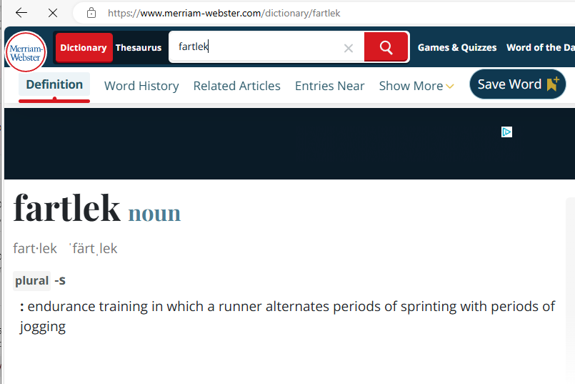
Real Life Dictionary
When using a dictionary one “looks up” the word in the dictionary.
The word provides the search parameter in order to retrieve additional details.
Lookup key
Lookup value

Slide 3
Real Life: Other Cases Of Looking Values Using A Key
Workers: using the Social Insurance Number (key) to find additional information about the person (data value).
Students: using the student identification number (key) to find student information such as: courses, grades, contact information… (data values).
ISBN: the unique identifier for a book (key) to find details about the book such as: title, author, publisher… (data values).

Slide 4
Python Dictionaries
Similar to lists, strings and arrays, a dictionary is a composite type that can be decomposed into multiple parts.
The curly braces specifies a dictionary.
Each element needs a pair
Key : data
Key: an integer that uniquely identifies the element (don’t try to repeat keys).
Data: the information that is stored for the element.
Example: 111: Jim Tam, undeclared
111: the lookup key (in this case the student identification number)
Jim Tam, undeclared: the data value for the element (in this case it’s the information about the student).
Individual elements are accessed via key not as a index from zero to (size-1).

Slide 5
Creating A Dictionary
Format:
<dictionary name> = {<key1>:<value1>, <key2>:<value2>,
<key3>:<value3>,... <key^{n}>:<value^{n}>}
Example:
students = {111:"James Tam,business,computer science",
250:"Jim Tam(Ace student,undeclared",
117:"Scott Bruce,business"}
aDictionary = {} #A reference to an empty dictionary
Important details:
Key: needs to be one: integer, bool, string, float – avoid the latter even though it meets syntax requirements because of precision issues).
Keys must be unique, repeating a key overwrites the previous value.
Values aren’t limited.

Slide 6
Accessing Dictionary Elements
Single element
Format:
<dictionary>[<key>]
Example:
print(students[studentID])
All elements
Format:
for <key> in <dictionary>:
students[<key>]
Example:
for aStudentID in students:
print(aStudentID,students[aStudentID])

Slide 7
Dictionary Basics: Complete Example
Name of the complete online example: 1dictonary_basics.py
students = {111:"James Tam,business,computer science",
250:"Jim Tam(Ace student,undeclared",
117:"Scott Bruce,business"}
studentID = 111
print(students[studentID])
print("Number of students %d" %(len(students)))
for aStudentID in students: #aStudentID=key
print("\t%d: %s" %(aStudentID,students[aStudentID]))
Unless the keys are a fixed ascending/descending sequence a while-loop can't be used. Dictionary values are retrieved through the keys not through an index from zero to (size-1)

Slide 8


Other Dictionary Operations
Many list operations are possible with dictionaries
Review of operations you just saw:
Creating a new dictionary
Access single element
Stepping through all elements
Getting a key for an element (needed for an assignment)
Changing elements (to be covered in the next example)
Add/creating new element (no such key exists).
Update/modifying an existing element (key already exists).
Creating a dictionary dynamically via a loop (needed for an assignment).
Deleting elements.
Checking for membership in the dictionary.
Clearing the dictionary (deleting the whole thing).

Slide 9
Other Dictionary Operations: Complete Example
Name of the full online example: 2creating_modifying_elements.py
scientists = {}
i = 1
size = 4
#3rd operation: Create dictionary dynamically via a loop
while(i <= size):
scientists[i] = "Scientist #" + str(i)
i = i + 1
size = size + 1
#1st operation: Add/create new element
scientists[size] = "Scientist #" + str(size)
#2nd operation: Change/modify existing element (key = 2)
scientists[2] = "James Tam"

Slide 10
Other Dictionary Operations: Complete Example (2)
#New dictionary operation #4: Deleting element by key
del scientists[1]
#5th dictionary operation: Checking for membership
key = 1
if key in scientists:
print("Scientist with ID %d exists" %(key))
else:
print("No such scientist with ID %d" %(key))
key = 2
if key in scientists:
print("Scientist with ID %d exists" %(key))
else:
print("No such scientist with ID %d" %(key))
#6th dictionary operation: Clearing the whole dictionary
scientists.clear()

Slide 11
Dictionary Key-Related Functions
Operation | Examples (Zhao/Hudson) | Description (students=dictionary)
List | list(students.keys()) | List all keys in dictionary
Sort | sorted(students.keys()) | Sort the dictionary by the keys
Keys | students.keys() | Get all the keys in the dictionary
Items | students.items() | Get all the items (key:values) in the dictionary
Functions already covered
Operation | Examples where it was covered
Access via key | print("\t%d: %s" %(aStudentID,students[aStudentID]))
Membership | if key in scientists:
Length | print("Number of students %d" %(len(students)))
Clear | scientists.clear()
Add / Create | scientists[size] = "Scientist #" + str(size)
Delete | del scientists[1]

Slide 12
When Can Dictionaries Be Used?
Composite data needs to be represented but one field uniquely identifies the element (it becomes the key).
Aforementioned examples: SIN, student identification number etc.
The key is how the dictionary element is retrieved.

Slide 13
Why Use Dictionaries Over Lists?
Efficiency (quickly) of accessing elements.
You will learn more about evaluating efficiency of your programs in CPSC 331 and in CPSC 413.
To quickly access list elements it’s typically sorted.
But the sorting operation takes time.
And time is still required to access elements with a sorted list.
Dictionaries use the programming technique called ‘hashing’ to allow for a fast lookup of the data values.
You will learn details about hashing algorithms in CPSC 331 but briefly the hashing maps the key to an index via the hashing function.
Bottom line: rather than the lookup time be affected by the size of the list (without hashing) the lookup time is a constant value.

Slide 14
Implementation Of Dictionaries In Memory
Similar to lists, creating a dictionary allocates a reference in memory.
These are references to an empty list and an empty dictionary respectively.
aList = []
aDictionary = []
Consequently “passing a dictionary” as a function parameter is actually passing a reference to the dictionary (address of the dictionary).

Slide 15
After This Section You Should Now Know
How to create a new dictionary using the methods covered.
Valid data types for the key and data value parts of a dictionary element.
How to access keys and data values using the methods covered.
How to iterate through the elements in a dictionary.
Other common operation: adding new elements, checking for membership, clearing dictionary, deleting elements, modifying existing elements.
How changes to dictionaries made inside a function will change the actual dictionary because references are employed.
When and why to use dictionaries

Slide 16
Copyright Notification
Unless otherwise indicated, all images in this presentation were provided courtesy of James Tam.

