Slide 1
Composites, Arrays: Part 3
This is a new composite type similar to a python list but with some unique advantages.

Slide 2
Summary Of Some List Operations & Methods
Name of the full online example: 1list_operations.py
Operation/method | Example
Create a fixed size list | aList = [1.5,True,"tam",123,"james tam"]
Checking for an occurrence | if "tam" in aList:
Determining length | len(aList)
Adding single element to the end | aList.append("another tam")
Extending with another list | aList.extend(["tam1","tam2"])
Arranging in ascending order | aList.sort()
Reversing order | aList.reverse()
Counting instances of an element | aList.count(1))

Slide 3
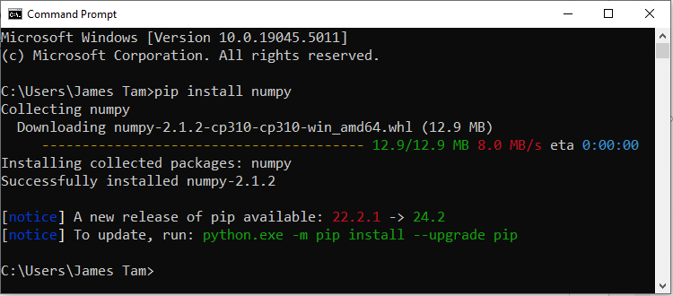
Using Arrays In Python: Need ‘Numpy’
Step 1: You need to install the numpy library/module on your computer.
Windows (with administrator access): Run the ‘cmd’ command and type “pip install numpy” which downloads/installs the code.
JT’s note: if you want to install other python ‘packages’ (modules/libraries) that don’t come with the python.org install you can also use ‘pip’.
Install this code at your own peril however (not mandatory for this course).

Slide 4
Using Arrays In Python: Need ‘Numpy’ (2)
MAC: you can search online for resources that show how to do the equivalent for your operating system.
Here’s the numpy.org support link (it’s not as straight-forward as others but it appears to be ‘official’): https://numpy.org/install/
CPSC Linux labs: this step is not needed!
PyCharm: A resource specifically covering installing numpy for this development environment:
https://d2l.ucalgary.ca/d2l/le/content/618004/viewContent/6705362/View
This resource doesn’t apply if you run python programs using another tool but it should work regardless of operating system (as long as you have PyCharm installed and running on the device).

Slide 5
Using Arrays In Python
Step 2: Now that the library is installed on the device where you are creating/running your python programs you can import it just like any other library/module.
import numpy as np
After the above import anytime you refer to ‘np’, python will ‘know’ you actually mean ‘numpy’.
If you just type import numpy
Then instead of typing ‘np’ then you have to type ‘numpy’
Comparing the different imports:
Longer full name for library/module
Your alias/nickname/shortcut
anArray = np.array([1,2.5])
anArray = numpy.array([1,2.5])

Slide 6
Basic Array Operations
Name of the full online example: 2array_basics.py
import numpy as np
anArray = np.array([1,2.5,True,"hi"])
print("\nDisplay each array element")
anArray = np.append(anArray,"new end")
for element in anArray:
print(element, end=" ") #Looks like a regular list
print("Display the type of information stored in each array
element")
for element in anArray:
print(type(element), end=" ") #Everything is a string
The type of array elements will all be the same (either float or string):
All floats: If all elements are numeric (float and/or int)
All strings: If any element is a string.

Slide 7
Advantages Of Numpy Arrays Over Python Lists
Efficiency in the storage of information (compact) for arrays as compared to lists.
Ease of use:
Numeric operations:
Array: define a python to perform that operation on the array once and that operation will be applied on each element.
Pseudo code example: Python multiply this list by two.
List: define the code to manually step through each element (using a loop or the equivalent) and apply that operation to each element.
Pseudo code example with a list with ‘n’ (n>=1) for multiply by two:
<list element index zero x 2>,
<list element index one x 2>,
...
list element index ‘n’ x 2>
Non-numeric operations (e.g. slicing) may also be implemented with greater ease with arrays vs. list.

Slide 8
Comparing More Advanced Operations
Name of the full online examples:
Array: 3Aarray_advanced.py
List: 3Bcorresponding_list_advanced.py

Slide 9
Numeric Operation: Double Value Of Elements
#Python list
aList = [[2,2,2],
[3,3,3]]
numRows = len(aList)
numColumns = len(aList[0])
r = 0
#Traverse each row
while(r<numRows):
c = 0
#Traverse each column
while(c<numColumns):
aList[r][c] =
aList[r][c]*2
c = c + 1
r = r + 1
print(aList)
#Numpy array
anArray = np.array([[2,2,2],
[3,3,3]])
anArray = anArray * 2

Slide 10
Numeric Operation: Slicing Into A Copy
#Python list
aList = [["a","b","c","d"],
["e","f","g","h"],
["i","j","k","l"],
["m","n","p","p"]]
tempList = []
for tempRow in aList[1:3]:
""""Each iteration slices
a row: row index 1,
row index 2 sliced
For that row slice off
elements at index:0,1 that
becomes a new row in
tempList
"""
tempList.append(
tempRow[0:2])
#Numpy array
anArray = np.array([["a","b","c","d"],
["e","f","g","h"],
["i","j","k","l"],
["m","n","p","p"]])
""""Display only 2nd,3rd rows and the 1st and 2nd columns of those rows
""""
print(anArray[1:3,0:2])
Access a row at a time
"b","c"
Parts of row sliced
The part of the row to slice off
"b","c"

Slide 11
After This Section You Should Now Know
How install and import the package (module/library) numpy
Array vs list operations
Creating a new array.
Display array elements.
Appending new elements onto the end.
Performing numeric operations on each element.
Performing a non-numeric operation (slicing) on each element.
How to determine the type of data stored in all of the elements in an array.
Advantages of an array implementation over one employing lists.

Slide 12
Copyright Notification
Unless otherwise indicated, all images in this presentation were provided courtesy of James Tam.

