Slide 1
Representations
What you should know:
Base^{(# digits)} = number of combinations
Examples:
Decimal:
1 decimal digit = 10 combinations (0-9)
2 decimal digits = 100 combinations (0-99)
Etc.
Binary
1 binary digit = 2 combinations (0 to 1)
2 binary digits = 4 combinations (00 to 11)
Etc.
N^{ary} base e.g. n = 8 (octal), 16 (hexadecimal) etc.
1 digit = N combinations (0 to N-1)
2 digits = N x N combinations (0 to (NxN)-1)
3 digits = N x N x N combinations (0 to (NxNxN)-1)

Slide 2
Applying Precedence/Order Of Operation
Name of the complete example: 1determingOrder.py

Slide 3
‘Classic’ Questions That Apply These Concepts
Generic question:
Given you have 9 values to represent what is the minimum number of bits needed to store all n values.
Tam question: The Borg¹ alphabet consists 66 symbols. How many bits would the Bynars¹ (0 to (NxN)-1) need to encode each letter?
Try to work these out on your own (answer at the end of these notes).
1 © Paramount

Slide 4
Applying Precedence/Order Of Operation
How to evaluate a logical expression when bracketing is not used.¹
Example:
if True or False and not True:
print("Expression true")
else:
print("Expression false")
1 JT’s comment: you should always use brackets to make things clear but you may be required to trace the code of another person does not.
Notes:
4

Slide 5
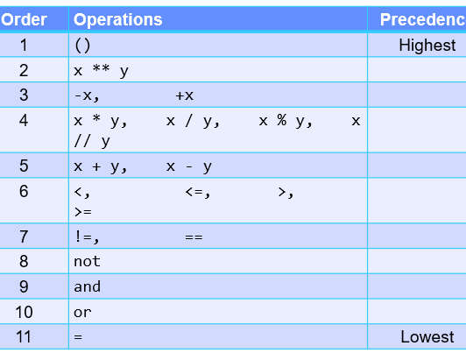
Applying Precedence/Order Of Operation
How to evaluate a logical expression when bracketing is not used.
Evaluating the Boolean expression:
True or False and not True
Precedence rules
Notes:
5

Slide 6
Applying Precedence/Order Of Operation
How to evaluate a logical expression when bracketing is not used.
Evaluating the Boolean expression:
True or False and not True
Precedence rules
Highest precedence
Notes:
6

Slide 7
Applying Precedence/Order Of Operation
How to evaluate a logical expression when bracketing is not used.
Evaluating the Boolean expression:
NOT has been evaluated
True or False and True
Precedence rules
Next highest
Notes:
7

Slide 8
Applying Precedence/Order Of Operation
How to evaluate a logical expression when bracketing is not used.
Evaluating the Boolean expression:
AND has been evaluated
True or False
Precedence rules
Remaining operator
Notes:
8

Slide 9
Applying Precedence/Order Of Operation
How to evaluate a logical expression when bracketing is not used.
Evaluating the Boolean expression:
OR has been evaluated
Final result of compound Boolean
if(True):
print("Expression true")
Precedence rules
Notes:
9

Slide 10
Precedence/Order Of Operation: A More Complex Example
Name of the complete example: 2determingOrder.py

Slide 11
Applying Precedence/Order Of Operation
How to evaluate a logical expression when bracketing is not used.
Evaluating the Boolean expression in the branch.
if 2<3 or 3!=3 and not 2<-2:
Precedence rules
First in a left-to-right order
Notes:
11

Slide 12
Applying Precedence/Order Of Operation
How to evaluate a logical expression when bracketing is not used.
Evaluating the Boolean expression in the branch.
if FALSE or 3!=3 and not FALSE:
Precedence rules
Next highest ordering
Notes:
12

Slide 13
Applying Precedence/Order Of Operation
How to evaluate a logical expression when bracketing is not used.
Evaluating the Boolean expression in the branch.
if FALSE or TRUE and not FALSE:
Precedence rules
Next highest ordering
Notes:
13

Slide 14
Applying Precedence/Order Of Operation
How to evaluate a logical expression when bracketing is not used.
Evaluating the Boolean expression in the branch.
if FALSE or TRUE and TRUE:
Precedence rules
Next highest ordering
Notes:
14

Slide 15
Applying Precedence/Order Of Operation
How to evaluate a logical expression when bracketing is not used.
Evaluating the Boolean expression in the branch.
if FALSE or TRUE:
Precedence rules
Remaining operator
Notes:
15

Slide 16
Applying Precedence/Order Of Operation
How to evaluate a logical expression when bracketing is not used.
Evaluating the Boolean expression in the branch.
if TRUE:
Precedence rules
Final result
The Tamman says again: “Bracket everything”.
You will sleep better and live a happier more fulfilling life (maybe not but you’ll aggravate your programming team mates less).
Notes:
16

Slide 17
Answer To The Questions Applying Representations

Slide 18
‘Classic’ Questions That Apply These Concepts
Generic question:
Given you have 9 values to represent what is the minimum number of bits needed to store all n values.
Answer: 4 bits. Using 3 bits is insufficient as not all values can be store with only 8 combinations. Although using 4 bits results in 7 used combinations this occurs in real life applications e.g. ASCII only requires 7 bits to encode the character information but 8 are used.
Tam question: The Borg¹ alphabet consists 66 symbols. How many bits would the Bynars¹ (0 to (NxN)-1) need to encode each letter?
Answer: 7 bits.
1 © Paramount

