Slide 1
Classes And Objects
Defining new types of variables that can have custom attributes and capabilities

Slide 2
Composites
What you have seen
Lists
Strings
Tuples
What if we need to store information about an entity with multiple attributes and those attributes need to be labeled?
Example: Client attributes = name, address, phone, email

Slide 3
Some Drawbacks Of Using A List
The parts of a composite list can be accessed via [index] but they cannot be labeled (what do these fields store?)
Which field contains what type of information? This isn’t immediately clear from looking at the program statements.
client = [“xxxxxxxxxxxxxxx",
“0000000000",
“xxxxxxxxx",
0]
Is there any way to specify rules about the type of information to be stored in a field e.g., a data entry error could allow alphabetic information (e.g., 1-800-BUY-NOWW) to be entered in the phone number field.

Slide 4

New Term: Class
Can be used to define a generic template for a new non-homogeneous composite type.
It can label and define more complex entities than a list.
This template defines what an instance (example) of this new composite type would consist of but it doesn’t create an instance.
Copyright information unknown

Slide 5


Classes Define A Composite Type
New term: Attribute
The class definition specifies the type of information (called “attributes”) that each instance (example) tracks.
Name:
Phone:
Email:
Purchases:
Name:
Phone:
Email:
Purchases:
Name:
Phone:
Email:
Purchases:

Slide 6
Defining A Class¹
Note the convention: The first letter is capitalized.
Format:
class <Name of the class>:
def __init__(self):
self.name of first field = <default value>
self.name of second field = <default value>
Example (attributes are explicitly named):
class Client:
def __init__(self):
self.name = "default"
self.phone = "(123)456-7890
Describes what information that would be tracked by a “Client” but doesn’t yet create a client variable
Defining a ‘client’ by using a list (# mapped to a attribute is not self- evident, determined by the index)
client = ["xxxxxxxxxxxxxxx",
[0]
1 It’s analogous to defining a function via ‘def’, the function definition specifies instructions when the function is called. The class definition specifies information to be stored should an instance of the class be declared but doesn’t actually create an instance.

Slide 7
Creating An Instance Of A Class
New terms:
Instance
Object
instantiation
Creating an actual instance (instance = object) is referred to as
Instantiation: declaring a variable whose type is new type that you defined in the class definition (e.g. creating a new Client variable).
Object: it is the variable whose type is the class you defined e.g. firstClient is a variable whose type is Client.
Similar to lists: the creation of an object creates a reference and the actual variable (object)
Format:
<reference name> = <name of class>()
Example:
firstClient = Client()

Slide 8


Defining A Class Vs. Creating An Instance Of That Class
Defining a class (~List type)
A template that describes that class: how many fields, what type of information will be stored by each field, what default information will be stored in a field.
Creating an object (~creating a new list)
Instances of that class (during instantiation) which can take on different forms.
Image copyright unknown
Example:
class Client:
def __init__(self):
self.name = "default"
self.phone = "(123)456-7890
Example:
firstClient = Client()

Slide 9
The Client List Example Implemented Using Classes And Objects
Exactly as-is i.e. no spaces, 2 underscores
Name of the online example: 1client.py
class Client:
def __init__(self):
self.name = "default"
self.phone = "(123)456-7890"
self.email = "foo@bar.com"
self.purchases = 0

Slide 10
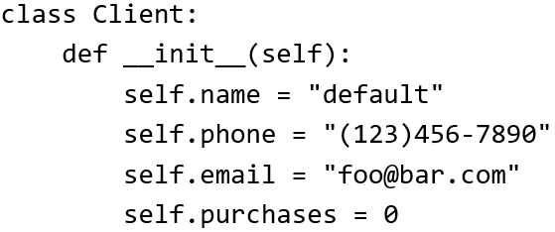

The Client List Example Implemented Using Classes (2)
Changes 2 attributes:
name = "James Tam"
email = "tam@ucalgary.ca"
def start():
firstClient = Client()
firstClient.name = "James Tam"
firstClient.email = "tam@ucalgary.ca"
print(firstClient.name)
print(firstClient.phone)
print(firstClient.email)
print(firstClient.purchases)
start()

Slide 11

Important Details
Accessing attributes inside the methods of the class.
Preface the attribute with ‘self’
class Client:
def __init__(self):
self.name = "default"
(More on the ‘self’ keyword later in
this section)
Accessing attributes outside the methods in the body of the class (e.g. start() function)
Need to create a reference to the object first
firstClient = Client()
Then access the object through that reference
firstClient.name = "James Tam"
self.<attribute name>
<Ref name> = <Class name>()
<Ref name>.<attribute name>

Slide 12
What Is The Benefit Of Defining A Class?
It allows new types of variables to be declared.
The new type can model information about most any arbitrary entity:
Car
Movie
Your pet
A bacteria or virus in a medical simulation
A ‘critter’ (e.g., monster, computer-controlled player) a video game
An ‘object’ (e.g., sword, ray gun, food, treasure) in a video game
A member of a website (e.g., a social network user could have attributes to specify the person’s: images, videos, links, comments and other posts associated with the ‘profile’ object).
Notes:
12

Slide 13
What Is The Benefit Of Defining A Class (2)
Unlike creating a composite type by using a list a predetermined number of fields can be specified and those fields can be named.
This provides an error prevention mechanism
class Client:
def __init__(self):
self.name = "default"
self.phone = "(123)456-7890"
self.email = "foo@bar.com"
self.purchases = 0
firstClient = Client()
print(firstClient.middleName) #Error: no such field defined

Slide 14
Revisiting A Previous Example: __init__()
New terms:
__init__()
Constructor
__init__() is used to initializing the attributes
Classes have a special function (actually ‘method’ – more on this later in this section) called a constructor that can be used to initialize the starting values of a class to some specific values.
This method is automatically called whenever an object is created e.g. bob = Person()
Format:
class <Class name>:
def __init__(self, <other parameters>):
<body of the method>
Example:
class Person:
def __init__(self):
self.name = "No name"
This calls the init() constructor

Slide 15

Classes Have Attributes
But Also Behaviors
ATTRIBUTES
Name:
Phone:
Email:
Purchases:
BEHAVIORS
Open account
Buy investments
Sell investments
Close account
A client
Image of James courtesy of James Tam

Slide 16
New Term: Class Methods (“Behaviors”)
List reference
Method operating on the list
1 Not all composites have methods e.g., arrays in ‘C’ are a composite but don’t have methods
Functions: not tied to a composite type or object
The call is ‘stand alone’, just name of function
E.g.,
print(), input()
Methods: must be called through an instance of a composite¹.
E.g.,
aList = []
aList.append(0)
Unlike these pre-created functions, the ones that you define with your classes can be customized to do anything that a regular function can.
Functions that are associated with classes are referred to as methods.

Slide 17
Defining Class Methods
Format:
class <classname>:
def <method name> (self, <other parameters>):
<method body>
Example:
class Person:
def __init__(self):
self.name = "I have no name :("
def sayName (self):
print ("My name is...", self.name)
Unlike functions, every method of a class must have the ‘self’ parameter (more on this later)
Reminder: When the attributes are accessed inside the methods of a class they MUST be preceded by the suffix “.self”

Slide 18

Defining Class Methods: Full Example
Name of the online example: 2personV1.py
class Person:
def __init__(self):
self.name = "I have no name :("
def sayName(self):
print("My name is...", self.name)
def start(): #Access outside class requires a reference
aPerson = Person()
aPerson.sayName()
aPerson.name = "Big Smiley :D"
aPerson.sayName()
start()

Slide 19
Calling A Classes’ Method Inside Another Method Of The Same Class
Similar to how attributes must be preceded by the keyword ‘self’ before they can be accessed so must the classes’ methods:
Example:
class Bar:
def __init__(self):
self.x = 0
def fun1(self):
print(self.x) #Accessing attribute ‘x’
def fun2(self):
self.fun1() #Calling method ‘fun1’

Slide 20
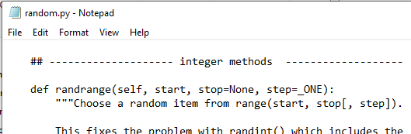
Subdividing A Program Into Parts
In addition to splitting a program by functions a large program may be split into different files.
New definition: Module = a file that contains a part of a program.
Because the code resides in another file the name of the module must be imported:
import random
print(random.randrange(0,6))
Module name = file name (random.py)

Slide 21
Modules: Dividing Up A Large Program
Import syntax:
# Import some functions
From <file/mod name> import <fun1>, <fun2>...
# Import all functions
From <file/mod name> import *
# Import only module/file (not functions)
import <file/mod name>
Mod = short for module

Slide 22
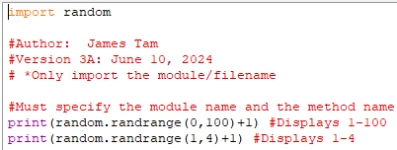
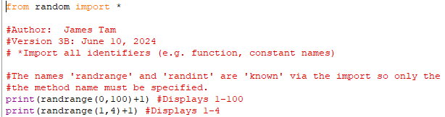
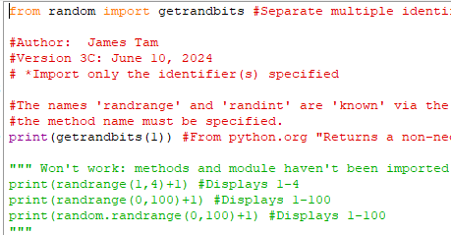
Different Types Of Imports: Pre-Created Module
Name of the folder containing the different versions of the program: 3imports_of_random

Slide 23
Different Types Of Imports: Code You Write
Name of the folder containing the different versions of the program: 4multiple_modules_procedural
Module_A
Def fun1
Def fun2
Module_B
Def fun3
Def fun4
Def fun5
Module_C
Def fun1
Def fun6
Module_D
Imports Module_A
Def fun1()
Calls Module_A.fun1()a
Driver
Import Module_A
From Module_B import *
From Module_C import fun1, fun6
Import Module_D
This example services to illustrate:
How to decompose a procedural program into modules
Why you should only import needed identifiers (minimize the use of from <module> import *

Slide 24
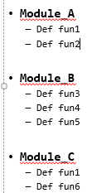
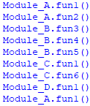
Different Imports: Function Calls
Driver
import Module_A
from Module_B import *
from Module_C import fun1, fun6
import Module_D
Module_A.fun1()
Module_A.fun2()
fun3() #Module_B
fun4() #Module_B
fun5() #Module_B
fun1() #Module_C
fun6() #Module_C
Module_D.fun1()
Module_D
import Module_A
def fun1():
print("Module_D.fun1()")
Module_A.fun1()

Slide 25
Modules And Classes
Class definitions are frequently contained in their own module.
A common convention is to have the module (file) name match the name of the class.
To use the code of class Person from another file module you must include an import:
from <filename> import <class name>
from PersonFile/PersonModule import Person
Filename: Person.py
class Person:
def fun1(self):
print("fun1")
def fun2 (self):
print("fun2")

Slide 26
Modules And Classes: Complete Example
Name of the folder containing all the modules for this example: 5multiple_modules_OO_simple
To start the whole program run the module with the ‘start’ function.
<< File = Driver.py >>
from Greetings import *
def start():
aGreeting = Greetings()
aGreeting.sayGreeting()
start()
When importing modules containing class definitions the syntax is (star ‘*’ imports everything):
From <filename> import <classes to be used in this module>

Slide 27
Modules And Classes: Complete Example (2)
<< File Greetings.py >>
class Greetings:
def sayGreeting(self):
print("Hello! Hallo! Sup?! Guten tag/morgen/aben! Buenos! Wei!" \
+"Konichiwa! Shalom! Bonjour! Salaam alikum! Kamostaka?")

Slide 28
Naming The Starting Module
Recall: The function that starts a program (first one called) should have a good self-explanatory name e.g., “start()” or follow common convention e.g., “main()”
Similarly the file module that contains the ‘start()’ or ‘main()’ function should be given an appropriate name e.g., “Driver.py” (it’s the ‘driver’ of the program or the starting point)
Filename: “Driver.py”
def start():
#Instructions
start()

Slide 29
Complete Example: Accessing Attributes And Methods: Person Module
Name of the folder containing all the modules for this example: 6multiple_modules_OO_intermediate
To start the whole program run the module with the ‘start’ function.
<< File: Person.py >>
class Person:
def __init__(self,newName,newAge):
self.name = newName
self.age = newAge
This is a good summary of:
Defining a class with attributes and methods (including __init__())
Creating an object
Accessing attributes inside of a class
Accessing methods inside of a class
Accessing attributes & methods outside of class
Splitting a program into modules

Slide 30
Complete Example: Accessing Attributes And Methods: Person Module (2)
def haveBirthday(self):
print("Happy Birthday!")
self.mature()
def mature(self):
self.age = self.age + 1

Slide 31
Complete Example: Accessing Attributes And Methods: The “Driver” Module
<< File: Driver.py >>
from Person import Person
def start():
aPerson = Person("Cartman",8)
print("%s is %d." %(aPerson.name,aPerson.age))
aPerson.haveBirthday()
print("%s is %d." %(aPerson.name,aPerson.age))
start()
def __init__(self,newName,newAge):
self.name = newName
self.age = newAge
def haveBirthday(self)
print("Happy Birthday!")
self.mature()
def mature(self):
self.age = self.age + 1

Slide 32
Object-Oriented Design: Advantage Over Procedural Decomposition
Procedural approach: functions can allow for nonsensical behaviors e.g. “flying pigs”
E.g.
def fly():
...
pigs = list["pig1","pig2"] fly(pigs)

Slide 33
Recall: Objected Approach Ties Behaviors (Functions/Methods) To Classes
Definition of a class (in this example it’s the parent whose methods are available to classes that are derived from this class)
class Flyer():
def fly(self):
….
Via inheritance: class definitions be extended by specifying that ‘child’ classes (derived from the parent) inherit (are able to access) the attributes and methods of the parent.
class Airplane(Flyer):
Alternative example: Java
public class Airplane extends Flyer
{
}
In python this allows an Airplane object to ‘fly’

Slide 34
After This Section You Should Now Know
How to define an arbitrary composite type using a class
Attributes and methods are bundled with (‘encapsulated’ into the class definition)
What are the benefits of defining a composite type by using a class definition over using a list
How to create instances of a class (instantiate)
How to access and change the attributes (fields) of a class
How to define methods/call methods of a class
What is the ‘self’ parameter and why is it needed
What is a constructor (__init__ in Python), when it is used and why is it used
How to divide your program into different modules
How inheritance can allow access to group of derived classes.

Slide 35
Copyright Notification
“Unless otherwise indicated, all images in this presentation are used with permission from Microsoft.”

