Slide 1
Changing Default File Location For IDLE
This is Windows 10 resource
MAC resources (not created by the author of this document so they are not guaranteed but hopefully they will help):
  https://stackoverflow.com/questions/1424398/default-save-path-for-python-idle

Slide 2
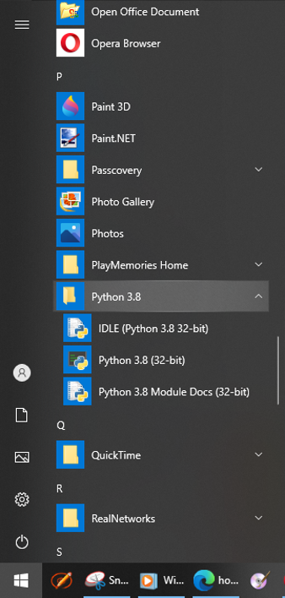
Find IDLE In The Start Menu

Slide 3
Shortcut Icon
Right click on the icon and in the popup menu select: More -> Open File Location

Slide 4
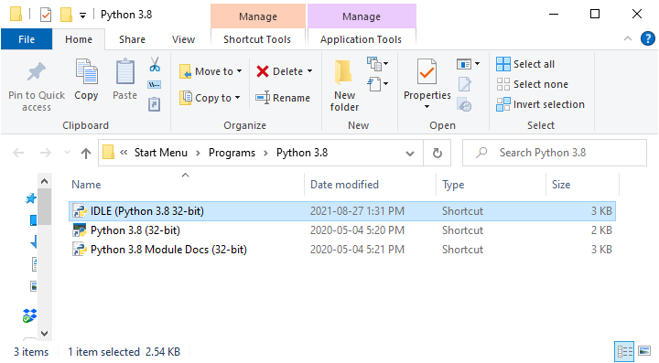
Popup Window
Right-click on the IDLE icon and select ‘Properties’ in the Windows popup menu

Slide 5
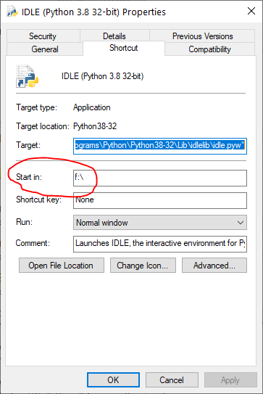
Properties Dialog Box
Change the location in the “Start in” field to the drive/location that you want as the default location for IDLE to open up python programs.

