Slide 1
Getting Started With Python Programming: Part I
Tutorial: creating computer programs
Variables
Getting information from the user
Common mathematical operators

Slide 2
Reminder!
These course notes are mandatory
  Get them before class and go over them before attending
(If all else fails then look through them afterwards – at the very least to see what concepts/topics you are responsible for knowing).
  It’s the *first* step you should complete if you’ve missed lecture and need to catch up.
  (The second step is to get the in class notes of a classmate).
  After going through these notes the third step is to ask us for help in filling in any conceptual gaps.

Slide 3
Tips For Success: Programming Sections
(The previous 4 tips are still applicable but there’s some tips specific to programming):
  Take extensive notes: everything in class not just what the instructor “writes down” but also what he/she “says in class”.
    Some students may find when studying the lecture slides for the exam that they cannot understand concepts.
    The extra “filling of the blanks” occurs during lecture so you need to annotate the slides with your own notes
  After lectures have covered a particular concept/example
    If you have time try writing example programs on your own (without looking at the online examples or notes) in order to create a program that fulfills the same task as the example program
    (It’s one thing to see the solution to a problem explained, your depth of understanding will be deeper if you have to re-create it from scratch yourself).
    JT’s note: you may find this unnecessary for the simple examples in this section but it will be beneficial to do this when more complex concepts are covered (e.g. nested loops onwards)

Slide 4
Python
This is the name of the programming language that will be used to illustrate different programming concepts this semester:
  My examples will be written in Python
  Your assignments will be written in Python
Some advantages (from Python dot org)
  Free
  Powerful
  Widely used (Google, NASA, Yahoo, Electronic Arts, some Linux operating system scripts etc.)
Some starting python resources
  Official website: http://www.python.org
  An overview of the web site: https://www.python.org/about/gettingstarted/

Slide 5
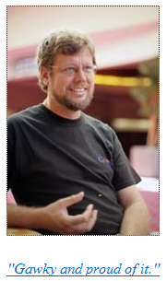
Python History
Developed in the early 1990s by Guido van Rossum.
Python was designed with a tradeoff in mind (from “Python for everyone” (Horstman and Necaise):
  Pro: Python programmers could quickly write programs (and not be burdened with an overly difficult language)
  Con: Python programs weren’t optimized to run as efficiently as programs written in some other languages.
From:
http://www.python.org/~guido/

Slide 6
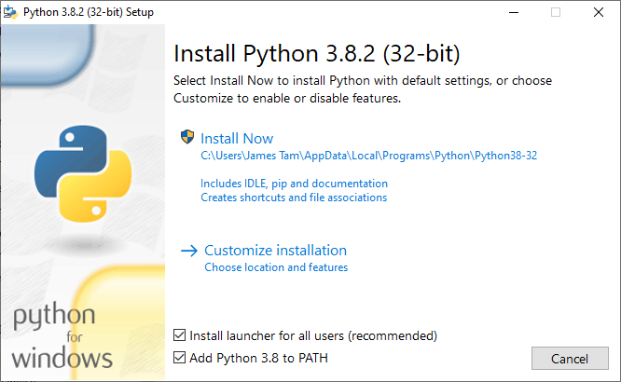
Working From Home (Installing Python): Windows
Getting Python (get version 3.X and not version 2.X)
  http://www.python.org/download/
  Detailed information:
    https://pages.cpsc.ucalgary.ca/~tamj/2023/217P/notes/pdf/installing_accessing_python.pdf
Then click “Install Now”
Make sure you check this option!

Slide 7
Online Help: Official Python Site
Basic explanation of concepts (for beginners: along with examples to illustrate)
  http://docs.python.org/py3k/tutorial/index.html
  (Skip the notes on the interactive mode for now – it’s where you don’t save the program which leaves you nothing to submit for assignments).
  For this course you need to create a python program in a file and then run the program defined in the file.

Slide 8
Creating A Computer Program
A programmer writes the instructions of the program in high level (human can read and understand) language.
  Examples: C, C++, java, python
The program must be created and saved using a text editor (e.g. Notepad, WordPad or the editor that comes with python IDLE).
  Don’t use a word processor!
The program is then translated into binary/machine language (the only form that the computer can understand).
# Details later this term
list = [1,2,’a’]
for element in list
print(element)
# Details in 2nd year
10000001
10010100 10000100
10000001 01010100

Slide 9
Location Of My Online Examples
For this semester you can find them in D2L under: Content->Lectures
Then look under the appropriately named folder which is listed by date and topic.
Alternatively you can find them by looking under the “main grid” of the course website (look for the ‘examples’ link):
  https://pages.cpsc.ucalgary.ca/~tamj/2023/217P/#Main_grid:_lecture_&_tutorial_schedule,_assignment_information

Slide 10
The First Python Program
Program name: small.py
Filename: 1small.py
print ("hello",end="")

Slide 11
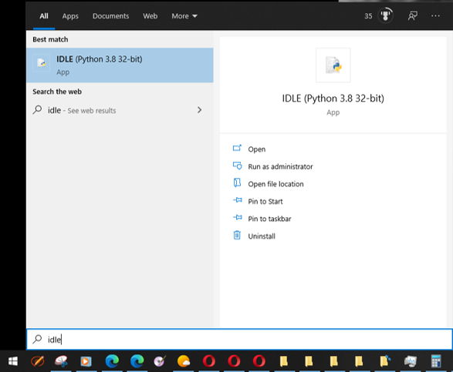
Creating/Running Programs: Windows
Step 0: Before writing your program start IDLE (python editor)
  The editor automatically comes installed with your python download so it’s the one that we will officially support.
  You can use other editors but keep in mind you may be on your own if you have problems with that editor!
    Starting IDLE (Windows)
  One Apple resource for using IDLE: https://www.python.org/download/mac/tcltk/

Slide 12
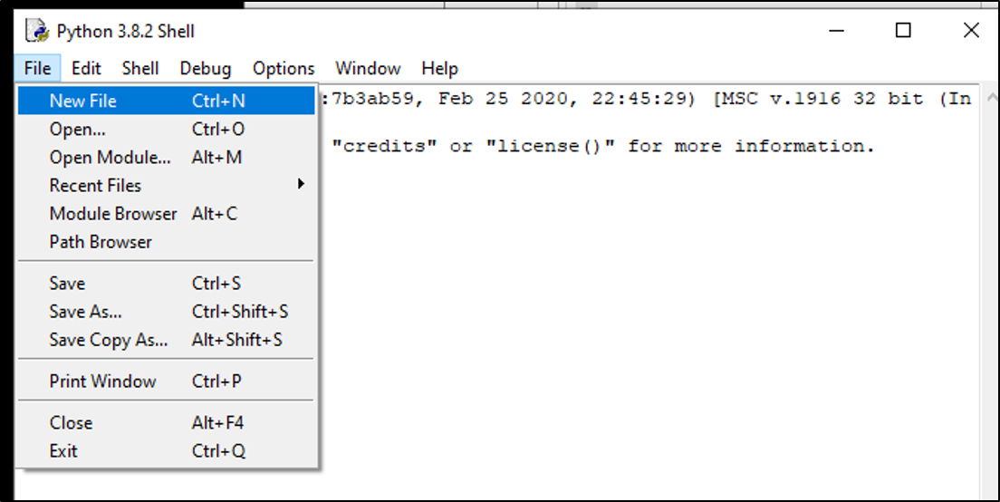
Creating/Running Programs: Windows (2)
Step 1: Starting the python program editor from IDLE: File->New File

Slide 13
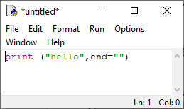
Creating/Running Programs: Windows (3)
Step 2: Type your program into the editor window that appears (appears if you completed the previous step correctly):
(The specifics of what to type into the editor will form the bulk of teaching material for this semester – details are coming soon).
  For now you can just type in what you see in the above image.

Slide 14
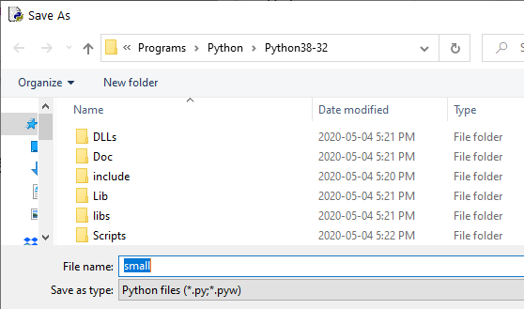
Creating/Running Programs: Windows (4)
Step 3: Name your program: File->Save
  Using the IDLE editor you can simply save under the default file type.
    (If you use another text editor such as WordPad then you will have to save it as a text file and make sure the filename ends with the right suffix “.py”).
    Save the program in a easy to remember location (don’t use the default location – it’s the install location of python and not easy to remember).
  Standards for naming programs
    Only use alphabetic or numeric characters in the save name
    Don’t include spaces or any other characters!

Slide 15
Creating/Running Programs: Windows (5)
Step 4: Running your program
  Via the menu: Run->Run Module
  Via key board shortcut: F5

Slide 16
Opening Previously Created Programs
Do this through the editor (IDLE):
Menu options: File->Open
Do not try to ‘click’ on the file.
  Windows: by default the operating system will try to run python programs (not allow you to edit it).

Slide 17
Windows: Do Not Click On The Python File
Don’t try to open or run your program by clicking on it!
  By default Windows will try to run the program in a new popup window and then close the window after the program finishes.
  Typical result: the appears and then almost immediately closes.
  Because the default behavior of files containing python programs is to execute the program the university MS-Exchange email server will block such file attachments.
    Workaround for mailing a python program: rename the file name from .py to .txt before attaching it.
      How to rename a file in Windows 10:
        https://www.howtogeek.com/665514/6-ways-to-rename-files-and-folders-in-windows-10/
      (How to view filename extensions in Windows 10):
        https://www.howtogeek.com/205086/beginner-how-to-make-windows-show-file-extensions/
      A MAC resource:
        https://support.apple.com/en-ca/guide/mac-help/mchlp2304/mac
Video: showing how useless it is to just click on a file containing a python program (use the method that will be covered shortly): https://pages.cpsc.ucalgary.ca/~tamj/resources/python/Clicking_on_a_python_program_annotated.mp4

Slide 18

Embedded Video (In Case You Can’t See It Via The Link On The Last Screen).

Slide 19
Requirements For Naming The File Containing Your Program
As mentioned: no spaces!
  Okay: A1.py, gradeProgram.py
  Not Okay: grade program.py
Just stick to using alphabetic characters, numbers may be used but the first character should only be alphabetic.
  Okay: A1Tam.py, A1Sept12.py
  Not Okay: A1(1).py, 9-25-2015.py

Slide 20
Section Summary: Writing A Small “Hello World” Program
You should know exactly what is required to create/run a simple, executable Python program.
  While you may not be able to create a new program from scratch at this point, you should be able to enter/run small.py yourself.
You should also become familiar with requirements for naming the file which contains your python program.

Slide 21
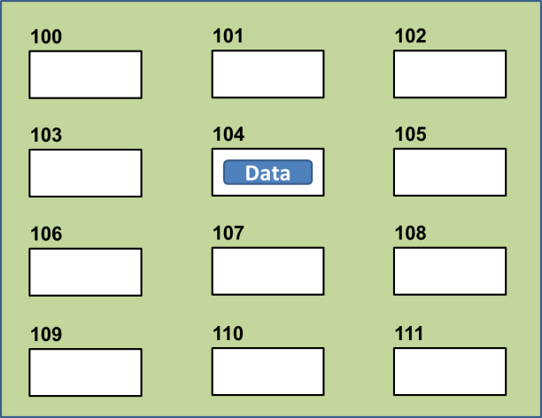
Variables
Set aside a location in memory.
Used to store information (temporary).
  This location can store one ‘piece’ of information.
    Putting another piece of information at an existing location overwrites previous information.
  At most the information will be accessible as long as the program runs i.e., it’s temporary
Some types of information which can be stored in variables include:
  integer (whole number storage only),
  floating point (fractional),
  strings (character information - essentially any characters you can type and more)
Image curtesy of James Tam

Slide 22

The Assignment Operator: =
The assignment operator '=' used in writing computer programs does not have the same meaning as mathematics.
  Don’t mix them up!
Example:
  y = 3 (what is stored in ‘y’ at this point)
  x = y (what is stored in ‘x’,’y’ at this point)
  y = 6 (what is stored in ‘x’,’y’ at this point)
What is the end result? How was this derived (what are the intermediate
Name of the full example: 2assignment.py
  Quick tip after using the assignment operator: to show what a variable currently contains put the name of the variable without quotes inside the round brackets for the print function e.g.,
    num = 888
    print(num)

Slide 23
Variable Naming Conventions
Python requirements:
  Rules built into the Python language for writing a program.
  Somewhat analogous to the grammar of a ‘human’ language.
  If the rules are violated then the typical outcome is the program cannot be translated (nor run).
    A language such as Python may allow for a partial execution (it runs until the error is encountered).
Style requirements:
  Approaches for producing a well written program.
  (The real life analogy is that something written in a human language may follow the grammar but still be poorly written).
  If style requirements are not followed then the program can still be translated but there may be other problems (not the least of which is a reduced assignment grade - more on this during the term).

Slide 24
Variable Naming Conventions (2)
  Style requirement: The name should be meaningful.
  Style and Python requirement: Names must start with a letter (Python requirement) and should not begin with an underscore (style requirement).
  Style requirement: Names are case sensitive but avoid distinguishing variable names only by case.
Examples
#1:
age (yes) x, y (no)
#2
height (yes) 2x, _height (no)
#3
Name, name, nAme (no to this trio)

Slide 25
Variable Naming Conventions (2)
  Style requirement: Variable names should generally be all lower case (see next point for the exception).
  Style requirement: For names composed of multiple words separate each word by capitalizing the first letter of each word (save for the first word) or by using an underscore. (Either approach is acceptable but don’t mix and match.)
  Python requirement: Can't be a keyword (see next slide).
Examples
#4:
age, height, weight (yes)
Age, HEIGHT (no)
#5
firstName, last_name
(yes to either approach)

Slide 26

Some Key Words In Python
and del from not while
as elif global or with
assert else if pass yield
break except import print
class exec in random
continue finally is return
def for lambda try
Program instructions
print("hi")
print = "bye"
print("hi again")
Result of running the program

Slide 27
Variable Naming Conventions: Bottom Line
Both Python and style requirements should be followed when creating your variables.

Slide 28
Extra Practice
Come up with example names that violate and conform to the naming conventions.
  (You will have to go through this process as you write your programs anyhow so it’s a good idea to take about 5 – 10 minutes to make sure that you know the requirements).

Slide 29
Section Summary: Variables
What is a variable
What are some types of variables available in Python
How to create a variable in Python
What are naming conventions for variables

Slide 30

Displaying Output Using The Print() Function
This function takes zero or more arguments (inputs)
  Multiple arguments are separated with commas
  print() will display all the arguments followed by a blank line (the cursor is automatically moved to the next line).
    end="" isn’t mandatory but can be useful to prevent Python from adding the extra line (when precise formatting is needed)
  Zero arguments just displays a blank line
Name of the full example: 3output.py
  print("hi")
  print("hey",end="")
  print("-sup?")

Slide 31

Print("… ") Vs. Print(<name>)
Enclosing the value in brackets with quotes means the value in between the quotes will be literally displayed onscreen.
Excluding the quotes will display the contents of a memory location.
Name of the full example: 4output.py
  aString = "Some message"
  print(aString)
  print("aString")

Slide 32

Print("… ") Vs. Print(<name>): 2
Student exercise 1: remove these quotes and see if you can correctly predict the results.
Student exercise 2: remove parts:
end=""
2) print()
See if you can correctly predict the results.
1 From what you’ve learned thus far each argument can be a constant string or name of a variable.
Format:
  print(arg1,arg2 … )¹
Name of the full example: 5output.py
  num = 10.0
  name = "james"
  print("Sup?")
  print("num=", end="")
  print(num)
  print()
  print("My name: ", name)

Slide 33
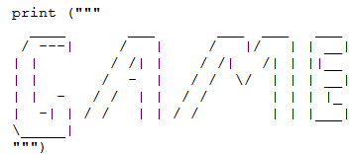
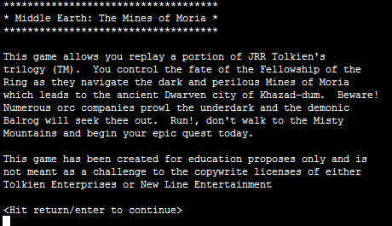
Triple Quoted Output
Used to format text output (free form and to reduce the number of calls to the print() function)
The way in which the text is typed into the program is exactly the way in which the text will appear onscreen.
Name of the full example: 6formatting.py
From Python Programming (2nd Edition) by Michael Dawson
From a CPSC 231 assignment (image courtesy of James Tam)

Slide 34
Side Note, Output: Python 3 Vs. Python 2
Python 3: to be consistent all functions require brackets to enclose the arguments/function inputs
  E.g. print("Sup?")
Python 2 does not explicitly bracket all functions
  E.g. print "Sup?"
There are other differences so make sure you are writing programs that follow the Python 3 syntax and not Python 2 syntax.

Slide 35
Arithmetic Operators
Name of the full example: 7operators.py
Operator | Description | Example
= | Assignment | num = 7
+ | Addition | num = 2 + 2
- | Subtraction | num = 6 - 4
* | Multiplication | num = 5 * 4
/ | Division (real number) | num = 9 / 2
// | Integer division | num = 9 // 2
% | Modulo (remainder) | num = 9 % 2
** | Exponent | num = 9 ** 2
4.5
4
1
81

Slide 36
Order Of Operation
First level of precedence: top to bottom
Second level of precedence
  If there are multiple operations that are on the same level then precedence goes from left to right.
1st | () | Brackets (inner before outer)
2nd | ** | Exponent
3rd | *, /, //, % | Multiplication, division, modulo
4th | +, - | Addition, subtraction
5th | = | Assignment
Example
num = 3 * 2 ** 3
Vs.
num = (3 * 2) ** 3

Slide 37
Order Of Operation And Style
Even for languages where there are clear rules of precedence (e.g., Java, Python) it’s good style to explicitly bracket your operations and use blank spaces as separators.
  x = (a * b) + (c / d)
It not only makes it easier to read complex formulas but also a good habit for languages where precedence is not always clear (e.g., C++, C).

Slide 38
After This Section You Should Now Know
How to create, translate and run Python programs.
Variables:
  What they are used for
  How to access and change the value of a variable
  Conventions for naming variables
  How information is stored differently with different types of variables, converting between types
Output:
  How to display messages that are a constant string or the value stored in a memory location (variable or constant) onscreen with print()
How/why use triple quoted output
What are the Python operators for common mathematical operations
How do the precedence rules/order of operation work in Python

