Slide 1
Academic Misconduct

Slide 2
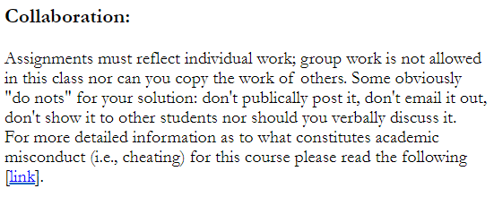
What You Have Been Told So Far
Basic information from each assignment description:

Slide 3
What You Have Been Told So Far
Information from the detail link
  https://pages.cpsc.ucalgary.ca/~tamj/2023/217F/assignments/misconduct.html
  Q: What constitutes cheating in this course?
  Q: What happens if you include someone else's code and you do credit the other person properly (this doesn't apply to your classmates, recall that you are not to see the assignment code of other students)
  Q: The code that you gave us in lecture or tutorial would be really handy for our assignments, are we allowed to use it and get credit for the work?
  Q: I have hired a tutor for this class can I get help on an assignment from this person?
  Q: Can I use an A.I. (Artificial Intelligence) tool such as Chat GPT to write my program and then submit that program?

Slide 4
How To Properly Cite External Code
Format is not as important as is the case with other classes.
Clarity is crucial
  You need to clearly distinguish between code that someone else wrote vs. your own work.
  Default: no citation means you work all the code yourself.
  If external code was included in your assignment submission but this was not clearly cited then this could be regarded as misconduct.

Slide 5
The “Sandwich” Approach For Citations
Specify the beginning and end of the external code (external code is sandwiched in between).
Provide specific details about where you got the external code:
  Author, program name, if it came from lecture or tutorial, name of the book or web address)
  Everything in between is code you did not write.
General format:
Student’s code
>>> The following instructions come from James Tam’s lecture example
>>> ‘loop1’ week of July 1 – 7
Some else’s code
Some else’s code
>>> End of external code
Student’s code

Slide 6
Academic Misconduct in CPSC (Exert from a department presentation by Dr. Pavol Federal)
Typical offences:
Collaboration
Copying friend’s work
Sharing solutions with friends
Copying from online sources
e.g. GitHub
Posting solutions publicly
e.g. GitHub
Paying for solutions
Possible Penalties:
Reduced grade (component or course)
Fail (component or course)
Probation
Suspension
Expulsion
Grade on hold, instructor and TA do not discuss case with student
Student interviewed by Assistant Head
Student interviewed by Associate Dean
!!!

Slide 7
Rules And Guidelines For This Course
Students should not see each other’s programs for graded work.
Also you should not discussing how you solved an assignment problem.
  There’s a danger of going too far.
  If someone needs help then there are resources you can refer them to:
    Instructor office hours
    Help tutorials (CT)
    (Mostly near the of the term): Open tutorials (teaching tutorials converted into help tutorial time).

Slide 8
Caution: Don’t Try To “Run The Gauntlet”
Considering the possibility of expulsion from the university (the most severe penalty) it just isn’t worth it.
Automated checking of assignment submissions will occur.
  This program was written by a Prof. who has expertise in program code analysis.
  You won’t be able to ‘fool’ or disguise the fact that you have copied someone else’s work so don’t do it.

