Slide 1
CPSC 217,
Loops In Python: Part 3
JT’s note: in the interests of time this section will not be covered during the live lecture. Instead you can get the lecture content via a pre-recorded video in D2L under ‘Lectures’ under the appropriate week’s material.
In this section you will learn some usability heuristics which can be used to design more user-friendly systems. (Coverage depends upon time constraints).

Slide 2
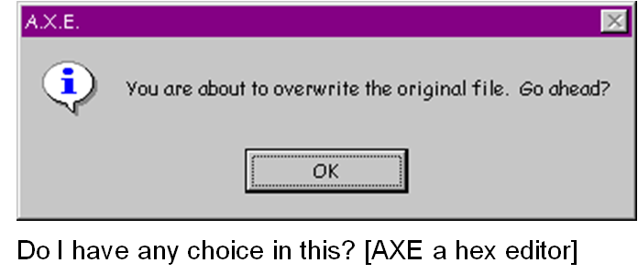
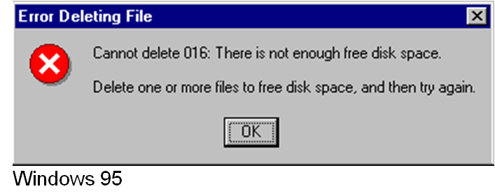
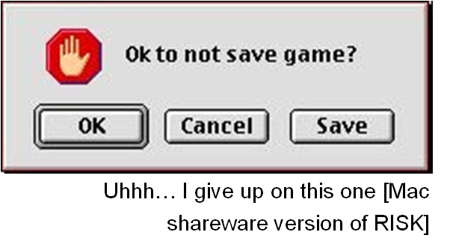
Why This Section Is Needed: Not So Friendly Examples Exist!

Slide 3
Some Heuristics (Rules Of Thumb) For Designing Software
(The following list comes from Jakob Nielsen’s 10 usability heuristics from the book “Usability Engineering”
  Simple and natural dialog
  Minimize the user’s memory load
  Be consistent
  Provide feedback
  Provide clearly marked exits
  Deal with errors in a helpful and
  positive manner
For more information:
Jakob Nielsen: https://www.nngroup.com/people/jakob-nielsen/
Book, “Usability Engineering (see Chapter 5)” https://books.google.ca/books?id=DBOowF7LqIQC&printsec=frontcover&source=gbs_ge_summary_r&cad=0#v=onepage&q&f=false

Slide 4
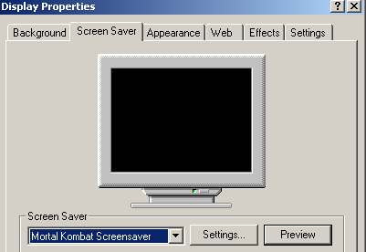
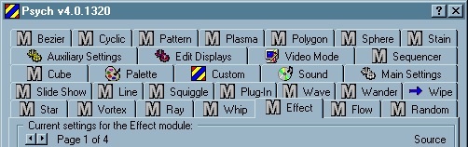
Simple And Natural Dialogue
Avoid making the interaction unnecessarily complex

Slide 5
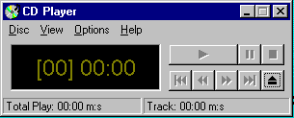
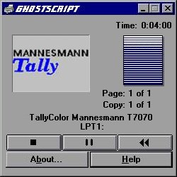
Simple And Natural Dialogue
Match the user’s conceptual model
Match the users’ task in as natural a way as possible
  Minimize mapping between interface and task semantics

Slide 6
Simple And Natural Dialogue
Present exactly the information the user needs when it is needed
  Less is more
    Less to learn, to get wrong, to distract...
    This not only includes minimizing the information displayed but also the steps needed during an interaction
  Remove or hide irrelevant or rarely needed information
    Competes with important information on screen
  Information should appear in natural order
    Order of accessing the information matches the user’s expectations
    Related information is graphically clustered
  Minimize or mitigate modes
  Use windows frugally
    Don’t make navigation and window management excessively complex

Slide 7
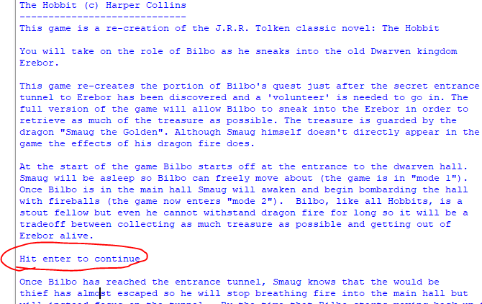
Simple And Natural Dialogue
Adding a ‘pause’ to allow the user to read long text can be of value.
input("Hit enter to continue")

Slide 8

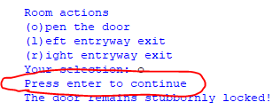
Simple And Natural Dialogue
Example dialogs that are neither simple nor natural
  Unnecessary confirmation (“Are you sure?”)
  Adding unnecessary steps (hit enter to continue right after typing in a command)

Slide 9
Minimize The User’s Memory Load
Computers are good at ‘remembering’ large amounts of information.
People are not so good remembering things.
These heuristics were covered in a video I made another semester and aside from numbering the content is the same.

Slide 10
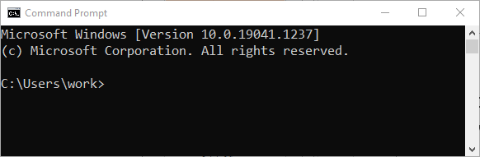
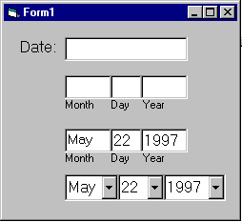
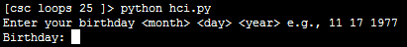
Minimize The User’s Memory Load
To reduce the memory load of the user:
  Poor approach: a command line interface (Windows ‘cmd’, MAC OS ‘terminal’)
  Example 1: applying the design principle with a graphical interface.
    Describe required the input format, show examples of valid input, provide default inputs.
  Example 2: applying the design principle with a command line interface.

Slide 11
Be Consistent
Consistency of effects (this command/action -> this result)
  Same words, commands, actions will always have the same effect in equivalent situations
  Makes the system more predictable
  Reduces memory load
Consistency of layout
  Allows experienced users to predict where things should be (matches expectations).

Slide 12
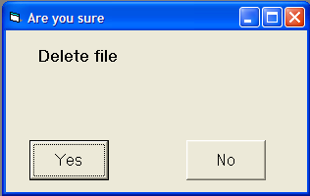
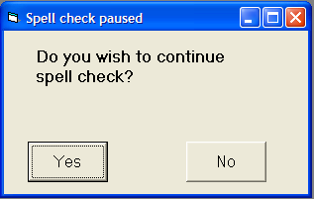
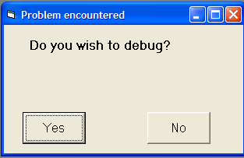
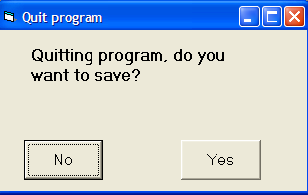
Be Consistent
Consistency of language and graphics
  Same information/controls in same location on all screens / dialog boxes forms follow boiler plate.
  Same visual appearance across the system (e.g. widgets).
Images courtesy of James Tam

Slide 13
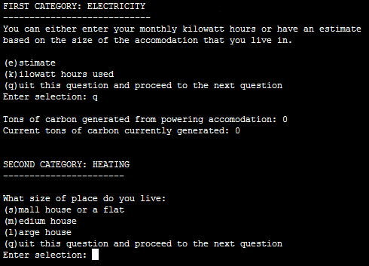
Be Consistent
This last option always allows the user to proceed to the next question.

Slide 14
Provide Feedback
Letting the user know:
  what the program is currently doing: was the last command understood, has it finished with its current task,
  what task is it currently working on,
  how long will the current task take etc.

Slide 15
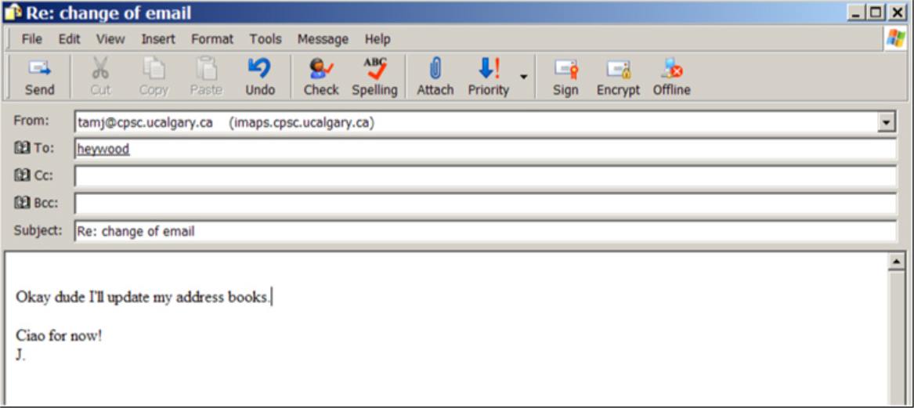
Provide Feedback
What is the program doing?
Outlook Express image courtesy of James Tam

Slide 16
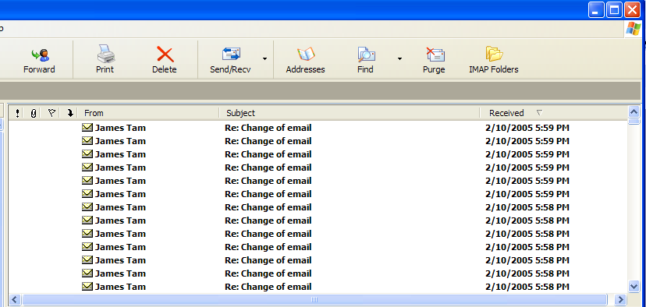
Provide Feedback
The rather unfortunate effect on the (poor) recipient.
Outlook Express image courtesy of James Tam

Slide 17
Provide Feedback
In terms of this course, feedback is appropriate for instructions that may not successfully execute
  what the program is doing (e.g., opening a file),
  what errors may have occurred (e.g., could not open file),
  and whenever possible ‘why’ (e.g., file “input.txt” could not be found)
...it’s not hard to do and not only provides useful updates with the state of the program (“Is the program almost finished yet?”) but also some clues as to how to avoid the error (e.g., make sure that the input file is in the specified directory).
At this point your program should at least be able to provide some rudimentary feedback
  E.g., if a negative value is entered for age then the program can remind the user what is a valid value (the valid value should be shown to the user as he or she enters the value):
  age = int(input ("Enter age (0 – 114): "))

Slide 18
Provide Clearly Marked Exits
This should obviously mean that quitting the program should be easy/self-evident (although this is not always the case with all programs!).
In a more subtle fashion it refers to providing the user the ability to reverse or take back past actions (e.g., the person was just experimenting with the program so it shouldn’t be ‘locked’ into mode that is difficult to exit).
Users should also be able to terminate lengthy operations as needed.

Slide 19
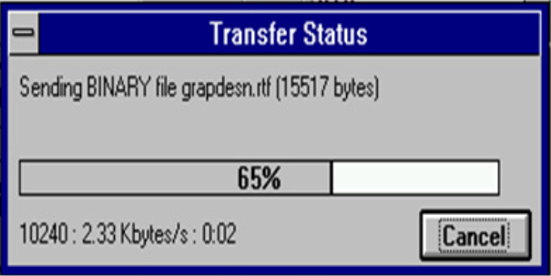
Provide Clearly Marked Exits
This doesn’t just mean providing an exit from the program but the ability to ‘exit’ (take back) the current action.
  Universal Undo/Redo
    e.g., <Ctrl>-<Z> and <Ctrl>-<Y>
  Progress indicator & Interrupt
  Length operations
Image: From the “HCI Hall of Shame”

Slide 20
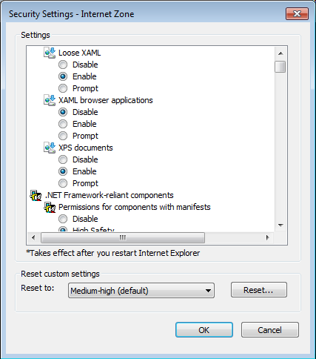
Provide Clearly Marked Exits
Restoring defaults
  Getting back original settings
What option did I change?
What was the original setting?
Allows for defaults to be quickly restored
Image: Internet Explorer security settings curtesy of James Tam

Slide 21
Provide Clearly Marked Exits
The user can skip or ‘exit’ any question.
Image: An old CPSC 231 assignment curtesy of James Tam

Slide 22
Deal With Errors In A Helpful And
Positive Manner
(JT: with this the heuristic it states exactly what should be done).

Slide 23
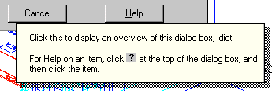
Rules Of Thumb For Error Messages
Polite and non-intimidating
  Don’t make people feel stupid
    Try again, bonehead!
Understandable
  Error 25
Specific
  Cannot open this document
  Cannot open “chapter 5” because the application “Microsoft Word”
  is not on your system
Helpful
  Cannot open “chapter 5” because the application “Microsoft Word”
  is not on your system. Open it with “WordPad” instead?
So obvious it could never happen?
No
Not
AutoCAD Mechanical
Why?
Better
Even better: A potentially helpful suggestion

Slide 24
“HIT ANY KEY TO CONTINUE”

Slide 25
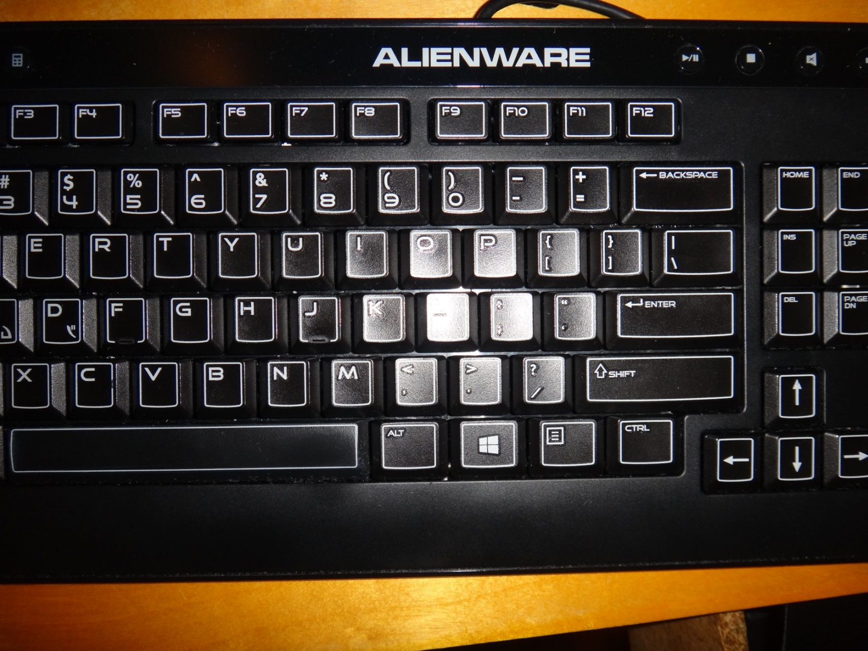
THE “Any Key”
Image: Curtesy of James Tam

Slide 26
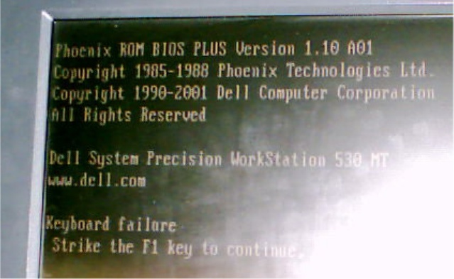
I’d Rather Deal With The ‘Any’ Key
Picture courtesy of James Tam: An error message from a Dell desktop computer.

Slide 27
After This Section You Should Now Know
Rules of thumb for designing more user-friendly technology.
  (New for subsequent semesters): simple and natural dialog
  Minimize the user’s memory load
  Be consistent
  Provide feedback
  Provide clearly marked exits
  Deal with errors in a helpful and
  positive manner

Slide 28
Copyright Notification
“Unless otherwise indicated, all images in this presentation are used with permission from Microsoft.”

