Slide 1
Getting Started With Python Programming: Part III
Named constants
Documenting programs
Prewritten python functions
Common programming errors
Programming style: layout and formatting of your program

Slide 2
Reminder: Variables
By convention variable names are all lower case
The exception is long (multi-word) names
As the name implies their contents can change as a program runs e.g.,
income = 300000
income = income + interest
Income = income + bonuses

Slide 3
Named Constants
They are similar to variables: a memory location that’s been given a name.
Unlike variables their contents shouldn’t change.
This means changes should not occur because of style reasons rather than because Python prevents the change
The naming conventions for choosing variable names generally apply to constants but the name of constants should be all UPPER CASE. (You can separate multiple words with an underscore).
Example PI = 3.14
They are capitalized so the reader of the program can distinguish them from variables.
For some programming languages the translator will enforce the unchanging nature of the constant.
For languages such as Python it is up to the programmer to recognize a named constant and not to change it.

Slide 4
Variables Vs. Constants: Case Study
First graded assignment: when deciding if a memory location (an identifier) should be treated as a constant or a variable ask yourself:
During the course of a semester should the contents of that identifier have the ability to change?
Full assignment 1 grade?
One of the exam grades?
The weight of Full Assignment 2?
The weight of the midterm?

Slide 5
Why Use Named Constants
They make your program easier to read and understand
# NO
populationChange = (0.1758 – 0.1257) * currentPopulation
Vs.
#YES
BIRTH_RATE = 17.58
MORTALITY_RATE = 0.1257
currentPopulation = 1000000
populationChange = (BIRTH_RATE - MORTALITY_RATE) * currentPopulation
Avoid unnamed constants whenever possible!

Slide 6
Why Use Named Constants (2)
2) Makes the program easier to maintain.
If the constant is referred to several times throughout the program, changing the value of the constant once will change it throughout the program.
Using named constants is regarded as “good style” when writing a computer program.

Slide 7
Purpose Of Named Constants (3)
One change in the initialization of the constant changes every reference to that constant
BIRTH_RATE = 0.998
MORTALITY_RATE = 0.1257
populationChange = 0
currentPopulation = 1000000
populationChange = (BIRTH_RATE - MORTALITY_RATE) * currentPopulation
if (populationChange > 0):
print("Increase")
print("Birth rate:", BIRTH_RATE, " Mortality rate:", MORTALITY_RATE, " Population change:", populationChange)
elif (populationChange < 0):
print("Decrease")
print("Birth rate:", BIRTH_RATE, " Mortality rate:", MORTALITY_RATE, "Population change:", populationChange)
else:
print("No change")
print("Birth rate:", BIRTH_RATE, " Mortality rate:", MORTALITY_RATE, "Population change:", populationChange)

Slide 8
Purpose Of Named Constants (5)
One change in the initialization of the constant changes every reference to that constant
BIRTH_RATE = 0.1758
MORTALITY_RATE = 0.0001
populationChange = 0
currentPopulation = 1000000
populationChange = (BIRTH_RATE - MORTALITY_RATE) * currentPopulation
if (populationChange > 0):
print("Increase")
print("Birth rate:", BIRTH_RATE, " Mortality rate:", MORTALITY_RATE, " Population change:", populationChange)
elif (populationChange < 0):
print("Decrease")
print("Birth rate:", BIRTH_RATE, " Mortality rate:", MORTALITY_RATE, "Population change:", populationChange)
else:
print("No change")
print("Birth rate:", BIRTH_RATE, " Mortality rate:", MORTALITY_RATE, "Population change:", populationChange)

Slide 9
When To Use A Named Constant?
(Rule of thumb): If you can assign a descriptive, useful, self-explanatory name to a constant then you probably should define and use a named constant.
Example 1 (easy to provide self explanatory constant name)
INCH_CM_RATIO = 2.54
height = height * INCH_CM_RATIO
Example 2 (providing self explanatory names for the constants is difficult)
calories used = (10 x weight) + (6.25 x height) - [(5 x age) - 161]

Slide 10
Named Constants: A Final Example
Correct/incorrect use of named constants can affect your assignment grade
Which of the following programs is more self explanatory (“self documenting” code)?
(You will learn how the ‘IF’ works in the branching/decisions making lectures).
Example #1 (less clear):
gameStatus = 1
silverLockPosition = 2
goldLockPosition = 0
if ((silverLockPosition == 1) and (goldLockPosition == 0)):
gameStatus = 2
Approach #2 (more explicit, better):
WON = 2
LEFT = 0
RIGHT = 1
CENTER = 2
If ((silverLockPosition == RIGHT) and (goldLockPosition == LEFT)):
gameStatus = WON

Slide 11
Extra Practice
Provide a formula where it would be appropriate to use named constants (should be easy).
Provide a formula where unnamed constants (i.e., named constant used instead of named constants) may be acceptable (may be trickier).
Search for formulas in science or engineering sites online if you can’t think of any formulas.

Slide 12
Section Summary: Named Constants
What is a named constant
How does it differ from a variable
How does it differ from an unnamed constant
What are some reasons for using named constants
Naming conventions for named constants

Slide 13
Program Documentation
Program documentation: Used to provide information about a computer program to another programmer (writes or modifies the program).
This is different from a user manual which is written for people who will use the program.
Documentation is written inside the same file as the computer program (when you see the computer program you can see the documentation).
The purpose is to help other programmers understand the program: what the different parts of the program do, what are some of it’s limitations etc.

Slide 14
Program Documentation (2)
Doesn’t contain instructions for the computer to execute.
Not translated into machine language.
Consists of information for the reader of the program:
The author of the program (or for a particular part of a program).
What does the program as a while do e.g., calculate taxes.
What are the specific features of the program e.g., it calculates personal or small business tax.
What are it’s limitations e.g., it only follows Canadian tax laws and cannot be used in the US. In Canada it doesn’t calculate taxes for organizations with yearly gross earnings over $1 billion.
What is the version of the program.
If you don’t use numbers for the different versions of your program then simply use dates (tie versions with program features – more on this in a moment “Program versioning and backups”).

Slide 15
Program Documentation (3)
Format (single line documentation):
# <Documentation>
Examples:
# Tax-It v1.0: This program will electronically calculate
# your tax return. This program will only allow you to complete
# a Canadian tax return.
The number sign ‘#” flags the translator that the remainder of the line is documentation.

Slide 16
Program Documentation (4)
Format (multiline documentation):
""" <Start of documentation>
...
<End of documentation> """
Examples:
"""
Tax-It v1.0: This program will electronically calculate
# your tax return. This program will only allow you to complete
# a Canadian tax return.
"""

Slide 17
Assignment Documentation Requirements
Information about you: author contact information (full name, student identification number, tutorial number that you are registered in).
Other information to document:
Program version
List of features in the assignment description that your program implemented for each version (paraphrase or even copy-pasting of requirements is acceptable).
Any weaknesses or limitation of your program (e.g. 1: program crashes if a non-numeric value is entered when a number is expected, e.g. 2: program cannot calculate a quotient if the user enters denominator of zero).
See the requirements of the specific assignment for any additional details.

Slide 18
Program Versioning And Back Ups
As significant program features have been completed (tested and the errors removed/debugged) a new version should be saved in a separate file.
Game.py
Game.Sept20
# Version: Sept 20, 2012
# Program features:
# (1) Load game
# (2) Show game world
Make backup file
# Version: Sept 20, 2012
# Program features:
# (1) Load game
# (2) Show game world

Slide 19
Program Versioning And Back Ups
As significant program features have been completed (tested and the errors removed/debugged) a new version should be saved in a separate file.
Game.Oct2
# Version: Oct 2, 2012
# Program features:
# (1) Save game
# Version: Sept 20, 2012
# Program features:
# (1) Load game
# (2) Show game world
Game.py
# Version: Oct 2, 2012
# Program features:
# (1) Save game
# Version: Sept 20, 2012
# Program features:
# (1) Load game
# (2) Show game world
Make new backup file
Game.Sept20
# Version: Sept 20, 2012
# Program features:
# (1) Load game
# (2) Show game world

Slide 20
Backing Up Your Work
Do this every time that you have completed a significant milestone in your program.
What is ‘significant’ will vary between people but make sure you do this periodically.
Ideally the backup file should be stored in a separate directory/folder (better yet on a separate device and/or using an online method such as an email attachment or ‘cloud’ storage).
Common student reason for not making copies: “Backing up files takes time!”
Compare:
Time to copy a file: ~10 seconds (generous in some cases).
Time to re-write your program to implement the feature again: 10 minutes (might be overly conservative in some cases).
Failing to backup your work is not a sufficient reason for receiving an extension.

Slide 21
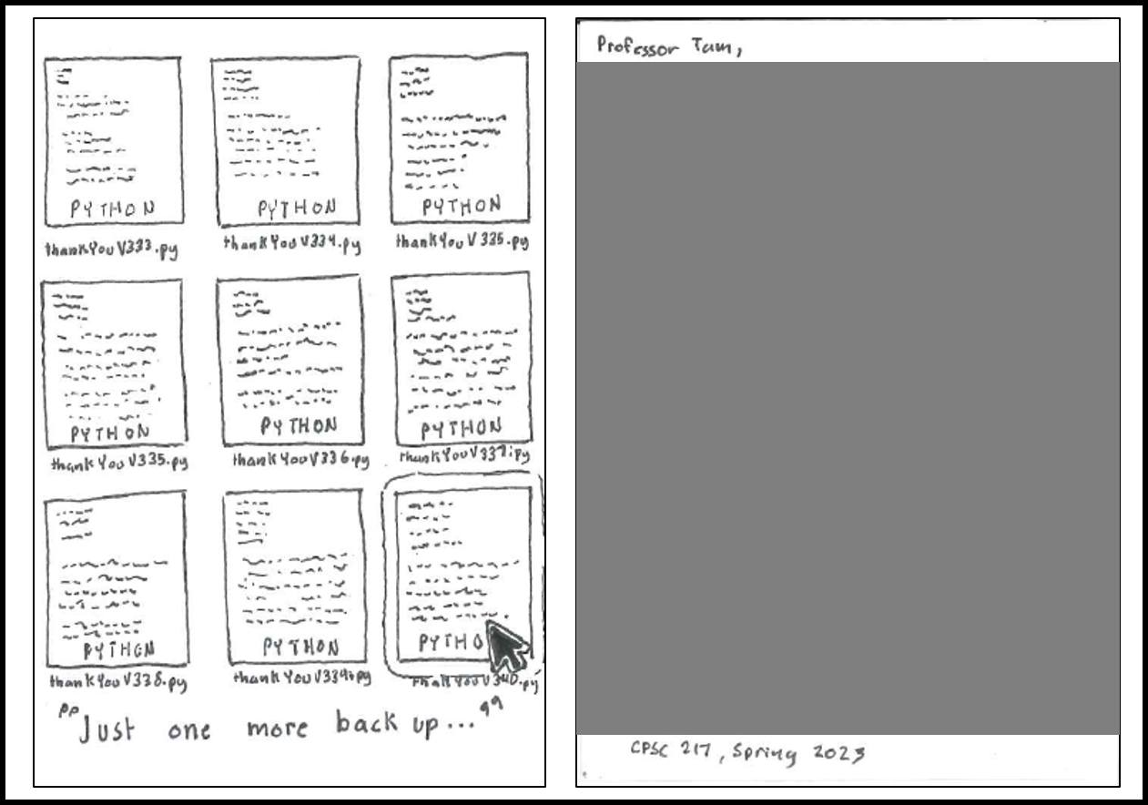
Backups: On A Positive Note

Slide 22
Over-Documenting A Program
Except for very small programs documentation should be included
However, it is possible to over-document a program
(Stating the obvious)
num = num + 1 #Variable num increased by one
(Documentation of the last row in a list may be a good reminder)
lastRow = SIZE – 1 #Row numbering begins at zero
Example: there are 3 rows in a list (SIZE = 3)
First row = 0
Second row = 1
Third (and last) row = 2 (equals 3-1 = 2)

Slide 23
Section Summary: Documentation
What is program documentation
What sort of documentation should be written for your programs
How program documentation ties into program versioning and backups

Slide 24
Prewritten Python Functions
Python comes with many functions that are a built in part of the language e.g., ‘print()’, ‘input()’
(If a program needs to perform a common task e.g., finding the absolute value of a number, then you should first check if the function has already been implemented).
For a list of all prewritten Python functions.
https://docs.python.org/3/library/functions.html
Note: some assignments may have specific instructions which list functions you are allowed to use (assume that you cannot use a function unless: (1) it’s extremely common e.g., input and output (2) it’s explicitly allowed )
Read the requirements specific to each assignment
When in doubt don’t use the pre-created code either ask or don’t use it and write the code yourself. (If you end up using a pre-created function rather than writing the code yourself you could receive no credit).

Slide 25
Types Of Programming Errors
Syntax/translation errors
Runtime errors
Logic errors

Slide 26
Syntax/ Translation Errors
Each language has rules about how statements are to be structured.
An English sentence is structured by the grammar of the English language:
My cat sleeps the sofa.
Python statements are structured by the syntax of Python:
5 = num
Grammatically incorrect (FYI: missing the preposition to introduce the prepositional phrase ‘the sofa’)
Syntactically incorrect: the left hand side of an assignment statement cannot be a literal (unnamed) constant (or variable names cannot begin with a number)

Slide 27
Syntax/ Translation Errors (2)
The translator checks for these errors when a computer program is translated to machine language.

Slide 28
Some Common Syntax Errors
Miss-spelling names of keywords
e.g., ‘primt()’ instead of ‘print()’
Forgetting to match closing quotes or brackets to opening quotes or brackets e.g., print("hello)
Using variables before they’ve been named (allocated in memory).
Name of the full example: 17error_syntax.py
print(num)
num = 123

Slide 29
Runtime Errors
“My computer crashed!”
Occur as a program is executing (running).
The syntax of the language has not been violated (each statement follows the rules/syntax).
During execution a serious error is encountered that causes the execution (running) of the program to cease.
With a language like Python where translation occurs just before execution (interpreted) the timing of when runtime errors appear won’t seem different from a syntax error.
But for languages where translation occurs well before execution (compiled) the difference will be quite noticeable.
A common example of a runtime error is a division by zero error.
We will talk about other run time errors later.

Slide 30
Runtime Error¹: An Example
Name of the full example: 18error_runtime.py
num2 = int(input("Type in a number: "))
num3 = int(input("Type in a number: "))
num1 = num2 / num3 # When zero is entered
print(num1)
1 When ‘num3’ contains zero

Slide 31
Logic Errors
Software “bugs”
The program has no syntax errors.
The program runs from beginning to end with no runtime errors.
But the logic of the program is incorrect (it doesn’t do what it’s supposed to and may produce an incorrect result).
Name of the full example: 19error_logic.py
print ("This program will calculate the area of a rectangle")
length = int(input("Enter the length: "))
width = int(input("Enter the width: "))
area = length + width
print("Area: ", area)

Slide 32
Some Additional Examples Of Errors
All external links (not produced by your instructor):
http://level1wiki.wikidot.com/syntax-error
http://www.cs.bu.edu/courses/cs108/guides/debug.html
http://cscircles.cemc.uwaterloo.ca/1e-errors/
http://www.greenteapress.com/thinkpython/thinkCSpy/html/app01.html

Slide 33
Practice Exercise
(This one will be an ongoing task).
As you write you programs, classify the type of errors that you encounter as: syntax/translation, runtime or logical.

Slide 34
Section Summary: The 3 Error Types
What are different categories of errors
What is the difference between the categories of errors and being able to identify examples of each

Slide 35
Layout And Formatting
Similar to written text: all computer programs (except for the smallest ones) should use white space to group related instructions and to separate different groups.
# These are output statements to prompt for user information
Instruction1
Instruction2
Instruction3
Instruction4
# These are instructions to perform calculations on the user
# input and display the results
Instruction5
Instruction6

Slide 36
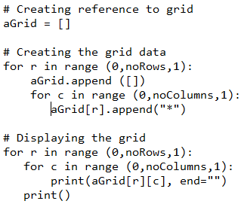
Layout And Formatting: Example

Slide 37
Section Summary: Layout And Formatting
Why is layout and formatting of programs important, how to do it

Slide 38
Extra: In Case You’re Interested
Different languages may have unique style guides
Here a style guide for Python:
http://legacy.python.org/dev/peps/pep-0008/

Slide 39
After This Section You Should Now Know
How to create, translate and run Python programs.
Variables:
What they are used for
How to access and change the value of a variable
Conventions for naming variables
How information is stored differently with different types of variables, converting between types
Output:
How to display messages that are a constant string or the value stored in a memory location (variable or constant) onscreen with print()
How/why use triple quoted output
How to format output through:
The use of format specifiers
Escape codes

Slide 40
After This Section You Should Now Know (2)
Named constants:
What are named constants and how they differ from regular variables
What are the benefits of using a named constant vs. unnamed constant
What are the Python operators for common mathematical operations
How do the precedence rules/order of operation work in Python
Input:
How to get a program to acquire and store information from the user of the program
What is program documentation and what are some common things that are included in program documentation
The existence of prewritten Python functions and how to find descriptions of them

Slide 41
After This Section You Should Now Know (3)
What are the three programming errors, when do they occur and what is the difference between each one
How to use formatting to improve the readability of your program

