Slide 1
Extra Topics From CPSC 231: O-O & Recursion
Section I: Defining new types of variables that can have custom attributes and capabilities
Section II: You will learn the definition of recursion as well as seeing how simple recursive programs work

Slide 2
Section I: Introduction To Object-Oriented Programming

Slide 3
Composites
What you have seen
  Lists
  Strings
  Tuples
What if we need to store information about an entity with multiple attributes and those attributes need to be labeled?
  Example: Client attributes = name, address, phone, email

Slide 4
Some Drawbacks Of Using A List
The parts of a composite list can be accessed via [index] but they cannot be labeled (what do these fields store?)
Which field contains what type of information? This isn’t immediately clear from looking at the program statements.
  client = [“xxxxxxxxxxxxxxx",
  “0000000000",
  “xxxxxxxxx",
  0]
Is there any way to specify rules about the type of information to be stored in a field e.g., a data entry error could allow alphabetic information (e.g., 1-800-BUY-NOWW) to be entered in the phone number field.

Slide 5

New Term: Class
Can be used to define a generic template for a new non-homogeneous composite type.
It can label and define more complex entities than a list.
This template defines what an instance (example) of this new composite type would consist of but it doesn’t create an instance.
Copyright information unknown

Slide 6


Classes Define A Composite Type
New term: Attribute
The class definition specifies the type of information (called “attributes”) tracked by each instance (example) of a composite.
Name:
Phone:
Email:
Purchases:
Each of these fields could be analogous to a list element but they are accessed via the name
Name:
Phone:
Email:
Purchases:
Name:
Phone:
Email:
Purchases:

Slide 7
Declaring A New Variable Type: Defining A Class¹
Note the convention: The first letter is capitalized.
Format:
  class <Name of the class>:
  def __init__(self):
  self.name of first field = <default value>
  self.name of second field = <default value>
Example (attributes clearer):
  class Client:
  def __init__(self):
  self.name = "default"
  self.phone = "(123)456-7890
Describes what information that would be tracked by a “Client” but doesn’t yet create a client variable
Defining a ‘client’ by using a list (index # mapped to a attribute is not self evident)
client = ["xxxxxxxxxxxxxxx",
"0000000000",
"xxxxxxxxx",
0]
1 Although capitalization of the class name isn’t the Python standard it is the standard with many other programming languages: Java, C++

Slide 8
Creating A Variable Of The New Type: An Instance Of A Class
New terms:
Instance
Object
instantiation
Creating an actual instance (instance = object) is referred to as
Format:
  <reference name> = <name of class>()
Example:
  firstClient = Client()

Slide 9


Defining A Class Vs. Creating An Instance Of That Class
Defining a class (~List type)
  A template that describes that class: how many fields, what type of information will be stored by each field, what default information will be stored in a field.
Creating an object (~creating a new list)
  Instances of that class (during instantiation) which can take on different forms.
Image copyright unknown
Example:
class Client:
def __init__(self):
  self.name = "default"
  self.phone = "(123)456-7890
Example:
firstClient = Client()

Slide 10
Accessing And Changing The Attributes - Outside Class Methods E.g. Inside Start()
Format:
  <reference name>.<field name> # Accessing value
  <reference name>.<field name> = <value> # Changing value
Example:
  def start():
  aClient.name = "James"
  print(aClient.name)

Slide 11
The Client List Example Implemented Using Classes And Objects
Exactly as-is i.e. no spaces, 2 underscores
Name of the online example: 1client.py
class Client:
def __init__(self):
self.name = "default"
self.phone = "(123)456-7890"
self.email = "foo@bar.com"
self.purchases = 0

Slide 12
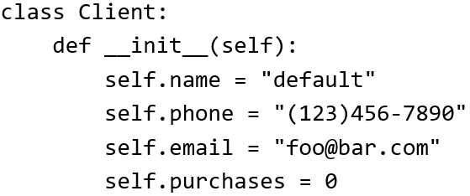

The Client List Example Implemented
Using Classes (2)
Changes 2 attributes:
name = "James Tam"
email = "tam@ucalgary.ca"
def start():
firstClient = Client()
firstClient.name = "James Tam"
firstClient.email = "tam@ucalgary.ca"
print(firstClient.name)
print(firstClient.phone)
print(firstClient.email)
print(firstClient.purchases)
start()

Slide 13
Important Details
Accessing attributes inside the methods of the class
  class Client:
  def __init__(self):
  self.name = "default“
  (More on the ‘self’ keyword later in
  this section)
Accessing attributes outside the methods in the body of the class (e.g. start() function)
  Need to create a reference to the object first
firstClient = Client()
  Then access the object through that reference
firstClient.name = "James Tam"
self.<attribute name>
<Ref name> = <Class name>()
<Ref name>.<attribute name>

Slide 14
What Is The Benefit Of Defining A Class?
It allows new types of variables to be declared.
The new type can model information about most any arbitrary entity:
  Car
  Movie
  Your pet
  A bacteria or virus in a medical simulation
  A ‘critter’ (e.g., monster, computer-controlled player) a video game
  An ‘object’ (e.g., sword, ray gun, food, treasure) in a video game
  A member of a website (e.g., a social network user could have attributes to specify the person’s: images, videos, links, comments and other posts associated with the ‘profile’ object).
Notes:
14

Slide 15
What Is The Benefit Of Defining A Class (2)
Unlike creating a composite type by using a list a predetermined number of fields can be specified and those fields can be named.
  This provides an error prevention mechanism
class Client:
def __init__(self):
self.name = "default"
self.phone = "(123)456-7890"
self.email = "foo@bar.com"
self.purchases = 0
firstClient = Client()
print(firstClient.middleName) #Error: no such field defined

Slide 16
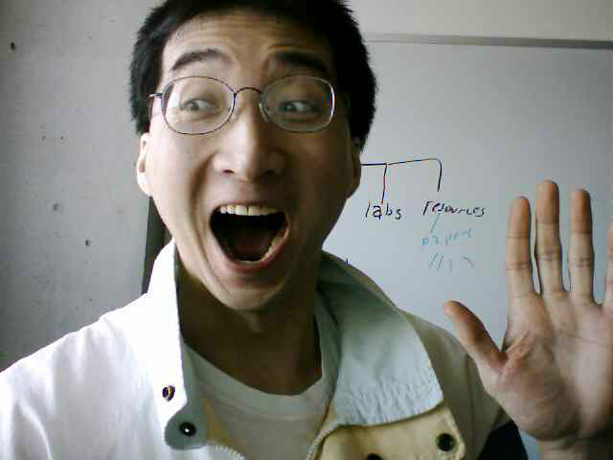
Classes Have Attributes
But Also Behaviors
ATTRIBUTES
Name:
Phone:
Email:
Purchases:
BEHAVIORS
Open account
Buy investments
Sell investments
Close account
A client
Image of James curtesy of James Tam

Slide 17
New Term: Class Methods (“Behaviors”)
List reference
Method operating on the list
1 Not all composites have methods e.g., arrays in ‘C’ are a composite but don’t have methods
Functions: not tied to a composite type or object
  The call is ‘stand alone’, just name of function
  E.g.,
  print(), input()
Methods: must be called through an instance of a composite¹.
  E.g.,
  aList = []
  aList.append(0)
Unlike these pre-created functions, the ones that you associate with classes can be customized to do anything that a regular function can (because you implement them yourself).
Functions that are associated with classes are referred to as methods.

Slide 18
Defining Class Methods
New term: class method
Format:
  class <classname>:
  def <method name> (self, <other parameters>):
  <method body>
Example:
  class Person:
  def __init__(self):
  self.name = "I have no name :("
  def sayName (self):
  print ("My name is...", self.name)
Unlike functions, every method of a class must have the ‘self’ parameter (more on this later)
Reminder: When the attributes are accessed inside the methods of a class they MUST be preceded by the suffix “.self”

Slide 19

Defining Class Methods: Full Example
Name of the online example: 2personV1.py
  class Person:
  def __init__(self):
  self.name = "I have no name :("
  def sayName(self):
  print("My name is...", self.name)
  def start(): #Access outside class requires a reference
  aPerson = Person()
  aPerson.sayName()
  aPerson.name = "Big Smiley :D"
  aPerson.sayName()
  start()

Slide 20
Object-Oriented Design: Advantage Over Procedural Decomposition
Procedural approach: functions can allow for nonsensical behaviors e.g. “flying pigs”
E.g.
  def fly():
  ...
  pigs = list["pig1","pig2"]
  fly(pigs)

Slide 21
Recall: Objected Approach Ties Behaviors (Functions/Methods) To Classes
Definition of a class (in this example it’s the parent whose methods are available to classes that are derived from this class)
  class Flyer():
  def fly(self):
  ….
Via inheritance: class definitions be extended by specifying that ‘child’ classes (derived from the parent) inherit (are able to access) the attributes and methods of the parent.
  class Airplane(Flyer):
Alternative example: Java
public class Airplane extends Flyer
{
}
In python this allows an Airplane object to ‘fly’

Slide 22
Simple Python Example Implementing Inheritance
Name of the online example: 3inheritance
  Derived child class access parent’s attributes/methods
  class Parent():
  def __init__(self):
  self.a = 1
  self.b = 2
  def display(self):
  print(self.a,self.b)
  class Child(Parent): #Can access Parent’s attributes/methods
  def __init__(self):
  super().__init__()
  super().display()
  self.c = "Attribute is unique to child"
  def displayUnique(self):
  print(self.c)
Notes:
Changing super classes attributes directly via sub class is more complex that with other languages apparently requires init)super class method
But generally one should not do this in sub class but in super class anyhow (due to information hiding)

Slide 23
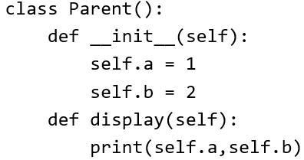
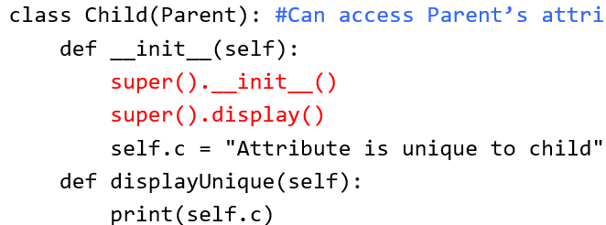
Simple Python Example Implementing Inheritance (2)
  def start():
  print("Parent")
  aParent = Parent()
  aParent.display()
  print(aParent.a,aParent.b)
  print("\nChild")
  aChild = Child()
  aChild.display()
  print(aChild.a,aChild.b,aChild.c)
  #Error: parent has no such attribute print(aParent.c)
  #Error: parent has no such method aParent.displayUnique()
  start()

Slide 24
After This Section You Should Now Know
How to define an arbitrary composite type using a class
  Attributes and methods are bundled with (‘encapsulated’ into the class definition)
What are the benefits of defining a composite type by using a class definition over using a list
How to create instances of a class (instantiate)
How to access and change the attributes (fields) of a class
How to define methods/call methods of a class
How inheritance can allow access to group of derived classes.
  The attributes and methods defined in the parent class can be accessed in the child class/classes.

Slide 25
Section II: Introduction To Recursion

Slide 26
Basic Definition Of Recursion
“A programming technique whereby a function calls itself either directly or indirectly.”

Slide 27
Direct Call
def fun ():
…
fun ()
…
function
Notes:
Recursion in Pascal
27

Slide 28
Indirect Call
f¹
f²
Notes:
Recursion in Pascal
28

Slide 29
Indirect Call
f¹
f²
f³
…
f^{n}
Notes:
Recursion in Pascal
29

Slide 30
Indirect Call (2)
Name of the online example: 1simpleRecursive.py
def fun1():
fun2()
def fun2():
fun1()
fun1()
Notes:
Recursion in Pascal
30

Slide 31
Requirements For Sensible Recursion
1) Base case
2) Progress is made (towards the base case)
Notes:
Recursion in Pascal
31
e.g., sum of a series of numbers from 1 – n.
Sum(4) = 4 + 3 + 2 + 1 = 10
Recursively:
Sum(4) = 4 + sum(3)
Sum(3) = 3 + sum(2)
Sum(2) = 2 + sum(1)
Sum(1) = 1
General:
Sum(n) = n + sum(n-1)

Slide 32
Example Program: 2sumSeries.py
def sum(no):
if (no == 1):
return 1
else:
return (no + sum(no-1) )
def start():
last = input ("Enter the last
number: ")
last = (int)last
total = sum(last)
print ("The sum of the series
from 1 to", last, "is",
total)
start()
sumSeries
total = sum(3)
6
sum (3)
if (3 == 1)
return 1
F
else
return (3 + sum (3 – 1))
3
sum (2)
if (2 == 1)
return 1
F
else
return (2 +sum (2 – 1));
1
sum (1)
if (1 == 1)
return 1
T
Notes:
Recursion in Pascal
32
Draw a memory map for each call to sum.

Slide 33
When To Use Recursion
When a problem can be divided into steps.
The result of one step can be used in a previous step.
There is a scenario when you can stop sub-dividing the problem into steps (step = recursive call) and return to a previous step.
  Algorithm goes back to previous step with a partial solution to the problem (back tracking)
All of the results together solve the problem.
Notes:
Recursion in Pascal
33
Show an example where information has to be reversed like a number conversion: display linked list in reverse order

Slide 34
When To Consider Alternatives To Recursion
When a loop will solve the problem just as well
Types of recursion (for both types a return statement is excepted)
  Tail recursion
    The last statement in the function is another recursive call to that function This form of recursion can easily be replaced with a loop.
  Non-tail recursion
    The last statement in the recursive function is not a recursive call.
    This form of recursion is very difficult (read: impossible) to replace with a loop.
Notes:
Recursion in Pascal
34

Slide 35
Example: Tail Recursion
Tail recursion: A recursive call is the last statement in the recursive function.
Name of the online example: 3tail.py
def tail(no):
if (no <= 3):
print (no)
tail(no+1)
return()
tail(1)
Notes:
1
2
3

Slide 36
Example: Non-Tail Recursion
Non-Tail recursion: A statement which is not a recursive call to the function comprises the last statement in the recursive function.
Name of the online example: 4nonTail.py
def nonTail(no):
if (no < 3):
nonTail(no+1)
print(no)
return()
nonTail(1)
Notes:
TO HELP Illustrate Non-tail: show a non-recursive example where fun1 calls fun2, fun2 must end before fun1 proceeds
5
4
3
2
1

Slide 37
Error Handling Example Using Recursion
Name of the online example: 5errorHandling_Loop.py
  Iterative/looping solution (month must be between 1 – 12)
  month = -1
  while ((month < 1) or (month > 12)):
  month = int(input("Enter birth month (1-12): "))

Slide 38
Error Handling Example Using Recursion (2)
  Name of the online example: 6errorHandling_Recursive.py
  Recursive solution (day must be between 1 – 31)
    def promptDay():
    day = int(input("Enter day of birth (1-31): "))
    if ((day < 1) or (day > 31)):
    day = promptDay()
    return(day)
    day = promptDay()
    print(day)

Slide 39
When To Use Iteration Or Recursion
Rule of thumb for using iteration: if you can implement a solution using a loop then you should do so.
When to employ a recursive solution: a loop cannot be employed.
  “Back tracking” is needed.
  Back tracking: When the repetition (whether via the iterations of a loop or a function calling itself over and over) ends the actual work of solving the problem occurs.
  Examples: Traversing a maze, traversing a file system (folders/directories containing other folders).

Slide 40
Applying Recursion: Traversing A Maze
Picked the wrong direction in the maze?
After repeatedly traversing the maze (going up, left, right, down) and you hit a dead end!
You must “back track” (retrace your steps)

Slide 41
Applying Recursion: Traversing A Directory/Folder Structure (Chart: James Tam)
Pseudo code
traverse(folder reference)
If (reference leads a folder)
traverse(go to left folder)
traverse(go to the right folder)
end if
return()
Storage drive
1
7
6
Folder
Etc.
2
5
3
4
Folder
No more folders: Stop function calls and return to previous time function was called
Folder
File
File
File
File
File
3

Slide 42
Copyright Notification
“Unless otherwise indicated, all images in this presentation are used with permission from Microsoft.”

