Slide 1
Introduction To Computer Science
In this section you will get an overview of some research areas and higher level courses in Computer Science.

Slide 2

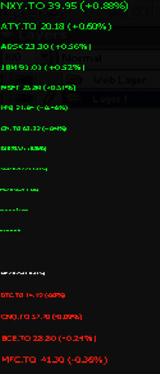
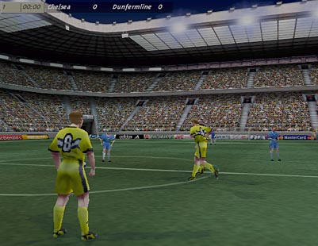
Introduction To Computer Science
Computer Science is about problem solving
Graphics:
Image curtesy of Xin Liu
Representing large sets of data
Image from:
Lau, E. (2003) Stocks.
Artificial Intelligence FIFA © Electronic Arts.

Slide 3
Some Areas Of Study And Research In Computer Science
Human-Computer Interaction
Computer Graphics
Information Visualization
Databases
Computer theory
Computer networking and distributed systems
Artificial Intelligence
Computer Vision
Software Engineering
Computer Security
Games programming
This list provides only a brief introduction to the different areas of Computer Science and is far from comprehensive: For a more updated list of research areas: http://www.cpsc.ucalgary.ca/Research/
Calendar (courses):
  http://www.ucalgary.ca/pubs/calendar/current/computer-science.html
  http://www.ucalgary.ca/pubs/calendar/current/software-engineering.html

Slide 4
Some Areas Of Study And Research In Computer Science
Human-Computer Interaction
Computer Graphics
Information Visualization
Databases
Computer theory
Computer networking and distributed systems
Artificial Intelligence
Computer Vision
Software Engineering
Computer Security
Games programming
This list provides only a brief introduction to the different areas of Computer Science and is far from comprehensive: For a more updated list of research areas: http://www.cpsc.ucalgary.ca/Research/
Calendar (courses):
  http://www.ucalgary.ca/pubs/calendar/current/computer-science.html
  http://www.ucalgary.ca/pubs/calendar/current/software-engineering.html

Slide 5
Human-Computer Interaction (HCI)
Most of Computer Science deals with the ‘technical’ side of computers such as:
Run computers faster!
Make computers store more information!!
Increase the networking capabilities of computers!!!
These technical issues (and others) are all very important but something is still missing...
For more information: http://ilab.cpsc.ucalgary.ca/

Slide 6
Human-Computer Interaction (HCI)
Most of Computer Science deals with the ‘technical’ side of computers such as:
Run computers faster!
Make computers store more information!!
Increase the networking capabilities of computers!!!
Increase the networking capabilities of computers!!!
These technical issues (and others) are all very important but something is still missing...
For more information: http://ilab.cpsc.ucalgary.ca/

Slide 7
Human-Computer Interaction
...but don’t forget about the other side of the relationship.
No matter how powerful the computer and how well written is the software, if the user can’t figure out how it works then the system is useless.
Software should be written to make it as easy as possible for the user to complete their task. (Don’t make it any harder than it has to be).
This is just common sense and should/is always taken into account when writing software?
Common sense?...come on!

Slide 8
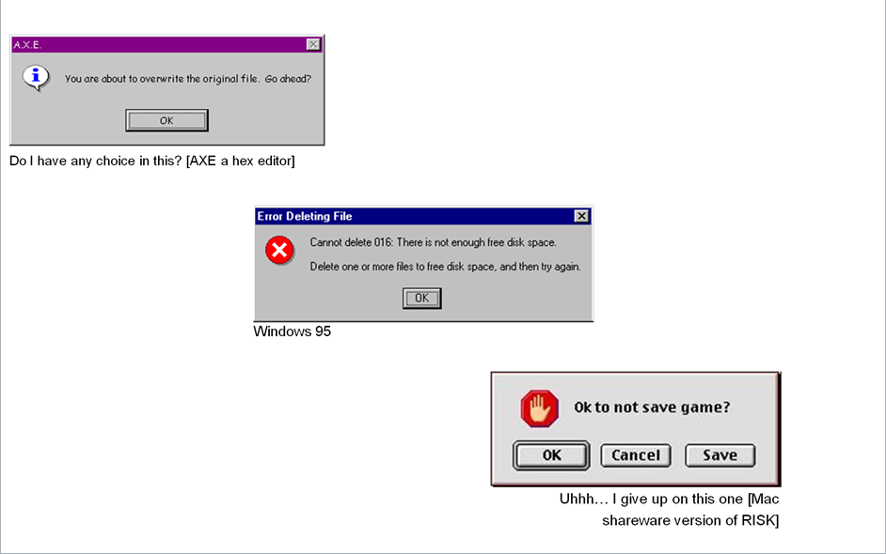
Previous Examples
Cases where designing “user-friendly” technology was not just a matter of commonsense.

Slide 9
What Is Human-Computer Interaction?
Difficult to use
Easy to use
Or at least easier to use

Slide 10
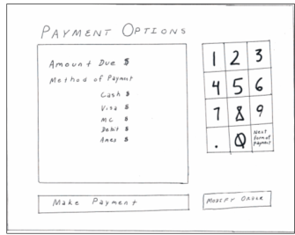
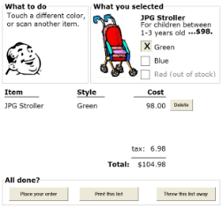
How Can This Be Done?
Many techniques have been developed.
  Some may have already been covered (Usability heuristics from ‘Repetition’)
One other technique: simple but effective (user-centered design)
  Basic principle: getting users involved in the design process from the beginning (rather than building the system and then getting feedback afterwards which is the traditional approach).
  Many benefits:
    Cost reduction: The further along the software development process the harder it is to make changes.
    Users may also provide many unexpected insights
Paper sketches
Complete software (from Saul Greenberg mockup)

Slide 11
HCI: Higher-Level Courses
CPSC 481: Human-Computer Interaction I
CPSC 581: Human-Computer Interaction II
(Related: Human-Robot Interaction)
  CPSC 599.65—Robot head-based interaction
  CPSC 599.62—Advanced topics in human-computer and human-robot interaction
  CPSC 599.17—Human-robot interaction

Slide 12
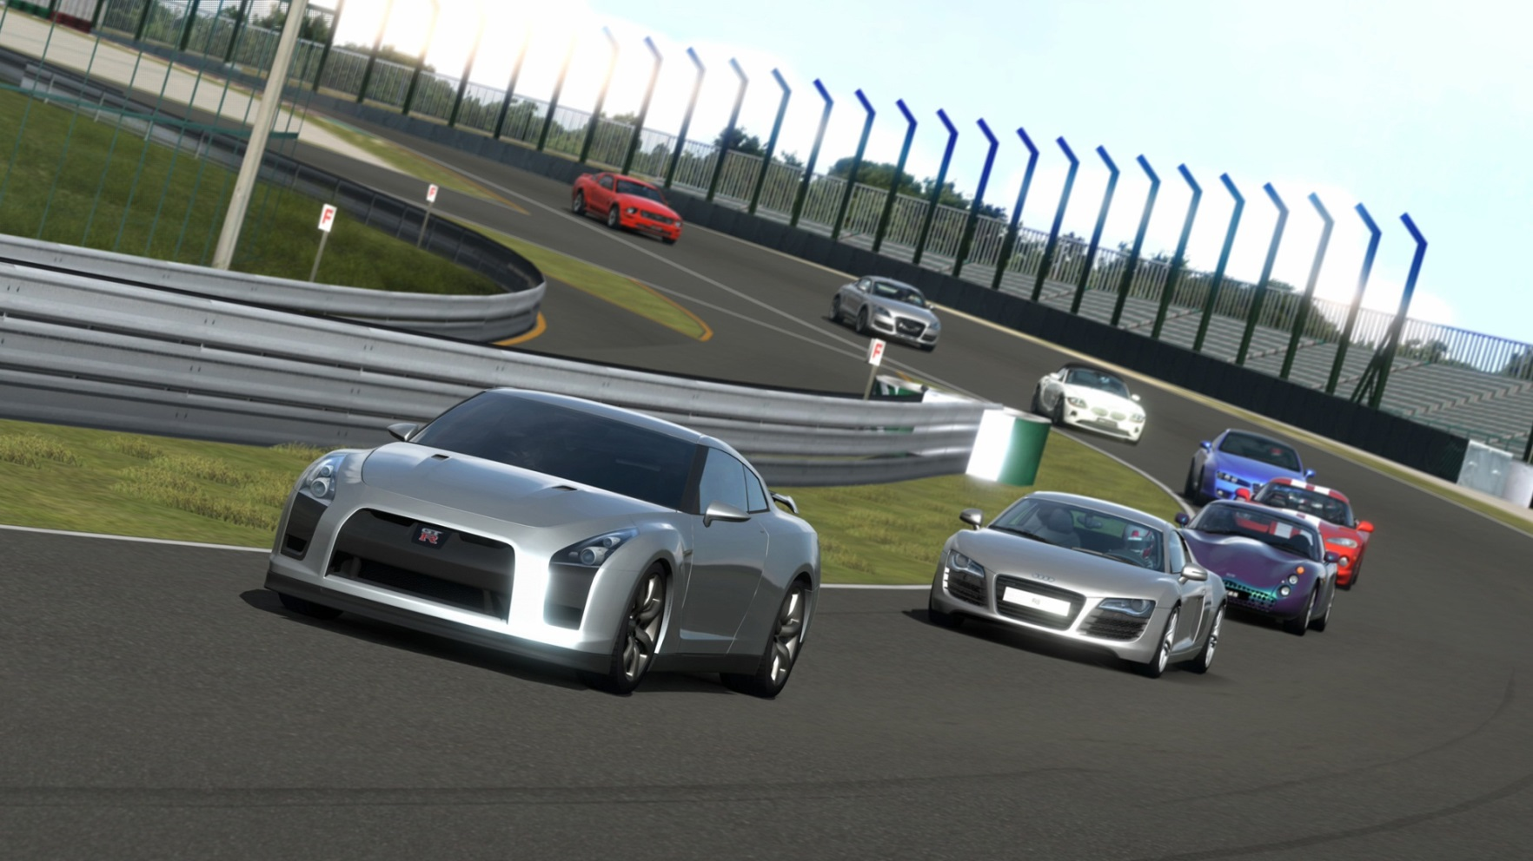
Computer Graphics
Concerned with producing and manipulating images using technology
Gran Turismo © Sony
For more information: http://jungle.cpsc.ucalgary.ca/

Slide 13

Computer Graphics: Issues
How to make the images look “real”?
From http://klamath.stanford.edu/~aaa/

Slide 14
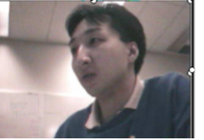
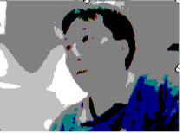
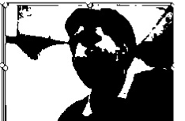
Computer Graphics: Common Misconception
It’s about creating the programs that produce the realistic images and animations (not using existing programs like Photo shop ©).

Slide 15
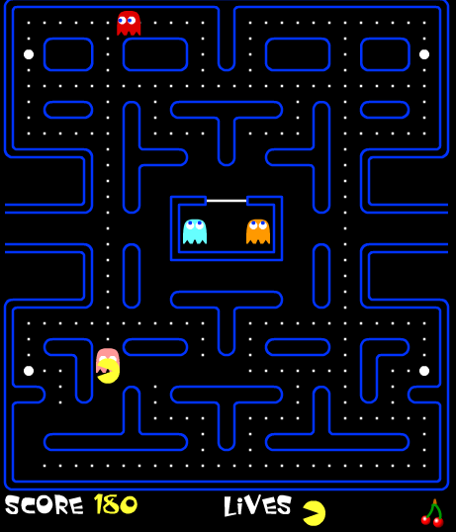
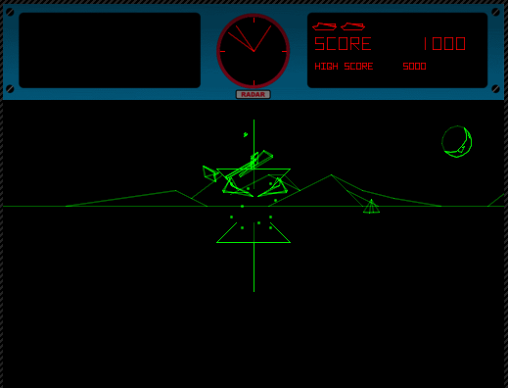
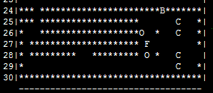
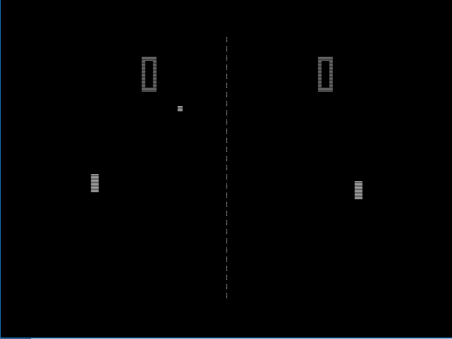
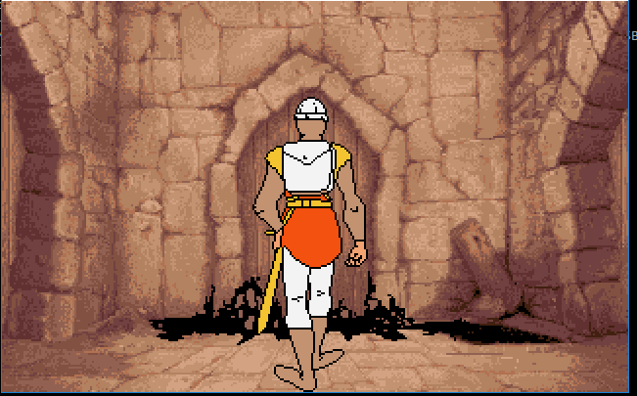
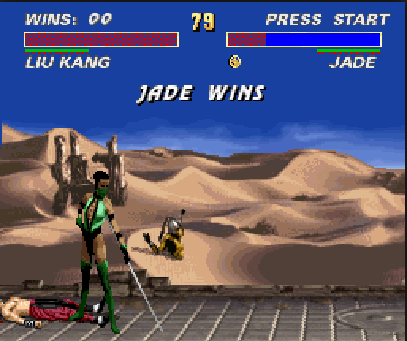
Computer ‘Graphics’ Have Come A Long Way!
“ASCII games” (Tam)
‘Pacman’: re-creation via http://www.webpacman.com/pacman.php
‘Battlezone’: re-creation via http://my.ign.com/atari/battlezone
‘Pong’: re-creation via “Ball 2.7”
Dragon’s lair
“’Ultimate’ Mortal Kombat” re-creation via
http://en.gameslol.net/ultimate-mortal-kombat-3-996.html

Slide 16

Computer Graphics: Still A Long Way To Go
“Even though modeling and rendering in computer graphics have been improved tremendously in the past 35 years, we are still not at the point where we can model automatically, a tiger swimming in the river in all it’s glorious details.” ¹
¹ From “The Tiger Experience” by Alain Fournier at the University of British Columbia

Slide 17

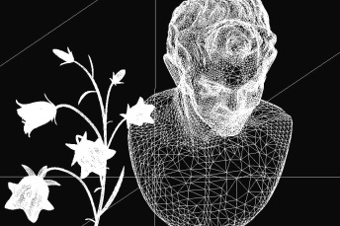



Graphics: Some Areas
Animations
Modeling
Rendering
Image processing
Xin Liu
Xin Liu
James Tam
James Tam

Slide 18
Graphics: Higher-Level Courses
CPSC 453: Introduction to computer graphics
CPSC 587: Fundamentals of computer animation
CPSC 589: Modeling for computer graphics
CPSC 591: Rendering

Slide 19
Artificial Intelligence
Trying to build technology that appears to be ‘intelligent’
Intelligence: What makes a person smart?
  Fact retrieval?
  Creativity?
  Solving problems?
For more information:
http://pages.cpsc.ucalgary.ca/~jacob/AI/ http://pages.cpsc.ucalgary.ca/~denzinge/
https://farhadmaleki.github.io/
https://klovens.github.io/

Slide 20
Artificial Intelligence: Some Areas
Expert systems
Neural networks

Slide 21
Expert Systems
The focus is on capturing the knowledge of a human expert as a set of rules stored in a database.
The expert system can then answer questions, diagnose problems and guide decision making.
Example applications: medicine, computer repair

Slide 22
Neural Networks
The focus is on building structures that function the way that neurons (and their connections in the brain) function.
(Simplified overview):
  Neurons take electrical pulses as input and send electrical pulses as output.
  A required level of input is required before the output is ‘fired’.
This approach has been applied to problems which involve pattern recognition ( e.g., visual, voice).

Slide 23
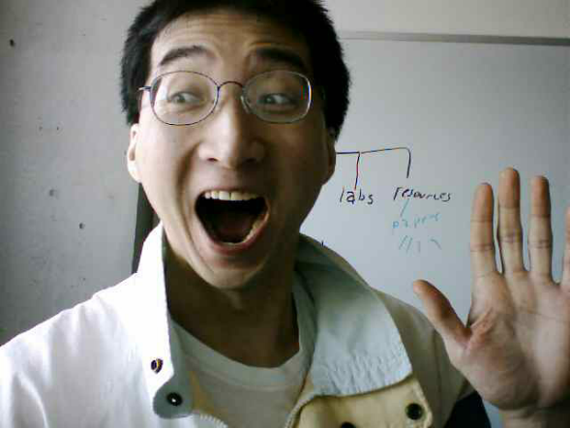
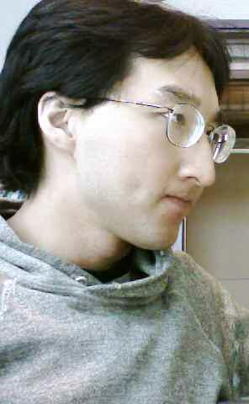

Artificial Intelligence: Mission Accomplished?
How do we know we have a "smart machine"?
  The Turing test
???
?
?

Slide 24
Artificial Intelligence: Higher-Level Courses
CPSC 433: Artificial Intelligence
CPSC 565: Emergent computing
CPSC 567: Foundations of multi-agent systems
CPSC 568: Agent communications

Slide 25

Computer Vision
The focus is on interpreting and understanding visual information.
No
?
No
?
No
No
For more information:
https://farhadmaleki.github.io/
https://klovens.github.io/

Slide 26
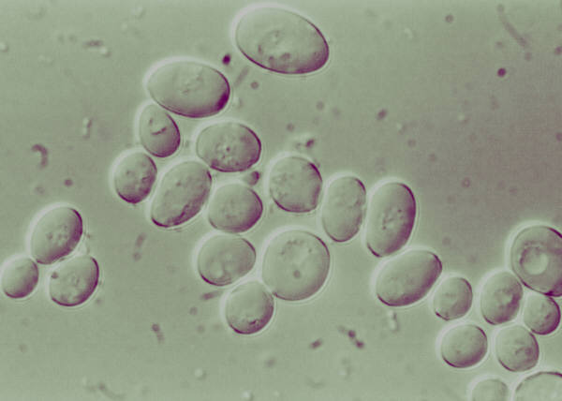


Computer Vision: Some Areas
Recognition
Identification of malignant cells: Stanford (Durmus et. al 2015)
Restoration
Image-based search engines
Removing imperfections such as blurring

Slide 27
Computer Vision: Higher-Level Courses
CPSC 535: Introduction to image analysis and computer vision

Slide 28
Software Engineering
Concerned with employing systematic ways of producing good software on time and within budget.
A typical person can only hold ~7 concepts in their mind at a time.
  A typical computer program consists of more than 7 ‘parts’.
Consequently mechanisms for dealing with this complexity are needed.
  Top down approach is one way: break a large (hard to conceive) problem into smaller more manageable parts.
For more information: http://www.cpsc.ucalgary.ca/cpsc_research/areas/evolutionary

Slide 29
Software Engineering (2): Techniques
Agile program development
Design patterns

Slide 30
Traditional Software Development “Waterfall”
Agile Software Development
(Specifics can vary generally this approach consists of a fixed one way sequence).
Gather requirements
Design the system
Implement and test the system
Verify with the user and make some changes
Maintain the system
The entire project is worked on for each step.
Software development is broken into parts rather than working on the entire system at once stage by stage.
With a particular portion of the program all 5 stages are worked on for several weeks.
  A representative stakeholder works with the team during this time.
At the end of that time that part of the project is sufficient to demonstrate to stakeholders.
Because only a part has been worked on it’s easier to go back (iteratively) and make changes based on feedback.

Slide 31
Traditional Waterfall Vs. Agile Development
Traditional approaches work well for extremely large projects that require a high degree of reliability.
Agile programming works well for smaller (although still large) projects where having a shorter development time is crucial.

Slide 32
Design Patterns
A design pattern: a way of creating software that has been shown to be been sound under a number of different contexts.
Design patterns are a way of documenting successful past approaches
  Top down design: although not one of the formally recognized designed patterns it shares some similarities to those approaches.

Slide 33
Software Engineering: Higher-Level Courses
Software Engineering 301 Analysis and Design of Large-Scale Software I (required for all CPSC majors)
Software Engineering 401 Analysis and Design of Large-Scale Software II
Software Engineering 403 Software Development in Teams and Organizations
Software Engineering 437 Software Testing
Software Engineering 471 Software Requirements Engineering
Software Engineering 511 Software Process and Project Management
Software Engineering 513 Web-Based Systems
Software Engineering 515 Agile Software Engineering

Slide 34
Software Engineering: Higher-Level Courses (2)
Software Engineering 521 Software Reliability and Software Quality
Software Engineering 523 Formal Methods
Software Engineering 533 Software Performance Evaluation
Software Engineering 541 Fundamentals of Software Evolution and Reuse

Slide 35

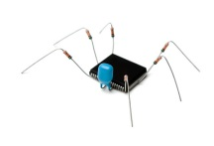

Computer Security
It can involve the creation of malicious software (‘malware’)
XXX
Cheap Viagra!
Buy more! Pay less!
Become rich overnight!
Spam generators
Purpose: learn about how malicious software is created and distributed.
Goal: develop countermeasures to protect computer systems
Colourbox
Virus software
Colourbox
For more information:
http://icis.cpsc.ucalgary.ca/
Spyware

Slide 36
Some Approaches To Computer Security
As just demonstrated, understanding ‘how things work’ is one key component to designing more secure systems.
  e.g., Creating viruses and other malware in order to create better defenses against them.
But also the ‘human’ factor must be considered: some security experts think that many security breaches are due to user actions not technical flaws (social engineering)
  Sometimes the “weakest line of defense” is not the technology but the person.

Slide 37


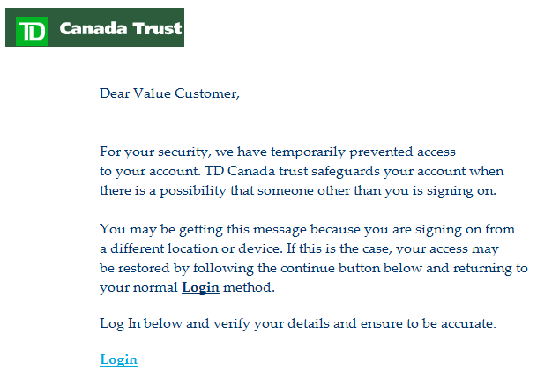
Which Is/Are Fake? Which Is/Are Real?

Slide 38
Cryptography
As may have already been described earlier in the semester (depends on the particular assignments), cryptography can play an important role in security.
  Transmitting and storing sensitive information.
  Cryptography involves the development of new and better approaches for encoding sensitive data to make unauthorized access harder.

Slide 39
Computer Security: Higher-Level Courses
CPSC 329: Explorations in information security and privacy
CPSC 418: Introduction to Cryptography
CPSC 525: Principles of computer security
CPSC 527: Computer viruses and malware
CPSC 528: Spam and spyware
CPSC 530: Information theoretic security

Slide 40
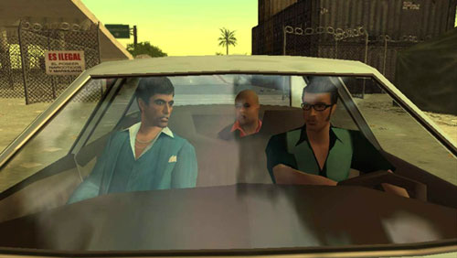
Games Development
The University of Calgary was the first Canadian university to offer this area of study.
<< Warning!!! >>
Blatant advertisement
<< Warning!!! >>
“Scarface: The World is Yours“ © Radical Entertainment
For more information: http://www.cpsc.ucalgary.ca/undergrad/courses_progression/concentration?conc=game

Slide 41
Areas Covered So Far: How (If At All) Does Games Programming Apply
Human-Computer Interaction
Computer Graphics
Artificial Intelligence
Computer Vision
Software Engineering
Computer Security

Slide 42
Computer Games: Higher-Level Courses
CPSC 585: Games programming
  Actual ‘industry practices’ are taught and applied during the semester
    Sound routines, graphics and more
  (Lectures have been taught by actual game developers)

Slide 43
After This Section You Should Know
What are some areas of Computer Science
What does each area entail
Some of the sub-areas, techniques employed or issues associated with each area of computer science

Slide 44
Copyright Notification
“Unless otherwise indicated, all images in this presentation are used with permission from Microsoft.”

Slide 45
Sound And Other Special Effects
Unless otherwise indicated they were produced and edited by James Tam :$

