Slide 1
Extra Topics From CPSC 231: O-O & Recursion
Section I: Defining new types of variables that can have custom attributes and capabilities
Section II: You will learn the definition of recursion as well as seeing how simple recursive programs work

Slide 2
Section I: Introduction To Object-Oriented Programming

Slide 3
Composites
What you have seen
  Lists
  Strings
  Tuples
What if we need to store information about an entity with multiple attributes and those attributes need to be labeled?
  Example: Client attributes = name, address, phone, email

Slide 4
Some Drawbacks Of Using A List
The parts of a composite list can be accessed via [index] but they cannot be labeled (what do these fields store?)
Which field contains what type of information? This isn’t immediately clear from looking at the program statements.
  client = [“xxxxxxxxxxxxxxx",
  “0000000000",
  “xxxxxxxxx",
  0]
Is there any way to specify rules about the type of information to be stored in a field e.g., a data entry error could allow alphabetic information (e.g., 1-800-BUY-NOWW) to be entered in the phone number field.

Slide 5

New Term: Class
Can be used to define a generic template for a new non-homogeneous composite type.
It can label and define more complex entities than a list.
This template defines what an instance (example) of this new composite type would consist of but it doesn’t create an instance.
Copyright information unknown

Slide 6


Classes Define A Composite Type
New term: Attribute
The class definition specifies the type of information (called “attributes”) tracked by each instance (example) of a composite.
Name:
Phone:
Email:
Purchases:
Each of these fields could be analogous to a list element but they are accessed via the name
Name:
Phone:
Email:
Purchases:
Name:
Phone:
Email:
Purchases:

Slide 7
Declaring A New Variable Type: Defining A Class¹
Note the convention: The first letter is capitalized.
Format:
  class <Name of the class>:
  def __init__(self):
  self.name of first field = <default value>
  self.name of second field = <default value>
Example (attributes clearer):
  class Client:
  def __init__(self):
  self.name = "default"
  self.phone = "(123)456-7890
Describes what information that would be tracked by a “Client” but doesn’t yet create a client variable
Defining a ‘client’ by using a list (index # mapped to a attribute is not self evident)
client = ["xxxxxxxxxxxxxxx",
"0000000000",
"xxxxxxxxx",
0]
1 Although capitalization of the class name isn’t the Python standard it is the standard with many other programming languages: Java, C++

Slide 8
Creating A Variable Of The New Type: An Instance Of A Class
New terms:
Instance
Object
instantiation
Creating an actual instance (instance = object) is referred to as
Format:
  <reference name> = <name of class>()
Example:
  firstClient = Client()

Slide 9


Defining A Class Vs. Creating An Instance Of That Class
Defining a class (~List type)
  A template that describes that class: how many fields, what type of information will be stored by each field, what default information will be stored in a field.
Creating an object (~creating a new list)
  Instances of that class (during instantiation) which can take on different forms.
Image copyright unknown
Example:
class Client:
def __init__(self):
  self.name = "default"
  self.phone = "(123)456-7890
Example:
firstClient = Client()

Slide 10
Accessing And Changing The Attributes - Outside Class Methods E.g. Inside Start()
Format:
  <reference name>.<field name> # Accessing value
  <reference name>.<field name> = <value> # Changing value
Example:
  def start():
  aClient.name = "James"
  print(aClient.name)

Slide 11
The Client List Example Implemented Using Classes And Objects
Exactly as-is i.e. no spaces, 2 underscores
Name of the online example: 1client.py
class Client:
def __init__(self):
self.name = "default"
self.phone = "(123)456-7890"
self.email = "foo@bar.com"
self.purchases = 0

Slide 12
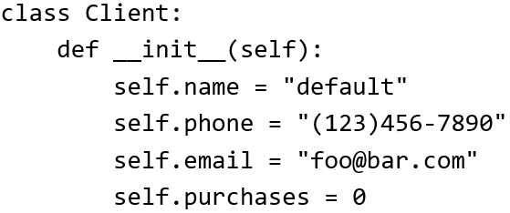

The Client List Example Implemented
Using Classes (2)
Changes 2 attributes:
name = "James Tam"
email = "tam@ucalgary.ca"
def start():
firstClient = Client()
firstClient.name = "James Tam"
firstClient.email = "tam@ucalgary.ca"
print(firstClient.name)
print(firstClient.phone)
print(firstClient.email)
print(firstClient.purchases)
start()

Slide 13
Important Details
Accessing attributes inside the methods of the class
  class Client:
  def __init__(self):
  self.name = "default“
  (More on the ‘self’ keyword later in
  this section)
Accessing attributes outside the methods in the body of the class (e.g. start() function)
  Need to create a reference to the object first
firstClient = Client()
  Then access the object through that reference
firstClient.name = "James Tam"
self.<attribute name>
<Ref name> = <Class name>()
<Ref name>.<attribute name>

Slide 14
What Is The Benefit Of Defining A Class?
It allows new types of variables to be declared.
The new type can model information about most any arbitrary entity:
  Car
  Movie
  Your pet
  A bacteria or virus in a medical simulation
  A ‘critter’ (e.g., monster, computer-controlled player) a video game
  An ‘object’ (e.g., sword, ray gun, food, treasure) in a video game
  A member of a website (e.g., a social network user could have attributes to specify the person’s: images, videos, links, comments and other posts associated with the ‘profile’ object).
Notes:
14

Slide 15
What Is The Benefit Of Defining A Class (2)
Unlike creating a composite type by using a list a predetermined number of fields can be specified and those fields can be named.
  This provides an error prevention mechanism
class Client:
def __init__(self):
self.name = "default"
self.phone = "(123)456-7890"
self.email = "foo@bar.com"
self.purchases = 0
firstClient = Client()
print(firstClient.middleName) #Error: no such field defined

Slide 16
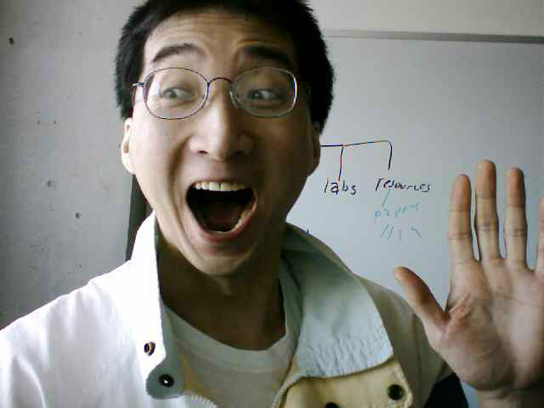
Classes Have Attributes
But Also Behaviors
ATTRIBUTES
Name:
Phone:
Email:
Purchases:
BEHAVIORS
Open account
Buy investments
Sell investments
Close account
A client
Image of James curtesy of James Tam

Slide 17
New Term: Class Methods (“Behaviors”)
List reference
Method operating on the list
1 Not all composites have methods e.g., arrays in ‘C’ are a composite but don’t have methods
Functions: not tied to a composite type or object
  The call is ‘stand alone’, just name of function
  E.g.,
  print(), input()
Methods: must be called through an instance of a composite¹.
  E.g.,
  aList = []
  aList.append(0)
Unlike these pre-created functions, the ones that you associate with classes can be customized to do anything that a regular function can (because you implement them yourself).
Functions that are associated with classes are referred to as methods.

Slide 18
Defining Class Methods
New term: class method
Format:
  class <classname>:
  def <method name> (self, <other parameters>):
  <method body>
Example:
  class Person:
  def __init__(self):
  self.name = "I have no name :("
  def sayName (self):
  print ("My name is...", self.name)
Unlike functions, every method of a class must have the ‘self’ parameter (more on this later)
Reminder: When the attributes are accessed inside the methods of a class they MUST be preceded by the suffix “.self”

Slide 19

Defining Class Methods: Full Example
Name of the online example: 2personV1.py
  class Person:
  def __init__(self):
  self.name = "I have no name :("
  def sayName(self):
  print("My name is...", self.name)
  def start(): #Access outside class requires a reference
  aPerson = Person()
  aPerson.sayName()
  aPerson.name = "Big Smiley :D"
  aPerson.sayName()
  start()

Slide 20
Object-Oriented Design: Advantage Over Procedural Decomposition
Procedural approach: functions can allow for nonsensical behaviors e.g. “flying pigs”
E.g.
  def fly():
  ...
  pigs = list["pig1","pig2"]
  fly(pigs)

Slide 21
Recall: Objected Approach Ties Behaviors (Functions/Methods) To Classes
Definition of a class (in this example it’s the parent whose methods are available to classes that are derived from this class)
  class Flyer():
  def fly(self):
  ….
Via inheritance: class definitions be extended by specifying that ‘child’ classes (derived from the parent) inherit (are able to access) the attributes and methods of the parent.
  class Airplane(Flyer):
Alternative example: Java
public class Airplane extends Flyer
{
}
In python this allows an Airplane object to ‘fly’

Slide 22
Simple Python Example Implementing Inheritance
Name of the online example: 3inheritance
  Derived child class access parent’s attributes/methods
  class Parent():
  def __init__(self):
  self.a = 1
  self.b = 2
  def display(self):
  print(self.a,self.b)
  class Child(Parent): #Can access Parent’s attributes/methods
  def __init__(self):
  super().__init__()
  super().display()
  self.c = "Attribute is unique to child"
  def displayUnique(self):
  print(self.c)

Slide 23
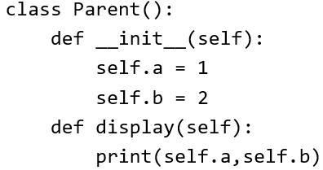
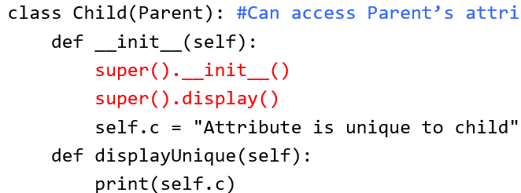
Simple Python Example Implementing Inheritance (2)
  def start():
  print("Parent")
  aParent = Parent()
  aParent.display()
  print(aParent.a,aParent.b)
  print("\nChild")
  aChild = Child()
  aChild.display()
  print(aChild.a,aChild.b,aChild.c)
  #Error: parent has no such attribute print(aParent.c)
  #Error: parent has no such method aParent.displayUnique()
  start()

Slide 24
After This Section You Should Now Know
How to define an arbitrary composite type using a class
  Attributes and methods are bundled with (‘encapsulated’ into the class definition)
What are the benefits of defining a composite type by using a class definition over using a list
How to create instances of a class (instantiate)
How to access and change the attributes (fields) of a class
How to define methods/call methods of a class
How inheritance can allow access to group of derived classes.
  The attributes and methods defined in the parent class can be accessed in the child class/classes.

Slide 25
Section II: Introduction To Recursion

Slide 26
Basic Definition Of Recursion
“A programming technique whereby a function calls itself either directly or indirectly.”

Slide 27
Direct Call
def fun ():
…
fun ()
…
function
Notes:
Recursion in Pascal
27

Slide 28
Indirect Call
f¹
f²
Notes:
Recursion in Pascal
28

Slide 29
Indirect Call
f¹
f²
f³
…
f^{n}
Notes:
Recursion in Pascal
29

Slide 30
Indirect Call (2)
Name of the online example: 1simpleRecursive.py
def fun1():
fun2()
def fun2():
fun1()
fun1()
Notes:
Recursion in Pascal
30

Slide 31
Requirements For Sensible Recursion
1) Base case
2) Progress is made (towards the base case)
Notes:
Recursion in Pascal
31

Slide 32
Example Program: 2sumSeries.py
def sum(no):
if (no == 1):
return 1
else:
return (no + sum(no-1) )
def start():
last = input ("Enter the last
number: ")
last = (int)last
total = sum(last)
print ("The sum of the series
from 1 to", last, "is",
total)
start()
sumSeries
total = sum(3)
6
sum (3)
if (3 == 1)
return 1
F
else
return (3 + sum (3 – 1))
3
sum (2)
if (2 == 1)
return 1
F
else
return (2 +sum (2 – 1));
1
sum (1)
if (1 == 1)
return 1
T
Notes:
Recursion in Pascal
32
Draw a memory map for each call to sum.

Slide 33
When To Use Recursion
When a problem can be divided into steps.
The result of one step can be used in a previous step.
There is a scenario when you can stop sub-dividing the problem into steps (step = recursive call) and return to a previous step.
  Algorithm goes back to previous step with a partial solution to the problem (back tracking)
All of the results together solve the problem.
Notes:
Recursion in Pascal
33

Slide 34
When To Consider Alternatives To Recursion
When a loop will solve the problem just as well
Types of recursion (for both types a return statement is excepted)
  Tail recursion
    The last statement in the function is another recursive call to that function This form of recursion can easily be replaced with a loop.
  Non-tail recursion
    The last statement in the recursive function is not a recursive call.
    This form of recursion is very difficult (read: impossible) to replace with a loop.
Notes:
Recursion in Pascal
34

Slide 35
Example: Tail Recursion
Tail recursion: A recursive call is the last statement in the recursive function.
Name of the online example: 3tail.py
def tail(no):
if (no <= 3):
print (no)
tail(no+1)
return()
tail(1)

Slide 36
Example: Non-Tail Recursion
Non-Tail recursion: A statement which is not a recursive call to the function comprises the last statement in the recursive function.
Name of the online example: 4nonTail.py
def nonTail(no):
if (no < 3):
nonTail(no+1)
print(no)
return()
nonTail(1)

Slide 37
Error Handling Example Using Recursion
Name of the online example: 5errorHandling_Loop.py
  Iterative/looping solution (month must be between 1 – 12)
  month = -1
  while ((month < 1) or (month > 12)):
  month = int(input("Enter birth month (1-12): "))

Slide 38
Error Handling Example Using Recursion (2)
  Name of the online example: 6errorHandling_Recursive.py
  Recursive solution (day must be between 1 – 31)
    def promptDay():
    day = int(input("Enter day of birth (1-31): "))
    if ((day < 1) or (day > 31)):
    day = promptDay()
    return(day)
    day = promptDay()
    print(day)

Slide 39
When To Use Iteration Or Recursion
Rule of thumb for using iteration: if you can implement a solution using a loop then you should do so.
When to employ a recursive solution: a loop cannot be employed.
  “Back tracking” is needed.
  Back tracking: When the repetition (whether via the iterations of a loop or a function calling itself over and over) ends the actual work of solving the problem occurs.
  Examples: Traversing a maze, traversing a file system (folders/directories containing other folders).

Slide 40
Applying Recursion: Traversing A Maze
Picked the wrong direction in the maze?
After repeatedly traversing the maze (going up, left, right, down) and you hit a dead end!
You must “back track” (retrace your steps)

Slide 41
Applying Recursion: Traversing A Directory/Folder Structure (Chart: James Tam)
Pseudo code
traverse(folder reference)
If (reference leads a folder)
traverse(go to left folder)
traverse(go to the right folder)
end if
return()
Storage drive
1
7
6
Folder
Etc.
2
5
3
4
Folder
No more folders: Stop function calls and return to previous time function was called
Folder
File
File
File
File
File
3

Slide 42
Copyright Notification
“Unless otherwise indicated, all images in this presentation are used with permission from Microsoft.”

