Slide 1
Branching In Python: Part 1
IF
IF-ELSE
Logic: AND, OR, NOT (conceptual and Google search examples)
  The application of logic used in Google searches is an exert of the “The Internet & web search” notes from CPSC 203

Slide 2
Recap: Programs You’ve Seen So Far Produces Sequential Execution
  print ("This program will calculate the area of a
  rectangle")
  length = int(input("Enter the length: "))
  width = int(input("Enter the width: "))
  area = length * width
  print("Area: ", area)
Programs you have seen thus far:
Execute statement after statement one after the other from start to finish.
There are no options for alternatives (branch in execution).
Nor are there options to repeat a portion.
Start
End

Slide 3
Programming: Branching
Why is it needed?
  When alternative courses of action are possible and each action may produce a different result.
In terms of a computer program the choices are stated in the form of a question that only yield an answer that is either true or false
  Although the approach is very simple, modeling branching in this fashion is a very useful and powerful tool.
New terminology
  These true/false questions are referred to “Boolean expressions”
    e.g., it is over 45 Celsius today
    e.g., the user correctly entered the password
    Python code example: If (income < 10000):

Slide 4

High Level View Of Branching For The Computer
Is income below $10,000?
True
False
Is income between $10K - $20K?
Nominal income deduction
Eligible for social assistance
True
False
Income tax = 20%
etc.

Slide 5
How To Determine If Branching Can Be Applied
Under certain conditions actions (programming instructions) will be taken by a program.
Examples:
  If users who don’t meet the age requirement of the website the user will not be allowed to sign up (conversely if users do meet the age requirement the person will be allowed to sign up).
  If an employee is deemed as too inexperienced and too expensive to keep on staff then person will be laid off.
  If a person clicks on a link on a website for a particular location then a video will play showing tourist ‘hot spots’ for that location.
  If a user enters invalid age information (say negative values or values greater than 114) then the program will display an error message.

Slide 6
Branching In Programming (Python)
Branches are questions with answers that are either true or false (Boolean expressions) e.g., Is it true that the variable ‘num’ is positive?
The program may branch one way or another depending upon the answer to the question (the result of the Boolean expression).
Branching structures in Python:
  If (reacts differently only for true case)
  If-else (reacts differently for the true or false cases)
  If-elif-else (multiple cases possible but only one case can apply, if one case is true then it’s false that the other cases apply)

Slide 7
New Terminology
New term, body: A block of program instructions that will execute when a Boolean expression evaluates to/works out to true)
  Body (of a python program)
  Body of a branch:
    Specified with indenting in python (4 spaces)
    Don’t use tabs (tabs won’t consistently indent across computers/programs)
    IDLE typically adds the indenting for you automatically.
name=input("Name: ")
print(name)
This/these instruction/instructions run when you give the Python interpreter the name of a file, the ‘body’ of the Python program runs
Is income below $10,000?
True
If (income < 10000):
deduction = 1.00
print("Assistance")
Nominal income deduction
Eligible for social assistance

Slide 8
New Terminology
Math Examples:
2 + 3
2 * (-3)
Relational logic examples (produce a Boolean result)
x > 2
username == "tam“ (The “equals-equals” operator checks if the expression on the left and right are equal)
Operator/Operation: action being performed
Operand: the item or items on which the operation is being performed.

Slide 9
Note On Indenting
With many programming languages indenting is part of good programming style.
In Python indenting is mandatory in order to determine which statements are part of a body (syntactically required in Python).
A body with multiple instructions simply requires all those statements to be indented.
Single statement body
  if (age == 0):
  print("'Gratz' it's your birthday!")
Multi-statement body
  if (age == 0):
  print("'Gratz' it's your birthday!")
  print("Many happy returns.")

Slide 10
Note On Indenting (2)
A “sub-body” (IF-branch) is indented by an additional 4 spaces (8 or more spaces) if one IF-branch is inside the body of another IF-branch (this is called ‘nesting’ – more details later).
  Example (just for reference for now, details come later)
  If (BE 1):
  first body #4 spaces
  if (BE2):
  second (nested body) #4 spaces + 4 spaces
Again you should NOT use tabs for indenting what looks neatly and consistently indented with one editor or operating system could be a mess in other cases:
  If you write programs on different platforms (e.g. using a UNIX editor in the lab and Notepad at home).
  When your marker views your assignment or project.

Slide 11
Allowable Operands For Boolean Expressions
Format:
  (operand relational operator operand):
Example:
  (age >= 18):
Some operand types
  Integer e.g. age = 12
  floats (~real) e.g. height = 68.5
  String e.g. name = "Tam"
  Boolean (True or False) E.g. gameWon = False
Make sure that you are comparing operands of the same type or at the very least they must be comparable (e.g. integer and float comparison is okay, integer and string is not)!

Slide 12
Allowable Relational Operators For Boolean Expressions
if (operand relational operator operand) then
Python Mathematical
operator equivalent Meaning Example
< < Less than 5 < 3
> > Greater than 5 > 3
== = Equal to 5 == 3
<= ≤ Less than or equal to 5 <= 5
>= ≥ Greater than or equal to 5 >= 4
!= ≠ Not equal to x != 5

Slide 13
Branching With An ‘If’
Question?
True
Execute a statement
or statements (body)
False
Remainder of
the program

Slide 14
The ‘If’ Structure
Boolean expression
Note: Indenting the body is mandatory!
Branching: checking if a condition is true (in which case something should be done).
Format:
(General format)
  if (Boolean expression):
  body
(Detailed structure)
if (<operand> <relational operator> <operand>):
body

Slide 15
The ‘If’ Structure (2)
Example (1if1.py):
  Learning objective of example: program executes a statement when a Boolean expression evaluates to true.
  age = int(input("Age: "))
  if (age >= 18):
  print("You are an adult")

Slide 16
Common Mistake
1 This not a syntax error in all programming languages so don’t get complacent and assume that the language will automatically “take care of things” for you.
Do not confuse the equality operator '==' with the assignment operator '='.
  Mistake: using a single equals sign instead of two when forming a Boolean expression.
Example (Python syntax error)¹:
  if (num = 1): # Not the same as if (num == 1):
  To be extra safe some programmers put unnamed constants on the left hand side of an equality operator (which always/almost always results in a syntax error rather than a logic error if the assignment operator is used in place of the equality operator).
A way of producing syntax rather than a logic error:
  if (1 = num)

Slide 17
A Similar Mistake
Example (Python syntax error, used to be a logic error):
  num == 1 # Not the same as num = 1
  Mistake: including two equals signs instead of one when trying to assign a value to memory location.

Slide 18
An Application Of Branches
Branching statements can be used to check the validity of data (if the data is correct or if the data is a value that’s allowed by the program).
General structure:
  if (error condition has occurred):
  React to the error (at least display an error message)
Example:
  if (age < 0):
  print("Age cannot be a negative value")
JT’s tip: if data can only take on a certain value (or range) do not automatically assume that it will be valid. Check the validity of range before proceeding onto the rest of the program.

Slide 19
Branching With An ‘If’: Summary
Used when a question (Boolean expression) evaluates only to a true or false value (Boolean):
  If the question evaluates to true then the program reacts differently. It will execute the body after which it proceeds to the remainder of the program (which follows the if structure).
  If the question evaluates to false then the program doesn’t react differently. It just executes the remainder of the program (which follows the if structure).

Slide 20
Branching With An ‘If-Else’
Question?
True
Execute a statement
or statements (if body)
False
Execute a statement
or statements (else body)
Remainder of
the program

Slide 21
The If-Else Structure
Branching: checking if a condition is true (in which case something should be done) but unlike ‘if’ also reacting if the condition is not true (false).
Format:
if (operand relational operator operand):
body of 'if'
else:
body of 'else'
additional statements

Slide 22
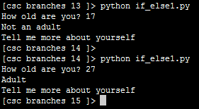
If-Else Structure (2)
If case
Else case
Program name: 2if_else1.py
  Learning objective of example: program executes one body when a Boolean expression evaluates to true and another when it’s false.
Partial example:
  if (age < 18):
  print("Not an adult")
  else:
  print("Adult")
  print("Tell me more about yourself")

Slide 23
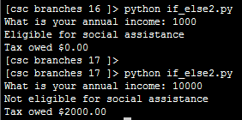
If-Else Example
Program name: 3if_else2.py
  Learning objective of example: defining the bodies of an IF-case and an ELSE-case with multiple statements.
Partial example:
  if (income < 10000):
  print("Eligible for social assistance")
  taxCredit = 100
  taxRate = 0.1
  else:
  print("Not eligible for social assistance")
  taxRate = 0.2
  tax = (income * taxRate) - taxCredit

Slide 24
Quick Summary: If Vs. If-Else
If:
  Evaluate a Boolean expression (ask a question).
  If the expression evaluates to true then execute the ‘body’ of the if.
  No additional action is taken when the expression evaluates to false.
  Use when your program is supposed to react differently only when the answer to a question is true (and do nothing different if it’s false).
If-Else:
  Evaluate a Boolean expression (ask a question).
  If the expression evaluates to true then execute the ‘body’ of the if.
  If the expression evaluates to false then execute the ‘body’ of the else.
  That is: Use when your program is supposed to react differently for both the true and the false cases.

Slide 25
Logical Operations
There are many logical operations but the three most commonly used in computer programs include:
  Logical AND
  Logical OR
  Logical NOT

Slide 26
Online Searches, Multiple Words: All Words Must Appear In Results
For instance you not only want to search for ‘CPSC’ courses but also ones with the course number ‘203’ in ‘Calgary’
Format (searches for all words):
  <First word> <Second word> (There is an implicit AND, but there is no need include a specific ‘AND’ operator with Google)
Example
  CPSC 203 Calgary

Slide 27
Logical AND
The popular usage of the logical AND applies when ALL conditions must be met.
Logical AND can be specified more formally in the form of a truth table in order to cover all cases of true/false.
Truth table (AND)
C1 | C2 | C1 AND C2
False | False | False
False | True | False
True | False | False
True | True | True

Slide 28
Logical AND: Three Input Truth Table
Truth table
C1 | C2 | C3 | C1 AND C2 AND C3
False | False | False | False
False | False | True | False
False | True | False | False
False | True | True | False
True | False | False | False
True | False | True | False
True | True | False | False
True | True | True | True

Slide 29
Evaluating Logical AND Expressions
In class:
  False AND True AND True
Extra for you to do:
  True AND True AND True
  True AND True AND True AND False
Notes:
29

Slide 30
Searching Among Alternatives
As you just saw when multiple words are typed into the search box Google will try to find web pages that include all of those words.
To specify that each word (or phrase) is an alternative separate each search criteria using the OR operator (capitalization is important).
Example (searches include alternatives):
  cute wallpapers cats OR dogs
  “Bruce Lee” OR “Little Dragon” OR “Lee Siu Lung”
  “Wayne Gretzky” OR “The Great One” OR “Number 99” OR “Number ninety nine”

Slide 31
Logical OR
The correct everyday usage of the logical OR applies when ATLEAST one condition must be met.
Truth table
C1 | C2 | C1 OR C2
False | False | False
False | True | True
True | False | True
True | True | True

Slide 32
Logical OR: Three Input Truth Table
Truth table
C1 | C2 | C3 | C1 OR C2 OR C3
False | False | False | False
False | False | True | True
False | True | False | True
False | True | True | True
True | False | False | True
True | False | True | True
True | True | False | True
True | True | True | True

Slide 33
Evaluating Logical OR Expressions
In class:
  False OR True OR True
Extra for you to do:
  True OR True OR True
  False OR False OR False OR True
Notes:
33

Slide 34
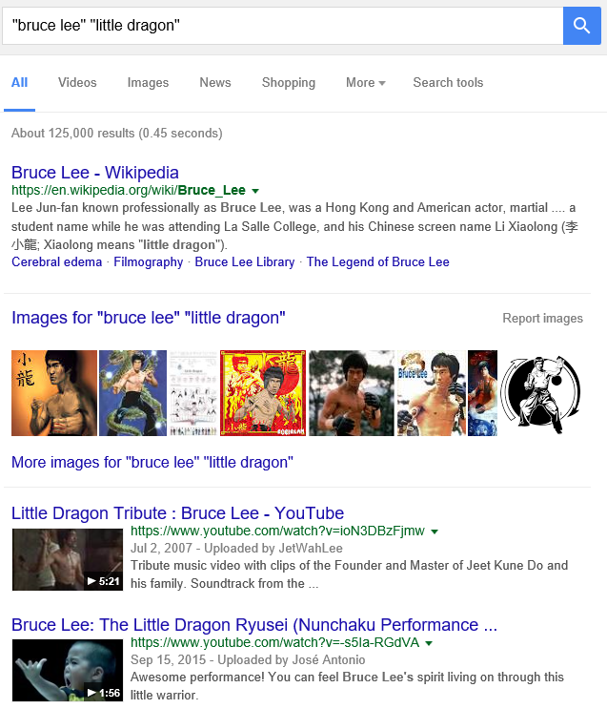
Example: Multiple Search Terms (Default Requires All Words: Logical AND)
Notes:
Pages must have both names (Logical AND is default)

Slide 35
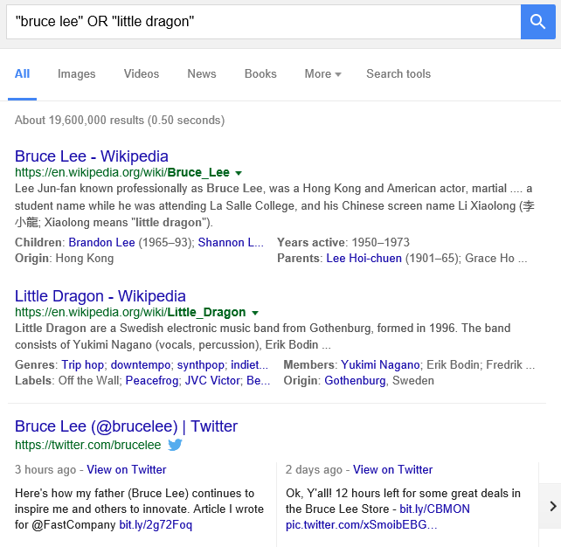
Example: Multiple Search Terms (“OR”)

Slide 36
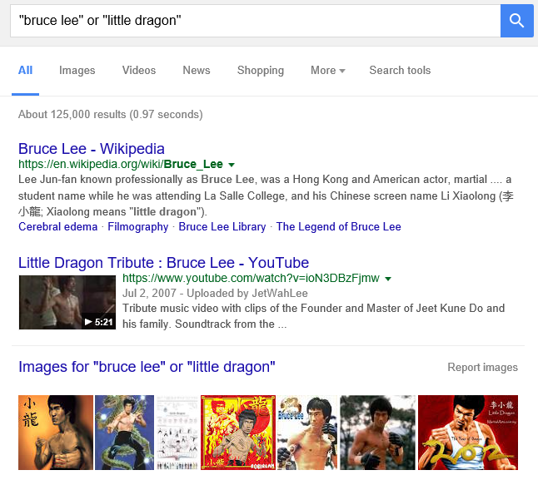
Example: Multiple Search Terms, OR - No Caps
Notes:
The lower case ‘or’ is just ignored

Slide 37
Excluding Words
Return search results excluding (or “not including” specified words)
There may be times when you want Google to exclude from results certain words or phrases.
This can be done with the subtraction operator (subtract the words that follow the operator from search results).
Example:
  “James Tam”
  Vs.
  “James Tam” –Calgary
An alternate approach is to use the ‘NOT’ operator
  “James Tam” NOT Calgary

Slide 38
Logical NOT
The everyday usage of logical NOT negates (or reverses) a statement.
The truth table for logical NOT is quite simple:
Truth table
C | Not C
False | True
True | False

Slide 39
Example Results: AND, OR, Subtraction (NOT)
Search phrase | Operator | ~Num. results
“james tam" | (Exact phrase) | 63,200
“james tam" -"computer science“ | NOT | 49,300
"james tam" AND "computer science" | AND | 13,400
"james tam" OR "computer science" | OR | 229,000,000

Slide 40
Evaluating More Complex Logical Expressions
Order of operation (left to right evaluation if the ‘level’ is equal)
  Brackets (inner first)
  Negation
  AND
  OR
Notes:
40

Slide 41
Evaluating More Complex Logical Expressions
In class:
  True OR False AND False
  (True OR False) AND False
  NOT False
  NOT NOT False
Extra for you to do:
  NOT (False OR True) OR True
  (False AND False) OR (False AND True)
  NOT NOT NOT NOT True
  NOT NOT NOT False
Notes:
41
if True or False and False:
print("And first")
else:
print("And/Or equal")

Slide 42
Student Exercise: Extra Practice
(From “Starting out with Python (2nd Edition)” by Tony Gaddis)
  Assume the variables a = 2, b = 4, c = 6
  For each of the following conditions indicate whether the final value is true or false.
Expression | Final result
a == 4 or b > 2
6 <= c and a > 3
1 != b and c != 3
a >-1 or a <= b
not (a > 2)

Slide 43
After This Section You Should Now Know
What are the three branching mechanisms available in Python:
  If
  If-else
  How does each one work
  When should each one be used
Introducing three logical operations
  AND
  OR
  NOT

Slide 44
After This Section You Should Now Know (2)
  How the bodies of the branching structures are defined:
  What is the body of a branching structure
  What is the difference between branching with simple bodies and those with compound bodies
What is an operand
What is a relational operator
What is a Boolean expression
How multiple expressions are evaluated and how the different logical operators work
Techniques for more effective web searches using Google:
  Requiring all words or phrases to appear in results: AND
  Searching for alternates: OR
  Excluding words and phrases: - (subtraction operator)

Slide 45
Copyright Notification
“Unless otherwise indicated, all images in this presentation are used with permission from Microsoft.”

