Slide 1
VBA: Tutorial Week 2
Going over the requirements of Workbook exercise #4
Displaying the number of spelling mistakes
Changing font properties
Writing text to a document
Finding things in a document (text strings, font effects, formatting styles in Word)
Official resource for MS-Office products: https://support.office.com

Slide 2
First Tutorial (Monday or Tuesday)

Slide 3
Workbook Exercise #4
This is the first graded component where you must write a program from scratch.
Don’t underestimate the time and level of challenge required by the previous assignments.
Start as soon as you possible.
  Even if not all the programming concepts have been covered yet, implement the parts that you have been taught.
  Don’t wait until “everything has been fully covered” before starting or you may not have enough time.
To ease the transition to implementing the assignment the solution for this workbook is smaller and less complex than the solution required for the assignment.

Slide 4
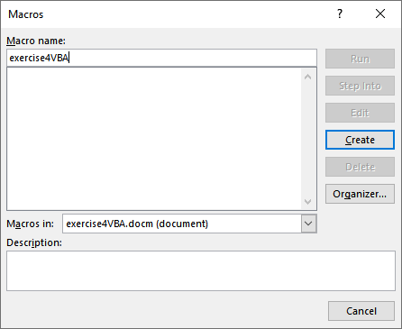
Starting The Workbook Exercise
Write a VBA program called "exercise4VBA"
  This will be the name of the Word document i.e. the full name is exercise4VBA.docm
  This will be the name of the subroutine (i.e. the name that you give to your program)

Slide 5
Minimum Number Of Tests
As a minimum use the test files provided in the description of the exercise to verify features of the program:
  case1A_has_typo_zero_shapes (at least one spelling mistake and no inline shapes)
  case1B_has_typo_3_shapes (at least one spelling mistake and multiple inline shapes)
  case2_no_typos_1_shape (no spelling mistakes and a single inline image)
  case3_no_typos_3_shapes (no spelling mistakes and multiple inline shapes)

Slide 6
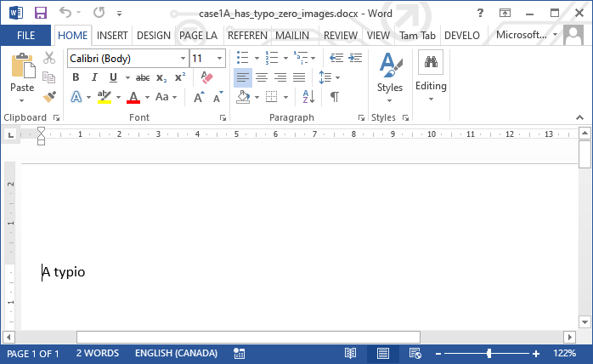
Running Your Program
The Word document containing the test data (such as the 4 Word documents that you have been provided) must be the currently active Word document.
You can make a Word document active by clicking on its window.
Click here!

Slide 7
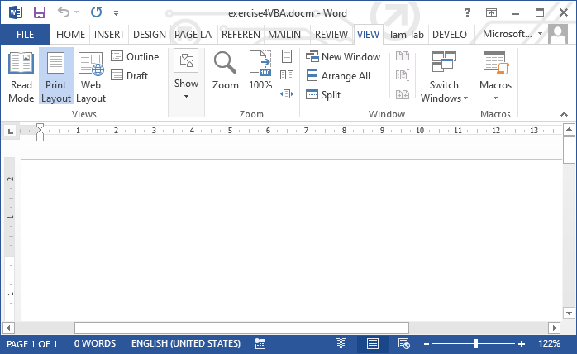
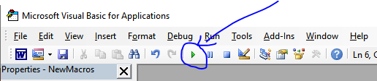
Running Your Program (2)
When you run your solution to the exercise do not do so via the Word document containing the program.
  NO! ☹
  YES ☺
If you click here to run the program then this Word document becomes the active one.

Slide 8
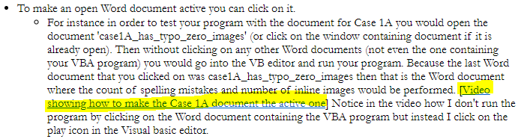
Running Your Program (3)
If are still unclear about how to make the proper Word document the active one when running your program then you can view the sequence of events in this sample run of a solution.
  https://pages.cpsc.ucalgary.ca/~tamj/2022/203W/assignments/workbook_exercise4/case1A.mp4
This link is also provided in the description of the exercise.

Slide 9
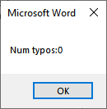
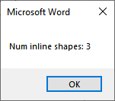
Features Of Your Program
These popups will always appear regardless of the Word document that is the currently active one used as the test input file.
  Count of the number of typographical errors in the document.
    Required format of the message¹:
    <"Num typos: "> <Actual # typographical mistakes>
    Example message:
  Count of the number of InlineShapes in the document.
    Required format of the message¹:
    <"Num inline shapes: "> <# of inline shapes>
    Example message:
1 The Angled brackets don’t appear in the actual popup.

Slide 10
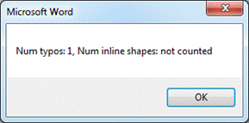
Features Of Your Program (2)
Based upon the number of typographical errors in the document and the number of inline shapes the program will display different popups.
  Case 1: If there are any typographical errors then the number of inline shapes will not have an effect, the following message will appear:
    Format:
    <"Num typos: "> <Actual # typographical mistakes> <", Num inline shapes: not counted">
    Actual message:

Slide 11
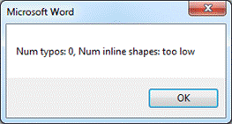
Features Of Your Program (3)
  Case 2: If there are no typographical errors and the number of inline shapes is fewer than 3 the following message will appear:
    Format:
    <"Num typos: "> <Actual # typographical mistakes> <", Num inline shapes: too low">
    Actual message:

Slide 12
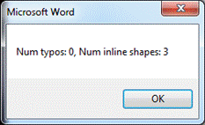
Features Of Your Program (4)
  Case 3: If there are no typographical errors and the number of inline shapes is 3 or greater following message will appear:
    Format:
    <"Num typos: "> <# typographical mistakes> <", Num inline shapes: "> <# of inline shapes>
    Actual message:

Slide 13
Second Tutorial (Wednesday or Thursday)

Slide 14
Activities In Tutorial
TA demos:
  Used for more complex features (typically multiple steps are required).
  The tutorial instructor will show on the projector/instructor computer each step for running the feature in Excel.
  Unless otherwise specified the tutorial material will take the form of a TA demonstrating the use of features in Excel.
  Slides titled “Lecture Review” are covered for the second time and dealing with less complex material.
    For this reason they will only be covered briefly in tutorial.
Student exercises:
  Used instead of TA demos for simpler features.
  You will have already been given a summary of how to invoke the feature and the purpose of the exercise is to give you a chance to try it out and get help if needed.

Slide 15
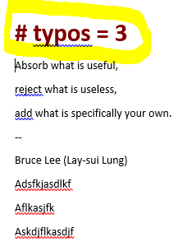
Example: Writing Text To A Document
The following program will write the number of typographical mistakes at the top of the currently active Word document.
The written text will have the following font characteristics:
  Bolded text
  Dark red in color
  24 point

Slide 16
Example 1
Example name: 1TypoCountFormattingFonts
Dim numTypos As Long
Dim message As String
numTypos = ActiveDocument.SpellingErrors.Count
message = "# typos = " & numTypos
MsgBox (message)
Selection.Font.Bold = True
Selection.Font.ColorIndex = wdDarkRed
Selection.Font.Size = 24

Slide 17
Student Exercise #1
Starting document: exercise1_starting
Document with solution: exercise1_solution
Open the starting document and add the following capabilities to the starting program:
  Selected Text will have the following font effects applied:
    Bold the text
    Change the color of the text to violet
    Change the font to Arial

Slide 18
Student Exercise #2
Starting document: exercise2_starting
Document with solution: exercise2_solution
Open the starting document and add the following capabilities to the starting program:
  Modify all the text in Word document in the following way:
    Underline the text with a dotted line.
    Change the color of the text to bright green.
    Prompt the user for a font name and the selected text will be changed to this type of font.
    Prompt the user for a name.
  Write the name (that the user was prompted to enter in the starting program) after the last part of the text in the document “Ip Man 2”
  After this is done automatically close and save the document without a user prompt.
  JT: this exercise may appear fairly daunting for beginners but you can refer to the lecture notes: VBA Part II (focus on the ActiveDocument and the Selection objects)

Slide 19
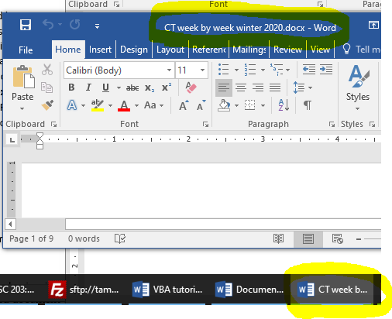
Finding (Replacing) Text In A Document
It can be done via the ActiveDocument object
(This will perform the ‘find’ in the currently active Word document).
If you have multiple Word documents open this may not always be the document containing your VBA program.
  Close all Word documents except for your program to avoid confusion!

Slide 20
Finding Things In A Document
It’s done through the ‘Find’ method and the find is done in the ActiveDocument object.
  i.e. some form of With ActiveDocument.Content.Find
  Some types of things that a VBA program can find:
    Text
    Font effects
    Styles (you have created)

Slide 21
Finding Text: V1
Name of the document containing the example: 2findReplaceOneCaseSensitive
  Features: replaces first instance, case sensitive find, find and replacement strings are constant strings (always the same)
  Sub findReplaceOneCaseSensitive()
  With ActiveDocument.Content.Find
  .Text = "cool"
  .Replacement.Text = "kewl"
  .Execute MatchCase:=True, Replace:=wdReplaceOne
  End With
  End Sub

Slide 22
Finding Text: V2
Name of the document containing the example: 3findReplaceAllCaseInsensitive
  Features: replaces all instances, case insensitive find, find and replacement strings are variable (depend upon user input)
  Sub findReplaceAllCaseInsensitive()
  Dim findWord As String
  Dim replacementWord
  findWord = InputBox("Word to find (try 'cOoL': ")
  replacementWord = InputBox("Replacement word (try 'aBx': ")
  With ActiveDocument.Content.Find
  .Text = findWord
  .Replacement.Text = replacementWord
  .Execute MatchCase:=False, Replace:=wdReplaceAll
  End With
  End Sub

Slide 23
Writing To A Document
It is accomplished using the Selection object and the TypeText method
To move the selection to the start of the document (write text at the start): Selection.HomeKey Unit:=wdStory
To move the selection to the end of the document (write text at the end): Selection.EndKey Unit:=wdStory
vbCr
  It is a Visual basic constant.
  Stands for ‘Visual Basic’ carriage return.
  Each each vbCr is equivalent to hitting enter.
  Example: "hi" & vbCr & "there"
    This puts ‘hi’ and ‘there’ on separate lines

Slide 24
Writing A Text String To A Document
Name of the document containing the example: 4writingToDocument
Features: writes the current location, at the start and end of the document. Spaces and carriage returns are concatenated into the text to be written.
Sub writingToDocument()
  Dim textInsertAtEnd As String
  textInsertAtEnd = InputBox("Type in text to insert at end: ")
  Selection.TypeText ("Inserted where the cursor was located")
  Selection.HomeKey Unit:=wdStory
  Selection.TypeText ("New text inserted at the very top")
  Selection.EndKey Unit:=wdStory
  Selection.TypeText (" " & textInsertAtEnd & vbCr & vbCr)
  End Sub

Slide 25
Visually Highlighting Written Text
To make text stand out font effects (color, bolding, size, font type can be applied to the written text).
This can be done via the attributes of the Font attribute of the Selection object.

Slide 26
Highlighting Written Text
Name of the document containing the example: 5modifyingFontText
Features: highlights inserted text by increasing the font size, changing the color and changing the font to the type specified by the user.
Sub modifyingFontText()
Dim insertionText As String
Dim newFontSize As Long
Dim newFontName As String
insertionText = InputBox("Type in text to insert: ")
newFontSize = InputBox("Size of the font: ")
newFontName = InputBox("Name of font (e.g. Arial black): ")

Slide 27
Highlighting Written Text: 2
insertionText = vbCr & insertionText & vbCr
'Order is cruical! Right after moving the selection to the top is
'when the statements to apply the font formatting effects should
'occur. Inserting other VBA instructions between may change the
'selection.
Selection.HomeKey Unit:=wdStory
Selection.Font.Bold = True
Selection.Font.Size = newFontSize
Selection.Font.Name = newFontName
Selection.Font.ColorIndex = wdBrightGreen
Selection.TypeText (insertionText)
End Sub

