Slide 1
VBA: Tutorial Week 6
Going over the Assignment 4 requirements.
Formatting cells: setting the fill color, changing fonts and font effects
Accessing cell data
Inserting and simple configuring of chart properties
Accessing specific worksheets in the currently active workbook
Data analysis: counting occurrences, specifying search criteria
Sorting spreadsheets
A return to nested loops
Official resource for MS-Office products: https://support.office.com

Slide 2
First Tutorial: Monday Or Tuesday

Slide 3
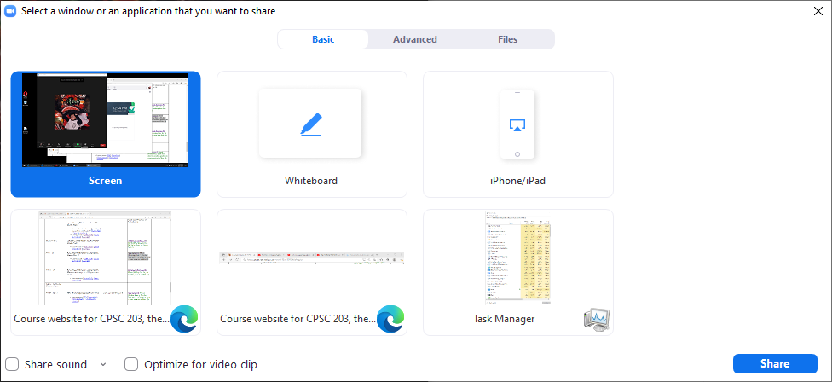
FYI For The Tutorial Instructor/TA
Since you will be playing a video with a voice narration make sure that you have enabled the “Share sound” option if you are using Zoom.
  You might want to use the pulldown (triangle) to ensure that audio is set to ‘stereo’ rather than ‘mono’.

Slide 4
VBA Programming For Excel
Many of the programming tools or structures you have been taught during the VBA-Word lectures and tutorials are applicable (e.g. documentation, variables, constants, getting input via a MsgBox, showing output messages via an InputBox, branching, loops etc.).
For this course: only a few things will be new such as Excel objects, methods/functions.
This is why so much time was provided to complete A3 but far less time is provided for A4.
  For A3 you were learning many new tools for the first time.
  For A4 you are applying previous tools and only a few new ones.

Slide 5
A4: Overview Video
This assignment allows you to work on a real world problem.
  Tracking actual Covid infection data in Alberta.
(To the tutorial instructor: in the interests of time you may want to show only select parts).
  https://www.youtube.com/watch?v=A0GuUGfvI5c&feature=youtu.be

Slide 6

A4: Feature #1
Write the text "Total cases" into the cell I1.

Slide 7
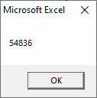
A4: Feature #2
Counts the total number of Covid cases and displays this information in a MsgBox.
  It includes all cases status such as 'Recovered', 'Active' etc.
  The count must be conducted with a loop and variable is used to track the count.

Slide 8


A4: Feature #3
Writes the count from the previous feature (i.e. the MsgBox output) to Cell J1.
Obviously what you write in the cell to the immediate left augments the number written into this cell.

Slide 9
A4: Feature #4
The two Cells (I1 and J1) where the information written from the previous two features are bolded.

Slide 10
A4: Feature #5
The data in the spreadsheet is sorted by date (earliest to latest).

Slide 11
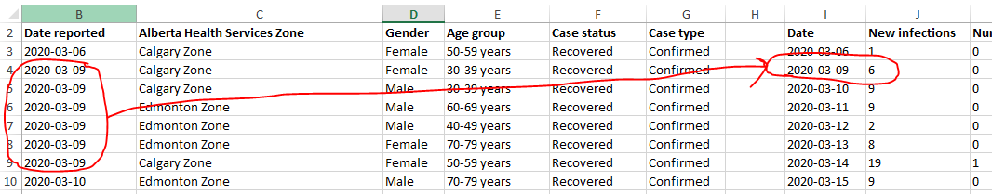
A4: Feature #6
The date in which infection data appears in the spreadsheet (i.e. the entry of a date in the rows of Column B signify that an infection occurred on that date) will be written into Column I.
Regardless of the number of infections that occurred on a particular day, the date information is only written into Column I once.

Slide 12
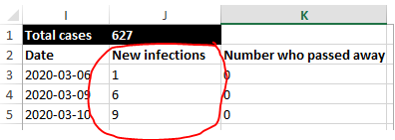
A4: Feature #7
(Nesting is mandatory)
  You will have an outer loop.
  The body of the outer loop contains a nested inner loop or a nested branching structure.
The number of new infections for a particular date are written into the rows of Column J with the first date appearing at Cell J3.
Because the date only appears once in Column I the number of infections for a particular day will appear only once on one row.

Slide 13
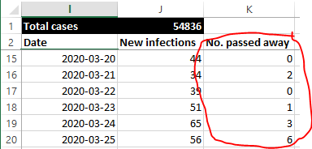
A4: Feature #8
(As with the previous feature nesting is mandatory).
The number of people who passed away on particular date will be written into the rows of Column K.
Similar to new infections only the total number of people who passed away on a particular date will be written and written once.

Slide 14
A4: Feature #9
(To get credit for this feature the previous 3 features need to correctly and completely implemented).
Insert a chart that graphs: the date, number of infections for each date, the number who passed away on each date.
Whether one chart is used for new infections and deaths, or one chart graphs infections over time while the other graphs deaths over time the same credit will be awarded.
Acceptable charts include: line, bar or column.
It's best to stick to one of the 3 specified types and use a 2D graph only.

Slide 15
A4: Feature #10
(Requires the previous feature to be complete and correct). The chart title must be changed to include the text "Alberta Covid statistics".
If you have a separate chart for new infections and deaths then each chart can include this text plus more specific information e.g. "Alberta Covid statistics: New infections" and "Alberta Covid statistics: Number of people who passed away".

Slide 16
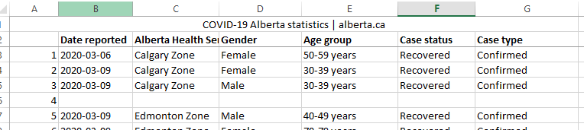
A4: Where Does It All End?
The end of the infection data will always be followed by an empty row in the spreadsheet.
(As shown in lecture on March 31, reducing the number of cases can make it easier to trace/debug a program).
Last row of Covid data

Slide 17
A4: Documentation Requirements
Contact information: your full name, student identification number, tutorial number (New for A4)
New for A4: Demonstrate some evidence of a versioning system. The program that you submit must specify at least one version number (a date is acceptable).
If your program includes more than one version then list the features completed for each version.
More information about versioning (and documentation) is provided in [the VBA Part I notes and lectures]

Slide 18
A4: Style Requirements
Each level of code indenting is consistently 1 tab.
Good naming conventions (e.g. variables, sub-routines, the name of Word document containing the VBA program and constants if applicable) are followed.
New for A4: The use of named constants (One of many possible examples: Const EMPTY_CELL As String = "") as appropriate.
  Named constants were first introduced in the first VBA programming set of notes. Examples have been shown in some of the subsequent Word examples and many were shown in the two "VBA Extras" lectures.

Slide 19
Example: Changing Fonts, Font Effects, Fill Color
Font changes can be made via the Cells or the Range object
Spreadsheet name: 1_formatting_cells
  Sub formattingEffects()
  Dim colorChoice As String
  Dim colorChoiceInvalid As Boolean
  Range("B2:D5").Font.Name = "Arial Black"
  Cells(1, 1).Font.Size = 24
  colorChoiceInvalid = True

Slide 20
Example: Changing Fonts, Font Effects, Fill Color (2)
  Do While (colorChoiceInvalid = True)
  colorChoiceInvalid = False
  colorChoice = InputBox("Color (red,blue,green): ")
  If ((colorChoice <> "red") And _
  (colorChoice <> "blue") And _
  (colorChoice <> "green")) Then
  colorChoiceInvalid = True
  ElseIf (colorChoice = "red") Then
  Range("C3:E7").Interior.Color = vbRed
  Range("C3:E7").Font.Color = vbWhite
  Range("C3:E7").Font.Bold = True
  ElseIf (colorChoice = "blue") Then
  Range("C3:E7").Interior.Color = vbBlue
  Range("C3:E7").Font.Color = vbYellow
  Range("C3:E7").Font.Bold = True

Slide 21
Example: Changing Fonts, Font Effects, Fill Color (3)
  ElseIf (colorChoice = "green") Then
  Range("C3:E7").Interior.Color = vbGreen
  Range("C3:E7").Font.Color = vbBlue
  End If
  Loop
  End Sub

Slide 22

Accessing Worksheets
Much like with a VBA program where instructions typically affect the currently active document, programs written for Excel will affect the currently active worksheet.
Worksheets can either be accessed by the name or the order in which the sheet was added to the spreadsheet (not the left-right ordering).

Slide 23
Example: Accessing Specific Worksheets
Spreadsheet name: 2_accessing_worksheets_by_user_input
  Sub accessingWorksheets()
  Dim worksheetName As String
  Dim worksheetNumber As Long
  worksheetName = InputBox("Worksheet name to change (Grade
  data, Students, Sheet2): ")
  worksheetNumber = InputBox("Worksheet number to change (1-
  3): ")
  Worksheets(worksheetName).Range("A1") = "Made change to
  worksheet " & worksheetName
  Worksheets(worksheetNumber).Range("B1") = "Made change to
  worksheet #" & worksheetNumber
  End Sub

Slide 24
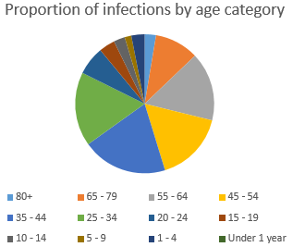
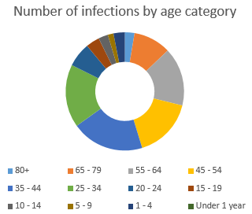
Commonly Used Charts To Represent Proportions
Pie chart
Donut chart

Slide 25
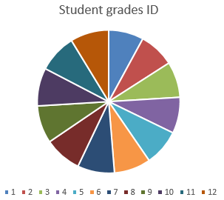
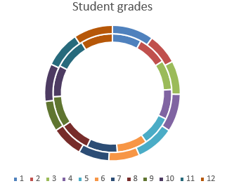
Pie And Donut Charts: When Not To Use
These types of representations are poor at representing exact numeric values (e.g. what was the grade for student #6?).
  Yet they are sometimes used this way in real life!

Slide 26
Example: Inserting Charts Representing Proportions
Spreadsheet name: 3_inserting_portional_charts
Sub insertPieChart()
  Range("A2:A14,C2:D14").Select
  ActiveSheet.Shapes.AddChart2(201, xlPie).Select
  ActiveChart.ChartTitle.Select
  ActiveChart.ChartTitle.Text = "Proportion of infections by age"
  End Sub
  Sub insertDonutChart()
  Range("A2:A14,C2:C14").Select
  ActiveSheet.Shapes.AddChart2(201, xlDoughnut).Select
  ActiveChart.ChartTitle.Select
  ActiveChart.ChartTitle.Text = "Number of infections by age"
  End Sub

Slide 27
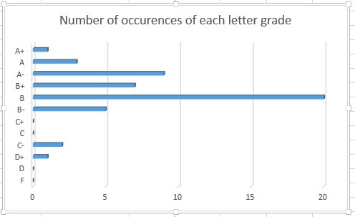
Example: Inserting Charts Representing Quantities
Some good choices include bar, column and line charts
Spreadsheet name: 4_inserting_quantitative_charts
  Bar chart
  Sub insertBarChart()
  Range("C2:D13").Select
  ActiveSheet.Shapes.AddChart2(201, xl3DBarClustered).Select
  ActiveChart.ChartTitle.Select
  ActiveChart.ChartTitle.Text = "Number of occurrences"
  End Sub

Slide 28
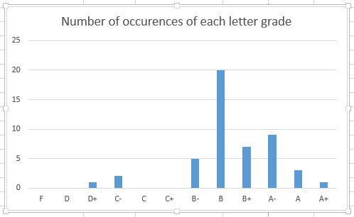
Example: Inserting Charts Representing Quantities (2)
  Sub insertColumnChart()
  Range("C2:D13").Select
  ActiveSheet.Shapes.AddChart2(201, xlColumnClustered).Select
  ActiveChart.ChartTitle.Select
  ActiveChart.ChartTitle.Text = "Number of occurrences"
  End Sub

Slide 29
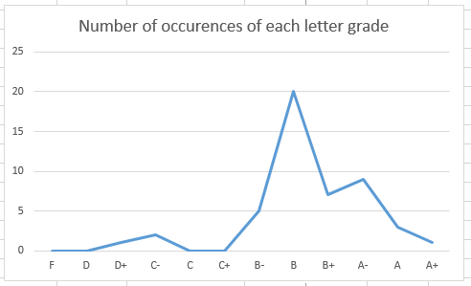
Example: Inserting Charts Representing Quantities (3)
  Sub insertLineChart()
  Range("C2:D13").Select
  ActiveSheet.Shapes.AddChart2(201, xlLine).Select
  ActiveChart.ChartTitle.Select
  ActiveChart.ChartTitle.Text = "Number of occurrences"
  End Sub

Slide 30
Second Tutorial: Wednesday Or Thursday

Slide 31
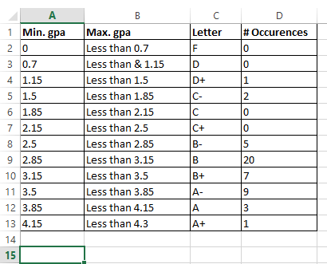
Counting The Number Of Rows In A Chart
With a small set of data you may be able to do this.
  What if you wanted to do this for many spreadsheets (instances of non-empty rows in 1000+ sheets).
A loop can be used to step through row by row until an empty row has been encountered.

Slide 32
Example: Counting Rows
Name of spreadsheet: 5_counting_rows_for_chart
  This program will only include in the chart the actual number of rows of data.
  Sub countingRowsToShart()
  Const LETTER_GRADE_COLUMN As Long = 3
  Const START_ROW As Long = 1
  Const EMPTY_ROW As String = ""
  Dim rowData As String
  Dim currentRow As Long
  Dim count As Long

Slide 33
Example: Counting Rows (2)
  'Counting number of rows
  currentRow = START_ROW
  count = 0
  rowData = Cells(currentRow, LETTER_GRADE_COLUMN)
  Do While (rowData <> EMPTY_ROW)
  count = count + 1
  currentRow = currentRow + 1
  rowData = Cells(currentRow, LETTER_GRADE_COLUMN)
  Loop
  'Insert chart based on range. Will always start at C1
  'but last row determined by number of rows
  Range("C1" & ":" & "D" & count).Select
  ActiveSheet.Shapes.AddChart2(201, xlLineMarkers).Select
  End Sub

Slide 34
Exercise 1
Program description:
  Counts the number of rows containing data (headings and student data).
  The count will be written to cell address that is specified by the user.
Spreadsheet containing the solution (don’t look at it until you have at least made an attempt): Exercise1_counting_rows_writing_user_specified_location

Slide 35
Example: Counting Instances Of User Specified Search Criteria
Spreadsheet name: 6_searching_spreadsheets_with_user_critiera_writing_results
  Sub searchV1()
  Const EMPTY_DATA As String = ""
  Const MEMBERS_ROW As Long = 2
  Const START_RESULTS_ROW As Long = 17
  Const SEARCH_CRITERIA_COLUMN = 2
  Const MEMBER_COLUMN As Long = 1
  Const ETHNICITY_COLUMN As Long = 2
  Const CITY_COLUMN As Long = 3
  Const AGE_COLUMN As Long = 4
  Const NUMBER_MATCHES_ROW As Long = 15
  Const NUMBER_MATCHES_COLUMN As Long = 2

Slide 36
Example: Counting Instances Of User Specified Search Criteria (2)
  Dim count As Long
  Dim searchRow As Long
  Dim currentResultsRow As Long
  Dim desiredCity As String
  Dim currentMemberName As String
  Dim minAge As Long
  Dim maxAge As Long
  Dim currentMemberCity As String
  Dim currentMemberAge As Long
  desiredCity = InputBox("City: ")
  minAge = InputBox("Youngest age for search: ")
  maxAge = InputBox("Oldest age for search: ")

Slide 37
Example: Counting Instances Of User Specified Search Criteria (3)
  Do While (currentMemberName <> EMPTY_DATA)
  currentMemberCity = Cells(searchRow, CITY_COLUMN)
  currentMemberAge = Cells(searchRow, AGE_COLUMN)
  If ((desiredCity = currentMemberCity) And _
  ((currentMemberAge >= minAge) And _
  (currentMemberAge <= maxAge))) Then
  count = count + 1
  Cells(currentResultsRow, MEMBER_COLUMN) = Cells(searchRow,
  MEMBER_COLUMN)
  Cells(currentResultsRow, SEARCH_CRITERIA_COLUMN) =
  desiredCity & ", " & currentMemberAge
  currentResultsRow = currentResultsRow + 1
  End If
  searchRow = searchRow + 1
  currentMemberName = Cells(searchRow, MEMBER_COLUMN)
  Loop

Slide 38
Example: Counting Instances Of User Specified Search Criteria (4)
  'Write out total number of matches
  Cells(NUMBER_MATCHES_ROW, NUMBER_MATCHES_COLUMN) = count
  End Sub

Slide 39
Exercise 2
Program description:
  Counts the number of occurrences of a Covid status (e.g. Recovered, Died) in the spreadsheet.
  The status is entered by the user.
  The count will be written to row 3, column 10 (Cell J3).
Spreadsheet containing the solution (don’t look at it until you have at least made an attempt): Exercise2_covid_data_counting_number_of_user_selected_occurance

Slide 40
Exercise 3
Program description:
  Starting with the solution to the previous exercise modify the program so the user can also select the location where results are written to the spreadsheet.
  It’s your choice if the destination is determined by a (row, column) integer pair or through a cell address.
Spreadsheet containing the solution (don’t look at it until you have at least made an attempt): Exercise3_covid_data_user_selects_start_and_end_count_range_and output location

Slide 41
Example: Error Checking Input, Sorting Based On User Criteria
Name of spreadsheet: 7_error_checking_input_sorting_by_user_criteria
  Sub errorCheckingSortingGrades()
  Dim sortCriteria As String
  Dim sortKey As String
  sortCriteria = InputBox("Sort criteria: ID', 'Last Name', 'GPA'")
  Do While ((sortCriteria <> "ID") And _
  (sortCriteria <> "Last Name") And _
  (sortCriteria <> "GPA"))
  sortCriteria = InputBox("Sort criteria: ID', 'Last name',
  'GPA'")
  Loop

Slide 42
Example: Error Checking Input, Sorting Based On User Criteria (2)
  If (sortCriteria = "ID") Then
  sortKey = "A1"
  ElseIf (sortCriteria = "Last Name") Then
  sortKey = "B1"
  ElseIf (sortCriteria = "GPA") Then
  sortKey = "E1"
  End If
  ActiveWorkbook.Worksheets(1).Sort.SortFields.Clear
  ActiveWorkbook.Worksheets(1).Sort.SortFields.Add Key:= _
  Range(sortKey), Order:=xlAscending
  With ActiveWorkbook.Worksheets(1).Sort
  .SetRange Range("A1:F12")
  .Header = xlYes 'Options: x1No, x1yes
  .Apply
  End With
  End Sub
Note: there is a recorded macro you can see in the VB editor that shows how to sort by multiple keys

Slide 43
Nesting
Two repeated processes.
  One is nested inside the other.
  That means that each time one process starts the nested/inner process starts from beginning to end.
Examples of nested loops (non-exhaustive list) from lecture.
  Washing Dishes
    While (there are dishes left unwashed)
    Get a dirty dish
    Apply soap to dish
    while (dish is still dirty)
    Rub dish with wet cleaning tool
    If (more soap needed)
    Apply soap to dish

Slide 44
Nesting (2)
Examples of nested loops (non-exhaustive list) from lecture (continued):
  Martial Arts
  While (there is still a compass point with opponent)
  Turn left to face opponent
  while (opponent is still standing)
  Throw right reverse punch
  Left rising block
  Throw right reverse punch
  Assume guard position

Slide 45
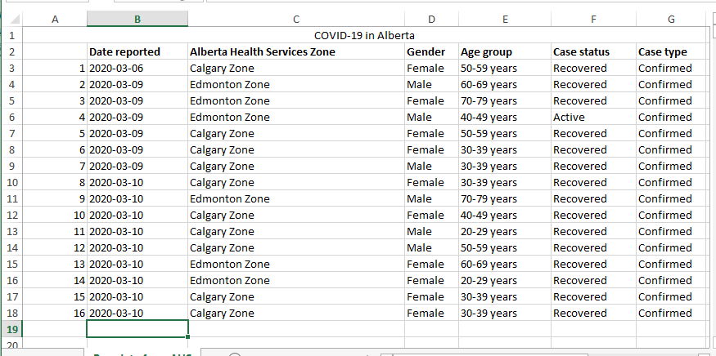
Nesting (3)
Examples of nested (non-exhaustive list) from lecture (continued):
  Counting Covid Alberta Cases

Slide 46
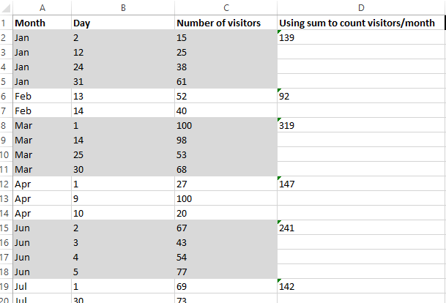
Nesting (4)
Another example: Workbook exercise

Slide 47
Example: Nesting
This program prompts the user for a North American country.
It will re-prompt so long as the country name isn’t one of three possibilities.
Each time the user enters a valid country the program will check if valid region has been entered (currently program only cross checks Canada with Canadian provinces).
Again the program re-prompts for a region until a valid one has been entered.
Spreadsheet name: 8_nested_loops_country_city_count

Slide 48
Example: Nesting (2)
  Sub countClients()
  Const COUNTRY_COLUMN As Long = 1
  Const REGION_COLUMN As Long = 2
  Const NO_VALUE As String = ""
  Const START_ROW As Long = 3
  Dim country As String
  Dim region As String
  Dim countryCount As Long
  Dim regionCount As Long
  Dim row As Long
  Dim countryFromSS As String
  Dim regionFromSS As String
  country = NO_VALUE
  region = NO_VALUE

Slide 49
Example: Nesting (3)
  Do While ((country <> "Canada") And _
  (country <> "USA") And _
  (country <> "Mexico"))
  country = InputBox("North American country: ")
  Do While ((region <> "British Columbia") And _
  (region <> "Alberta") And _
  (region <> "Saskatchewan") And _
  (region <> "Manitoba") And _
  (region <> "Ontario") And _
  (region <> "Quebec") And _
  (region <> "New burnswick") And _
  (region <> "Nova Scotia") And _
  (region <> "Prince Edward Island") And _
  (region <> "Newfoundland and Labrador"))
  region = InputBox("Province to count: ")
  Loop
  Loop

Slide 50
Example: Nesting (4)
  countryCount = 0
  regionCount = 0
  row = START_ROW
  countryFromSS = Cells(row, COUNTRY_COLUMN)
  Do While (countryFromSS <> NO_VALUE)
  regionFromSS = Cells(row, REGION_COLUMN)
  If (countryFromSS = country) Then
  countryCount = countryCount + 1
  End If
  If (regionFromSS = region) Then
  regionCount = regionCount + 1
  End If
  row = row + 1
  countryFromSS = Cells(row, COUNTRY_COLUMN)
  Loop

Slide 51
Example: Nesting (4)
  Range("F2") = "# clients from " & country
  Range("G2") = countryCount
  Range("F3") = "# in " & country & " who live in " & region
  Range("G3") = regionCount
  End Sub

Slide 52
(WB Ex 5) An Excellent Exercise To Help You Prepare For The Assignment: The Last Workbook Exercise
The last exercise is quite challenging (you already have 3 graded components assigned which included the basics of VBA programming).
Similar to the full assignment the exercise requires that you implement a solution using nested loops.
  Workbook Exercise:
    Outer loop to traverse from the start of the days where visitors came to town until the end.
    Inner (nested) loop runs from start to finish each time the outer loop runs: traverses all the visitor information for a particular month.
  Assignment:
    Outer loop to traverse from the start of the Covid cases until the end (empty row).
    Inner (nested) loop runs from start to finish each time the outer loop runs: traverses or steps through all the Covid cases for a particular day.

Slide 53
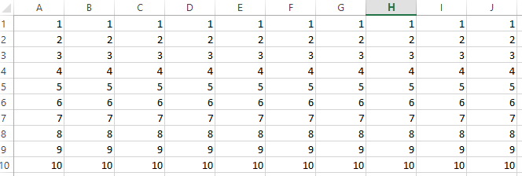
Exercise 4
Program description:
  Using nested loops the program will write the following information into the spreadsheet.
  JT’s comment: this one is substantially more challenging than the previous exercises but solving it will help you find a solution to the graded components.
  Along row 1 from column 1 – 10 write the number 1 into sheet.
  Along row 2 from column 1 – 10 write the number 2 into sheet.
  Along row 3 from column 1 – 10 write the number 3 into sheet.
  Continue along this pattern up to and including row 10 where the number 10 will be written.
Spreadsheet containing the solution (don’t look at it until you have at least made an attempt): Exercise4_nested_loops_numbering_cells

Slide 54
Exercise 5
Program description: get and display the month and year
  Branch nested within a loop
  Prompt the user for a month as a numerical value from 1 – 12.
  As long as value outside this range is entered the program will repeat the prompt.
  After a valid value for the month has been entered the program will prompt for the day (again an integer value).
  The program will repeatedly prompt for the day as long as a value outside the valid range has been entered.
    The valid range depends upon the month:
      February: ignore leap year and assume the maximum number of days is 28.
      Month with 30 days: April, June, September, November
      Months with 31 days: all other months
Spreadsheet containing the solution (don’t look at it until you have at least made an attempt):Exercise5_nested_loops_entering_month_day

