Slide 1
VBA: Tutorial Week 4
Non-linear, non-sequential programming using loops
Nesting: branches and loops
Collaboration vs. misconduct
Official resource for MS-Office products: https://support.office.com

Slide 2
First Tutorial (Monday or Tuesday):

Slide 3
Open Tutorial
No new teaching will occur but the TA will be available for help.
During this "Open Tutorial" any CPSC 203 student can ask for help and not just the students who are registered in a particular tutorial.
The purpose is to provide extra help because the next workbook exercise is the first one in which you need to write a program from scratch.

Slide 4
Second Tutorial (Wednesday or Thursday):

Slide 5
Microsoft Introduction/Overview Of VBA
https://docs.microsoft.com/en-us/office/vba/library-reference/concepts/getting-started-with-vba-in-office

Slide 6
Activities In Tutorial
TA demos:
Used for more complex features (typically multiple steps are required).
The tutorial instructor will show on the projector/instructor computer each step for running the feature in Excel.
Unless otherwise specified the tutorial material will take the form of a TA demonstrating the use of features in Excel.
Slides titled “Lecture Review” are covered for the second time and dealing with less complex material.
For this reason they will only be covered briefly in tutorial.
Student exercises:
Used instead of TA demos for simpler features.
You will have already been given a summary of how to invoke the feature and the purpose of the exercise is to give you a chance to try it out and get help if needed.

Slide 7
Looping/Repetition
Used when a part (or the entire) program needs to repeat as long a condition has been met.
The condition is a Boolean expression.
START
Do while (Condition)
Instruction(s)
Loop
Run game
Y
Play again?
N
END GAME

Slide 8
Example: Counting Program (Up/Increases)
Name of the document containing example: 4loopV1Up
Features:
The program will iterate (count) through the sequence of numbers 1 – 11 in increments of 2 (1, 3, 5, 7, 9, 11)
Sub countingLoopV1Up()
Dim i As Long
i = 1
Do While (i <= 11)
MsgBox ("i=" & i)
i = i + 2
Loop
End Sub
Student exercise: what if the Boolean expression was changed to (i <= 10)?

Slide 9
Example: Counting Program (Down/Decreases)
Name of the document containing example: 5countingloopV2Down
Features:
The program will iterate (count) through the sequence of numbers 10 – 1 in decrements of 3 (10, 7, 4, 1)
Sub nineLoopV2()
Dim i As Long
i = 10
Do While (i >= 1)
MsgBox ("i=" & i)
i = i - 3
Loop
End Sub
Student exercise: what if the Boolean expression was changed to (i >= 0)?

Slide 10
Student Exercise
Write a program that will, using a loop, display all the multiples of 5 in the range from 5 – 15,625.
The program will display each multiple of 5 within this range in a MsgBox one-at-a-time.
Document containing the solution: 2multiples_of_five_solution

Slide 11
Nesting: Branches And Loop
Branches and loops can be nested within each other
Scenario 1
If (Boolean) then
If (Boolean) then
...
End if
End if
Scenario 2 Scenario 3
Do while (Boolean) If (Boolean) then
If (Boolean) then Do while (Boolean)
... ...
End if Loop
Loop End if

Slide 12
Recognizing When Nesting Is Needed
Scenario 1: Only if a question answers true then check if another question answers true or false.
Example: If the user entered Canada as country of residence then ask if the user’s province of residence is Alberta.
Type of nesting: a IF-branch
nested inside of an IF-branch
If (Boolean) then
If (Boolean)
...
End If
End If
Q:Canadian?
F
T
Residence is CA
Q: Albertan?
F
T
Residence also AB
Done

Slide 13
(Key Part: IF) Nested Inside An IF
Nesting: a structure (e.g. IF) is nested inside of another structure (e.g. IF) when the second structure is part of the body of the first structure.
Word document containing the example: 6nesting_branch_within_branch
'Some parts excluded for brevity.
country = InputBox("Current country of residence: ")
If (country = "Canada") Then
message = message & "Great country, "
province = InputBox("Current province of residence: ")
If (province = "AB") Then
message = message & " Greatest place on earth ^-*"
End If 'Checking province
End If 'Checking country
Recall: the check for the Boolean expression for the second IF does not occur unless the first Boolean expression is true. (Don’t bother checking if province is AB if country isn’t Canada).

Slide 14
Recognizing When Nesting Is Needed
F
Scenario 2: If a question answers true then check if a process should be repeated.
Example: If the user entered an odd number then count through a sequence 1 to this number and display each odd number in this sequence.
Type of nesting: a Do-While loop nested inside of an IF-branch
If (Boolean) then
Do While (Boolean)
...
Loop
End If
Q:Odd #?
T
Q: Not yet exceeded last #?
F
T
Display current #
Increment to next odd #
Done

Slide 15
(Key Part: Do-While) Nested Inside An IF
Word document containing the example: 7nesting_loop_in_branch
'Variable & constant declaration excluded for brevity
lastOdd = InputBox("Enter last odd number in sequence: ")
remainder = lastOdd Mod 2
If (remainder = 0) Then
MsgBox (lastOdd & " is even not odd.")
Else
If (lastOdd <= MAX_ODD) Then
count = 1
Do While (count <= lastOdd)
MsgBox ("Current number = " & count)
count = count + 2
Loop
End If 'End: checks size of last #
End If 'End: checks if # is odd or even

Slide 16
Recognizing When Nesting Is Needed
Q: As last # not exceeded?
Scenario 3: As long some condition is met a question will be asked. As long as some condition is met a popup will be displayed.
Example: While the last number in a sequence hasn’t been exceeded if the current number is even it will be displayed.
Type of nesting: an IF-branch nested inside of a Do-While loop
Do While (Boolean)
If (Boolean) then
...
End If
Loop
F
T
Q: Even?
F
T
Display #
Increment to next #
Done

Slide 17
(Key Part: IF Nested) Inside A Do-While
Word document containing the example: 8nesting_branch_in_loop
Const MAX_NUMBER As Long = 20
Dim lastNumber As Long
Dim count As Long
Dim remainder As Long
lastNumber = InputBox("Enter last number in a sequence: ")
If (lastNumber <= MAX_NUMBER) Then
count = 1
Do While (count <= lastNumber)
remainder = count Mod 2
If (remainder = 0) Then
MsgBox ("Current even #: " & count)
End If
count = count + 1
Loop
End If

Slide 18
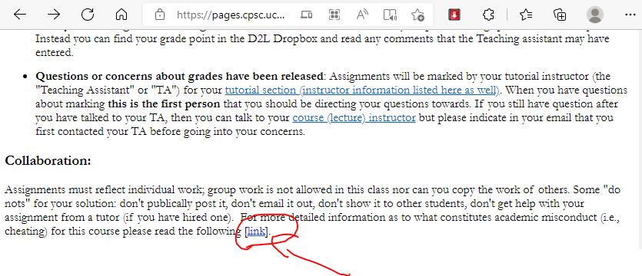
Collaboration Vs. Misconduct
There’s a link to additional details in every assignment and exercise description.
Web address:
https://pages.cpsc.ucalgary.ca/~tamj/2022/203W/assignments/misconduct.html

Slide 19
Avoiding Misconduct
Some "do nots" for your solution: don't publically post it, don't email it out, don't show it to other students, don't get help with your assignment from a tutor (if you have hired one).
You cannot copy the work of other students nor can students work in groups. To avoid potential cases of misconduct students should not show or otherwise provide their assignment solutions to their classmates.

Slide 20
What Is Academic Misconduct?
Cheating has occurred if you hand in someone else's work as if it were your own (without crediting the other person).
If a student knowingly provides his or her graded work to another student then both students are guilty of academic misconduct (the first student helped the second student to cheat).

Slide 21
What Happens If I Cite My Sources
You are required to cite all sources including lecture and tutorial notes (if applicable). If you don't cite the source then you have made the strong implication that this work is yours when it isn't so you will be guilty of academic misconduct.
What happens if you include someone else's work and you do credit the other person properly (this doesn't apply to your classmates, recall that you are not to see the assignment work of other students).
This won’t count as cheating but since someone else did the work for that section of your assignment you won't get credit for that part of the assignment (you can get credit if you use code from tutorial or lecture if it’s cited, where you won’t get credit is other sources such as the web or a book).
You could get marks for the other parts of the assignment.
The crediting of other's people work must be very specific and clear because your marker needs to be able to unambiguously determine which parts of your assignment did you complete and which parts came from an outside source.

Slide 22
How To Cite Your Sources
The format of the citation isn’t what’s important.
Instead you should focus on clearly communicating to your marker exactly what parts of your submission that you completed and what parts come from external sources.
If there is no citation then the assumption is that you are the sole source.
One approach: use the “sandwich method”

Slide 23
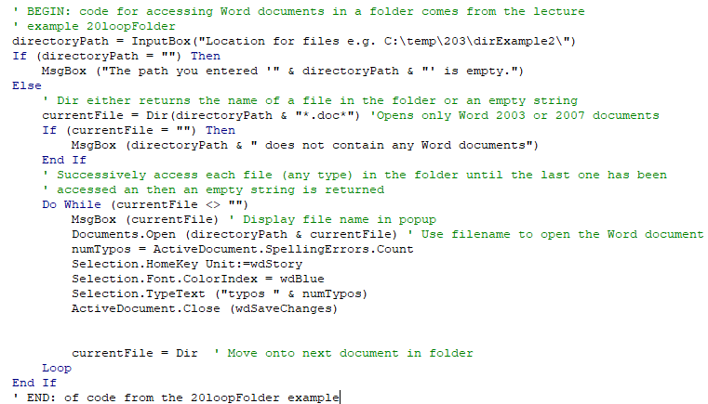
Example Of Sandwiching Your Citation
Start of citation
Sandwiched code from an external source
End of citation
All external code is sandwiched.
Any code outside of a sandwich is assumed to be written by the student (make sure this is ac

Slide 24
What If You Hired A Tutor?
Can I get help on an assignment from this person?
Tutors can be useful helping to clarify concepts (e.g. what is 'loop' in programming) or showing you where to find features in Office or how they work. The problem with going over an assignment with a tutor is that the 'help' ends up with the tutor completing some or all of the assignment for you.
This is similar to getting a solution from a class mate because you didn't do the work so it is likely that it will be ruled as academic misconduct.

Slide 25
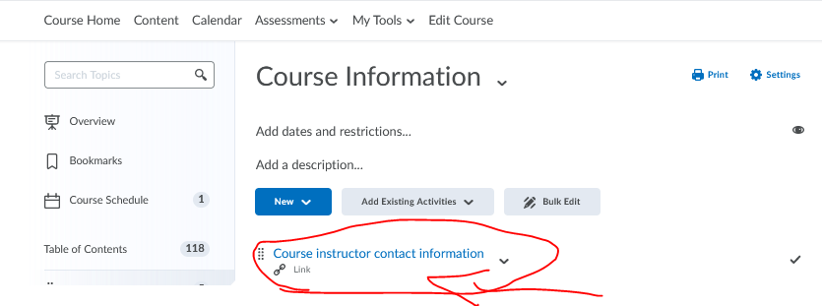
What If We Have Questions About What’s Allowed?
Normally you can ask the Teaching Assistants questions.
If you have questions about what’s allowed and not allowed in terms of misconduct then you should ask the course instructor rather than the TA.
Link to the contact times/information for the course instructor in D2L:

