Slide 1
The Basics Of MS-Word
These common features includes assumed prior knowledge. The purpose of these notes is for students who are missing some of the basics.

Slide 2
Audience/Purpose
These resources are meant to show a beginner the common features of Word.
The focus is showing one way that features may be run rather than distracting the reader and showing all possible ways.
  Learning multiple methods may shift the focus from using a feature to memorizing all the ways in which that feature may be run.
Because of the rudimentary nature of the material, the focus is on how to run features rather than why use them (it should be self evident why one would want to save a document).

Slide 3
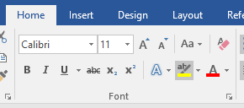
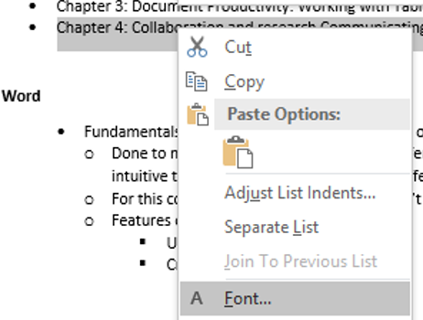
MS-Office
There’s different ways of completing the same task
  Alternatives make things easier for the user (different people may find one way more intuitive than another) e.g. fonts and font effects
  Example: choosing fonts and font effects
For this course and in “real life” one way isn’t better than another (just learn *a* way that works)

Slide 4
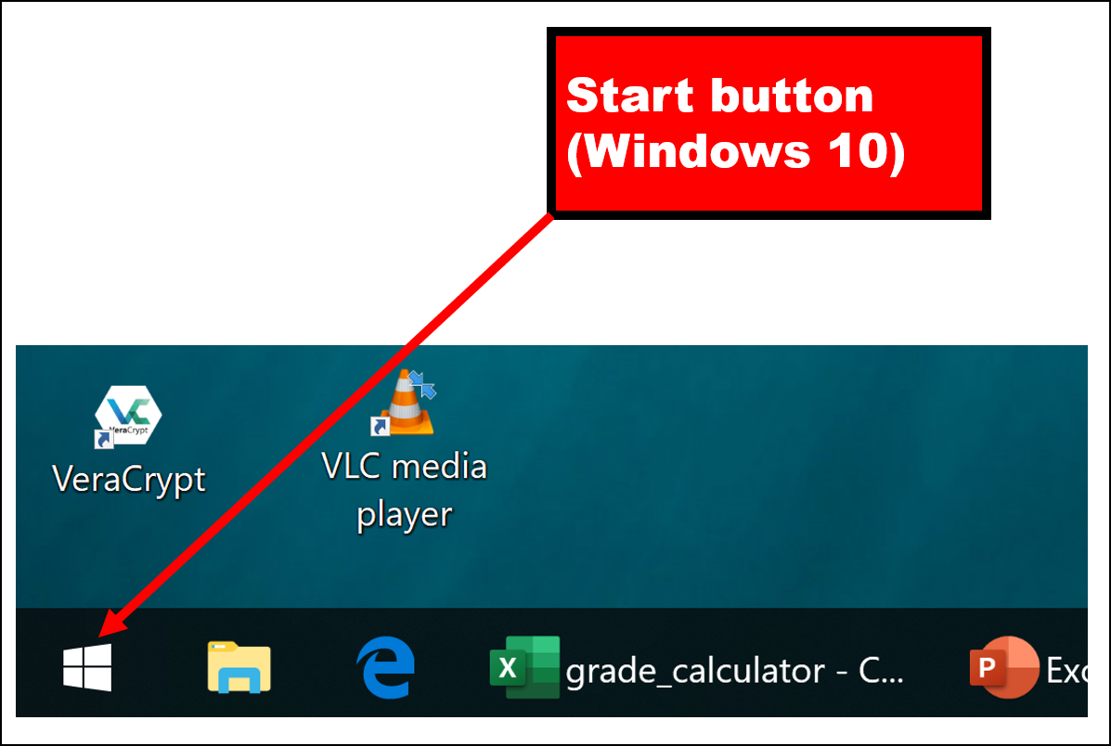
Starting Word: Invoking The Start Menu
Click on the Start Button (the exact appearance may vary depending upon the version of Windows that you are running).

Slide 5
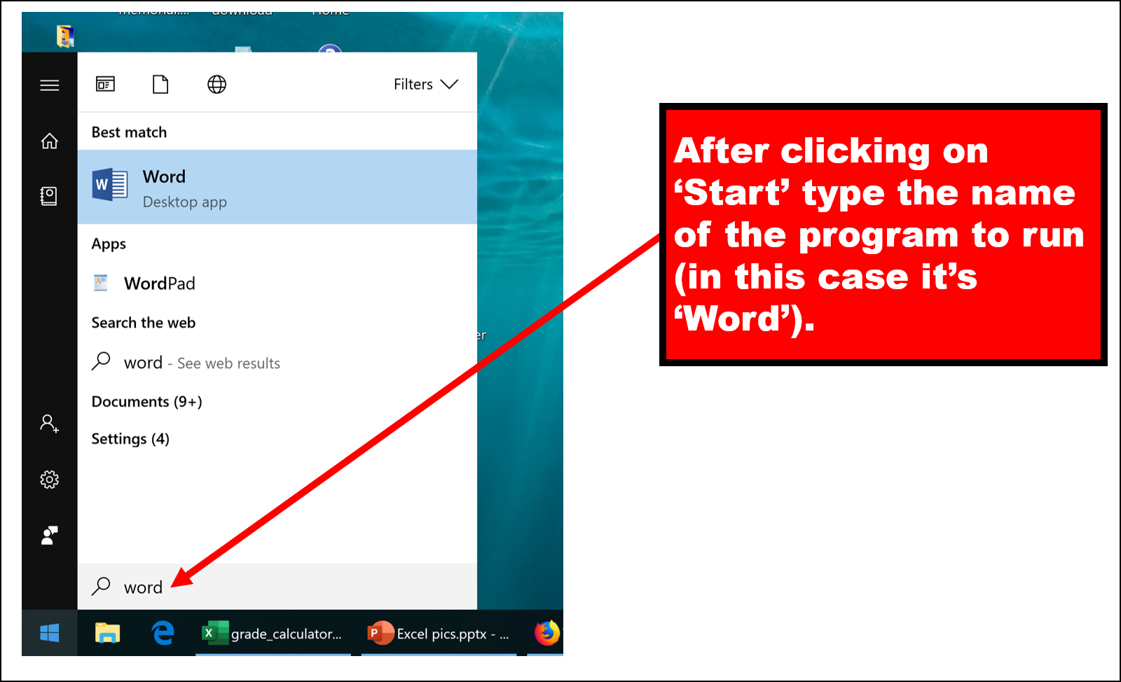
Starting Word: Running Word
With the Start button clicked type in “Word” (the name of the program you wish to run).
(There are many ways of starting a program in Windows, this is an example where there is no “one right way” to do things).

Slide 6
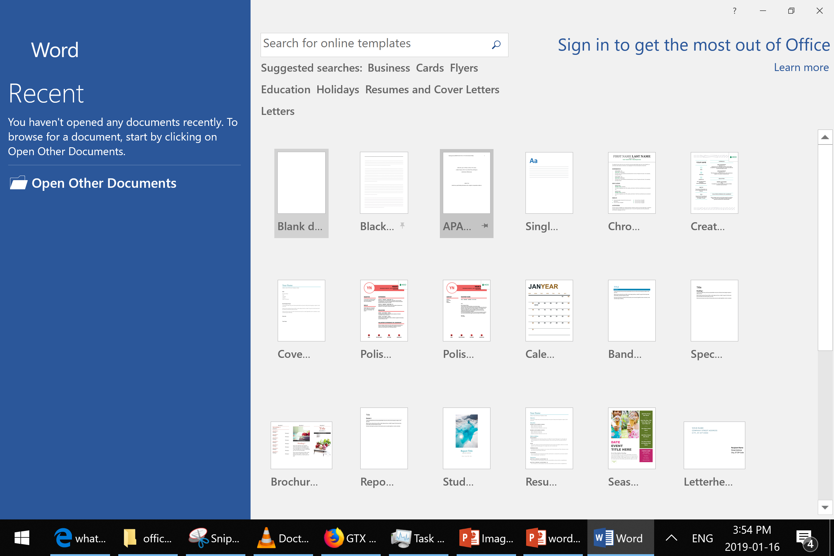
Using Pre-Created Templates
Templates have already been formatted (e.g. font type, size, indenting etc.)
The image below highlights the APA (American Psychological Association) report format.

Slide 7
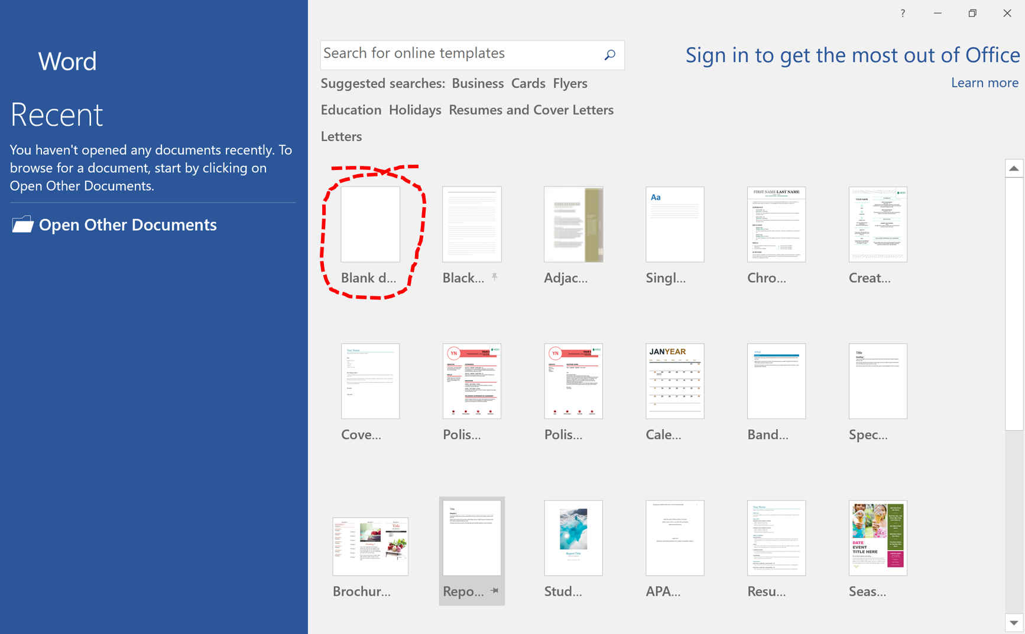
Creating A Blank Document

Slide 8
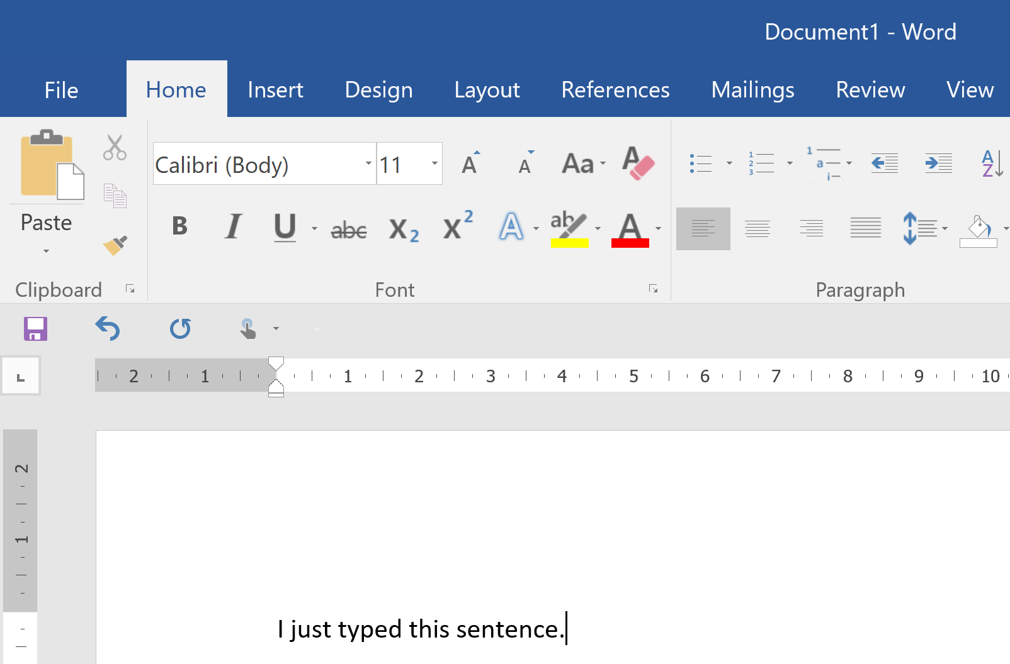
The Word Editor
Creating a new document (or opening an existing document – described later) will pull up the Word editor.
When the window containing the Word editor is the currently selected window what you type is what will appear in the editor
Text typed from the keyboard.
The cursor specifies the current text entry point.

Slide 9
Some Ways Of Navigating The Word Editor
Keystroke | Effect in Word
↑ (up arrow) | Cursor moves up one line
↓ (down arrow) | Cursor moves down one line
← (left arrow) | Cursor moves left one character
→ (right arrow) | Cursor moves right one character
Home key | Cursor moves to the beginning of the line
End Key | Cursor moves to the end of the line
<Ctrl>-<Home key> | Cursor moves to the beginning of the document
<Ctrl>-<End key> | Cursor moves to the end of the document

Slide 10
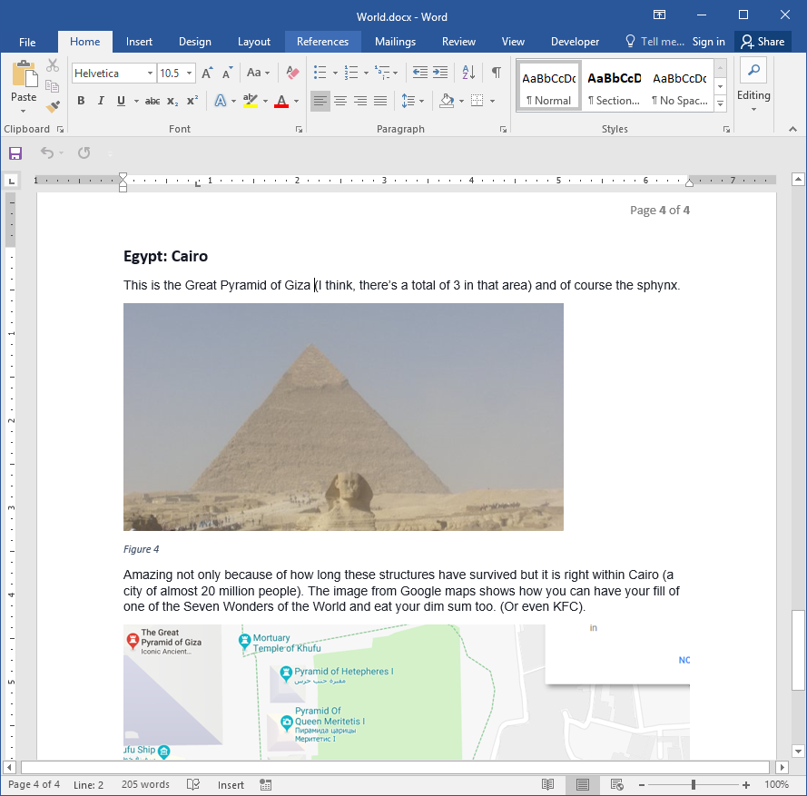
Other Ways Of Navigating In Word
Clicking directly in the editing area
Clicking in the scrollbar

Slide 11
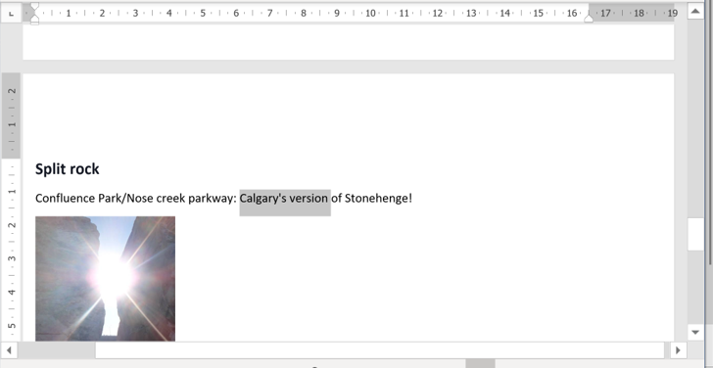
Copy/Cut-Pasting
Select some text (images can also be selected)

Slide 12
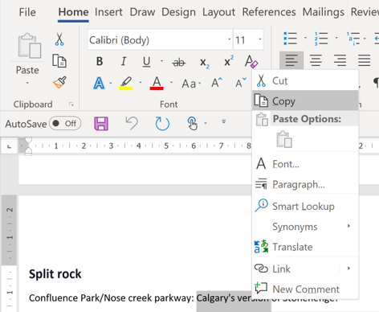
Copy/Cut-Pasting (2)
Right click and select the ‘Cut’ or ‘Copy’ option.
  Cut: the selection will be removed from the document (when pasted).
  Copy: the selection will be duplicated (when pasted).

Slide 13
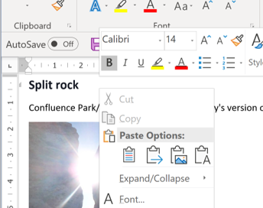
Copy/Cut-Pasting (3)
Navigate to the location where you wish the selection to appear.
Right click and select a paste option.

Slide 14
Paste Options¹
Keep source formatting (default): retains the character styles and formatting applied to the selected text.
Match destination formatting: Pasted text takes on the formatting and character style of the text that immediately precedes the cursor when the text is based. The previous formatting is discarded (although formatting that is considered emphasis such as bold and italics is retained).
Keep text only: All formatting and non-text elements are modified (pictures are discarded, tables are converted to paragraphs).. Pasted text takes on the style of the paragraph where it is pasted (takes on formatting and character styles of the text that immediately precedes the cursor).
1 From https://support.office.com

Slide 15
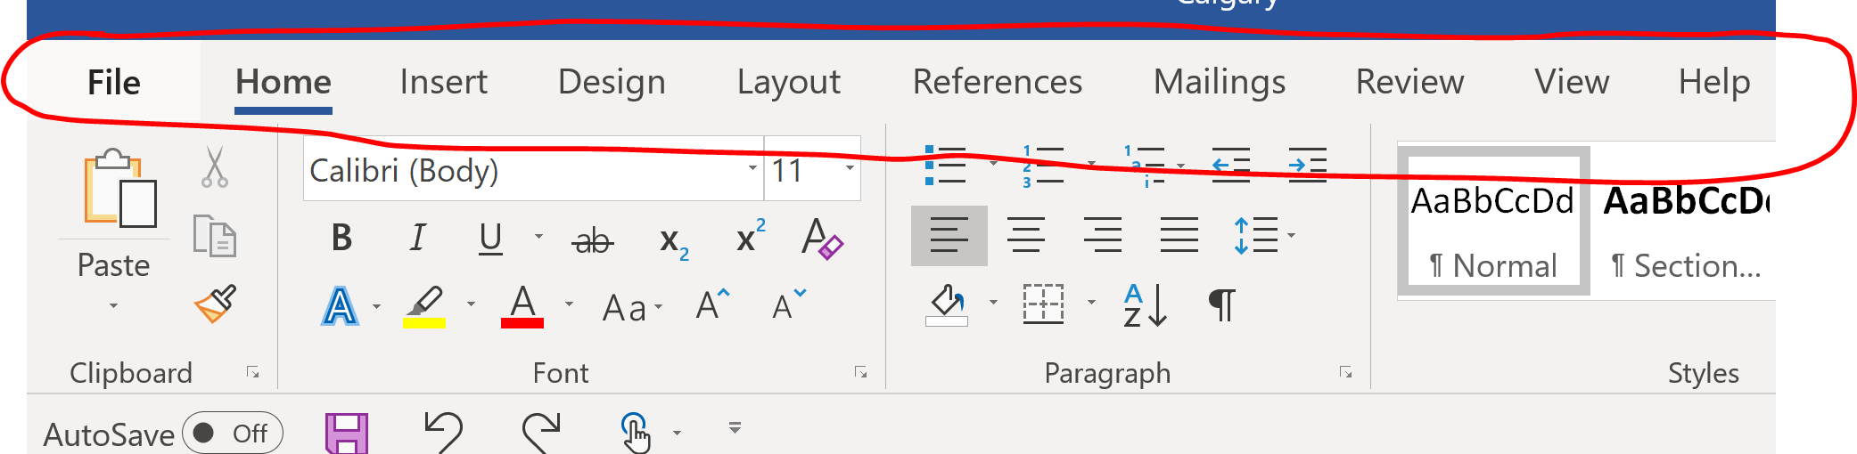
Accessing Word’s Features
Via the tabs of the ribbon

Slide 16
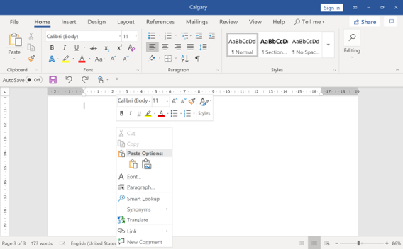
Shortcut For Accessing Common Features
Right clicking on the main editing area of Word (only some of the features are available via this option)

Slide 17
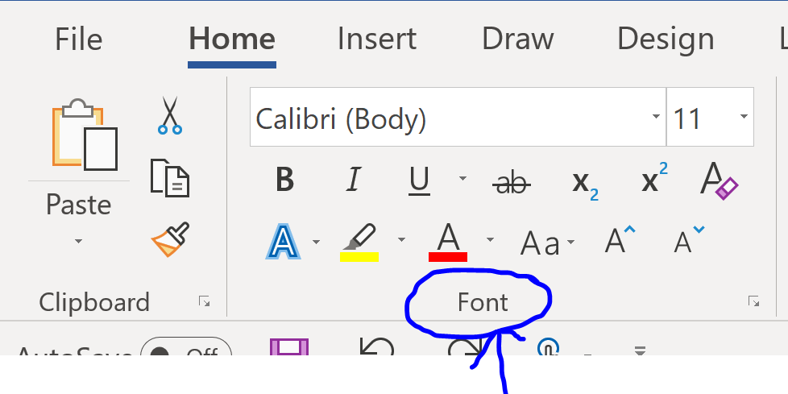
Formatting Text
Includes but is not limited to:
  Font type (e.g. Calibri, Times New Roman, Arial etc.)
  Font size (‘point’ size)
  Choosing a color
  Font effects (bold, italics, underline, strike through etc.)
Accessing the formatting option
  Home tab on the ribbon (Font group)

Slide 18
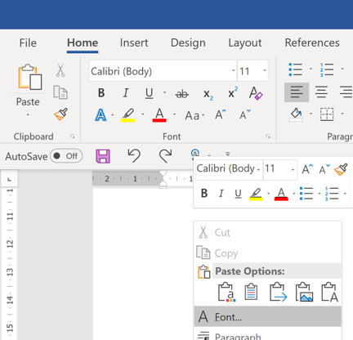
Formatting Text (2)
Accessing the formatting option (continued)
  Right clicking and selecting the ‘font’ option in the menu

Slide 19
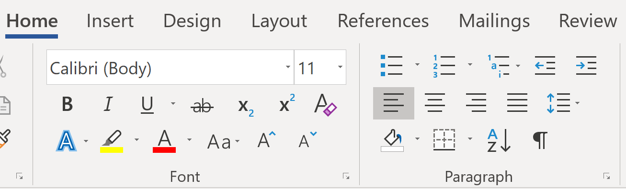
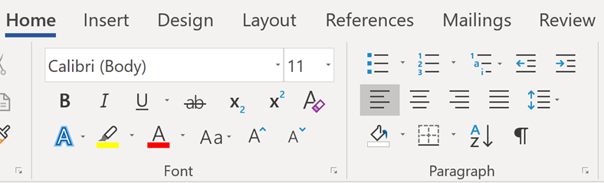

Paragraph Effects: Alignment
Home tab on the ribbon (Paragraph group)
Aligning text (left, right, center, right & left justify)

Slide 20

Paragraph Effects: Lists
Numbered and bulleted lists

Slide 21
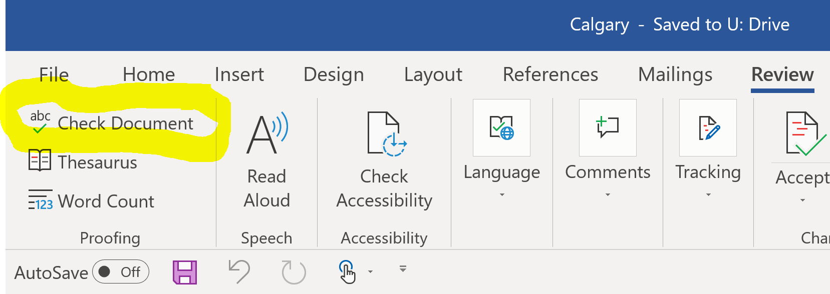
Running Spell Check
Via the ribbon:
  Review tab (Proofing group) -> Check document (or Spelling & Grammar)
Shortcut
  Press the F7 key

Slide 22
Saving/Copying A Document (With A New Name)
Save:
  Saves the document under the current name.
  If the document was not yet named then a prompt will appear allowing it to be named.
Save As
  Allows the document to be renamed (“Save As” a new name) under a different name.
  The document with the original name is still retained.

Slide 23
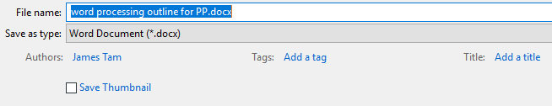
‘Saving As’: Tagging Documents
Similar to ‘tagging’ videos online (with words and phrases that are meaningful) Office documents can be annotated.

Slide 24
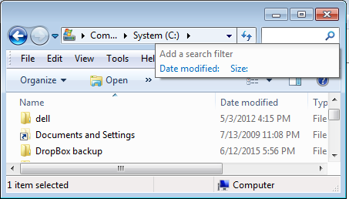
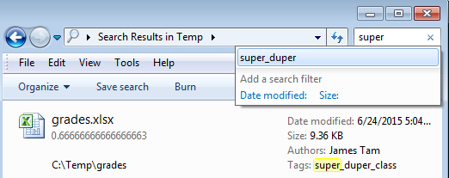
Excel Example Using Tags (Also Applies To Word)
The tag is separate from the file name but may still be used as search criteria (if posted online or even via Windows Explorer)

Slide 25
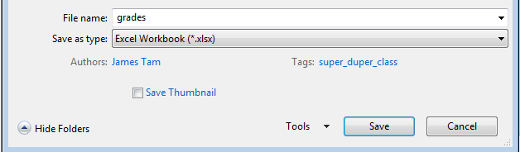
Excel Example: Using Tags
W

Slide 26
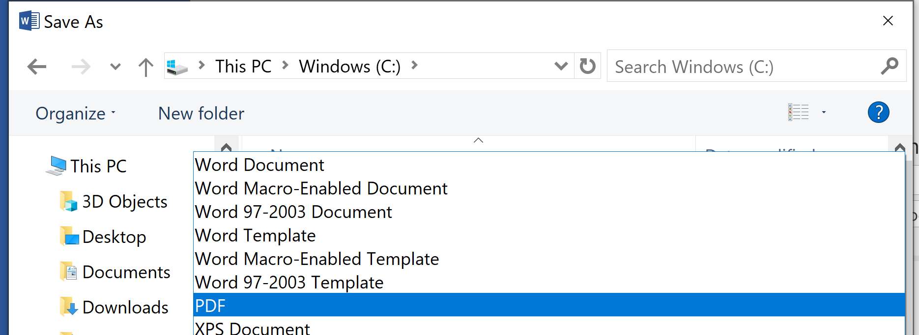
Creating PDF Documents
PDF (Portable document Format) documents
  Allows documents to be saved and viewed with different computer operating systems.
  Ensures a consistent layout and formatting.
PDF documents can be created out of a Word document using the “Save As” feature.
  Select ‘PDF’ as the file type under the pull down menu.

Slide 27
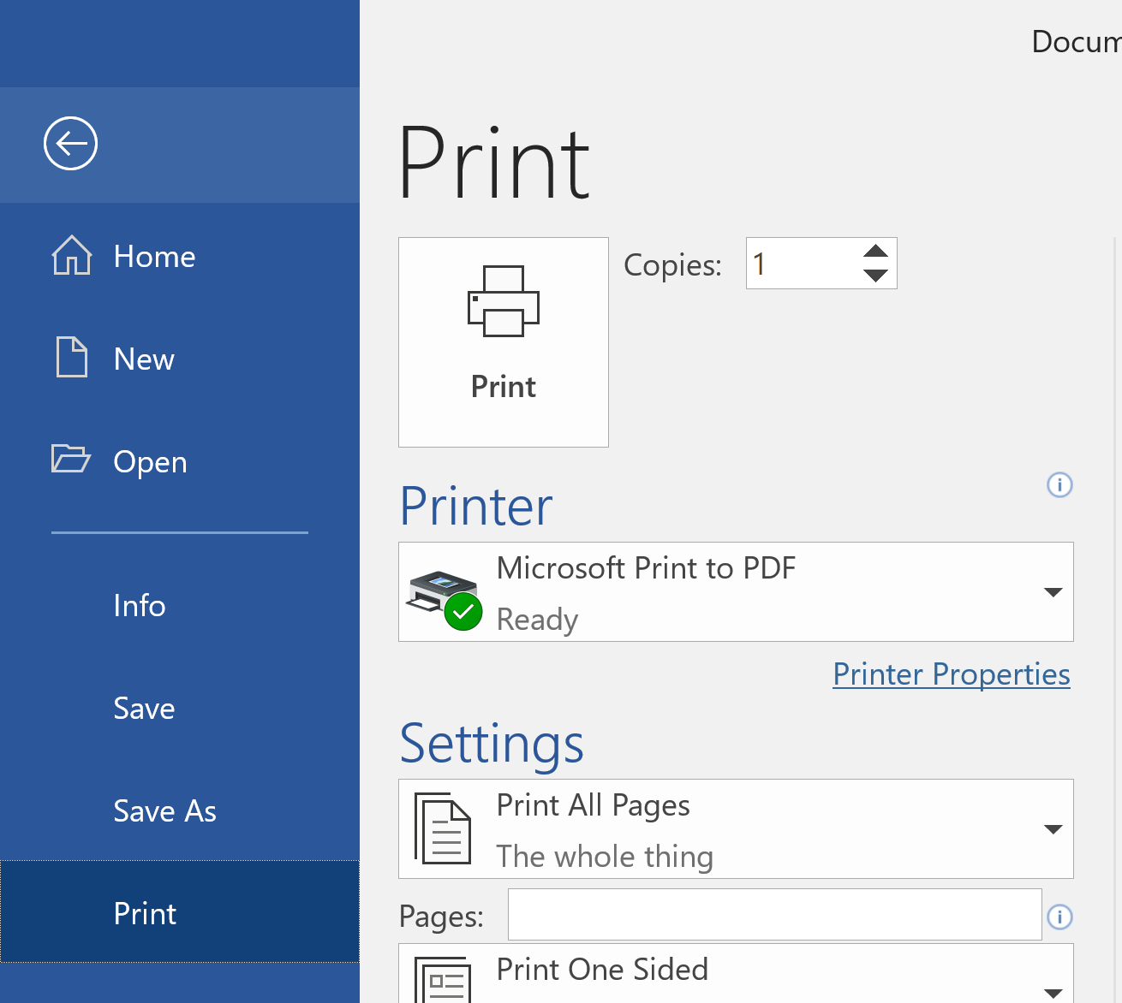
Printing A Document
File tab -> Print

Slide 28
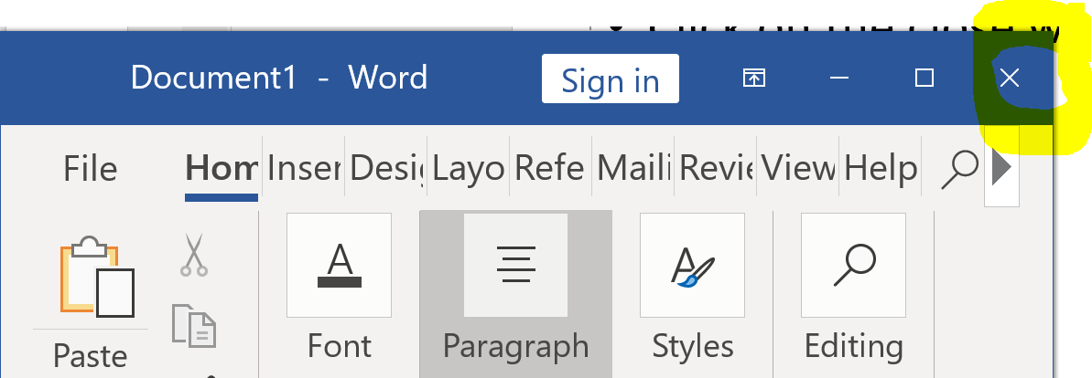
Quitting Word
Click on the close window icon (top right hand side of the window).
Via the ribbon
  File tab -> Close
If the document has not been saved since the last edit then a prompt to save the document will appear.

Slide 29
Converting Between Versions Of Word
Different version of Word (and Office) have different features
https://support.office.com/en-us/article/Compare-Word-features-on-different-platforms-5e00dfba-3d7c-4222-b850-a0527ff7b066
https://support.office.com/en-us/article/Compatibility-changes-between-versions-CB713C85-3145-4E83-A8B6-1E3227A4C059
Checking for compatibility issues in a document
  File->Info->Check for issues->Check compatibility
Converting older versions to the newest version of Word
  File->Info->Convert (the ‘convert’ option only appears for older versions of Word documents).
  File->Save As (Word Document *.docx) i.e. save under the new file type to do the conversion.

Slide 30
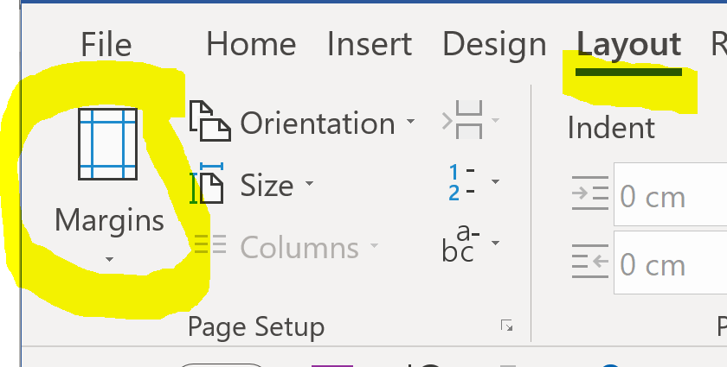
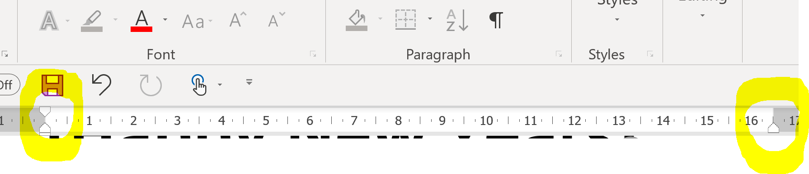
Changing Margins
Via the Ribbon: Layout tab -> Page Setup group: Margins
Via the ruler (the ruler must be made visible first, this can be done via: View ribbon->(Show group: checking the ruler option)

Slide 31
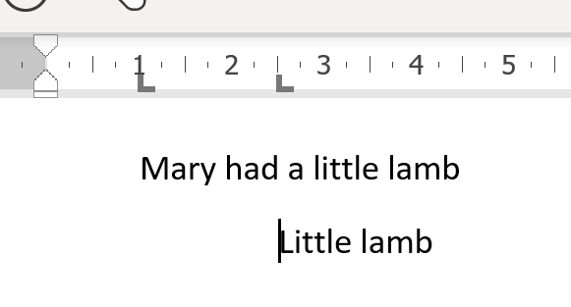
Tabs
A “tab stop” can be added with the ‘Tab’ key
The amount of indenting produced by a tab can be changed with the ruler.
Tab settings
Single tab
Two tabs

Slide 32
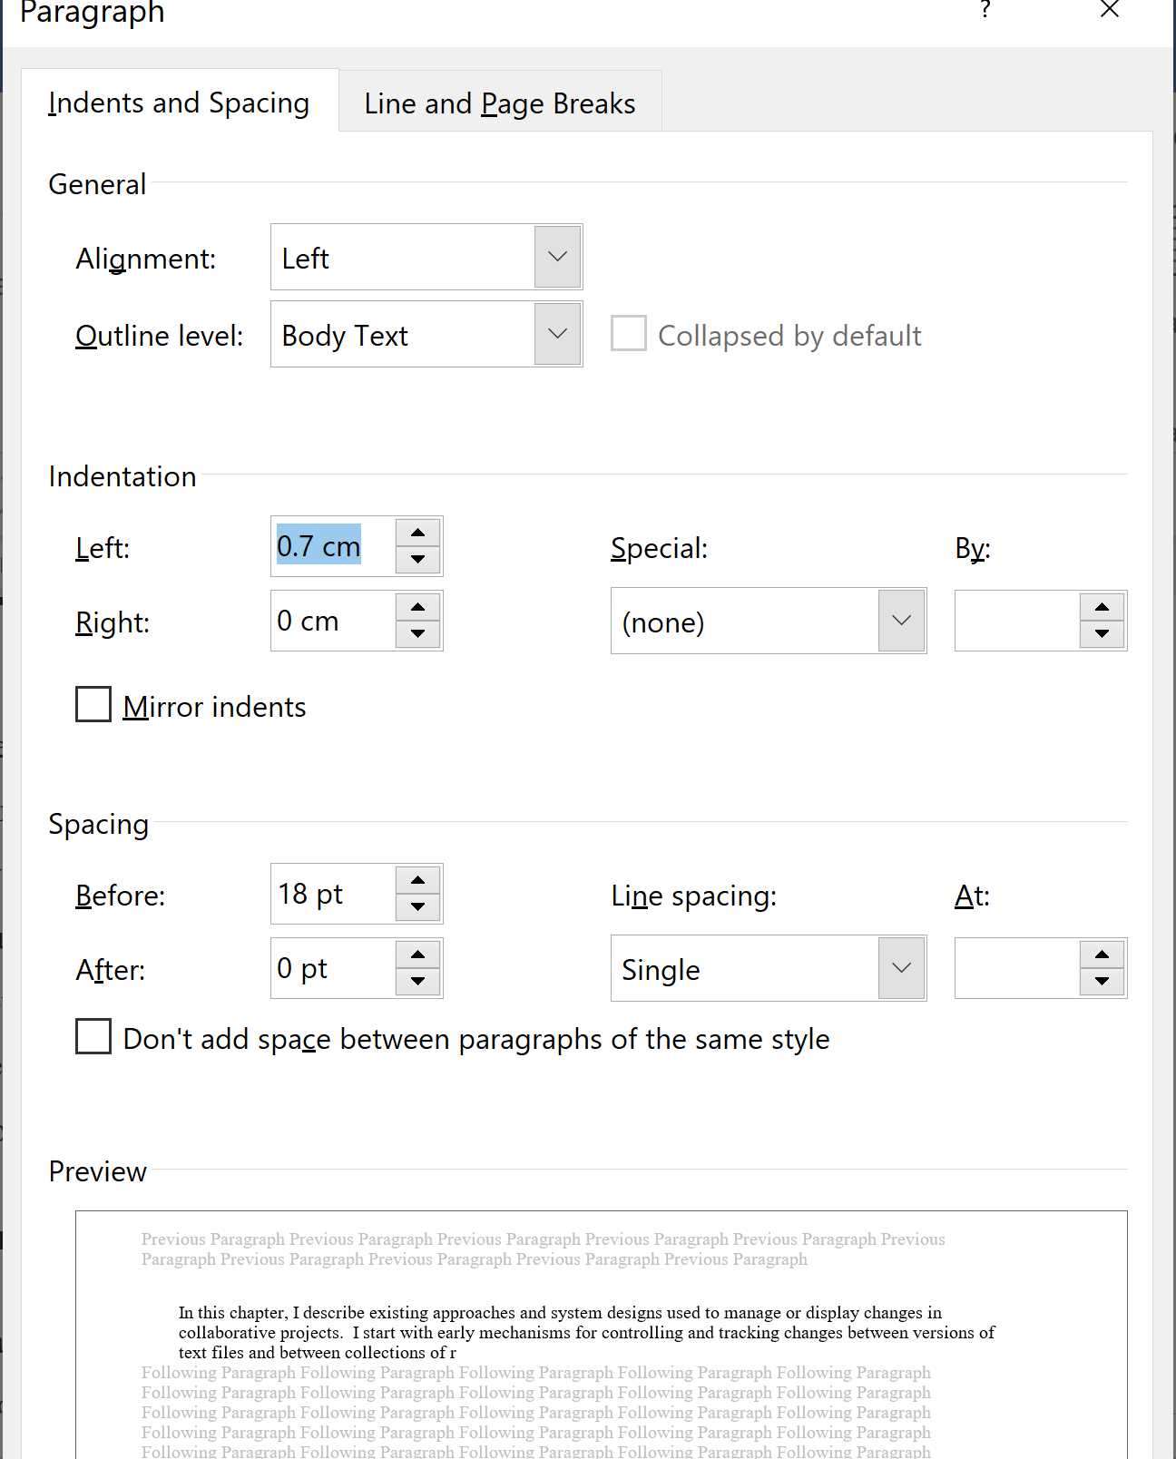
Paragraph Formatting Options

Slide 33
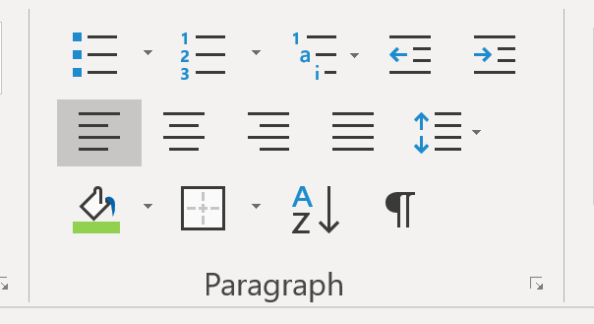
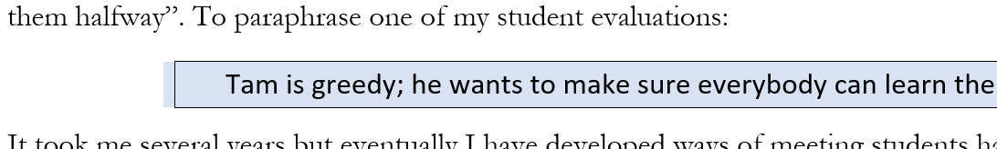
Paragraph Formatting Options (2)
To emphasize a paragraph, borders and shading can be added (this should be done only sparingly).
  Location of controls: Home->Paragraph group
  Effects applied
Shading
Border

Slide 34
Moving Text To The Next Line
Word wrap
Hard return
Soft return

Slide 35
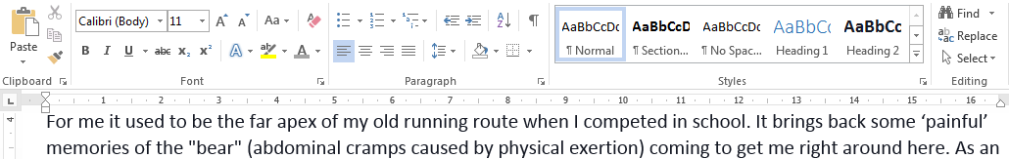
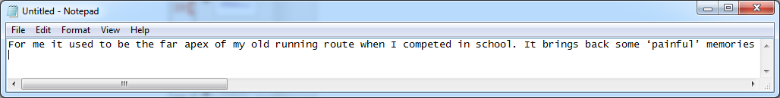
Word Wrap
A feature automatically built into Word processors (e.g. Word) and many text editors (WordPad but not Notepad). Long text is moved to the next line.
  MS-Word: word wrapped, words are move to the next line (without splitting up a word).
  MS-Notepad: no word wrapping (text is one long line).
  Word wrapping can be affected by variables such as margin settings in a document.

Slide 36
Hard Return
Used when the editor specifically wants text to always appear on a separate line regardless of variables such as margin settings.
In word processors and text editors a hard return can be added to a document by hitting the ‘enter’ key.

Slide 37
Soft Return
Similar to a hard return a soft return will move text to another line.
The difference is that the distance between the two lines is not as large as the case with a hard return.
In Word a soft return is inserted by pressing the ‘shift’ and the ‘enter’ key at the same time.
  Shorthand notation: <Shift>-<Enter>
Soft returns can be used where the two lines must be separate but still in close proximity e.g. lines of an address, headings and sub-headings.

Slide 38
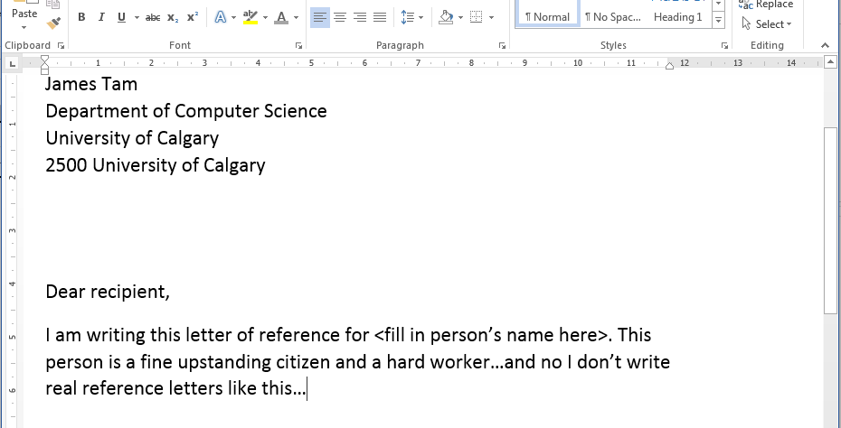
Line Separators: An Example
Soft returns
Hard returns
Wrapped text

Slide 39
Other Word Resources
Online training resources created by Microsoft:
  https://support.office.com/en-us/article/word-for-windows-training-7bcd85e6-2c3d-4c3c-a2a5-5ed8847eae73

Slide 40
Copyright Notification
“Unless otherwise indicated, all images in this presentation were created by James Tam.”

