Slide 1
MS-Word
Week 3
Official resource for MS-Office products: https://support.office.com

Slide 2
Activities In Tutorial
TA demos:
  Used for more complex features (typically multiple steps are required).
  The tutorial instructor will show on the projector/instructor computer each step for running the feature in Word.
Student exercises:
  Used instead of TA demos for simpler features.
  You will have already been given a summary of how to invoke the feature and the purpose of the exercise is to give you a chance to try it out and get help if needed.

Slide 3
Master-Subdocuments: Student Exercise
Create two Word documents that will act as subdocuments.
  Add some text to that you can recognize when they have been added to the master.
  Insert a reasonably large image into one of the documents to increase the file size.
Create a third Word document that will act as the master document.
  Insert (links to) the subdocuments in the master document
  Save and close the master document.

Slide 4
Master-Subdocuments: Student Exercise (2)
(In Windows) examine the file size of the master document and the subdocument with the image.
  There’s different ways of determining file size, but two ways include:
    Mousing -over each document until the information appears
    If that doesn’t work after a few seconds right click on each document to see it’s properties.
  The master document should be smaller than the sub-document.
  This should convince you that the master document does not directly contain the subdocuments.

Slide 5
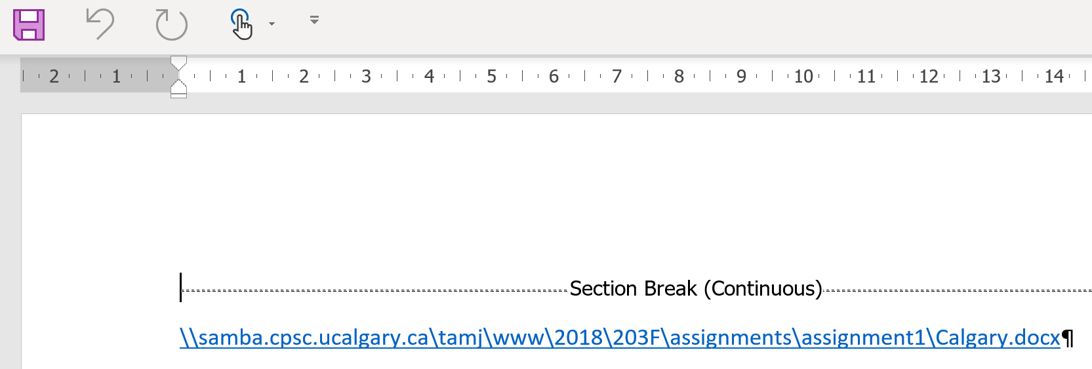
Master Document: Reopening
You won’t see the contents of the subdocuments, instead you will only see a link to the subdocument (location will vary depending upon where you store the documents on your computer).

Slide 6
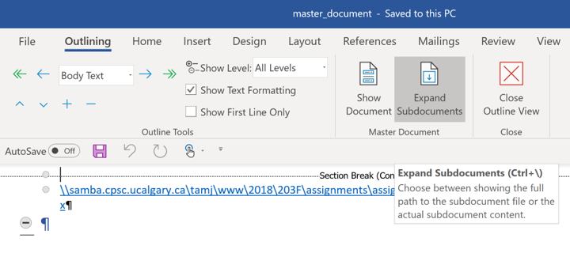
Master Document: View Contents Of Subdocument
To view the contents
  View->Outline->Expand Subdocuments
  Close the outline view to get a normal view of the document.

Slide 7
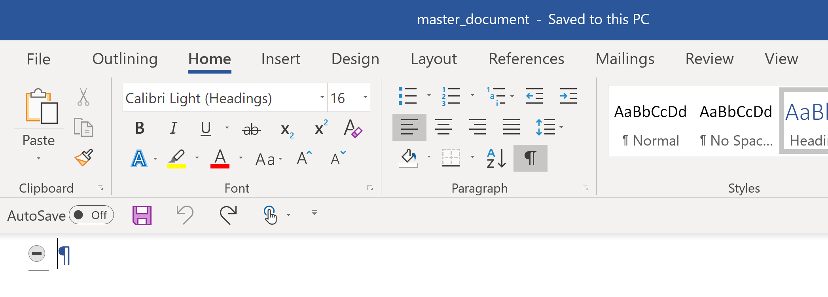
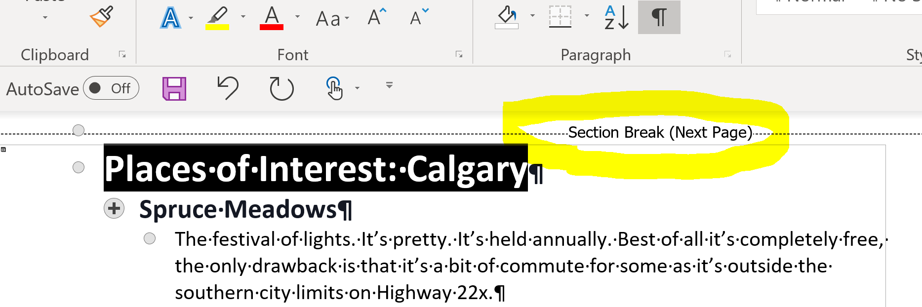
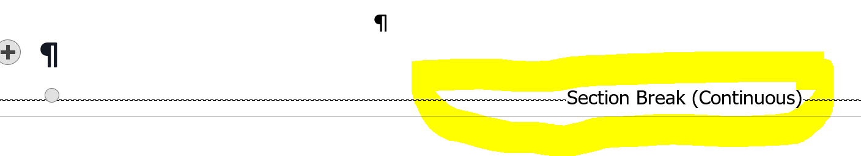
Be Aware: Additional Formatting Is Added
Master document: before inserting subdocument
After the insertion
Additional section breaks are automatically inserted at the start and end of the sub-document

Slide 8
Master-Subdocuments: Part II Of Student Exercise
(Back to using Word) open the master document.
  Go through the steps needed so you can see the contents of the sub-documents (via expand).
  Notice how the extra section breaks have been added to separate the contents of each subdocument.

Slide 9
Another Reminder: Transporting Master-Subdocuments
Because master documents do not contain the contents of subdocuments when submitting your work for assignments you need to include the master document and all the subdocuments.
If just the master document is submitted then the marker will not be able to see the subdocuments and cannot provide you with any credit for any work done on them.
  Again: make sure you do it right before the due date, no do-overs afterwards.
  You can check your work by downloading what you submitted and opening the documents.
    Do the check on a different computer (best to try a campus computer or a different campus computer because sometimes your own computer may have local links that won’t work for your marker).

Slide 10
Mail Merge
This feature can be used to create customized documents that are based on a starting template e.g. emails, letters, mailing labels etc.
In general for mail merge what’s needed inputs to the merge:
  “Original main document” a Word document that provides the starting template for the parts of the document that will be same e.g. “Sincerely: Peter Griffon” for a letter.
  “Data source” contains information for the parts that will be customized e.g. Excel spreadsheet, Access database etc.

Slide 11
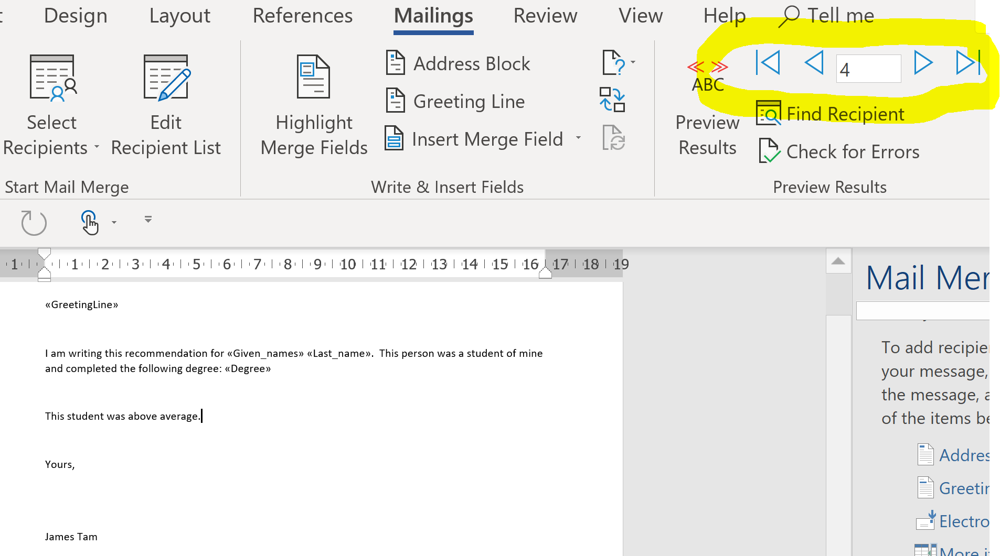
What You Get From The Merge
Outputs of the merge:
  Default output (this is what you will submit for the assignment)
    The original main document will contain the customized documents.
    You can ‘click’ through all the different letters and see how the main document has been customized.
    Changes can be made in the customization.

Slide 12
What You Get From The Merge (2)
  Optional output:
    Generated if you select “finish and merge”
    Creates a new Word document that only contains the customized results (e.g. the sequence of customized letters that can be printed or sent).
    Only the individual letters can be customized.
      Looks the same as manually typing all the individualized letters (which is why it won’t merit any credit because it doesn’t demonstrate mastery of the mail merge feature).
    Not needed for assignments.

Slide 13
Mail Merge Example: TA Demo
This will be different from lecture: The wizard will not be used
Example files can be found in the tutorials link for this week under the subfolder ‘mail_merge_example’ and the subfolder ‘first_example’
Since this is a longer multi-step process, students can download this example from the tutorial portion of the course website and follow along as the tutorial instructor works through the process.
  There will also be student exercise to follow:
Contents of this folder:
  Original main document (Word document): form_for_creating_recommendations-ORIGINAL
  Data source (Excel spreadsheet): students

Slide 14
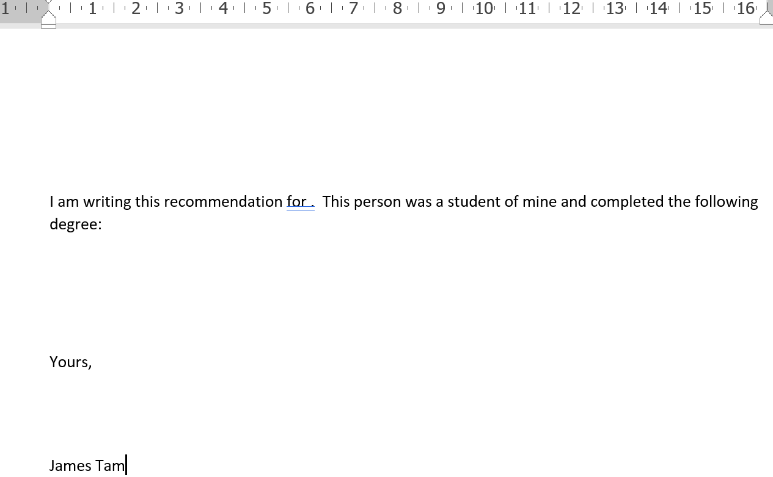
Original Main Document
CUSTOMIZATIONS FROM THE MERGE
1) Salutation
2) Student name
3) Qualifications
4) Extra endorsement (GPA 3.0 and above)

Slide 15
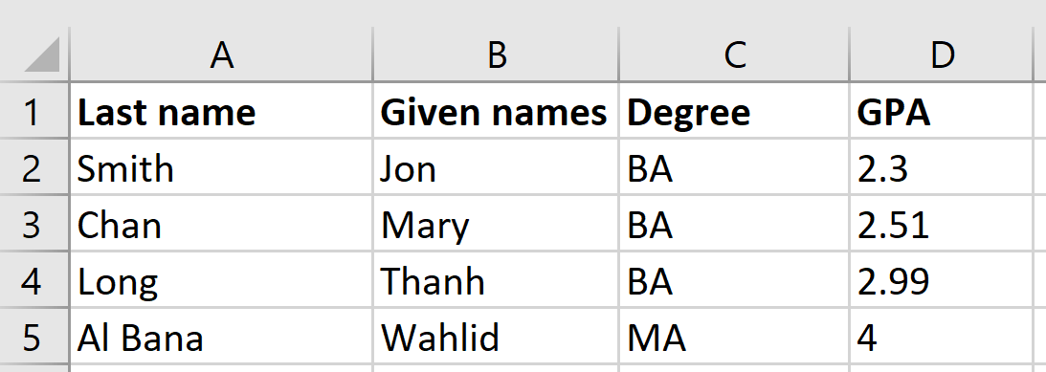
Data Source

Slide 16
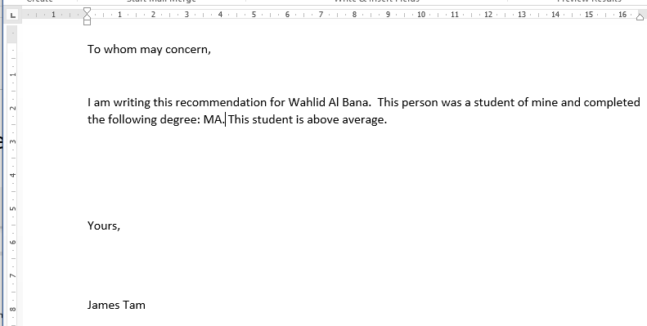
Example Customized Letter

Slide 17
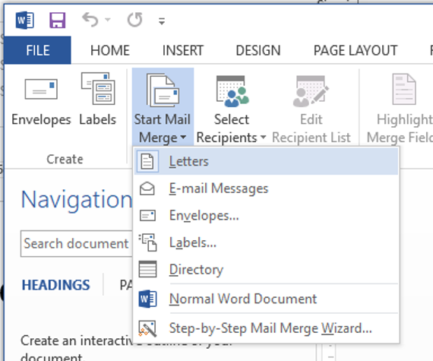
Starting The Mail Merge
(In this case the original main document and the data source has already been created, normally you would have to create those yourself).
Open the original main document in Word.
Select: Mailings tab->Start Mail Merge->Letters

Slide 18
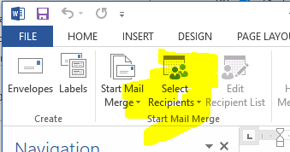
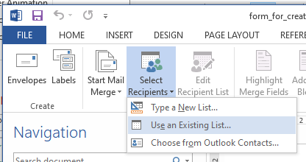
Mail Merge: Select The Data Source
Similar to the step when using the Wizard this allows you determine where the customized data comes from:
  Mailings -> Start Mail Merge: Select Recipients
  From there select the ‘Use Existing List’ option.

Slide 19
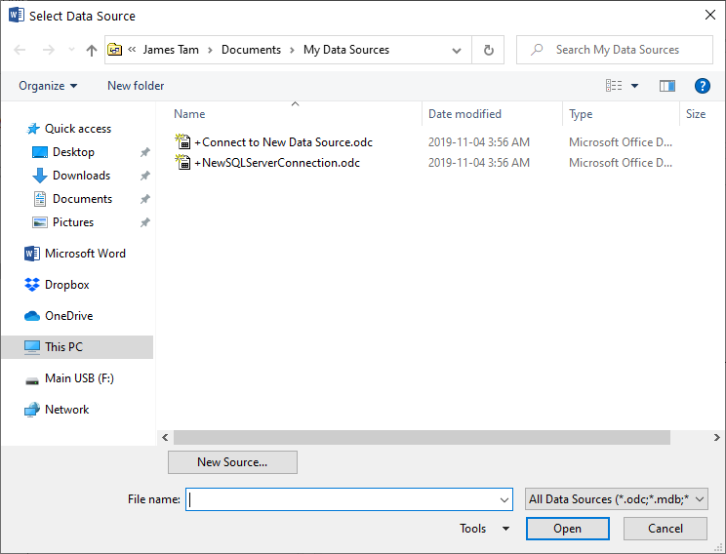
Mail Merge: Select The Data Source (2)
Now you have the ability to navigate to the location where the data source (in this case it’s the ‘students’ Excel file) is located.
  Complete the other steps for selecting the data source as you would when using the wizard.

Slide 20
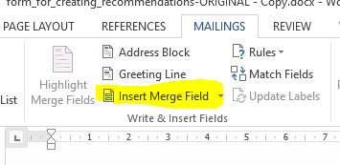
Mail Merge: Insert The Student Name
  Click on the line containing the text “I am writing this recommendation for .”
    Click just in front of the period.
    Insert the given name:
      Mailings -> Write & Insert Fields: Insert Merge Field
  Select ‘Given names’ and click ‘OK’
  Then ‘insert’ “Given names”
  AdFollow this by an ‘insert’ of “Last name”

Slide 21
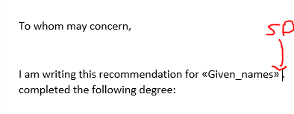
Mail Merge: Insert The Student Name (2)
  Add a space after the inserted given name field to separate it from the last name.
  Insert the last name in a fashion similar to how you inserted the last name (previous slide).

Slide 22
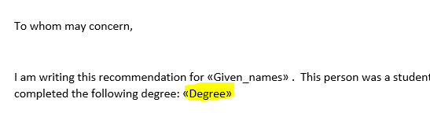
Mail Merge: Insert The Degree
It’s very similar to how you inserted the given and last names:
  Mailings -> Write & Insert Fields: Insert Merge Field
  (Select the ‘Degree’ field this time).
  Insert the degree at the end of the letter after the space which follows the text “This person was a student of mine and completed the following degree:”
  After inserting the degree add a period after the degree.

Slide 23
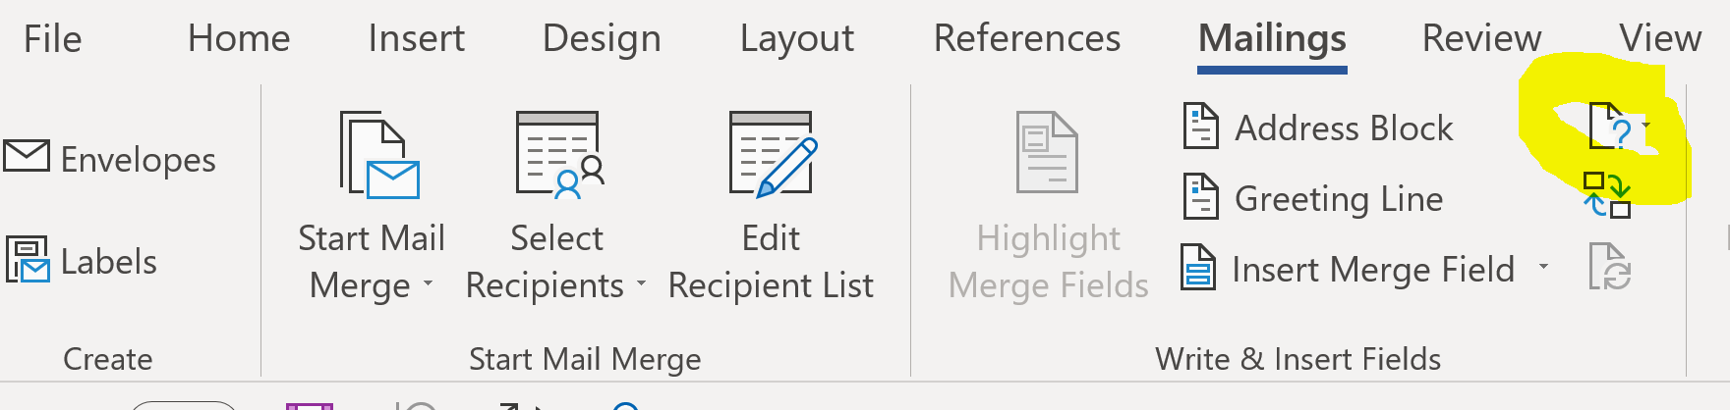
Mail Merge: Include A Conditional Endorsement
  Students whose GPA is 3.0 or greater will have the text “This student was above average.” added to the end of the letter (after the degree).
  Click two lines below the text “This person was a student of mine and completed the following degree: “
  Select under the ‘Mailings’ tab: Write & Insert Fields group: Rules->IF-THEN-ELSE

Slide 24
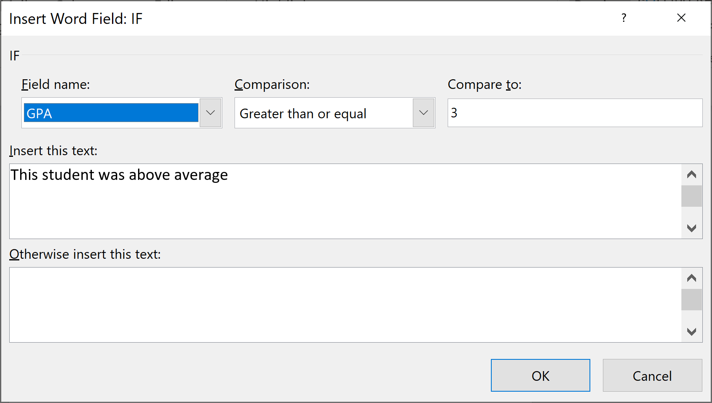
Mail Merge: Include A Conditional Endorsement (2)
Include a conditional endorsement (continued)
  A popup dialog box comes up
  Under the “Field name” option select “GPA”
  Under the “Comparison” option select “Greater than or equal”
  Type ‘3’ into the “Compare to” field
  Type ‘This student is above average.’ in the “Insert this text” field
  (Leave the “Otherwise insert this text” field blank.

Slide 25
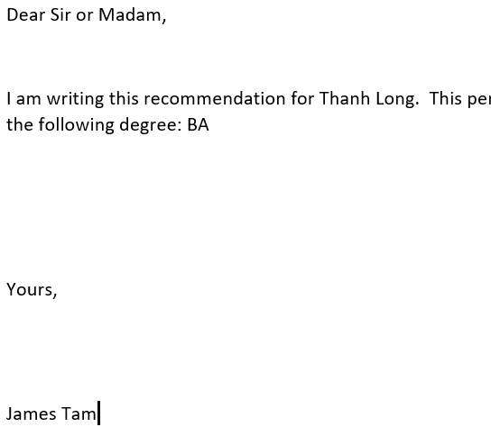
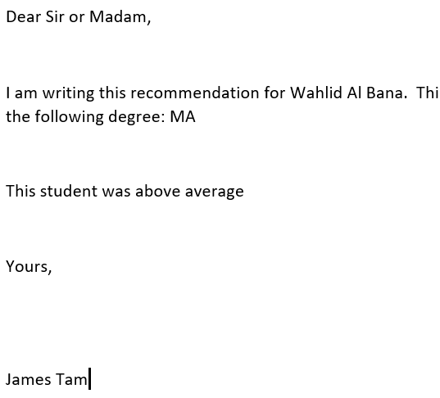




Mail Merge: Checking Results
You can see the individual results under:
  Mailings tab-> Preview Results: Preview results (and then click forward or backward)

Slide 26
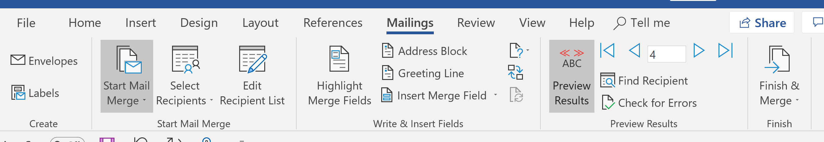

Mail Merge: Do Not Finalize The Process For Any Assignments (If Applicable)
“Finish and Merge” can be used in ‘real life’ to produce a Word document that contains all the merged letters (for printing or emailing).
However, if you only submit the finalized the document there is no way that the marker can tell that you actually performed a mail merge.
  The different letters cannot be “clicked through” (previous slide).
  (The results could have been produced by simply typing the results into Word).
  To see the result of the finished document using this example see: incorrect_finish_and_merge_document

Slide 27
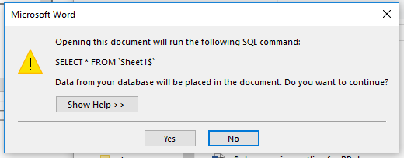
Opening A Word Document Using Mail Merge
Because the Word document is connected to another document you will get a prompt each time that you open it.
  Just select “Yes”

Slide 28
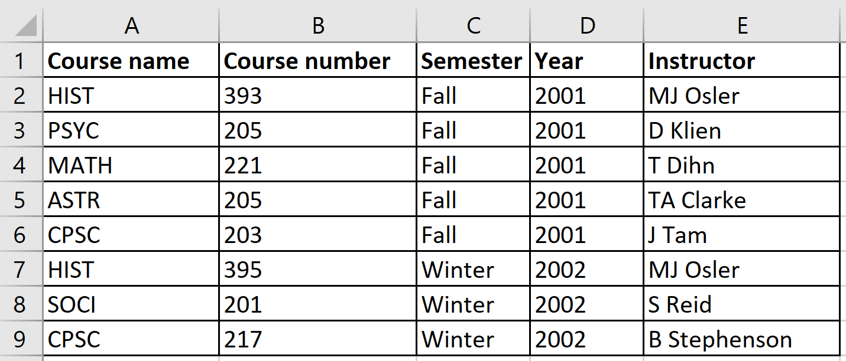
Mail Merge: Student Exercise
In the folder “Student_mail_merge_exercise”, use the following files:
  Original main document (Word document): mail_merge_student_exercise-ORIGINAL
  Data source (Excel spreadsheet): courses

Slide 29
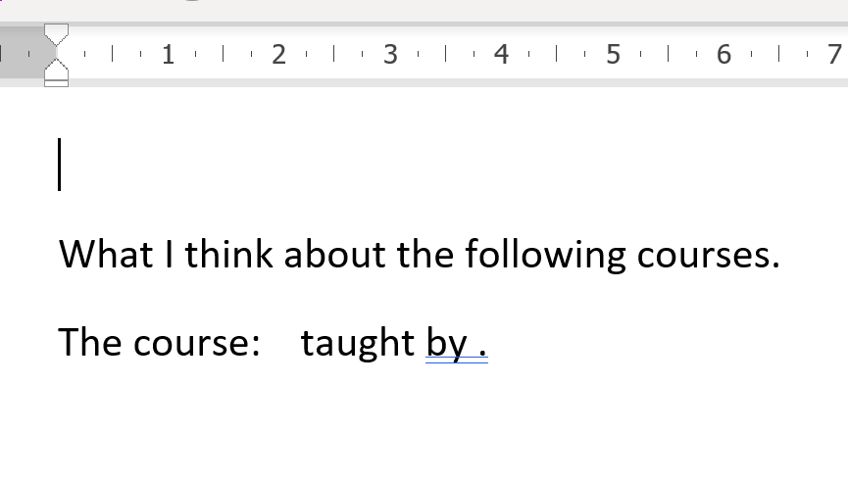
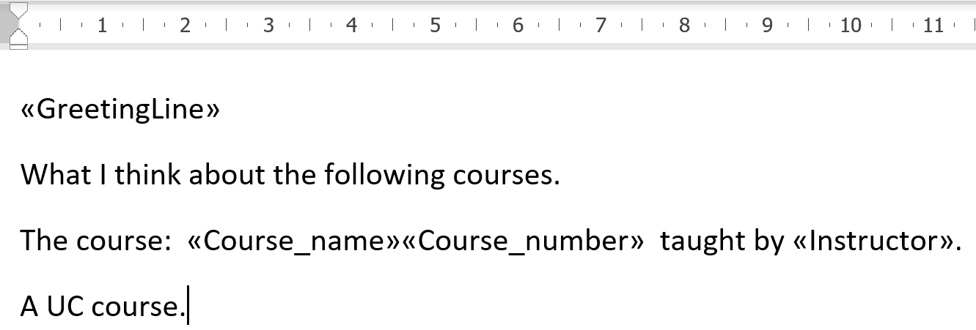
Mail Merge Student Exercise
Open the Word document and use it as the starting template
Using the mail merge add the following in the merged letters. Don’t use the Wizard!
“To whom it may concern”
e.g. CPSC 203
Text varies:
For ‘CPSC’ courses = Highly recommended!
For all others = A UC course.
e.g. J Tam

Slide 30
Resources For The References Examples
Example files can be found in the tutorials link for this week under the subfolder ‘references_4_Word’

Slide 31
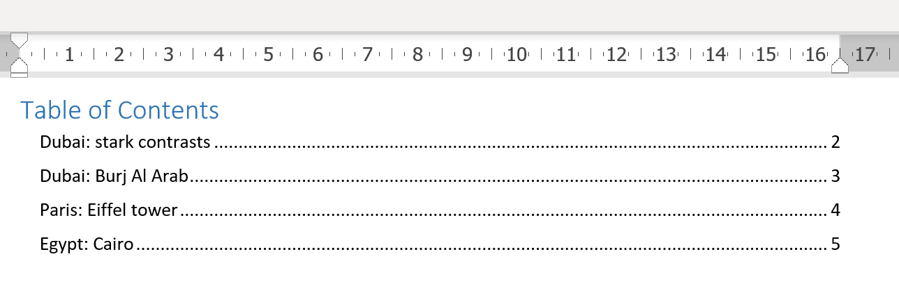
Table Of Contents
Document to use for this example:
  Word document: World
In Word
  References tab->Table of Contents->(Select the type of table: For A1 it’s “Automatic Table 2”)
Student exercise:
  Insert an “Automatic Table 2” into the World document.

Slide 32
Citations
Can be used to attribute credit to a quote.
Document to use for this example:
  Word document (you can use it to create a master): the_hobbit
Steps:
  Enter the information for the citation.
  Refer to the citation in the document.

Slide 33
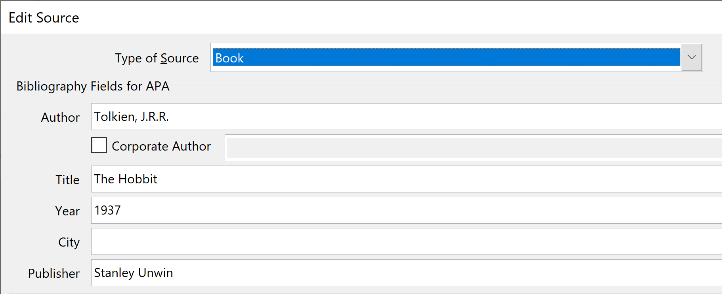
Citations
Step 1: Create the citation (enter information regarding the source or citation)
  Creating citation in Word:
    References->Citations & Bibliography group: Insert Citation->Add New Source
  (If you need to change the citation later):
  References-> Citations & Bibliography group: Insert Citation->Manage Sources->Select the citation->Edit

Slide 34
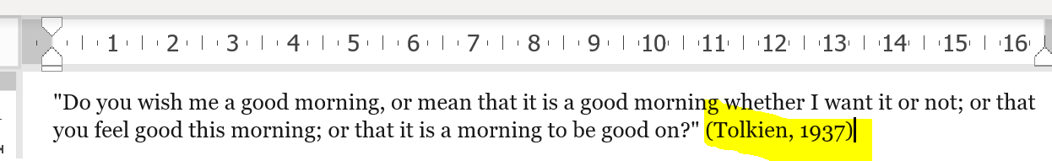
Citations (2)
Step 2: Using or referring to the citation
  Navigate to the location in Word where the citation will be located
  Insert the citation at that location:
    References-> Citations & Bibliography group: Insert Citation->(Select the citation source from the list)

Slide 35
Citations (3)
Student exercise, step 1: creating the citation
  Author: Tolkien, J.R.R.
  Title: The Hobbit
  Year: 1937
  Publisher: Stanley Unwin
Student exercise, step 2: using/inserting the citation
  Insert the citation after the quote
    "Do you wish me a good morning, or mean that it is a good morning whether I want it or not; or that you feel good this morning; or that it is a morning to be good on?"

Slide 36
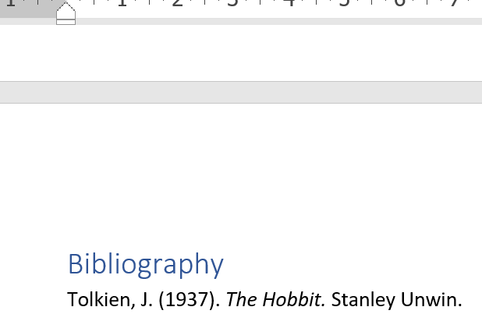
Bibliographies
Using the same Word documentation, a bibliography can be added from the newly created citation.
References-> Citations & Bibliography group: Bibliography
Student exercise:
  At the end of the document insert a page break
  Insert a new citation for the book.

Slide 37

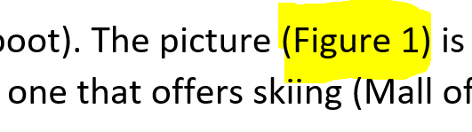
Figure Captions
Allows the figure captions to be tracked and updated (as necessary) by Word.
Also allows references to the figures (“cross references”) to be tracked and updated by Word.

Slide 38
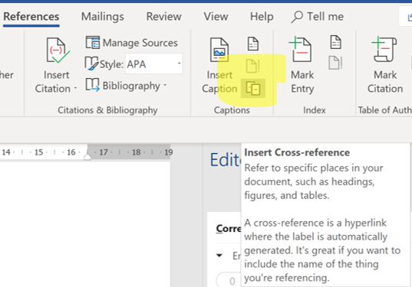
Figure Captions
First part: creating the caption
  References tab->Caption group: Insert caption
Second part: adding caption as a cross reference
  References tab->Caption group: Insert cross reference

Slide 39

Student Exercise: Figure Captions
Starting document: World
  Delete the image Figure 2 and the caption.

Slide 40
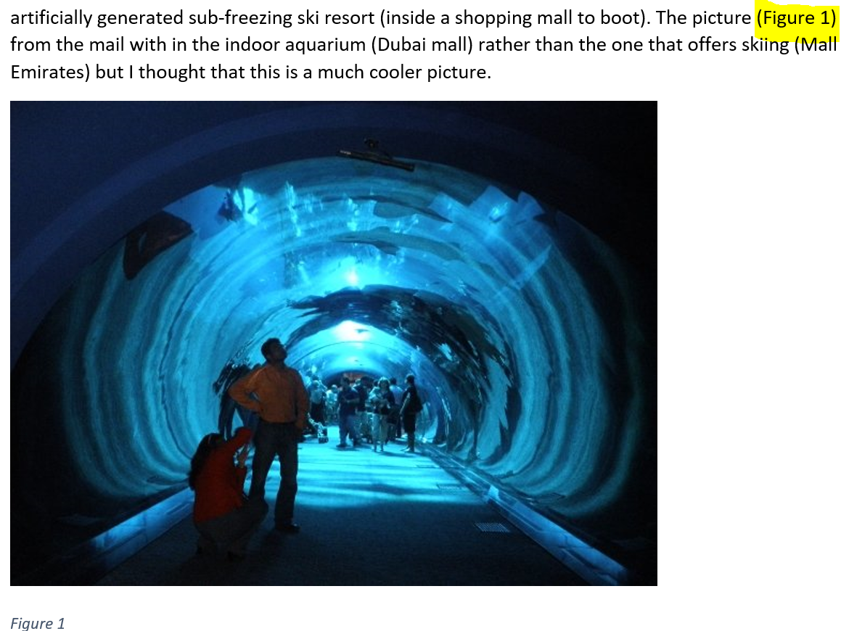
Student Exercise: Figure Captions (2)
On Page 1 insert a cross reference to Figure 1.
Update the captions:
  Select the entire document.
  Right click (without losing the selection) select “Update field”.
  (The images of Dubai and the pyramids should now be captioned as Figure 2 & 3 respectively).

Slide 41
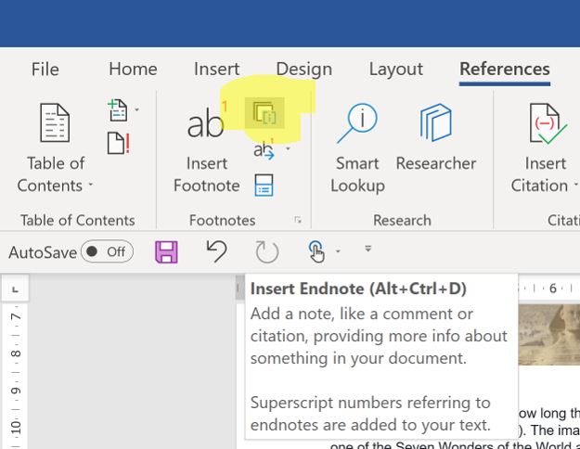
Footnotes & Endnotes
Footnotes are added to the bottom of the current page.
  References tab->Footnotes group: Insert Footnote
Endnotes are added to the end of the current document.
  References tab->Footnotes group: Insert Endnote

Slide 42
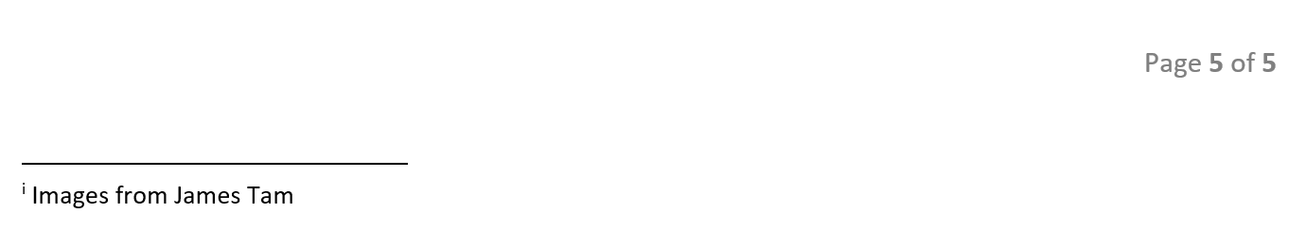
Student Exercise: Endnote
Using the ‘World’ document insert an endnote: “Images from James Tam”

Slide 43
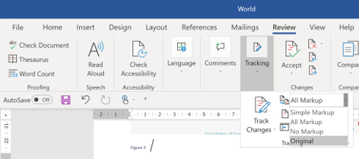
Tracking Changes
Word can be used to track changes made to a document.
The changes are tracked and graphically illustrated after Word has been instructed to “Track changes”.
  Review tab->Tracking->Track Changes
Choosing the level of detail for illustrating changes made to the document:
  Review tab->Tracking->All markup option and then select level (All markup, Simple markup, No markup)
  Reviewing and accepting or rejecting changes:
  Review tab->Changes group->Accept (then select among options to accept or reject)

Slide 44
Tracking Changes: Level Of Detail
Changes made to the ‘World’ document.
  ‘50’ deleted
  ‘49.5’ added
  Aquarium image (of Dubai) deleted

Slide 45
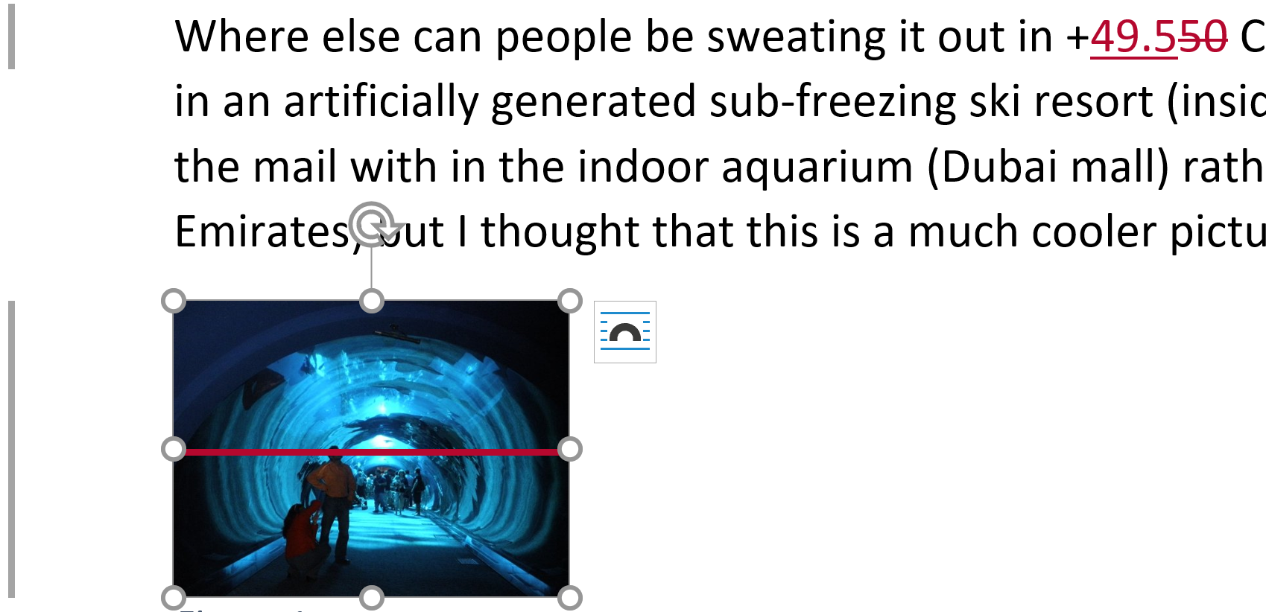
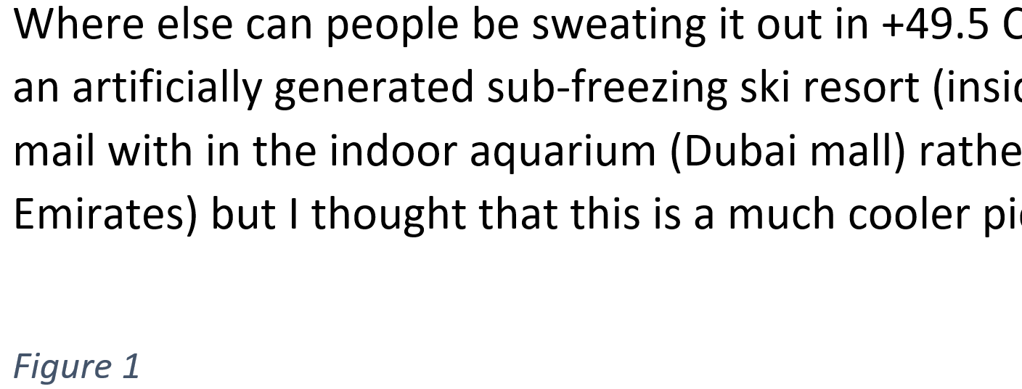
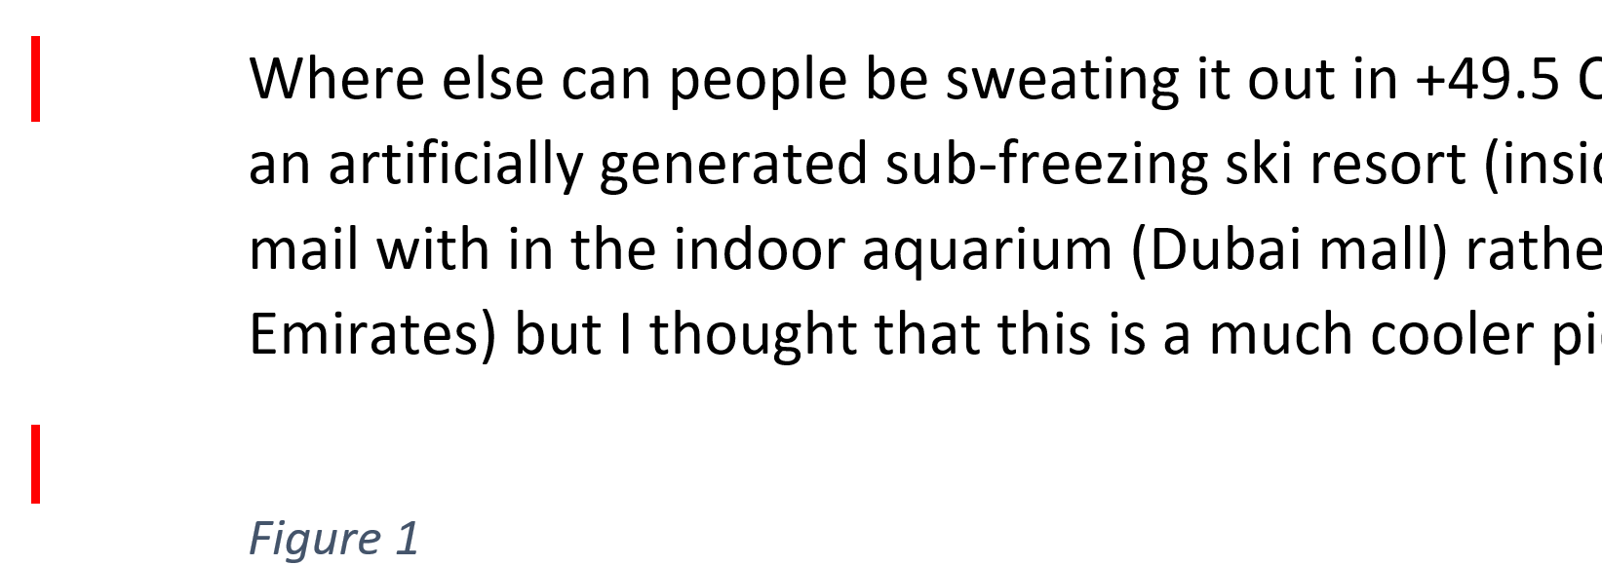
Tracking Changes: Level Of Detail (2)
All markup
No markup
Simple markup

Slide 46
Copyright Notification
“Unless otherwise indicated, all images in this presentation were created by James Tam.”

