Slide 1
MS-Word
Week 1
Official resource for MS-Office products: https://support.office.com

Slide 2
Activities In Tutorial
TA demos:
  Used for more complex features (typically multiple steps are required).
  The tutorial instructor will show on the projector/instructor computer each step for running the feature in Word.
  Unless otherwise specified the tutorial material will take the form of a TA demonstrating the use of features in Word.
Student exercises:
  Used instead of TA demos for simpler features.
  You will have already been given a summary of how to invoke the feature and the purpose of the exercise is to give you a chance to try it out and get help if needed.

Slide 3
First Tutorial

Slide 4
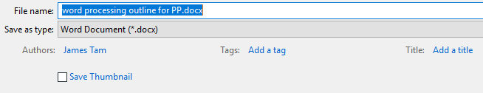
‘Saving’/ ‘Saving As’ Documents
Saving (you should know): saving the current document under the existing name
Saving as:
  You probably know: saving the current document under a different name
  What about the following features?

Slide 5
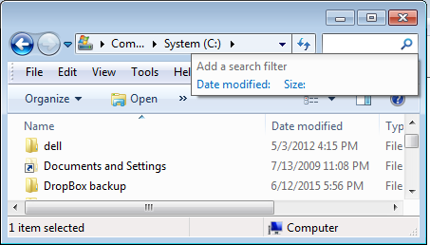
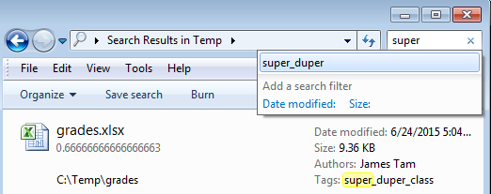
Excel Example Using Tags (Also Applies To Word)
The tag is separate from the file name but may still be used as search criteria

Slide 6
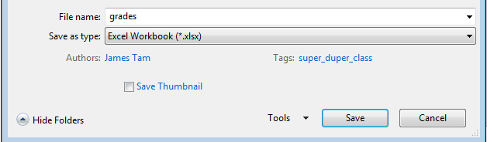
Excel Example: Using Tags
W

Slide 7
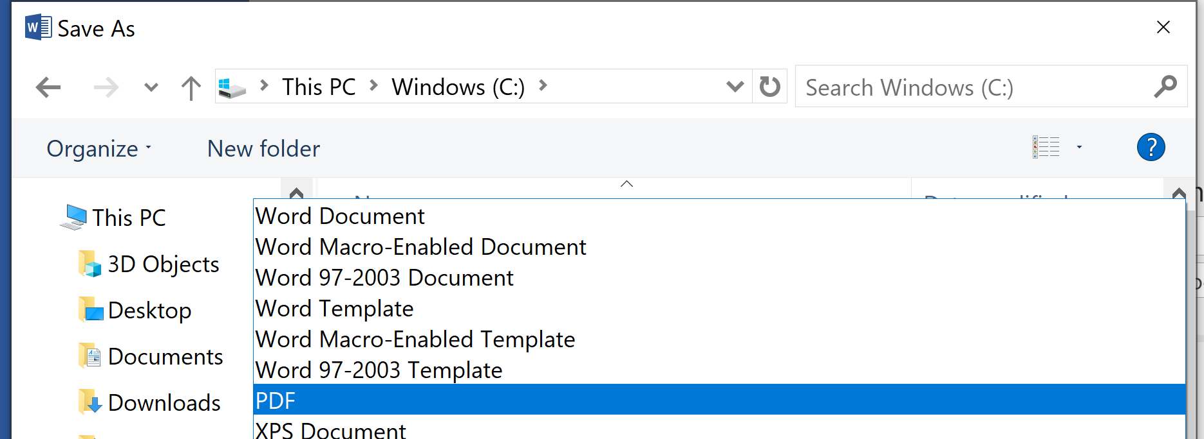
Creating PDF Documents
PDF (Portable document Format) documents
  Allows documents to be saved and viewed with different computer operating systems.
  Ensures a consistent layout and formatting.
PDF documents can be created out of a Word document using the “Save As” feature.
  Select ‘PDF’ as the file type under the pull down menu.

Slide 8
Configuring Word To Mitigate Against Disaster
AutoRecover:
  Word can save a document periodically (default is 10 minutes)
  Situations designed to mitigate: Word crashes, loss of power
  Configuring save duration:
    File->Options->Save->Save Auto recovery information
Automatic Word backups:
  Word will save a backup document every time that you save (same location)
  Situations designed to mitigate: document becomes in accessible (e.g. corrupted, deleted) the backup may still be usable
  Default: this feature is turned off
  Configuring auto backup:
    File->Options->Advanced->(Save group: Always create backup copy)

Slide 9
Manual Backups:
With all the features built into Word why bother making backups yourself?
Notes:
A:
You know exactly what version you are saving, what features exist in the documents
Automatic and manual saves are complementary not exclusive, you should use both for important documents

Slide 10
Converting Between Versions Of Word
Different version of Word (and Office) have different features
https://support.office.com/en-us/article/Compare-Word-features-on-different-platforms-5e00dfba-3d7c-4222-b850-a0527ff7b066
https://support.office.com/en-us/article/Compatibility-changes-between-versions-CB713C85-3145-4E83-A8B6-1E3227A4C059
Checking for compatibility issues in a document
  File->Info->Check for issues->Check compatibility
Converting older versions to the newest version of Word
  File->Info->Convert (the ‘convert’ option only appears for older versions of Word documents).
  File->Save As (Word Document *.docx) i.e. save under the new file type to do the conversion.

Slide 11
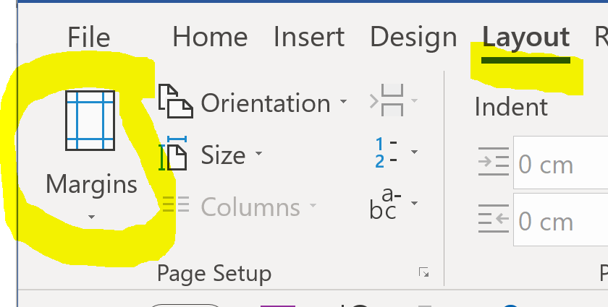
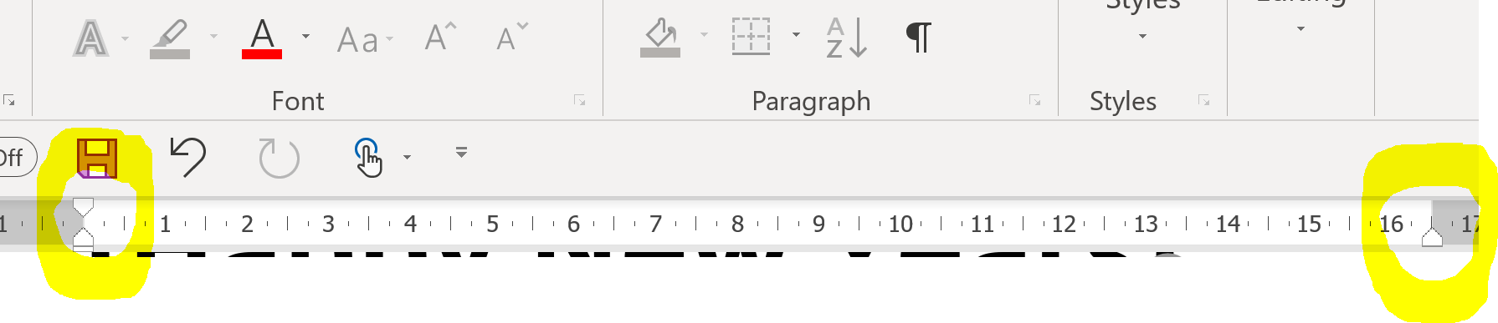
Changing Margins
Via the Ribbon: Layout tab -> Page Setup group: Margins
Via the ruler (the ruler must be made visible first, this can be done via: View ribbon->(Show group: checking the ruler option)

Slide 12
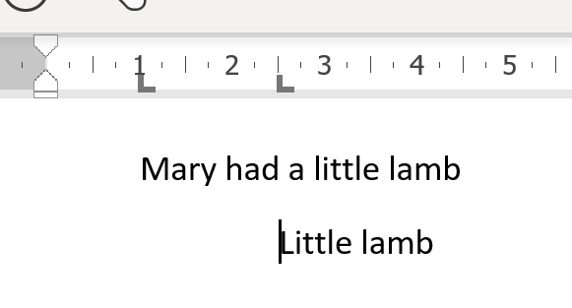
Tabs
A “tab stop” can be added with the ‘Tab’ key
The amount of indenting produced by a tab can be changed with the ruler.
Tab settings
Single tab
Two tabs

Slide 13
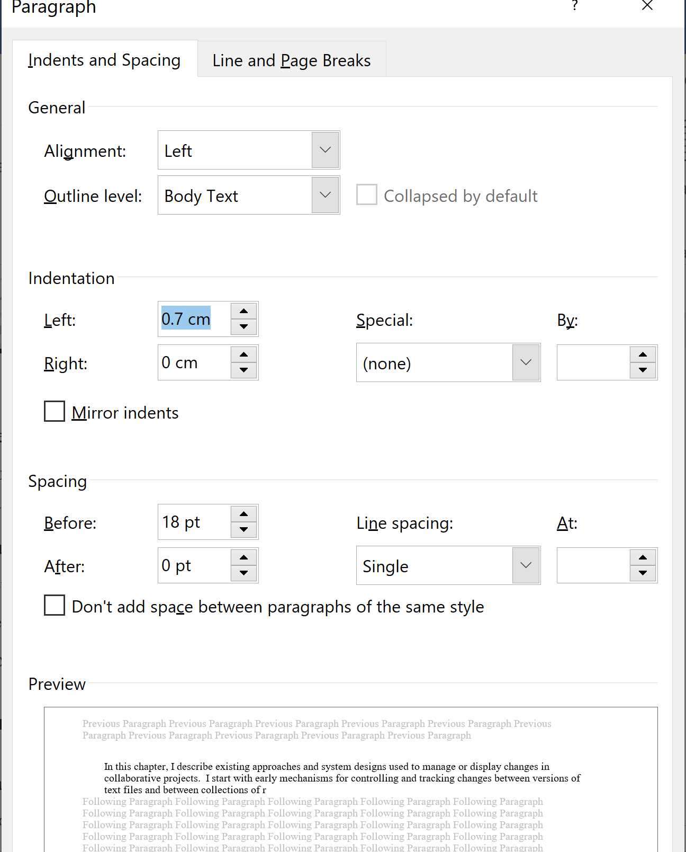
Paragraph Formatting Options

Slide 14
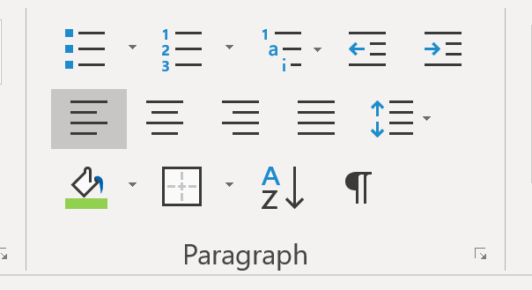
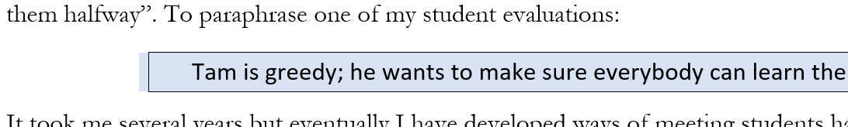
Paragraph Formatting Options (2)
To emphasize a paragraph, borders and shading can be added (this should be done only sparingly).
  Location of controls: Home->Paragraph group
  Effects applied
Shading
Border

Slide 15
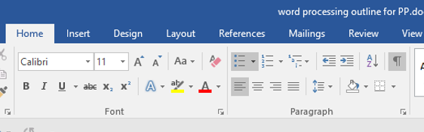
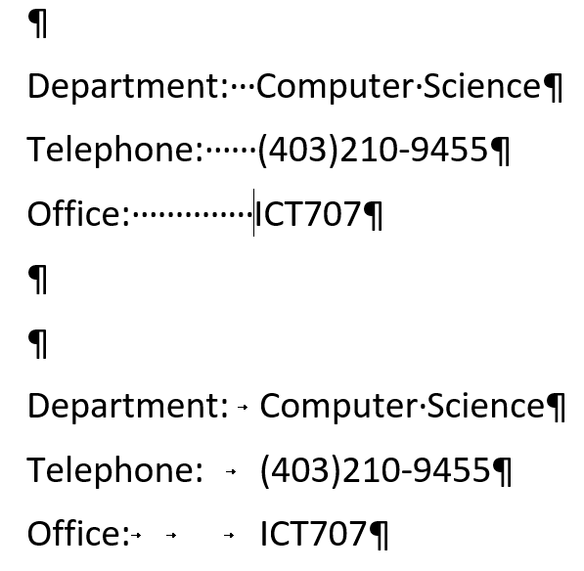
Show/Hide Formatting Symbols
Some characters (e.g. formatting) affect formatting but have no visible appearance (e.g. space, tab etc.)
Formatting symbols (tabs vs. spaces)
View formatting symbols

Slide 16
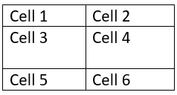
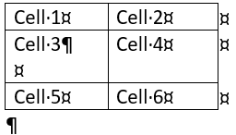
Example: How Formatting Symbols Can Be Useful
Why won’t the thickness of Row 2 decrease?
Showing the formatting marks can provide the answer.

Slide 17
Moving Text To The Next Line
Word wrap
Hard return
Soft return

Slide 18
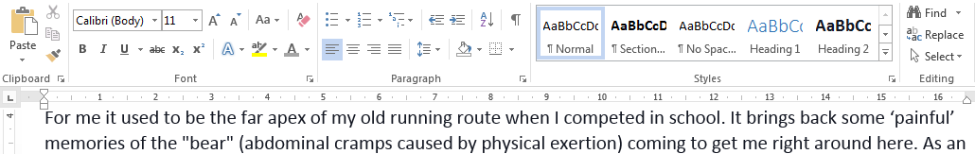
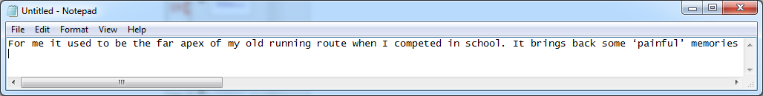
Word Wrap
A feature automatically built into Word processors (e.g. Word) and many text editors (WordPad but not Notepad). Long text is moved to the next line.
  MS-Word: word wrapped, words are move to the next line (without splitting up a word).
  MS-Notepad: no word wrapping (text is one long line).
  Word wrapping can be affected by variables such as margin settings in a document.

Slide 19
Hard Return
Used when the editor specifically wants text to always appear on a separate line regardless of variables such as margin settings.
In word processors and text editors a hard return can be added to a document by hitting the ‘enter’ key.

Slide 20
Soft Return
Similar to a hard return a soft return will move text to another line.
The difference is that the distance between the two lines is not as large as the case with a hard return.
In Word a soft return is inserted by pressing the ‘shift’ and the ‘enter’ key at the same time.
  Shorthand notation: <Shift>-<Enter>
Soft returns can be used where the two lines must be separate but still in close proximity e.g. lines of an address, headings and sub-headings.

Slide 21
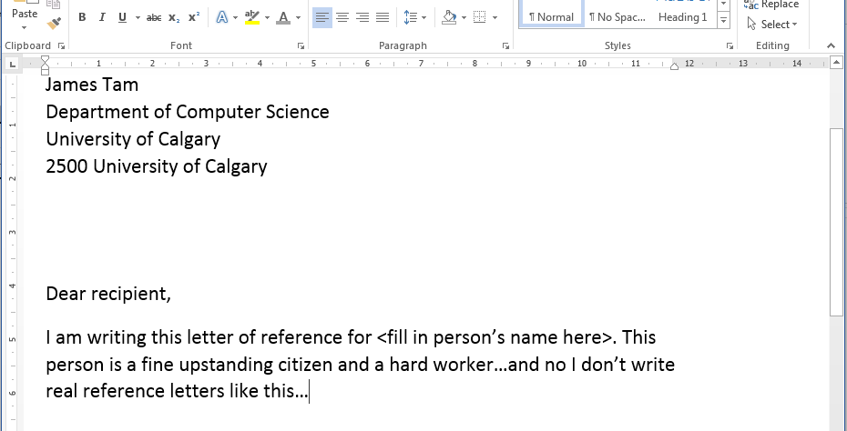
Line Separators: An Example
Soft returns
Hard returns
Wrapped text

Slide 22
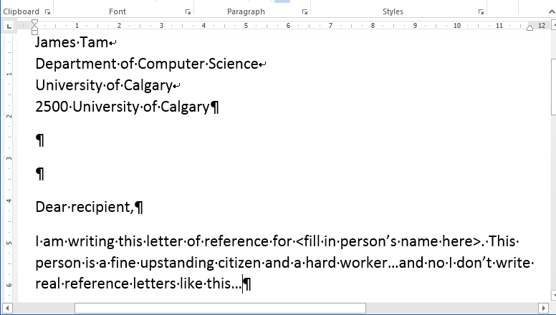
Showing Line Separators: Formatting Marks On

Slide 23
Second Tutorial

Slide 24
Insertions In Word
Images
Page breaks
Cover pages
Section breaks (changing the layout)
Symbols & Equations

Slide 25
Insertions: Images
Images from your computer
  Insert->Illustrations group: Pictures
Online images
  Insert->Illustrations group: Online pictures
  Advantage over a regular web search: by default the images have a Creative Common license (allow for legal non-commercial use)
    For more information on a CCLs and copyright:
    https://creativecommons.org/licenses/
    https://www.microsoft.com/en-us/legal/copyright/default.aspx
Notes:
Print Screen: show things that you can’t get from Snipping tool and inserting screenshots like tool tips or selected menu options

Slide 26
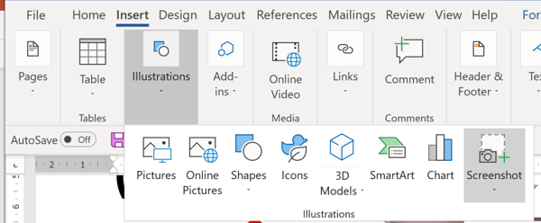

Getting Screenshots Of Open Windows
JT: Yes you can use a phone camera but it may not be of sufficient quality.
Getting screenshots is built into Word:
  Insert tab -> Illustrations group: Screenshot
Side note (getting screenshots beyond Word):
  Snipping tool (Available Windows Vista onwards and even XP via an add-on) – in the future the feature is moving to “Snip & Sketch”)
  Print Screen – useful for situations where menu options must be opened.

Slide 27
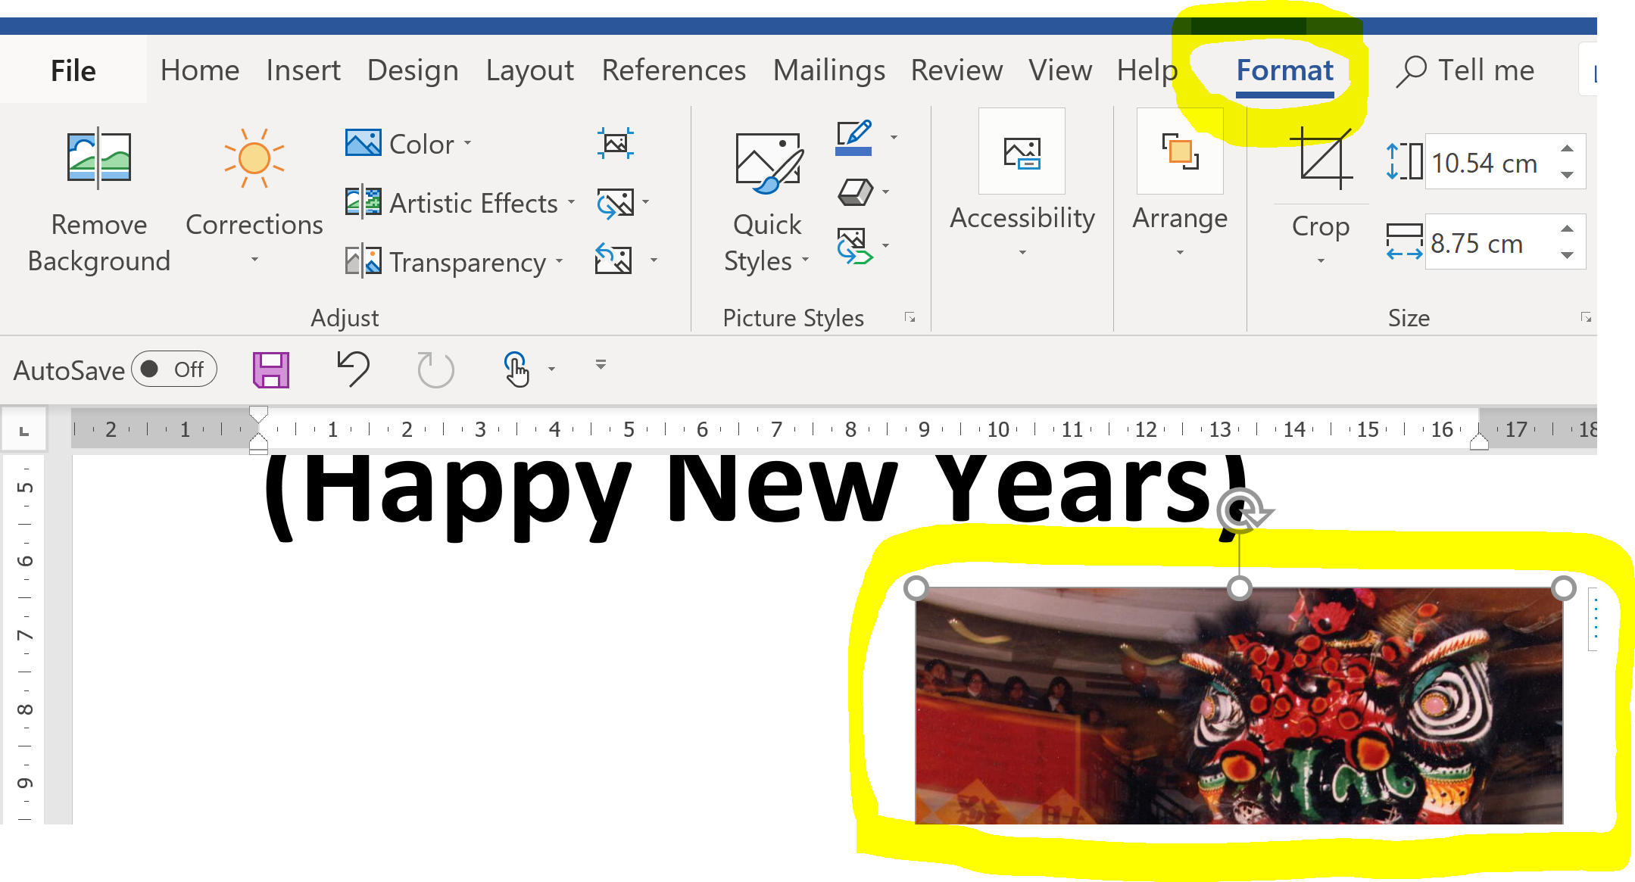
Editing Images
The ‘format’ tab only appears on the ribbon when an image is selected in Word:
JT’s note: for simple imaging editing tasks I prefer using PowerPoint (handles layout better).

Slide 28
Insertions: Page Breaks
Insert->Pages group: Page Break
Moves text after the page break to the top of the next page
If an assignment instruction specifies a page break vs. hard returns make sure you don’t mix the two up or your grade will be affected.

Slide 29
Insertions: Cover Page
Insert->Pages group: Cover Page
Pre-created cover pages already specify things such as: layout, alignment, images, fonts etc.

Slide 30
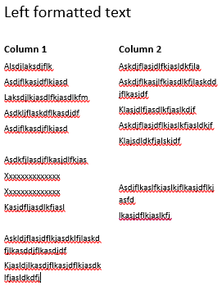
‘4th Insertion’: Section Break
Sections in a document can have different formatting applied or have it’s own sequence of page numbering
Sections can be on different pages or reside on the same page.
(Section breaks are actually not ‘inserted’ into a Word document).
  They ‘change’ layout although one may think that a section break has been ‘inserted’ so it’s covered now.
Sections on different page
  Layout->Page Setup group: Breaks->Next page
Sections on same page
  Layout->Page Setup group: Breaks->Continuous
Notes:
TA tip:
The very top of the page (heading = Left formatted text) is one section (single column)
The rest of the page is formatted as two columns
The section break allows for different formatting

Slide 31
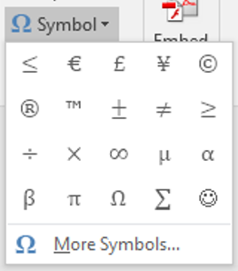
Insertions: Symbols & Equations
A useful time saver:
  Symbols
    Insert->Symbols group: Symbols
  Equations (Math and other formulas)
    Insert->Symbols group: Equations

Slide 32
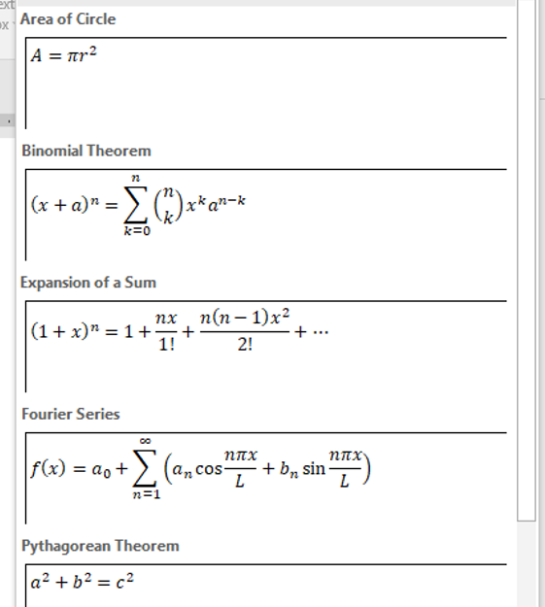
Insertions: Symbols & Equations (2)
  Equations
    Insert->Symbols group: Equations

Slide 33
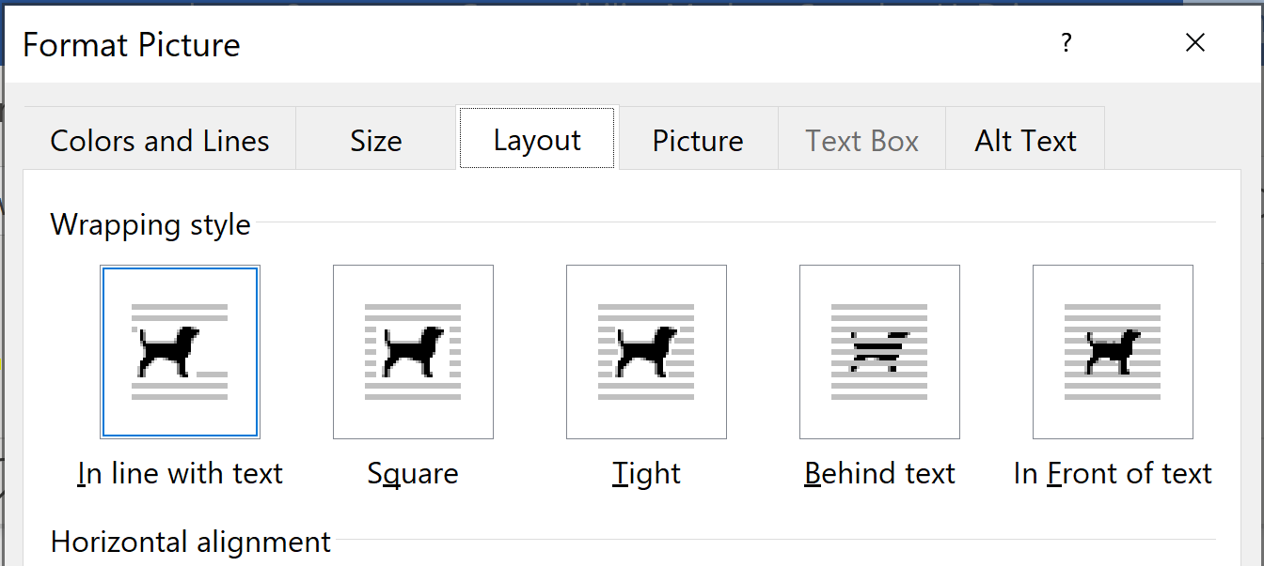
Options For Setting Picture Layout
Select a picture
Right click and select the ‘Picture’ option
Pull up the ‘Layout’ tab

