Slide 1
Excel: Tutorial Week 3
Branching and logic
Logic and web searches: AND, OR, NOT (subtraction)
Cell references: more advanced examples, transposing their use
Official resource for MS-Office products: https://support.office.com

Slide 2
Second Tutorial

Slide 3
The IF() Function
It operates in a similar fashion to conditional formatting and the COUNTIF() function: is it true that some condition has been met.
Unlike the formatting feature and the COUNTIF() function the return value can be specified:
A constant e.g. number, text string, Boolean (12, -12, 1.5, “Pass”, True etc.)…any value that be typed into an Excel cell can be the specified constant.
A reference to a cell (and that cell can then contain one of the above values).
An expression that evaluates to any one of the above values e.g. 2*3, “hi”&”there”

Slide 4
Structure Of The IF() Function
Format (the function should be all on one line, it’s shown on multiple lines to allow details to be specified).
IF (<Boolean value>¹,
<return value if Boolean is true>,
<return value if Boolean is false>)
Example:
=IF(A3>=$F$2,$F$3,$F$4)
Note
The Boolean can be a constant (True, False), a reference to a cell that contains a Boolean or an expression that evaluates to a Boolean result (e.g. A3 >= 2.0)
1 A Boolean is either the value True or the value False, a Boolean expression (works out to a Boolean) is allowable e.g. 3 > 2, A2 >= 50 etc.

Slide 5
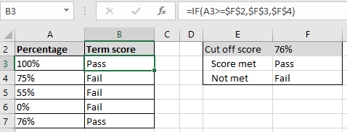
IF Example: Pass/Fail Clinical Coursework
Nursing students must earn a grade of 76% or higher in order to pass their clinical course work.
Example spreadsheet: if_example_clinical_example
Note the use of the dollar sign
F2: A lookup table with the cut off value used in the Boolean expression.
F3, F4: Return values for the respective true/false cases (each student will always refer to these cells so the references must include the dollar sign).

Slide 6
Review: Logic
AND:
Used when all conditions must be true
The typical default when entering parameters into a search website e.g. CPSC 203 will return as search results pages that contain ‘CPSC’ and ‘203’.
OR:
Used when at least one condition is true
(Variant of the example from lecture), Internet search: “Bruce Lee” OR “Little Dragon” will return as search results pages that contain either one (or both) of these names.

Slide 7
Logical ‘AND’ & Web Searches: Student Exercise
Search case #1, type the following into a search site:
coronavirus cases
Note the number of search results
Search case #2, type the following into a search site:
coronavirus cases Canada
Note the number of search results (increased or decreased?)

Slide 8
Logical ‘OR’ & Web Searches
Search case #1, type the following into a search site:
“Calgary headlines" “Edmonton headlines”
Note the number of search results
Search case #2, type the following into a search site:
“Calgary headlines" OR “Edmonton headlines” (OR is case sensitive)
Note the number of search results (increased or decreased?)
Search case #3, type the following into a search site:
“Calgary headlines" or “Edmonton headlines” (OR is case sensitive)
Note the number of search results (increased or decreased?)

Slide 9
New: Logical Not
Negates or reverses the logic (true becomes false, false becomes true).
Excel NOT function
Usage: NOT(<Boolean expression>)
Examples: NOT(True), NOT(False), NOT(A1), NOT(2>1)
Negation in terms of web searches:
The negation operator is also known as the ‘subtraction’ operator.
Explanation in terms of ‘subtraction’: Search results that would normally appear are subtracted from the list of results displayed.
Alternatively in terms of ‘negation’ or ‘not’: When it’s true that a web page meets the search criteria adding a negation will make it false (i.e. that page won’t appear as a search result).
Web search subtraction/negation operator: - (‘minus’)

Slide 10
Logical Not: Web Search Student Exercise
Your name is Justin and you are tired of seeing search results displaying ‘Bieber’ web pages whenever you “Google yourself”.¹
Search case #1, type the following into a search site:
Justin
Note the number of search results and if any search results return pages that contain the text “Justin Bieber”.
Search case #2, type the following into a search site:
Justin -Bieber
Note the number of search results and if any search results return pages that contain the text “Justin Bieber”.
1 This example was chosen for teaching purposes simply because of the large number of results that return pages containing “Justin Bieber” when the search criteria is ‘Justin’. Apologies to any one that happens to be hard core Beliebers. https://www.urbandictionary.com/define.php?term=Belieber

Slide 11
From Lecture: Advanced Web Searches?
Link to the week in lecture when Google searches were covered:
https://pages.cpsc.ucalgary.ca/~tamj/2024/203W/#Lecture_week_3

Slide 12
Using The Logical Functions (AND, OR) In Excel
Format:
AND(<True or False>,<True or False>...)
OR(<True or False>,<True or False>...)
Types of inputs:
A constant value (False, True)
A cell reference (e.g. A2, BB64 etc.)
An expression that evaluates to True or False result (e.g. 3 > 2, A2 >= 50 etc.)
Examples:
AND(False,True,False)
AND(B1,True)
OR(False,False,True)
Exercise: what does this function return?
OR(B1>B2,B2>B1)
Notes:
Exercise: what does this function return?
OR(B1>B2,B2>B1)
A: It depends!

Slide 13
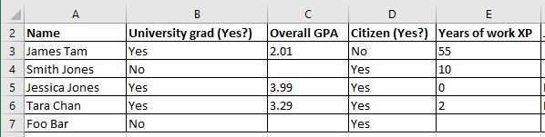
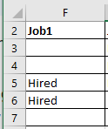
Using Logic In Conjunction With The IF Function
Example spreadsheet: logic_if
Job 1 Requirements (matched to the applicant on a row by row basis)
=IF(AND(B3="Yes",D3="Yes"),"Hired","")
Results? (Why?)

Slide 14
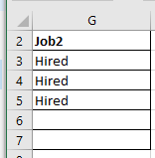
Using Logic In Conjunction With The IF Function
Example spreadsheet: logic_if
Job 2 Requirements (matched to the applicant on a row by row basis)
IF(OR(AND(B3="YES",C3>=3.3),E3>=10),"Hired","")
Results?

Slide 15
Absolute Vs. Relative Cell References
Absolute $: cell reference does not change regardless how far formula is cut-pasted or copy-pasted.
The dollar sign $ can be in front of either the column or row coordinate for that coordinate value to be absolute.
E.g. =$C$3 (absolute row & column), =$C3 (absolute column), =C$3 (absolute row)
Relative: cell reference changes depending upon far formula is moved.
When should each one be employed?
Absolute for constants (lookup table values) e.g. cut off to pass/fail a course because the cut off is always the same.
Relative for variables e.g. student grades.

Slide 16
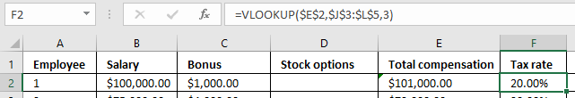

Mixing Up Absolute And Relative Cell References
Example spreadsheet: absolute_income_lookup
First argument (total income) is absolute rather than relative.
The second argument in Column F is unchanged $J$3:$L$5: =VLOOKUP($E$2,$J$3:$L$5,3)
(Absolute means that when the formula is copied all pasted lookups refer to Cell E2 – everyone’s taxes are based on the income of one person!)

Slide 17
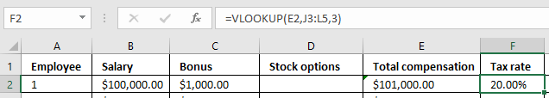

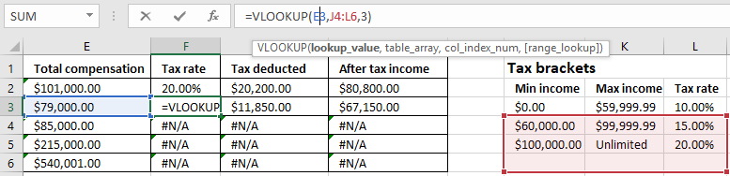
Mixing Up Absolute And Relative Cell References (2)
Example spreadsheet: relative_tax_rate_lookup
Second argument (tax rate lookup) is now relative.
Original value in Cell F2: =VLOOKUP(E2,J3:L5,3)
Formula copied down 1 row to Cell F3: =VLOOKUP(E3,J4:L6,3)

Slide 18
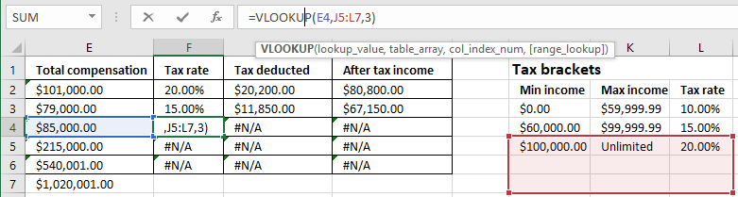
Mixing Up Absolute And Relative Cell References (3)
Copied down 2 rows to Cell F4: =VLOOKUP(E4,J5:L7,3)
The lookup income value is $85,000 which is below the first value in the lookup table (=$100,000) so #N/A is returned (the lookup value doesn’t fit into any of the ranges because it’s below the boundary of the lowest range in the lookup table from J5 – L7).

Slide 19
Other Excel Resources
Online training resources created by Microsoft:
Tutorials
https://support.office.com/en-us/article/excel-for-windows-training-9bc05390-e94c-46af-a5b3-d7c22f6990bb
A MAC specific resource
https://support.office.com/en-us/article/excel-2016-for-mac-help-2010f16b-aec0-4da7-b381-9cc1b9b47745

