Slide 1
Excel: Tutorial Week 2
Multiple worksheets
Named constants
Using pre-created functions
Setting the format of data in a cell
Highlighting important information via conditional formatting
Lookup tables and lookup functions
Counting occurrences
The column chart
Official resource for MS-Office products: https://support.office.com

Slide 2
First Tutorial

Slide 3
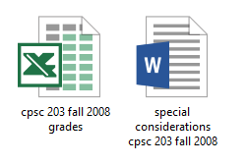
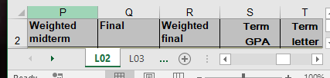
Terminology
Spreadsheet (referred to as a “workbook” by Microsoft)
  A Microsoft Excel file
Worksheet
  A part of a spreadsheet

Slide 4
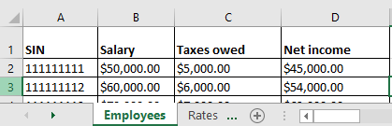

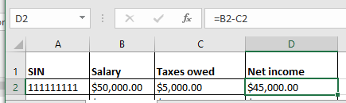
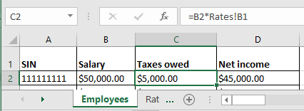
Formula References To Other Worksheets
Example spreadsheet: “references_V1_10%tax”
“Employees” worksheet
“Rates” worksheet
References to same worksheet
Reference to another worksheet

Slide 5
Named Constant
The same value is referenced many times in sheet so it is defined once as a “named constant” – a constant given a name
  Named constants: Tax Rate = 10%, PI = 3.14
  Unnamed constant: =B2 * 0.1
  Named constants are typically defined and grouped in a lookup table
  This is an example of how your assignment style marks could be affected i.e. retyping the 0.1 (poor approach, what if the weighting changes then the unnamed constant must be retyped many times)
    = B2 * 0.1
    = B3 * 0.1

Slide 6

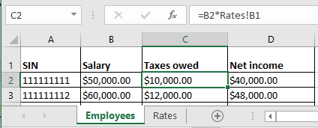
Advantages Of Using Unnamed Constants
Taxes change, example spreadsheet: references_V1_20%tax
One change updates everything that refers to !RatesB1
(More on this later)

Slide 7
Using Pre-Created Formulas
Entering pre-created formulas, refer again to a previous example:
  Name of the example spreadsheet: functions

Slide 8
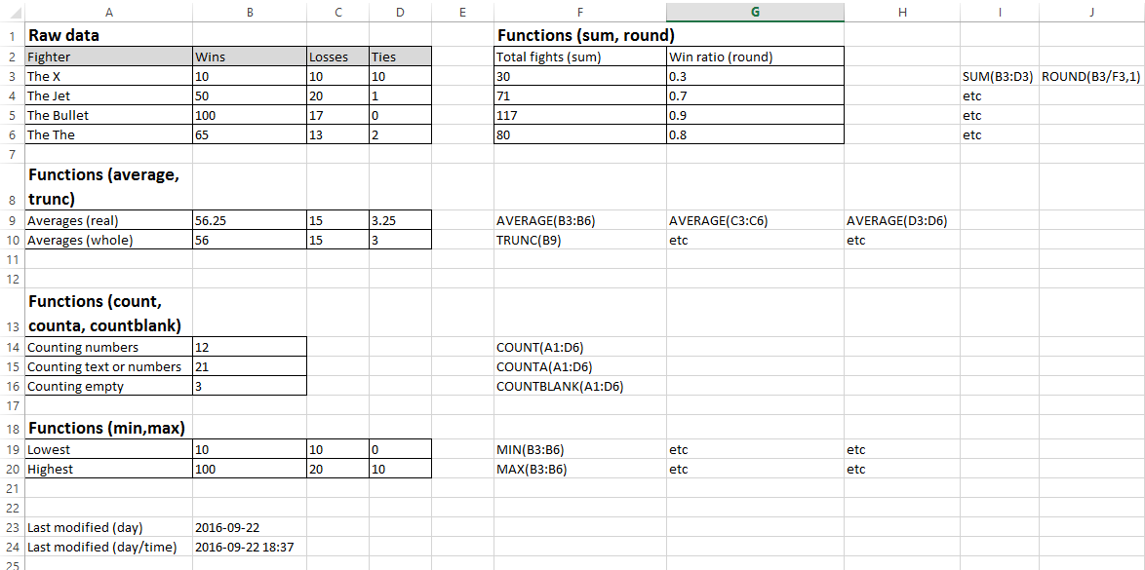
Sample Data

Slide 9
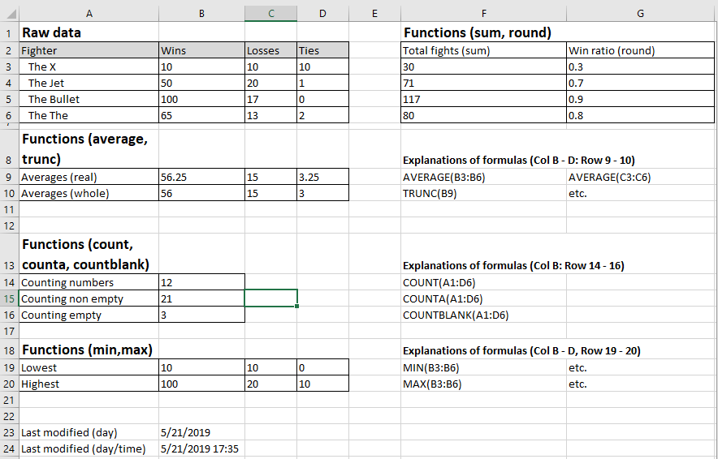
SUM (Col F), ROUND (Col G)
Notes:
e.g. 1 Cell F3: =SUM(B3:D3),
e.g. 2 Cell G3 =ROUND(B3/F3,1) The last argument is the number of places of precision

Slide 10
AVERAGE, TRUNC
(Average: Row 9, Trunc: Row 10 – Truncates the averages from Row 9)
Notes:
Everything on Row 9 (Col B – D) employs the AVERAGE function e.g. Cell B9: =AVERAGE(B3:B6)
Everything on Row 9 (Col B – D) employs the TRUNC function e.g. Cell B10: =TRUNC(B9)

Slide 11
Counting functions (Col B, Rows 14 - 16)
(Count: Row 14, CountA: Row 15, CountBlank: Row 16)
Notes:
Col B: Counts from Cell A1 to Cell D6
B14: =COUNT(A1:D6) ANSWER = 12 (3 x 4 of B3 to D6)
B15: =COUNTA(A1:D6) ANSWER = 21 (everything in the range is included in the
count). Only B1 – D1 are empty (not text or numbers)
B16: =COUNTBLANK(A1:D6) ANSWER = 3 (B1 to D1) Returns non-blank cell count, 3
blank cells = B1 – D1

Slide 12
MIN, MAX (Row 19 – 20, Col B - D)
Notes:
All of Row 19 (Col B – D) are the lowest values for Wins, losses, ties e.g. B19: =MIN(B3:B6)
All of Row 20 (Col B – D) are the highest values for Wins, losses, ties e.g. B20: =MAX(B3:B6)

Slide 13
Time Information: TODAY (B23), NOW (B24)
Notes:
B23: =TODAY()
B24: =NOW()

Slide 14
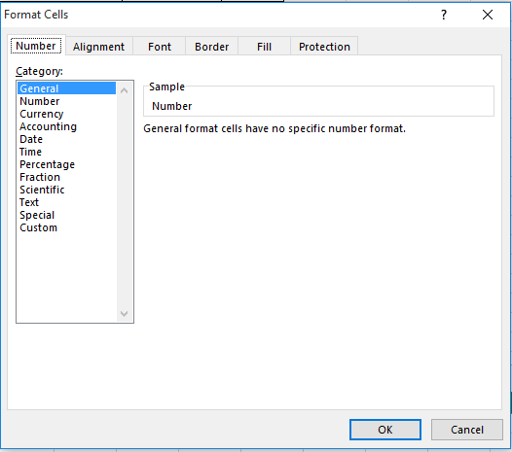
Setting The Format Of Cell Data
Name of the example spreadsheet: data_types
Setting the data type (again right click and select ‘Format Cells’)
  Reminder: The ‘Number’ tab is the default selection

Slide 15
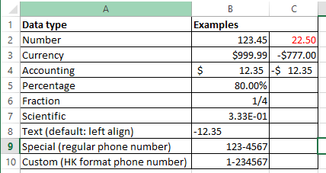
Examples Of Different Types
Notes:
Data in cells
B5: 0.8 is the actual data but displayed as 80% because the percent format is selected
B6: =0.25 (but displays as ¼ because fractional type selected)
B7: =1/3 (displays in scientific format)
B9 & B10: original data typed in as 1234567 by selecting a format Excel takes cares of putting the dash in the correct place

Slide 16
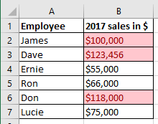
Conditional Formatting
Example spreadsheet: conditional_formatting
It can be used to visually highlight data which has met a certain condition (e.g. 6 figure sales volume or higher in 2017).
Can either be used to:
  Assign specific colors when a condition is met (e.g. red for all finance employees and blue for marketing)
  Assign a range or gradient of colors depending upon to what degree that a condition is met (e.g. red for high income, darker for higher values)

Slide 17
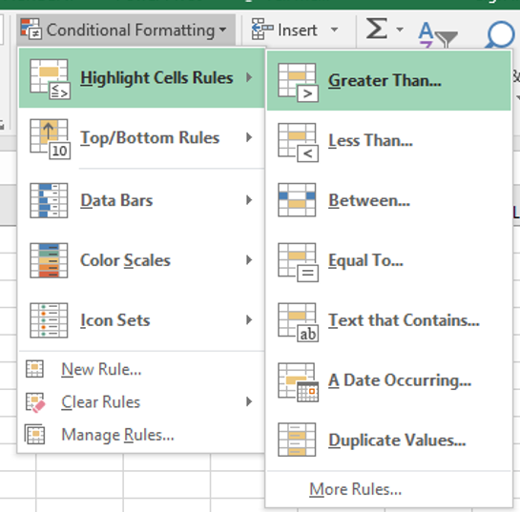
Setting Conditional Formatting
Home -> Styles: Conditional formatting
If you don’t know much about visual design then keep it simple, stick to the basics (highlighting only if a condition is met rather than setting gradients for the degree to which a condition is met)

Slide 18
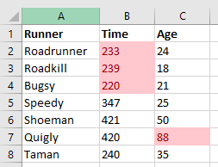
Conditional Formatting Exercise
Student exercise: modify spreadsheet “conditional_formatting_exercise” so that the cells are colored under the following conditions:
Time is less than 240 seconds
Age is greater than 50 years
One example solution

Slide 19
Second Tutorial

Slide 20
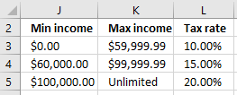
Lookup Functions
One application: finding which range does a numerical value fall into.
Example:
  Total income = $62,500, Tax rate = 15%
  Total income = = $100,000, Tax rate = 20%
Using lookup functions
  A lookup table must be created (includes the ranges and return value once the range is determined).

Slide 21
Lookup Tables/VLOOKUP
Important lookup table requirements
  Lookup tables for these VLOOKUP examples must be in ascending order.
  Cell references to the lookup table must be preceded by a dollar sign e.g. $J$3:$L$5 (this ensures that the function will always lookup the same range for the cells of the lookup table).

Slide 22
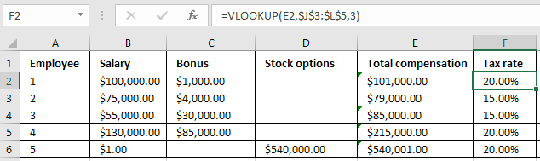
VLOOKUP: Format
  VLOOKUP(<Lookup value>,
  <Lookup table Start : End>,
  <Lookup table Column specifying the return value>)
Example spreadsheet: salaries_vlookup_function
How interpret =VLOOKUP(E2,$J$3:$L$3,3)
E2 is the salary
Lookup table is from J3 – L5
Return value from Col 3 in the table (tax rate)

Slide 23
Crucial Points When Defining Lookup Tables
Given the usage of the VLOOKUP function that you have been taught (finding which range does a numerical value fall into) your lookup tables must be sorted in ascending order.
Also the values in the first column can only be numeric
Correct
Incorrect
Min income | Max income | Tax rate
0 | Under $20,000 | 0%
20000 | Under $50,000 | 10%
50000 | Unlimited | 15%
Min income | Max income | Tax rate
50000 | Unlimited | 15%
20000 | Under $50,000 | 10%
0 | Under $20,000 | 0%

Slide 24
Types Of Formula Errors In Excel
Syntax error (occurs when the syntax, or rules, of defining the formula have been violated):
  A pre-created Excel formula is incorrectly named or has incorrect arguments e.g. =AVERIGE(A1:F10), =IF("Hello",C2,A2)
  Excel will provide clues when a syntax error has occurred.
  #NAME? (There is no formula named ‘AVERIGE’)
  #VALUE! (A value or argument has been specified incorrectly)
Logic error (occurs when the logic, or value produced, by the formula is wrong):
  A formula is specified incorrectly e.g. area of a rectangular property is specified using addition rather than multiplication (=A1+B1)
  Logic errors are more difficult to find and fix.

Slide 25
Finding And Fixing Logic Errors
Testing the formula is one approach for ‘debugging’/finding & fixing the error/bug (e.g. enter 4 and 3 into Cells A1 and B1 respectively and see if the expected value of 12 is returned by the formula
  This error is easy to catch, not all logic errors will be this easy.
    That’s why there are bugs in actual commercial programs.
  Two things to look for when debugging logic errors:
    Check the input data is correct
      E.g. area of circle: A = Π * r², A = 1.34 * 10² incorrectly uses 1.34 instead of 3.14
    Check the formula is correctly specified
      E.g. area of a rectangle = width * length, A = w + l incorrectly uses addition instead of multiplication

Slide 26
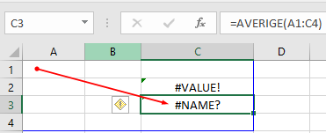
Excel’s Built-In Tools For Dealing With Errors
Trace Precedents and dependents
  Precedents: “Cells that are referred to by a formula in another cell”¹
    e.g. Cell C3 contains the formula =A1*0.1
    A1 is the precedent for C3
  Dependents: “these cells contain formulas that refer to other cells” ¹
    e.g. Cell B6 contains the formula =10-B3
    Cell B6 is the dependent of Cell B3
  Accessing the tracing feature:
    Formulas -> Formula auditing: {Trace Precedents / Trace Dependents}
More information on Excel’s built in help for errors:
1 https://support.office.com/en-us/article/Display-the-relationships-between-formulas-and-cells-a59bef2b-3701-46bf-8ff1-d3518771d507

Slide 27
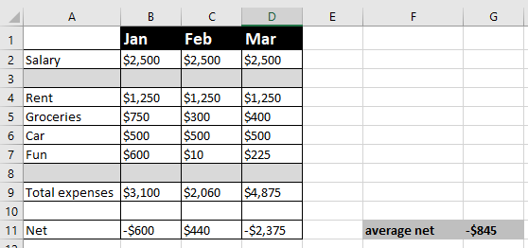
Example: Precedents & Dependents
A spreadsheet that tracks net income (salary minus all expenses).
Average net (G11) is the average net income for all 3 months
There is an error in the spreadsheet.
  It’s easy to spot the error in a small spreadsheet like the one below.
  But a complicated example will make it harder to see how the tracing feature of Excel works.

Slide 28
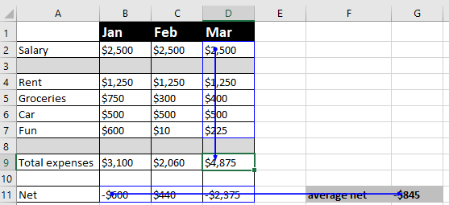
Example: Using Precedents To Error Trace
Example spreadsheet: finding_fixing_errors
This shows which cells have values that are dependent upon (values are affected by the contents of) of other cells.

Slide 29
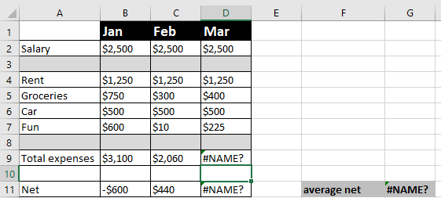
Finding Syntax Errors

Slide 30
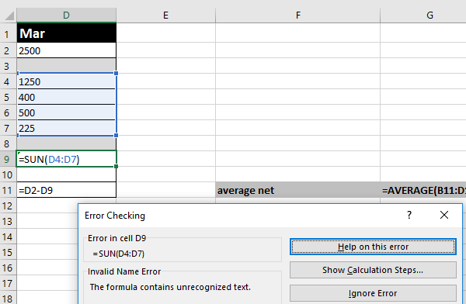
Finding Syntax Errors (2)
If you can’t spot the syntax error by manually scanning formulas (e.g. spreadsheet is too large) then there’s an automated mechanism.
  Formulas : Formula auditing : Error checking -> Error checking

Slide 31
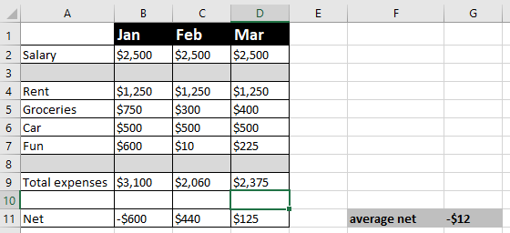
Finding Syntax Errors (3)
Sometimes fixing the error in the original precedent cell will fix several errors.
  The example below shows the result of correcting the formula in Cell D9.
  Syntax errors in other cells D11 and G11 are automatically fixed.

Slide 32
Circular References
A specific type of error when a cell containing a formula includes that cell in the formula.
Cell A10 contains the formula: =AVERAGE(A1:A10).

Slide 33
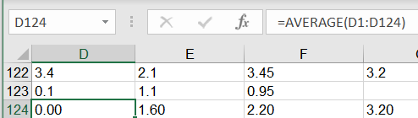
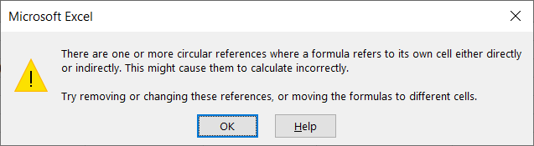
Finding Circular References
Example
  To make it easy to see how things work you are shown exactly which cell contains the circular reference.
One clue: After the formula has been entered Excel will provide an alert that a circular reference exists

Slide 34
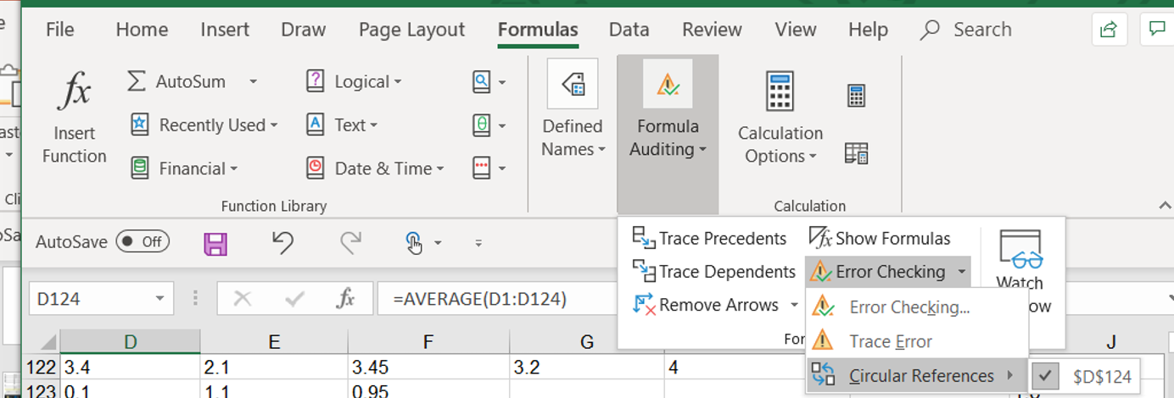
Finding Circular References
Finding the problem afterward: you can use the built in mechanism for finding circular references:
Formulas : Calculations : Error Checking -> Circular references

Slide 35
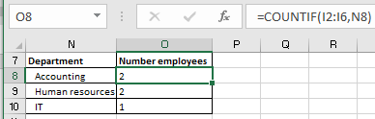
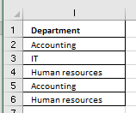
The COUNTIF() Function
Example spreadsheet: countif
Counts (adds to a tally when a cell in a range meets a condition) e.g. # of IT employees
Example: For the formula in Cell O8 whenever a cell in the range I2:I6 contain the string in Cell N8 “Accounting” one is added to the tally.
  In other words it counts the number of employees from the accounting department
Employee info

Slide 36
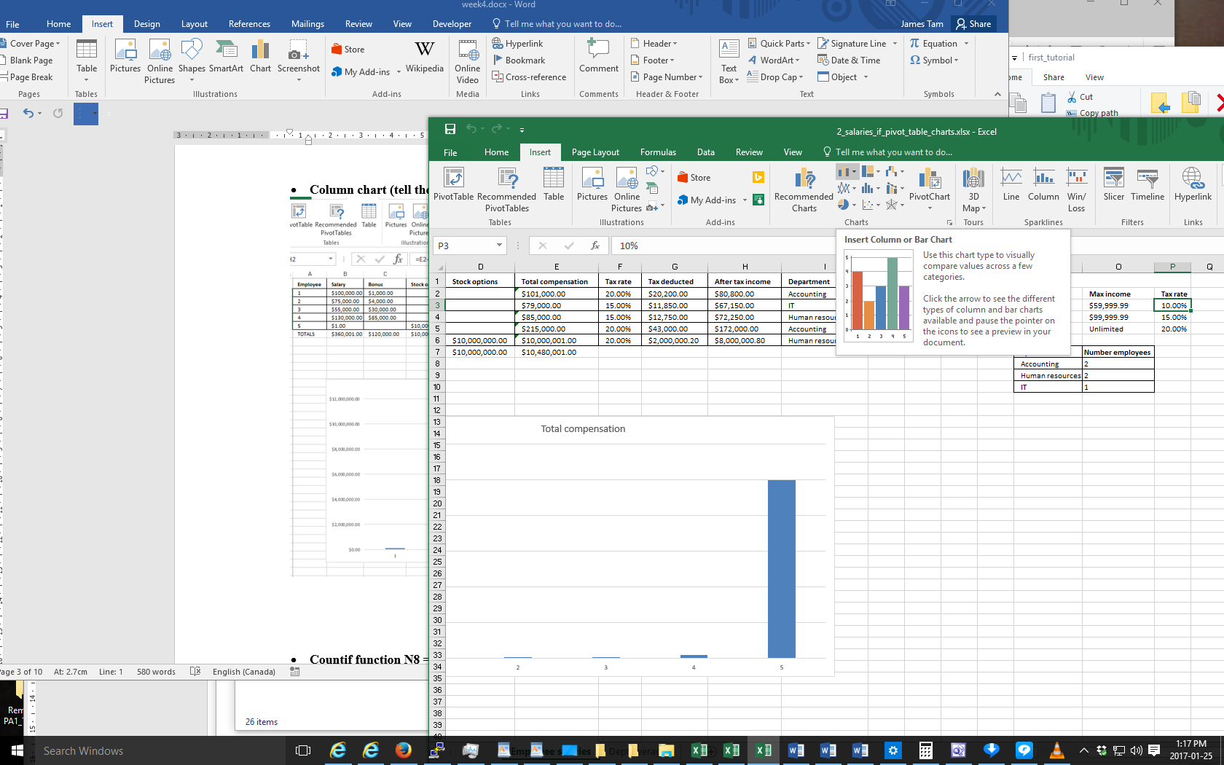
Inserting A Column Chart
“Insert” the chart: Insert -> Charts: (Select a column chart)
Keep it simple e.g. avoid fancy 3D effects
  Avoid “chart junk” – look up this bad design practice online (described by Edward Tufte) for more details

Slide 37
Other Excel Resources
Online training resources created by Microsoft:
  Tutorials
    https://support.office.com/en-us/article/excel-for-windows-training-9bc05390-e94c-46af-a5b3-d7c22f6990bb
  A MAC specific resource
    https://support.office.com/en-us/article/excel-2016-for-mac-help-2010f16b-aec0-4da7-b381-9cc1b9b47745

