Slide 1
Excel: Tutorial Week 1
Common math operators and the order of operation
Formatting long sequences of data: merging and wrapping
Defining new formulas
Within worksheet and cross worksheet references
Named constants
Data validation
Official resource for MS-Office products: https://support.office.com

Slide 2
Activities In Tutorial
TA demos:
  Used for more complex features (typically multiple steps are required).
  The tutorial instructor will show on the projector/instructor computer each step for running the feature in Excel.
  Unless otherwise specified the tutorial material will take the form of a TA demonstrating the use of features in Excel.
Student exercises:
  Used instead of TA demos for simpler features.
  You will have already been given a summary of how to invoke the feature and the purpose of the exercise is to give you a chance to try it out and get help if needed.

Slide 3
First Tutorial

Slide 4
Requirements For First Excel Workbook Exercise
Error prevention (before) and error handling (after):
  10 digit Canadian telephone number.
  Selecting a university faculty from a list or entering a correct faculty.

Slide 5
Requirements For The Spreadsheet Full Assignment: Excel
Calculating and visualizing grading information for the CPSC 203 class of the future (AD 2063: Anyone realize the significance of that year?...A major ‘first’ for humanity)
You MUST use the starting grades in the starting spreadsheet.
  (It should go without saying that you must not modify the grade information either).
  Why?
    Streamline marking (consistency will allow the marker grade more quickly)
    In industry your (paying) client or your boss wants you to implement certain features with a given data set and a given problem. (No one will pay you for just demonstrating that you know how to use a feature with data different from the original).
Read the assignment requirements thoroughly and carefully: there are many other things that you MUST do in order be awarded credit.
Notes:
2063: https://ca.startrek.com/article/origin-of-first-contact-day-explained

Slide 6
Second Tutorial

Slide 7
Symbols In Excel: Common Math Operations
Operation | Symbol in common use | Symbol used in Excel | Example usage (Excel)
Assignment | = | = | =3 (puts 3 into the cell)
Addition | + | + | =2+2
Subtraction | - | - | =7-3
Multiplication | × | * | =9*9
Division | ÷ | / | =36/6
Exponent | NA: superscripting is used e.g. 3² | ^ | =3^2 (3 squared)
Full details:
https://support.office.com/en-us/article/Calculation-operators-and-precedence-in-Excel-48be406d-4975-4d31-b2b8-7af9e0e2878a

Slide 8
Order Of Operation In Excel (First To Last)
Operator | Description
Brackets | Inner brackets before outer e.g. =((4+2)/3)-1
Negation | =-3*2
Exponent | =2^4/4
Multiplication, Division | These operators are evaluated left to right in terms of order because their order is equal e.g. =10/3*2
Additional, subtraction | Similar to multiplication and division these operations are equal in terms of order (so a left to right evaluation is used)
First
Last
For full details of how other operators are ordered in Excel:
https://support.office.com/en-us/article/Calculation-operators-and-precedence-in-Excel-48be406d-4975-4d31-b2b8-7af9e0e2878a

Slide 9
Example Exercise
What is the result of the following expression?
= 7 + 8 * 3 / 2 – 4 = 15
Lesson:
Explicitly bracket everything!
Notes:
Equivalent to (7 + ((8 * 3) / 2)) – 4 = 15
Different from ((7+8)*(3/2))-4= 18.5

Slide 10
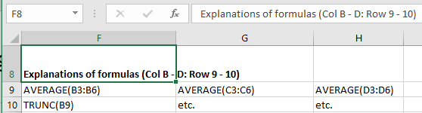
What To Do When The Data Is Too Long
The data is Cell F8 is cut off
  Full data: Explanations of formulas (Col B - D: Row 9 - 10)
  Data displayed: Explanations of formulas (Col B –
Options:
  Merging cells
  Wrap the cell data
  (Resizing rows and columns is covered in the introductory Excel material).

Slide 11
Merging Cells: Spreadsheet
Example spreadsheet: You can use this spreadsheet (under the tutorial materials for this week) to see the effects of merging cells: functions

Slide 12
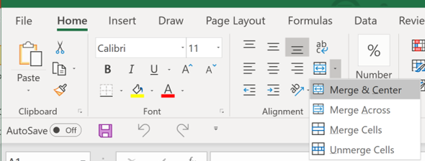
Invoking Features To Merge Cells
Home -> Alignment group

Slide 13
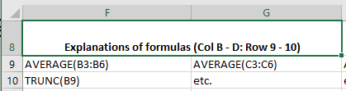
Merge (Only Combining Columns In 1 Row)
Merging cells F8 to G8
Unmerged cells
Merge and center

Slide 14




Merge (Combine Columns Spanning Multiple Rows)
Merging cells A9 to D10
Before merging
Merge and center (combines columns & row)
  Combine & center align the contents of selected cells into one larger new cell
  JT: Keeps top LHS cell only
Merge across (combines columns)
  “Merge selected cells in the same row into one large cell”
  JT: Keeps left-most column only
Merge cells (combines columns & rows)
  “Merge the selected cells into one cell”
  JT: Similar to M&C but result isn’t centered

Slide 15
Using Merge: Caution & JT’s Tips
Using the “Unmerge cells” option in Excel will not restore lost data.
  JT: Use the ‘undo’ option instead <Ctrl>-<Z>
JT: It’s recommended that the merge features only be used only a spreadsheet that is largely finalized because merged cells will interfere with some Excel operations:
  E.g. copy pasting will ‘unmerge’ cells

Slide 16
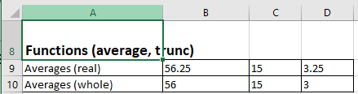
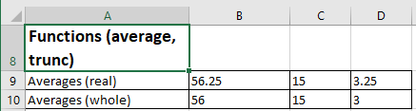
Wrapping Cell Data
Example, text not wrapped (some text can be cut off)
Wrapped text (text wraps to the next row or rows)

Slide 17
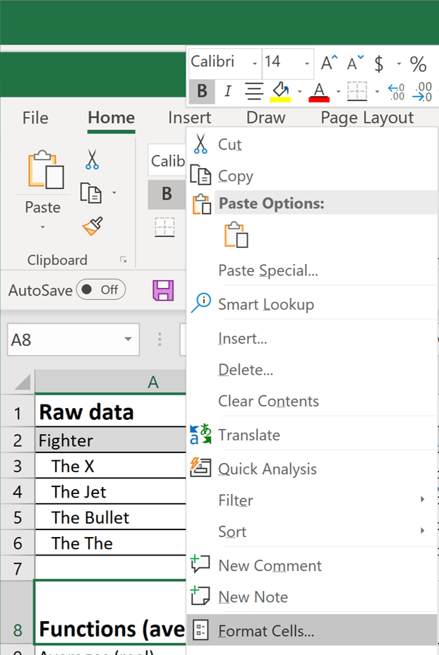
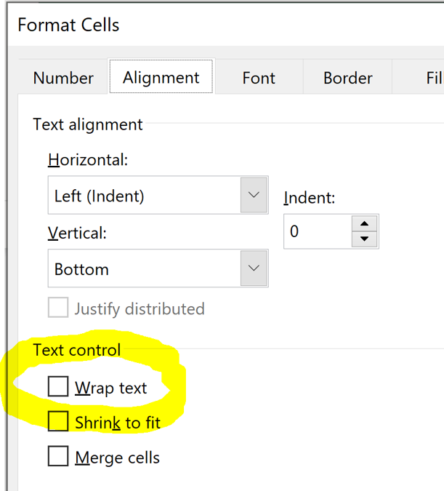
Invoking Text Wrapping
Right click on the cell or cells
Under the ‘Alignment’ tab (text control group) check “Wrap text”

Slide 18
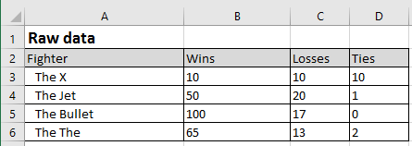
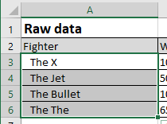
Indenting
Indenting (Rows 3 – 6)
Step 1: Right click on cell or range of cells and select ‘Format Cells’ to change indenting (and fill color)

Slide 19
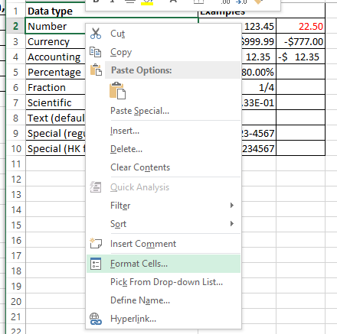
Indenting (2)
Step 2: Select “Format cells”

Slide 20
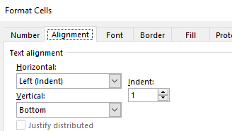
Indenting (3)
Step 3: Select the alignment tab (the ‘Number’ tab is selected by default)

Slide 21
Indenting (4)
Step 4: Specifying the amount of indenting desired (0 = no indenting, the larger the number the greater the amount of indenting).

Slide 22
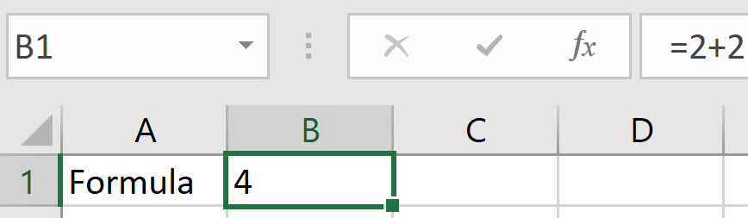
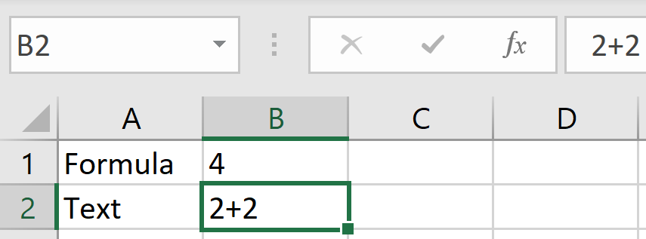
Defining New Formulas
The first character must be the “assignment operator” =
  Formula =2 + 2
  Text 2 + 2

Slide 23

Formulas Referring To Other Cells
Reminder:
  Approach 1: manually type in the formula
    Type in the formula manually e.g. type =A2*B2
  Approach 2: type and click (used when a formula refers to a cell)
    Click on a cell where you want to enter the formula e.g. click on cell C2
    Using the above example:
      Type in the assignment operator =
      Click on Cell A2
      Type in the multiplication operator *
      Click on Cell B2

Slide 24

Student Exercise: Formulas
Starting spreadsheet: “formula exercise”
For CPSC 409: the term GPA is calculated from the following proportions
  Midterm #1: 35% of term grade
  Midterm #2: 35% of term grade
  Final exam: 30% of term grade
In cell D3 calculate the weighted term GPA
Notes:
Solution 1
D3=A3*0.35)+(B3*0.35)+(C3*0.3)
Solution 2
(Assume that there is a lookup table created with the following values)
E1 = 0.35
E2 = 0.35
E3 = 0.3
D3=A3*E1)+(B3*E2)+(C3*E3)
Note that this formula is correct but the ‘style’ could and will be better in later versions (uses lookup table and named constants for the weights)

Slide 25
Data Validation
There are tools in Excel to ensure the validity of data:
  The type of information entered is of the correct type e.g. whole numbers only, no fractions allowed.
  The data entered falls within a valid range e.g. no negative values can be entered for age.
Invoking data validation:
  Data -> Data Tools : Data Validation
For more information:
https://support.office.com/en-us/article/Apply-data-validation-to-cells-29FECBCC-D1B9-42C1-9D76-EFF3CE5F7249

Slide 26
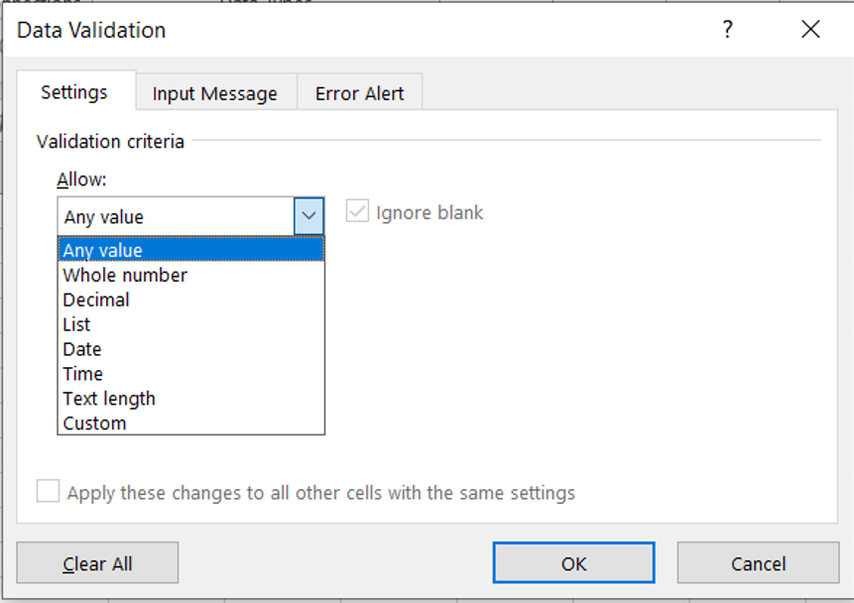
Data Validation: Specifying The Type Of Data
Options that are largely self explanatory
Whole number
Decimal
Date
Time
No restrictions on data entry
Any value
Restrictions on the number of characters
e.g. login user name must be 3 – 50 characters in length

Slide 27
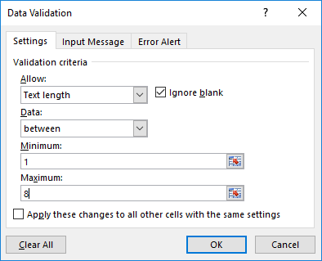
Data Validation: Input Length Restrictions
Steps: Data -> Data Tools : Data Validation and then select the ‘Settings’ tab (‘Settings’ should be selected by default).

Slide 28
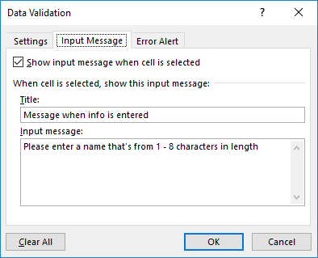
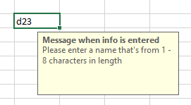
Data Validation: Guiding The User Beforehand
Select the Input Message tab.
Helpful message appearing when a cell mouse-over occurs

Slide 29
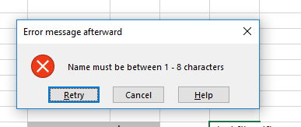
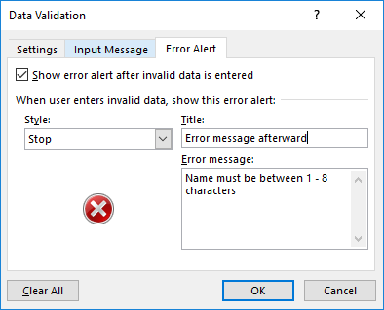
Data Validation: Letting The User Know After The Fact
Select the Error Alert tab.
Popup error message appearing when the validation rule has been violated.

Slide 30
Other Excel Resources
Online training resources created by Microsoft:
  Tutorials
    https://support.office.com/en-us/article/excel-for-windows-training-9bc05390-e94c-46af-a5b3-d7c22f6990bb
  A MAC specific resource
    https://support.office.com/en-us/article/excel-2016-for-mac-help-2010f16b-aec0-4da7-b381-9cc1b9b47745

