Slide 1
The Basics Of Excel
These common features includes assumed prior knowledge. The purpose of these notes is for students who are missing some of the basics.
It also includes some useful features that you may not be familiar with but because of time constraints they won’t be covered in teaching tutorial.

Slide 2
Audience/Purpose
These resources are meant to show a beginner the common features of Excel.
The focus is showing one way that features may be run rather than distracting the reader and showing all possible ways.
  Learning multiple methods may shift the focus from using a useful feature to memorizing all the ways in which that feature may be run.
Because of the rudimentary nature of the material, the focus is on how to run features rather than why use them (it should be self evident why one would want to save a document).

Slide 3
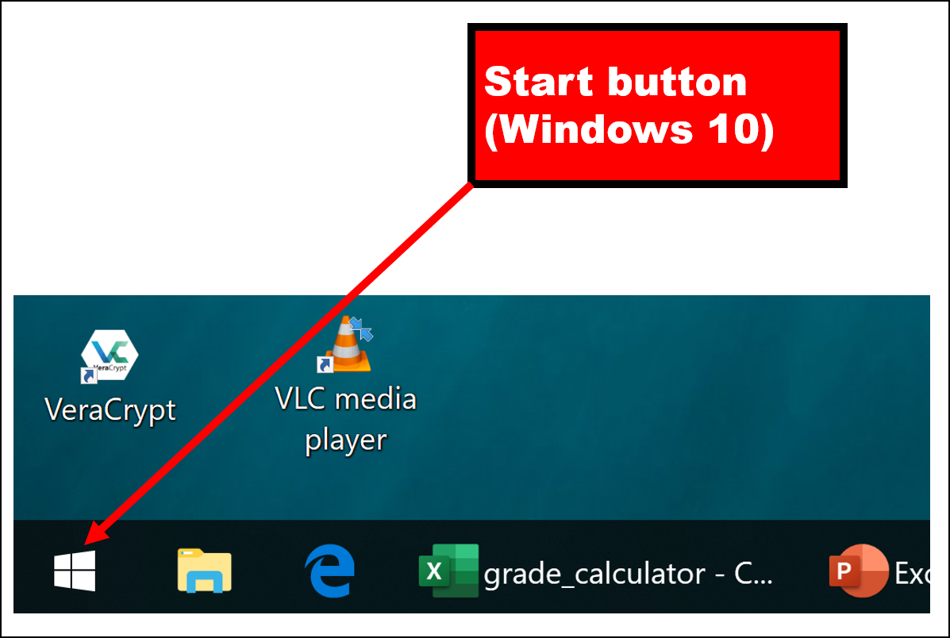
Starting Excel: Invoking The Start Menu
The process is similar to the Word tutorial (or starting any program in Windows).
Click on the Start Button (the exact appearance may vary depending upon the version of Windows that you are running).

Slide 4
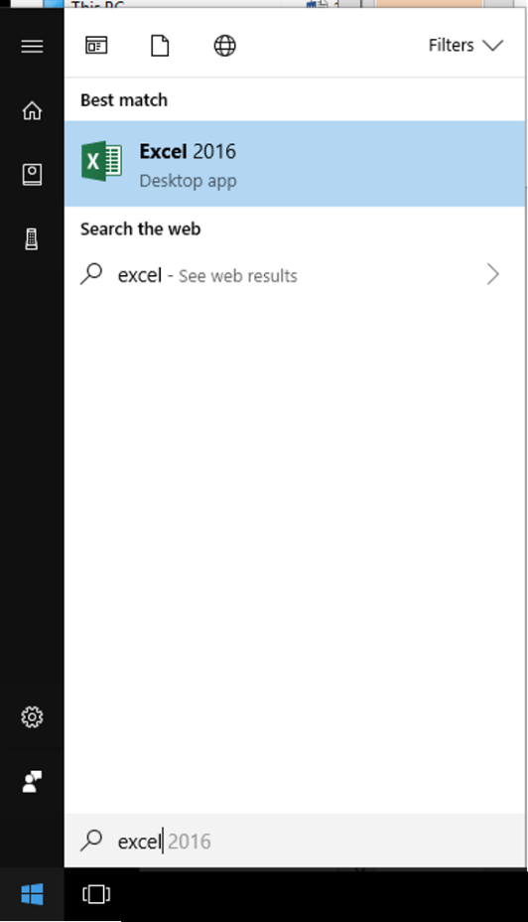
Starting Excel: Running Excel
With the Start button clicked type in “Excel” (the name of the program you wish to run).
(There are many ways of starting a program in Windows, this is an example where there is no “one right way” to do things).

Slide 5
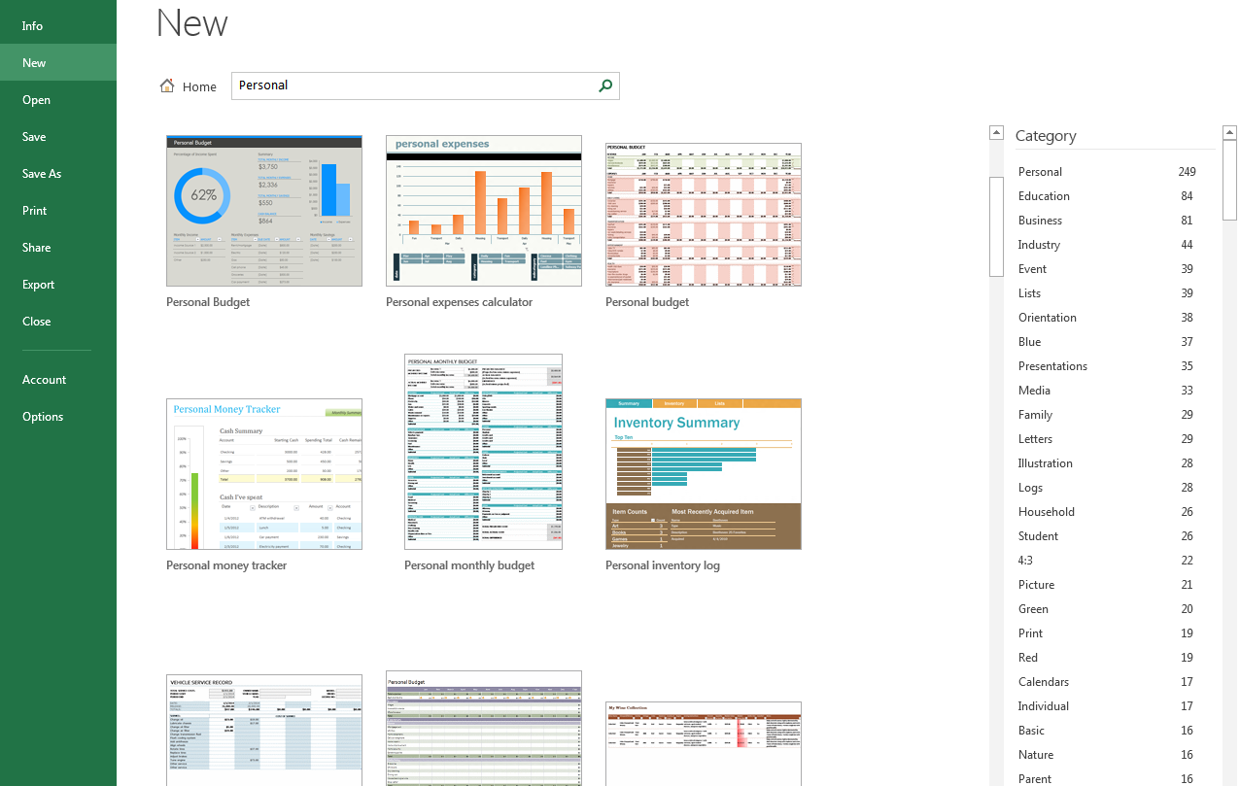
Templates
Pre-created spreadsheets for many types of problems

Slide 6
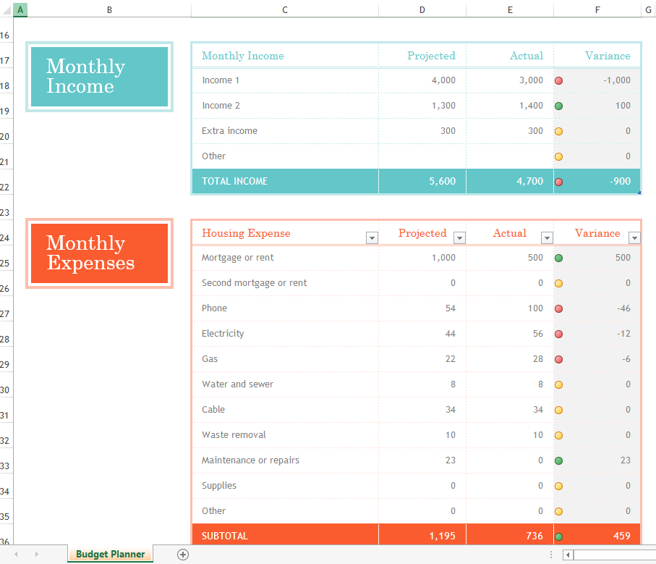
Example Template

Slide 7
Terminology
A typical file produced by Word is referred to as a ‘document’.
A typical file produced by a spreadsheet program such as Excel or Google docs is often described as a ‘spreadsheet’.
Be aware that Microsoft uses it’s own terminology.
  A spreadsheet (file produced by a spreadsheet program such as Excel) is described as a ‘workbook’ by Microsoft.

Slide 8
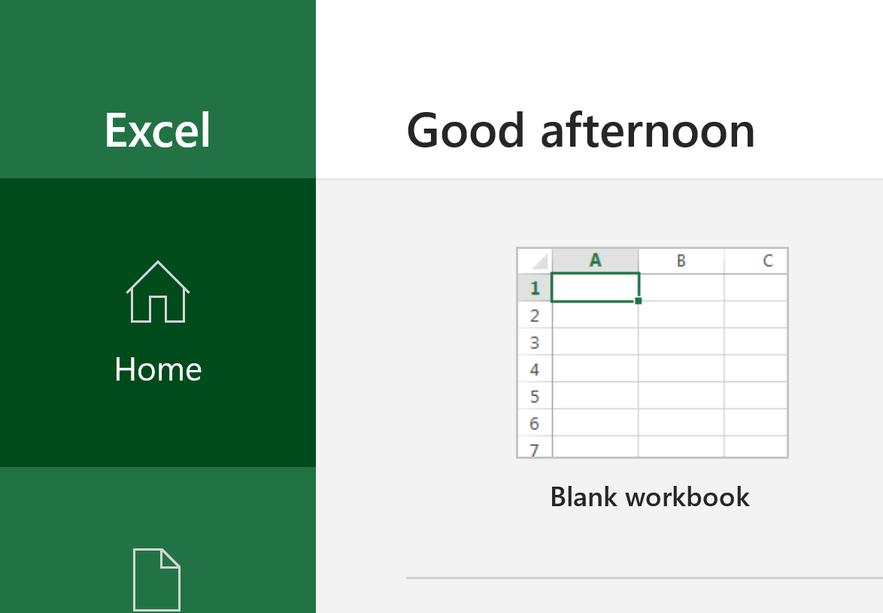
Creating A New Blank Worksheet

Slide 9
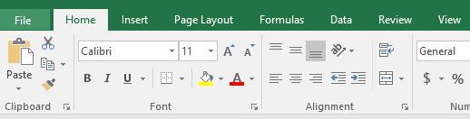
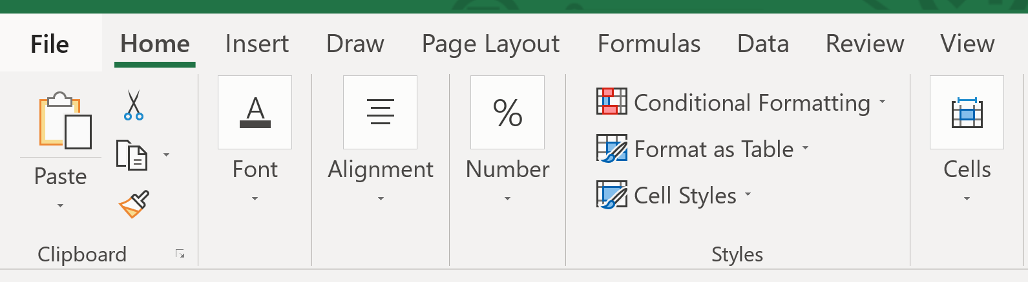
The Excel Ribbon
Similar to Word, the features of Excel can be accessed via the ribbon.
The tabs differ slightly between Office 2016 and 2019 (Draw)
  Office 2016:
  Office 2019:

Slide 10
Quick Summary Of Features In Each Tab Of The Ribbon
File
  Operations on an Excel spreadsheet (a spreadsheet ‘file’): save, save-as, print etc.
Home
  Many commonly used features: copy-cut-paste, formatting text, cell alignment and even more advanced formatting features such as “conditional formatting”.
Insert
  Charts, pictures, shapes, symbols, pivot tables and more.
Page Layout
  For configuring Excel when printing but other features, such as setting a background image, for the spreadsheet can be done here.

Slide 11
Quick Summary Of Features In Each Tab Of The Ribbon (2)
Formulas
  Groups all the built-in formulas (e.g. SUM, AVERAGE etc.) into categories
  Also it includes the ability to check or audit formulas
Data
  Includes: the ability to get data from other sources (e.g. MS-Access database), sort and filter data, run different scenarios “what-if analysis” on the data and determine results.
Review
  Similar to the identically named feature in Word and includes: the ability to annotate the spreadsheet, translate to other languages, spell check and thesaurus look up.

Slide 12
Quick Summary Of Features In Each Tab Of The Ribbon (3)
View
  Allows the spreadsheet to been viewed in different ways (e.g. zoom in and out, lock or ‘freeze’ parts so they stay visible even when scrolling through a long spreadsheet).
Draw (Office 2019 only)
  Some of the ability to insert simple shapes (e.g. lines, textbox, simple geometric shapes) was moved from “Insert” to “Draw” with new abilities added (e.g. adding a physical ruler that can assist in freehand drawing).
Relevant additional details will be provided in future tutorials and in lecture.
A good overview of the Excel tabs in the ribbon:
  https://openoregon.pressbooks.pub/beginningexcel/chapter/1-1-overview-of-microsoft-excel/

Slide 13
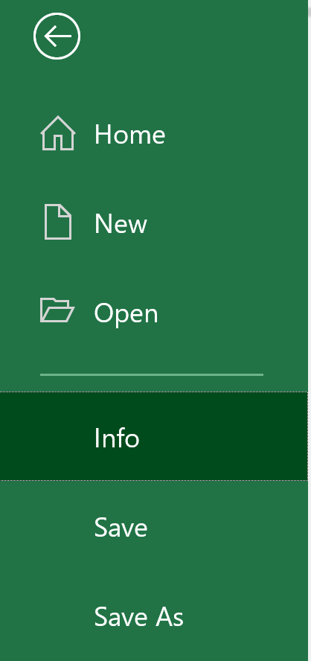
Saving/Copying A Spreadsheet
Similar to saving Word documents
  Save: save the spreadsheet under the current name (if not currently named then a prompt to enter the name will appear).
  Save As: allows a copy of the spreadsheet to be saved under a different name.
    Similar to Word documents Excel spreadsheets can also be tagged.

Slide 14
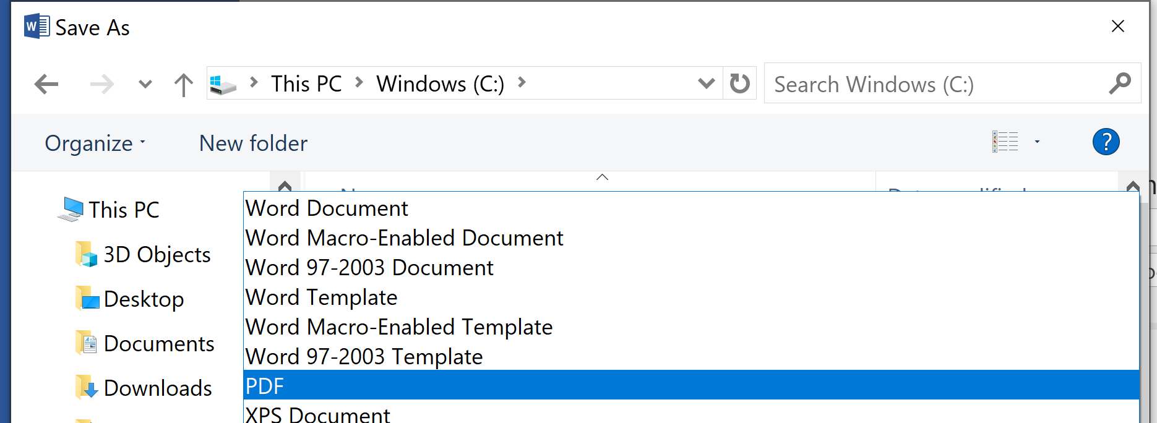
Creating PDF Version Of A Spreadsheet
PDF (Portable document Format) documents
  Allows documents to be saved and viewed with different computer operating systems.
  Ensures a consistent layout and formatting regardless of operating system.
Creating PDF documents using Excel via the “Save As” feature.
  Select ‘PDF’ as the file type under the pull down menu.

Slide 15
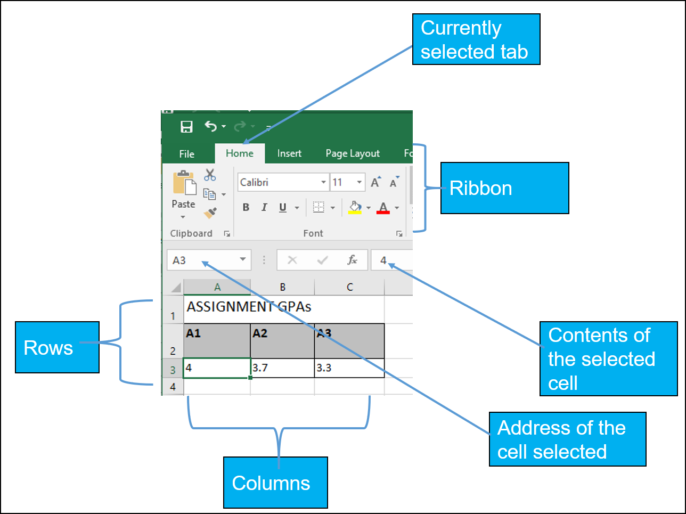
Excel Basics

Slide 16
Some Ways Of Navigating An Excel Spreadsheet
Keystroke | Effect in Word
↑ (up arrow) | Cursor moves up one row
↓ (down arrow) | Cursor moves down one row
← (left arrow) | Cursor moves left one column
→ (right arrow) | Cursor moves right one column
Home key | Cursor moves to the first column (Column A)
End Key | Toggles End Mode on/off¹
Page up | Move a *window full* of rows up²
Page down | Move a *window full* of rows down²
For a full list of keyboard shortcuts (include ones that allow navigating an Excel sheet): https://support.office.com/en-us/article/Keyboard-shortcuts-in-Excel-for-Windows-1798d9d5-842a-42b8-9c99-9b7213f0040f
1 In End mode, you can press an arrow key to move to the next nonblank cell in the same column or row as the active cell.
2 The exact number of rows will vary depending upon the size of the Excel window.

Slide 17
Some Ways Of Navigating An Excel Spreadsheet (2)
Keystroke | Effect in Word
<Alt>-<Page up> | Move a *window full* of columns left³
<Alt>-<Page down> | Move a *window full* of columns right³
<Control>-↑ | Go to the first row⁴
<Control>-↓ | Go to the last row⁵
For a full list of keyboard shortcuts (include ones that allow navigating an Excel sheet): https://support.office.com/en-us/article/Keyboard-shortcuts-in-Excel-for-Windows-1798d9d5-842a-42b8-9c99-9b7213f0040f
3 The exact number of columns will vary depending upon the size of the Excel window.
4 The first row will the first column with data, or if that row is the current one or the sheet is it empty then it will be the first physical row 1.
5 The last row will the last row with data, or if that row is the current one or the sheet is it empty then it will be the last physical row 1,048,576.

Slide 18
Some Ways Of Navigating An Excel Spreadsheet (3)
Keystroke | Effect in Word
<Control>-← | Go to the first column⁶
<Control>-→ | Go to the last column⁷
For a full list of keyboard shortcuts (include ones that allow navigating an Excel sheet): https://support.office.com/en-us/article/Keyboard-shortcuts-in-Excel-for-Windows-1798d9d5-842a-42b8-9c99-9b7213f0040f
6 The first column will the first column with data, or if that column is the current one or the sheet is it empty then it will be the first physical column A.
7 The column will the last column with data, or if that column is the current one or the sheet is it empty then it will be the last physical column XFD.

Slide 19
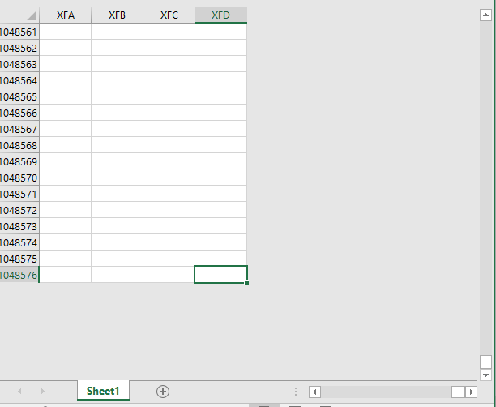
Other Ways Of Navigating Excel
Clicking directly in the editing area
Clicking in the scrollbar

Slide 20
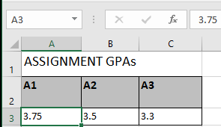
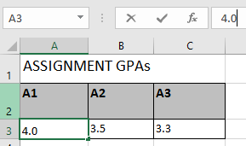
Entering Something Into A Cell
Click on a cell
Enter the data or formula into the cell

Slide 21
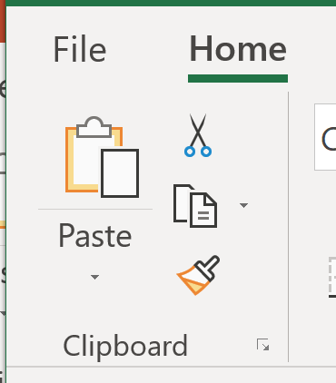
Copy/Cut-Pasting
Right click and select the ‘Cut’ or ‘Copy’ option.
  Cut: the selection will be removed from the spreadsheet (when pasted)
  Copy: the selection will be duplicated (when pasted)
These features can also be accessed via the Home tab as well.
Cut
Paste
Copy

Slide 22
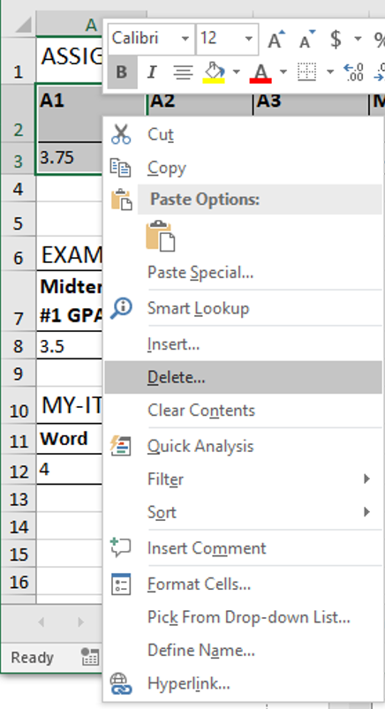
Removing What’s In A Cell
Options to do this can been accessed by right clicking when a cell or cells have been selected in Excel

Slide 23
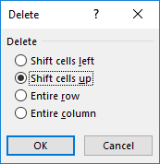
Removing What’s In A Cell (2)
Clear contents (this feature can also be invoked by selecting a cell or cells and pressing the ‘delete’ key)
  The contents of the cell are removed.
  Only the data is removed, other information such as background coloring and font formatting (e.g. bolding) remains.
Delete contents
  Does not just affect a single cell.
  This operation will delete a row/rows or column/columns from the spreadsheet (resulting in other cells ‘moving’).

Slide 24
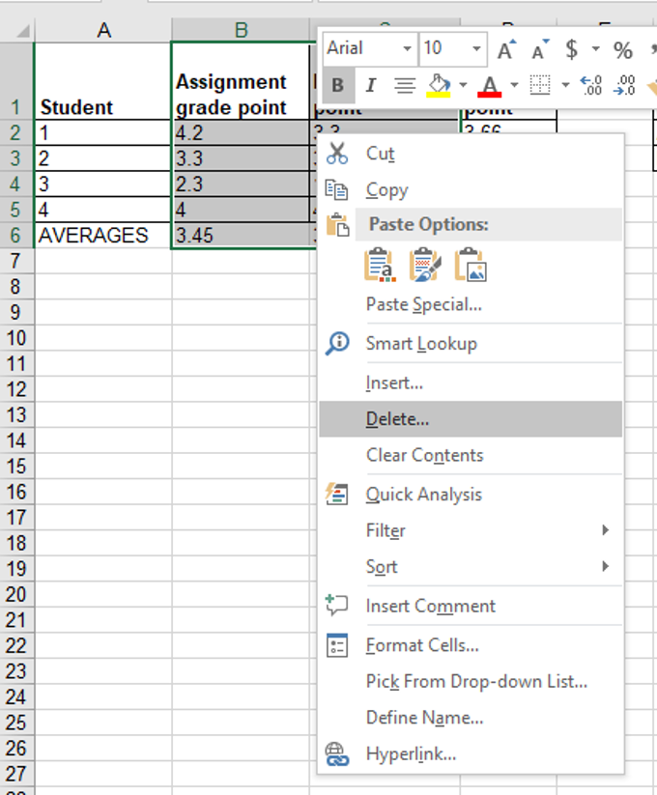
Deletions: Right Click

Slide 25
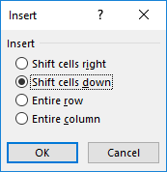
Inserting Rows Or Columns
Similar to (but in reverse of) deleting rows or columns, this operation will shift over other parts of the spreadsheet:

Slide 26
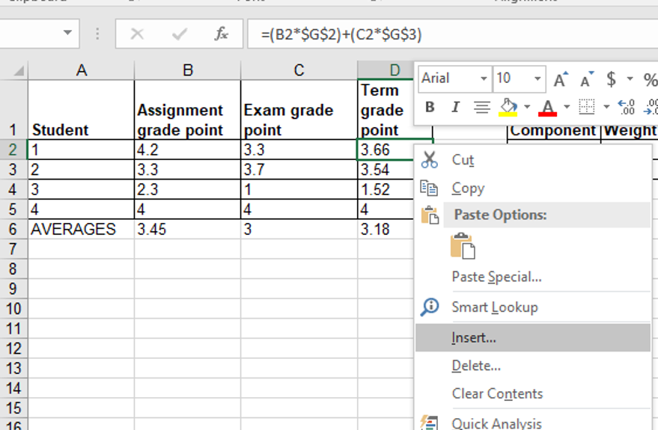
Inserting Rows And Columns
Can be done via ‘right clicking’ at the insertion point
Notes:
Better guide for input masks: https://support.office.com/en-CA/article/Guide-data-entry-in-Access-by-using-input-masks-b69187b0-e01c-4a4d-bcbe-e3f714d0c62d

Slide 27
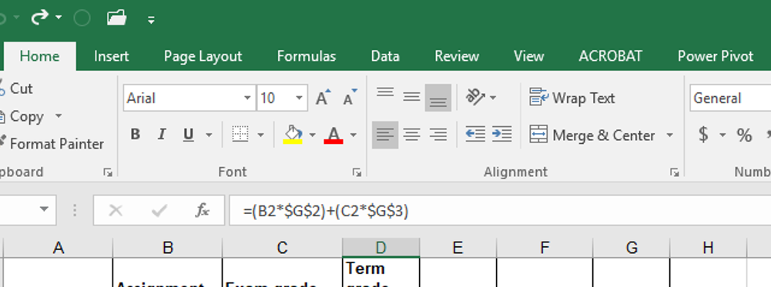
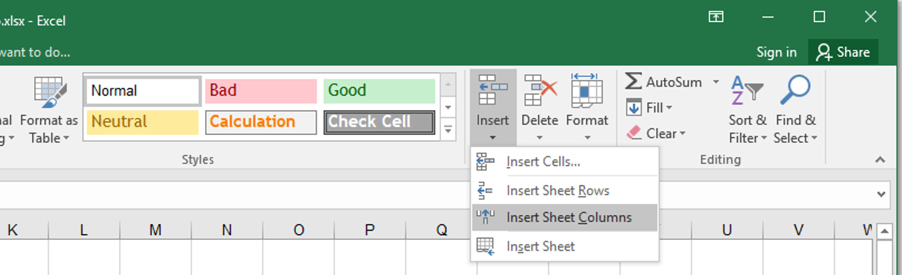
Insert Rows And Columns
Can also be done via: Home->Insert

Slide 28



Contents Of A Cell: Types
Raw data: also referred to as ‘constants’
Label: describe the contents of another cell
Formula: derived values, usually from the raw data (e.g., calculations: =2+2, lookup values: =D2*2, functions: =sum(B2,B9))
Notes:
Numbers
Labels: annotations to group categories of information
Formula: calculations that may be made on the raw data

Slide 29


Distinguishing Formulas From Data Or Labels
In Excel all formulas must be preceded by the ‘=‘ symbol (assignment) to distinguish it from a label
Example spreadsheet: 1_formulas
  Label
  2 + 2
  Formula
  = 2 + 2
  For the sake of brevity, you can assume that all formulas in this section will be preceded by the assignment operator ‘=‘
Notes:
Some say raw data may need to be preceded by = to disambiguate e.g., =1/2 (0.5) vs. Jan 2
You can still set the cell contents from data to fraction or just directly enter the decimal value

Slide 30
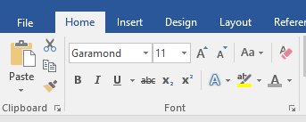
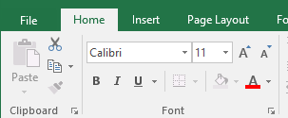
Formatting Text
It’s similar to Word, text formatting icons can be found under the Home tab in the Font group.
  Word
  Excel

Slide 31
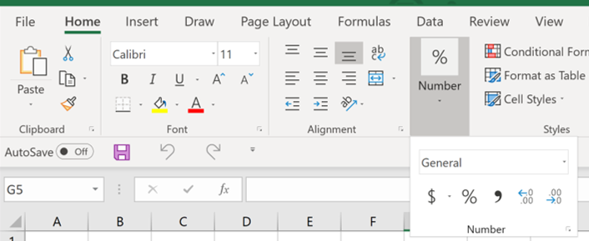
Formatting Numbers
Properties of numerical data: number of fractional digits displayed, should currency symbols be displayed, separators between groups of numbers etc.

Slide 32
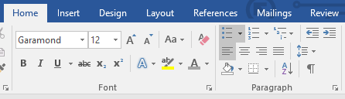
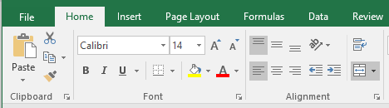
Changing Cell Alignment
Again it’s similar to Word but the icons are located in a different group.
  Word (Paragraph group)
  Excel (Alignment group)
    Also with Excel there’s icons for vertical alignment (the 3 icons on the first row) as well as horizontal alignment (the 3 icons on the second row).

Slide 33
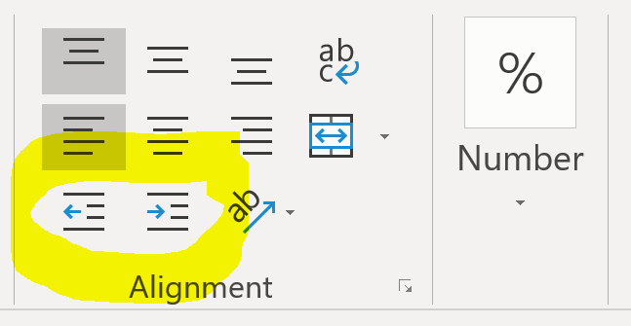
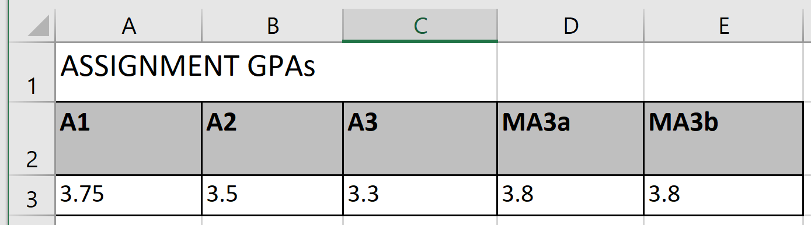
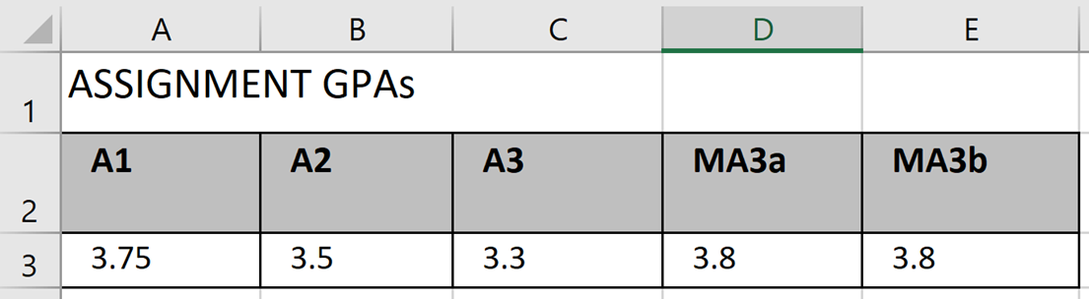
Changing Cell Indenting
Indenting can be increased or decreased via:
  Home -> Alignment group
  No indenting levels (all indenting levels are identical).
  Indenting applied to Row 2 & 3.

Slide 34
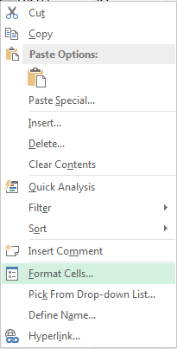
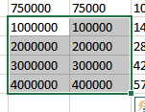
Other Ways Of Formatting Cells Via “Right Click”
Excel provides the ability to format the spreadsheet in various locations of the ribbon.
You also can access these functions in the context of a cell or cells in the spreadsheet.
  Select a cell or cells for which you wish to apply similar formatting effects.
  Right click and select “Format Cells”

Slide 35
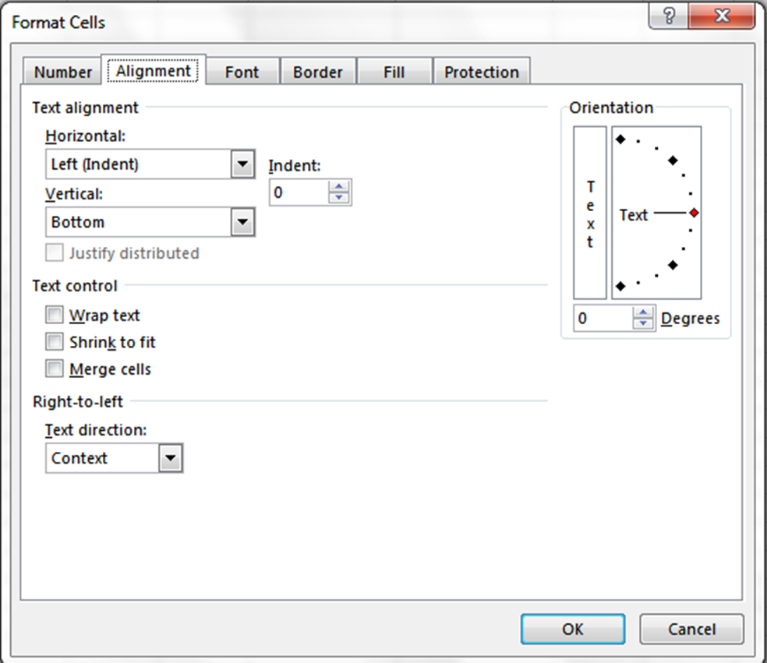
Formatting Cells: Text Alignment

Slide 36
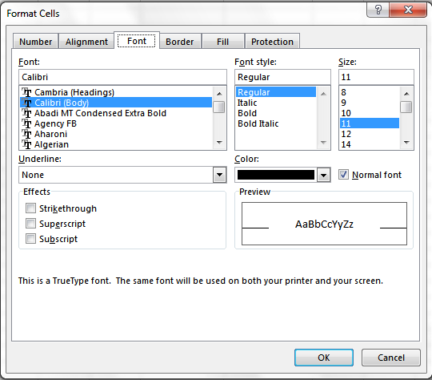
Formatting Cells: Font (Text) Formatting

Slide 37
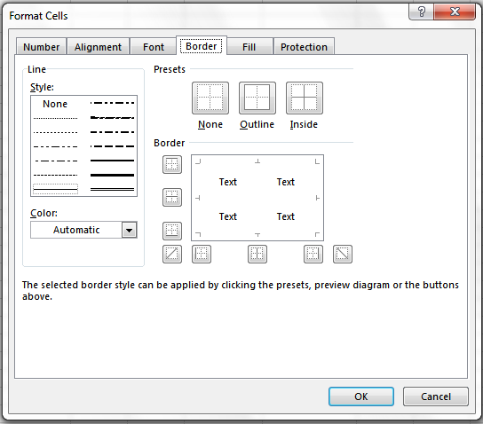
Formatting Cells: Borders Around Cells

Slide 38
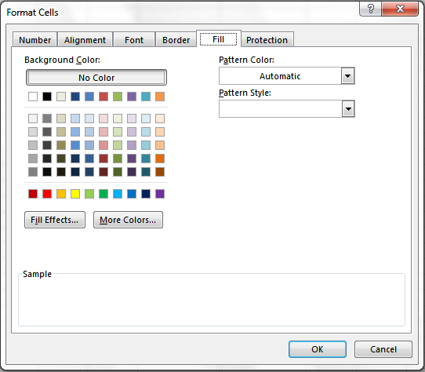
Formatting Cells: Cell Fill Effects

Slide 39
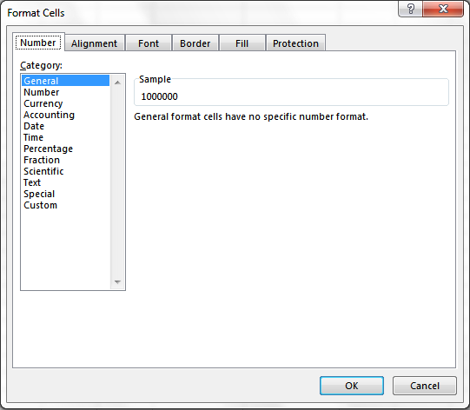
Formatting Cells: Choices Of Cell Data
General: No special format
Number:
  Separator (1 comma for 3 digits)
  Several options for displaying negative numbers
Currency:
  Currency sign appears
  Several options for displaying negative numbers
  Columns aligns decimal points
Accounting:
  Similar to currency but no special options for displaying negative values
Date, Time:
  Both allow the display to appear in different formats
Percentage: E.g. 100%
Fraction: e.g. when 0.75 is typed in it displays as 3/4

Slide 40
Formatting Cells: Choices Of Cell Data
Scientific: E.g. 1.23E+06
  Decimal point shifting = Exponent
Text:
  Treats everything (even numbers) as text
  Cell data is displayed exactly as entered.
Special:
  Country specific information (e.g. zip)
Custom:
  You can create your own formats e.g. ID number = A22-B (alpha, two digits, dash, alpha)

Slide 41
Formatting Cells: Choices Of Cell Data, Example
Example spreadsheet: data_types
(You can view the effect of setting different formatting types in this spreadsheet).

Slide 42
Data Too Big For Your View
Covered in the lectures notes
  Freeze panes
  Simple merging of cells (merging cells on a single row).
Covered in the introductory tutorial notes (these notes)
  Resizing rows or columns
  Wrap the data
  Merge data (other ways of merging as well as merging multiple rows as well as multiple columns)

Slide 43
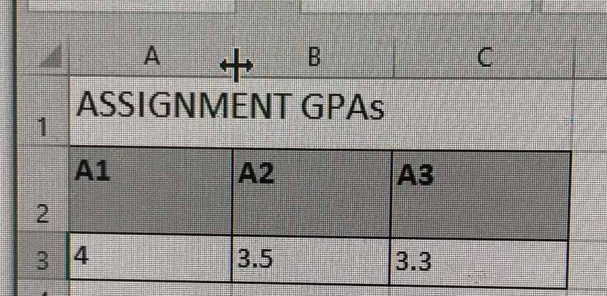
Resize Width (Column)
Resizing columns:
  Move the mouse to just after the end of the column to be resized (mouse pointer icon changes appearance to indicate Excel is in “resize column mode”).
  In the image Column A can be resized.
  While the pointer is in resize mode, move it left (reduce width) or right (increase width).

Slide 44
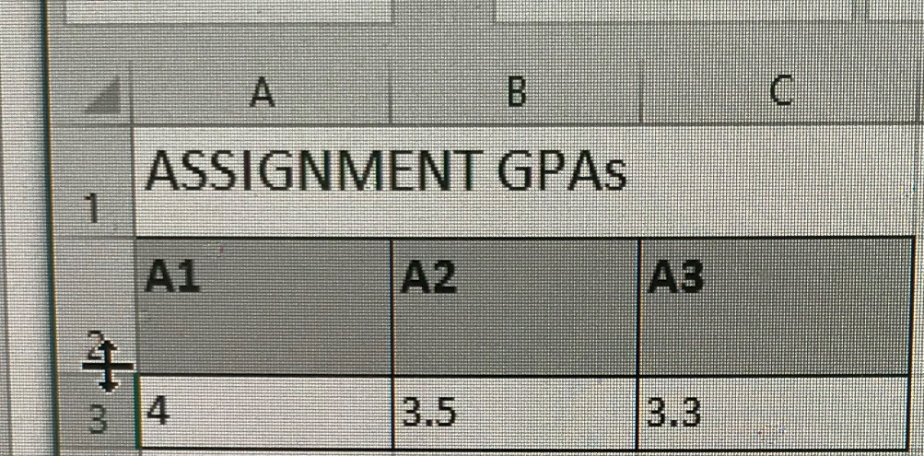
Resize Height (Row)
Resizing rows:
  Move the mouse to just after the bottom of the row to be resized (mouse pointer icon changes appearance to indicate Excel is in “resize row mode”).
  In the image Row 2 can be resized.
  While the pointer is in resize mode move it up (reduce width) or down (increase width).

Slide 45
Resizing Multiple Rows Or Columns
To resize all columns or rows:
  Select all the columns or rows by pressing the <Ctrl> key and the ‘A’ key simultaneously.
  Now when the mouse pointer is in column (or row) resize mode all the columns (or rows) in the spreadsheet will be resized.
To resize selected columns or rows:
  Press the <Ctrl> key and without releasing the key, click on the columns (or rows) to be resized.
    This allows multiple columns (or rows) to be selected.
    Now when the mouse pointer is in a column (or row) resize mode all the selected columns (or rows) in the spreadsheet will be resized.

Slide 46
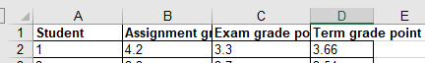
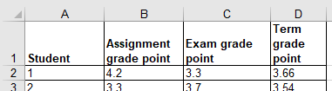
Wrapping Data
When the data in a cell is too wide for a column the data can be ‘wrapped’ or made to continue on the next line.
Example starting spreadsheet: “data_too_wide” (Row 1 data is too wide for the column)
Example starting spreadsheet (Row 1 text is wrapped): wrapped_data

Slide 47
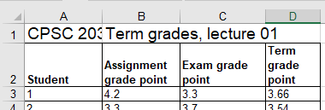
Merging Data
Example starting spreadsheet: merging_example_too_wide_data
Cell A1: CPSC 203
B,C,D: before merge
Cell B1: Term grades, lecture 01

Slide 48
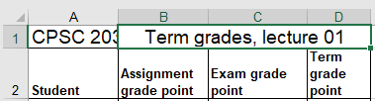
Options For Merging Cells In Excel: Merge & Centre
“Merge & center” (e.g. 7B: Columns B-D “after” merge): “merging_exammple_merge_and_centre”
Notes:
* Only keeps the left most column

Slide 49
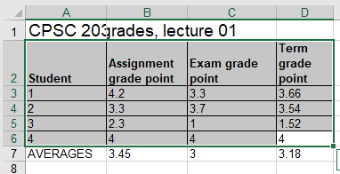
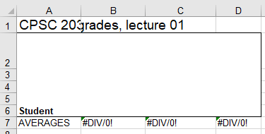
Options For Merging Cells In Excel: Merge Cells
Merge across: “merging_example_merge_cells”
  Description of how it works from MS-Excel tooltip: “Merge the selected cells into one cell”)
  JT’s translation of MS-Excel help: only the data in the top left most cell in the selected range is retained.
  e.g. Merging in the range A2:D6 only retains the data in Cell A2.
Before
After
Notes:
* Only keeps the left most column

Slide 50
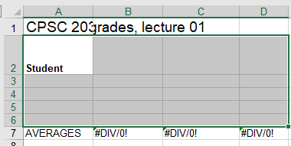
Merge Cells: Unmerge Applied
“Unmerge cells”: only unmerges the cells, data is not restored
JT: instead of using ‘Unmerge’ use the ‘undo’ feature of MS-Office: Simultaneously press the keys <Ctrl>-<y>
After (unmerge)

Slide 51
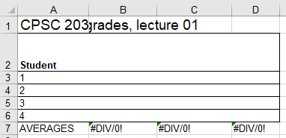
Options For Merging Cells In Excel: Merge Across
“Merge across”: “merging_example_merge_across”
  Description of how it works from MS-Excel tooltip: “Merge selected cells in the same row into one larger cell”
  JT’s translation of MS-Excel help: only the data in the left most column in the selected range is retained.
  e.g. Merging in the range A2:D6 only retains the data in Col A.
Before
After (merge across)
Notes:
* Only keeps the top LHS cell

Slide 52
Merge Across: “Taking Back” Results
Similar to the “Merge cells” you should use the ‘Undo’ feature rather than the ‘Unmerge’ feature if you want to retain your original data in the merged cells.

Slide 53
Hiding/Showing Columns
Sometimes you don’t want to delete a column (data needed e.g. student ID) but you want to temporarily obscure one or more columns
Hide:
  Select columns to hide, right click and select ‘hide’ (click at very top of column)
  (Press control and click on the columns to hide 1+ non-adjacent columns)
Show:
  Select the column adjacent to the hidden column and select ‘show’ (the mouse pointer changes appearance)
  (Or simply move the mouse to the appropriate location – see above point – and then ‘drag’ a hidden column into appearance)
Specific resource for this feature
  https://support.office.com/en-us/article/Hide-or-show-rows-or-columns-659c2cad-802e-44ee-a614-dde8443579f8

Slide 54
Hiding/Showing Rows
Hiding/showing rows works the same way but select a row or rows by clicking to the far left not the top
Individual cells cannot be hidden

Slide 55

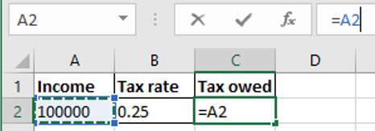

How To Enter Formulas That Refer To Other Cells
Approach 1: manually type in the formula
  Click on a cell where you want to enter the formula e.g. click on C2
  Type in the formula manually e.g. type =A2*B2
Approach 2: type and click (used when a formula refers to a cell)
  Click on a cell where you want to enter the formula e.g. click on cell C2
  When you get to the part of the formula that refers to another cell then just click on the cell rather than typing in the information e.g. Entering formula into cell C2, after typing the ‘=‘ click in in Cell A2
2) Reference to Cell A2 appears here
1) Click here

Slide 56
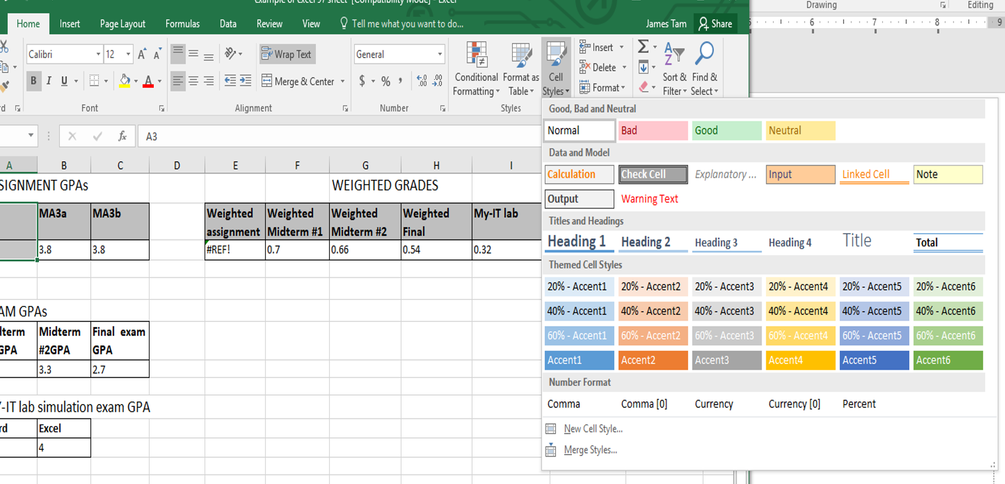
Using Pre-Created Styles
Similar to Word, Excel comes with pre-created text styles (font, color, font effects such as bolding etc.)
  Home -> Styles : Cell Styles
  Also new styles can be created.

Slide 57
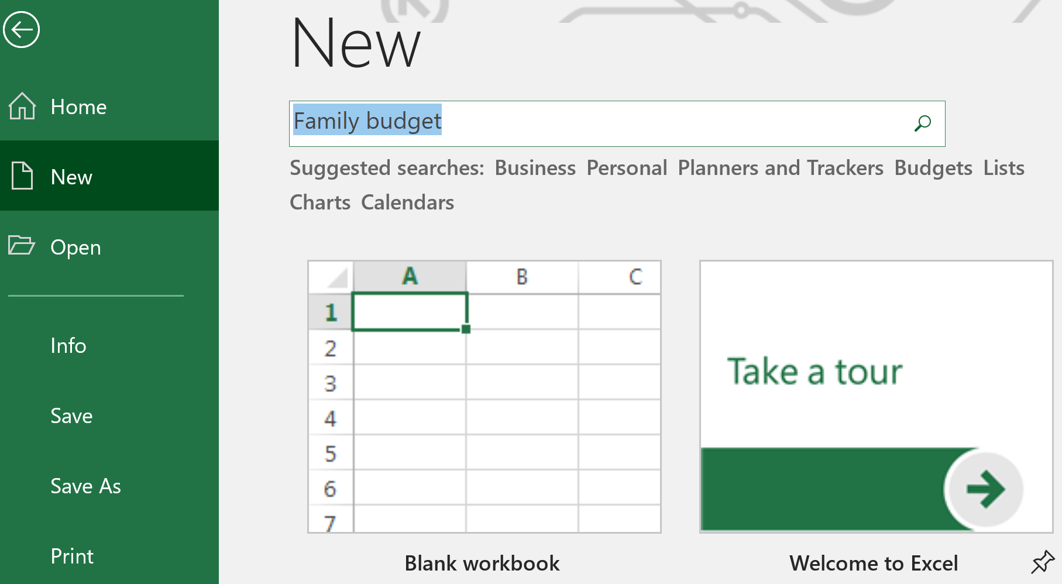
Using A Pre-Created Spreadsheet
Similar to using pre-created styles but these sheets provide more e.g. labeled headings and calculations for a family budget in addition to pre-set formatting effects.
Finding a style:
Enter the information about the desired pre-created spreadsheet

Slide 58
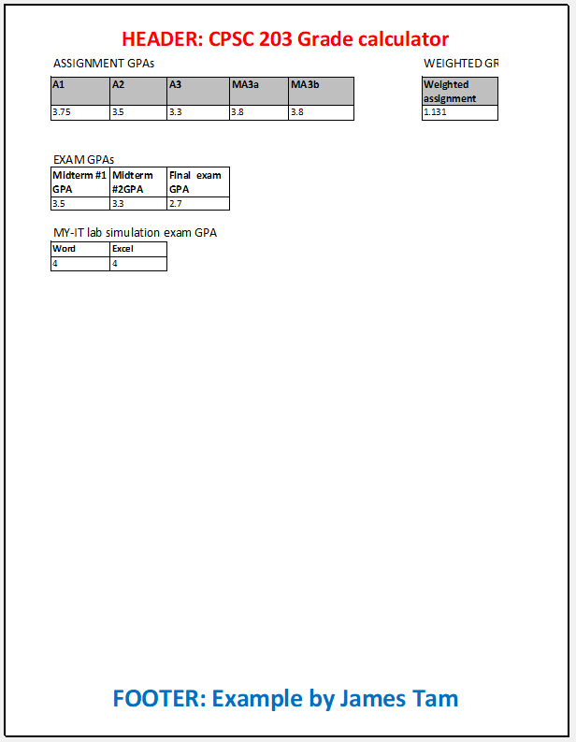
Headers And Footers
Header: appears at the top of each page
Footer: appears at the bottom of each page

Slide 59

Inserting Headers And Footers
Insert -> Text : Header & Footer
https://support.office.com/en-us/article/Headers-and-footers-in-a-worksheet-CAE2A88C-64A7-42AB-96A4-28D2FC16AD31

Slide 60

Page Breaks
Inserting or editing page breaks:
  Page Layout -> Page Setup : Breaks (Insert Page Break / Remove Page Break / Reset All Page Breaks)

Slide 61


Page Breaks
Viewing the location of page breaks:
  View -> Workbook Views : Page Break Preview
  The heavy blue line signifies a break (in the example below Row 34 is on a new page).
https://support.office.com/en-us/article/Set-or-clear-a-print-area-on-a-worksheet-27048af8-a321-416d-ba1b-e99ae2182a7e

Slide 62


Printing An Entire Spreadsheet
File -> Print
Print preview provided when selecting the option to print

Slide 63

Print Orientation: Portrait
This the default
“Longer than wider”

Slide 64

Print Orientation: Landscape
“Wider than longer”

Slide 65
Some Other Print Options
Scaling: the printed size of the spreadsheet can be changed to fit more (or less) of the sheet on each page.
Margins: similar to Word, the size of the margins surrounding the spreadsheet can be customized.

Slide 66

Setting A Print Area
Filters printing so only portions of a spreadsheet are printed.
Setting the print area:
  Page Layout -> Page Setup : Print Area -> Set Print Area
Viewing the print area via print preview
  File -> Print
https://support.office.com/en-us/article/Set-or-clear-a-print-area-on-a-worksheet-27048af8-a321-416d-ba1b-e99ae2182a7e

Slide 67
Converting Between Versions Of Excel
Different version of Excel have different features
  (Features of 2007+ vs. earlier versions):
  https://support.office.com/en-us/article/excel-formatting-and-features-that-are-not-transferred-to-other-file-formats-8fdd91a3-792e-4aef-a5bb-46f603d0e585
  (Using the latest version of Excel with spreadsheets created with older versions)
  https://support.office.com/en-us/article/Use-Excel-with-earlier-versions-of-Excel-2fd9ffcb-6fce-485b-85af-fecfd651a5ac
Checking for compatibility issues in a document
  File->Info->Check for issues->Check compatibility
Converting older versions to the newest version of Excel
  File->Info->Convert (the ‘convert’ option only appears for older versions of Excel spreadspreadsheets).
  File->Save As (Excel workbook *.xlsx) i.e. save under the new file type to do the conversion.

Slide 68


Terminology
Spreadsheet (referred to as a “workbook” by Microsoft)
  A Microsoft Excel file
Worksheet
  A part of a spreadsheet

Slide 69




Formula References To Other Worksheets
Example spreadsheet: “references_V1_10%tax”
“Employees” worksheet
“Rates” worksheet
References to same worksheet
Reference to another worksheet

Slide 70

Copying/Moving A Worksheet
Sometimes you may wish to duplicate the data and calculations from one worksheet into another e.g. term grade calculation from one lecture to another.
  Right click on the source worksheet and select ‘Move’ or ‘Copy’

Slide 71

Renaming Worksheets
Right click on the appropriate worksheet and select the ‘Rename’ option.

Slide 72

Miscellaneous Features: Freezing Panes
Freeze panes
Options & method of invoking the option:
  Freeze top (currently visible) row: View -> Window : Freeze Panes : Freeze Top Row
  Freeze left (currently visible) column: View -> Window : Freeze Panes : Freeze First Column
  Freeze any row:
    Click on the row below the row to be frozen: View -> Window : Freeze Panes : Freeze Panes
Notes:
Freeze panes, have students freeze the headings in Row 2

Slide 73
Hiding/Showing Columns
Sometimes you don’t want to delete a column (data needed e.g. student ID) but you want to temporarily obscure one or more columns
Hide:
  Select columns to hide, right click and select ‘hide’ (click at very top of column)
  (Press control and click on the columns to hide 1+ non-adjacent columns)
Show:
  Select the column adjacent (right hand side) to the hidden column and select ‘show’ (the mouse pointer changes appearance)
  (Or simply move the mouse to the appropriate location – see above point – and then ‘drag’ a hidden column into appearance)
Specific resource for this feature
  https://support.office.com/en-us/article/Hide-or-show-rows-or-columns-659c2cad-802e-44ee-a614-dde8443579f8

Slide 74
Hiding/Showing Rows
Hiding/showing rows works the same way but select a row or rows by clicking on an adjacent row (below the hidden row or rows)
Individual cells cannot be hidden

Slide 75
Charting Information In Excel
In tutorial you learned how to insert a column chart (‘grows’ vertically).
Some other types of charts covered in this section include: bar charts and pie charts.
Also you will learn how to filter chart data.

Slide 76
Other Charts: Bar
Example spreadsheet: example_creating_charts
In Excel: a column chart grows vertically while a bar chart grows horizontally.
  Column chart
  Bar chart

Slide 77
Other Charts: Pie
Example spreadsheet: example_creating_charts
Show proportions rather than exact values
  Example good usage: proportion of students who were awarded ‘A’ vs ‘A-’ grades (i.e. roughly ¼ awarded a ‘B’ grade in the chart to the left)
  Example poor usage: exact numbers of students who were awarded A grades, A- grades etc. (e.g. did 25, 26 or 30 students get a ‘B’?)

Slide 78

Other Charts: Clustered Column
Example spreadsheet: clustered_column_chart_filtering_data
Used when multiple categories of data must be plotted
  E.g. 1: Number of births at different hospitals over the last year.
    One axis is the months of the year, the other is the number of births. With a 2D chart all dimensions are accounted for.
  E.g. 1: Rating scores for different questions comparing an individual vs. department vs. faculty scores.
    One axis is for the different questions, one axis is for the actual score.
    Plotted as a column chart additional columns can be used to display scores.
This type of chart allows comparison between the categories (e.g. individual vs. department for each of the 12 questions).

Slide 79

Filtering Chart Data
(The previous example spreadsheet may be used here).
Under different situations it may be desired to see only a subset of the data.
  In the previous example suppose that for one type of evaluation the individual was to be judged only vs. other members of the department and not the whole faculty.
  The filtering temporarily affects what data is charted and can be toggled (turned on/off).

Slide 80

Filtering Chart Data (2)
Step 1: Right click on the chart and click on the “Select Data” option

Slide 81

Filtering Chart Data (3)
Step 2: Check or Uncheck the data that you wish to be charted (in the example below we have unchecked the option to chart faculty scores).

Slide 82
Resources For Useful Excel Charting Features
Moving and resizing (within and between worksheets):
  https://support.office.com/en-us/article/Move-or-resize-a-chart-F9D6087B-1D7B-4A72-8D81-1D0788EA783F
Editing titles and data labels:
  https://support.office.com/en-us/article/edit-titles-or-data-labels-in-a-chart-248bfe15-02ed-477a-81b6-b14e2c03b87e
Adding titles to the axis
  https://support.office.com/en-us/article/Add-axis-titles-to-a-chart-5861B8D8-7FC8-441E-87D5-4CD9CD2B46CE
Changing data labels
  https://support.office.com/en-us/article/Change-the-format-of-data-labels-in-a-chart-EE7525E3-3A58-4142-B0E3-8140A1D6545E

Slide 83

Quitting Excel
Similar to Word
Click on the close window icon
Select the close option: File->Close

Slide 84
Other Excel Resources
Online training resources created by Microsoft:
  Tutorials
    https://support.office.com/en-us/article/excel-for-windows-training-9bc05390-e94c-46af-a5b3-d7c22f6990bb
  A MAC specific resource
    https://support.office.com/en-us/article/excel-2016-for-mac-help-2010f16b-aec0-4da7-b381-9cc1b9b47745

