Slide 1
Spreadsheets: Part 2
You will learn about some important features of Excel.
  Online MS-Office information source: https://support.office.com/

Slide 2
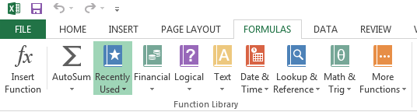
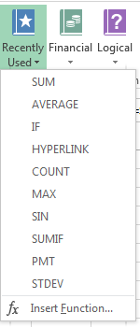
Pre-Created Excel Formulas

Slide 3
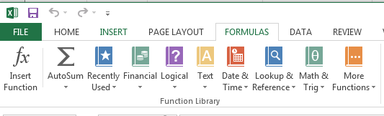
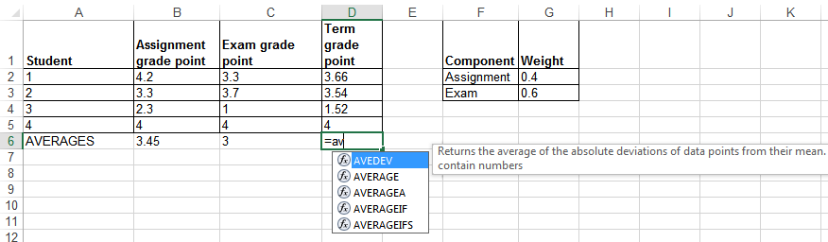
What Function Is Right For Your Situation?
Excel provides reminders.
Built in functions are grouped into the ‘formulas’ tab on the ribbon
Also Excel provides “name completion” and “tool tips”

Slide 4
Input Format For Excel Functions
Required input is typically a range of cells
  Format:
  =FUNCTION(<start cell> : <end cell>)
  Example:
  =AVERAGE(A1:A3)
Alternatively input may be fixed inputs (type data directly into the brackets)
  =AVERAGE(20,30,10)
Optional function inputs (“arguments”)
  Distinguished by the use of square brackets [optional argument]
  =IF (<condition to check>,
  <return value: condition true>,
  [<return value: condition false>])
For the exam you can see either form

Slide 5
Basic Statistics
Example spreadsheet:
  10_basic_statistics
Example formulas: SUM(), AVERAGE(), MIN(), MAX()
General usage:
  Each formula requires as input a sequence of numbers
  E.g., formula(1,2,3):
    Sum = 6 , =SUM(1,2,3)
    Average = 2 , =AVERAGE(1,2,3)
    Min = 1 , =MIN(1,2,3)
    Max = 3 , =MAX(1,2,3)

Slide 6
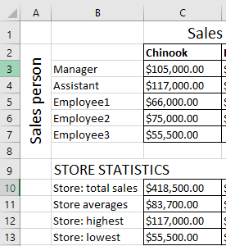
Basic Statistics (2)
Referring to a range of cells
=SUM(C3:C7)
=AVERAGE(C3:C7)
=MAX(C3:C7)
=MIN(C3:C7)

Slide 7
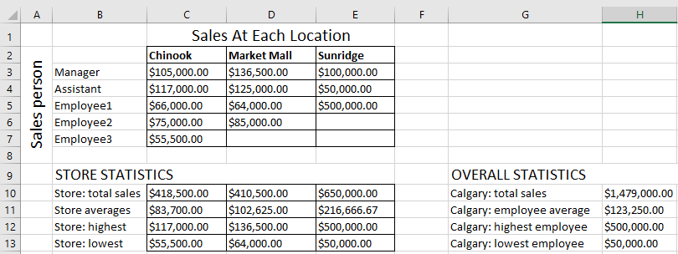
Basic Statistics (3)
FYI: Ranges can span multiple rows and columns
=SUM(C3:E7)

Slide 8
Counting Functions
All of these functions tally up the number of cells that do or do not contain a certain type of data e.g., numbers, blank cells…
General usage:
  FUNCTION(<start cell range> : <end cell range>)
  An array (list) of inputs can be the function argument but this is rare except for illustration or examination purposes e.g., =COUNT(1,"A",2)

Slide 9
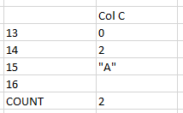
Counting Functions: COUNT()
Counts the number of cells within the specified range that contain a numeric value.
https://support.office.com/en-US/article/COUNT-function-A59CD7FC-B623-4D93-87A4-D23BF411294C
=COUNT(C13:C16)
Q: What is the result?
Notes:
E.g., = 2
Doesn’t count empty or alpha

Slide 10
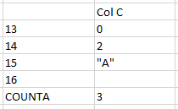
Counting Functions: COUNTA()
Counts the number of cells within the specified range that aren’t empty
https://support.office.com/en-US/article/COUNTA-function-7DC98875-D5C1-46F1-9A82-53F3219E2509
=COUNTA(C13:C16)
Q: What is the result?

Slide 11
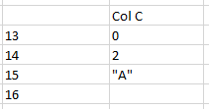
Counting Functions: COUNTBLANK()
Counts the number of empty cells within the specified range
https://support.office.com/en-US/article/COUNTBLANK-function-6A92D772-675C-4BEE-B346-24AF6BD3AC22
=COUNTBLANK(C13:C16)

Slide 12
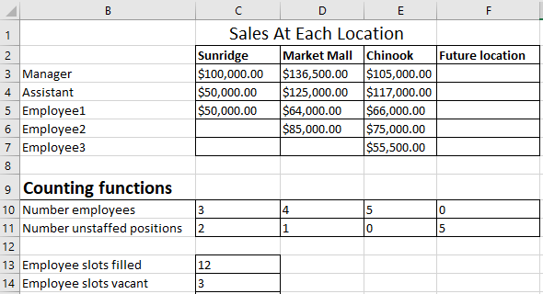
Counting Functions: Spreadsheet Example
Example spreadsheet: 11_counting_functions
  COUNT(): Also used in Row 10
  COUNTBLANK(): Also used in Row 11
=COUNT(C3:E7)
=COUNTBLANK(C3:E7)

Slide 13
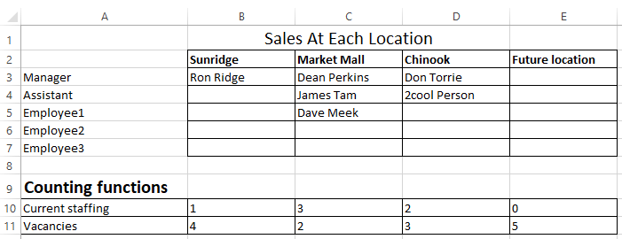
Counting Functions: Spreadsheet Example (2)
  COUNTA(): Number of cases where the employee name has been entered into the system.
    That is, blank cells can be either for unstaffed positions or cases where the name of the staff member has not yet been entered.
=COUNTA(B3:B7)

Slide 14
Lookup Functions
One common use of a lookup function is to determine which category that some numeric value resides.
Membership in a category is often determined by ranges:
  Mapping raw scores to a letter grade.
  Determining your ‘tax bracket’.
  Evaluating your “FICO” credit score.

Slide 15
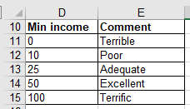
Lookup Tables
Lookup functions require a ‘lookup table’ that specifies the ranges.
  Example: for your given grade in a course, a lookup table specifies the various cutoffs for the different letter grades.
  Similar to a lookup table containing constants but these examples are for a range of values (there are strict requirements in the format) rather than a single value.
Important format requirements for the first column of the lookup table examples covered this term:
  table values must be in ascending order,
  column values can only be numeric.
In the example the data in cells D11 – D15 follow these requirements.

Slide 16
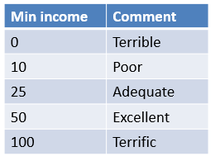
Example: Specifying Conditions
income>=0 and <10?
True
“Terrible”
False
income>=10 and <25?
True
“Poor”
False
income>=25 and <50?
True
“Adequate”
According to the values in this table: a numeric value<0 is an error condition
False
income>=50 and <100?
True
“Excellent”
False
income>=100?
True
“Terrific”

Slide 17
VLOOKUP
Official link for help
https://support.office.com/en-US/article/VLOOKUP-function-0BBC8083-26FE-4963-8AB8-93A18AD188A1
Format:
  VLOOKUP(<Lookup value>,
  <Lookup table Start : End>,
  <Lookup table Column specifying the return value>)
Example:
  =VLOOKUP(B2, D11:E15, 2)
Cell:
Contains value to find in table e.g., a grade point
Lookup table:
Start : End
cell coordinates
Lookup table:
Column value to return, for this example:
(1 = first col. = ‘D’,
2 = second col. = ‘E’)

Slide 18
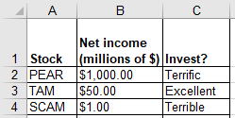
VLOOKUP: Investments
Example spreadsheet: 12_vlookup
=VLOOKUP(B2,D11:E15,2)
Col D (1st)
Col E (2nd)
Min income | Comment
0 | Terrible
10 | Poor
25 | Adequate
50 | Excellent
100 | Terrific
11
12
13
14
15

Slide 19
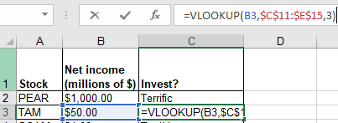
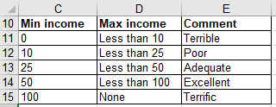
VLOOKUP: Multi-Column (3+) Lookup Table
Name of example spreadsheet: 13_vlookup_multiple_columns
Lookup function
Excellent
Lookup table
Col 1
Col 2
Col 3

Slide 20
Conditional Counting Function
Increases a tally count if one or conditions have been met
COUNTIF()

Slide 21
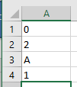
Conditional Counting Function: COUNTIF()
Counts the number of cells that meets a particular requirement
  How many employees of a multi-national corporation are Canadian?
  How many students in a class were awarded an “A+” grade?
  Example below: Count the number of cells within the range that contain a positive numeric value.
  https://support.office.com/en-US/article/COUNTIF-function-E0DE10C6-F885-4E71-ABB4-1F464816DF34
=COUNTIF(A1:A3,">0")

Slide 22
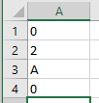
Conditional Counting Function: COUNTIF(), 2
=COUNTIF(A1:A3,"B")

Slide 23
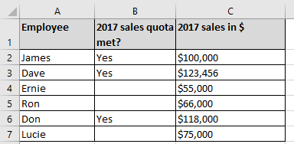

COUNTIF(): Full Example
Example spreadsheet: 14_countif
Conditions tallied
  Which employees met quota? (If the cell contains “Yes”)
  Which employees had sales that were deemed as high (above $100,000)
=COUNTIF(B2:B7,"YES")
=COUNTIF(C3:C8,">100000")

Slide 24
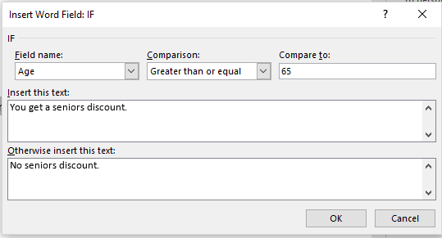
Recall: From Word Mail Merge Filters
Example Mail merge filters covered previously
  Filter rule based on age:
    65 and over: “You get a seniors discount.”
    Under 65: “No seniors discount.”
The If-Then-Else filter checks if a condition has been met e.g. a field in the spreadsheet data source was equal to some value.
  If the condition has been met (condition = true) then display a message.
  If the condition has not been met (condition = false) then display another message.

Slide 25
New Terminology
A Boolean expression takes a condition (a comparison such as degree being equal to ‘B.Sc.’’) as input and returns a Boolean value.
  The conditions must be specified to yield either a Boolean result.
Boolean / Boolean value: must be either true or false
  Examples of statements that must be true or false:
    A job applicant has been awarded a B.A. degree.
    The customer is a senior citizen.
    It is below freezing [freezing point of water] today.
The result of this comparison is Boolean (the condition can only be met or not met).

Slide 26
Format: IF-ELSE
Format:
  =if (<Boolean expression>,
  <Boolean return value: condition true>,
  [<Boolean return value: condition false>])
  Reminder: square brackets [] is the notation used by Microsoft for optional arguments
Example:
  =IF (B2>=100,"GO!","Don’t’ waste your $")
Official help link
https://support.office.com/en-US/article/IF-function-69aed7c9-4e8a-4755-a9bc-aa8bbff73be2?CorrelationId=6aeb3056-a94b-47ac-af6e-90dff250a029

Slide 27
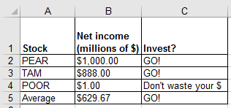
Excel IF-Function: Investing Example
In column ‘C’ the sheet will display “GO!” if net income is 100 (millions of $) or greater “Don’t waste your $” otherwise.
  Example spreadsheet: 15_if_invest_or_not
Boolean expression
=IF (B2>100, "GO!", "Don’t’ waste your $")
Return: condition true
Return: condition false - “else case”

Slide 28
Comparators
Mathematical representation | Excel representation | Meaning
< | < | Less than
> | > | Greater than
= | = | Equal to
≤ | <= | Less than, equal to
≥ | >= | Greater than, equal to
≠ | <> | Not equal to

Slide 29
Example Return Values
Type of return value | Example return value | Example use
Text | “GO” | =IF (B2>100,"GO!", "No go")
Numeric | 4, 4.0 | =IF (C3="A+",4.3, -1)
Cell reference | A2, A3 | =IF(A1>0,A2,A3)
Boolean | True, False | =IF(1>2,True,False)
)

Slide 30
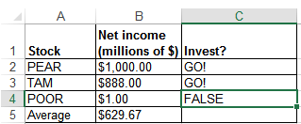
IF: Specifying Only The True Case (Poor Approach)
Example spreadsheet: 16_if_else_invest_or_not_NO_FALSE_return
If only a return value for the true case has been specified:
  When the condition has not been met (False result from the Boolean expression)…literally the text “FALSE” will be displayed.
=IF(B4>100,"GO!")

Slide 31
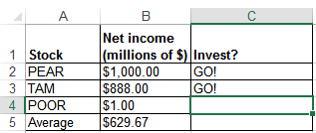
IF: Specifying Only The True Case (Better Approach)
Example spreadsheet: 17_if_else_invest_or_not_ammended
Consequently:
  When a message is desired only when the ‘if condition case’ is true then something, even an empty message, should be specified for the ‘else return case’ (false that the condition has been met).
=IF(B4>100,"GO!","")

Slide 32
Logic: What You Learned
You were informally taught the AND as well as the OR logical operations in the section covering Internet searches.
Example:
  “James Tam” Calgary Logical AND (default)
  Vs.
  “James Tam” OR Calgary Logical OR
More formally: AND, OR are logical operators
Mathematical operators take numbers as input and return a number
New term: Logical operators take a Boolean as input and return a Boolean value.
  Logical operators can connect compound (2+) Boolean expressions.
  (Boolean expression) Logical operator (Boolean expression) etc.

Slide 33
Logical AND: All Restrictions
Used when all conditions / Boolean expressions (BE) must be true
Example:
  Prerequisites for CPSC 233: Introductory programming course as well as discrete math (“as well as” = AND in this case).
  Intro programming grade >= C- AND Math grade >= C-
  If either course grade is not satisfactory it’s false that the requirement is met.
    With Logical-AND if any Boolean Expression is false then the entire compound condition is made false.
  Only if all course grades satisfactory will it be true that the pre-requisites have been met.
    With Logical-AND only if all conditions are true will the entire compound condition be true.
Condition 1 / BE 1
Condition II / BE 2

Slide 34
Logical AND: Many Conditions
To evaluate the result just extend the general rule:
  Multiple AND-expressions must all be true for the overall result to be true.
  If at least one expression is false then the overall result is false.
Example:
  Internet search: “James Tam” CPSC Calgary
    Before a webpage appears as a search result, all three conditions must be met (the three text phrases must appear in that page).
      The more search phrases that you include, the more narrow will be your results (fewer).
  A course with 3 or more prerequisites.
  Job applicants must meet 3 or more requirements e.g. Applicant must be an adult, awarded a university undergraduate degree (or a superior degree), overall grade point from that degree must be at least 3.0.

Slide 35
Logical OR: At least One Restriction
Used when at least one condition / Boolean expression (BE) must be met (true).
Example:
  Prerequisites for CPSC 233: One of CPSC 217 or 231
  CPSC 231 GPA >= C- OR CPSC 217 GPA >= A-
  If at least one of: CPSC 217, 231 was completed satisfactorily, then the intro programming requirement was met.
    With Logical-OR if any condition / Boolean Expression is true then the entire compound condition is made true.
  Only if no courses were completed satisfactorily then the programming requirement has not been met.
    With Logical-OR only if all conditions are false will the entire compound condition be false.
Condition 1 / BE 1
Condition 2 / BE 2

Slide 36
Logical OR: Many Conditions
As was the case with Logical-AND to evaluate the result just extend the general rule:
  If at least one expression is true then the overall result is true.
  Multiple OR-expressions must all be false for the overall result to be false.
Example:
  Internet search: “Wayne Gretzky” OR “The Great One” OR “Number 99” OR “Number ninety nine”
    A website that includes at least one of the text phrases will be shown as a search result.
      Increasing the number of OR-expressions will broaden (increase) the number of search results.
  A course with a choice of prerequisites.
  Job applicants can be awarded one of a number of degrees e.g. B.A., B.Comm, B.Sc. etc.

Slide 37
Mixed Logical Expressions
AND, OR conditions can be combined in actual usage.
Example:
  Internet search: “Wayne Gretzky” OR “The Great One” OR “Number 99” OR “Number ninety nine” AND “Edmonton Oilers”
    A website will show as a search result if it contains at least one of the three ‘names’ as well as containing the text “Edmonton Oilers”.
  Course prerequisites: CPSC 233 requires one of: CPSC 217, 231 as well as Math 271
    In actual usage logical operators may be implicit so you should be able to interpret plain English descriptions in an assignment or during an examination.
    CPSC 217 OR CPSC 231 AND MATH 271
    With logic and software ‘AND’ is a higher order precedence than OR so the above is not evaluated left-right, the above is the same as:
      CPSC 217 OR (CPSC 231 AND MATH 271)
    (CPSC 217 OR CPSC 231) AND MATH 271 (To avoid confusion bracket expressions to make things explicit).
Notes:
With logical precedence AND occurs before OR

Slide 38
Logical Functions In Excel
The basic logical operations: AND, OR can be invoked as functions in Excel
  Similar to evaluating logical expressions on paper, all Excel logical function inputs can only be a True or False value.
  Function inputs can be:
    Boolean constant e.g. AND(True,False,False)
    Boolean expression e.g. OR(A1>0,A2>0,3>2)
    A cell that contains a Boolean value e.g. AND(A1,A2), OR(B1,Z2)
Format:
  AND(<True or False>,<True or False>...)
  OR(<True or False>,<True or False>...)

Slide 39
Types Of Inputs: Logic Functions
Examples (spreadsheet name: 18_logic)
  AND(C1>=45,D1="John Smith")
  OR(C1>=0,D2>=0)

Slide 40
New Terminology: Nested Calculation
Nested calculation: one calculation is nested within another second calculation when the result of the first calculation is used to determine the result of the second calculation.
Simple example:
  Calories expended = (height + 7) * 100
More complex example:
  First calculation: determine the total cost of salaries and other expenditures for each Canadian province.
  Second calculation: determine total for all sources of revenue for each province.
  Third calculation: calculate the surplus (of deficit) for each province
    = (sum all provincial revenues) – (total provincial expenditures)
  The calculations for revenues and expenditures are nested within (part of) the calculation for the surplus (or deficit)

Slide 41
Nested Functions
The return result of one function is used as an argument for another function.
Example:
  Find the maximum grade for each lecture section.
  Example:
    Lecture 01: =MAX(A2:A101)
    Lecture 02: =MAX(B2:B101)
  Calculate the average of the lecture maximums
    Average of the maximum scores: = AVERAGE(MAX(A2:A101), MAX(B2:B101))
=MAX(A2:A101)
MAX(B2:B101)
=AVERAGE( , )

Slide 42
Using One Function’s Return Value As Input For Another Function (Nesting Functions: Logic, IF)
Breaking down the process into parts
  Call a function and that function returns a value e.g. B4 = 3.7, C4 = 4
  Use the return value of the first function as part/all of the input of a second function
    The first function is nested within the second function.
AND(B4>=3.7,C4>=5)
Returns False
=IF( , "H","")
Actual formulation of the function
IF(AND(B4>=3.7,C4>=5), "H","")

Slide 43
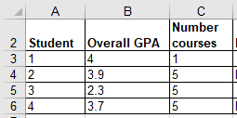

Logic And IF’s: Example
Being on the Dean’s list requires: a grade point of 3.7 or higher and a full load 5 or more courses.
AND Excel example: Dean’s list
  Signify when a student has made the Dean’s list requirements with an “D”, blank cell otherwise.
Example spreadsheet: 19_if_with_logic
=IF(AND(B4>=3.7,C4>=5),"D","")

Slide 44


Logic And IF’s: Example (2)
OR Example: Hired if at least one requirement has been met:
  work experience of 5+ years,
  grade 3.7 or higher
  (Same spreadsheet as previous example)
E12
G16
=IF(OR(E12>=5,G16>=3.7),"1+ requirement met","")

Slide 45
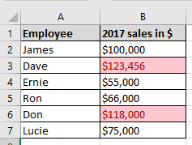
Conditional Formatting
Example spreadsheet: 20_conditional_formatting
It can be used to visually highlight data which has met a certain condition.
Highlight if sales exceeds 100,000

Slide 46
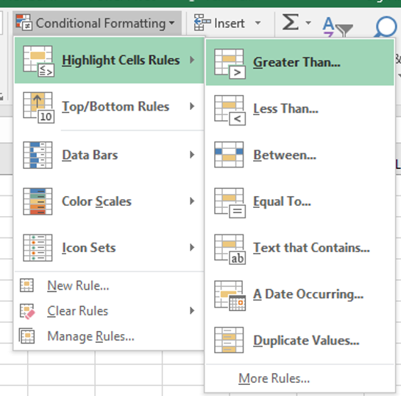
Setting Conditional Formatting
Home Tab-> (Styles group: Conditional formatting)
  With the previous example select:
    “Greater Than”
    Enter 99999.99 with “Light Red Fill with Dark Red Text”
If you don’t know much about visual design then keep it simple, stick to the basics!

Slide 47
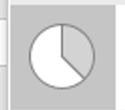
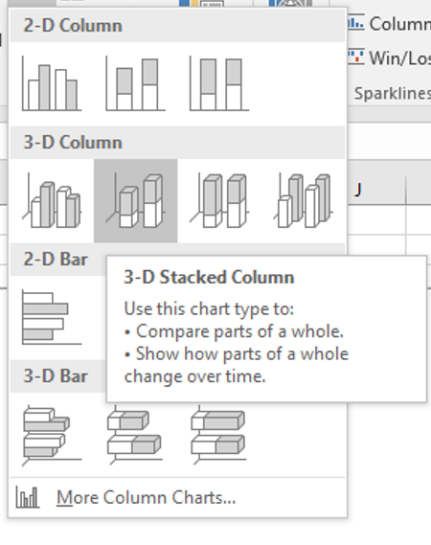

Ways Of Graphically Representing Information
Pie chart
Bar graph
  Excel: Column (vertical),
  bar (horizontal)
Line graph

Slide 48
Pie Charts
Good for showing proportions, how much of the whole does each item contribute.
It’s poor for showing exact numeric values.

Slide 49
Bar And Line Graphs
  For showing trends
  Comparing functions

Slide 50
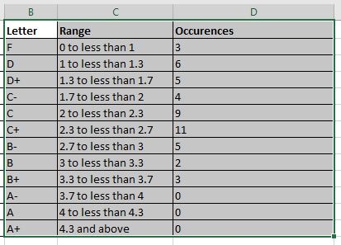
Creating Graphs Using Excel: Specifying Data
Select the range of cells

Slide 51
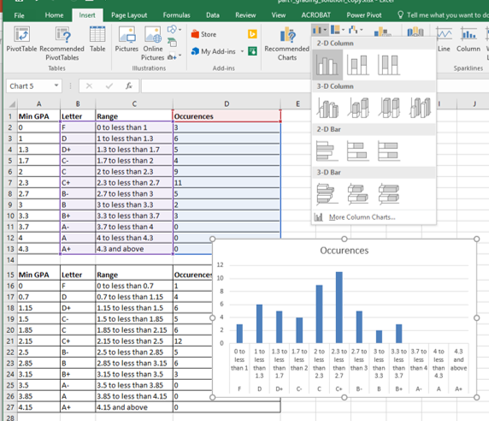
Creating Graphs Using Excel: Inserting Graph
Insert-> (Charts Group: Type of graph e.g. 2D Column)

Slide 52
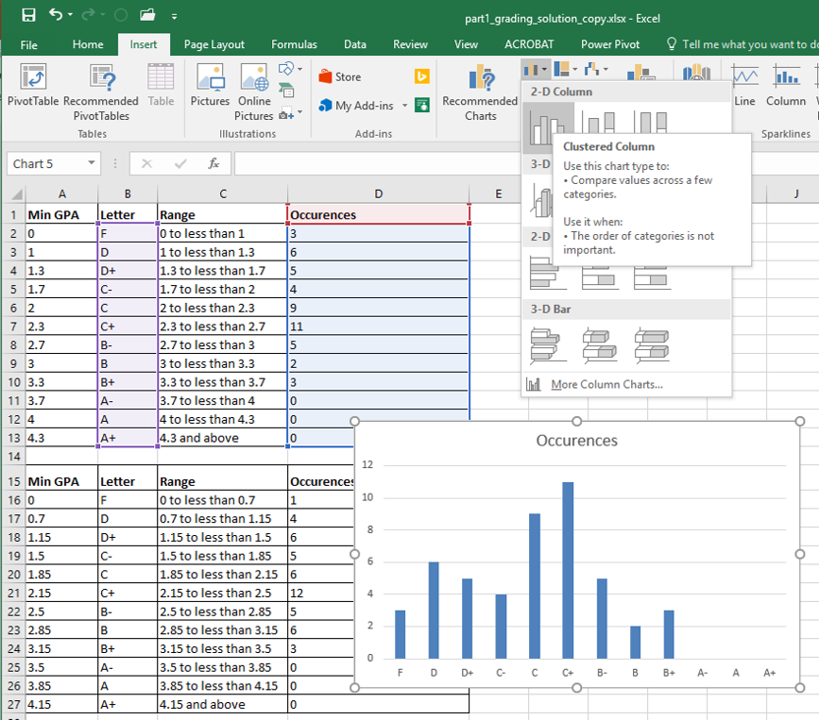
Creating Graphs Using Excel: Choosing Specific Data
To select non-adjacent columns select the first column, press and don’t release control and then select the next column.

Slide 53
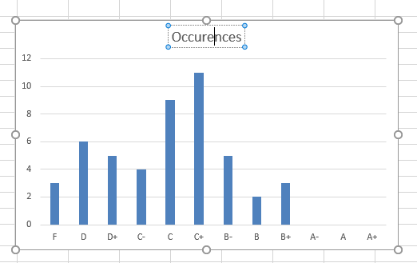
Editing The Graph Title (And Other Parts)

Slide 54
Rules Of Thumb For Graphs
    What type of graph to use:
      Bar graphs are used to plot non-continuous data e.g., the number of patients that go to different hospitals.
      Line graphs are used to plot continuous data e.g., mortality trends over time.
    JT: Avoid or minimize the use 3D graphics! Keep things simple.

Slide 55
After This Section You Should Now Know
How to use basic statistical formulas: sum(), average(), min(), max()
How to use counting functions: count(), counta(), countblank(),countif()
How to use the lookup function: vlookup() and how to properly define lookup tables
A conditional counting function: countif()
The ‘if-else’ function
Logic functions: and, or

Slide 56
After This Section You Should Now Know (2)
What is a nested function: Using the output of one function become the input of another function, example: and, or in conjunction with if-else
How to apply conditional formatting to a spreadsheet
When to use pie charts vs. bar graphs vs. line graphs
How to use graphs in Excel

Slide 57
Images
“Unless otherwise indicated, all images were produced by James Tam
Notes:
http://office.microsoft.com/en-ca/images/nature-CM079001922.aspx

