Slide 1
CPSC 203
Administrative information and introduction to the course
These notes can be found on the course website: https://pages.cpsc.ucalgary.ca/~tamj/2023/203W/index.html
(There is a link to this website in D2L).

Slide 2
This Course Focuses On The Windows Operating System (Not Apple/MAC)
Although assignments are mostly on MS-Office, this course will be using a version of MS-Windows.
(The MAC-specific lecture is no longer timetabled by our department).
You might be able to implement your work on a MAC (some 203 students successfully done this) but keep in mind available resources and help are for Windows.
That means if you have an odd technical glitch you might be on your own.
You can work on assignments in tutorial labs (MS118)
Other campus labs may have some features disabled (this is beyond your instructor’s control).
Only assignments that work on lab computers will be awarded any credit (test your work periodically).
Notes:
https://support.office.com/en-us/article/Check-a-document-for-compatibility-C5AA52E0-15C8-4DA7-9942-379552795D90

Slide 3

Contact Information (James Tam)
Days/times of availability:
Monday: 4:50 - 5:15 PM (ST 143). Please identify yourself as a CPSC 203 student.
Tuesday: 5:15 - 5:30 PM (ENA 101).
And of course you can send email:
Since I teach more than one course and to make it easier to flag your emails include the course name and number in the subject line of the email ‘CPSC 203’
Other times may be possible via a remote session.
© Tam

Slide 4
Course Resources
Main course webpage (link can be found in D2L under: Content->Course information) https://pages.cpsc.ucalgary.ca/~tamj/2023/203W/#Main_grid
You can also find specific sub-links of the course website under D2L, examples:
Lecture notes: Content->Lecture information
Assignment and work book exercise descriptions: Content -> Assignments and work book exercises
Course textbooks (both are available as an eText and a print edition).
#1 (Hardware, VBA programming sections) “Computer Science Chop Suey! (Lite Edition) Computer & software fundamentals, practical problem solving” by James Tam (Published by Wiley)
You may find the full edition which is mostly similar but the lite edition is newer and may cost less because it’s shorter.
#2 (Hardware, Word, Excel, VBA problems) “Computer Science Chop Suey! Chop-Chop problems” by James Tam (Published by Wiley)

Slide 5
Teaching Tutorials
As the name implies teaching will occur during this time.
It may overlap with lecture but unique material will also be taught in tutorial.
Teaching Assistants are not required to record their teaching sessions.
Make sure you attend a tutorial session so you don’t miss anything.
Similar to enrolling in the lecture you needed to enroll in a specific tutorial when you registered in this course.
(2 times per week): Tutorials are scheduled either for MW or TR (depending upon the section) via another Zoom link
Day/time/instructor information about each section:
https://pages.cpsc.ucalgary.ca/~tamj/2023/203W/#Tutorial_information
Teaching will occur remotely via Zoom, in D2l: Content-> Teaching tutorials
You can find your registration information in PeopleSoft’s Student Center.

Slide 6
Help Tutorials
Also known as Continuous tutorials (or CT for short)
A sort of “Help desk” specific to this course staffed by Teaching Assistants
For the distance learning lectures look in D2L under: Content-> Help tutorials (CT) and then can see the names of the people who staff the CT.
In order to make the most efficient use of finite resources (Teaching Assistant work hours):
more hours will be scheduled when there is higher anticipated demand,
some weeks will have little or no CT times scheduled.
You can attend the Help Tutorial/CT of any Teaching Assistant.

Slide 7
Remote Learning? (Last Minute ‘No’ Given To Me)
Because lectures and examinations cannot be conducted in person there will differences in the course offered this term.
Some topics will change.
There won’t be any examinations (ignore any references to them here).
Instead there will be one additional regular assignment and one extra workbook exercise (more on assessment later).

Slide 8
Yes: “This Stuff Will Be On The Exam”
The administrative notes contains important information e.g. how your grades are calculated, assignment requirements etc.
To encourage students to pay attention to details (and to reward those who do so):
Some of your midterm multiple questions will come from this section.
You may see a question or two from this section on the final exam as well.

Slide 9
Evaluation Components: Hands On
A0: submitting files AND properly verifying submissions in D2L.
Due 4 PM Friday Jan. 27 via D2L, not graded but still important.
4 regular assignments:
All assignments are due at 4 PM submit via D2L
A1 (Using MS-Word): Due Monday Feb. 6 worth 22.5%
A2 (Using MS-Excel): Due Friday Mar. 3 worth 22.5%
A3 (Writing a VBA program for MS-Word): Due Friday Mar. 31 worth 22.5%
A4 (Writing a VBA program for MS-Excel): Due Wednesday Apr. 12 worth 22.5%
5 workbook type exercises (similar to those in the Chop-Chop problems text)
All book exercises are due at 4 PM via D2L. Each is worth 2% x 5 = 10% for all.
WB Ex 1, using Word: Due Monday Jan. 30
WB Ex 2, using Excel : Friday Feb. 17
WB Ex 3, VBA programming for Word : Monday Mar. 13
WB Ex 4, VBA programming for Word: Monday Mar. 20
WB Ex 5, VBA programming for Excel: Friday Apr. 7
Notes:
I tend to focus on the proportion of the term grade that a particular component contributes
Because grade points are used, sometimes they are confused if percentages instead of proportions are used

Slide 10
Assignments: Late Submissions
In the event of illness you can have up to one full assignment (A1 – A4) and up to two workbook exercises not counted in your grading.
Situations where you won’t be able to get these special considerations (not have assignments counted in grading) include scenarios that are typical of student life: having multiple due dates, work commitments etc. Forgetting to hand in or submitting an invalid file for part or all of your assignment is not a valid reason for an extension.
The usual late penalties specified in the requirements will be applied in these cases.

Slide 11
Assignments: Late Submissions (2)
Late assignment submissions without an extension will have the following penalties applied.
Late workbook exercise submissions without an extension will have the following penalties applied.
Submission received: | On time | Hours late : >0 and <=24 | Hours late: >24 and <=48 | Hours late: >48 and <=72 | Hours late: >72 and <=96 | Hours late: >96
Penalty: | None | -1 GPA | -2 GPA | -3 GPA | -4 GPA | No credit
Submission received: | On time | Hours late : >0 and <=24 | Hours late: >24 and <=48 | Hours late: >48
Penalty: | None | -1 GPA | -2 GPA | No credit

Slide 12
No Group Allowed For Assignments
Assignments and exercises must be individually completed and individually submitted using the D2L Dropbox.
There is no group work allowed for this class.
Students should not see the assignment solutions produced by other students.
If you employ a tutor for this class then you should not go over the assignment with your tutor.
Violating these rules may result in an academic misconduct investigation being conducted by the office of the dean.

Slide 13
Submitting Assignments: Preparing For The Worst
Submitting assignments
Do it early! (Get familiar with the system)
Do it often! (If somehow real disaster strikes and you lose everything at least you will have a partially completed version that the TA can mark).
Check your D2L Dropbox submission.
Don’t assume that everything was submitted OK.
Don’t just check file names but at least skim the actual contents (not only to check that the file didn’t become corrupt during the upload but also that you submitted the correct version, the latter is a good idea when you make multiple backup copies)….important part of A0.
It is each student’s responsibility to make sure that the correct file was submitted on time into D2L.
Alternate submission mechanisms e.g., email, uploads to cloud-based systems such as Google drive, time-stamps, TA memories cannot be used as alternatives if you have not properly submitted into D2L.

Slide 14
Evaluation Components: Examinations
No exams for remote lectures
Two examinations (Proportion of term grade: 68/100)
They are ‘paper’ exams written in a lecture room.
“Exam type” questions will be provided during the semester in lecture.
Two examinations:
Midterm: (Friday March 6), 28/100 marks ENG60 5:30 PM - 6:45 PM
Final exam: will be scheduled by the Registrar (login to the “My Ucalgary” portal for details), 40/100 marks
Somewhat similar to assignments, if miss an exam with a good reason and appropriate documentation then you can have the weight for one examination shifted to the other exams.

Slide 15
Grades For Each Component
The official grading mechanism for this (and most) universities is a letter grade/grade point e.g. A/4.0, A-/3.7 etc.
Term grades must be stated as a letter grade.
Component grades (assignment, exam etc.) can either be a letter grade or a raw score (e.g. percentage)
If want to know the reason why grade points are used for this class: [Information link:
https://pages.cpsc.ucalgary.ca/~tamj/2022/203W/notes/pdf/why_are_grade_points_used.pdf]
For this class each major component will be awarded a grade point (and not a percentage) and this is the value used to determine the term grade.
Each assignment component: A1, A2, A3 etc.
Each workbook exercise.
Paper examination components: midterm, final exam

Slide 16
Mapping Raw Scores To Grade Points: Assignments
Assignment marking keys will specify grade points only
Example:
Page numbering (Bold numbers 3) in the header of each page in the specified format = 0.2 grade points,
Table of contents (Automatic table 2: 0.2 GPA) at the start of the document on it's own page (0.2 GPA) = 0.4 grade points total
Footnote for the Spruce meadows web address = 0.2 grade points.
Create a new citation for the Cool Runnings film (0.3 GPA) and insert it into the document (0.2 GPA) = 0.5 grade points total
Sum the grade points for each feature in order to yield the grade point awarded for the assignment e.g., 0.2 + 0.4 + 0.2 + 0.5 = 1.3 GPA earned if only the above features were implemented.

Slide 17
Grade Points Are Letter Grades Not Percentages
Obvious examples why:
4.0/A does not require a “100 % to attain this grade”
A passing grade of 1.0/D does equate to passing students who attain at 25% score (if percentages are used).
In a similar fashion one cannot equate grade point cut offs to percentages:
Examples:
A cut off of 1.85 GPA or higher for an ‘C’ letter grade does not equate to a percentage cut off of 46%.
A cut off of 3.85 GPA or higher for an ‘A’ letter grade does not equate to a percentage cut off of 96%.

Slide 18
Mapping Raw Scores To Grade Points: Exams
No exams for remote lectures
For examinations the mapping between a raw score and a grade point occurs one way (raw score mapped to grade point)
Example (purely for illustration purposes) 65 – 69% = C/2.0, 70 – 74% = C+/2.3
But grade points don’t correlate back to percentages
e.g. I was awarded a 66% on midterm and then I see this is a 2.0 GPA (out of 4.0)
Does this mean that my percentage ‘went’ from a 66% to a 50%!!!???
No.
A C/2.0 does not mean that 50% was awarded as a course grade.
To put this in perspective a passing grade point in this university is a 1.0/D in a course. If a grade point mapped back to a percentage this would mean that anyone getting a 25% or higher would pass any course here.
The mapping of the midterm to grade point will be posted sometime after the midterm grades have been released.
The mapping of the final exam to grade point will be posted sometime after the final exam grades have been released.

Slide 19
Estimating Your Overall Term Grade Point
To determine your weighted term grade point simply multiply each grade point by the weight of each component = weighted component grade
Sum the weighted grade points to determine the term grade.
Percentages won’t be used to determine the term grade/letter grade
So don’t ask me: “What percent do I need to pass this class?”
The official passing letter/grade point for this university is a ‘D’ or 1.0.

Slide 20
Calculating Your Overall Term Grade Point
To determine your weighted term grade point simply multiply each grade point by the weight of each component.
Percentages won’t be used to determine the term grade point/letter
Sum the weighted grade points to determine the term grade.
Simple and short example (not exactly the same as this term but it should be enough to give you an idea of how to do the specific calculations required this semester):
Assignment 1: weight = 60/100, example score = A
Assignment 2: weight = 40/100, example score = B+
Weighted assignment 1: 0.6 * 4.0 = 2.4
Weighted assignment 2: 0.4 * 3.3 = 1.32
Total term grade point = 2.4 + 1.32 = 3.72
(In this case the term letter is A- if the official university cutoffs were used – more on this shortly)
(The number and weight of graded components will needed by adjusted to compute your actual term grade).

Slide 21
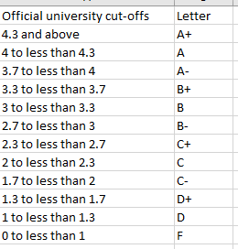
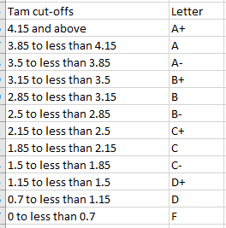
Contrast The Cut-Offs
Official UC cutoffs
The Tam cutoffs
Term GPA
4
4
3.7
3.3
3.0
2.7
2.3
2.0
1.7
1.3
1.0
0
The cutoffs in the spreadsheet are significantly more lenient (almost everyone “gets a big break” e.g. instead of 3.7 for an A- it’s 3.5 (midpoint between A-/3.7 and B+/3.3 is the higher letter grade)
Do not expect a further “rounding up” at the end of the term e.g.
Q: 3.4999999999999999999999999999999999999999999999999 is soooooooooooooooooooooooooooooooooooooooooooooooo close to 3.5 can’t you get an “A-”
A: ‘No’ or using an Internet emphasis
NOOOOOOOOOOOOOOOOOOOOOOOOOOOOOOOOOOOOOOOOOOOOOOOOOOOOOOOOOOOOOOOOOOOOOOOOOOOOOOOOOOOOOOOOOOOOOOOOO!!!!!!!!!!!!!!!!!!!!!!!!!!!!!!!!!!!!!!!!!!!!!!!!!!!!!!!!!!!!!!!!!!!!!!!!!!!!!!!!!!!!!!!!!!!!!!!!!!!!!!!!!!!!!!!!!!!!!!!!!!!!!

Slide 22
Estimating Your Overall Term Grade Point (2)
You can use the spreadsheet on the course web page to estimate your term letter grade:
http://pages.cpsc.ucalgary.ca/~tamj/2023/203W/203_grade_calculator.xlsx

Slide 23
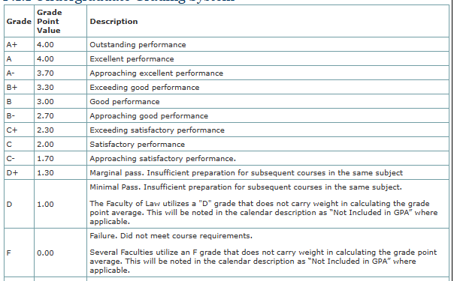
Your Term Letter Grade
After being assigned a letter grade for a class regardless of how it was derived then the numeric value for that letter uses the standard university values e.g. for determining your term average and your overall average.
The GPA to letter cut off scale is not known the Registrar and won’t ‘lower’ your score in this class.

Slide 24
Enhancing Your Learning
Computer Science is “hands on”, someone can teach you: theory, principles as well as how to do something
You get better by trying things yourself.
Using MS-Office (A1 & A2): Try the features of Excel and Word either in class or as soon as possible after class.
Don’t just focus on how to run different features but also make sure that you truly understand how they work (this can be challenging for complex features).
Similar to getting fit: you can’t just watch
You have to do it yourself

Slide 25
Enhancing Your Learning (2)
“Programming” A3 onward
‘Trace programs’: read through the lecture examples and try to figure out ‘by hand’ (not by running them) what happens if the programs were run.
Verify your prediction by running the program after the hand trace
Writing programs (“coding”): try writing the lecture examples yourself from scratch (don’t look at the answer in the lecture notes until you’ve given it attempt)
More details provided later.
The more your practice, the deeper will be your understanding of concepts (all assignments) and more skilled a programmer you will be (A3 & for this term A4).
The workbook was written to increase your ability to practice concepts.

Slide 26
Enhancing Your Learning (3)
For most students simply sitting and listening isn’t enough.
It has been shown that learning will be enhanced by taking notes (properly – don’t capture lectures word for word, paraphrase).
Hand written notes are better than electronic versions (and you can probably take down information more quickly by hand especially if you need to draw diagrams).
Ask questions!
If after trying to figure things out yourself make sure you clarify! (Remember I have office hours and there’s a CT for this course)
If you are attending class, taking down notes and otherwise giving the course a good effort don’t “feel dumb” asking a question

Slide 27

Tam’s “House Rules”
I will endeavor to keep the lecture within the prescribed time boundaries
You won’t pack up and end before time is up

Slide 28




Tam’s “House Rules”
No recordings/captures without permission during class please
(Recall that learning tends to increase with additional levels of engagement).

Slide 29


Tam’s “House Rules”
Quiet whispering is OK…
…but make sure if it is *quiet*. If it’s loud enough for me to hear then it’s likely that others are being disturbed by the noise as well.

Slide 30
Tam’s House Rules (Remote Learning)
Some of the common sense rules and social norms that apply for face-to-face to learning also apply to the online version e.g. turn taking.
Please do ask questions!
But when you have a question use the “raise your hand” feature in Zoom: Reactions -> Raise hand
Of course you shouldn’t just turn on your microphone and start talking.
Avoid using the text chat (unless you don’t have working mic.)
Text chat messages go to me (use it after you raise your hand but your audio input device isn’t working).
Virtual office time: similar to a physical office, I will help one person at a time (the rest come into a virtual waiting room).
https://support.zoom.us/hc/en-us/articles/115000332726-Waiting-Room
The TAs will likely employ a waiting room for their help tutorials (CT).

Slide 31
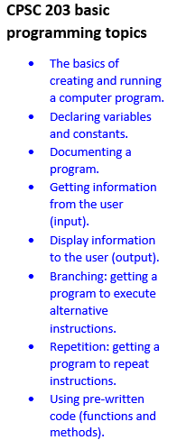
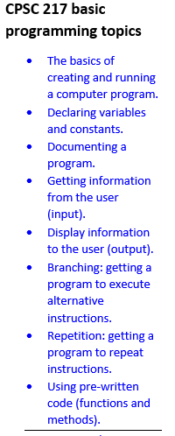
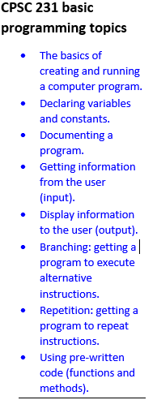
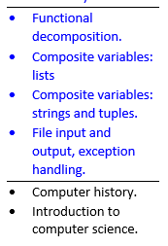
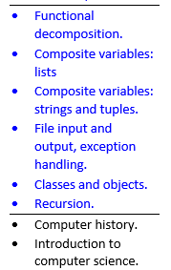
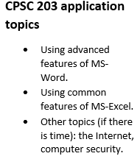
203 Is For Non-Majors: Comparisons To Other Courses

Slide 32
University Account Issues (UC-IT)
The Department of Computer Science does not manage the university network (e.g. email, PeopleSoft, D2L is managed by UC-IT).
In short UC-IT deals with technical issues related to university computers (e.g. accounts, login issues etc.)
Where to go for issues with your university account: Math Science (not ICT) MS773.
UC-IT support page:
https://ucalgary.service-now.com/it

Slide 33
Copyright Notice
Unless otherwise specified, images are from ColourBox: www.colourbox.com

