Slide 1
The Recent History of Computers & Technologies
You will learn about the developments in computing and other related technologies that were made from the 1970s onward.

Slide 2
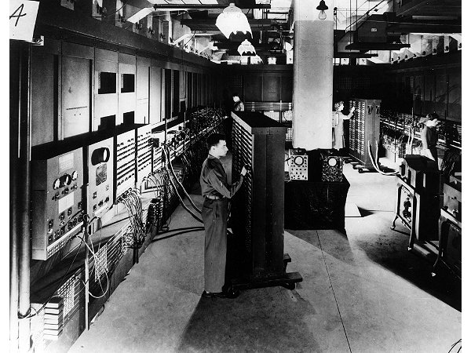
Computers Before The Microprocessor
Image © University of Pennsylvania

Slide 3
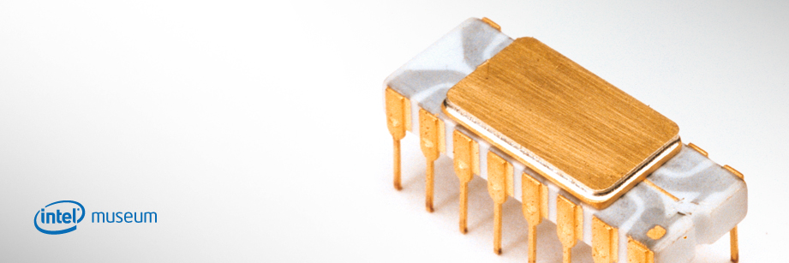
The First Microprocessor: 4004
From the “Intel museum” www.intel.com
1 http://www.intel.com/pressroom/kits/quickreffam.htm
Produced by Intel in the early 1970s
It’s development revolutionized computers by allowing computers to be more widely used.
Clock speed: 108 kHz¹

Slide 4
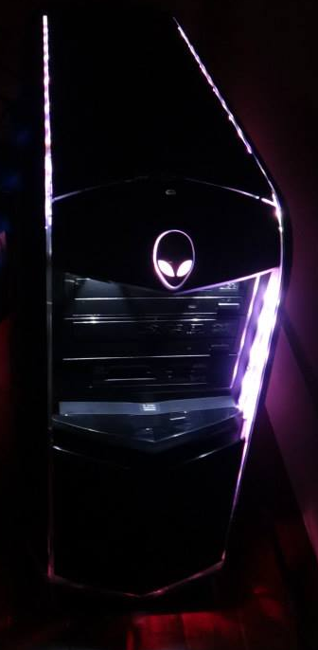
What Is Microcomputer?
A computer that uses a microprocessor as it’s main processor.
Sometimes it’s referred to as a ‘PC’ (Personal Computer).
  Designed for use by only one person at a time.
  Unfortunately this term has taken on multiple meanings.
    PC = IBM PC (a model produced by IBM)
    PC = A computer running a Microsoft operating system.
Consequently the less ambiguous term ‘microcomputer’ will be used.
Image courtesy of James Tam

Slide 5
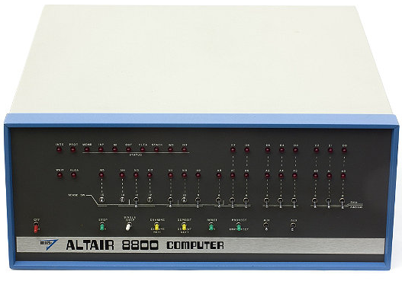
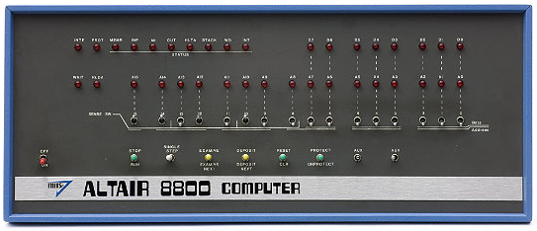
The First Popular Computer For Home Users: The Altair
Images © Mark Richards from www.computerhistory.org

Slide 6
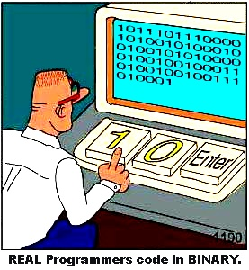
Note: Most Computer Users At The Time Were Extremely Technically-Oriented
Image by Chris Kania
http://www.kaniamania.com/

Slide 7
Microsoft’s Influence On Microcomputers¹
IBM OS???
1 https://www.forbes.com/sites/timbajarin/2021/08/25/attack-of-the-clones-how-ibm-lost-control-of-the-pc-market/?sh=1e6da2dd5b81
Clipart: Microsoft

Slide 8
Microsoft’s Influence On Microcomputers (2)
IBM approached two companies as possible vendors of an operating system to run it’s computers:
  Digital Research
  Microsoft (never wrote operating system software just a BASIC interpreter).
  Microsoft: 7 million in annual sales
  IBM: 30 billion in yearly revenues.
IBM and Microsoft worked out an arrangement to have a version of Microsoft’s DOS (Disk Operating System) run IBM computers: PC-DOS.
MS-DOS was based on 86-DOS an OS written by Tim Paterson of Seattle Computer products (later Q-DOS).
With the arrangement with IBM Microsoft could (and eventually did) license its operating system to other computer manufacturers.

Slide 9
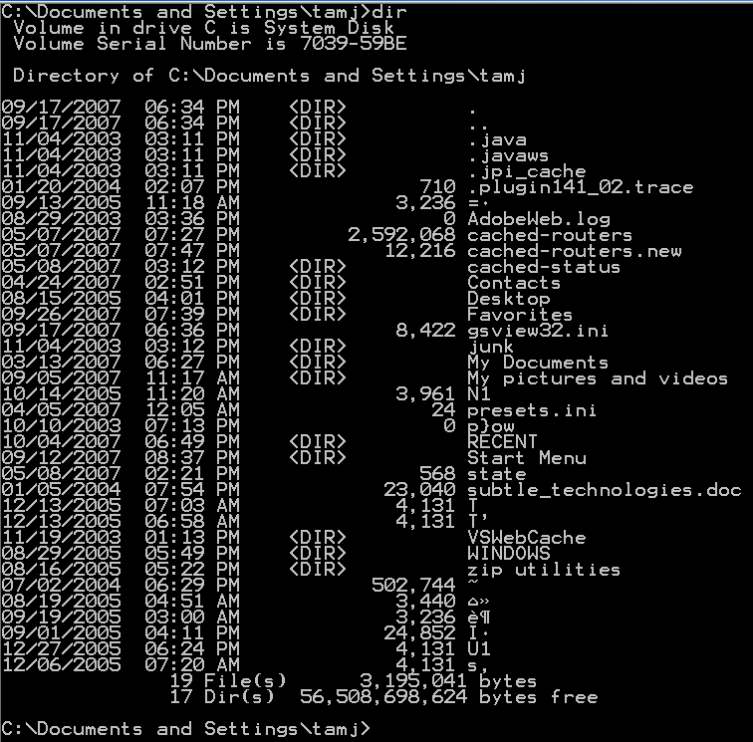
Microsoft’s Influence On Microcomputers (3)
Command
Effect of the command
The interface of PC/MS-DOS has been criticized as being user-unfriendly.

Slide 10
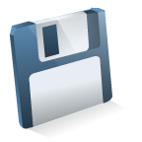
Microsoft’s Influence On Microcomputers (4)
Digital Research Inc.: CP/M operating system
Reboot
computer
Wrong disk!!!
However the interface of PC/MS-DOS was a significant improvement over other operating systems of the day.

Slide 11
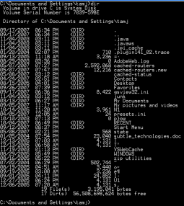
Microsoft’s Influence On Microcomputers (4)
PC/MS-DOS operating system
Abort,
retry, fail?
Wrong disk!!!
Correct disk
However the interface of PC/MS-DOS was a significant improvement over other operating systems.

Slide 12
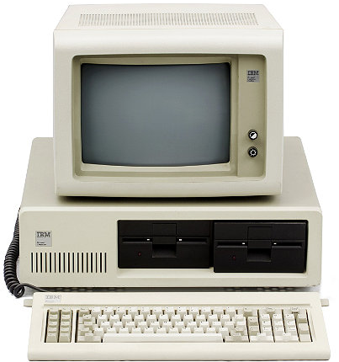
The IBM PC (Personal Computer: 1981)
www.computerhistory.org
IBM was a large company but a late comer into the microcomputer market.
As mentioned the IBM PC used an operating system produced by Microsoft.

Slide 13
The IBM PC (Personal Computer: 1981): 2
IBM PC
Word processing
Accounting software
Games
Spreadsheets
With the entry of IBM in the microcomputer market, many developers produced a plethora of software.

Slide 14
The IBM PC (Personal Computer: 1981): 3
Apple sales
IBM sales
Apple sales
IBM sales
There were many other important microcomputer manufacturers (omitted for brevity)
Apple entered the microcomputer market sooner and already had an established market when IBM began to first market the PC.
Because of the prevalence of so much software the IBM-PC soon overtook the Apple in sales.

Slide 15
The Attack Of The Clones
Apple sales
IBM sales
Although it was a late entry into the microcomputer market IBM eventually dominated.

Slide 16
The Attack Of The Clones (2)
Processor: Company A
Hard drive: Company B
Floppy drive: Company C
Expansion card: Company D
IBM-PC
Although the IBM-PC was marketed and sold under the IBM brand most of the parts were not manufactured in-house.

Slide 17
The Attack Of The Clones (3)
IBM-PC
Compaq clone
The parts manufacturers were free to sell their components to other companies.
Shortly after the IBM-PC was released, three ex-employees of Texas Instruments founded their own company: Compaq.
  They conceived of the idea of producing their own copy of the IBM-PC under their own brand name.
  It would run under MS-DOS and be 100% compatible with application software written for the PC.
  The first IBM-PC clone was delivered by Compaq in 1983.

Slide 18
The Attack Of The Clones (4)
Compaq clone
IBM-PC
Mom and pop shop clone
Dell clone
This opened the flood gates for other computer manufacturers to produce their own clone computers.

Slide 19
The Attack Of The Clones: Result
Apple sales
IBM sales
Microsoft operating system
Apple sales
IBM sales
Compaq sales
Dell sales
Mom & pop shop sales
The result was that IBM eventually lost control over the computer architecture that it was the first one to market.

Slide 20
IBM’s Attempt To Take Back Their Market
IBM later developed their own operating system (OS2 for the PS2 computer).
Even with it’s benefits their attempt to standardize the market around OS2 failed.

Slide 21
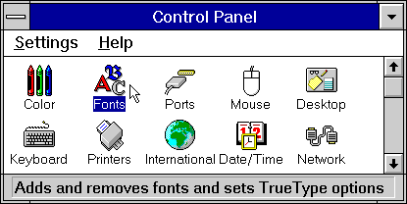
The Attack Of The Clones: The Rise Of Microsoft
Windows 3 image from www.microsoft.com
The loser of the clone war was IBM.
The real winner of the clone war was Microsoft.
By the 1990s Microsoft developed an interface for MS-DOS that incorporated some of the features of the MAC GUI.

Slide 22
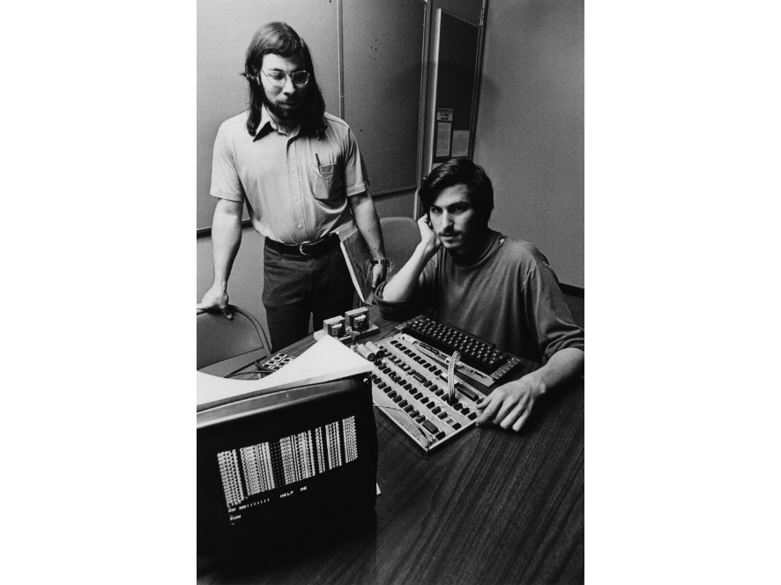
The History Of Apple Computers: Steve And Steve
Steve Jobs
Steve Wozniac
Images © Apple Computer, Inc. from www.computerhistory.org
Apple was founded by Steven Jobs and Steve Wozniac in Silicon Valley garage.

Slide 23
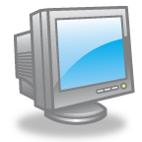
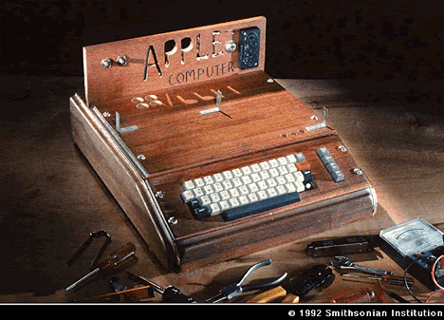
The Apple I Computer (1976)
Extras
It was far from the standard of a modern computer

Slide 24
Apple I To The Apple II
HP programmable
VW van
A local electronic shop owner immediately put in for an order of 50 computers.
Cash was so tight for ‘Apple’ that payment for the parts had to made on credit.
Even then personal sacrifices had to be made.
Wozniak`s friend: Ronald Wayne helped him assemble the computers in Wozniak`s living room.
Even this preassembly process the machine still required some assembly by the end customers.
Notes:
24

Slide 25
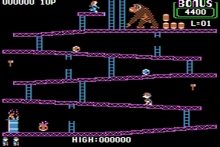
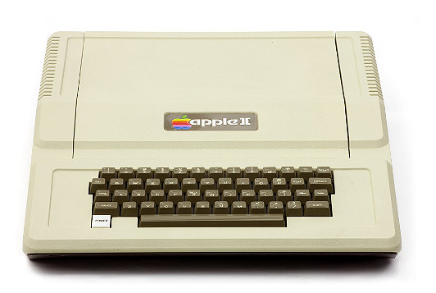
The Apple II Computer (1977)
Images
Apple II:
www.computerhistory.org
Donkey Kong: www.donkeykong.gamebub.com
It was a simpler and more powerful design than the Altair
The color graphics were superior to larger and more expensive computers
Strong selling points
  Name
  Appearance

Slide 26
The Apple II Computer (1977): 2
Images
Apple II:
www.computerhistory.org
Donkey Kong: www.donkeykong.gamebub.com
1 “Just for Fun” (Chapters 2,3) by Torvalds and Diamond
The storage device was primitive by today’s standards but actually sufficient to meet the needs of the time
VisiCalc: “It was the software tail that wagged the hardware dog”¹

Slide 27
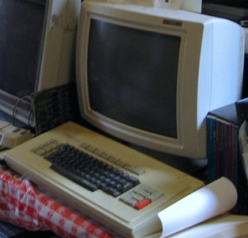
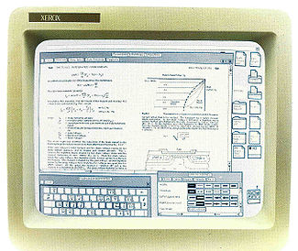
First Graphical Interface
Image of Xerox Star screen from Xerox brochure
Xerox star hardware picture: www.flickr.com/photos/mwichary
Contrary to popular belief it was not invented by Apple.
Xerox star: pioneered the GUI (graphical user interface) in 1981:
  Other GUI-based computers: Apple {Lisa (1983), McIntosh (1984)}, the Commodore Amiga 1000 (1985).
  Although it was a technical innovation the Star was regarded as a business failure.
  It was Apple (and others such as Commodore) who successfully mass marketed a GUI-based computer.

Slide 28
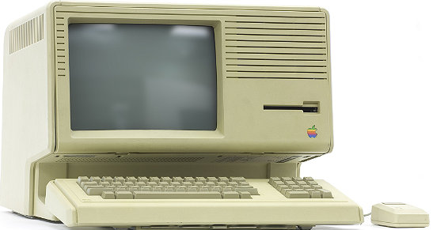
The Apple Lisa (1983)
Image © Mark Richards from www.computerhistory.org
Unlike other Apple computers which were text-based, this one would employ a GUI.
  It was inspired by a tour of the Xerox PARC (Palo Alto Research Center) laboratories.
    It cost $1 million in Apple stock for a 3 day tour of Xerox.
    It was a failure but laid the ground work for the successful Macintosh.
      The Lisa (1983) incorporated many of the features of the Xerox Star.
      Like the Star it was expensive ($10K) and sales were weak

Slide 29
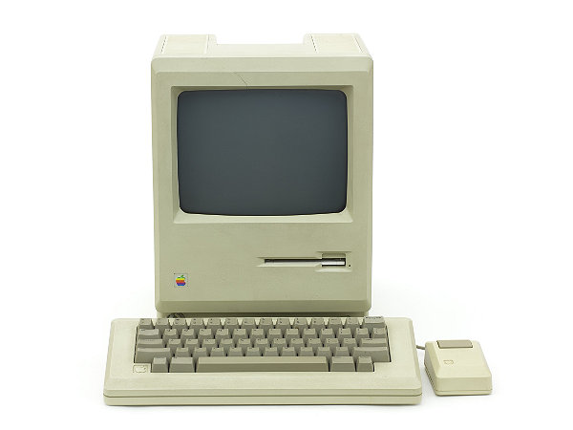
The Apple Macintosh (1984)
Image © Mark Richards from www.computerhistory.org
Apple’s next computer was the Macintosh
It incorporated the best features of the Lisa but was sold at a substantially lower price ~$2.4K
Compared to the IBM-PC it was a price/performance vs. ease of use tradeoff

Slide 30
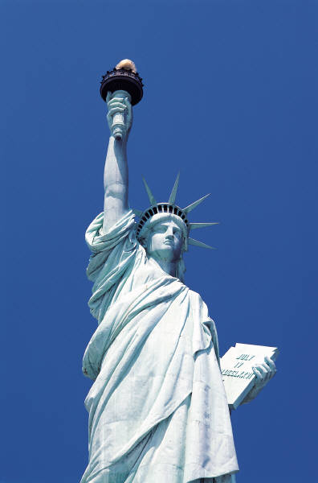
Origins Of The Internet
What was happening in the 1950s
The major powers of the cold War
Image Credit: Microsoft

Slide 31
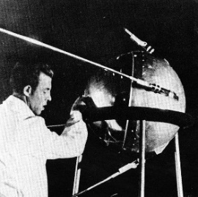
The Cold War And The Space Race
http://astroprofspage.com
At the same time that each side (USSR-USA) was trying to be dominant on the ground they also wanted to be dominant in space.
Both sides tried to be the first to send a satellite into space.
In the 1950s it appeared that the USSR had a technological edge:
  Americans in 1957: A sophisticated three stage rocket was planned as the first human-made vehicle to be spent into space.
  The USSR in 1957: surprised the world by launching Sputnik I (first artificial satellite).
  The launch of Sputnik helped motivate the creation of ARPA (Advanced Research Projects Agency) in the US.
Notes:
31

Slide 32
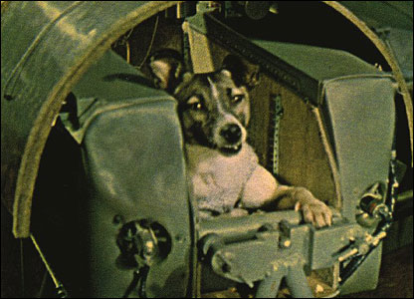
The Cold War And The Space Race (2)
Later in 1957 the USSR launched another satellite carrying the dog Laika “bark/barker” on a one way trip into space :’(
http://news.bbc.co.uk

Slide 33
The Cold War And The Space Race (3)
These events shook the US image as a technological super power (who had a technological lead in the Cold War).
  It was believed that if the Soviets could launch artificial satellites into space they could launch nuclear armed missiles at North America.
  It was believed that the math and science requirements would have to be revamped in high school (so the Americans could out think their Soviet counterparts).
  “…for your own sake and for the sake of the nation do your homework.” (apparently a quote from the Harvard president James Bryan Conant).¹
To close the perceived technological gap president Dwight Eisenhower brought together the best technological minds and ARPA (Advanced Research Projects Agency), an arm of the department of defense, was created.²
1 “The Ancient History of the Internet” (Edwin Diamond , Stephen Bates): American Heritage Pct 95: Vol. 46, Issue 6
2 “On the Way to the Web” (Michael A. Banks)

Slide 34
ARPA
As mentioned APRA was a branch of the ministry of defense.
The focus was on:
  Getting different types of computers communicating
It funded research at several universities across the US.
Size and mandate of ARPA:
  Very small: no physical labs
  It issued research and development contracts to other organizations.
1962: ARPA’s (then) director, Jack Ruina (focus on ballistic missile defense, nuclear test detonation) recruited JCR Licklider to work on “command and control, and behavioral sciences”

Slide 35
ARPA (2)
In the early days of ARPA there 3 separate and incompatible networks to communicate with the 3 different research centers that worked with ARPA.
Project Genie (University of California, Berkley)
Interface 1
System Development group (Santa Monica)
Interface 2
MULTICS project SHOPPING (Massachusetts Institute of Technology (MIT))
Interface 3
Image credits: Microsoft
1 “A History of the Internet and the Digital Future” (Johnny Ryan, Reaktion Books)

Slide 36
ARPANET
The first computers were connected via ARPANET (Advanced Research Projects Agency Network).
The initial ARPANET consisted of 2 host computers which were connected at the start of 1969 (birth of the early Internet!) from the following locations:
  UCLA
  Stanford
  A standard protocol was used so the computers could communicate
UCLA
Stanford
Notes:
36

Slide 37
ARPANET (2)
UCLA
U of Utah
U of California
Stanford
Later additional hosts were added to the network (end of 1969) from:
  The University of California (Santa Barbara)
  The University of Utah

Slide 38
The First Data Sent On The Internet¹
Originally the message ‘login’ was to be transmitted.
But the connection was lost and the transmission stopped after the first two characters were sent.
  …and thus ‘LO’ the Internet was born!
1 “On the Way to the Web” (Michael A. Banks, Wiley)

Slide 39
Important Milestones Of The Internet
In 1972
  The first "hot application” was introduced by Ray Tomlinson.
1989:
  The ideas behind the World Wide Web were first described in a paper.
1990:
  The ARPANET was shut down.
  The first “Internet” search program Archie was developed at McGill university.
  The first web browser was written.
1991:
  The World Wide Web was released to the public.

Slide 40
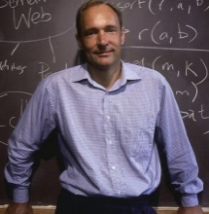
The History Of The World Wide Web
From www.computerhistory.org (2012)
Source http://www.w3.org/People/Berners-Lee/WorldWideWeb.html
Designed in 1989 by Tim Berners-Lee and scientists in Geneva who were interested in making it easier to share research documents.
Documents could be linked through a protocol called http (hyper text transfer protocol).
Documents were made available for free browsing and downloading from the web (substantially easier than the alternative).
1990:
  The first web browser “WorldWideWeb” (later renamed ‘Nexus’¹ was written.
1993:
  Mark Andreessen of NCSA (National Center for Super Computing Applications) launched Mosaic X the first popular web browser.

Slide 41
The History Of The World Wide Web (2)
From www.computerhistory.org
Prior to the advent of the WWW the Internet was largely used by a niche user group.
The advent of the WWW drastically changed that.
  Now some people even equate the World-Wide-Web with the Internet itself!

Slide 42
The Mouse
1962: ARPA (under JCR Licklider) provided a special fund to realize the vision of a “mechanically enhanced man”.
  It came out of a paper published by Licklider (before he joined ARPA) where he “…forecast a future that will involve a very close coupling between the human and electronic members of the [human-technology] partnership.”¹
Douglas Engelbart applied for funding.
1 “A History of Modern Computing” (Paul Ceruzzi: MIT Press 2003)

Slide 43
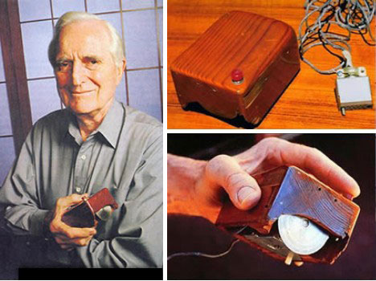
The Mouse (2)
Engelbart spent his time studying an experimenting with ways to improve communication between people and computers.
1967: he described (his most famous) invention, the mouse.
http://gajitz.com

Slide 44
You Should Now Know: History
How the invention of the microprocessor revolutionized computing
What was the first computer that was successfully targeted specifically for the home user
What was the influence of Microsoft on microcomputers
The history of the IBM-PC
The foundation of Apple Computers
The history of some of Apple's early computers: Apple I, Apple II, Lisa, Macintosh
How IBM lost control over a computer architecture that it developed through the rise of clone computers
How the rise of clone computers lead to the market dominance of Microsoft in the microcomputer market

Slide 45
You Should Now Know: History
What was the first GUI-driven computer: Xerox Star
The early history of the Internet
  When did it first become operational
  How it works
  What were some major milestones and when did they occur
  When was the WWW invented and who was behind its creation
Computer Mouse
  Who invented the device
  When was it invented
  What was the motivation for its creation

