Slide 1
VBA: Tutorial Week 5
Branching, looping and the InlineShapes collection
Option Explicit
Using the VBA debugger
Requirements for Workbook Exercise #5
Official resource for MS-Office products: https://support.office.com

Slide 2
First Tutorial: Monday Or Tuesday

Slide 3
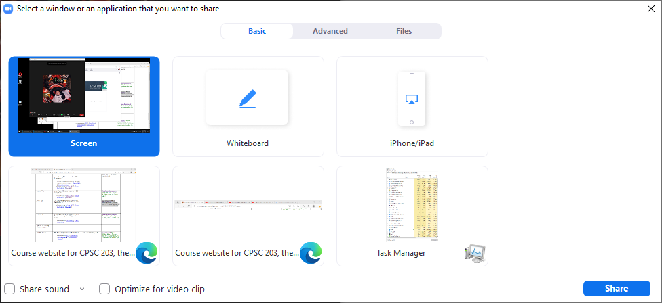
FYI For The Tutorial Instructor/TA
Since you will be playing a video with a voice narration make sure that you have enabled the “Share sound” option if you are using Zoom.
  You might want to use the pulldown (triangle) to ensure that audio is set to ‘stereo’ rather than ‘mono’.

Slide 4
Microsoft Introduction/Overview Of VBA
https://docs.microsoft.com/en-us/office/vba/library-reference/concepts/getting-started-with-vba-in-office

Slide 5
Activities In Tutorial
TA demos:
  Used for more complex features (typically multiple steps are required).
  The tutorial instructor will show on the projector/instructor computer each step for running the feature in Excel.
  Unless otherwise specified the tutorial material will take the form of a TA demonstrating the use of features in Excel.
  Slides titled “Lecture Review” are covered for the second time and dealing with less complex material.
    For this reason they will only be covered briefly in tutorial.
Student exercises:
  Used instead of TA demos for simpler features.
  You will have already been given a summary of how to invoke the feature and the purpose of the exercise is to give you a chance to try it out and get help if needed.

Slide 6
Return To Collections
Recall with the collections you have seen: Documents, InlineShapes, Shapes, Tables you can access a particular element or item in the collection by that item’s index.
  Example (accesses the first InlineShape): ActiveDocument.InlineShapes(1)
Also the number of items in the collection can be accessed through the collection’s count attribute.
  Example (the variable numTables will contain the current number of tables in the currently active Word document):
  numTables = ActiveDocument.Tables.count

Slide 7
Return To Collections (2)
Now that you have learned how to use looping and branching structures, you can:
  Access each item in a collection (using a loop).
  Check if the number of items in the collection is the desired amount (using a branch).

Slide 8
Collections: Inline Shapes
Example program: 1_loop_branch_inline_shapes
  For documents containing 2 - 4 InlineShapes (images) the program will halve the size of odd numbered images.
  Sub reduceOddInlineShapes()
  Const MIN_SHAPES As Long = 2
  Const MAX_SHAPES As Long = 4
  Dim count As Long
  Dim numShapes As Long
  Dim tempWidth As Long
  numShapes = ActiveDocument.InlineShapes.count
  If ((numShapes < MIN_SHAPES) Or (numShapes > MAX_SHAPES)) Then
  MsgBox ("Number of Inline Shapes not " & MIN_SHAPES & _
  "-" & MAX_SHAPES)

Slide 9
Collections: Inline Shapes (2)
  Else
  count = 1
  Do While (count <= numShapes)
  If ((count Mod 2) = 0) Then
  tempWidth = ActiveDocument.InlineShapes(count).Width / 2
  ActiveDocument.InlineShapes(count).Width = tempWidth
  End If
  count = count + 1
  Loop
  End If
  End Sub

Slide 10
Student Exercise 1
Write a program that will prompt the user for a positive integer value (1 or greater).
The program will then double the size of the item # of the Inline Shape in the currently active document.
Name of the document containing the solution: 1_enlarge_A_pic_solution

Slide 11
Student Exercise 4
Modify the solution to the previous exercise so that the program error checks the user’s input.
If the value enter by the user is less than 1 or it exceeds the current number of In line shapes in the document:
  The program will display an error message specifying the correct range of values that can be entered (it needs to be based on the actual number of shapes in the currently active document).
  The program will repeat the prompt until a value within the correct range has been entered.
Name of the document containing the solution: 2_enlarge_A_pic_solutionV2

Slide 12
Counting Occurrences Of A Word
It’s an application of the ‘Find’ method of the ActiveDocument object combined with looping.
Why count occurrences:
  Evaluating resumes by matching skills sought vs. skills listed by the applicant.
  Ranking the relevance of a paper vs. a search topic by the number of times that the topic is mentioned.
    Word frequency may be one criteria employed when websites rank search results according to relevance

Slide 13
Checking Occurrences
Word document containing the macro (actually it checks if word is or isn’t found rather than doing an actual count but a small modification will allow a count to be performed):
2_determine_if_word_occurs
  Sub checkingOccurence()
  Dim occurs As Boolean
  Dim searchWord As String
  searchWord = InputBox("Word to search for")
  occurs = False
  With ActiveDocument.Content.Find
  Do While .Execute(FindText:=searchWord, Forward:=True, _
  MatchWholeWord:=True) = True
  occurs = True 'Word was found change state
  Loop
  End With

Slide 14
Checking Occurrences
  True: search for exact word
  False: partial match counted e.g. when looking for ‘the’ words like ‘there’ are counted
  Search not started, assume Word not in document
Word document containing the macro (actually it checks if word is or isn’t found rather than doing an actual count but a small modification will allow a count to be performed):
2_determine_if_word_occurs
  Sub checkingOccurence()
  Dim occurs As Boolean
  Dim searchWord As String
  searchWord = InputBox("Word to search for")
  occurs = False
  With ActiveDocument.Content.Find
  Do While .Execute(FindText:=searchWord, Forward:=True, _
  MatchWholeWord:=True) = True
  occurs = True
  Loop
  End With
  Word to find in document
Body of Do-While entered when a match occurs (in this case can set variable to indicate that it’s true that word was found)

Slide 15
Checking Occurrences
Once the search is complete display the results of the search
  If (occurs = True) Then
  MsgBox ("'" & searchWord & "'" & " was found")
  Else
  MsgBox ("'" & searchWord & "'" & " could not be found")
  End If
  End Sub

Slide 16
Student Exercise 3
Modify the previous program. Instead of determining if the search word was or was not found have your program count the number of occurrences.
  A word should be counted if it’s a partial match e.g. when search for ‘the’ the words ‘the’, ‘their’, ‘they’re’ and ‘there’ should all be counted.
After the search is complete the number of occurrences should be displayed in a popup
Name of the document containing the solution: 3_count_occurences.docm
Example data used to test the correctness of your solution.
  Search for ‘the’, count should be 2
  Search for ‘at’, count should be 2
  Search for ‘t’, count should be 4

Slide 17
Exercise 3: Solution
  Sub countingOccurence()
  Dim occurrences As Long
  Dim searchWord As String
  searchWord = InputBox("Word to search for")
  occurrences = 0
  With ActiveDocument.Content.Find
  Do While .Execute(FindText:=searchWord, Forward:=True,
  _ MatchWholeWord:=False) = True
  occurrences = occurrences + 1
  Loop
  End With
  MsgBox ("'" & searchWord & "'" & " was found " &
  occurrences & " times.")
  End Sub

Slide 18

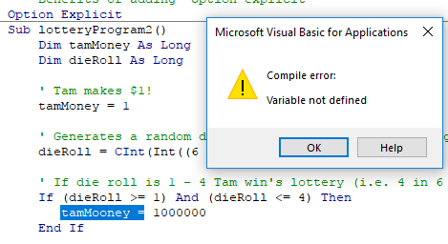
Option Explicit Used
Including ‘Option Explicit’ requires that variables must be created via ‘Dim’ variable declaration
  E.g. Dim tamMoney As Long
After creating/declaring the variable the memory location can be used by assigning a value into that location.
  E.g. tamMoney = 1
Advantage: helps catch bugs
  If you type in the wrong variable name if you use Option Explicit then VBA may tell you exactly where the error lies.
tamMoney
1

Slide 19
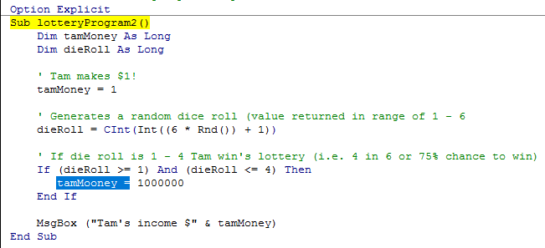
Example: Option Explicit Used
VBA will automatically catch the error and point out the location
Example: 3A_optionExplicitUsed.docm

Slide 20
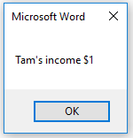
Example: Option Explicit Not Used
Example: 3B_optionExplicitNotUsed.docm
  Sub lotteryProgram2()
  Dim tamMoney As Long
  Dim dieRoll As Long
  tamMoney = 1
  dieRoll = CInt(Int((6 * Rnd()) + 1))
  If (dieRoll >= 1) And (dieRoll <= 4) Then
  tamMooney = 1000000
  End If
  MsgBox ("Tam's income $" & tamMoney)
  End Sub
The program erroneously set the wrong variable!
Tam didn’t get the “big bucks” ☹
Errors like this can be hard to catch/fix in all but smallest programs

Slide 21
A More Complex But Practical Example
Example: 4_set_fill_color_for_all_documents_in_a_folder.docm
  (The file name describes exact what this program does).
  Sub setFillAllFolderDocuments()
  Const ERROR_MESSAGE As String = "No shapes in document to
  fill"
  Dim location As String
  Dim currentDocumentName As String
  Dim fullname As String
  Dim currentShape As Long
  Dim numShapes As Long
  location = ""
  currentDocumentName = ""

Slide 22
A More Complex But Practical Example (2)
  'Check if user didn't enter any location
  Do While (location = "")
  location = InputBox("Enter path to Word documents " &
  _ "(e.g. C:\temp): ")
  If (location = "") Then
  MsgBox ("You entered '" & location & _
  "', don't enter an empty location")
  End If
  Loop

Slide 23
A More Complex But Practical Example (3)
  'Separator between last containing folder and filename
  location = location & "\"
  'Only consider and open Word (2003 or 2007+) documents
  currentDocumentName = Dir(location & "*.doc*")
  'Check if program is unable to find Word documents in location
  If (currentDocumentName = "") Then
  MsgBox ("Unable to retreive any docs in the " & _
  "specified location")

Slide 24
A More Complex But Practical Example (4)
  'Folder contains at least one Word document
  Else
  'Loop executes so long as there is another Word document
  'that hasn't already been accessed
  Do While (currentDocumentName <> "")
  fullname = location & currentDocumentName
  Documents.Open (fullname)
  numShapes = ActiveDocument.Shapes.Count
  'No shapes write error message
  If (numShapes = 0) Then
  Selection.Font.Bold = True
  Selection.Font.ColorIndex = wdRed
  Selection.Font.Size = 24
  Selection.TypeText (ERROR_MESSAGE)

Slide 25
A More Complex But Practical Example (5)
  'Document has shapes
  Else
  'Starting with first shape so long as there's another
  'shape in document repeat loop
  currentShape = 1
  Do While (currentShape <= numShapes)
  ActiveDocument.Shapes(currentShape).Fill.ForeColor =
  vbRed
  'Move onto next shape
  currentShape = currentShape + 1
  Loop 'Goes through each shape in current doc
  End If 'Checks if any shapes in current doc
  'Automatically save and close document, move onto next
  ActiveDocument.Close (wdSaveChanges)
  currentDocumentName = Dir
  Loop 'Goes through each Word doc
  End If 'Checks if any Word docs in folder

Slide 26
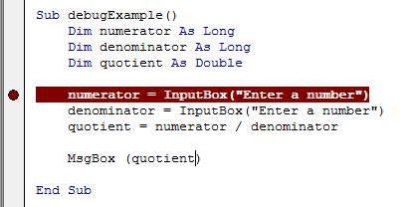
The VBA Debugger
Debuggers can be used to help find errors in your program
Setting up breakpoints
  Points in the program that will ‘pause’ until you proceed to the next step
  Useful in different situations
    The program ‘crashes’ but you don’t know where it is occurring
      Pause before the crash
    An incorrect result is produced but where is the calculation wrong
Set up breakpoints
  Click in the left margin

Slide 27
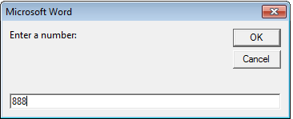
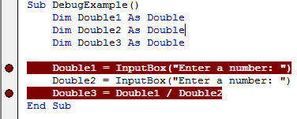
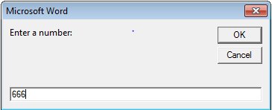
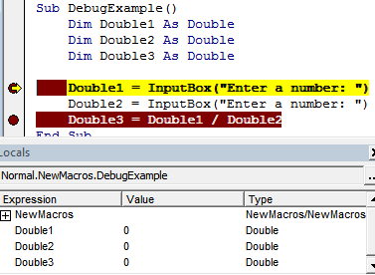
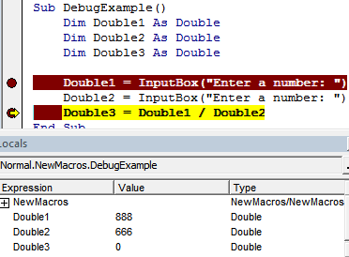
The VBA Debugger (2)
Multiple breakpoints
Program pauses when breakpoints are reached
  The contents of variables can be displayed at that point in the program

Slide 28
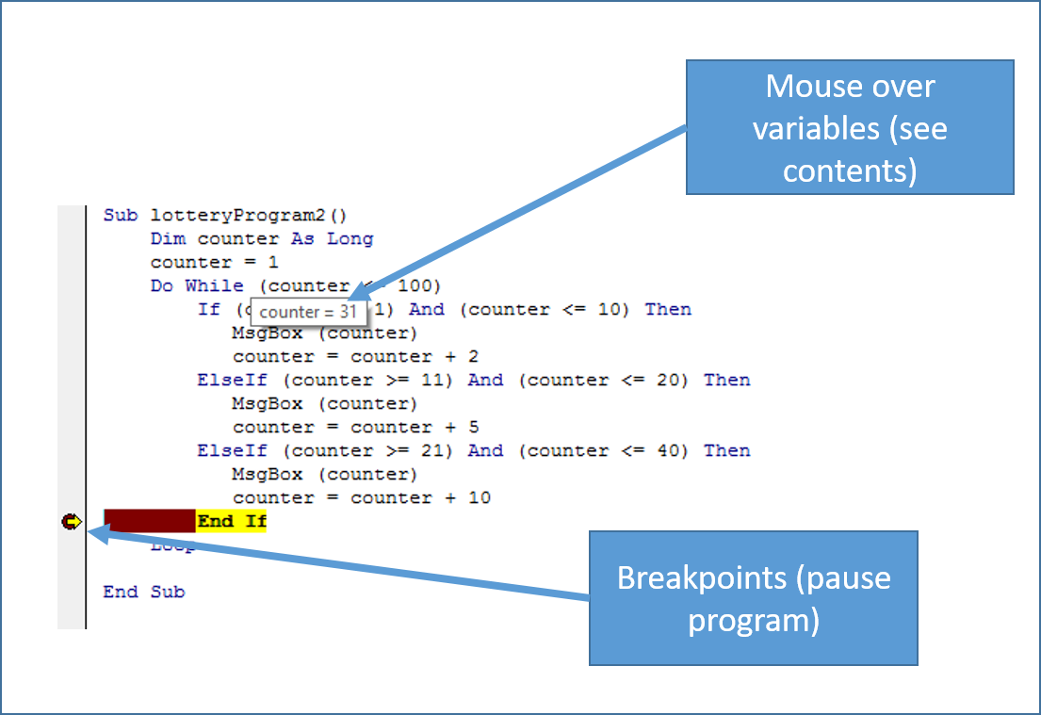
The VBA Debugger (3)
Combining breakpoints and viewing variables.

Slide 29
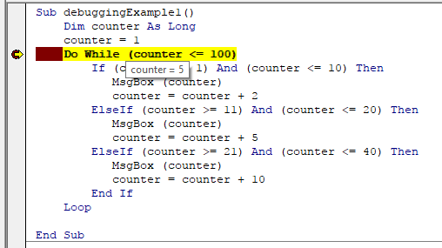
An Example To Run With The Debugger
Set up a breakpoint and trace through the program step-by-step while viewing the contents of the loop control during each iteration of the loop
Example: 5_debuggerExample.docm
  Sub: DebuggingExample1

Slide 30
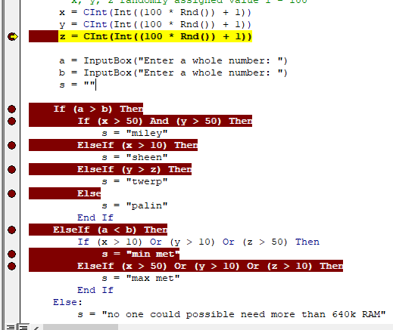
An Example To Run With The Debugger (2)
Program randomly assigns value into x, y, z (1 – 100)
Set up multiple breakpoints and mouse over variables at the breakpoints to view their contents.
This time x = 71, y = 54, z = 1
Which branches execute
What values will be assigned to the string ‘s’
Example (cont’): 5_debuggerExample.docm
  Sub: DebuggingExample2

Slide 31

Workbook Exercise #5: First Feature
Writes the hard-coded text "Total yearly visitors=" to cell E1 using the Cells or Range object.

Slide 32

Workbook Exercise #5: Second Feature
Correctly writes the total number yearly visits to Cell F1
  Requires Feature 3A to be correct for credit to be awarded because a loop is required step through the rows in order to perform the tally.

Slide 33
Workbook Exercise #5: Second Feature
Correctly writes the total number yearly visits to Cell F1
  Requires Feature 3A to be correct for credit to be awarded because a loop is required step through the rows in order to perform the tally.

Slide 34
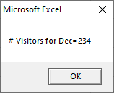
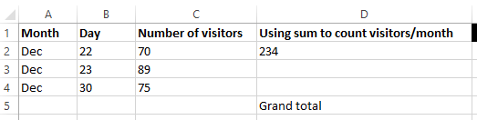
Workbook Exercise #5:Third Feature
Correctly counts the total number of visitors for each month and displays the count using a MsgBox.
  Example with the ‘2018’ worksheet active
  Feature 3A: Uses a loop to step through each non-empty row in the worksheet.
Not empty
Not empty
Empty
Not empty

Slide 35
Workbook Exercise #5:Third Feature (2)
Feature 3B: Uses a loop nested inside of the one written for Feature 3A to step through the visits for a month.
  This loop repeats the process (or reruns from start to end for each month where visits have occurred).
  In the starting spreadsheet the nested loop for Feature 3B will run 10 times from start to finish for the 10 months for the 2019 year and once for the 2018 year.
  The number of times the nested loop runs for each of those 10 months varies depending upon the number of entries for that month e.g. Jan. 2019 it runs 4 times, Feb. 2019 it runs twice.
  Obviously this feature requires Feature 3A (the code for the outer loop) to be complete and correct.
  An alternative (which can also be awarded full credit) to nesting a loop within a loop for 3B is to nest a branch within loop (there is a lecture example that shows branch nested in a loop).

Slide 36
Workbook Exercise #5:Third Feature (3)
Feature 3C: The nested loop from 3B (or nested branch) is used to count and display the visits for each month via popup MsgBox.
Obviously requires Feature 3B to be complete and correct.
  Example with the 2018 worksheet active.
The same information to be shown in the popups is the same as results from the Excel SUM function shown in Column 'D'.
  The information is shown in that column to help you check the results of your program.

Slide 37
Workbook Exercise #5: Video
Although this is a fairly simple exercise here is a run of my solution to the exercise in case you need it.
  https://pages.cpsc.ucalgary.ca/~tamj/2022/203W/assignments/workbook_exercise5/WB_EX5.mp4

Slide 38
Second Tutorial (Wednesday or Thursday)

Slide 39
Open Tutorial
No new teaching will occur but the TA will be available for help. During this "Open Tutorial"
Any CPSC 203 student can ask for help and not just the students who are registered in a particular tutorial.
The purpose is to provide extra help.

