Slide 1
VBA: Tutorial Week 4
A3 requirements & tips for success
Non-linear, non-sequential programming using loops
Nesting: branches and loops
Collaboration vs. misconduct
Official resource for MS-Office products: https://support.office.com

Slide 2
First Tutorial (Monday or Tuesday): A3

Slide 3
CPSC 203: A3
This is your first ‘real’ program writing assignment so you should not under estimate the time and effort required by typical students.
Here’s some “tips for success” that are given to students who are first learning how to write programs (exert from CPSC 217 and CPSC 231)
  Practice things yourself
  Make sure that you keep up with the material
    Study concepts as soon as possible after class
    If you fall behind more than 1 or 2 weeks without studying then you may not be able to catch up! ☹
  Start working on things early

Slide 4
A3: Feature #1
Prompt the user for a word to find in a document(s).
If Feature #6 is implemented the same word will be ‘found’ by the program in each document opened by your program.

Slide 5
A3: Feature #2
Count the number of instances of the word (from Feature #1) using the appropriate parts of the ActiveDocument object.
Not case sensitive.
Partial matches are counted.

Slide 6
A3: Feature #3
Display the count of the instances via a MsgBox in the following form. "Number occurrences: <actual number of occurrences of the search word>"
  e.g. Number occurrences: 2

Slide 7
A3: Feature #4
Write information about the number of instances into the currently active Word document using the appropriate parts of the Selection object.
(If Feature #6 is implemented then this information would be written into the respective document in which the count was being conducted).

Slide 8
A3: Feature #4 (2)
Format of the written text:
  The text written should take the form: "Number occurrences: <actual number of occurrences of the search word>"
    e.g. Number occurrences: 2
  This text should appear on its own line i.e. it should be preceded by "a hard return" or a VBA carriage return "vbCr".
  The text appears at the end of the document ("end of story").
  If the search word (entered with Feature #1) appears two times or more then the text (from Feature #4a) to be written (Feature 4a) is colored red. Credit will be awarded if the text is colored under the correct condition.
  If the search word appears three or more times then the text to be written (from Feature #4a) is also bolded. Credit will be awarded if the text is bolded under the correct condition.

Slide 9
A3: Feature #5
Double the size (both the height and width change so the proportions of height to size remains the same) of each image (in VBA "InLineShapes" in the document.
If the document doesn't contain any images then a MsgBox will appear with the message "No images to modify".

Slide 10
A3: #Feature #6
Program runs Features 2 - 5 on all the Word documents at a location specified by the user.
Features #2-5 are contained in the body of a loop defined for Feature #6.
  Feature #1 runs only once, the program searches for the same word for all Word documents.

Slide 11
A3: Parts Of Feature #6
Prompt the user for the location of the Word documents using an InputBox e.g. e.g. "C:\203".
  The program should not require that the user enters a slash after the name of the last folder (in this example the containing folder is '203') because your VBA program will automatically add it to the end before trying to open any documents.
If the user enters an empty location the program will display a MsgBox that contains the message "No location entered, ending program" and then the program will end.
If the location is not empty then the program will successively open each Word document the at that location using the appropriate parts of the Documents collection.

Slide 12
A3: Parts Of Feature #6 (2)
The program must not only open just Word documents but only open certain types of Word documents:
  older Word 97-2003 (.doc) documents,
  newer Word 2007+ (.docx) documents,
  macro enabled documents (.docm).
After opening each Word document the program will apply Features 2 - 5 on each document.

Slide 13
A3: Documentation Requirements
Contact information: your full name as provided to the university (make sure it matches, don't include 'nicknames'), student identification number, tutorial number.
Specifying clearly what features of the assignment that you completed or didn't complete. In order to get credit the documentation has to be clear and complete.

Slide 14
A3: Style Requirements
Each level of code indenting is consistently 1 tab.
  Instructions in the sub-routine (between the 'sub' and 'end-sub' is 1 level.
  The body of IF or WHILE structures counts as another level of indenting.
  A tab is used for each level of indenting
Example:
  Sub exampleIndenting()
  Do while()
  If () then
  if () then
  End if
  else
  End if
  Loop
  End sub

Slide 15
A3: Style Requirements (2)
Good naming conventions (e.g. variables, sub-routines, the name of Word document containing the VBA program and constants if applicable) are followed. Some examples of naming conventions are provided in [the VBA Part I notes].
  https://pages.cpsc.ucalgary.ca/~tamj/2022/203W/notes/pdf/vba_part1.pdf

Slide 16
First Tutorial (Monday or Tuesday): Programming Constructs

Slide 17
Microsoft Introduction/Overview Of VBA
https://docs.microsoft.com/en-us/office/vba/library-reference/concepts/getting-started-with-vba-in-office

Slide 18
Activities In Tutorial
TA demos:
  Used for more complex features (typically multiple steps are required).
  The tutorial instructor will show on the projector/instructor computer each step for running the feature in Excel.
  Unless otherwise specified the tutorial material will take the form of a TA demonstrating the use of features in Excel.
  Slides titled “Lecture Review” are covered for the second time and dealing with less complex material.
    For this reason they will only be covered briefly in tutorial.
Student exercises:
  Used instead of TA demos for simpler features.
  You will have already been given a summary of how to invoke the feature and the purpose of the exercise is to give you a chance to try it out and get help if needed.

Slide 19
Looping/Repetition
Used when a part (or the entire) program needs to repeat as long a condition has been met.
The condition is a Boolean expression.
START
Do while (Condition)
Instruction(s)
Loop
Run game
Y
Play again?
N
END GAME

Slide 20
Example: Counting Program (Up/Increases)
Name of the document containing example: 4loopV1Up
Features:
  The program will iterate (count) through the sequence of numbers 1 – 11 in increments of 2 (1, 3, 5, 7, 9, 11)
  Sub countingLoopV1Up()
  Dim i As Long
  i = 1
  Do While (i <= 11)
  MsgBox ("i=" & i)
  i = i + 2
  Loop
  End Sub
  Student exercise: what if the Boolean expression was changed to (i <= 10)?

Slide 21
Example: Counting Program (Down/Decreases)
Name of the document containing example: 5countingloopV2Down
Features:
  The program will iterate (count) through the sequence of numbers 10 – 1 in decrements of 3 (10, 7, 4, 1)
  Sub nineLoopV2()
  Dim i As Long
  i = 10
  Do While (i >= 1)
  MsgBox ("i=" & i)
  i = i - 3
  Loop
  End Sub
  Student exercise: what if the Boolean expression was changed to (i >= 0)?

Slide 22
Student Exercise
Write a program that will, using a loop, display all the multiples of 5 in the range from 5 – 15,625.
The program will display each multiple of 5 within this range in a MsgBox one-at-a-time.
Document containing the solution: 2multiples_of_five_solution

Slide 23
Second Tutorial (Wednesday or Thursday)

Slide 24
Nesting: Branches And Loop
Branches and loops can be nested within each other
  Scenario 1
  If (Boolean) then
  If (Boolean) then
  ...
  End if
  End if
  Scenario 2 Scenario 3
  Do while (Boolean) If (Boolean) then
  If (Boolean) then Do while (Boolean)
  ... ...
  End if Loop
  Loop End if

Slide 25
Recognizing When Nesting Is Needed
Scenario 1: Only if a question answers true then check if another question answers true or false.
  Example: If the user entered Canada as country of residence then ask if the user’s province of residence is Alberta.
  Type of nesting: a IF-branch
  nested inside of an IF-branch
    If (Boolean) then
    If (Boolean)
    ...
    End If
    End If
Q:Canadian?
F
T
Residence is CA
Q: Albertan?
F
T
Residence also AB
Done

Slide 26
(Key Part: IF) Nested Inside An IF
Nesting: a structure (e.g. IF) is nested inside of another structure (e.g. IF) when the second structure is part of the body of the first structure.
Word document containing the example: 6nesting_branch_within_branch
  'Some parts excluded for brevity.
  country = InputBox("Current country of residence: ")
  If (country = "Canada") Then
  message = message & "Great country, "
  province = InputBox("Current province of residence: ")
  If (province = "AB") Then
  message = message & " Greatest place on earth ^-*"
  End If 'Checking province
  End If 'Checking country
Recall: the check for the Boolean expression for the second IF does not occur unless the first Boolean expression is true. (Don’t bother checking if province is AB if country isn’t Canada).

Slide 27
Recognizing When Nesting Is Needed
F
Scenario 2: If a question answers true then check if a process should be repeated.
  Example: If the user entered an odd number then count through a sequence 1 to this number and display each odd number in this sequence.
  Type of nesting: a Do-While loop nested inside of an IF-branch
    If (Boolean) then
    Do While (Boolean)
    ...
    Loop
    End If
Q:Odd #?
T
Q: Not yet exceeded last #?
F
T
Display current #
Increment to next odd #
Done

Slide 28
(Key Part: Do-While) Nested Inside An IF
Word document containing the example: 7nesting_loop_in_branch
'Variable & constant declaration excluded for brevity
lastOdd = InputBox("Enter last odd number in sequence: ")
remainder = lastOdd Mod 2
If (remainder = 0) Then
MsgBox (lastOdd & " is even not odd.")
Else
If (lastOdd <= MAX_ODD) Then
count = 1
Do While (count <= lastOdd)
MsgBox ("Current number = " & count)
count = count + 2
Loop
End If 'End: checks size of last #
End If 'End: checks if # is odd or even

Slide 29
Recognizing When Nesting Is Needed
Q: As last # not exceeded?
Scenario 3: As long some condition is met a question will be asked. As long as some condition is met a popup will be displayed.
  Example: While the last number in a sequence hasn’t been exceeded if the current number is even it will be displayed.
  Type of nesting: an IF-branch nested inside of a Do-While loop
  Do While (Boolean)
    If (Boolean) then
    ...
    End If
    Loop
F
T
Q: Even?
F
T
Display #
Increment to next #
Done

Slide 30
(Key Part: IF Nested) Inside A Do-While
Word document containing the example: 8nesting_branch_in_loop
  Const MAX_NUMBER As Long = 20
  Dim lastNumber As Long
  Dim count As Long
  Dim remainder As Long
  lastNumber = InputBox("Enter last number in a sequence: ")
  If (lastNumber <= MAX_NUMBER) Then
  count = 1
  Do While (count <= lastNumber)
  remainder = count Mod 2
  If (remainder = 0) Then
  MsgBox ("Current even #: " & count)
  End If
  count = count + 1
  Loop
  End If

Slide 31
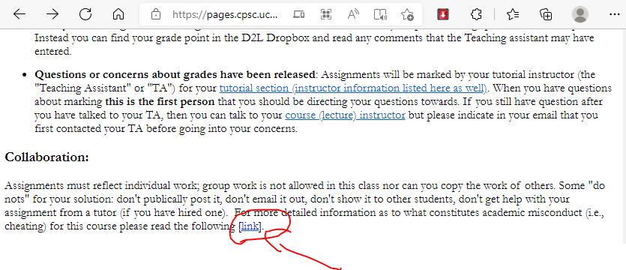
Collaboration Vs. Misconduct
There’s a link to additional details in every assignment and exercise description.
Web address:
  https://pages.cpsc.ucalgary.ca/~tamj/2022/203W/assignments/misconduct.html

Slide 32
Avoiding Misconduct
Some "do nots" for your solution: don't publically post it, don't email it out, don't show it to other students, don't get help with your assignment from a tutor (if you have hired one).
You cannot copy the work of other students nor can students work in groups. To avoid potential cases of misconduct students should not show or otherwise provide their assignment solutions to their classmates.

Slide 33
What Is Academic Misconduct?
Cheating has occurred if you hand in someone else's work as if it were your own (without crediting the other person).
If a student knowingly provides his or her graded work to another student then both students are guilty of academic misconduct (the first student helped the second student to cheat).

Slide 34
What Happens If I Cite My Sources
You are required to cite all sources including lecture and tutorial notes (if applicable). If you don't cite the source then you have made the strong implication that this work is yours when it isn't so you will be guilty of academic misconduct.
What happens if you include someone else's work and you do credit the other person properly (this doesn't apply to your classmates, recall that you are not to see the assignment work of other students).
This won’t count as cheating but since someone else did the work for that section of your assignment you won't get credit for that part of the assignment.
  You could get marks for the other parts of the assignment.
  The crediting of other's people work must be very specific and clear because your marker needs to be able to unambiguously determine which parts of your assignment did you complete and which parts came from an outside source.

Slide 35
How To Cite Your Sources
The format of the citation isn’t what’s important.
Instead you should focus on clearly communicating to your marker exactly what parts of your submission that you completed and what parts come from external sources.
  If there is no citation then the assumption is that you are the sole source.
One approach: use the “sandwich method”

Slide 36
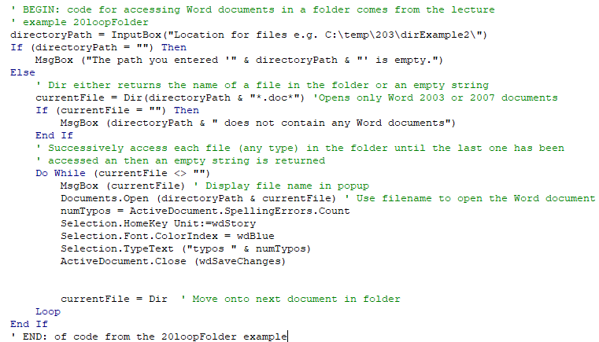
Example Of Sandwiching Your Citation
Start of citation
Sandwiched code from an external source
End of citation
All external code is sandwiched.
Any code outside of a sandwich is assumed to be written by the student (make sure this is ac

Slide 37
What If You Hired A Tutor?
Can I get help on an assignment from this person?
Tutors can be useful helping to clarify concepts (e.g. what is 'loop' in programming) or showing you where to find features in Office or how they work. The problem with going over an assignment with a tutor is that the 'help' ends up with the tutor completing some or all of the assignment for you.
This is similar to getting a solution from a class mate because you didn't do the work so it is likely that it will be ruled as academic misconduct.

Slide 38
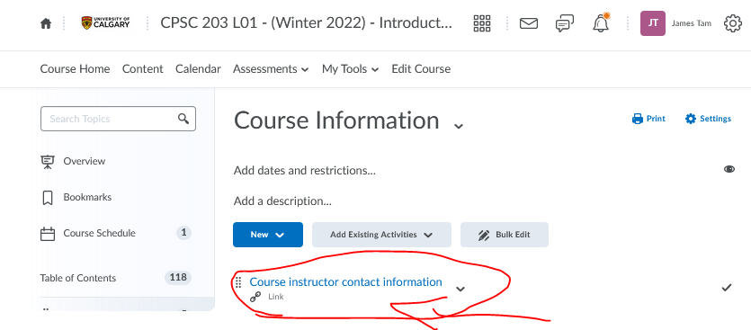
What If We Have Questions About What’s Allowed?
Normally you can ask the Teaching Assistants questions.
If you have questions about what’s allowed and not allowed in terms of misconduct then you should ask the course instructor rather than the TA.
  Link to the contact times/information for the course instructor in D2L:

