Slide 1
Word Processing Using Word
Common and useful features: inserting things into a document, formatting text through text styles and the format painter, finding text in a document, tables and formulas
References: table of contents, bibliographies, citations, captions, footnotes and endnotes
Mail merge
Collaboration tools
Help with MS-Office products: https://support.office.com/

Slide 2
What You Already Know (Some Features Of Word)
Starting Word / Quitting Word
Creating a new document
Entering, deleting text along with simple edits
Copy/cut pasting of text
Saving a document
Spell checking a document
Printing documents
Etc.
For more information for catching up see the notes:
  “Assumed student knowledge of Word” (Jan 9 – 15 of lecture schedule)

Slide 3
Additional Resources For MS-Word
Basics (also includes some more advanced features)
    https://support.office.com/en-us/article/create-a-document-in-word-2016-aafc163a-3a06-45a9-b451-cb7250dcbaa1
Research, edit, and design (e.g. styles and themes)
  https://support.office.com/en-us/article/research-edit-and-design-in-word-2016-bc819ecd-9887-4a15-8eda-d90cbc58f8fb
Collaborating using Word
  https://support.office.com/en-us/article/collaborate-in-word-2016-b3d7f2af-c6e9-46e7-96a7-dabda4423dd7
Training videos
  https://support.office.com/en-us/article/word-for-windows-training-7bcd85e6-2c3d-4c3c-a2a5-5ed8847eae73?ui=en-US&rs=en-US&ad=US
MAC help (recall though this is not a MAC-specific course but we provide what help we can)
  https://support.office.com/en-us/article/word-2016-for-mac-help-c3292414-89c0-46e5-82a7-d55a1720f3bd

Slide 4
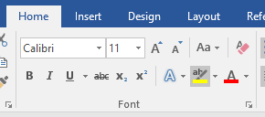
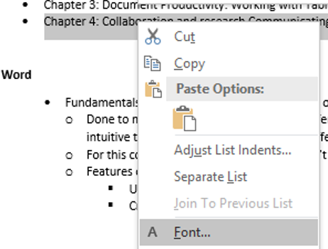
MS-Office
There’s different ways of completing the same task
  Alternatives make things easier for the user (different people may find one way more intuitive than another) e.g. fonts and font effects
  Example: choosing fonts and font effects
For this course and in “real life” one way isn’t better than another (just learn *a* way that works)

Slide 5
Exam Questions
Assignments will require you to invoke different features of Word
  So you will learn how/where to run those features
Exams: because they will be on paper and not in front of the computer
  The focus will be on how different features of Word work over “where you have to click” in order to run those features.
  Sample exam question (relatively easy): Refer to the line of text “The cat in the cat”. The entire line is selected and the bold toggle feature is run (e.g. selecting the feature in the ribbon or by right clicking on the text etc.). What is the result?
    ‘Cat’ is bolded
    ‘Cat’ is unbolded
    The entire line is bolded
    The entire line is unbolded

Slide 6
Inserting Page Breaks
Insert->Page Break
Moves text after the page break to the top of the next page
This is not the same as a hard return (hitting the ‘enter’) key

Slide 7
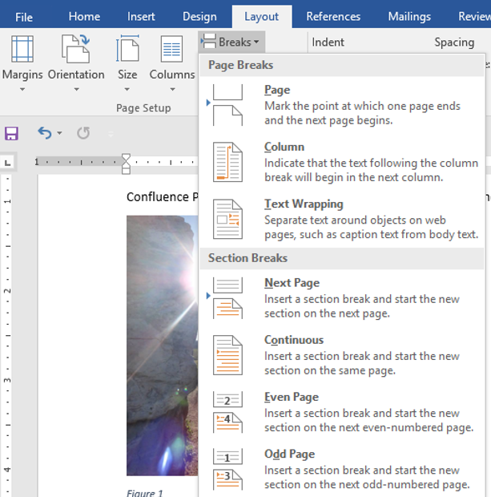
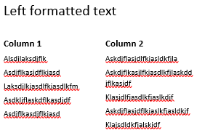
Inserting A Section Break
Sections in a document can have different formatting applied or have it’s own sequence of page numbering
Sections can be on different pages or reside on the same page.
(Section breaks are actually not ‘inserted’ into a Word document).
  Change layout
Section on different page
  Layout->Breaks->Next page
Section on same page
  Layout->Breaks->Continuous

Slide 8
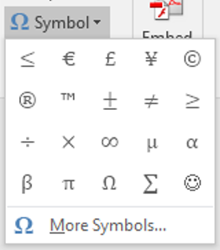
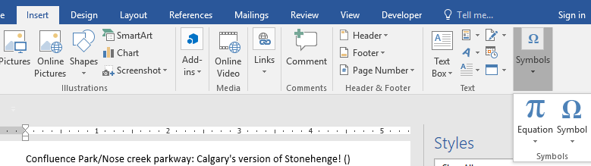
Insertions: Symbols & Equations
A useful time saver:
  Symbols
    Insert->(Symbols group: Symbols)
  Equations
    Insert->(Symbols group: Equations)
Notes:
Time saver: lists ones that it thinks you will use (ones that you last used or if none used it’s based on popularity)

Slide 9
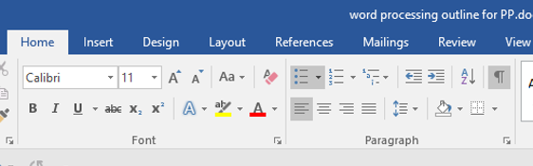
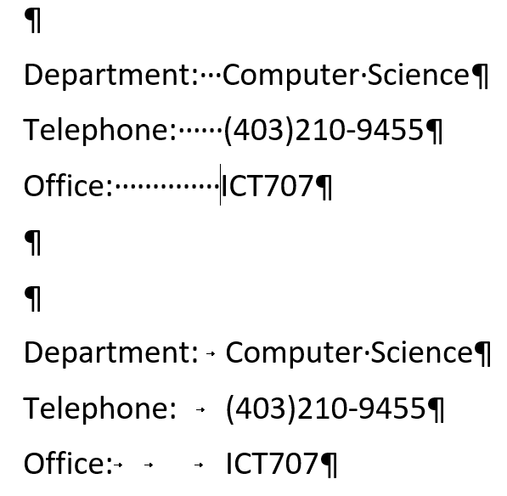
Show/Hide Formatting Symbols
Some characters (e.g. formatting) affect formatting but have no visible appearance (e.g. space, tab etc.)
Formatting symbols (tabs vs. spaces)
View formatting symbols

Slide 10
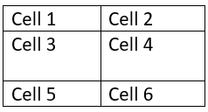
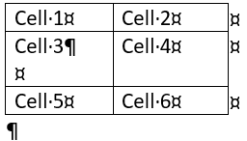
Sometimes Seeing Formatting Symbols Can Be Useful
Why can’t Row 2 resize

Slide 11
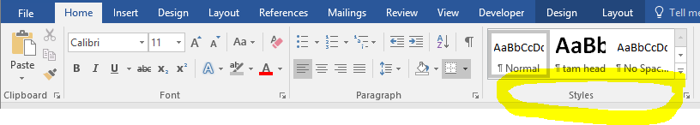
Text Styles
Home->(‘Styles’ group)
Styles have pre-defined fonts, font sizes and font effects which can be applied with a single click.
Word comes with pre-defined styles that can be applied to text.
New styles can also be pre-defined
Some documents may be formatted (e.g. margins, spacing, fonts, font effects etc.) to conform to common writing styles:
  APA template:
    https://templates.office.com/en-US/APA-style-report-6th-edition-TM03982351

Slide 12
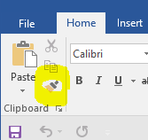
The Format Painter
A shortcut to using styles is the format painter (copy-paste formatting)
  Home->Clipboard group: Format painter

Slide 13
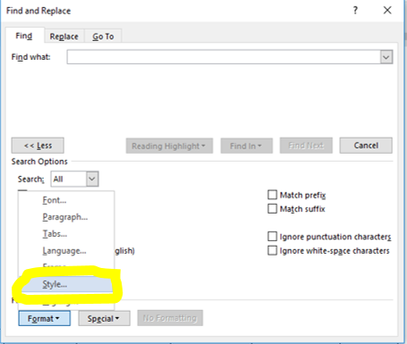
Finding Text In A Document
This is one of the major advantage for having an electronic instead of a paper copy.
  Example: “Where in this giant section of notes did Tam talk about ‘inserting’ things into Word”
Shortcut:
  <Ctrl>-<f> Press both keys (same time or one after another without releasing the first)
  Home->Editing group: Find (or Replace)
  Styles can even be ‘found’ and replaced

Slide 14
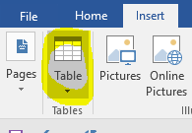
Working With Tables (Basics Are Assumed Knowledge)
Creating a new table
  Insert->Table
Tables in Word allow for simple (simple as compared to a spreadsheet such as Excel) calculations to be performed
  Layout (new tab on far right)->(Data group: formula)

Slide 15
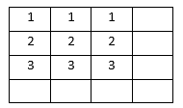
Table Formulas To Know For The Exam
Average(<direction>)
Max(<direction>)
Min(<direction>)
Sum(<direction>)
Directions: above, below, left, right
Example (created via: Layout->(Data group: Formula) & inserting into Row 4, Column 1):
Inserted formula
=sum(left)
Inserted formula
=average(above)
Notes:
=average(above) = (1+2+3)/3 = 2
=sum(left) = 3+3+3 = 9

Slide 16


Note: Inserting Formulas Via Running a Feature In The Ribbon Vs. Typing
With the previous example and the data in the first three rows:
Selecting the 4th row and directly typing in there ‘=sum(above)’ will have the result be treated as text and yield:

Slide 17
Sub-Section: References
Table of contents
Bibliography
Citations
Captions
Foot/end notes

Slide 18
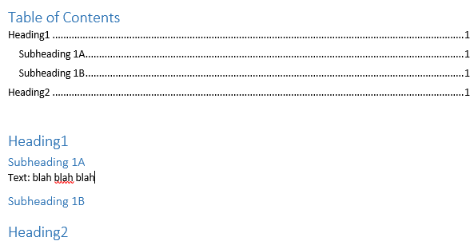
Table Of Contents (What You Need Before Inserting One)
The ‘Heading’ styles must be used (or a new style created that is derived from either Heading 1, Heading 2 or Heading 3).
That is because the headings (and sub headings) in the document will be used to form the table of contents.

Slide 19
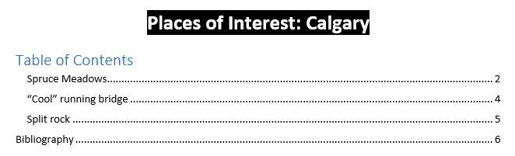
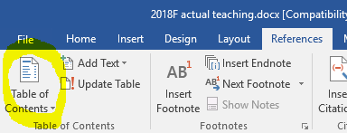
Table Of Contents
In Word
  References->Table of Contents->(Select the type of table: For A1 it’s “Automatic Table 2”)

Slide 20
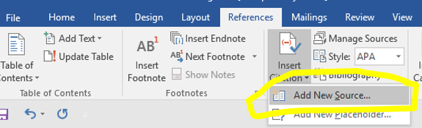
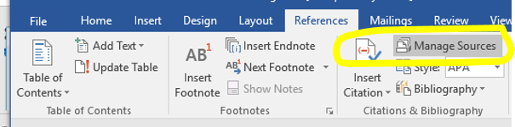
Citation
Step 1: Create the citation (enter information regarding the source or ‘citation’)
  Creating citation in Word:
    References->Insert Citation->Add New Source
  (If you need to change the citation later):
    References->Insert Citation->Manage Sources->Select the citation->Edit

Slide 21
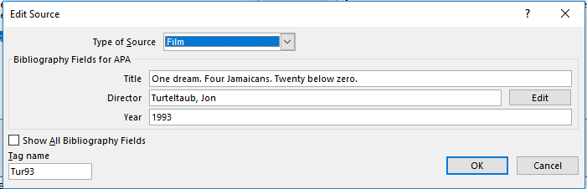
Step 1: Create the citation (2)
Step 1: Create the citation (continued)
  Entering the information for the (source of the) citation e.g. “Film”

Slide 22
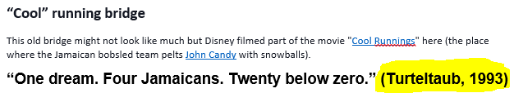
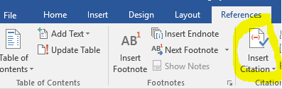
Citation (2)
Step 2: Using or referring to the citation
  Navigate to the location in Word where the citation will be located
  Insert the citation at that location:
    References->Insert Citation->(Select the citation source from the list)

Slide 23
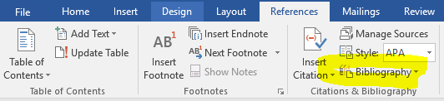
Bibliography
The above bibliography was created from the previous citation.
In Word
  For A1: References->Bibliography->(Select Bibliography)

Slide 24
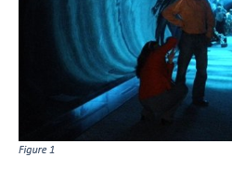
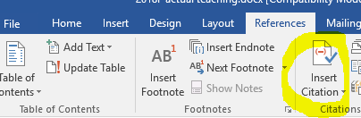
(Image) Captions
Via the Word Ribbon:
  References->Insertion Caption

Slide 25
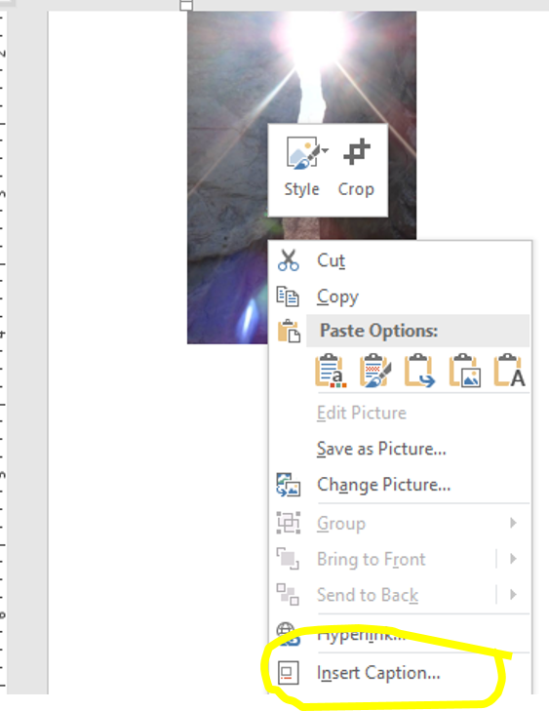
(Image) Captions (2)
Via Right-click in Word
  Select image
  Right click
  Select “Insertion caption”

Slide 26
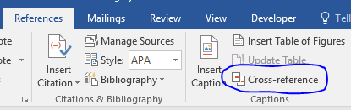
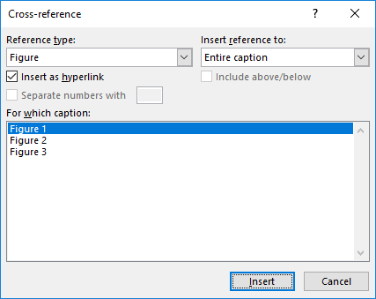
Cross References
Text that refers to items in the document such as figures and tables.
  Don’t just “type in” this text. (Why not?)
Step 1: Caption the image (previous slide)
Step 2: Insert the caption that refers to the image
    References->Cross Reference->(Select the type of reference: Figure)->(Select the figure being referenced)

Slide 27
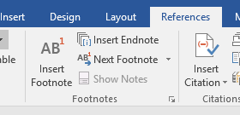
Footnotes And Endnotes
Footnote
  Appear at the end of the page
  Step 1: Navigate to the location where the footnote will appear
  Step 2: References->Insert Footnote
  Step 3: Enter the information for the footnote (appears at bottom of page)
Endnote
  Appear at the end of the document
  Step 2: References->Insert Endnote
  All other steps are the same

Slide 28
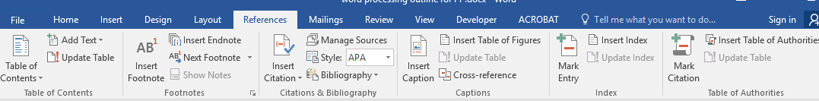
Automatically Generating References & Captions (Word)
Q: Why not just type them in manually?
No credit will be earned for the assignment if you manually type in information such as a table of contents or figure captions.
Notes:
Why not just type them in manually?
Consider if changes must be made
Add new sections in a document (table of contents must be updated)
Although not required for A1 consider also if cross references were used.
A new image for a figure and a caption is added in the middle of a document (other captions may have text that refer to the particular figure and figure number).

Slide 29
Recap Of This Section: Things You Should Now Know
How to run (although not for the exam) the following features of Word as well as how they work (know for the exam)
  Inserting a table of contents
  Creating new citations, inserting citations
  Creating a bibliography from citations
  Inserting image captions, creating cross references
  Inserting footnotes and endnotes

Slide 30
Sub-Section: Mail Merge

Slide 31
Mail Merge: How It Works
Combines information from a main document (a Word document sometimes referred to as the ‘starting document’) with a data source (e.g. Excel spreadsheet, Access database sometimes referred to as the ‘recipients’ list).
The information specified in the main document stays the same (e.g. a form letter) whereas the data source provides the customized information.
Example customizations (non-exhaustive list):
  Letters & emails
  Envelopes
  Labels

Slide 32
Mail Merge
MAC users caution: It appears that the mail merge feature is implemented in a different fashion.

Slide 33
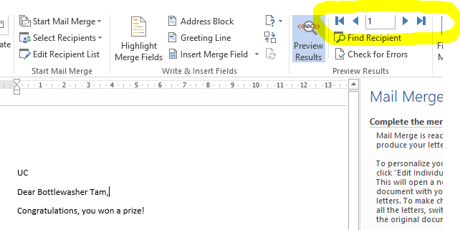
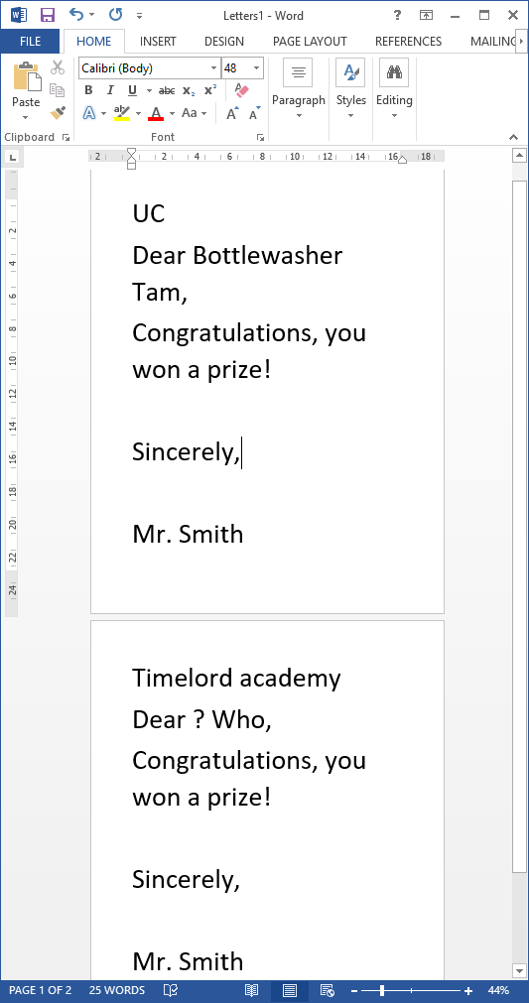
Mail Merge:
Example:
  Folder name: mail_merge_example
  Starting files in the folder:
    starting_recipient_list (Excel file)
    starting_letter (Word document)
  Products of the merge in the folder:
    merged_letter (you can “click through” (preview) the merged letters, this is how you should do it for the assignment in order to be awarded credit).
    step6_completed_merged_letters (you can see the results of the mail merge in a single printable Word document but because these results could have created with out a mail merge you won’t be awarded credit if you submit this for the assignment).
merged_letter
step6_completed
_merged_letters

Slide 34
Example Mail Merge Process
Main document
Merged document (don’t submit this for the assignment)
<< Address >>
Dear <<Name>>,
Congratulations, you won a prize!
Sincerely,
Mr. Smith
U of C
Dear Bottlewasher Tam,
Congratulations you won a prize!
Sincerely,
Mr. Smith
Galifrey
Dear ? Who,
Congratulations you won a prize!
Sincerely,
Mr. Smith
Data source
Title | Last name | Last name | Address
Bottlewasher | James | Tam | U of C
? | Dr. | Who | Galifrey
 | … | … | …

Slide 35
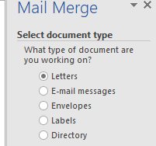
Mail Merge: Step 1 (Document Type)
Determine the type of main document needed (A1 = ‘letter’)
The easiest approach when first learning how to do it is to use the Mail merge wizard
  Mailings->Start Mail Merge->Step-By-Step Mail Merge Wizard
  (In the right hand side of the Window select the type of document):
  Click ‘next’ to create or select the main document

Slide 36
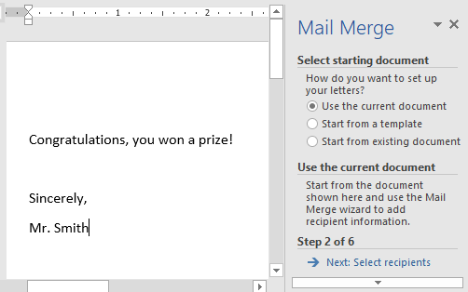
Mail Merge: Step 2 (Creating Document)
Select or enter the information for your main document.
The parts of the letter that are always the same (appears in each letter) is entered in the left part of the window.
Click ‘next’ to select the recipients

Slide 37
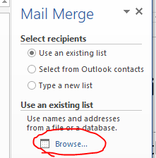
Mail Merge: Step 3 (Recipients)
What’s done prior to this step: Mailings->Start Mail Merge->Step-By-Step Mail Merge Wizard
Do for this step: Use an existing list->Browse
  For this exercise select the spreadsheet: starting_recipient_list
  For A1 select an existing list: “clients.xlsx
Other options when specifying contacts:
  Select from Outlook contacts
  Type in a new list (creates an Access database)
Click ‘next’ to customize or create the letter

Slide 38
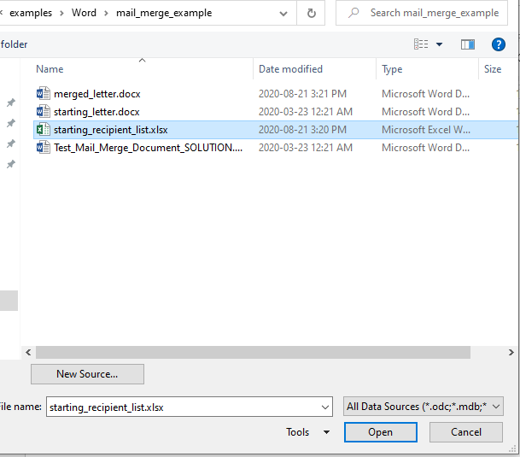
Step 3A
Navigate to the location where the spreadsheet is located:
  Click on the spreadsheet.
  Click on the ‘Open’ button.

Slide 39
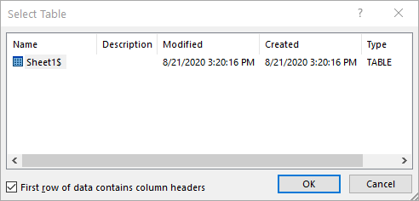

Step 3B
Specify if the first row of the spreadsheet should or should not be treated as containing client information (headers are labels)
  Exclude the first row, use the default “First row of data contains column headers”: click ‘OK’
  FYI: in this case the first row of the spreadsheet doesn’t contain client information.

Slide 40
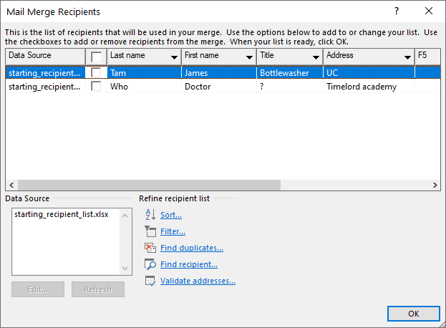
Step 3C
Options for organizing and filtering the data from the spreadsheet.
  For this exercise it’s not necessary so just click ‘OK’

Slide 41
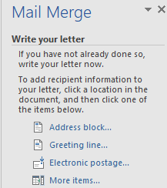
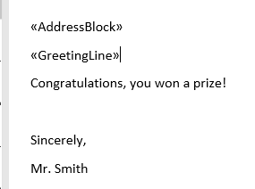
Mail Merge: Step 4 (Write)
In Word it’s labeled as ‘write’ the letter but for this exercise the letter has partially been written (the parts of the letter that appear the same for each client have already been typed in).
  So for this exercise you can customize the letter: address & greet the person by name.
  (However if you didn’t anything for the letter previously then you can do so now).
Selecting the customized fields
Letter
Fixed part of letter (no angled brackets)
Notes:
Using the address block is hit and miss, even if you label a column as ‘address block’
Better off manually specifying it
‘More items’

Slide 42

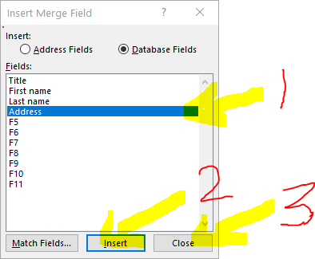
Mail Merge: Step 4 (Alternate Write)
Add the line that says “Congratulations, you won a prize!” put each of the following on it’s own line.
    Step 4A: Selecting the “address block” directly can be problematic so it’s best to manually select the appropriate column ‘address’ from the spreadsheet.
  Step 4B: Click “Greeting line” and then ‘OK’. Word will customize the greeting with the client’s name e.g. Dear Bottlewasher Tam
Click ‘next’ to preview the letters
Clients spreadsheet

Slide 43
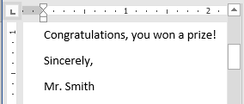
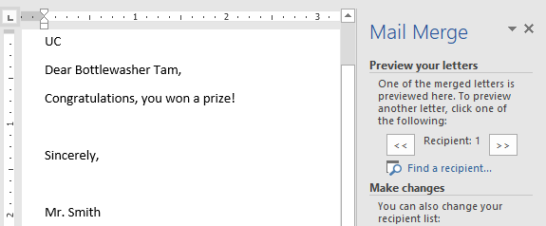
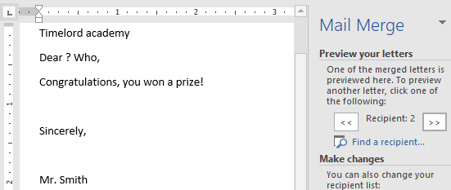

Mail Merge: Step 5 (Preview)
INPUTS
OUTPUT
Original main document (text that is always the same) ‘starting_letter’
Merged letters (customized form letters): ‘merged_letter’
Data source (custom fields): ‘starting_recipient_list’

Slide 44
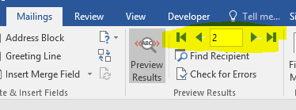
Previewing Results: “Click Through” The Letters
Use the ‘forward’ and ‘backward’ controls
Important: You need to submit something that the marker can ‘click’ through (yellow highlight in above image) so the person can tell the merge was correctly done.
Don’t expect credit for handing in something that looks like it could have been manually typed in (“finish and merge”)

Slide 45
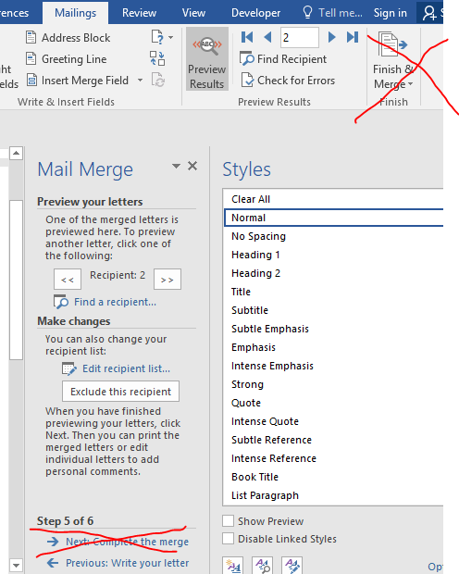
Mail Merge: Step 6 (Don’t Submit The Product Of This Step For The Assignment)
No need to complete this step for assignments.
In “real life” it will produce an additional Word document that contains the output of the merge that can be printed or otherwise distributed.
Do not complete this step and hand in the resulting document for the assignment!

Slide 46
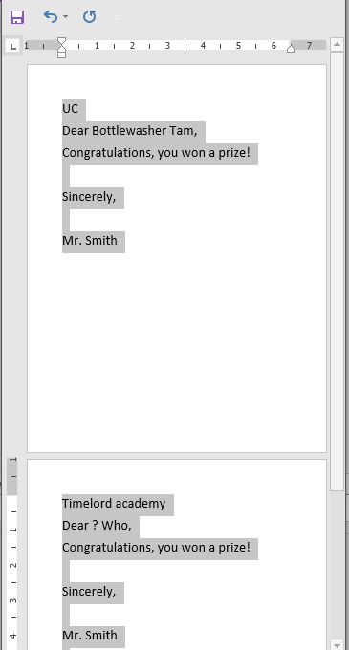
Step 6: End Product Of Completing The Merge
You can see the document to view the end results: “step6_completed_merged_letters”
  (Image enlarges the fonts to make it easier to recognize the letters)
  (The merge fields cannot be identified because it cannot be “clicked through” nor can they be edited) = “hard coded”
Submitting this final ‘hard coded’ result (produced from Step 6: Finish and Merge) will result in no credit.
  The results could have produced by manually typing the letters without using the mail merge feature.

Slide 47
Sample Exam Question: Mail Merge
Given some main document and the details of a data source what will be the result of the mail merge.
Example of how questions can focus on “how things work” over “where to click”

Slide 48
Mail Merge: Rules For Filtering The Merge
Example:
  Folder name: merge_filter_rule
  Files in the folder:
    students (Excel file),
    example_mail_merge_filter (Word document)

Slide 49
Mail Merge: Rules For Filtering The Merge (2)
The rules can produce different results in the merge document according to the data source.
Two filter rules for this example:
  Bcomm graduates see the extra message “Business graduates get a special offer.”
  Rule based on age:
    65 and over: “You get a seniors discount.”
    Under 65: “No seniors discount.”

Slide 50
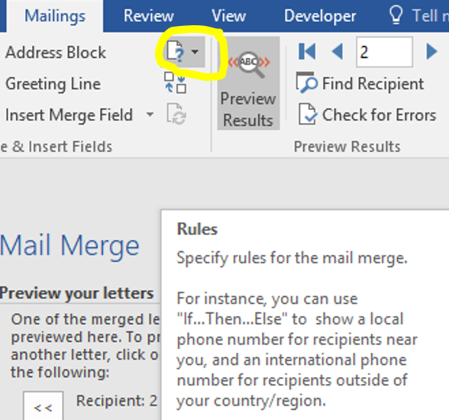
Mail Merge: Rules For Filtering The Merge (3)
Mailings->(Write & Insert Fields group: Rules)->IF...THEN...ELSE

Slide 51
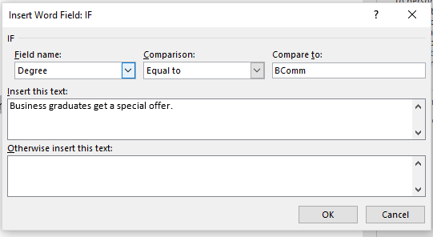

Mail Merge: Rules For Filtering The Merge (4)
Specifying the rules for the mail merge filter

Slide 52

Sample Exam Question: Mail Merge Rules
Writing rules.
  Enter the information in the fields for the IF-Rule to produce a certain result.
Tracing rules.
  Given a data source and some pre-written rules what will be the resulting merge document.

Slide 53

Scary Message
When you open the merged document again you will see a scary looking popup.
  Normally you should be cautious when encountering such warnings but you can largely ignore it for merge documents that you have created yourself which haven’t been edited by others.
After selecting ‘Yes’ you will then need to locate the spreadsheet and click on it.

Slide 54
Recap Of This Section: Things You Should Now Know
How to run (although not for the exam) the following features of Word as well as how they work (know for the exam)
  How to use mail merge to create a customized form letter.
  Why use mail merge
  Filtering merge results using IF-rules (writing and tracing rules)

Slide 55
Subsection: Collaboration Tools
Sharing documents
Tracking the work of others
Commenting on documents

Slide 56
Sharing Documents
The focus for this course will be on the format of the document formats over cloud-based storage and sharing tools such as Dropbox or OneDrive.
  Some file formats (e.g. .wmv, .bmp, .xpf) aren’t commonly used so it reduces the ability to share.
Both PDF and XPF documents have a fixed layout format retaining the original look and feel of electronic documents
  Sometimes Word documents appear different on different printers
  PDF: universal (viewable across multiple operating systems)
  XPF: Microsoft specific

Slide 57

Tracking Work
In Word it consists of tracking changes that have been made to a document over time.
Visual annotations can be added in order to specify: what parts have changed and how they have changed.
Access in Word
  Review->(Tracking group)

Slide 58




Turn On Tracking
Review->Track Changes->(Select “Track Changes”)
Before
After

Slide 59




Levels Of Annotations
Review->(Tracking Group)
Level of detail via 3 levels of markup
No
Markup
Simple
Markup
All
Markup

Slide 60


Commenting On Documents
Think of it as the electronic equivalent of “sticky notes” attached to document providing explanations to other authors or even for yourself
  Adding comments
    Review->New Comment
  Removing comments (select a comment and then complete the following):
    Review->Delete

Slide 61
Recap Of This Section: Things You Should Now Know
The difference between PDF and XPS documents and benefit of these types of documents
How to run (although not for the exam) the following features of Word as well as how they work (know for the exam)
  Tracking changes:
    Setting different levels of viewing detail (markup)
  Commenting on documents

Slide 62
Summary: Prior Skills
Starting Word
Using pre-created Word templates
Creating blank documents
Entering text into Word
Navigating a Word document
Various ways of copy pasting
Accessing features of Word via the ribbon and through right clicking
Formatting text
Paragraph effects: alignment, lists
Spell checking a document
Save vs Save as

Slide 63
Summary: Prior Skills (2)
Tagging documents
Creating PDF documents
Printing a document
Quitting Word
Converting between versions of Word
Changing margins
Using/setting tabs
Paragraph formatting effects
Moving text to the next line: word wrap, hard return, soft return

Slide 64
Summary: Skills Covered In The Word Section
Inserting page & section breaks as well as symbols and equations
Showing/hiding formatting symbols and the benefit of seeing formatting symbols
How to use, create and apply text styles
Using the format painter to copy-paste formatting effects
Finding/replacing text (and styles) in a document
4 common table formulas

Slide 65
Summary: Skills Covered In The Word Section (2)
Inserting a table of contents
Creating new citations, inserting citations
Creating a bibliography from existing citations
How to use mail merge to create a customized form letter.
Why you should use mail merge
Filtering merge results using IF-rules (writing and tracing rules)

Slide 66
Summary: Skills Covered In The Word Section (3)
Inserting image captions, creating cross references
Inserting footnotes and endnotes
The difference between PDF and XPS documents and benefit of these types of documents
Tracking changes:
  Setting different levels of viewing detail (markup)
Commenting on documents

Slide 67
Copyright Notification
“Unless otherwise indicated, all images in this presentation were created by James Tam.”

