Slide 1
VBA Programming: Part III
VBA structures: IF branching, Do-While repetition/looping
Return to VBA collections
The DIR function
Basics of the VBA debugger

Slide 2
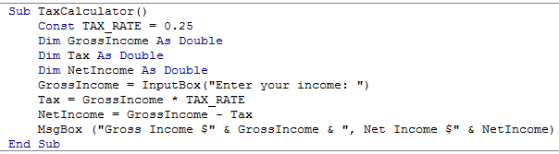
Recap: Programs You’ve Seen So Far Produces Sequential Execution
Each instruction executes from beginning to end, one after the other
When the last instruction is reached then the program ends
Start
End

Slide 3
New Program Writing Concepts (Non-Sequential)
Branching (alternatives)
Looping (repetition)
Grade point >= 1.0
True
False
MsgBox(“Passed”)
MsgBox(“Failed”)
START
Run game
Y
Play again?
N
END GAME

Slide 4
New Terminology
What you know: Boolean expression: An expression that must work out (evaluate to) to either a true or false value.
  e.g., it is over 45 Celsius today
  e.g., the user correctly entered the password
New term, body: A block of program instructions that will execute under a specified condition (for branches the body executes when a Boolean is true)
  Style requirement
    The ‘body’ is indented (1 tab)
    A “sub-body” (IF-branch) is indented by an additional 1 tab (2 or more tabs)
Sub Document_Open()
MsgBox ("Fake virus!")
End Sub
This/these instruction/instructions run when you tell VBA to run the macro, the ‘body’ of the macro program

Slide 5
Branching: Alternative Courses Of Execution
Similar to the Excel (IF-Function): Check if some condition has been met (e.g., password for the document correctly entered): Boolean expression
But the IF-structure employed with programming languages is not just a function that returns a value for the true or false cases.
For the programming IF: a statement or a collection of statements can be executed (again this is referred to as “the body” of the if or else case.
  The programming IF is far more flexible (powerful) that the function equivalent.

Slide 6
Branching: Alternative Courses Of Execution (2)
Example where alternatives are possible: Checking if the keyboard has caps lock enabled when the user is typing in some text.
  A popup with the text “KEYBOARD CAPS LOCK ON” when the caps lock is on.
  A popup with the text “Caps lock off” when the caps lock is off.
  If (Application.CapsLock = True) Then
  MsgBox ("KEYBOARD CAPS LOCK ON")
  Else
  MsgBox ("Caps lock off")
  End If
  Explanations regarding the IF-ELSE structure will be coming shortly.

Slide 7
Branching Mechanisms
If-Then Similar to the Excel IF function (no false case)
If-Then, Else Similar to the Excel IF function
true and false case specified)
If-Then, ElseIf, Else The Excel equivalent are nested
IF functions (may or may not
have been covered).
A more powerful structure
than a lookup function.

Slide 8
Allowable Operators For Boolean Expressions (Same Symbols As Excel)
if (value operator value) then e.g. if (age >= 0) then
VBA Mathematical
operator equivalent Meaning Example
< < Less than 5 < 3
> > Greater than 5 > 3
= = Equal to 5 = 3
<= ≤ Less than or equal to 5 <= 5
>= ≥ Greater than or equal to 5 >= 4
<> ≠ Not equal to x <> 5

Slide 9
Branching With ‘If-Then’
Boolean
True
Then execute an
instruction or instructions
False
Remainder of
the program

Slide 10
If-Then
Format:
  If (Boolean expression) Then
  If-Body
  End if
Learning Objective: Program reacts for the true case, counting words in a document.
Example usage (full example coming up):
If (totalWords < MIN_SIZE) Then
  MsgBox ("Document too short, total words " & _
  totalWords)
  End If

Slide 11
If-Then: Complete Example
Learning objective:
  Show how to use an IF structure (program reacts for the true case)
  Counting the number of words in Word document
Word document containing the macro: 1wordCountTooFewWords.docm
  ' Try deleting all the words in the Word doc and run the
  ' macro again
  Sub wordCount()
  Dim totalWords As Long
  Const MIN_SIZE As Long = 4
totalWords =
ActiveDocument.Range.ComputeStatistics(wdStatisticWords)
  If (totalWords < MIN_SIZE) Then
  MsgBox ("Document too short, total words " &
  totalWords)
  End If
  End Sub

Slide 12
Branching With An ‘If, Else’
Boolean
True
Execute an instruction
or instructions (if-body)
False
Execute an instruction
or instructions (else-body)
Remainder of
the program

Slide 13
If-Then (True), Else (False)
Format:
  If (Boolean expression) Then
  If-Body
  Else
  Else-Body
  End if
Example:
  If (totalWords < MIN_SIZE) Then
  MsgBox ("Document too short, total words " & totalWords)
  Else
  MsgBox ("Document meets min. length requirements")
  End If

Slide 14
If-Then (True), Else (False): Complete Example
Learning objective:
    Show how to use an IF-Then structure (program does something for true and false case)
Word document containing the macro: 2wordCountV2TooFewOKCount.docm
  Sub wordCountV2()
  Dim totalWords As Long
  Const MIN_SIZE As Long = 4
  totalWords =
  ActiveDocument.Range.ComputeStatistics(wdStatisticWords)
  If (totalWords < MIN_SIZE) Then
  MsgBox ("Document too short, total words " &
  totalWords)
  Else
  MsgBox ("Document meets min. length requirements")
  End If
  End Sub

Slide 15
Applications Of Branching
Checking state
  IF(program is in some state) then
  Program reacts
  End
Example application #1:
  If (Application.CapsLock = True) Then
  MsgBox ("Caution: Caps Lock is On!“)
  End If
Example application #2:
  age = InputBox("Age: ")
  If (age < 0) Then
  MsgBox ("Age cannot be negative")
  End If

Slide 16
Applications Of Branching (2)
Example 3: Learning objective is how to check for empty user input (“empty string”)
(Name of the Word document that contains the VBA example): 3checkingForEmptyString.docm
firstName = InputBox("Enter your first name: ")
If (firstName = "") Then
MsgBox ("You typed in an empty name")
Else
MsgBox (firstName & " sup?")
End If

Slide 17
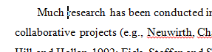

The Selection Object Again
With previous approaches if no text was selected then the program would produce no visible effect.
  Sub SelectedFontChange()
  Selection.Font.Bold = wdToggle
  End
A modified version automatically selects text.
  Sub AutoSelectedFontChange()
  Selection.Expand
  Selection.Font.Bold = wdToggle
  End Sub
Before
After
Notes:
* Auto-selection: what if the auto selected text wasn’t the text you wanted to change

Slide 18
The Selection Object Again
A further modified version (augmented using the IF structure):
  If no text has been selected then display an error message
  If text has been selected then the formatting will be changed

Slide 19
Constants For The Selection Object
Name of constant | Meaning of constant
wdSelectionIP | No text selected
wdSelectionNormal | Text (e.g., word, sentence) has been selected
wdSelectionShape | A graphical shape (e.g., circle, text box) has been selected
Application of these constants coming up on the next slide

Slide 20
The Selection Object And A Practical Application Of Branching
An example application of branching: check if a selection has been made and only apply the selection if that is the case.
  Checking if a condition is true
Learning objective: Application of branching (notify user if an action is not valid given the state of Word, empty selection)
Word document containing the macro: “5ifSelectionExample.docm”
  Sub checkSelection()
  If (Selection.Type = wdSelectionIP) Then
  MsgBox ("No text selected, nothing to change")
  Else
  Selection.Font.Bold = wdToggle 'wdToggle, constant
  End If
  End Sub
Notes:
Selection.Type = wdSelectionIP: not includeed in final exam API

Slide 21
What To Do When Multiple Conditions Must Be Checked
Case 1 (mutually exclusive):
  At most one condition is true.
  The result of one condition affects other conditions (when one condition is true then the other conditions cannot be true)
  Which of the following is your place of birth? (Answering true to one option makes the options false)
    Calgary
    Edmonton
    Lethbridge
    Red Deer
    None of the above
  If-then, elseif, else should be used

Slide 22
Branching With If-Then, Elseif, Else
Boolean
True
Instruction or
instructions
False
Boolean
True
Instruction or
instructions
False
JT’s note: once the first ‘true’ case is encountered all remaining and related Boolean expressions (using ‘Elseif’) are skipped
Instruction or
instructions
Remainder of
the program

Slide 23
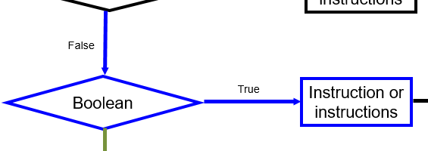
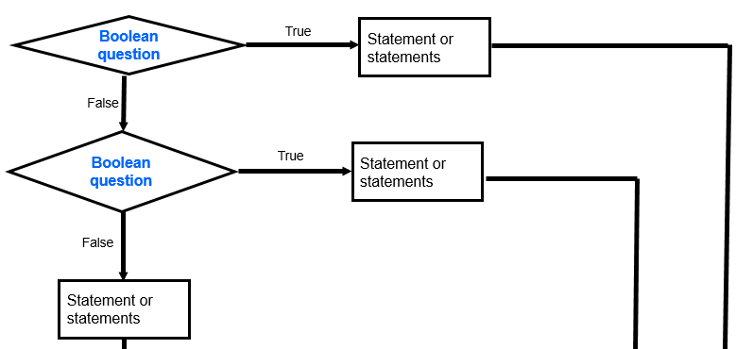
Elseif Vs. Else
Elseif:
  Checks if a condition has been met before a body executes.
Else
  When used in conjunction with a number of IF, ELSEIF structures the ELSE body executes if all the other cases don’t apply (Boolean expressions are false).
IF
ELSEIF
ELSE

Slide 24
Multiple If-Elseif-Else: Use With Mutually Exclusive Conditions
Mutually exclusive
One condition evaluating to true excludes other conditions from being true
Example: having your current location as ‘Calgary’ excludes the possibility of the current location as ‘Edmonton’, ‘Toronto’, ‘Medicine Hat’
Format:
if (Boolean expression 1) then:
body 1
elseif (Boolean expression 2) then
body 2
...
else
body n
' Only one ‘end-if’ at very end
end if
statements after the conditions

Slide 25
If-Elseif-Else: Mutually Exclusive Conditions (Example)
Learning objective: determining which case applies (0 or 1 only applicable)
Word document containing the macro (empty document, see macro editor for the important details): “6gradesEfficient.docm”
  If (letter = "A") Then
  grade = 4
  ElseIf (letter = "B") Then
  grade = 3
  ElseIf (letter = "C") Then
  grade = 2
  ElseIf (letter = "D") Then
  grade = 1
  ElseIf (letter = "F") Then
  grade = 0
  Else
  grade = -1 'A signal that letter was invalid
  End If
This approach is more efficient when at most only one condition can be true.
Extra benefit:
The body of the else executes only when all the Boolean expressions are false. (Useful for error checking/handling).

Slide 26
What To Do When Multiple Conditions Must Be Checked
Case 2: If each condition is independent of other questions
  Multiple if-then expressions can be used
  Example:
  Q1: Are you an adult?
  Q2: Are you a Canadian citizen?
  Q3: Are you currently employed?

Slide 27
Branching With Multiple If-Then
Q1: Boolean 1
False
  Each question is independent (previous answers have no effect on later questions because all questions will be asked).
  Q1: Are you an adult?
  Q2: Are you a Canadian citizen?
  Q3: Are you currently employed?
True
Instruction or
instructions
Q2: Boolean 2
False
True
Instruction or
instructions
Remainder of
the program

Slide 28
Multiple If-Then
Any, all or none of the conditions may be true
Employ when a series of independent questions will be asked
Format:
if (Boolean expression 1) then
body 1
end if
if (Boolean expression 2) then
body 2
end if
...
statements after the conditions

Slide 29

Multiple If-Then (2)
Learning objective: a program that handles multiple independent conditions
Word document containing the macro: 7multipleIfs.docm
  Sub multipleIf()
  ' Check if there were any 'comments' added to the document.
  If (ActiveDocument.Comments.Count > 0) Then
  MsgBox ("Annotations were made in this document")
  End If
  ' A numbered item includes numbered and bulleted lists.
  If (ActiveDocument.CountNumberedItems() > 0) Then
  MsgBox ("Bullet points or numbered lists used")
  End If
  End Sub
Notes:
* JT: whether or not there are any bulleted lists has nothing to do if the document has any comments inserted.

Slide 30
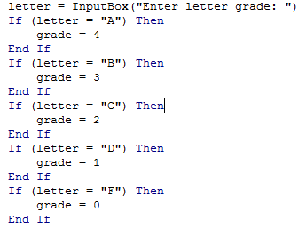
Location Of The “End If”: Multiple If
Independent If-then’s:
  Since each ‘if’ is independent each body must be followed by it’s own separate ‘end if’

Slide 31

Location Of The “End If”: If-then, Else
If-then, Else:
  Since the ‘if-then’ and the ‘else’ are dependent (either one body or the other must execute) the ‘end if’ must follow the body of the ‘else- body’ (last dependent “if-branch”)
Document either does or does not have enough words (one option IF or the other option ELSE must be applied)

Slide 32
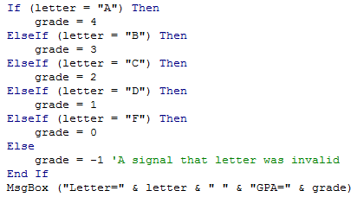
Location Of The “End If”: If-Then, ElseIf
Dependent If-then, Else-If:
  Since the results of earlier Boolean expressions determine whether later ones can be true (reminder: because at most only one can be true) all of the if-then and Elseif expressions are dependent (one related block).
  The “end if” belongs at the very end of the block

Slide 33
Logical AND: Review From Google Searches
AND:
  Requires that a website includes all the words before that site shows up as a search result (all conditions must be true before the entire AND-expression is true)
  Conversely if a site does not include any of the search words then the site should not appear as a search result (if any condition is false then the entire AND-expression is false)
  Format:
    <First word> (implicit AND) <Second word>
  Example:
    Calgary Canada

Slide 34
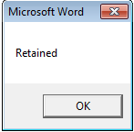
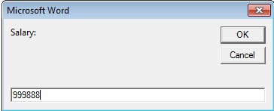
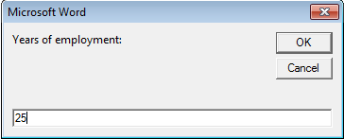
Logic: The VBA “AND” Operator
Learning objective: a program that reacts only if all conditions met
Format:
If ((Boolean expression) And (Boolean expression)) then
body
End if
Word document containing the macro (empty document, see macro editor for the important details): 8if_and_firing.docm
  salary = InputBox("Salary: ")
  years = InputBox("Years of employment: ")
  If ((salary >= 100000) And (years < 2)) Then
  result = "Fired!"
  Else
  result = "Retained"

Slide 35
Firing Example: Example Inputs & Results
If ((salary >= 100000) And (years < 2)) Then
Salary | Years on job | Result
1 | 100 | Retained
50000 | 1 | Retained
123456 | 20 | Retained
1000000 | 0 | Fired!

Slide 36
Logical OR: Review From Google Searches
OR:
  If a website includes any of the search words then the site shows up as a search result (a single true result will make the entire OR-expression is true)
  Conversely only if a website does not include any of the search words will a site not appear as a result (only if all results are false will the entire OR-expression evaluate to false)
  Format:
    <First word> OR <Second word>
  Example:
    Calgary OR Edmonton

Slide 37
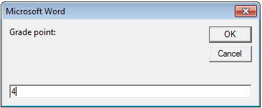
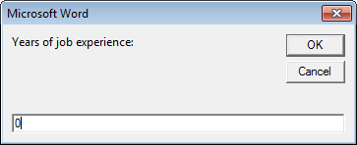
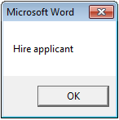
Logic: The VBA “OR” Operator
Format:
If ((Boolean expression) OR (Boolean expression)) then
body
End if
Learning objective: a program that reacts if at least one condition met.
Word document containing the macro (empty document, see macro editor for the important details): 9if_or_hiring.docm
  gpa = InputBox("Grade point: ")
  experience = InputBox("Years of job experience: ")
  If ((gpa > 3.7) Or (experience > 5)) Then
  result = "Hire applicant"
  Else
  result = "Insufficient qualifications"

Slide 38
Hiring Example: Example Inputs & Results
If ((gpa > 3.7) Or (experience > 5)) then
GPA | Years job experience | Result
2 | 0 | Insufficient qualifications
1 | 10 | Hire
4 | 1 | Hire
4 | 7 | Hire

Slide 39
Line Continuation Character (Repeated Again For Branching)
To increase readability of long IF statements the line continuation character can split the Boolean expressions (one Boolean per line)
  If ((income > 99999) And _
  (experience <= 2) And _
  (numRepramands > 0)) Then
  MsgBox ("You're fired!")
  End If
Reminder:
  To split the line the line continuation character (underscore) must be preceded by a space.
Keywords cannot be split between lines e.g.
    Msg _
    Box
For more details see: http://support.microsoft.com/kb/141513

Slide 40
Application: IF-Branching (Marking Program)
Case 1, Failure: document has any spelling mistakes
Case 2, Pass: document has no spelling mistakes
Learning Objective: Application of branching and other concepts, marking a document based on the number of typographical errors and formatting the marking feedback.
Name of the Word document that contains the program: 10Marking programV1_IF.docm

Slide 41
Marking Program
Sub MarkingProgram()
Dim totalTypos As Long
Const MAX_TYPOS = 0
Dim feedback As String
totalTypos = ActiveDocument.SpellingErrors.Count
feedback = "Marking.."
Selection.HomeKey Unit:=wdStory
If (totalTypos > MAX_TYPOS) Then
feedback = feedback & "Has typos: Fail"
Else
feedback = feedback & ": Passing grade"
End If

Slide 42
Marking Program (2)
feedback = feedback & vbCr & vbCr
Selection.Font.ColorIndex = wdRed
Selection.Font.Size = 16
Selection.Font.Name = "Arial"
Selection.TypeText (feedback)
End Sub

Slide 43
Conditions Inside Of Conditions
This is referred to as ‘nesting’ (one form of nesting)
An IF can contain within its body a second IF
  IF (Boolean expression 1 for outer IF)
  ..
  IF (Boolean expression 2 for inner IF)
  ..
  End IF 'Inner If
  End IF 'Outer If
  In other words: Boolean expression 2 is checked only when Boolean expression is true
Outer body
2nd IF Nested (inside of) within outer IF body

Slide 44
Recognizing When Nesting Is Needed
Scenario 1: A second question is asked only if a first question answers true:
  Example: If it’s true the applicant is a Canadian citizen, then ask for the person’s income (checking if eligible for social assistance).
  Type of nesting: an IF-branch nested inside of another IF-branch
  If (Boolean) then
    If (Boolean) then
    ...
    End If
    End if
Q: Citizen?
F
T
Q: Low income?
F
T
Nested branch/IF
May receive assistance
No assistance

Slide 45
Nested IFs
Learning objective: Conditions checked only if other conditions are true.
Word document containing the example: 11nestingIFinsideIF.docm
  Sub nestedCase1()
  Dim country As String
  Dim income As Long
  Const INCOME_CUTOFF = 24000
  country = InputBox("What is your country of citizenship?")
  If (country = "Canada") Then
  income = InputBox("What is your income $")
  If (income <= INCOME_CUTOFF) Then
  MsgBox ("Citizenship: " & country & "; " & _
  "Income $" & income & _
  ": eligible for assistance")
  End If
  End If
  End Sub

Slide 46
Looping/Repetition
How to get the program or portions of the program to automatically re-run
  Without duplicating the instructions
  Example: you need to calculate tax for multiple people
Ask for income
Loop: allows you to repeat the same tasks over and over again
Calculate deductions
Display amounts

Slide 47

Looping/Repetition (2)
The entire program repeats
START
Play game again?
Run game
Y
Play again?
N
www.colourbox.com
END GAME

Slide 48

Looping/Repetition (3)
Only a specific part of the program repeats
Re-running specific parts of the program
Flowchart
Invalid input?
N
Y
Ask for input again
…rest of program

Slide 49
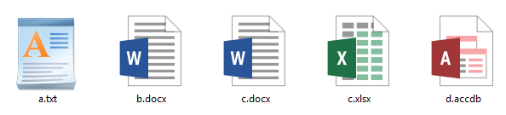
Looping/Repetition (4)
Process Word documents in a folder as long as there are unprocessed documents remaining in the folder.
Docs left?
Docs left?
Stop

Slide 50
Characteristics Of Do-While Loops
Described as variable repetition loops: runs as long as some condition holds true (number of times that the loop repeats is variable)
  e.g., while the user doesn’t quit the program re-run the program
  e.g., while the user enters an erroneous value ask the user for input.
  e.g. while there are unprocessed documents (0? 1? 50?)

Slide 51
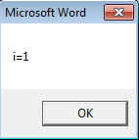
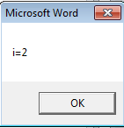
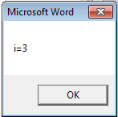
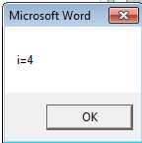
Do-While Loop
Start
Condition?
F
T
Format:
  Do While <Condition>
  <Statement(s)>
  Loop
Learning objective: illustrating loop with a program that counts up by 1
Example: “12whileUpOne.docm”
  Dim i As Long
  i = 1
  Do While (i <= 4)
  MsgBox ("i=" & i)
  i = i + 1
  Loop
Statements
Loop
End
Any valid mathematical expression here e.g. count up by 10, decrease by 1, exponential function etc.
Notes:
While –wend: older legacy method of pre-test loop just included for backwards compatibility
http://msdn.microsoft.com/en-us/library/aa266320(v=vs.60).aspx
Newer way allows for more flexibility e.g., exit do

Slide 52
Programming Style: Variable Names
In general variable names should be self-descriptive e.g., ‘age’, ‘height’ etc.
Loop control variables are an exception e.g., ‘i’ is an acceptable and commonly used variable name
  It’s sometimes difficult to come up with a decent loop control name
  Loop control variables are given shorter names so the line length of a loop isn’t excessive
  Dim loopControl As Integer
  loopControl = 1
  Do While (loopControl <= 4)
  ...

Slide 53
Application Of Looping: Error Handling
General structure:
  Do While (Error occurring)
  Instructions to deal handle error
  Loop
Start
Error?
F
T
React to error
Loop
End

Slide 54
Error Handling Example
Learning objective: a program that uses a loop to prevent the user from entering a value outside a valid range.
Name of the Word document containing the complete program: 13errorHandlingLoop.docm
  Dim income As Long
  Dim tax As Long
  Const TAX_RATE = 0.2
  income = InputBox("Enter a non-negative income $")
  Do While (income < 0)
  MsgBox ("Income cannot be less than zero")
  income = InputBox("Enter a non-negative income $")
  Loop
  tax = income * TAX_RATE
  MsgBox ("Income $" & income & " requires $" & tax & _
  " _taxes paid")

Slide 55
Example: Searching A Document For A Word Using A Loop
  Sub countingOccurences()
  Dim occurrences As Long
  With ActiveDocument.Content.Find
  Do While .Execute(FindText:="the", Forward:=True, _
  MatchWholeWord:=True) = True
  occurrences = occurrences + 1
  Loop
  End With
  MsgBox ("'the' " & " was found " & occurrences & _
  " times.")
  End Sub
For more information on using the ‘Find’ method to find occurrences of text: https://docs.microsoft.com/en-us/office/vba/api/word.find.execute

Slide 56
Logic And Loops
Both AND, OR logic can be employed with loops
AND: when a loop repeats while all conditions are true.
OR: when a loop repeats when at least one condition is true.

Slide 57
Error Handling Loop: OR
Learning objective: a program using a loop to ensure entry of value that’s inside a valid range (not too low or too high). Program repeats if input is either too low or too high.
Name of the Word document that contains the complete program: 14errorHandlingLoopOR.docm
  Dim age As Long
  Dim catAge As Long
  Const MIN_AGE = 0
  Const MAX_AGE = 118
  Const CAT_HUMAN_AGE_RATIO = 7
  age = -1
  Do While ((age < MIN_AGE) Or (age > MAX_AGE))
  age = InputBox("Enter age (0-118): ")
  MsgBox ("Age must be in the range of 0-118")
  Loop
  catAge = age * CAT_HUMAN_AGE_RATIO

Slide 58
Error Handling Loop: AND
Learning objective: A program that only allows one out of a set of valid values (loops as long as the value is not the first valid value and not the second value and not the third value).
Name of the Word document that contains the complete program: 15errorHandlingLoopAND.docm
  Dim province As String
  province = "ON"
  Do While ((province <> "BC") _
  And (province <> "AB") _
  And (province <> "SK"))
  province = InputBox("Enter a Western Canadian " & _
  " province: ")
  Loop
  MsgBox (province & " is a Western province.")

Slide 59
Looping And Collections
Because the number of objects within a collection can vary (e.g. number of documents currently open) and loops can repeat a variable number of times it’s common to employ a do-while loop when accessing parts of a collection.

Slide 60
Loops And Collections: Example #1
  Learning objective: Using a loop to automatically print (one at a time) all the documents currently opened in Word.
  Word document containing the macro example: 16printMultipleDocuments.docm
  Sub PrintDocumentsCollection()
  Dim numDocuments As Integer
  Dim count As Integer
  numDocuments = Documents.count
  count = 1
  Do While (count <= numDocuments)
  Documents.Item(count).PrintOut
  count = count + 1
  Loop
  End Sub

Slide 61
Loops And Collections: Example #2
Learning objective: Using a loop to automatically sort all of the tables in the currently active Word document.
Word document containing the macro example: 17sortingMultipleTables.docm
Dim CurrentTable As Integer
Dim NumTables As Integer
NumTables = ActiveDocument.Tables.Count
' Case 1: No tables in document
If NumTables = 0 Then
MsgBox ("No tables to sort")

Slide 62
Loops And Collections: Example #2 (2)
'At least one table in the document.
Else
CurrentTable = 1
Do While (CurrentTable <= NumTables)
MsgBox ("Sorting Table # " & CurrentTable)
ActiveDocument.Tables(CurrentTable).Sort
CurrentTable = CurrentTable + 1
Loop
End If

Slide 63


More On The Sort Method
A parameter that can be used to leave out the first (header) row during the sort
Format
  Sort (<Boolean whether there a header in the table – True or False>)
  Exclude the header (1st row) from sort
Example
  ActiveDocument.Tables(CurrentTable).Sort(True)
  Before
  After

Slide 64
Sorting A Table With Headers: Variant Example #2
Learning objective: same as previous program but excludes table headers from the sort.
Word document containing the macro example: 18sortingMultipleHeaderedTables.docm
Dim CurrentTable As Integer
Dim NumTables As Integer
NumTables = ActiveDocument.Tables.Count
If NumTables = 0 Then
MsgBox ("No tables to sort")
Else
CurrentTable = 1
Do While (CurrentTable <= NumTables)
MsgBox ("Sorting Table # " & CurrentTable)
ActiveDocument.Tables(CurrentTable).Sort (True)
CurrentTable = CurrentTable + 1
Loop
End If

Slide 65
The DIR Function
If used in conjunction with a loop:
  It can be used to go through all the documents in a folder (this will be illustrated gradually in advanced examples but the first one will be rudimentary)
  It can be used to go through the entire contents of a folder including sub-folders and sub-sub folders (very advanced use: well beyond the scope of the this course)
Basic use: this function takes a location (e.g., C:\temp\) and a filename as an argument and it determines if the file exists at the specified location.
  If the file is found at this location then the function returns the name of the file.
  If the file is not found at this location then the function returns an empty string (zero length)

Slide 66
Simple Use Of The DIR Function
  Learning objective: a learning example to show how the DIR function works
  Word document containing the macro example: 19DIRFunctionSimple.docm
Dim location As String
Dim filename As String
Dim result As String
location = "C:\temp\203\dirExample1\" 'Always look here
result = Dir(location) ' Name of first file
MsgBox (result)
result = Dir(location & "*.xls*") 'Any Excel document
MsgBox (result)
filename = "b.docx"
result = Dir(location & filename) 'Always look for b.dox
MsgBox (result)
Notes:
filename = InputBox("File name in C:\temp")
result = Dir(location & filename)
MsgBox (result)
Returns filename3 if found else empty string

Slide 67
Nesting: Loop Within A Branch
The upcoming example will employ another form of nesting:
  If (Error: empty folder path)
  Display popup error message
  Else
  While (there is another unopened Word document)
  Open document
  Move onto the next document

Slide 68
Practical Use Of Dir: Access Each File In A Directory
  Learning objective: the program will automatically open and modify in succession all the Word documents in a folder specified by the user.
  Word document containing the macro example: 20loopFolder.docm
  Features:
    Prompts the user for the location to the Word documents (‘path’)
    Error handling (First “IF-body”)
      Empty path (i.e. no location entered by the user)
    Non-error case (“ELSE-body”)
      Path is okay: check if there are Word documents in the location and if so use a loop open each Word document in turn
Notes:
' *.* = Filename must contain a 'dot'.
' Any text can precede the dot (including no text)
' Any text can follow the dot (including no text)
' When there are no more documents to examine current file is an emtpy string
Do While currentFile <> ""
MsgBox (currentFile)
' Calling dir again then returns the name of the next file in that folder that meets the criteria
currentFile = Dir
Loop

Slide 69
VBA Program: Successively Access Word Documents
Dim directoryPath As String
Dim currentFile As String
Dim numTypos As Long
directoryPath = InputBox("Location for files e.g.
C:\temp\203\dirExample2\")
If (directoryPath = "") Then
MsgBox ("The path you entered '" & directoryPath & "' is
empty.") 'User entered no path (empty string)
Else
currentFile = Dir(directoryPath & "*.doc*")
If (currentFile = "") Then
MsgBox (directoryPath & " does not contain any Word
documents")
End If 'DIR returns empty string if no documents in location

Slide 70
VBA Program: Successively Access Word Documents (2)
' Path is OK, contains Word documents
Do While (currentFile <> "")
' Display file name in popup
MsgBox (currentFile)
' Use filename to open the Word document from
' currentFile = Dir(directoryPath & "*.doc*")
Documents.Open (directoryPath & currentFile)
'Modify each document (next screen)
'Move onto next document in folder
currentFile = Dir
Loop
End If

Slide 71
VBA Program: Successively Access Word Documents (How Each Open Document Is Modified)
'How the program modifies each document (these
'instructions should be inserted into the specified
'location on the previous screen
numTypos = ActiveDocument.SpellingErrors.Count
Selection.HomeKey Unit:=wdStory
Selection.Font.ColorIndex = wdBlue
Selection.TypeText ("typos " & numTypos)
ActiveDocument.Close (wdSaveChanges)

Slide 72
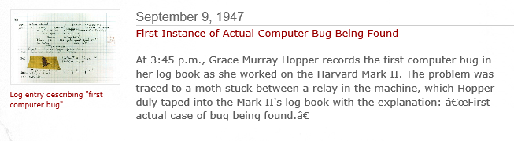
The VBA Debugger
‘Bug’:
  An error in the logic of your program.
  The program “doesn’t do what it is supposed to do”
  Example: an erroneous formula for calculating an area of a rectangle
  area = length + width
  Bugs will seldom be this obvious
Debuggers can be used to help find errors in your program
Normally more information on using the VBA debugger will be provided in tutorial
Screenshot: www.computerhistory.org

Slide 73
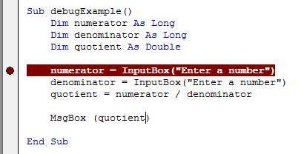
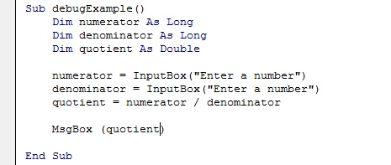
The VBA Debugger (If There Is Time)
Debuggers can be used to help find errors in your program
Setting up breakpoints
  Points in the program that will ‘pause’ until you proceed to the next step
  Useful in different situations
    The program ‘crashes’ but you don’t know where it is occurring
      Pause before the crash
    An incorrect result is produced but where is the calculation wrong
Set up breakpoints
  Click in the left margin

Slide 74
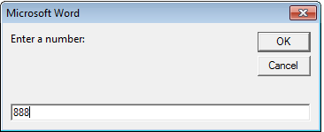
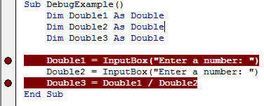
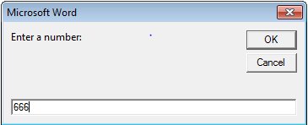
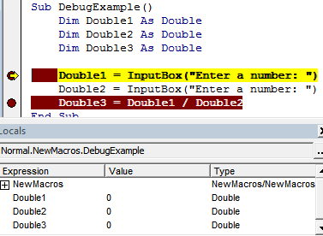
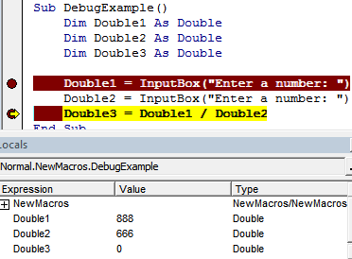
The VBA Debugger (2) (If There Is Time)
Multiple breakpoints
Program pauses when breakpoints are reached
  The contents of variables can be displayed at that point in the program

Slide 75
Common Mistake #1
Mixing up branches (IF and variations) vs. loops (do-while)
Related (both employ a Boolean expression) but they are not identical
Branches
  General principle: If the Boolean evaluates to true then execute a statement or statements (once)
  Example: display a popup message if the number of typographical errors exceeds a cutoff.
Loops
  General principle: As long as (or while) the Boolean evaluates to true then execute a statement or statements (multiple times)
  Example: While there are documents in a folder that the program hasn’t printed then continue to open another document and print it.

Slide 76
Common Mistake #1: 2
Contrast (try running both cases with >1 invalid values)
Learning objective: learning example illustrating the difference between using a branch (wrong approach for error handling in this case) vs. a loop (better approach).
Word document containing the complete program: 21loopVsBranch.docm
age = InputBox("Age (positive only)")
If (age <= 0) then
age = InputBox("Age (positive only-IF)")
End if
MsgBox(age)
Vs.
age = InputBox("Age (positive only)")
Do While (age <= 0)
Age = InputBox("Age (positive only-WHILE)")
Loop
MsgBox(age)

Slide 77
After This Section You Should Now Know
How to use branches to make decisions in VBA
  If
  If-else
  Multiple If’s
  If, else-if, else
  Using logic (AND, OR, NOT) in branches
How to get a program to repeat one or more instructions using Do-while loops
Nesting:
  IF within an IF
  Do-While within an IF
  Writing and tracing/nested structures
  When to apply nesting

Slide 78
After This Section You Should Now Know (2)
Applying looping to collections
How to use the ‘Dir’ function to access a folder
  Using this function to step through all the documents or specific types of documents in a folder

Slide 79
Images
“Unless otherwise indicated, all images were produced by James Tam
Notes:
http://office.microsoft.com/en-ca/images/nature-CM079001922.aspx

