Slide 1
VBA Programming: Part I
This is a Basic introduction into creating VBA programs for Word
Online support: https://support.office.com/en-US/article/create-or-run-a-macro-c6b99036-905c-49a6-818a-dfb98b7c3c9c

Slide 2
VBA (Visual Basic For Applications)
VBA is a “programming language”
  A programming language allows a person to write a computer program
  VBA is based on but not identical to Visual Basic (VB)
  Visual Basic is seldom used
  VBA programs must be associated with a ‘host’ application (usually it’s Microsoft Office document such as MS-Word but other applications can also be augmented by VBA programs).
  Because host applications such as a Office are popular, VBA is still used to create actual programs.
    The host application is enhanced or supplemented by the VBA program
    “Why do I have to keep going through these same steps over and over again for each document?”
      VBA can be used to automate tedious tasks
    “Why doesn’t this stupid word processor have this feature??!!”
      Now you can add that feature yourself using VBA

Slide 3
VBA And Macros
A macro programming language: allows a series of commands to be recorded into a computer program.
  Running the program will execute that sequence of commands.
  Because VBA does have a macroing capability VBA is often referred to as a ‘macroing’ language.

Slide 4
!!!Important Warnings!!!
Because the VBA programs modify Word documents, close important Word documents when you run your programs.
Also, if a VBA program you are running will modify Word documents at a specified location (e.g. C:\work\) make sure that you NEVER put any of your important documents at that location.
And it’s always a good idea to regularly backup your computer files with the backup stored in the cloud or a storage device that isn’t continuously connected.

Slide 5
Accessing The Program Writing Capability In Word
Method 1: In the Word ribbon look under the ‘View’ ribbon
  This ribbon is visible by default
  But looking the View-ribbon doesn’t show all the options for macros
    Can’t ‘record’ macros: this doesn’t affect your working 203 assignment but it’s something to keep in mind if you ever need the auto record capability in the future.
Method 2: Alternatively you can enable the ‘Developer’ ribbon
  This ribbon has more options than the View-ribbon

Slide 6
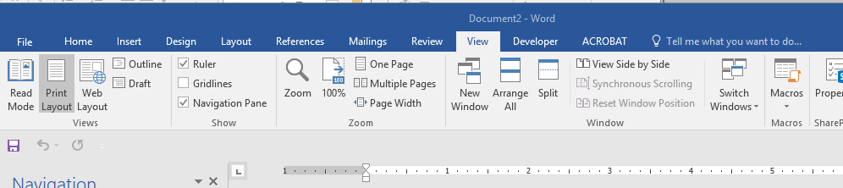
Method 1: View-Ribbon
View->Macros

Slide 7
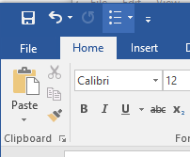
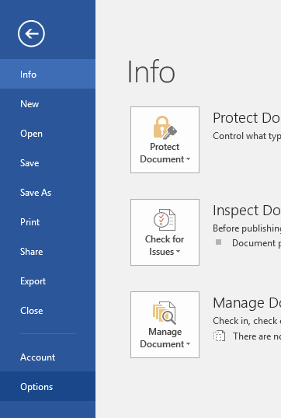
Method 2: Developer-Ribbon
Steps for making a new ribbon tab (Developer) visible
  Select the ‘File’ tab in the ribbon
  Select ‘Options’

Slide 8
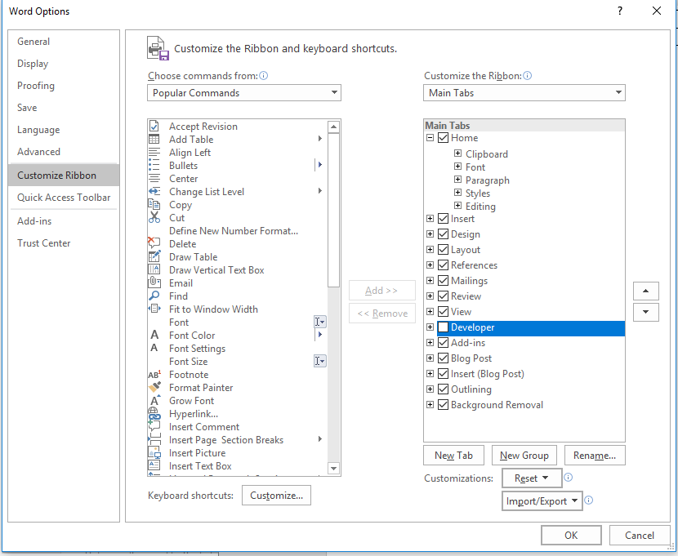
Viewing The ‘Developer’ Ribbon (MS-Word)
3A) Select “Customize the ribbon”
3B) Check the ‘Developers’ box

Slide 9

Viewing The ‘Developer’ Ribbon (MS-Word): 2
This should add a new tab in the ribbon “Developer”

Slide 10
How To Create VBA Programs
Method 1: Record the macro automatically: keystrokes and mouse selections will be stored as part of the program.
Method 2: Manually enter the program (type it in yourself into the VBA editor).

Slide 11
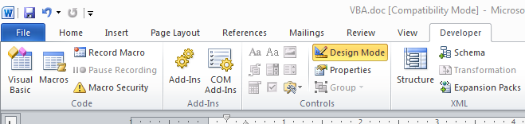
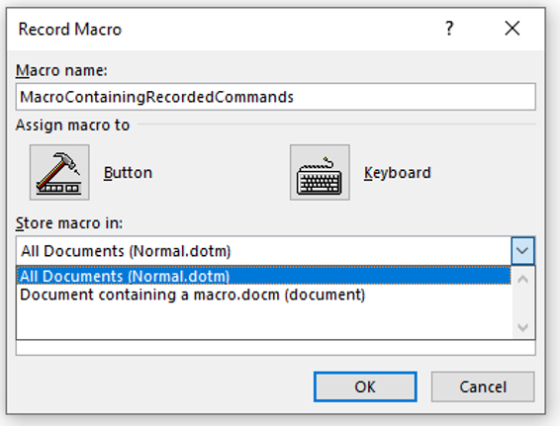
Method 1: Recording A Macro
Developer ribbon
  Click on “Record Macro”
  Recording details
What to name the macro (next slide for more info)
Document to store the macro (select the current Word document – in the example it’s the 2nd option)

Slide 12
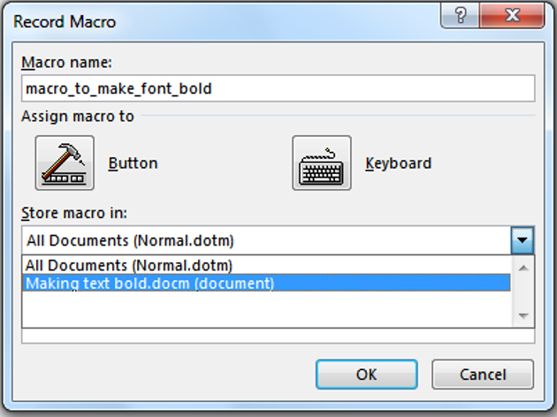
Recording A Macro (2)
    Give the macro a self explanatory name and press ‘OK’ (recording begins).
    Important reminder: record the macro in the current document and not “All documents” (Important!)

Slide 13
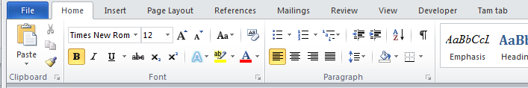
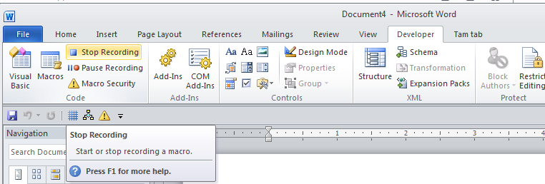
Recording A Macro (3)
While recording you can run whatever Word features you want to add to the recording of the macro
  In this case you would select bold font
  For this simple example all commands have been entered so you can stop the recording (click “Stop recording”)

Slide 14
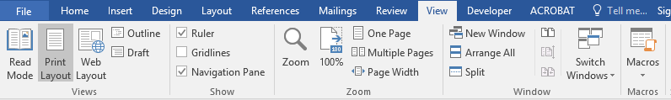
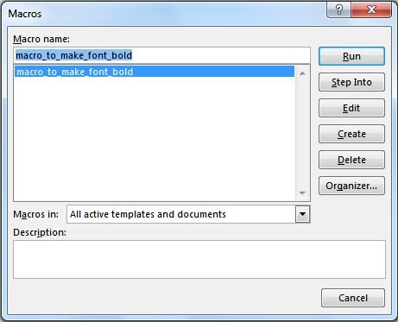
Running A Recorded Macro
Under the ‘View’ ribbon select ‘Macros’
Select the macro (Under “Macro name”) and then click ‘Run’

Slide 15
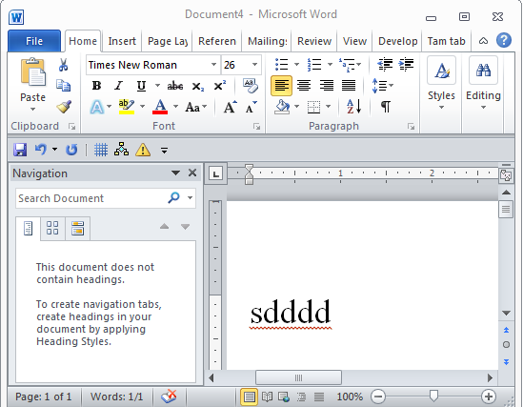
Running A Recorded Macro (2)
In this case nothing happened?
  This macro changes selected/highlighted text to bold
  You need to select some text before running the macro

Slide 16
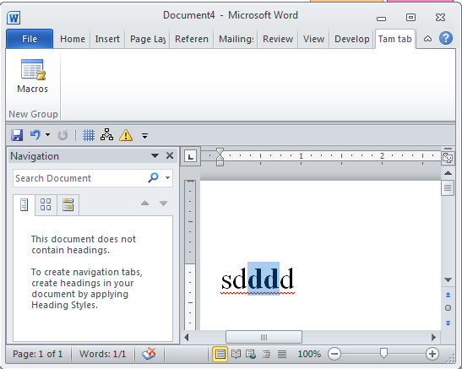
Running A Recorded Macro (3)
After selecting the text and running the macro again, whatever text was highlighted now becomes bold.

Slide 17
Other Examples Of Useful (?) Recorded Macros
Printing: selecting a printer and setting print options can be tedious if your print driver application does not save your previous selections.
  Even if previous selections are saved recording a macro may be useful if you have multiple printing profiles e.g. I print low quality black and white double sided documents stapled on the top left for staff and high quality color single sided with multiple staples with glossy paper for clients.
Entering hard to spell words (especially if they are new)
  Example: “Gotterdammerung” is hard enough to spell but this word is supposed to have the “umlaut” for the ‘o’ (actually ö) and ‘a’ (actually ä).
  JT: shifting to German keyboard in Word can be done via: <Ctrl>-<shift>-<;> (this key combination must be entered prior to typing each alternate character).

Slide 18
Method 1: Recording Macros (Comments)
It’s a good and simple way for anyone to automate a tedious series of commands in Word.
This approach is quite limited.
  E.g. how would you record a macro to automatically open, edit and print all the documents in a folder?
  The main goal in introducing the recording approach is to make you aware of this capability for your future use.
For the assignment this approach will not work.
Also on the exam you must manually write macros (on paper) or trace a macro (figure out what happens when it runs).
  “Recording” is not feasible for the exam

Slide 19
How To Create VBA Programs
Method 1: Record the macro automatically: keystrokes and mouse selections will be stored as part of the program
  An example was just covered.
Method 2: Manually enter the program (type it in yourself into the VBA editor)
  This is how you are to complete your assignment and is how many VBA programs are created.
  Consequently the remainder of the course notes will focus on Method 2

Slide 20
Steps For Method 2: Typing In Your VBA Macro Programs
Open Word
If you created a new blank document: change this document to one that contain macros:
  Save As (document that can contain a macro which is a “Word macro enabled document” or ‘docm’)
View->Macro
Save the VBA macro program into current document if not selected:
  Select the option that includes the name of the Word document that you just created.
  Under macro name enter a good descriptive name (no spaces)
  Click the create button
Type in your program (more later) e.g. MsgBox("hi")

Slide 21
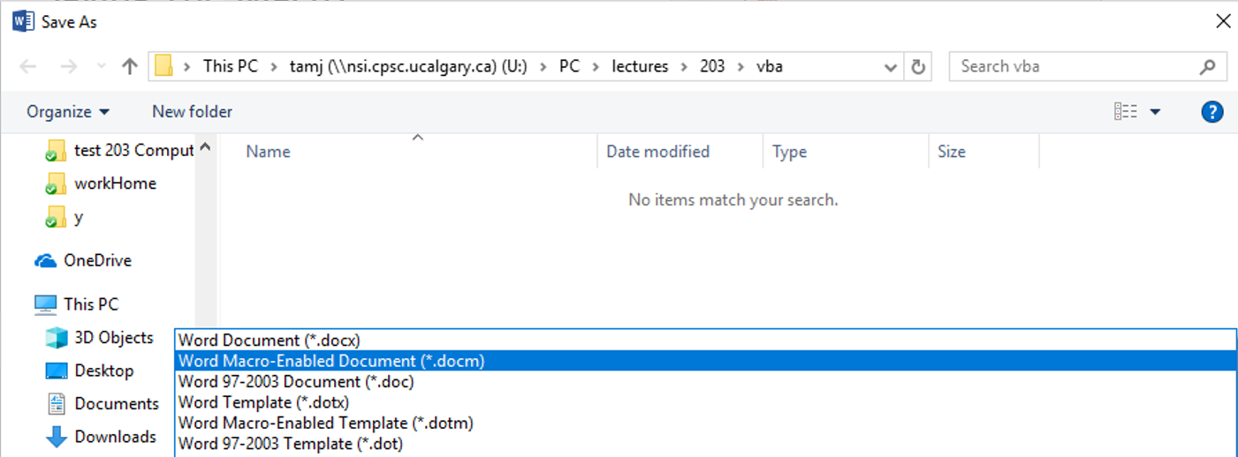
Step 2: Saving The Macro Into A Document That Can Contain Macros
Save using Word rather than in the VBA editor
Make sure you ‘Save as’ as a MACRO ENABLED Word document

Slide 22
Step 3: Viewing The Ability To Write Programs In Word
View->Macros

Slide 23
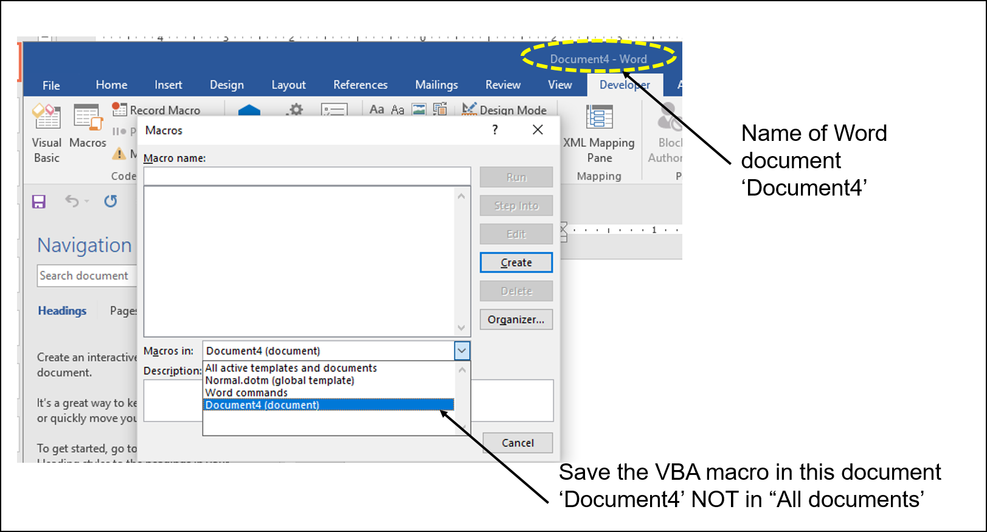
Step 4: Saving The Macro In Current (Not All) Word Documents
Reminder: After the previous step (clicking on “Visual Basic”) you will need to indicate that you want to save the VBA program in the CURRENT DOCUMENT not in all documents.

Slide 24
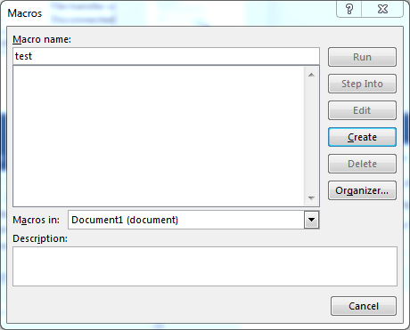
(Prior To Step 5)
“Macro name”: usually you should enter a good self descriptive name, if you can’t think of anything else for your test program then call it ‘test’.
  Then select ‘create’

Slide 25
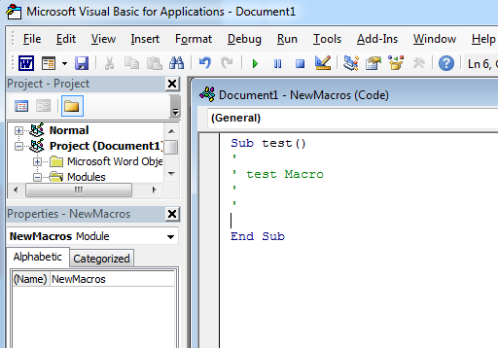
Step 5:Entering The Program Into the VBA Editor
(Selecting ‘create’ in the previous step then causes the VBA editor to appear)
Much of the rest of the VBA lectures will describe the types of instructions that you can type between the ‘sub’ and ‘end sub’
Enter your program here (indent each level by at least one tab), until you see the examples in the last section of notes there will only be one level of indenting.

Slide 26
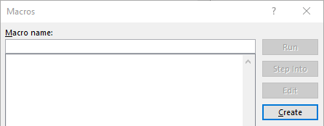
The Visual Basic Editor
You don’t need to familiarize yourself with every detail of the editor in order to create VBA programs.
Just a few key features should be sufficient
Starting the editor:
  Because VBA programs are associated with an office application open the editor from MS-Word
  ‘View->Macros->’
    Making a new macro then select: ‘Create’
    Accessing a macro you already created: ‘Edit’ (greyed out in the image because no macros have been created yet).

Slide 27
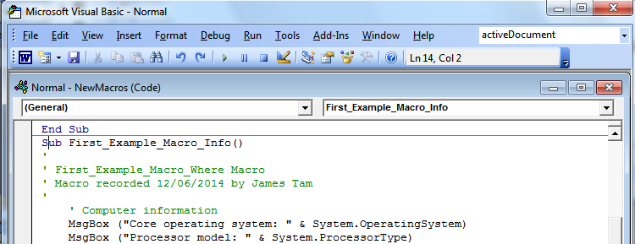
Overview Of The Important Parts Of The VBA Editor
Cut, copy, paste
Find, replace
Help lookup
Program editor
Undo, redo
Run, pause, stop (VBA subroutine program)
Current location
JT’s opinion: focus on just the features with bolded text

Slide 28
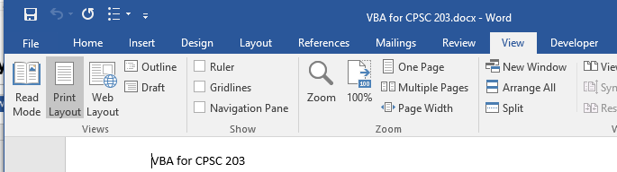
VBA Editor: Don’t Mix It Up With The Word Editor

Slide 29
Writing A Program In The VBA Editor
Format:
  ' Program documentation goes here (more on this later)
  sub <sub-program name>()
  End Sub
Example:
  ' Author, version, features etc.
  Sub first_example_macro_info()
  MsgBox ("First computer program")
  End Sub
Note: large VBA programs have multiple (sub) parts but for this class you only need to define a single ‘sub’.
Instructions in the body of program (indent by 1 tab)
Notes:
https://msdn.microsoft.com/en-us/library/ie/ms535841(v=vs.85).aspx

Slide 30
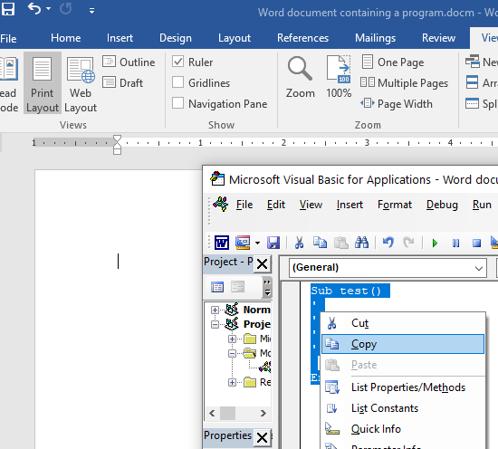
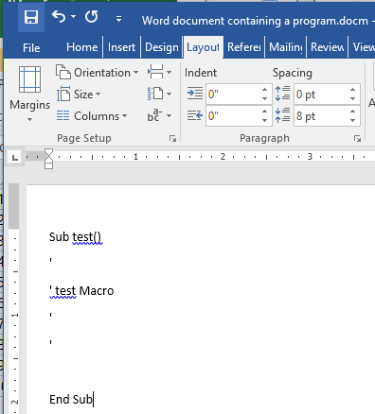
Copy-Paste The Program (VBA Editor->Word)

Slide 31
Transferring Your Work
If you work on your own computer you need to test your program periodically.
If you work only on campus computers then you need to save on a flash drive or via the cloud.
Important summary:
  Save the VBA macro in the current Word document:
  And you saved that document as a Word Macro-Enabled document (*.docm) then you simply have to transfer that Word document.
  Copy-paste the VBA program into the body of regular Word document (at least copy it in the document containing your program) just to be safe.

Slide 32
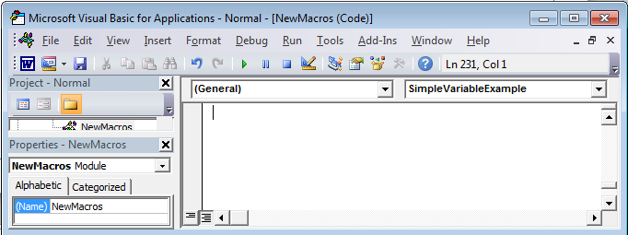
First VBA Example
Learning Objectives:
  Creating/running a VBA program
  Creating a popup message using a “MsgBox”
Reminder steps (since this is your first example)
  Start up the application (MS-Word)
  Complete Steps 2 – 4 of creating a VBA program by typing
  If successful you should see something similar to the image
Enter your program instructions here (program editor)

Slide 33
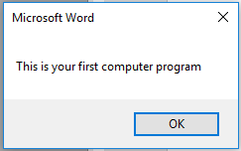
First VBA Example (2)
Type in or cut-and-paste the following example into the VBA editor (see the image previous slide for how the editor appears)
  This is NOT the same as pasting it directly into MS-Word.
  Word document containing the macro (empty document see the macro editor for the important details): 1firstExampleMacro.docm
  Sub first_example_macro_info()
  MsgBox ("This is your first computer program")
  End Sub

Slide 34
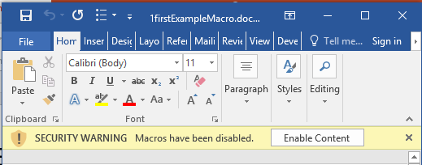
Opening Word Documents Contain Macros
If you don’t change the default setting in Word you should get a warning when you open the Word document (containing macros).
You can “enable the content” of your own programs or the examples that I wrote.
JT’s caution
You should NOT casually select this option for all MS-Word documents
It’s recommended that you ONLY enable macros you have created (or the lecture & tutorial examples)

Slide 35
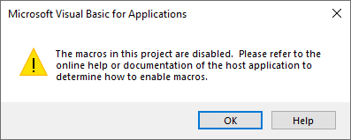
New: Opening Word Documents Contain Macros
Recently (noticed as of Oct 2020) there was a change in how Word handles Macro security.
The popup shown in the previous slide may not appear yet and macros will not run even if you change the security settings in Word to the least restrictive security settings! :(
  The popup error message is not helpful. ¯\_(ツ)_/¯

Slide 36
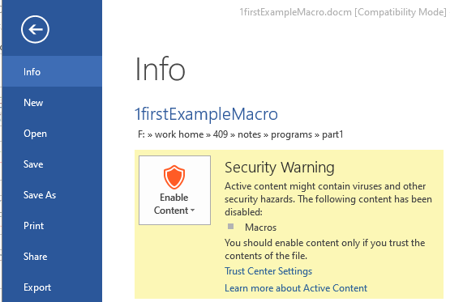
New: Opening Word Documents Contain Macros (2)
What’s the issue?
  Microsoft’s Word developers in it’s collective wisdom decided to move the option to enable macros from a prominent place in the Home tab.
  You now have to look in the File tab under Info. (Much better right?)

Slide 37
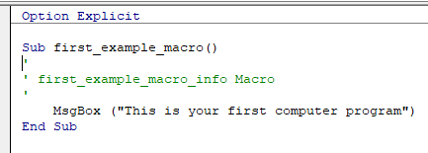
Option Explicit
It’s a good idea to include this in all your programs.
It should be located before the ‘sub’ keyword.
Explanations about what it does will come in subsequent lectures (in conjunction with more advanced material).
For now “just add it in” because it may result in fewer problems for you later.

Slide 38
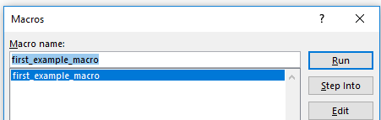
Reminder: Running Macros
Click View->Macros
The single macro should be highlighted, then click ‘run’

Slide 39
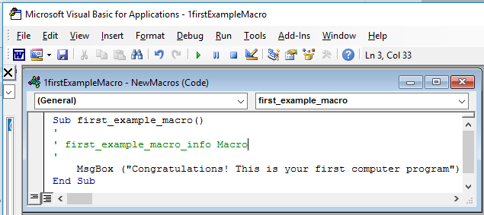
Running VBA Programs You Have Entered (2)
Alternatively: you can run the program right after you have entered it (in the editor).
Ensure correct program “sub” is to be executed (click there)
Press the ‘play/run’ button or “F5”

Slide 40
Writing Programs On Your Own
After this point you will be required to type in your programs from scratch rather than copy-paste a pre-created program into the editor.
This means that additional details are needed.

Slide 41

VBA Programming: How To Study
At the very least: try typing the programs into the VBA editor or cutting and pasting them yourself (watch for altered characters such as quotes)
For the more complex programs (end of this section as well as the next section) try re-creating the programs on your own:
  Think about what tasks are accomplished by my solution program
  Without looking at my solution try entering into the program into the VBA editor to accomplish these same tasks
With programming you learn by “doing yourself” rather than by watching someone else ‘do’
Sub first_example
MsgBox(“This

Slide 42
Program Structure And The ‘Sub’ Keyword
Sub stands for ‘subroutine’ or a portion of a VBA program Format:
  Sub <subroutine name>()
  <Instructions in the subroutine>
  End Sub
Example:
  Sub First_Example_Macro_Info()
  End Sub
Unless otherwise told all VBA program statements must be inside the subroutine (“Option Explicit” excluded)
Header, start of subroutine:
Has word ‘Sub’
Name of subroutine
Set of brackets
Note: all lines in between are indented (1 tab, 2+ tabs if sub-indenting is used – later sets of notes)
End of subroutine:
Has ‘End Sub’

Slide 43
The ‘Sub’ Keyword: 2
Real world VBA programs will be broken down into multiple ‘subs’ (subroutines or program parts)
Again: Because this is only brief introduction into writing VBA programs you will only have to define one subroutine for your assignment.

Slide 44
Naming The Subroutine
This is what follows the ‘sub’ keyword.
Example
  Sub formattingResume
  End Sub
Naming standards:
  The name chosen should summarize what the program is supposed to do.
  The choice of the name will play a role in determining your assignment grade.
  If you can’t come up with a good name for the assignment then at least make it a practical one for the marker e.g. “a3”

Slide 45
Choosing A Name: VBA Technical Requirements
Must start with an alphabetic letter, after than any combination of letters and numbers may be used
  OK: “assigment1”, “a2939” Not OK: “1assignment”, “*assignment”
Maximum length of 80 characters
It cannot contain spaces, punctuation or special characters such as # or !
  ‘resume headings’ (Not Allowed: space character)
  ‘macros!’ (Not Allowed: special character)
Can contain underscores (separate long names)

Slide 46
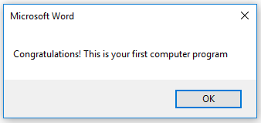
Message Box
(Details of the previous example)
Creates a popup window to output information from your program
Useful for testing
  Is my program working?
  Which part is running?
Also useful for displaying status messages about the current state of the program

Slide 47
Creating A Message Box
Format:
  MsgBox ("<Message to appear>")
Example:
  MsgBox ("This your first computer program")
Notes on ‘Format’:
Italicized: you have a choice for this part
Non-italicized: mandatory (enter it as-is)
Don’t type in the angled brackets (used to help you visually group)

Slide 48
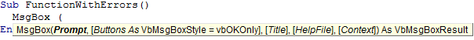
VBA Visual Aids: Function Arguments
As you type in the name of VB functions you will see visual hints about the arguments/inputs for the function.
  JT: You won’t need to worry about all functional arguments for this class.
  Enter the function name and then a space
Function arguments
(Bold): mandatory arguments

Slide 49
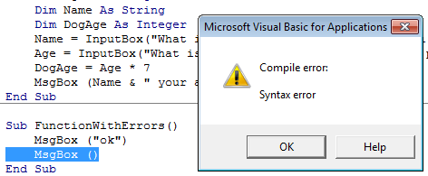

VBA Visual Aids: Error Information
The requirements for forming VBA programming instructions are referred to as the ‘syntax’ (grammar/rules) of the language.
Syntax violations are visually highlighted in VBA:
Required argument missing
Part of program that contains errors (yellow highlight)
Specific statement/instruction causing the error (red font)

Slide 50

Program Documentation
Instructions for the computer
(Computer): problem, I don’t know how to run the “James Tam” instruction
Your VBA assignment submission must include identification about you and information the features of your program
  Full name
  Student identification number
  Tutorial number (if applicable)
  List the program features (from the assignment description) and clearly indicate if the feature was completed or not completed.
  Program version
DON’T just enter this information into your program instructions

Slide 51
Program Documentation (2)
You must ‘mark’ this information so it doesn’t cause an error
  The marking will indicate to the VBA translation mechanism that the line is for the reader of the program and not to be translated and executed
  The marking is done with the single quote '
Format:
  '<Documentation>
Example:
  'Author: James Tam
No error: Everything after the quote until the end of the line will not be executed
That means documentation doesn’t have to be a valid and executable instruction

Slide 52
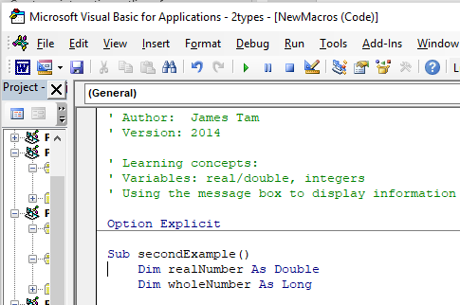
Program Documentation (3)
Contact information should be located before your program
Before the ‘sub’ keyword and before the “Option Explicit”
Documentation: marked in red

Slide 53
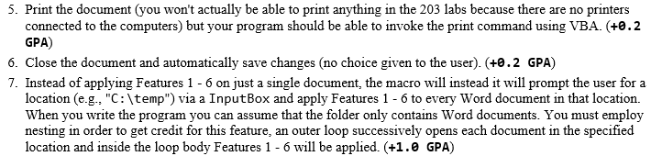
Program Documentation (4)
Program features (this will be worth a fair number of marks)
Example assignment description
Program documentation
  ' Author: James Tam ID: 123456
  ' Version: Nov 2, 2015
  ' Tutorial: 99
  ' PROGRAM FEATURES
  ' #5: Printing: completed
  ' #6: Close and save: not completed
  etc
These are easy marks to earn!

Slide 54
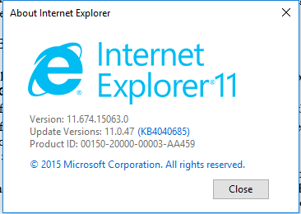
Program Documentation (5)
Versioning
  It’s a commonly used industry practice:
  For assignments you can either use version numbers or dates (recommended)

Slide 55
Program Versioning And Back Ups
As significant program features have been completed (tested and the errors removed/debugged) a new version should be saved in a separate file.
A3.Oct2
' Version: Oct 2, 2012
' Program features:
' (2) Count, display typos
' Version: Sept 20, 2012
' Program features:
' (5) Print
' (6) Save & close
A3.docm
' Version: Oct 2, 2012
' Program features:
' (2) Count, display typos
' Version: Sept 30, 2012
' Program features:
' (5) Print
' (6) Save & close
Make new backup file
A3.Sept30
' Version: Sept 20, 2012
' Program features:
' (5) Print
' (6) Save & close
Don’t touch the backups (date in the file name) and only work on A3.docm

Slide 56
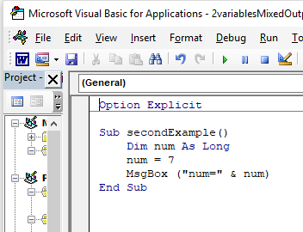
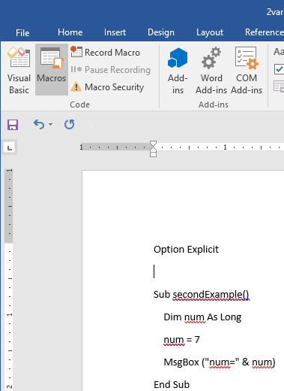
Additional Backup Tip: Copy-Paste
Periodically copy-paste the VBA program into a regular Word document

Slide 57
Variables
Used to temporarily store information at location in memory
Variables must be declared (created) before they can be used.
Format for declaration:
  Dim <Variable name> as <Type of variable>
Example declaration:
  Dim BirthYear as Long
CPSC mail
TAM

Slide 58
Common Types Of Variables
Type of information stored | VBA Name | Example variable declaration | Default Value
Whole numbers | Long | Dim LuckyNumber as Long | 0
Real numbers | Double | Dim MyWeight As Double | 0
Chararacters¹ | String² | Dim Name As String | Empty string
Date³ | Date | Dim BirthDate As Date | 00:00:00
1) Any visible character you can type and more e.g., ‘Enter’ key
2) Each string can contain up to a maximum of 2 billion characters
3) Format: Day/month/year

Slide 59
Variable Naming Conventions
Language requirements (syntax):
  Rules built into the Visual Basic (recall VBA is essentially Visual Basic tied to an MS-Office Application) language.
  Somewhat analogous to the grammar of a ‘human’ language.
  If the rules are violated then the typical outcome is the program cannot execute.
Style requirements:
  Approaches for producing a well written program.
  (The real life analogy is that something written in a human language may follow the grammar but still be poorly written).
  If style requirements are not followed then the program can execute but there may be other problems (e.g., it is difficult to understand because it’s overly long and complex - more on this during the term).

Slide 60
Naming Variables: VBA Language Requirements
Names must begin with an alphabetic character
  OK: name1 Not OK: 1name
Names cannot contain a space
  OK: firstName Not OK: first name
Names cannot use special characters anywhere in the name
  Punctuation: ! ? .
  Mathematical operators: + - * / ^
  Comparison operators: < <= > >= <> =

Slide 61
Naming Variables: Style Conventions
Style requirement (all languages): The name should be meaningful.
Style requirement (from the Microsoft Developer Network¹):
  Choose easily readable identifier names
  Favor readability over brevity.
Examples
#1:
age (yes)
x, y (no)
HorizontalAlignment (yes)
AlignmentHorizontal (no)
CanScrollHorizontally (yes)
ScrollableX (no)
1 http://msdn.microsoft.com/en-us/library/ms229045.aspx

Slide 62
Naming Variables: Style Conventions (2)
Style requirement: Variable names should generally be all lower case except perhaps for the first letter (see next point for the exception).
Style requirement: For names composed of multiple words separate each word by capitalizing the first letter of each word (save for the first word) or by using an underscore. (Either approach is acceptable but don’t mix and match.)
Avoid using keywords as names (next slide)
Examples
#3:
age, height, weight (yes)
HEIGHT (no)
#4
firstName, last_name
(yes to either approach)

Slide 63
Some Common Visual Basic Keywords¹
And Boolean Call Case Catch Continue
Date Decimal Default Dim Do Double
Each Else End Erase Error Event
Exit False Finally For Friend Function
Get Global Handles If In Inherits
Integer Interface Is Let Lib Like
Long Loop Me Mod Module Next
Not Nothing Of On Operator Option
Optional Or Out Overrides Partial Private
Property Protected Public Resume Return Select
Set Shadows Short Single Static Step
Stop String Sub Then Throw To
True Try Using Variant When While
Widening With
1 The full list can be found on the MSDN http://msdn.microsoft.com/en-us/library/dd409611.aspx
Notes:
63

Slide 64
Variable Naming Conventions: Bottom Line
Both the language and style requirements should be followed when declaring your variables.

Slide 65
Examples Of Assigning Values To Variables
CPSC mail
TAM
mail
Note: some types of variables requires some mechanism to specify the type of information to be stored:
Strings: the start and end of the string must be marked with double quotes "
Date: the start and end of the string must be marked with the number sign #
Dim LuckyNumber As Long
LuckyNumber = 888
Dim BirthDay As Date
BirthDay = #11/01/1977#
Dim MyName As String
MyName = "James"

Slide 66
Basic Mathematical Operators
Operation | Symbol used in VBA | Example
Addition | + | 2 + 2
Subtraction | - | 3 – 2
Multiplication | * | 10 * 10
Division | / | 81 / 9
Exponent | ^ | 2 ^ 3

Slide 67
MsgBox And Variables
Typing the name of a variable in a message box (no quotes) will display the current contents of that variable.
Example (from a program coming up)
  Dim realNumber As Double
  realNumber = 1 / 3
  MsgBox (realNumber)
  MsgBox ("realNumber")
0.333... appears
realNumber appears

Slide 68
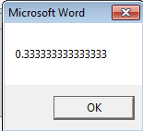
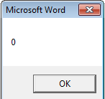
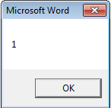
Second VBA Example (2)
  Learning objective: Display the contents of variables
  Word document containing the macro: 2types.docm
  Sub secondExample()
  Dim realNumber As Double
  Dim wholeNumber As Long
  realNumber = 1 / 3
  MsgBox (realNumber)
  wholeNumber = 5 / 10
  MsgBox (wholeNumber)
  wholeNumber = 6 / 10
  MsgBox (wholeNumber)
  End Sub
JT’s note: Anything over 0.5 is rounded up

Slide 69
Common Mistake #1
A variable is just that – it can change as a program runs.
Approach #1: variable not used (lacks flexibility)
  MsgBox ("My age is...")
  MsgBox ("...37")
Approach #2: variable employed (age can be changed with any mathematical expression)
  Dim age As Long
  age = 37
  MsgBox ("My age is...")
  MsgBox (age)
  age = 38
  MsgBox ("My age is...")
  MsgBox (age)

Slide 70
MsgBox: Displaying Mixes Of Strings And Variables
Format:
  MsgBox ("<Message1>" & <variable name>)
Learning objective: Mixed output in a MsgBox (variables and constant text strings)
Name of the online example: 3variablesMixedOutput.docm
  Dim num as Long
  num = 7
  MsgBox ("num=" & num)
"num=" : A literal string
num : contents of a variable (slot in memory)

Slide 71
Why Mix The Display Of Strings & Variables
Labeling variables as they appear makes your program easier to understand
4.3
3.3
3.7
2.0
4.0
4.0
3.9
1.0
Student 1: 4.3
Student 2: 3.3
Student 3: 3.7
Student 4: 2.0
Student 5: 4.0
Student 6: 4.0
Student 7: 3.9
Student 8: 1.0
Vs.

Slide 72
Student Exercise #1: Mixed Output
What is the output of the following MsgBox:
Solution: Exercise1.docms
Sub exercise1()
Dim num As Long
Dim aStr As String
num = 12
aStr = "num="
MsgBox (aStr & num)
End Sub
Notes:
Num=12

Slide 73


Variables: Metaphor To Use
www.colourbox.com
Think of VBA variables like a “mail slot in memory”
Unlike an actual mail slot computer variables can only hold one piece of information
  Adding new information results in the old information being replaced by the new information
Dim num as Long
num
Representing num twice doesn’t mean there exists two locations by this name
num
num = 1
1
17
num = 17

Slide 74
Common Mistake #2
Assigning values from one variable does not ‘link’ them
  num1 = 1
  num2 = num1
  num1 = 2
Notes:
Num1 = 2
Num2 = 1

Slide 75
Student Exercise #2
  Also each computer variable is separate location in memory.
  Each location can hold information independently of other locations.
    Note: This works differently than mathematical variables!
    What is the result?
    Solution: Exercise2.docms
Sub exercise2()
Dim num1 as Long
Dim num2 as Long
num1 = 1
num2 = num1
num1 = 2
End Sub
Notes:
1 1
2 1

Slide 76
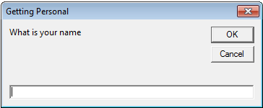
Getting User Input
A simple approach is to use an Input Box
Format:
  <Variable name> = InputBox(<"Prompt">, <"Title bar">)
Example:
  Name = InputBox("What is your name", "Getting Personal")
Note: only the string for the prompt (first) is mandatory.
If the title bar information is omitted then the default is the application name (“Microsoft Word”)

Slide 77
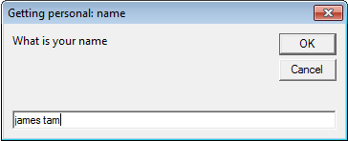
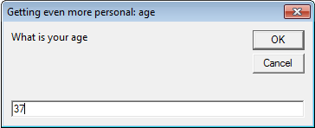
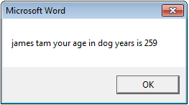
Example: InputBox
Learning objective: getting information from the user.
Word document containing the macro: 4inputBox.docm
  Sub InputExample()
  Dim age As Long
  Dim name As String
  Dim dogAge As Long
  name = InputBox("What is your name", "Getting personal: name")
  age = InputBox("What is your age", "Getting even more personal: age")
  dogAge = age * 7
  MsgBox (Name & " your age in dog years is " & dogAge)
  End Sub
  Note: there are two input boxes, one that prompts for the name and the other for the age. Each is given a self-descriptive name to distinguish them (an example of good programming style – more on this shortly)
Notes:
Setting MsgBox title bar is more complicated
Dim a As Integer
MsgBox (Application.Windows.Count)
a = MsgBox("Do you want to continue?", vbYesNo, "This is the title of the msgbox")

Slide 78
Student Exercise #3: Getting Input, Display Output Based On The Input
Write a program that will ask the user for their age and name.
The program will then display the name and age of the user in the following format:
  Format of what program displays:
    <Name> : <Age> is a good age
  Example output: user enters ‘james’ and 1
    James: 1 is a good age
(You can use Example 4 as a starting point for your program).
Solution: Exercise3.docms

Slide 79
The Line Continuation Character
Learning objective: how to split a long VBA instruction between multiple lines.
Misnomer: The “line continuation character” is actually two characters.
  Space (i.e. press the space bar)
  This is immediately followed by the under score

Slide 80
Line Continuation Character Example
Example VBA document containing the program: 5lineContinuationCharacter
  Dim name As String
  Dim address As String
  Dim phone As String
  Dim age As Long
  name = InputBox("What is your name")
  address = InputBox("Address: ")
  phone = InputBox("Phone (format: (xxx)xxx-xxxx): ")
  age = InputBox("What is your age")
  MsgBox (name & " lives at " & address _
  & " " & phone & " " & age)
  The last line is equivalent to:
  MsgBox (name & " lives at " & address & " " & phone & " " & age)

Slide 81
After This Section You Should Now Know
How to copy and run the pre-created lecture examples
How the VB editor identifies programming errors
How to create and execute simple VBA macros
  You should know that macros can be automatically recorded but specifics will be covered in tutorial
  Manually entering programs into the VB editor yourself
How to create/use a Message Box “MsgBox”
How to use basic mathematical operators in VB expressions
How to create and use variables
Naming conventions for variables

Slide 82
After This Section You Should Now Know (2)
What are commonly used variable ‘types’ in VB
How to get user input with an Input Box “InputBox”
How to create program documentation (as well contact information that should be included in documentation)

Slide 83
Images
“Unless otherwise indicated, all images were produced by James Tam
Notes:
http://office.microsoft.com/en-ca/images/nature-CM079001922.aspx

