Slide 1
VBA Extras Part 2: Excel Programming & Data Visualization
Excel VBA programming: Inserting charts into a spreadsheet & sorting data
General programming concept, nesting: loops within loop
Visualizing information in Excel: Pivot tables

Slide 2
Excel VBA Programming

Slide 3
Inserting Charts Into A Spreadsheet¹
Step 1: A range of cells needs to be selected via the Range object, examples:
  Adjacent columns:
    Range("C1:D13").Select
  Non-adjacent columns
    Range("C1:C13,E1:D13").Select
Step 2: the chart² is added inside of container shape
  ActiveSheet.Shapes.AddChart2(201, xlLineMarkers).Select
1 Information links on adding a chart
https://docs.microsoft.com/en-us/office/vba/api/project.shapes.addchart
https://docs.microsoft.com/en-us/office/vba/api/Excel.shapes.addchart2
2 Information specifying named constants for different chart types
https://docs.microsoft.com/en-us/office/vba/api/Excel.XlChartType

Slide 4
VBA Example: Inserting Chart Clustered Line
Name of the spreadsheet that contains the VBA example: Excel5_insert_chart_clustered_line
  Learning objective: inserting this chart type with a hard coded (fixed) range.
    Sub insertChartClusteredLine()
    Range("C1:C13,D1:D13").Select
    ActiveSheet.Shapes.AddChart2(201, xlLineMarkers).Select
    End Sub

Slide 5
VBA Example: User Specified Values For Charts
Specifying variable range of data (entered by a user) to chart
  (Assumes the columns are side by side, modifications needed to chart non-continuous data).
    startRange = InputBox(...)
    startRange = InputBox(...)
    range(startRange & ":" & endRange).Select
Specifying chart title from a variable (entered by a user)
  (Assumes that a chart has just been added)
    chartTitle = InputBox(...)
    ActiveChart.chartTitle.Select
    ActiveChart.chartTitle.Text = chartTitle

Slide 6
VBA Example: Inserting Variable Chart Data
Name of the spreadsheet that contains the VBA example: Excel6_insert_chart_clustered_line_variable_range_and_title
  Learning objective: inserting this chart type with a user specified range and title.
    Dim startRange As String
    Dim endRange As String
    Dim chartTitle As String
    'Specifying the user selected range
    startRange = InputBox("Start cell of data to chart: ")
    endRange = InputBox("End cell of data to chart: ")
    Range(startRange & ":" & endRange).Select

Slide 7
VBA Example: Inserting Variable Chart Data (2)
    ActiveSheet.Shapes.AddChart2(201, xlLineMarkers).Select
    'Setting the user specified title
    chartTitle = InputBox("Title for the chart: ")
    ActiveChart.chartTitle.Select
    ActiveChart.chartTitle.Text = chartTitle

Slide 8
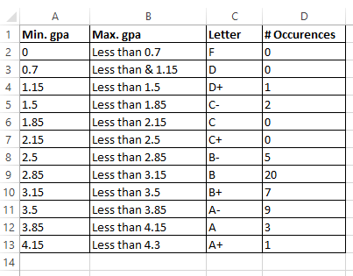
Counting Number Of Rows Of Data
Start count
Count + 1

Slide 9
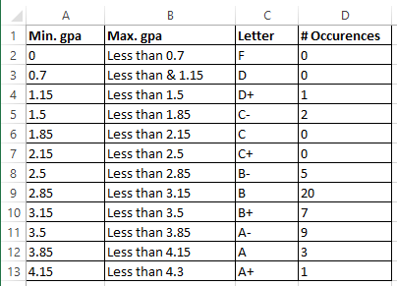
VBA Counting Rows Of Data
Name of the spreadsheet that contains the VBA example: Excel7_counting_rows
  Learning objective: determining the number rows of data (data = non-empty) in a spreadsheet.
    Const LETTER_GRADE_COLUMN As Long = 3
    Const START_ROW As Long = 1
    Const EMPTY_ROW As String = ""
    Dim rowData As String
    Dim currentRow As Long
    Dim count As Long
LETTER_GRADE_COLUMN
EMPTY_ROW

Slide 10
VBA Counting Rows Of Data (2)
    currentRow = START_ROW
    count = 0
    rowData = Cells(currentRow, LETTER_GRADE_COLUMN)
    Do While (rowData <> EMPTY_ROW)
    count = count + 1
    currentRow = currentRow + 1
    rowData = Cells(currentRow, LETTER_GRADE_COLUMN)
    Loop
    MsgBox ("Num. rows=" & count)

Slide 11
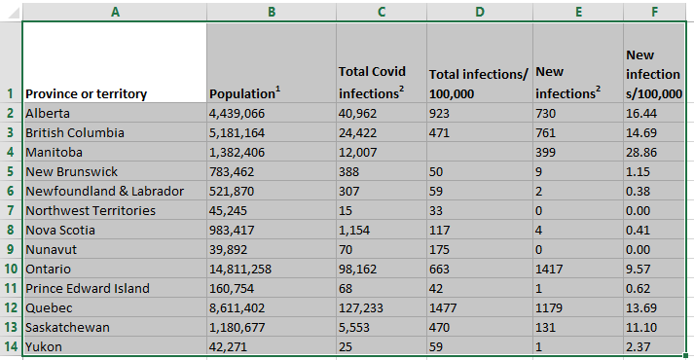
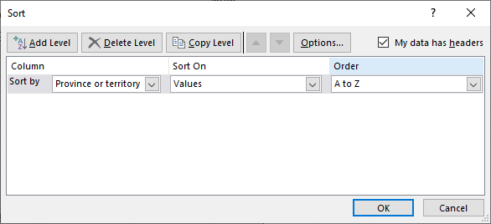
Sorting Spreadsheets In Excel
Select the range
Set sort criteria

Slide 12
VBA Sort Code Criteria
You must first do this:
  (According to MS-docs) Clears all the SortFields objects:
    ActiveWorkbook.Worksheets(1).Sort.SortFields.Clear
Specify the criteria used in the sort ‘key’:
  ActiveWorkbook.Worksheets(1).Sort.SortFields.Add Key:= Range("A1")
Specify the sorting order (ascending “A-Z” or descending “Z-A”)
  ActiveWorkbook.Worksheets(1).Sort.SortFields.Add Order:=xlAscending 'x1Descending is the other option
Specify the range of cells to be sorted
  ActiveWorkbook.Worksheets(1).Sort.SetRange Range("A1:F14")
Specify if there is a header row
  ActiveWorkbook.Worksheets(1).Sort.Header = xlYes
  'x1No=range has no header, x1yes=range has header
For more information: https://docs.microsoft.com/en-us/office/vba/api/excel.sort

Slide 13
VBA Example: Simple Sort
Name of the spreadsheet that contains the VBA example: Excel8_simple_sort
  Learning objective: sorting with a predetermined fixed range in the currently active worksheet.
    ActiveWorkbook.Worksheets(1).Sort.SortFields.Clear
    ActiveWorkbook.Worksheets(1).Sort.SortFields.Add Key:= _
    Range("A1"), Order:=xlAscending
    With ActiveWorkbook.Worksheets(1).Sort
    .SetRange Range("A1:F14")
    .Header = xlYes 'Options: x1No, x1yes
    .Apply
    End With

Slide 14
VBA Example: More Advanced Sort
Name of the spreadsheet that contains the VBA example: Excel9_advanced_sort
  Learning objective: sorting only rows that contain data, sorting the worksheet with the specified name.
    'Count number of rows (i.e. contain data)
    currentRow = START_ROW
    count = 0
    rowData = Cells(currentRow, 1)
    Do While (rowData <> EMPTY_ROW)
    count = count + 1
    currentRow = currentRow + 1
    rowData = Cells(currentRow, 1)
    Loop

Slide 15
VBA Example: More Advanced Sort
    'Sort only occupied cells worksheet called "Covid Stats"
    ActiveWorkbook.Worksheets(1).Sort.SortFields.Clear
    ActiveWorkbook.Worksheets(1).Sort.SortFields.Add Key:= _
    Range(SORT_CRITERIA), Order:=xlAscending
    With ActiveWorkbook.Worksheets("Covid Stats").Sort
    .SetRange Range(START_RANGE & ":" & "F" & count)
    .Header = xlYes
    .Apply
    End With
Specify worksheet name
Sort only occupied rows

Slide 16
General Programming Concept: Nested Loops

Slide 17
Recognizing When Nesting Is Needed
Review: A second question is asked only if a first question answers true:
  Example: If it’s true the applicant is a Canadian citizen, then ask for the person’s income (checking if eligible for social assistance).
  Type of nesting: an IF-branch nested inside of another IF-branch
  If (Boolean) then
    If (Boolean) then
    ...
    End If
    End if
Q: Citizen?
F
T
Q: Low income?
F
T
Nested branch/IF
May receive assistance
No assistance

Slide 18
New: Recognizing When Nested Repetition Is Needed
For each step that a process repeats, repeat another process from start to end.
F
Q: 1st process not done?
T
Steps of 1st process
Q: 2nd process not done?
F
T
Steps of 2nd process
Completed repetition

Slide 19
Example 1: Washing Dishes
While (there are dishes left unwashed)
Get a dirty dish
Apply soap to dish
while (dish is still dirty)
Rub dish with wet cleaning tool
If (more soap needed)
Apply soap to dish

Slide 20
Example 2: Practicing A Martial Arts Set
Assume guard position
While (there is still a compass point with opponent)
Turn left to face opponent
while (opponent is still standing)
Throw right reverse punch
Left rising block
Throw right reverse punch
Assume guard position
Assume the curtesy (bow and finish)
Bad guy
Bad guy
Sifu (master) Tam
Bad guy
Bad guy

Slide 21
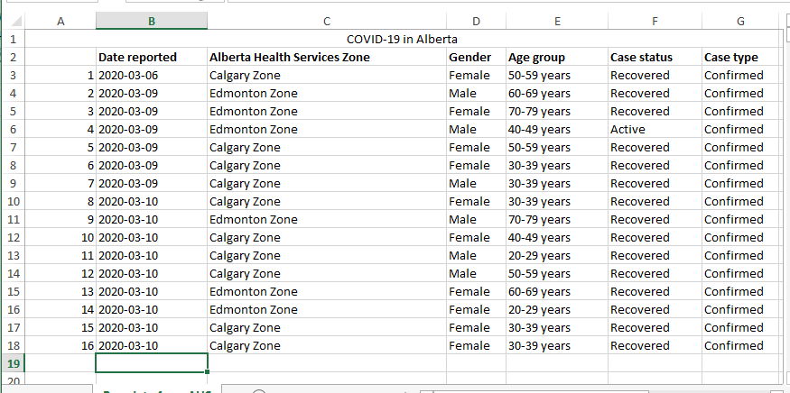
Example 3: Counting Covid Alberta Cases

Slide 22
Review Example: Nested Branch Inside Loop
Name of the spreadsheet that contains the VBA example: Excel10_counting_occurences
  Learning objective: review of how to write a program that checks a condition (IF-branch) each time that a process repeats (or runs for the first time) – which is a WHILE-loop.
    currentRow = START_ROW
    currentStatus = Cells(currentRow, STATUS_COLUMN)
    Do While (currentStatus <> EMPTY_ROW)
    If (currentStatus = STATUS_OF_INTEREST) Then
    count = count + 1
    End If
    currentRow = currentRow + 1
    currentStatus = Cells(currentRow,
    STATUS_COLUMN)
    Loop
    Cells(OUTPUT_ROW, OUTPUT_COLUMN) = count
    Const START_ROW = 3
    Const STATUS_COLUMN = 6
    Const EMPTY_ROW = "“
    Const STATUS_OF_INTEREST = "Recovered"
    Dim count As Long
    Dim currentRow As Long
    Dim currentStatus As String
    Const OUTPUT_ROW As Long = 3
    Const OUTPUT_COLUMN As Long = 10

Slide 23
Example Nested Loop
While the user indicates that he/she wants to calculate another tax return (first, outer loop) prompt the user for income, while the income is invalid repeatedly prompt for income (second, nested inner loop).
  Do while(another tax return)
  Do while(income is negative)
  ...
  Loop
  Loop

Slide 24
Nested Loop: Example Process In Pseudo Code
Do While (user wants to calculate another return)
Do While (salary invalid)
Get salary information
Do While (investment income invalid)
Get investment income
…
Each time we have a tax return to calculate
For each client as long as salary invalid repeatedly prompt
Complete each of these steps from start to end

Slide 25
Loop Nested Inside A Loop
Name of the spreadsheet that contains the VBA example : Excel11_nested_loops_taxes
  Learning objective:
    Summary: Each time a process repeats (calculate a new tax return) prompt for income so long as income is less than zero.
  Program details:
    Outer loop (first repeated process):
      As long the user indicates there is another tax return to
      calculate the program will go through all the steps needed.
      to calculate taxes owed.
    Inner loop (second process repeated each time the outer loop runs):
      As long as the user enters a negative income the program will keep prompting for an income.
      The prompt will involve getting the user to enter a value and error checking that value.

Slide 26
First Nested Loop Program
    Const MIN_INCOME As Long = 0
    Const TAX_RATE As Double = 0.17
    Dim runAgain As Long
    Dim income As Double
    Dim taxOwed As Double
    runAgain = vbYes
    'vbYes = 6, vbNo = 7

Slide 27
First Nested Loop Program (2): Loop Inside An Outer Loop
Do While (runAgain = vbYes)
income = InputBox("Income $")
Do While (income < MIN_INCOME)
If (income < MIN_INCOME) Then
MsgBox ("Income cannot be less than $" & MIN_INCOME)
End If
income = InputBox("Income $")
Loop
taxOwed = income * TAX_RATE
MsgBox ("Taxes owed $" & taxOwed)
runAgain = MsgBox("Calculate another tax return?", vbYesNo)
Loop

Slide 28
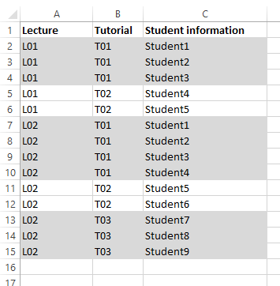
Second Nesting Problem
Counting the number of students in each tutorial for each lecture.

Slide 29
Counting Students In Each Tutorial
Name of the spreadsheet that contains the VBA example : Excel12_nested_loops_counting_students
Learning objective:
    Summary: applying nested loops in the processing of data in a spreadsheet.
    Repeated process (outer loop): while the end of the spreadsheet has not yet been reached process the row in the spreadsheet and move onto the next row.
      Second repeated process (inner loop): each time that a new row in the spreadsheet has been reached:
        Check if the end of the tutorial has been reached.
        If not increase the student count for the tutorial
        Move onto the next row

Slide 30
Counting Students In Each Tutorial
tutorialCount = 0
currentRow = 2
cellContents = Cells(currentRow, TUTORIALS)
Do While (cellContents <> EMPTY_ROW)
startTutorial = cellContents
currentTutorial = startTutorial
tutorialCount = 0
Do While (currentTutorial = startTutorial)
tutorialCount = tutorialCount + 1
currentRow = currentRow + 1
currentTutorial = Cells(currentRow, TUTORIALS)
Loop
MsgBox ("Tut: " & startTutorial & ", count=" & _
tutorialCount)
cellContents = currentTutorial
Loop
2
""
2

Slide 31
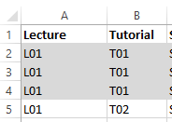
Counting Students: Alternative Solution
Students sometimes find nested loops complex.
  Sometimes it’s unavoidable and the program must have one loop inside the other.
Here is an alternative to using the nested loops of the previous example.
  The solution is implemented with a branch inside of a loop
Name of the example: Excel12_nested_loops_counting_students_NO_NESTED_LOOPS
  High level view of the solution:
  Do-while (End of data – an empty row not reached)
  If (current row is still part of the current tutorial) Then
  increase the count for # students in the current tutorial
  move onto the next row
  Else ‘Current row is part of the next tutorial
  reset count for # of students in tutorial (starting a new tutorial)
  End-Loop

Slide 32
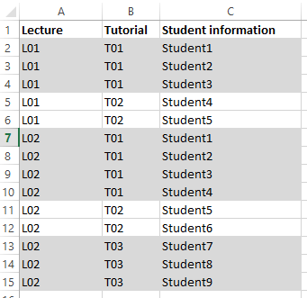
Counting Students: Alternative Solution (2)
Const TUTORIALS As Long = 2
  tutorialCount = 0
  currentRow = 2
  cellContents = Cells(currentRow,
  TUTORIALS)
  startTutorial = cellContents
  currentTutorial = startTutorial
  tutorialCount = 0
T01

Slide 33
Counting Students: Alternative Solution (3)
Const EMPTY_ROW As String = ""
Const LECTURES As Long = 1
Const TUTORIALS As Long = 2
T01
  Do While (cellContents <> EMPTY_ROW)
  If (currentTutorial = startTutorial) Then
  lecture = Cells(currentRow, LECTURES)
  tutorialCount = tutorialCount + 1
  currentRow = currentRow + 1
  cellContents = Cells(currentRow, TUTORIALS)
  currentTutorial = cellContents
  Else
  MsgBox (lecture & " " & startTutorial & ", count="
  & tutorialCount)
  tutorialCount = 0
  startTutorial = currentTutorial
  End If
  Loop
  MsgBox (lecture & " " & startTutorial & ", count=" &
  tutorialCount
T01
T01
2
0
2

Slide 34
Visualizing Information In Excel

Slide 35
Pivot Tables
A useful tool for visualizing information:
  Summarize data
  Filter criteria
  Create reports
  (And more!)
References:
    https://support.microsoft.com/en-us/office/create-a-pivottable-to-analyze-worksheet-data-a9a84538-bfe9-40a9-a8e9-f99134456576
    https://eitsc.com/blog/the-benefits-of-using-pivot-tables-to-manage-your-data/

Slide 36
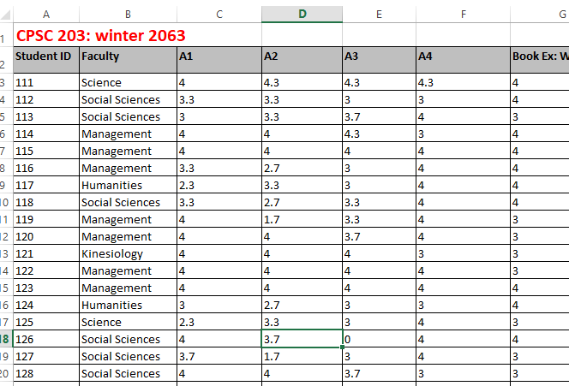
Basic Pivot Table Example
Example spreadsheet used: Excel13_Visualization_example

Slide 37
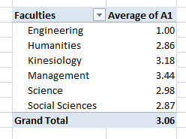
Pivot Table Example: Summarizing Data

Slide 38
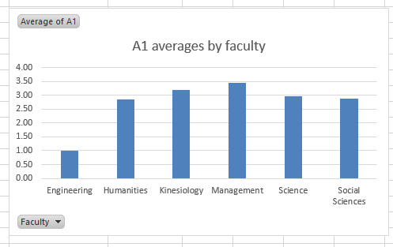
Pivot Table Example: Charting Results

Slide 39
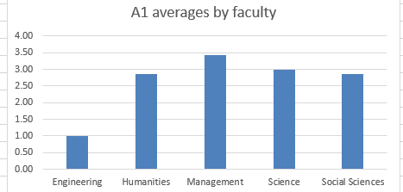
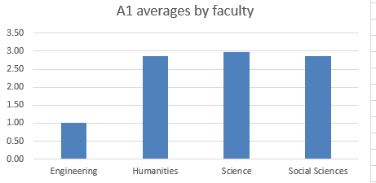
Pivot Table Example: Filtering
Faculty of kinesiology removed.
Only show averages for faculties that are 3.0 GPA or less.

Slide 40
After This Section You Should Now Know
How to write VBA instructions to insert a chart into a spreadsheet with hard coded or variable properties (title and range) for the chart
How to write the instructions to count the number of non-empty rows in a spreadsheet
How to write the VBA instructions sort the rows of spreadsheet
Nested loops
  What is a nested loop
  How to trace a nested loop
  Scenarios when nested loops can be applied
Some of the benefits of using a pivot table, how to insert one into a spreadsheet and how to chart the data

Slide 41
Images
“Unless otherwise indicated, all images were produced by James Tam
Sound effects produced by James Tam

