Slide 1
Spreadsheets: Part 1
You will learn about some important features of Excel.
  Online MS-Office information source: https://support.office.com/

Slide 2
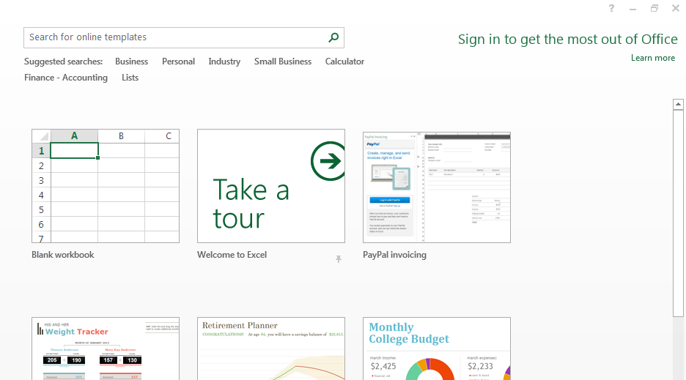
Getting Started: Creating A New Blank SpreadSheet (Excel: “Workbook”)
Once Excel has started, select the option for creating a new sheet:
Select this for CPSC 203

Slide 3
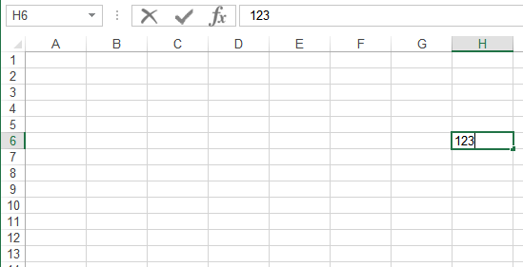
Spreadsheets 101 (Basics)
Column headings
Coordinates of current cell
Row numbers
Current cell
Contents of current cell

Slide 4
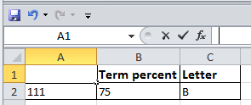
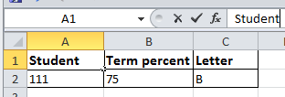
Entering Data
Click on cell to enter the data (in the example: selected cell A1)
Type in cell contents (data entered in the example: ‘Student’)

Slide 5



Contents Of A Cell: Types
Raw data: also referred to as ‘constants’
Labels: describe the contents of another cell
Formula: values derived from the raw data (e.g., calculations: =2+2, lookup values: =D2*2, functions: =sum(B2,B9))
Notes:
Numbers
Labels: annotations to group categories of information
Formula: calculations that may be made on the raw data

Slide 6


Distinguishing Formulas From Text
In Excel all formulas must be preceded by the ‘=‘ symbol (“assignment operator”) to distinguish it from text.
Example spreadsheet: 1_formulas
  Label
  2 + 2
  Formula
  = 2 + 2
  For the sake of brevity, you can assume that all formulas in this section will be preceded by the assignment operator ‘=‘

Slide 7

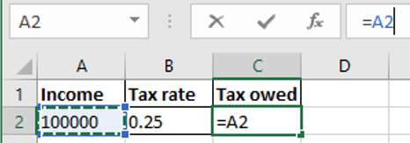

Entering A Formula That Refers To Another Cell Or Cells
Approach 1: type it all in all
  Click on a cell where you want to enter the formula e.g. click on C2
  Type in the formula manually e.g. type =A2*B2
Approach 2: type and click
  Click on a cell where you want to enter the formula e.g. click on C2
  When you get to the part of the formula that refers to another cell then just click on the cell (being referred to) rather than typing in the cell address e.g. click on A2 after typing the ‘=‘ in C2
1) Click here
2) Reference to Cell A2 appears here

Slide 8
Formatting Cells
For other information for the other tabs (right clicking on a cell to ‘format cells’)
  Similar to the basic features of Word these features will be assumed prior knowledge or knowledge that students can pick up on their own.
  These features won’t be covered in lecture nor will they be covered in tutorial.
  For more information please refer to the tutorial notes: “excel_basic_features”.

Slide 9
Basic Mathematical Operators
Example spreadsheet: 2_operators
Mathematical operation | Excel operator | Example
Assignment | = | = 888
Addition | + | = 2 + 2
Subtraction | - | = 7 – 2
Multiplication | * | = 3 * 3
Division | / | = 3 / 4
Exponent | ^ | = 3 ^ 2

Slide 10
Order Of Operation
Design rule of thumb: use brackets to make the ordering explicit.
Operations on a higher level are evaluated first
  8 / 2 ^ 3 Equals 8 / 8 or 1
When a sequence of operators from same level (e.g. addition, subtraction) are encountered in a cell the expression is evaluated from in order in which they appear (left to right).
  2 + 2 - 1 Equals 4 – 1 or 3
Level | Operation | Symbol
1 | Brackets (inner before outer) | ()
2 | Exponent | ^
3 | Division, Multiplication, | / *
4 | Addition, Subtraction | + -

Slide 11
Designing Spreadsheets: Rules Of Thumb
Use brackets to make ordering clear
  Do this even if order can be determined using the specified rules of operation.
    NO
      C1 + C2 * D2 / E2
    YES (brackets help to visually group information as well making ordering clear)
    YES
      C1 + ((C2 * D2) / E2)

Slide 12

Designing Spreadsheets: Rules Of Thumb
Do not directly enter values as data that can be derived from other values (this is a numerical calculation example)
  Example
    Assignment grade (assume one assignment worth 40%) = 4.2 (data in cell A2)
    Exam grade (assume only one exam worth 60%) = 3.3 (data in cell B2)
    Calculate term grade point =(A2*0.4)+(B2*0.6) OR directly enter 3.66?
4.2
3.3
=(A2*0.4)+(B2*0.6)
A2
B2

Slide 13
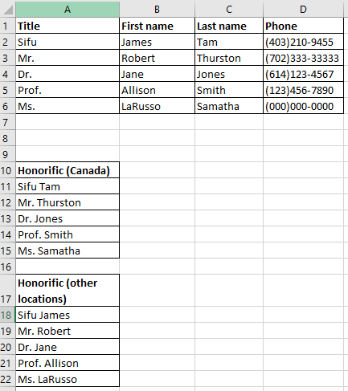
Designing Spreadsheets: Rules Of Thumb
Do not directly enter values as data that can be derived from other values (the ‘&’ operator connects text)
Example: 3_generating_honorifics
Manually entered data
=A2 & " " & C2
Generated (and updated) according to the data
=A2 & " " & B2
In Excel the ampersand ‘&’ connects text strings

Slide 14
Designing Spreadsheets: Rules Of Thumb
Label information so it can be clearly understood

Slide 15
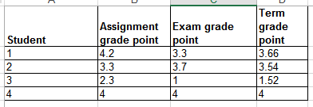
Designing Spreadsheets: Rules Of Thumb (4)
Never enter the same information more than once
  Example spreadsheet: 4grades_formulas
    Advantages: reduces size and complexity of the sheet, making changes can be easier.
    Seems obvious? Not always
    Example: What if the previous spreadsheet were used to calculate the grades for a class full of students?
    Some would create the sheet this way:
=(B2*0.4)+(C2*0.6)
=(B3*0.4)+(C3*0.6)
Etc.

Slide 16
Designing Spreadsheets: Rules Of Thumb (5)
=(B2*0.4)+(C2*0.6)
  Issues:
    Making changes: What if the value of each component (40% assignments, 60% exams) changed?
      Retyping/modifying all formulas is inefficient (at least a copy-paste is needed)
    Clarity: What does the 0.4 & 0.6 refer to (sometimes it’s not so obvious)? It violates the “label information” rule of thumb.
=(B3*0.4)+(C3*0.6)
Etc.

Slide 17
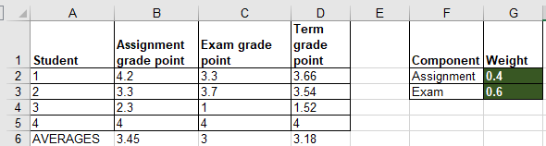
Lookup Tables
Example spreadsheet: 5_grades_lookup
As the name implies it contains information that needs to be referred to (“looked up”) in a part of the spreadsheet.
Can be used to address some of the issues related to the previous example:
  Clarity
  Entering the same data multiple times
=(B2*$G$2)+(C2*$G$3)

Slide 18
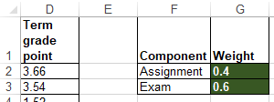
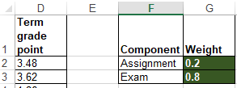
Quick Hint #1: When To Use the $ Sign (Absolute Cell Reference)
If a formula always refers to the same location in the spreadsheet (e.g. lookup table or lookup cell)
Always precede references to cells being looked up with a dollar sign
  Values in G2 and G3 are needed in calculations for all students so the row and column are preceded by a dollar sign: (B2*$G$2)*(C2*$G$3)
  The dollar signs ensure that when the formula is copy-pasted, other student’s term grade points always refers to grade weightings specified in the lookup table defined in Cell G2 and Cell G3.
=(B2*$G$2)+(C2*$G$3)
Changing the lookup table values automatically changes all cells that refer to the table (i.e. term GPAs update)

Slide 19
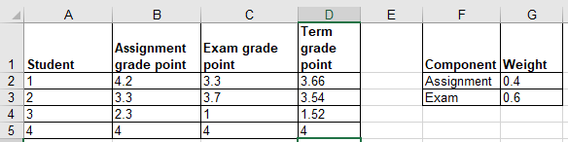
Quick Hint #2: When NOT To Use the $ Sign (Relative Cell Reference)
If a formula will refer to different cells if it is copy-pasted (or moved) to another part of the spreadsheet.
  E.g. assignment and exam GPA used to calculate term grade.
Original formula
=(B2*$G$2)+(C2*$G$3)
Formula copied down 1 row (row +1)
=(B3*$G$2)+(C3*$G$3)

Slide 20
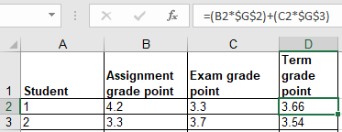
Relative Cell Reference: No $ Sign
General rule:
  If the formula is moved/copied ‘down’ by ‘a’ rows then the relative row references increases by ‘a’ amount.
    Previous example: formula is copied down by 1 row so the cell references increased by 1: from B2 to B3 (+1) for the assignment component and from C2 to C3 (+1) for the exam component.
    Thus the formula changed:
      From: =(B2*$G$2)+(C2*$G$3)
      To: =(B3*$G$2)+(C3*$G$3)
  If the formula is moved/copied ‘up’ by ‘a’ rows then the relative row references decreases by ‘a’ amount.
  If the formula is moved/copied ‘left’ by ‘c’ rows then the relative cell references decreases by ‘c’ amount.
  If the formula is moved/copied ‘right’ by ‘d’ rows then the relative cell references increases by ‘d’ amount.

Slide 21
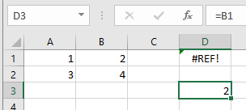
Relative Cell Reference: Errors
If a relative cell reference produces a row or column reference outside the valid range (e.g. below ‘A’ or ‘1’) an error message will appear.
Example: copy the relative cell reference from D3 to D1.
  The new formula would refer to Cell =B1 minus two rows (not possible).
Maximum number of cells in an Excel spreadsheet¹
  1,048,576 rows by 16,384 columns
  (This information is included for your own reference rather than something you should know as a requirement for the exam).
  1 Source: https://support.office.com/en-us/article/excel-specifications-and-limits-1672b34d-7043-467e-8e27-269d656771c3

Slide 22
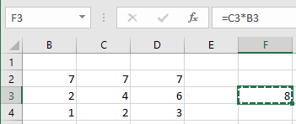
Cell References: Example Exam Question
What’s the result of copying the expression from F3 to G4?
Note: References to empty cells (e.g. B1) that are used in a mathematical expression return 0.
  Example B1 + C1 = 0

Slide 23
Data Too Big For Your View
Covered in this section of lectures notes
  Freezing panes
  Simple merging of cells (merging cells on a single row).
Covered in the introductory tutorial notes
  Resizing rows or columns
  Wrap the data
  Merge data (merging multiple rows as well as multiple columns)

Slide 24
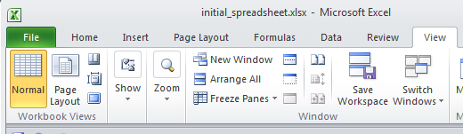
“Freezing” Panes: How/Why
Often used to lock the view so labels always stay onscreen regardless of which part of the sheet you are viewing.
Obviously this is useful for cases that contain column (or row) headings.
Running the Freeze Panes feature: View -> Window: Freeze Panes

Slide 25
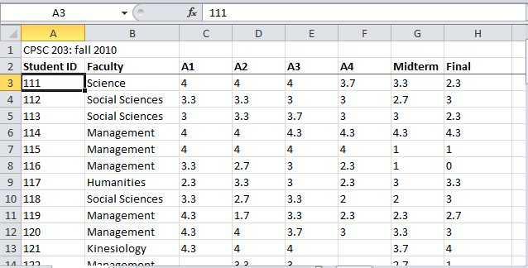
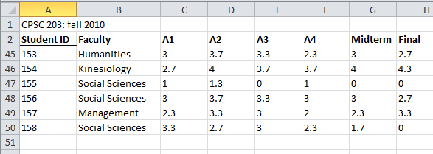
Freezing Panes: Effect On Example Spreadsheet

Slide 26
Freeze Panes: Procedure
Move to the row below the row to be ‘frozen’.
In the previous example with student grades it would be Row 3.
Select:
  View -> Window : Freeze Panes and then select the “Freeze Pane” option among the options.

Slide 27



Merging The Columns Along A Single Row
Combines the columns into one wider column.
Before the merge
(Merging Row 1: Col A – E)
After “Merge & Center” (merge and center align)
After the Merge Across, Merge Cells (merge and retain previous alignment settings)

Slide 28
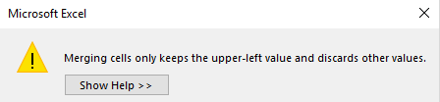



Merge Columns (Each Containing Data)
Only the data in the top left-most cell of the merged range is retained.
Before the merge.
After the merge: Merge and center (“L01” is lost)
After the merge: Merge across, Merge cells (data “L01” is lost)

Slide 29
Copy-Paste: Explanation
A single cell or a range of cells can be copied (or cut) and pasted.
There are a number of options for how the originating cell or cell is pasted into the new location.
We will cover a few of the options for this class
  “Paste”: copies the formula (which may be modified if the cell references are relative)
    May update final values if the data changes (relative references used).
  “Paste values”: includes only data or the final result of a formula.
    If the formula changes then the pasted data won’t be updated.
  “Paste link”(always updates to the current value in the source cell)

Slide 30
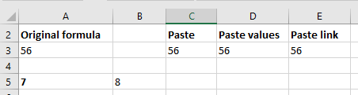
Copy-Paste: Example
Example spreadsheet: 6_copy_paste
  Copy paste from A3 into C3 (paste current formula), D3 (paste current data), D3 (paste link)
  Changes in data in the source cell: if the values in A5 & B5 change to 9 and 6 respectively what will the values be in C3, D3, E3 and why.
  Changes in the formula in the source cell: Contents of A3 was changed to =9*3
=$A$5*$B$5
56
=$A$3
=$A$5*$B$5

Slide 31
Copy-Paste
For your information: Multiple cells (an entire row, column or even a range of cells e.g. A1:C10 can by copied-pasted)

Slide 32
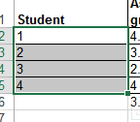
Autofill
Allows for a sequence (constant or addition by a constant amount) to be extended
  E.g., The sequence “1, 2, 3” (can be extended to include “…4, 5, 6”)
Steps:
  Highlight the cells containing the sequence to extend (selecting one cell just repeats the contents of that one cell).
  Move the mouse pointer to the ‘handle’ at the bottom right

Slide 33
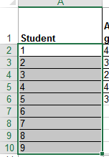
Autofill (2)
    Drag the mouse as far down as you wish the sequence to be extended to.
Notes:
* exam: what if the row with ‘student’ selected?

Slide 34




Autofill (3)
It’s best to only extend a sequence that only employs addition (e.g. +1, +3, -1, -10) or a constant sequence using autofill handles.
To extrapolate other sequences (e.g. multiplication) don’t use autofill:
  https://support.office.com/en-us/article/project-values-in-a-series-5311f5cf-149e-4d06-81dd-5aaad87e5400

Slide 35
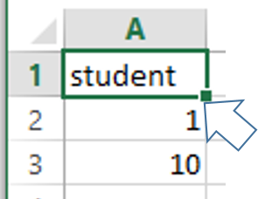
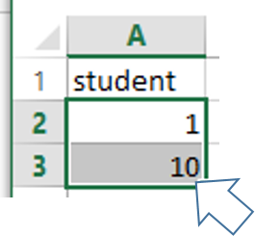
Autofill: Practice
What would be the autofill result of the following.
E.g.1
E.g. 2

Slide 36
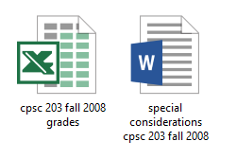
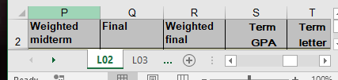
Terminology
Spreadsheet (referred to as a “workbook” by Microsoft)
  A Microsoft Excel file
Worksheet
  A part of a spreadsheet

Slide 37
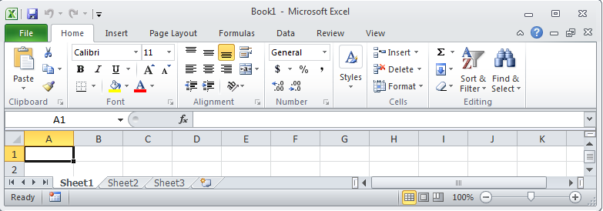
Worksheets
Each spreadsheet can consist of multiple worksheets.
  Example:
    Spreadsheet: all my CPSC 203 grades for the CPSC 203 fall 2008 term.
    Worksheets for each of the two lectures taught by this instructor that term.
Worksheet
Create new worksheet
Spreadsheet

Slide 38
When To Use Multiple Worksheets
Rules of thumb:
  When there are multiple sheets of related information, each group of information can be stored in it’s own worksheet (self contained)
Grades for lecture 01
(worksheet)
Grades for lecture 02
(worksheet)
Grades for lecture 03
(worksheet)
Grades for all sections(spreadsheet)
Budget for dad (worksheet)
Budget for mom
(worksheet)
Budget for sunny-boy
(worksheet)
Family budget (spreadsheet)

Slide 39
When Not To Use Multiple Worksheets
If the information consists of groups of unrelated information then the information about each group should be stored in a separate spreadsheet/workbook rather than implementing it a spreadsheet with multiple worksheets.
Grades for mom (spreadsheet)
Expenses for the family business (spreadsheet)
Daily calorie intake for dad (spreadsheet)

Slide 40

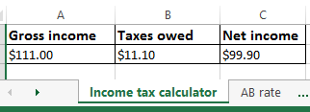
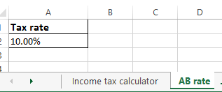
Referring To Other Worksheets
One worksheet can refer to information stored in another worksheet.
Example spreadsheet:
  7_multiple_worksheet_example
JT’s tip:
For more complex examples you might want to take extra “in-class” notes.
(It could be hard to understand the concepts at a level sufficient for the exam or remember notation/symbols if you just look at the slides).

Slide 41
References Between Spreadsheets
In a fashion similar to using multiple worksheets, one spreadsheet can refer to information stored in another spreadsheet.
Example spreadsheets:
  8A_multiple_spreadsheet_example
  8B_multiple_spreadsheet_example

Slide 42
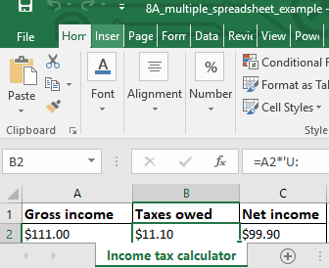
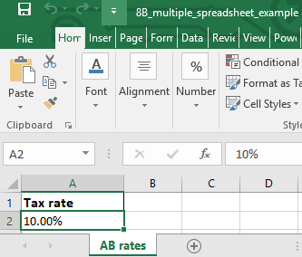
8A
8B
=A2*'[8B_multiple_spreadsheet_example.xlsx]AB rates'!$A$2

Slide 43
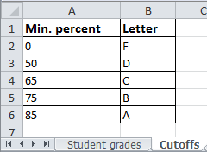
Why Use Cross References?
Cross references:
  a worksheet refers to another worksheet,
  a spreadsheet refers to another spreadsheet,
…may be used when:
  the second worksheet or spreadsheet contains data that needs to be “looked up” (e.g., a lookup table)
Some examples where cross reference lookups may be needed:
  Grade cutoffs
  Tax brackets
  Product numbers (lookup a product number to get more information about the product)

Slide 44
Data Validation
Ensures that the data falls within a valid range (e.g. Age must be 0 – 116) or that a specific type of data is entered (e.g. whole number only).
Invoking:
  Data->Data Tools: Data Validation
Example spreadsheet: 9_data_validation
  Name: no restrictions e.g. “James Tam”, “James Tam 2”, “James Goldstein-Chan” “James.org”
  Age: number years (whole number) from 1 – 116
  Income: can include any value from $0.00 - $1,000,000.00 (cents can be entered)
  Make sure you include good error messages when setting up data validation rules..
    Tell the user what range of values and/or the type of values that can be entered.

Slide 45
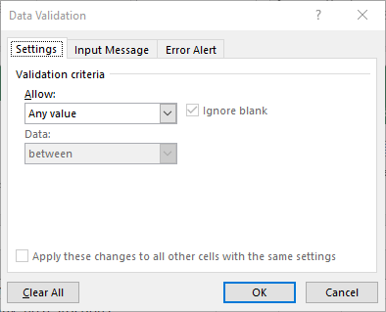
Data Validation Example: Name
No restrictions on input (this is the default in Excel)

Slide 46
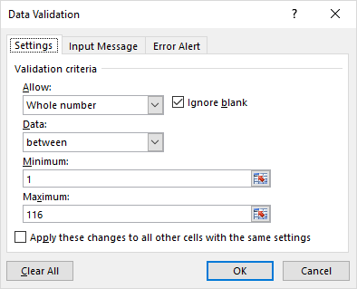
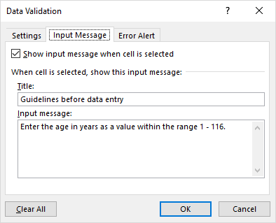

Data Validation Example: Age
Age must be a whole number from 1 – 116.
Tools to prevent errors in input
  Restricting the input
  Tooltip help before data entry

Slide 47
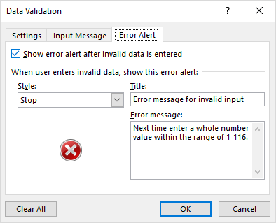
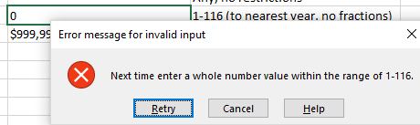
Data Validation Example: Age
A tool to react after bad data has been entered.
  Popup error message appears after the input restrictions have not been met.

Slide 48
Data Validation Example: Income
Income allow for any value from $0.00 - $1,000,000.00 (cents may be entered – this is a clue that the input should not be restricted only to whole numbers).

Slide 49
After This Section You Should Now Know
The benefit of electronic over paper spreadsheets
Spreadsheets 101: The basic layout and components of a spreadsheet
Entering data: manually and via autofill
Raw data vs. labels vs. formulas
  How formulas are distinguished from text
  Specifying formulas that refer to other cells
Formatting cells
Common mathematical operators and the order of operation
The rules of thumb for designing spreadsheets
  Bracket everything
  Don’t make something data if it can be derived
  Label everything so it can be understood
  Don’t duplicate data

Slide 50
After This Section You Should Now Know (2)
Lookup tables
  How to create and use a lookup table
  Includes lookup tables with constant values and lookup tables to be used in conjunction with lookup function
When to use absolute vs. relative cell references in formulas
  How do formulas using absolute vs. cell references change when copied elsewhere
Ways of changing views when the data is too large for the display
  Freezing panes
  Merging cells

Slide 51
After This Section You Should Now Know (3)
Different forms of copy paste:
  Paste
  Paste values
  Paste link
What is a worksheet
  When to use multiple spreadsheets vs. multiple worksheets
  How to reference data in other spreadsheets or worksheets (cross references)
How to prevent errors using data validation

Slide 52
Images
“Unless otherwise indicated, all images were produced by James Tam

