Slide 1
Spreadsheets: Part 3 (Design)
Using color
C.R.A.P.
Fonts and font effects

Slide 2
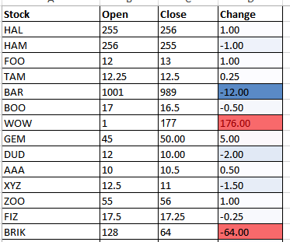
Color: Properly Used
When used sparingly color can draw attention to important information.
This is an especially valuable tool when there is a large amount of information.
The information may be “all there” but don’t make it any harder than it has to be for the viewer to find it.

Slide 3
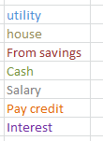
Color Misused
The overuse of color:
Reduces it’s ability to make information stand out.
Makes it harder to understand what information is mapped to a particular color e.g. using different colors to represent faculty and grades
Notes:
Some color mappings you might be able to figure out: date, cash in, cash out, balance because the information is communicated in other ways (labels and arranged in columns)
But the information that only uses color to group is harder to discern
Overuse of color: A2 use color to represent faculty OR grade but don’t use color for both

Slide 4
Rule Of Thumb For Color: Make It Subtle
We have all seen the use of ‘loud’ and clashing colors that can make text very hard to read.
Ingredients
Sugar, lactose, fructose, corn syrup, glucose…lots of carbohydrates
JT: I’ve actually seen green-red color combinations on listings of food ingredients

Slide 5
Rule Of Thumb For Color: Subtle But Not Near-Invisible
The “flip side”, lack of contrast between foreground can also be problematic.
Ingredients
Sugar, lactose, fructose, corn syrup, glucose…lots of carbohydrates

Slide 6
Rule Of Thumb For Color
Balance the use of color between noticeability and subtlety
Make it as subtle as possible while still conveying the necessary information using color

Slide 7
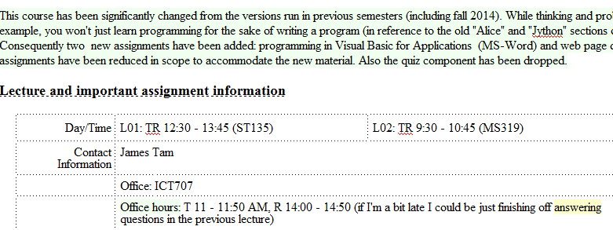
Additional Issues Associated With Color
Color blindness affects a portion of the population:
The majority of people who are color blind are red-green color blind so using only these colors to represent information should be avoided e.g. traffic lights
Field size
The larger the area to be color coded, the more easily that colors can be distinguished.
Larger areas: colors can be more subtle
Smaller areas: colors may have to employ greater contrast
Notes:
* Point out that the use of color coding for ‘office hours’ may be missed (smaller area being colored)

Slide 8
Additional Issues Associated With Color (2)
When objects are small (text or small graphics) and color is used to distinguish information use highly saturated colors.
This is important information!
This is important information!

Slide 9
Fonts And Font Effects
Example fonts:
Ariel
Calibri
Helvetica
Times New Roman
Font effects:
Italics
Bold
Underline
Normal
Font sizes

Slide 10
Fonts And Font Effects (2)
As a rule of thumb use no more than 3 sizes and font effects / font sizes in a particular document.
Similar to color, their overuse reduces their effectiveness and makes it harder to interpret meaning.
Also if you don’t know much about fonts just stick to the common or default ones provided (Arial, Calibri, Helvetica, Times New Roman)
If you’re not sure if a font is a good one for a particular situation then it probably isn’t:
Extreme example “Wing (Web) dings”: wing dings
But the use of “extreme fonts” are the only pitfall: printing problems, web browser issues, operating system font-issues

Slide 11
C.R.A.P.¹
Simple design principles that can be applied in a variety of situations
Contrast
Repetition
Alignment
Proximity
1 From “The non-designers type book” by Robin Williams (Peach Pit express)

Slide 12
Contrast & Repetition
Contrast:
Make different things look significantly different
Repetition (Consistency):
Repeat conventions (e.g. fonts, font effects, alignment, colors used) throughout the interface to tie elements together

Slide 13
Example: No Contrast

Slide 14
Example: Weak Contrast
Notes:
Font size of headings slightly increased
In a small no document it may not make a big deal
In a large document with say many sub headings (you often scan headings to determine if you read the contents) this can make it harder than it has to be to find the necessary information

Slide 15
Example: Headings Stand Out
Good contrast:
If contrast is not (or weakly) employed for a small set of data it may not be a large issue.
But for larger data sets (“real data”) it may make it more work than is necessary.
Repetition:
Same fonts, font sizes and font effects used in the headings vs. the data.
Makes it easier to see and understand the structure
Notes:
No so bad if the sheet is small
Can be harder to find relevant information if there’s a lot of data to look through

Slide 16
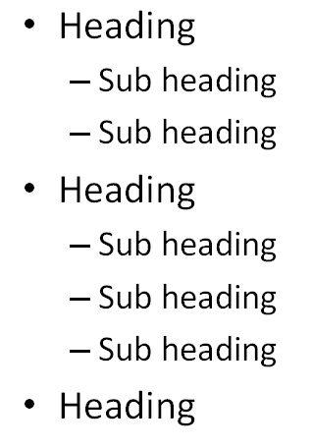
Alignment
It can be used to structure a document (represents hierarchical relationships).

Slide 17
Alignment And Repetition
Consistent alignment (left or right and not center) can be used to represent relationships.
All the data in a column are consistently aligned to signify they belong a group
Example: movie credits
The Kung Fu master
Arch villain
Kung Fu student #1
Kung Fu student #2
Thug #1
Thug #2
Damsel in distress
James “The Bullet” Tam
James (Evil dude) Tam
Eager Tam1
Eager Tam2
Cannon-fodder Tam #1
Cannon-fodder Tam #2
Jamie Tametta

Slide 18
Center Alignment

Slide 19
Centre Alignment (2)
Don’t use it for hierarchical documents because it removes or hides the organization.
In a document that contains structure center alignment can look unorganized (the center alignment appears as no alignment, disorganized)
At most: sparing use can be used to provide contrast e.g., slide titles vs. content.
Because it removes a common method for structuring a document it can make reading text more difficult.
At most use it as an exceptional case to make an item stand out.

Slide 20
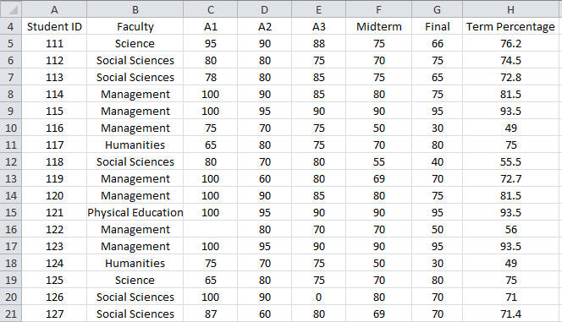
Center Alignment
Again: while sparing use of center alignment can be used to provide contrast it should NEVER be used as the default in documents such as spreadsheets.

Slide 21
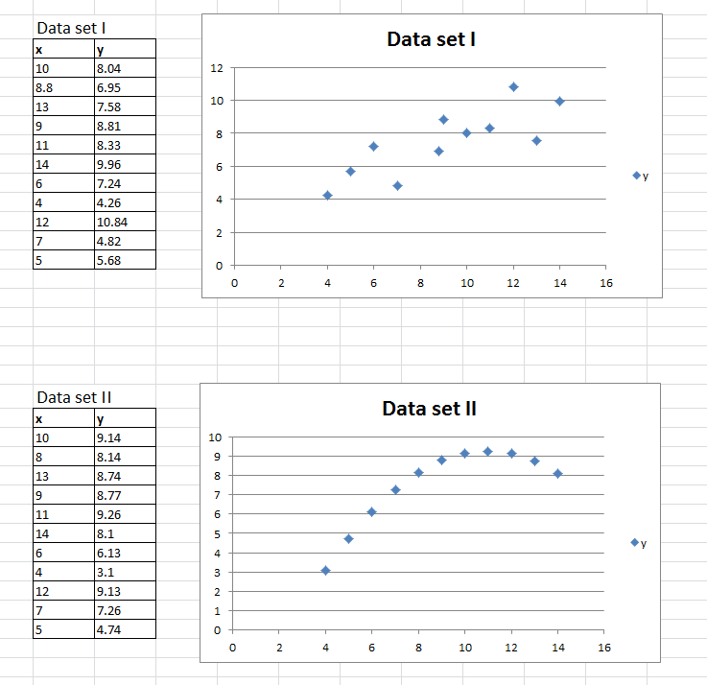
Proximity
Related items are in close proximity
Unrelated items are separated
Notes:
Table and graph for each data set are in close proximity
Data sets are separated

Slide 22
After This Section You Should Now Know
Rules for using and not misusing color as well issues associated with color: color blindness and field size
Rules of thumb for using fonts and font effects
C.R.A.P.
What does each part mean
How it can be used for effective graphic design

Slide 23
Copyright Notification
“Unless otherwise indicated, all images in this presentation were produced by James Tam.”

