Slide 1
The Internet
You would learn the basics of the Internet, how to effectively search for information online as well as how to evaluate the quality of information sources

Slide 2
Design Of The Internet
The original internet designed to connect computers and collaborate/interact with others
  Consequently a common protocol was developed so connected computer nodes could communicate
  This is still one of the major uses of the Internet today
    Connect & interact: Mac, Windows, phone all connected and communicating through web sites like Facebook, Snapchat, Twitter etc.
  The security of those connections weren’t a consideration because access to the computers being connected was restricted (university researchers)

Slide 3
Internet Addresses
You are not anonymous on the Internet
  Don’t think you can ‘troll’ (or do worse things) online with impunity
  Methods of masking/disguising an IP address (e.g. “Tor”) aren’t infallible
Each node (connected device) on the Internet has an address so that information can reach it “IP address” or “IP” for short.
The address takes the form of a sequence of numbers
But usually a more meaningful address is used in place of the numeric IP address by users.
  e.g. www.facebook.com
The IP address of your Internet devices at home is provided by your Internet service provider/ISP (e.g. Shaw, Telus etc.).
  Using a free Wi-Fi network will allow your device to get an IP address from the host of that network.

Slide 4
Modern Consequence Of Historical Roots
Information is typically routed among several computers and may take multiple paths even in one ‘session’
e.g., one session could consist of the viewing of a single video or even a single financial transaction.
Unknown ISP
Unknown ISP
Tam’s machine
Tam’s ISP
Bank’s ISP
Tam’s bank
Unknown ISP
Unknown ISP
Unknown ISP
Always takes this path
Sometimes takes this path

Slide 5
Reasons For Multiple Paths Along The Internet
Unknown ISP
Unknown ISP
  Benefits:
    Stability
    Speed
  Need for an IP address
    Information may need to be resent.
    Each ‘portion’ (packet) of transmitted data needs to contain the IP address of the destination.
Tam’s machine
Tam’s ISP
Bank’s ISP
Tam’s bank
Unknown ISP
Unknown ISP
Unknown ISP

Slide 6
Searching For Information Using Google
There are other search sites.
Some may actually work as well as (or for some tasks – better than Google).
We will talk about some of the advantages of some of these other sites later.
Google however is by far the most popular search site and for simple/common searches it will probably provide at least reasonable results.

Slide 7
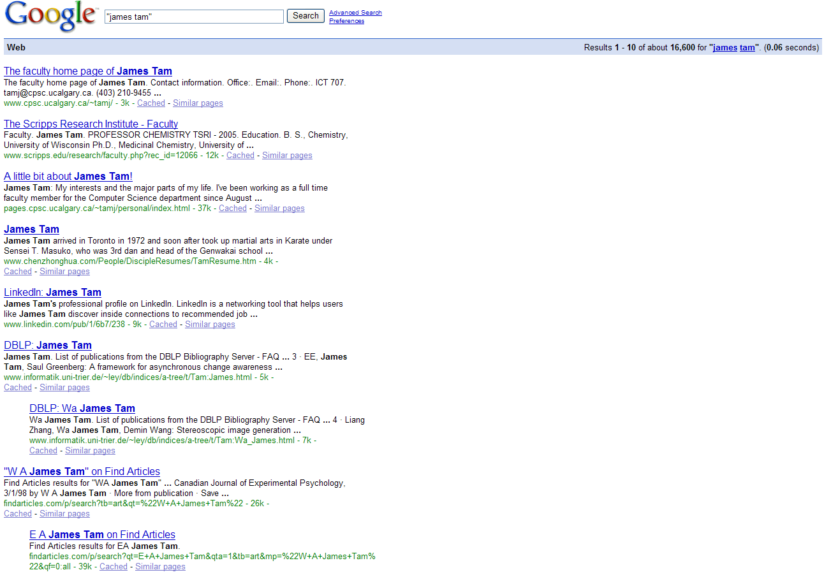
Search Websites Rank Results According To Relevance

Slide 8
Making Your Site More Noticeable (Higher Rank)
  Old approach (it still applies but it doesn’t play as large a role as it used to in the ranking of search results)
    Add relevant keywords to your page.
    The frequency and location of keywords may play a role in determining relevance.
    Trying to artificially rank your page higher in search results may result in a page being put at the bottom of the list (e.g. Your page is listed on page 100 out of 100 pages of results).
      e.g., adding celebrity ‘gossip’ to my CPSC page may rank it higher but not relevant info for most visitors.
  Google “Page rank”
    Links (to your site) also affect ranking (“cross links” between pages)
    Popular/relevant pages linking to your page rank your page higher on search results than links from irrelevant pages.

Slide 9
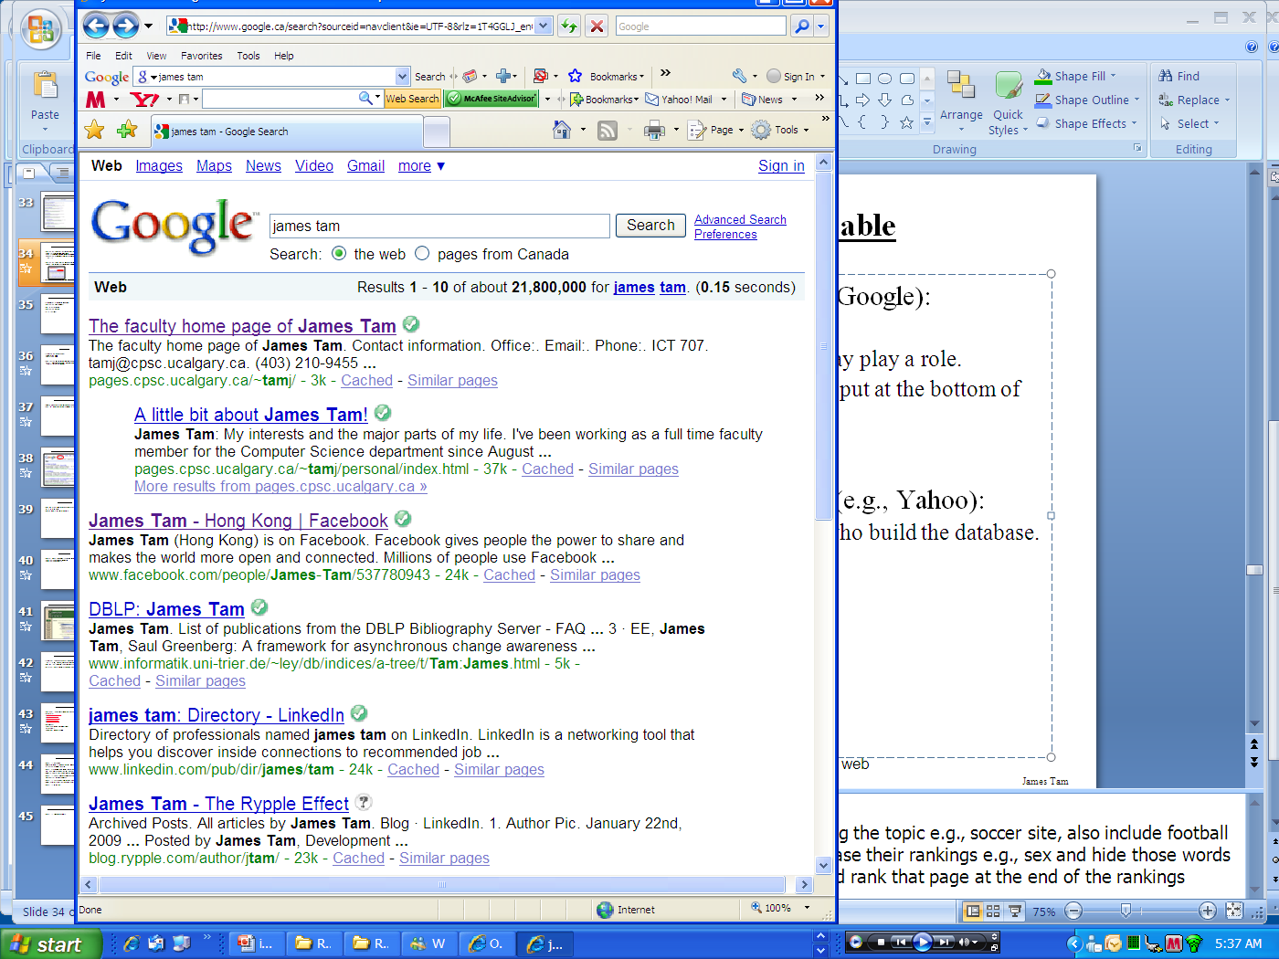
Searching For Information On The Internet: Google
Easy? Just type in what you’re searching for…
…you may get the information that you were looking for plus much more!

Slide 10
You Will Learn Strategies For Narrowing Your Search Results (This Is For Google But Largely Applies To Other Sites):
Reducing the number of unrelated results.
Explicitly avoiding pages with certain words.
Searching for information from select pages.
Source (last accessed 2009): http://www.google.com/support/websearch and http://www.googleguide.com

Slide 11
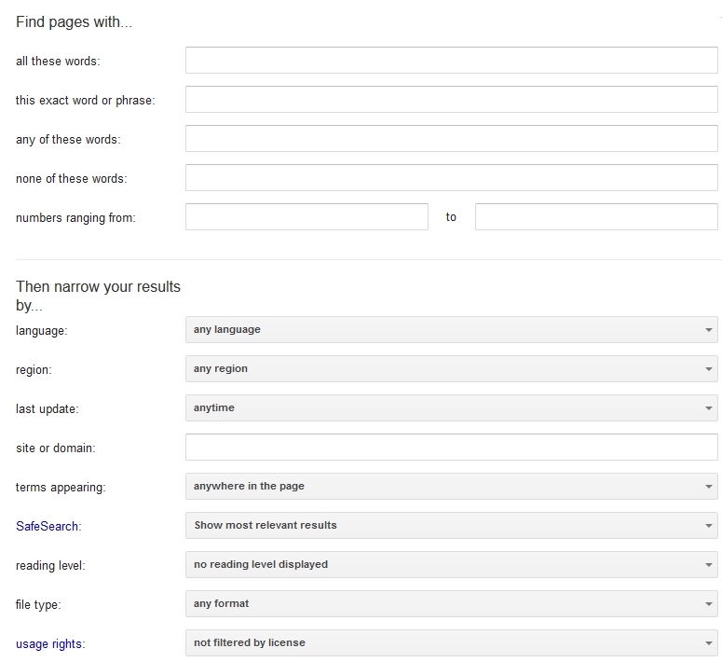
Employing These Search Strategies
Many (but not all) of the features can be found through an “Advanced Search” subpage of the Google site.
  http://www.google.com/advanced_search
There are several options on this page (to be covered shortly):

Slide 12
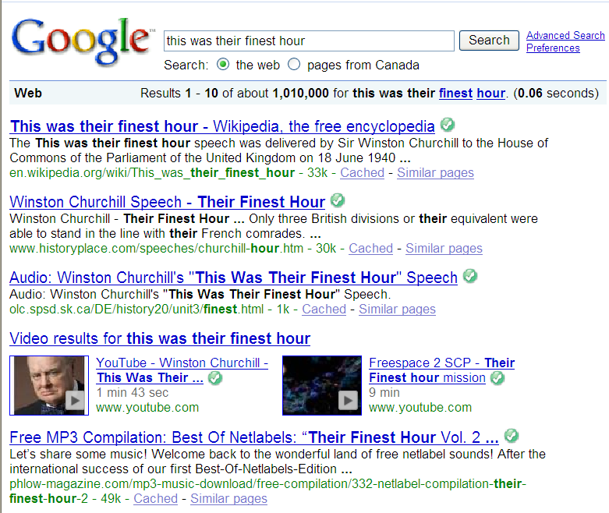
Searching For Exact Phrases
Sometimes you may be looking for information about a famous quote.
  Want: “This was their finest hour!” – Winston Churchill
No quotes
Many results must be reviewed.
Unrelated websites show up: Their finest hour

Slide 13
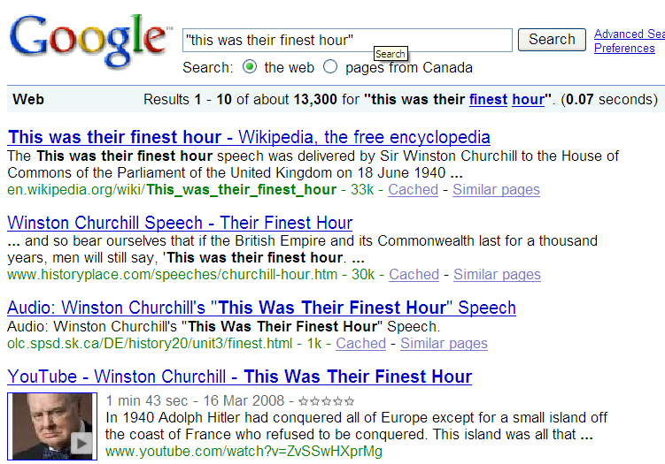
Searching For Exact Phrases (2)
Enclosing the phrase that you are searching for in quotes will search for pages that contain only that specific exact phrase.
  Any variations (e.g. order of words) should be excluded
The desired phrased enclosed quotation marks.
Fewer but more relevant results show up

Slide 14
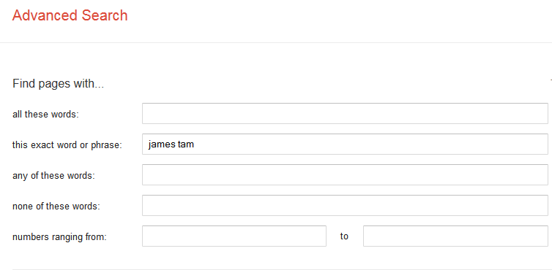
Searching Exact Phrases: Advanced Search
No other combinations are possible (same as using quotes)

Slide 15
Words That Are Commonly Ignored By Google
Stop words are ignored by search engines such as Google:
  Common words e.g. ‘the’, ‘a’, ‘to’, ‘in’, ‘I’…
  Reserved words e.g. ‘OR;
The search engine can be forced to include the stop words:
  Use quotes
  best places to eat in Calgary
  Vs.
  “best places to eat in Calgary”
  Use the ‘plus’ operator. (Not available after Google+ came out)
  Star Wars I
  Vs.
  Star Wars +I

Slide 16
What If More Than One Word Can Be Used?
You only remember a part of a phrase and there is more than one way in which the phrase may be completed
Example¹:
  The world’s longest runway
  The world’s longest undefended border
  The world’s longest beard
  Etc.
The wildcard operator * allows one or more words to be substituted for the ‘star’ or ‘asterisk’
Example:
  “The world’s longest *”
1 Example from: https://support.google.com/websearch/answer/2466433?hl=en

Slide 17
Using Multiple Wildcards
Examples:
  a funny * happened on the * to the * ¹
  Brad Pitt played the character * in *
1 From: https://www.lifewire.com/search-using-wildcards-google-1616504

Slide 18


Searching A Range
Searching numerical values within a certain min – max range
Range operator .. (multiple dots)
Example:
  Qatar History 2000..2009
  laptop $300..$500 canada
…

Slide 19
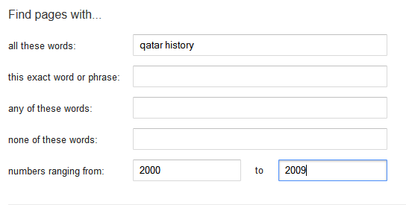
Range Searching: Advanced Search
Search criteria
Numerical range (same as ..)

Slide 20
Searching Among Alternatives
Use the OR operator
Normally when a word is typed into the search box Google will try to find web pages that include all of those words.
Example (searches for all words):
  <First word> <Second word> (There is an implicit AND, but there is no ‘AND’ operator with Google)
  cute wallpapers cats dogs
Example (searches include alternatives):
  cute wallpapers cats OR dogs
  “Bruce Lee” OR “Little Dragon” OR “Lee Siu Lung”
  “Wayne Gretzky” OR “The Great One” OR “Number 99” OR “Number ninety nine”

Slide 21
Searching Among Alternatives (2)
Note: Google is case sensitive in this situation! (OR must be upper case in order to search for alternatives).
The following searches are not identical!
To be or not to be
Vs.
To be OR not to be

Slide 22
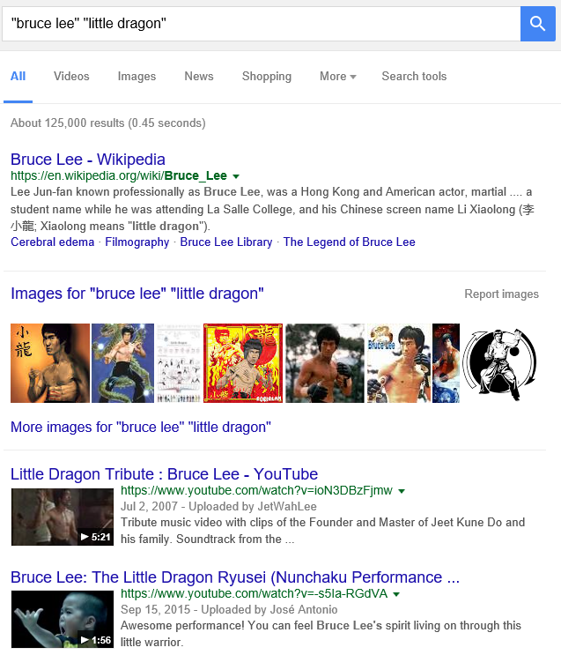
Example: Multiple Search Terms (Default Is AND)

Slide 23
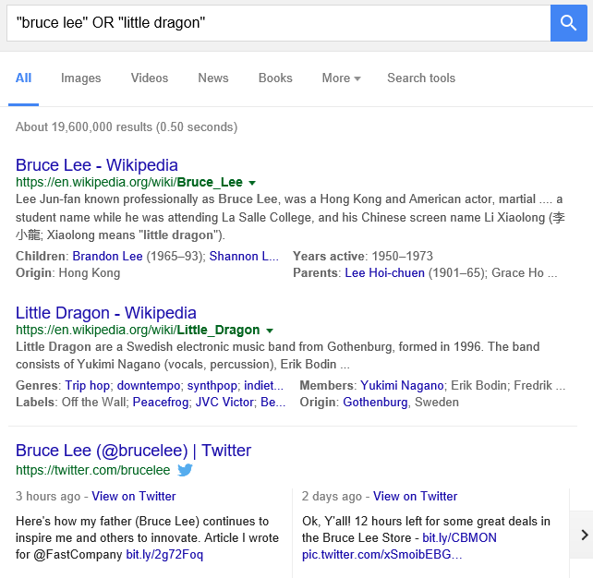
Example: Multiple Search Terms (“OR”)

Slide 24
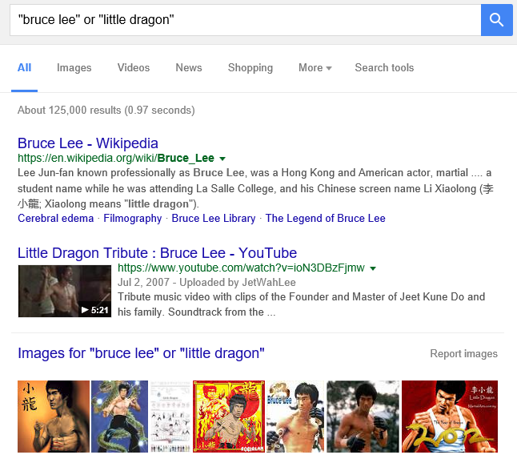
Example: Multiple Search Terms, OR - No Caps

Slide 25
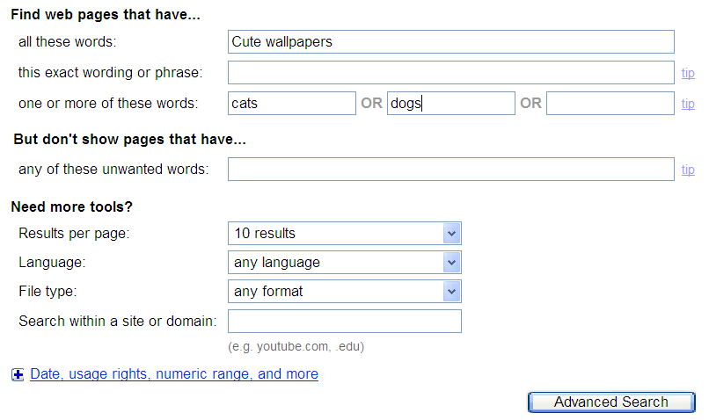
Searching Alternatives: Advanced Search
All words that must appear same as “AND”
One or more of these words can appear (same as “OR”)

Slide 26
Using ‘OR’: Exceptions¹
Google was designed to approximate how people think and behave when searching for information.
Consequently exceptions to the rules are sometimes made.
Example²:
  What you tell the Google: “For better” OR “for worse”
  What Google looks for: “For better or for worse”
1 From http://www.google.com/support/websearch
2 Google and other search engines may automatically assume you are looking for the Lynn Johnson comic strip (https://www.fborfw.com/) when you enter this phrase.

Slide 27
Excluding Words
Return search results excluding (or “not including” specified words)
There may be times when you want Google to exclude from results certain words or phrases.
This can be done with the subtraction operator (subtract the words that follow the operator from search results).
Example:
  “James Tam”
  Vs.
  “James Tam” –Calgary
An alternate approach is to use the ‘NOT’ operator
  “James Tam” NOT Calgary

Slide 28
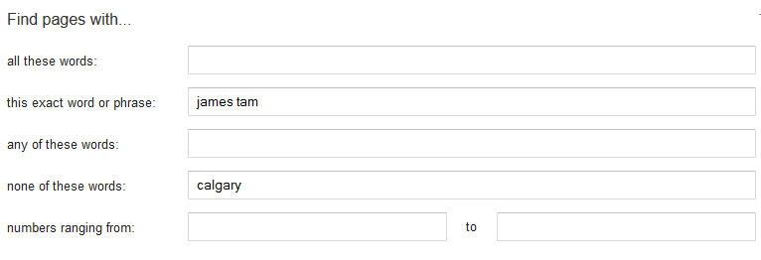
Excluding Words: Advanced Search
Exact search phrase
Excluded word (same as -, NOT

Slide 29
Example Results: AND, OR, Subtraction (NOT)
Search phrase | Operator | ~num. results
“james tam" |  | 63,200
“james tam" -"computer science“ | NOT | 49,300
"james tam" AND "computer science" | AND | 13,400
"james tam" OR "computer science" | OR | 229,000,000

Slide 30
Site Specific Searches
Useful when a webpage is large and/or not well organized:
  Searching the current webpage
  Searching the entire site (and only that site)

Slide 31
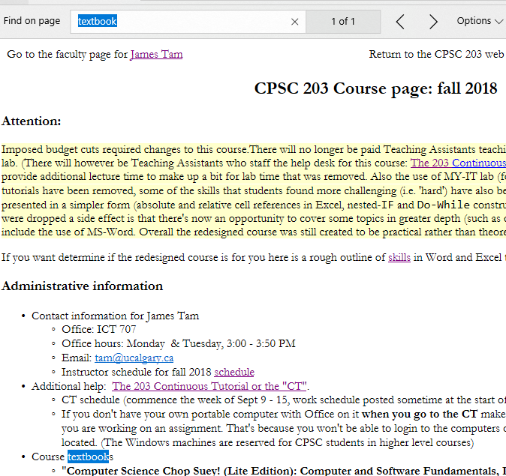
Searching The Currently Viewed Web Page
<CTRL>-<F>
(Edge, IE, Firefox,Opera)

Slide 32
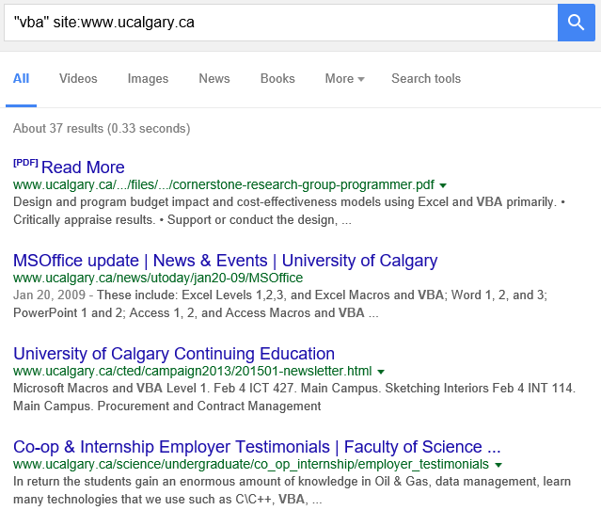
Searching One Website
Involves searching one entire site (and not just the page from the site that is currently loaded into the web browser). Results from other sites will not be shown.
  Use the ‘site’ keyword
Example:
Search only the University of Calgary website for the desired text
Results are only from the University of Calgary website

Slide 33
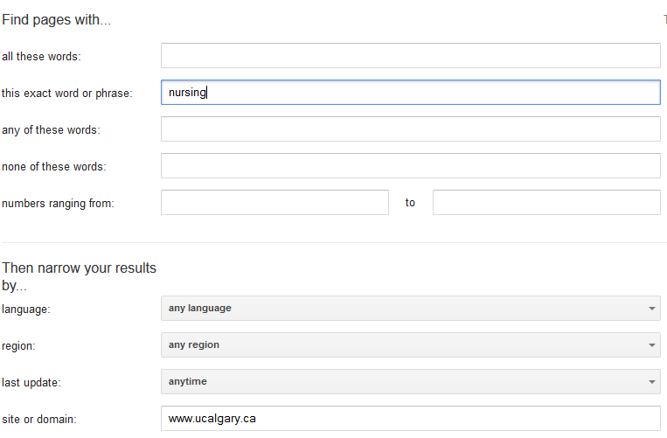
Searching One Website: Advanced Search
Information sought
Site being searched (same as ‘site’)

Slide 34
Online Documentation: Google Operators
(Last accessed Jan 2020)
  https://support.google.com/websearch/answer/2466433?hl=en

Slide 35
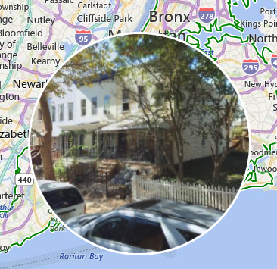
Other Search Websites: Google Comparison
Google (Alphabet)
  Overall the most frequently used search site (~75% - 95% searches occur via Googles)
  Pros (Google)
    Text search:
      Now: generally good
      Past: clearly superior to similar sites
    Maps/geographical – can’t be beat especially with extensive street and satellite views
  Cons (Google)
    Complaints about biases in ranking e.g. competitors to Google are ranked lower
    Privacy/tracking issues (may be more than you think, not just ‘ads’)
Bing: rotating ‘360’ degree street side view (not the same experience)

Slide 36
Other Search Websites: Google Comparison
  Cons (Google continued))
    Privacy/tracking issues (may be more than you think, not just ‘ads’)
      Example (location and time map):
        https://www.cnbc.com/2017/11/20/what-does-google-know-about-me.html
      “Why Google’s Spying on User Data Is Worse than the NSA’s”
        https://www.huffpost.com/entry/why-googles-spying-on-use_b_3530296

Slide 37
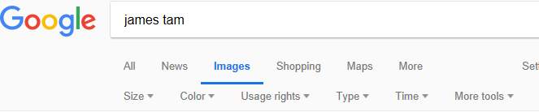
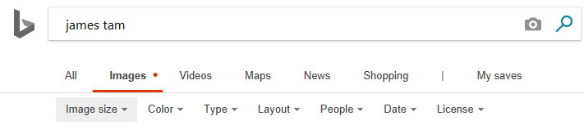
Other Search Sites: Microsoft Bing¹
www.bing.com
The results from text searches (e.g. “Who will win the Stanley cup” +2019) are often comparable to Google (some claim Bing is greatly superior)
The search tabs (e.g. images) provide similar search parameters
1 References (Accessed Sept 2018)
http://blogs.cornell.edu/info2040/2016/10/17/bing-vs-google-seo-and-search-algorithms/
https://www.pcworld.com/article/2685215/websites/the-4-reasons-i-switched-from-google-to-bing.html
https://www.cnet.com/news/so-i-put-google-and-bing-in-the-ring-guess-who-won/
https://help.bing.microsoft.com/#apex/18/en-US/10001/-1

Slide 38
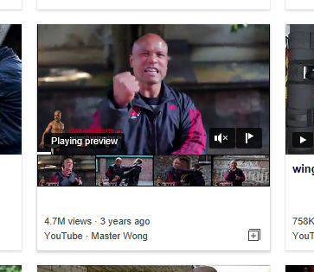
Other Search Sites: Bing (2)
Bing video: includes a ‘preview’ feature of videos
Google video: includes a visual ‘closed captioned’ search criteria

Slide 39
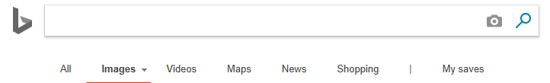
Other Search Sites: Image-Based Searches (Reverse Image Searches)
Yandex: www.yandex.com
  Largest technology company and largest search website in the Russian Federation¹
  It’s biggest ‘claim to fame’ is the quality of it’s image-based searches
    Image-based search (reverse image search): Instead of typing text criteria when looking for pictures online you can upload a picture and the search website
    Other search websites also have this feature (e.g. Google, Bing. Tineye etc.) but the results may not as useful.
1 "Yandex, Russia's biggest technology company, celebrates 20 years". The Economist. September 30, 2017.

Slide 40
Student Discussion
Why/when would you use the image-based search feature?
Are there any drawbacks/personal security issues (current or future) for websites that include image-based searches as a feature?

Slide 41
Google’s Image-Based Search
Reference (last accessed Sept 2018)
  https://support.google.com/websearch/answer/1325808?hl=en
  “How reverse image search works
  When you search using an image, your search results may include:
    Similar images
    Sites that include the image
    Other sizes of the image you searched for”

Slide 42
Privacy And Web Searches
Many search sites tracks your searches - wired.com
  “Google saves all your searches”
  “Google records what you say every time you speak to it”
  “Google tracks and records your location”
It should be possible to remove the stored information but you have to take the time to learn how to do it (opt-in by default is the norm)
What about “private browsing” modes provided in web browsers
  It prevents information being stored on your local computer
  That is, it prevents other users of that computer from seeing what you’ve done, what sites that you’ve been to
References
https://www.wired.co.uk/article/google-history-search-tracking-data-how-to-delete
https://www.cnet.com/how-to/how-to-prevent-google-from-tracking-you/

Slide 43
Privacy Via VPNs (Virtual Private Network)
Running a VPN during your Internet connection can increase your security.
A VPN can also help to make your searches private.
  The VPN encrypts the searches so that intermediaries cannot see your search information (not even your ISP – although they will be able to detect that you are using a VPN).
  If you are logged into your Google account while performing Google searches then your search history will still be available to Google.

Slide 44
Private Search Websites
Private search websites claim that none of search information is retained.
Example: Duckduckgo.com
  Description (from their website)
  “We don’t store your personal information”
  “We don’t follow you around with ads”

Slide 45
Finding And Evaluating Information
This section is crafted for students who need to conduct research for an undergraduate course e.g., writing a paper
  But the principles can be applied when researching information for personal reasons because it may improve the quality of the results (e.g., “Are there technical reasons as to why a MAC is any more or less secure than a Windows-PC?”)
Finding: Where to look for information
Evaluating: Determining the quality of information?

Slide 46
Finding Information
When conducting formal research (or even research for undergraduate courses) information sources should be evaluated for quality
  Not all sources of information are equal in terms quality.
  Contrast: a private individual’s personal blog (opinion) vs. a website containing the current research being conducted by the experts in a particular field.
Where to start?
  Check with your course instructor: what level of research is expected?
  Books
  Journals and conference proceedings (may be too much for undergraduate courses)
  Online: websites

Slide 47
Journals And Conference Proceedings
JT: for most undergrad courses you would probably look at journals/conferences for 5xx level course (if at all)
Publications that describe the latest theories and research produced by domain experts
The quality of publications can vary
  Which ones are at least reasonably good ones? Start with the instructor’s publication list and look at the journals and conferences in which this person has published.

Slide 48
Journals And Conference Proceedings (2)
Overall the quality of the information is generally good
Since it is written by ‘experts’ for ‘experts’ it may be difficult for the typical student to read and understand
Examples of good conferences (in case you’re curious):
    http://www.sigchi.org/conferences/ “User-friendly technology”
    http://cscw.acm.org/ “Technology to support groups”

Slide 49
Books
Books: First look at the intended audience
  General population books: with no background knowledge in the domain?
    e.g., “A brief history of time” by Stephen Hawking
    Probably too rudimentary for use in post-secondary courses.
  Students: high school or post-secondary textbook
    May be at an appropriate level of detail (for the latter category) if you just want general knowledge of a topic (e.g., instead of taking a course)
    Probably not specialized enough if you need to write a detailed term paper for a course
    e.g., you are taking CPSC 203 there is a brief hardware introduction but the introduction is not sufficient if you need to write a paper on the specific hardware needed for high-end gaming computers

Slide 50
Online: Websites
Even more than the other sources, websites vary greatly in quality
    The publishers of conference may host websites describing the latest research conducted by the experts
    On the other hand: anyone can make their own website about a particular topic
Some things to keep in mind when evaluating the quality of a website:
  Who is the author:
    Widely regarded expert in the field (but some experts write about other areas)
    Industry expert (which field, is it similar to the one described in the website)
    Does the person have any apparent conflicts or agendas e.g., a CEO of a computer manufacturing company writing a review of laptops (sometimes affiliations are not so obvious)
    https://www.quora.com/What-does-Google-know-about-me/answer/Gabriel-Weinberg
    Are points backed by facts? Are those facts citing reputable sources?
      Some present opinions as facts.

Slide 51
Online: Websites (2)
  Who is the intended audience of the website (Will you be able to use the information)
    Expert researchers? (Example: conference/journal papers)
    General population? (Example: News outlet, specialized magazine)
    Combination? E.g., www.mayoclinic.org, http://www.hopkinsmedicine.org
If the content is produced by a university or reputable research group then it’s probably correct
  E.g., Mayo clinic, Johns Hopkins
  But may or may not be targeted specifically to a ‘general’ audience and be of insufficient depth for your research
In general use websites with a strong degree of a caution.

Slide 52
Wikipedia
“Wikipedia is a collaboratively edited, multilingual, free Internet encyclopedia…” – from www.wikipedia.org
Anyone can contribute
“Many eyes view it” (and presumably check the quality)
Question for students: Is this a good quality source of information when researching a topic?
  Some students: “It’s great I use it everyday” (I’ve even heard this from the occasional post-secondary instructor).
  Other students (paraphrase): “It’s a waste of time to talk about Wikipedia, everyone knows you shouldn’t use stuff from there!”

Slide 53
Wikipedia (2)
Many ‘eyes’ view but are those the ‘right eyes’
  Some topics require expert knowledge e.g., ‘Rocket science’
Anyone can edit:
  There is no guarantee that the experts in the area will be viewing, let alone actively editing Wikipedia documents
  Furthermore the document that you view one day may not be the same one that you view on another day
  Side note: Actively study the history of changes of a document and compare differences?
  Subject to bias - extreme cases of “vandalism” has lead to “lock downs”
    Yes files can be secured (locked) from further edits but consider what’s the point of a wiki (anyone on the web can edit)

Slide 54
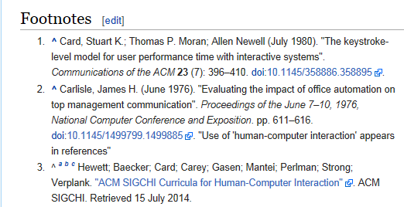
Using Wikipedia
Similar to regular encyclopedia or perhaps a newspaper article it’s a distillation of different sources of information.
  Generally it is not accepted as a direct primary source (don’t directly cite a Wikipedia article in your research paper).
It may be a starting point to find good sources of information.
  You may be use the sources listed in Wikipedia references to learn about topics and to list in your citations.
Example: “Human-Computer interaction”
Wikipedia cites a good research conference (usability “user friendly” technology)

Slide 55

Using The University Library
Services provided for students:
  From the UC library website, formerly it was http://library.ucalgary.ca/student-support)
    “As a student attending the University of Calgary, you have access to the books, journals and online resources of a major research institution. Your subject librarians are available for research assistance as well.
    Your University of Calgary ONEcard is your library card, and gives students the following privileges:
      Borrowing books with a loan period of two weeks for undergraduate students and a term loan for graduate students
      Interlibrary loan
      Off-campus access to Library Research Databases”

Slide 56

Online Web Search Without The Library
The general Internet user does not have a license to access many good online resources.
After finding the publisher of the article: Journal of American Medical Association you must pay to see the contents.
If you just ‘Google-It’ you have pay $30

Slide 57

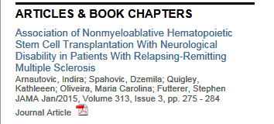
The University Library: Online Resources
The publications of many journals, conference proceedings, online books can be accessed “for free” (licensed) through the university portal:
  Requires login with the UC login credentials.
  Combine the library licensing with an online web search:
Use regular search websites to find the relevant paper.
  E.g., “Direct Stimulation of Angiotensin II Type 2 Receptor Initiated After Stroke Ameliorates Ischemic Brain Damage” – found via Google scholar
Then access the content of the paper through the university portal

Slide 58
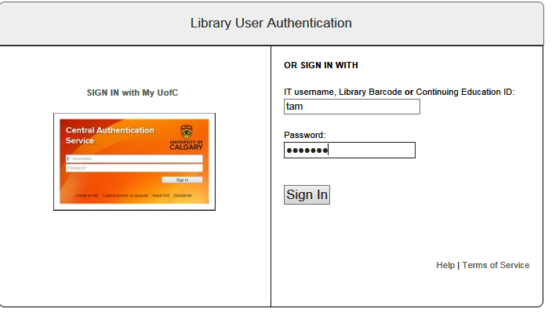
Authentication Is Require To Access The Article

Slide 59
After This Section You Should Now Know
Some factors that can determine the ranking of search results
Techniques for more effective web searches using Google:
  Searching for exact phrases: using quotes
  How to include “stop words” in searches: quotes
  How to use the wildcard: *
  Searching ranges: ..
  Searching for alternates: OR
  Excluding words and phrases: - (subtraction operator)
  Conducting site specific searches:
    Finding content within the webpage currently viewed: ‘find in page’
    Searching for content within a particular website: site

Slide 60
After This Section You Should Now Know (2)
Some of the strengths of other search websites as compared to Google: Bing, Yandex, Duckduckgo.
How to evaluate the quality of information: journals/conferences, books, websites
Examples of some scholarly websites
How the university library can complete online searches

Slide 61
Images
“Unless otherwise indicated, all images were produced by James Tam

