Slide 1
Introduction To Java Programming
You will learn the basics of creating a Java program: writing/translating a program, writing documentation, declaring variables, constants, getting input, displaying output.
Notes:
1

Slide 2
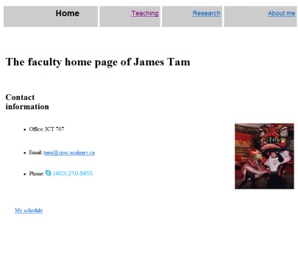
Java: Write Once, Run Anywhere
Consequence of Java’s history (coming later): platform-independence
Click on link to Applet
Mac user running Safari
Virtual machine translates byte code to
native Mac code and the Applet is run
Web page stored on Unix server
Byte code is downloaded
Byte code (part of web page)
Windows user running Edge

Slide 3
Java: Write Once, Run Anywhere
Consequence of Java’s history (coming later): platform-independence
Mac user running Safari
Web page stored on Unix server
Click on link to Applet
Byte code is downloaded
Byte code (part of web page)
Windows user running Edge
Virtual machine translates byte code to
native Windows code and the Applet is run

Slide 4
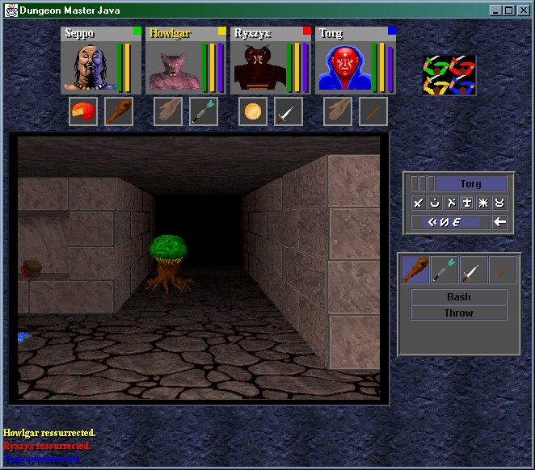
Java: Write Once, Run Anywhere (2)
But Java can also create standard (non-web based) programs
Kung Fu Panda:
Accessed 2013
screen grab from www.kunfupanda.com
Dungeon Master (Java version)
Accessed Jan. 2021
Dungeon Master Java Download (2001 Role playing Game) (old-games.com)
Some examples of mobile Java games: http://www.mobilegamesarena.net

Slide 5
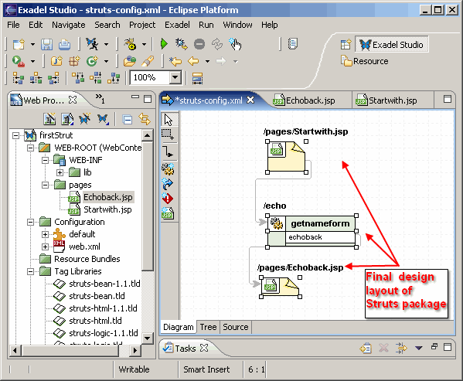
Java: Write Once, Run Anywhere (3)
Java has been used by large and reputable companies to create serious stand-alone applications.
Example:
Eclipse¹: started as a programming environment created by IBM for developing Java programs. The program Eclipse was itself written in Java.
1 For more information (last accessed 2015): http://www.eclipse.org/downloads/

Slide 6
JT’s Note: IDEs
There are many graphical development environments available for Java (e.g., Eclipse).
Learning one or more these environments prior to embarking on employment would be a valuable experience.
However it is not recommended that you use them for this course.
You may have drastic problems configuring the environment (e.g., if you have to use example starting code).
It’s easier programming without an IDE and then learning one later than the opposite (not all development teams can/will use them).
With the size of the programs you will see in this class it would be a good learning experience to ‘work without a net’.
Because you have to do it all yourself you will likely learn things better.

Slide 7
IDEs: Bottom Line
Assignments must be submitted in the form of .java text files that will compile and run on the computer science network.
If you have problems with the IDE or getting your programs to work on our network then you will likely be on your own.
Remote learning version: program needs to work in the latest version of Java when run compiled and run through a command line

Slide 8
Official Online Java Documentation
“Getting started” tutorials (last accessed 2021):
http://docs.oracle.com/javase/tutorial/

Slide 9
Which Java?
Download link:
https://www.oracle.com/java/technologies/javase-downloads.html
Java JDK (Java Development Kit), Standard Edition includes:
JDK (Java development kit) – for developing Java software (creating Java programs).
JRE (Java Runtime environment) –for running pre-created Java programs.
Java Plug-in – a special version of the JRE designed to run through web browsers.
For consistency/fairness: Your graded work will be based on the version of Java installed on the CPSC network
Only run your program using a remote connection program (e.g., SSH to a CPSC Linux computer) or test your code periodically on the network to make sure it’s compatible.
It’s your responsibility to ensure compatibility.
If the program doesn’t work on the Lunix computers in the lab then it will only receive partial marks (at most).
Remote learning version: program needs to work in the latest version of Java when run compiled and run through a command line

Slide 10
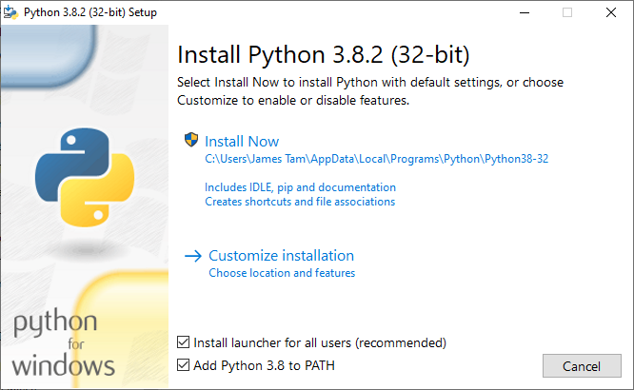
Getting Java Setup
Unlike installing python the java install leaves out one small but critical step:
(Python):
(The ‘path’ specifies to your operating system the location or ‘path’ to where the translation program ‘python’ or ‘javac/java’ resides on your computer).
JT’s editorial opinion: since Java is also used as a language for beginners this was a real dumb omission. (Don’t blame JT!)
The benefits of leaving out the option provided with Python don’t outweigh the costs.

Slide 11
Setting The Path For Java
Windows help document (Step II specifies how to set the path): https://www.oracle.com/webfolder/technetwork/tutorials/OracleCode/Windows-HOL-setup.pdf
Help link for other operating systems (MAC-OS, UNIX):
https://www.oracle.com/java/technologies/installation-solaris2-009.html
Web search terms if you don’t like these tutorials: ‘set’ or ‘setting’, ‘java’, ‘classpath’

Slide 12
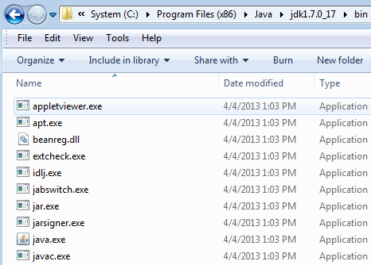
Alternative: Simple But A Hack
Create your Java programs in the same location as the Java compiler (you should remember where you installed it).

Slide 13
Compilation
Translating from a high level programming language such as Java or C++ to low level machine language (binary).
Python:
One stage translation process: from Python to machine occurs each time the program runs.
The translated instructions remain in memory.
Java
Two stage process:
A one time translation occurs from Java to a generic binary that is common to many computers and many electronic devices (this creates a ‘byte code’ file)
Each time the program is run the generic binary is translated to machine language which is specific to the computer or device.

Slide 14
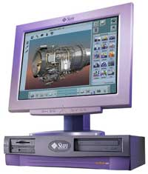
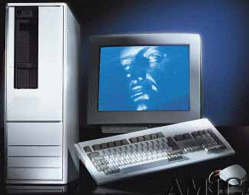
Compiled Programs With Different Operating Systems: Multiple Compilers Needed
Windows compiler
Executable (Windows)
Computer program
Mac OS compiler
Executable (Mac)
UNIX compiler
Executable (UNIX)

Slide 15
A High Level View Of Translating/Executing Java Programs
Stage 1: Compilation
Filename.java
Java compiler “javac”
Filename.class
Java program
Java byte code (generic binary)

Slide 16
A High Level View Of Translating/Executing Java Programs (2)
Stage 2: Final translation and execution of the byte code
Machine language instruction (UNIX)
Filename.class
Java interpreter “java”
Machine language instruction (Windows)
Java byte code (generic binary)
Machine language instruction (Apple)

Slide 17
Java Syntax Requirements To Compile A Program
Type the following into a text file called “Smallest.java”:
public class Smallest
{
public static void main(String[] args)
{
System.out.println("Small program running");
}
}

Slide 18
Compiling And Running A Java Program (Windows)
These steps assume that you already have Java installed on your computer and the path has already been properly set!
Type in your program using a text editor (e.g. Notepad, WordPad, Notepad++).
Save the program as a ‘text’ file (for now try it with the program called Smallest.java. Make sure the program ends in the suffix .java and NOT anything else e.g. .txt.
For now save the program under C:\users\<Your Windows user name>
Open a command line (‘cmd’ in Windows or ‘terminal’ with a computer running OS X).
If the command line shows the location as C:\users\<Your Windows user name> then type the following. If the command line opens elsewhere then move your Java program to this location.
Compile the program by typing the following at the command line: javac Smallest.java
If your program has no error messages specifying syntax problems then the command line it will then allow you to enter new input. Run the interpreter (and run the program) by typing: java Smallest

Slide 19
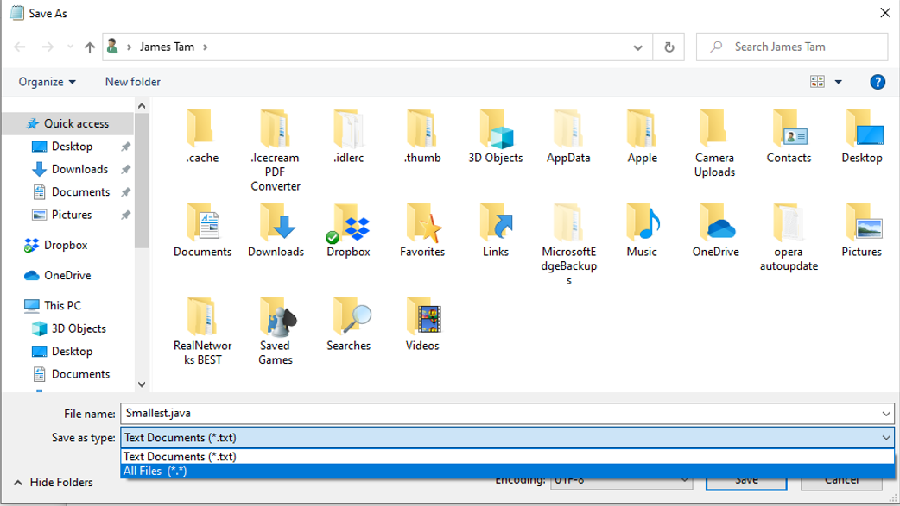
Step 1: Example Of Saving (Notepad)
“Save As” allows the file suffix to be changed from the ‘.txt’ default
Select “All Files” and then you can add the suffix ‘.java’ to the file name.

Slide 20
Step 1: Example Of Saving (WordPad)
Select “Save As” from the menu and then the file type as “Text document” but change the suffix from ‘txt’ to ‘java’

Slide 21
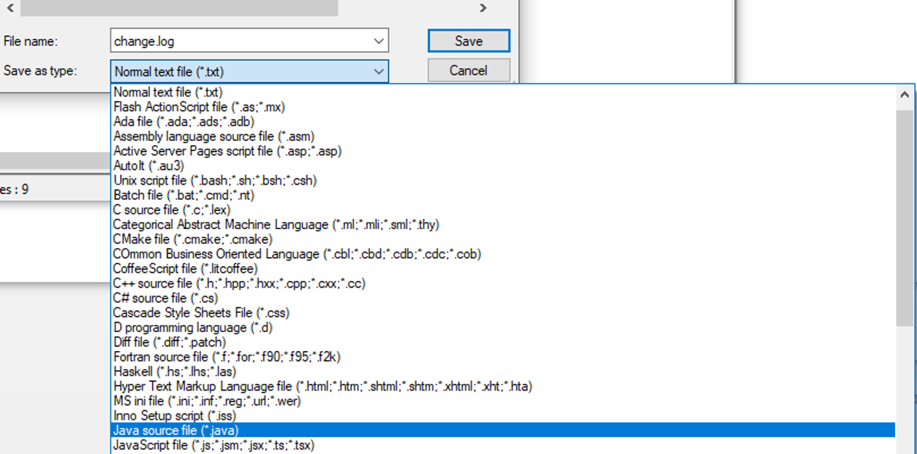
Step 1: Example Of Saving (Notepad++)
“Save as” type: Java source file.

Slide 22
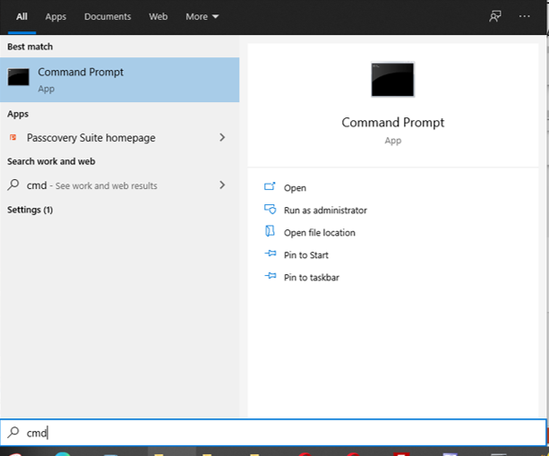
Step 2: Starting A Command Line (Windows Cmd)
Click on the Start button and type ‘cmd’
Click on the ‘Open’ option for the Command Prompt (you may need to click on “Run as Administrator” if you are not currently running an administrator account).

Slide 23
Step 3A: Compile The Program
What’s needed: The location opened by the prompt matches the recommended location for this example (for me its C:\Users\James Tam).
Compile the program (translate to machine/binary) by typing the following at the command line and then hit enter: javac Smallest.java
In this case there were no syntax errors and after compilation the command prompt returns.

Slide 24
Step 3B: Run The Program
Run the Java interpreter (which runs your program) by typing the following at the command line and hitting enter: java Smallest
Result of executing the program
public class Smallest
{
public static void main(String[] args)
{
System.out.println("Small program running");
}
}

Slide 25
General Rule: Creating/Running Programs
Very important Java requirement: the name after the word class must match the name of the file AND it is what you type in when compile (ending in.java) and run your program (no suffix).
public class Biggest
{
public static void main(String[] args)
{
System.out.println("Big program");
}
}

Slide 26
Documentation / Comments
Multi-line documentation
/* Start of documentation
*/ End of documentation
Don’t nest this form of documentation (results in a syntax error)
Documentation for a single line
//Everything until the end of the line is a comment

Slide 27
Review: What Should You Document
Program author
What does the program as a while do e.g., tax program.
What are the specific features of the program e.g., it calculates personal or small business tax.
What are its limitations e.g., it only follows Canadian tax laws and cannot be used in the US. In Canada it doesn’t calculate taxes for organizations with yearly gross earnings over $1 billion.
What is the version of the program
If you don’t use numbers for the different versions of your program then consider using dates
Tie versions with program features: for each version list the features completed.

Slide 28
Important Note
Each Java instruction must be followed by a semi-colon!
General format
Instruction1;
Instruction2;
Instruction3;
: :
Examples
int num = 0;
System.out.println(num);
: :

Slide 29
Java Output: Common Methods (~Function)
Print only the output specified (no other formatting: spaces, tabs, newlines)
(Java)
System.out.print();
(Python)
print(…, end="")
Print the output specified followed by a newline.
(Java)
System.out.println();
(Python)
print()

Slide 30
Java Output: Specifics
Format:
System.out.print(<string or variable name one> + <string or variable name two>..);
OR
System.out.println(<string or variable name one> + <string or variable name two>..);
Complete online example: OutputExample.java
public class OutputExample
{
public static void main(String [] args)
{
int num = 123; // Details coming
System.out.println("Good-night gracie!");
System.out.print(num);
System.out.println("num="+num);
}
}

Slide 31
Output : Some Escape Sequences For Formatting
The escape sequence is placed between the quotes in print() or println() e.g., System.out.print("hi\tthere");
Escape sequence | Description
\t | Horizontal tab
\n | New line
\" | Double quote
\\ | Backslash

Slide 32
Variables
Unlike Python variables must be declared before they can be used.
Variable declaration:
Creates a variable in memory.
Specify the name of the variable as well as the type of information that it will store.
E.g. int num;
Although requiring variables to be explicitly declared appears to be an unnecessary chore it can actually be useful for minimizing insidious logic errors (example to follow shortly).
Using variables
Only after a variable has been declared can it be used (e.g., assignment)
E.g., num = 12;

Slide 33
Using Variables: A Contrast
Python
Java
Variables do not need to be declared before being used.
Easy to start programming.
Easy to make logic errors!
incomeTam = 25000
if (winLottery):
incomeTan = 1000000
Syntax rule: variables must always be declared prior to use.
A little more work to get started.
Some logic errors may be prevented.
int incomeTam = 25000;
if (winLottery)
incomeSmith = 1000000;
BAD, Logic error: can be tricky to catch in a real (large and complex) program
BETTER, Syntax error: compiler points out the source of the problem

Slide 34
Declaring Variables: Syntax
Format:
<type of information> <name of variable>;
Example:
char firstInitial;
Variables should be initialized (set to a starting value) as they’re declared:
char firstInitial = 'j';
String firstName = "James";
int age = 30;
Note: In Java Strings MUST be enclosed in double quotes. Single quotes are used for characters (which are not the same as a Java String).

Slide 35
Some Built-In Types Of Variables In Java
Type | Description
byte | 8 bit integer
short | 16 bit integer
int | 32 bit integer
long | 64 bit integer
float | 32 bit real number (rare)
double | 64 bit real number (default for many operations)
char | 16 bit Unicode character (stores ASCII values and values beyond). Use single quotes.
boolean | True or false value
String | A sequence of characters between double quotes ("")
Notes:
boolean b = true;
if (b)
System.out.println("true");

Slide 36
Location Of Variable Declarations
public class <name of class>
{
public static void main(String[] args)
{
// Local variable declarations occur here
//Program statements
...
}
}

Slide 37
Java Strings
Similar to Python strings: a sequence of characters indexed from zero to (length – 1)
Don’t try to directly access elements via the index e.g., string1[0];
Elements can be accessed via a method charAt(int)
Unlike Python strings Java Strings only use double quotes
(In Java single quotes encloses a single character)
Format (creating string variable):
String <string name> = "<value>";
Example (creating string variable):
String username = "tamj";

Slide 38
Common String Methods
Examples useful methods:
Method | Description
string.charAt(int) | Retrieves character at the specified index
string.compareTo(String s) | Compares string with parameter: Zero returned if string and parameter equal Less than zero if the string comes before the parameter Greater than zero if the string comes after parameter
string.compareToIgnoreCase (String s) | As compareTo() but case insensitive
string.length() | Returns the length of the string
string.toLowerCase() | Converts alphabetic characters to lower case
string.toUpperCase() | Converts alphabetic characters to capitals
For more info look under “class String”
http://docs.oracle.com/javase/8/docs/api/

Slide 39
A String Example
Name of the complete online example: StringEg.java
String myString = "ab*cde";
System.out.println(myString.charAt(0) +
" " + myString.charAt(2));
System.out.println(myString.length());
System.out.println("-");
myString = myString.toUpperCase();
System.out.println(myString);
myString = myString.toLowerCase();
System.out.println(myString);
System.out.println("-");

Slide 40
A String Example (2)
// recall myString = "ab*cde"
System.out.println
(myString.compareToIgnoreCase("ab*cde"));
System.out.println
(myString.compareToIgnoreCase("zzz"));
System.out.println
(myString.compareToIgnoreCase("ab"));
ab*cde(zzz)
ab*cde(ab)

Slide 41
Style Hint: Initializing Variables
Always initialize your variables prior to using them!
Do this whether it is or is not required by the syntax of the language.
Example: A how not to approach (with some languages you’ll get a logic and not a syntax error as you do with Java).
Name of the complete online example: OutputExample.java
public class OutputExample1
{
public static void main(String [] args)
{
int num;
System.out.print(num);
}
}
OutputExample1.java:7: error: variable num might not have been initialized
System.out.print(num);
^

Slide 42
Formatting Output: Elective Topic
It’s somewhat similar to Python.
The field width and places of precision (float point) can be specified.
Format (‘System.out.’ requirement excluded for brevity):
printf("%<field width>d", price); // Integer
printf("%<field width>s", price); // String
printf("%<field width>.<precision>f", price); // Floating point
If field width greater than the size of the data:
A positive field width will result in leading spaces (right justify).
A negative field width will result in trailing spaces (left justify).

Slide 43
Formatting Output (2): Elective Topic
Name of the complete online example: FormattingExample.java
public class FormattingExample
{
public static void main(String [] args)
{
String str = "123";
int num = 123;
double price = 1.999;
System.out.printf("%-4s", str);
System.out.printf("%5d", num);
System.out.printf("%6.2f", price);
}
}
Notes:
‘123’ has a trailing space
123 has two leading spaces
1.999 rounded to decimal places and two leading spaces

Slide 44
Java Constants (“Final”)
Reminder: constants are like variables in that they have a name and store a certain type of information but unlike variables they CANNOT change. (Unlike Python this is syntactically enforced…that’s a good thing!).
The syntactically enforced unchanging nature of constants is specified with the ‘final’ key word.
Stylistic reminder: constants must be capitalized.
Format:
final <constant type> <CONSTANT NAME> = <value>;
Example:
final int SIZE = 100;
SIZE = 1000; // Syntax error

Slide 45
Location Of Constant Declarations
public class <name of class>
{
public static void main(String[] args)
{
// Local constant declarations occur here (for now)
// Local variable declarations
< Program statements >>
: :
}
}

Slide 46
Variable Naming Conventions In Java
Compiler requirements
Can’t be a keyword nor can the names of the special constants: true, false or null be used.
Can be any combination of letters, numbers, underscore or dollar sign (first character must be a letter or underscore)
Common stylistic conventions
The name should describe the purpose of the variable
Avoid using the dollar sign
With single word variable names, all characters are lower case
e.g., double grades;
Multiple words are separated by capitalizing the first letter of each word except for the first word
e.g., String firstName = "James";
To avoid confusion don’t use method names
E.g. String println;

Slide 47
Some Java Keywords (Avoid Using As Identifiers)
abstract | boolean | break | byte | case | catch | char
class | const | continue | default | do | double | else
extends | final | finally | float | for | goto | if
implements | import | instanceof | int | interface | long | native
new | package | private | protected | public | return | short
static | super | switch | synchronized | this | throw | throws
transient | try | void | volatile | while

Slide 48
Common Operators
Operation | Operator | Example usage
Assignment | = | num = 123;
Addition | + | num = 2 + 2;
Subtraction | - | num = 5 – 2;
Multiplication | * | num = num * 2;
Division | / | num = 9 / 3;
Remainder | % | num = 9 % 2
Negation | - | -num;

Slide 49
Post/Pre Operators
Post/Pre Increment
A common shorthand notation used in several languages (e.g., Java, C, C++) which will increase a variable by one.
Post-increment
num++;
Pre-increment
++num;
Pre vs. post operators will produce identical results if the increment is the only operation (two previous examples):
The specific difference between ‘post’ vs. ‘pre’ will be coming up shortly

Slide 50
Post/Pre Decrement
Operates in a similar fashion to post/pre decrement except that a variable is decreased by one.
Post decrement
num--;
Pre decrement
--num;

Slide 51
Post/Pre Operators
Name of the complete online example: Order.java
public class Order
{
public static void main(String [] args)
{
int num = 5;
System.out.println(num);
num++;
System.out.println(num);
++num;
System.out.println(num);
System.out.println(++num);
System.out.println(num++);
}
}

Slide 52
Casting: Converting Between Types
Casting: the ability to convert between types.
Of course the conversion between types must be logical otherwise an error will result e.g., multiplication on a String is a nonsensical operation
In Java unlike Python the conversion isn’t just limited to a limited number of functions.
Consequently Python doesn’t have true ‘casting’ ability.
Format:
<Variable name> = (type to convert to) <Variable name>;

Slide 53
Casting: Structure And Examples
Name of the complete online example: Casting.java
public class Casting {
public static void main(String [] args) {
int num1;
double num2;
num2 = 1.9;
// Cast needed to explicitly convert (going from more to less)
num1 = (int) num2;
System.out.println(num1 + " " + num2);
// Cast not needed: going from less to more
num2 = num1;
System.out.println(num1 + " " + num2);
}
}
Converting/casting types:
Simple but important concept
Going from ‘more’ to ‘less’ and ‘less’ to ‘more’: we’ll return back to this in the ‘hierarchies’ section (inheritance)

Slide 54
Accessing Pre-Created Java Libraries
It’s accomplished by placing an ‘import’ of the appropriate library at the top of your program.
Syntax:
import <Full library name>;
Example:
import java.util.Scanner;

Slide 55
Getting Text Input
You can use the pre-written methods (functions) in the Scanner class.
General structure:
Creating scanner entity (object)
import java.util.Scanner;
main(String [] args)
{
Scanner <name of scanner> = new Scanner(System.in);
<variable> = <name of scanner>.<method>();
}
Getting user input with a method

Slide 56
Getting Text Input (2)
Name of the complete online example: MyInput1.java
import java.util.Scanner;
public class MyInput1
{
public static void main(String [] args)
{
String name;
int age;
Scanner in = new Scanner(System.in);
System.out.print("Enter your age: ");
age = in.nextInt();
in.nextLine();
System.out.print("Enter your name: ");
name = in.nextLine();
System.out.println("Age: " +age +"\t Name:" + name);
}
}

Slide 57
Useful Methods Of Class Scanner¹
nextInt()
nextLong()
nextFloat()
nextDouble()
nextLine()
1 Online documentation: http://docs.oracle.com/javase/8/docs/api/

Slide 58
Reading A Single Character
Text menu driven programs may require this capability.
Example:
GAME OPTIONS
(a)dd a new player
(l)oad a saved game
(s)ave game
(q)uit game
There’s different ways of handling this problem but one approach is to extract the first character from the string.
Partial example:
String s = "boo";
System.out.println(s.charAt(0));

Slide 59
Getting Input: A Common Issue
Many methods or functions that get non-String input (e.g. numeric) will leave the “End of Line” <EOL> character in the input buffer. (Not Java specific).
Example when you type in a number you must signal the end of the input by hitting enter.
The enter character signifies that the entry of input has occurred (“end of the line” has been reached) and is a valid String.
This can be a problem if there’s a need to get String input immediately afterward.
Example: get the user to enter a number and then a String.
Solution:
After getting non-String input call a function or method immediately afterward that gets String input to remove the EOL from the buffer.
Then call the function/method a second time to prompt for the String.

Slide 60
Getting Input: Example Solution
Name of the complete online example: MyInput2.java
public class MyInput2
{
public static void main(String [] args)
{
String name;
int age;
Scanner in = new Scanner(System.in);
System.out.print("Enter your age: ");
age = in.nextInt();
in.nextLine(); //Solution
System.out.print("Enter your name: ");
name = in.nextLine();
System.out.println("Hi " + name + " you're "
+ age);
}
}

Slide 61
Copyright Notification
“Unless otherwise indicated, all images in this presentation are used with permission from Microsoft.”

